Slide 1

GRAPHS
DATA STRUCTURES AND ALGORITHMS
DATA STRUCTURES AND ALGORITHMS

Slide 2
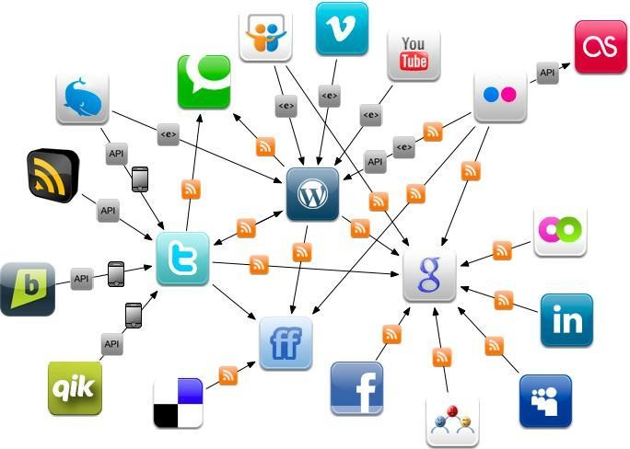
DATA STRUCTURES AND ALGORITHMS
GRAPHS DATA STRUCTURE AND ALGORITHMS
Graph
Graph Overview
Definition
Types of graph
Application
Graphs Presentations
Adjacency Matrix
Fulfilling, Printing
Adjacency List
Fulfilling, Printing
Edge list
Fulfilling, Printing
Converting one type to another

Slide 3
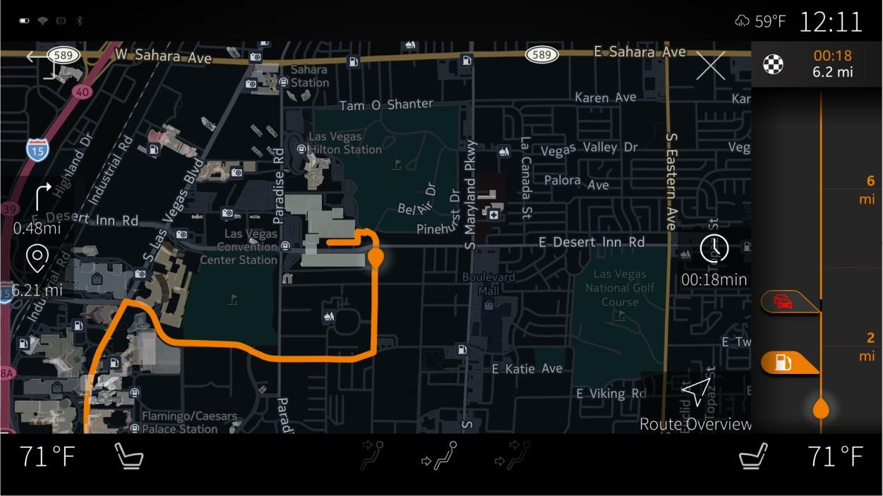
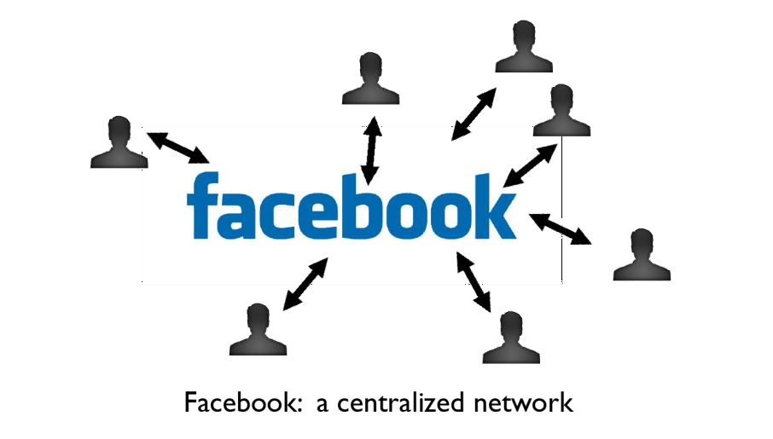
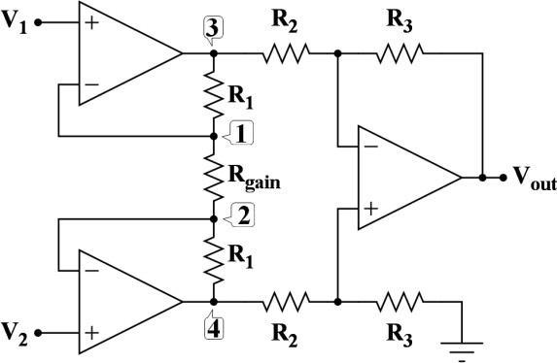

DATA STRUCTURES AND ALGORITHMS
APPLICATIONS AND USAGE
Applications
Navigation
Path planning
Relations
Connecting
Social networks
Bio Programming
Graphics Applications
Autodesk
Network Flows
Calculating traffic jams
Cables calculating

Slide 4

INTRODUCTION TO GRAPHS
DATA STRUCTURES AND ALGORITHMS
DATA STRUCTURES AND ALGORITHMS

Slide 5
DATA STRUCTURES AND ALGORITHMS
GRAPH
𝐺 = 𝑉, 𝐸
𝐸 ⊂ 𝑉𝑥 𝑉
Undirected
vertex
3
1
5
𝑢𝑛𝑑𝑖𝑟𝑒𝑐𝑡𝑒𝑑 𝑔𝑟𝑎𝑝ℎ 𝑢, 𝑣 ∈ 𝐸
𝑖𝑓𝑓(𝑣, 𝑢) ∈ 𝐸
𝑉 = { 1, 2, 3, 4, 5 }
edge
Set of vertices V and set of edges E
2
4
𝐸 = { 1,2 {2,1} 1,4
4,1 , 1,3 , {3,1} 3,4 {4,3}{3,5}{5,3}}
Directed
𝑉 = { 1, 2, 3, 4, 5 }
Graphs
Directed / Undirected
Weighter vs Unweighted
Cyclic vs Acyclic
1
3
5
2
4
𝐸 = { 1,2 ,{4,1},{4,3},{3,1},{1,3},{3,5}}
𝐸 = { 1,2
3,1 {1,3} 4,1 , 4,3 , 3,5 }

Slide 6
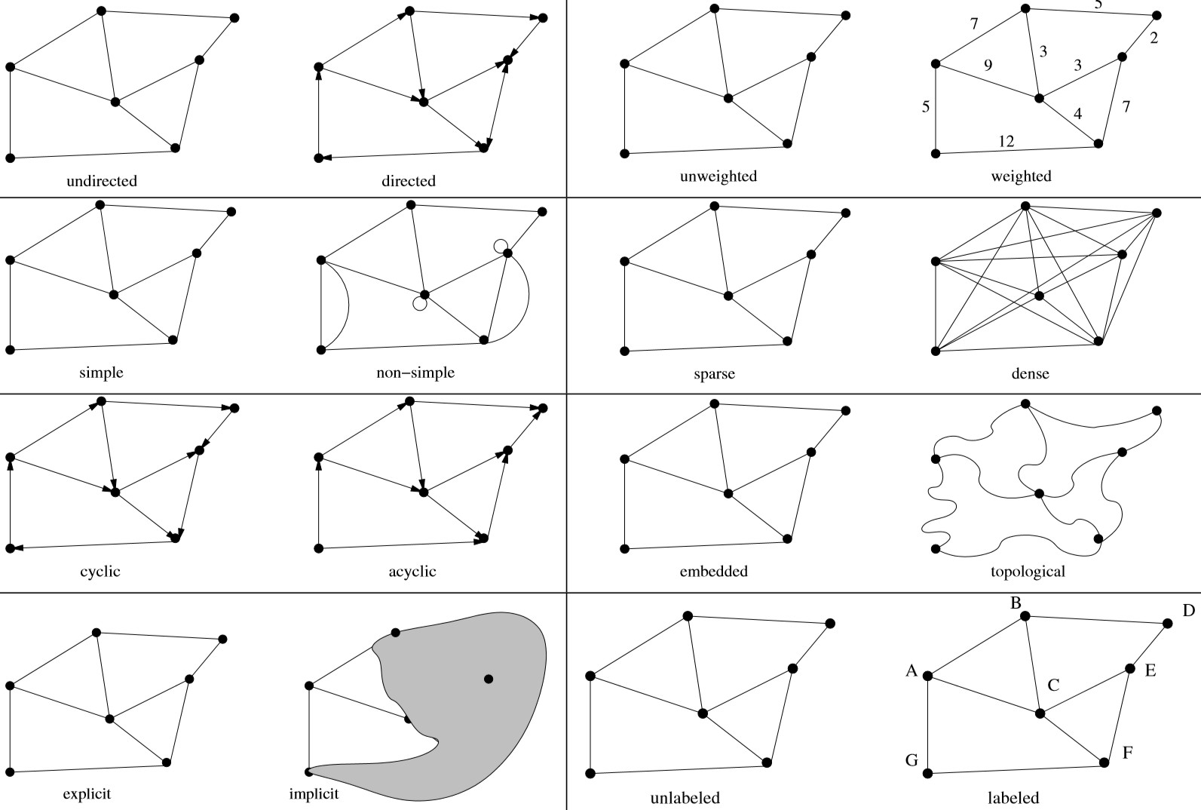
DATA STRUCTURES AND ALGORITHMS
GRAPHS TYPES
Classification
Directed / Undirected
Simple / Non-Simple
Non-Simple graphs contain self
loop {x,x}
Cyclic / Acyclic
Cyclic – node has path to itself
Explicit / Implicit
Implicit graphs usually known by
traversing
Unweighted / Weighted
Sparse / Dense
Dense – quadratic number of edges
Embedded / Topological
Embedded graph has geometric position
Unlabeled / Labeled

Slide 7
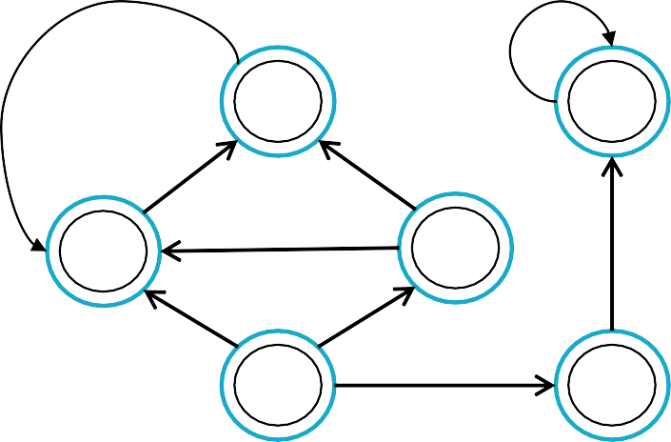
DATA STRUCTURES AND ALGORITHMS
GRAPHS REPRESENTATION
E
0 → 1
0 → 3
0 → 4
1 → 2
2 → 1
3 → 1
3 → 2
4 → 5
5 → 5
M | 0 | 1 | 2 | 3 | 4 | 5
0 | 0 | 1 | 0 | 1 | 1 | 0
1 | 0 | 0 | 1 | 0 | 0 | 0
2 | 0 | 1 | 0 | 0 | 0 | 0
3 | 0 | 1 | 1 | 0 | 0 | 0
4 | 0 | 0 | 0 | 0 | 0 | 1
5 | 0 | 0 | 0 | 0 | 0 | 1
L
0
1
2
3
4
5
→ 1 → 3 → 4
→ 2
→ 1
→ 1 → 2
→ 5
→ 5
2
5
1
3
0
4
Graph
Adjacency Matrix
Adjacency List
Adjacency Edge
𝑉 = { 0, 1, 2, 3, 4, 5 }
𝐸 = { 0,1 , 0,3 , 0,4 , 1, 2 , 2, 1 , 3, 1 , 3, 2 , 4, 5 , {5, 5}}

Slide 8

MATRIX REPRESENTATION
DATA STRUCTURES AND ALGORITHMS
DATA STRUCTURES AND ALGORITHMS
8

Slide 9
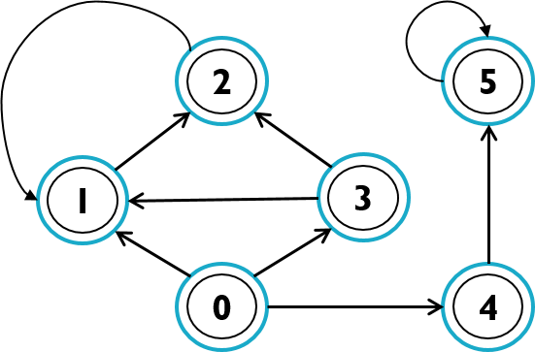
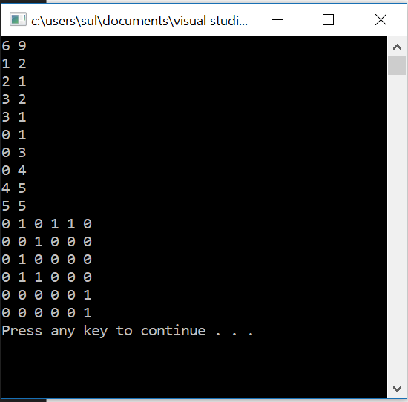
DATA STRUCTURES AND ALGORITHMS
ADJUCENCY MATRIX FULFILL AND PRINT
int main(){
int n, m;
int a[100][100];
cin>>n>>m; int from, to;
memset(a, 0, sizeof(a));
for (int i = 0; i < m; i++){
cin>>from>>to; a[from][to] = 1;
}
Adjacency Matrix Fulfilling
for (int i = 0; i < n; i++){
for (int j = 0; j < n; j++){
cout<<a[i][j]<<" ";
}
cout<<endl;
}
system("pause"); return 0;
}

Slide 10
ADJACENCY LIST REPRESENTATION
DATA STRUCTURES AND ALGORITHMS
DATA STRUCTURES AND ALGORITHMS
10

Slide 11
DATA STRUCTURES AND ALGORITHMS
GRAPH REPRESENTATION: ADJACENCY LIST
typedef vector<int> vi; vector<vi> adj;
vector<vector<int>> adj;
List presentation
An adjacency list could be implemented by vectors or by linked list,.
The inner vector ( vi ) representing the nodes. Must be assigned while before use the graph.
The outher vector ( Adj ) represents list of connections. Must not be assigned, but dynamically adds nodes and resizes own size. push_back( ) method
List presentation
2
0: {1}
1: {0}, {2}
2: {1}, {3}
3: {2}, {1}
1
3
0
𝑉 = { 0, 1, 2, 3}

Slide 12
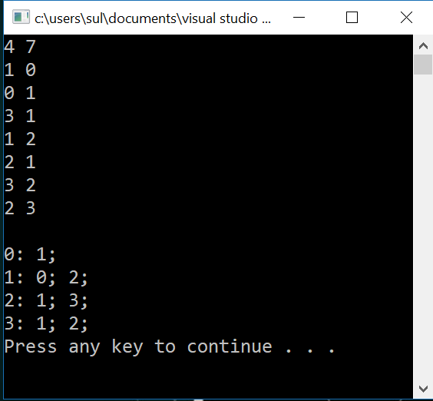
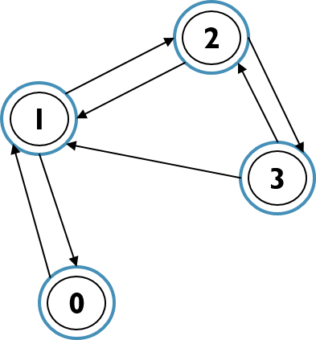
DATA STRUCTURES AND ALGORITHMS
GRAPH REPRESENTATION: ADJACENCY LIST FULFILLING AND PRINT
typedef vector<int> vi;
vector<vi> adj;
int main(){
int n, m; // nodes, edges cin>>n>>m;
adj.assign(n, vi()); // important ! int from, to, weight;
for (int i = 0; i < m; i++)
{
cin>>from>>to; adj[from].push_back(to);
// 2*m in undirected
//adj[to].push_back(from); // for undirected
}
cout<<endl;
for (int i = 0; i < adj.size(); i++){
auto edges = adj[i];
cout<<i<<": ";
for (int j = 0; j < edges.size(); j++){ cout<<edges[j]<<"; ";
}
cout<<endl;
}
system("pause");
return 0;
Adjacency List Fulfilling
}

Slide 13
DATA STRUCTURES AND ALGORITHMS
GRAPH REPRESENTATION: ADJACENCY LIST (WITH WEIGHT)
typedef pair<int,int> ii; // to, weight
vector<vector<pair<int,int>>>
typedef vector<ii> vii; vector<vii> adj;
// from -> to
// graph
Graph
4
2
9
0
11
0: {1, 3}
1: {0, 7}, {2, 4}
2: {1, 0}, {3, 9}
3: {2, 11}, {1, 19}
1
19
3
3
7
0
List presentation with weight
𝑉 = { 0, 1, 2, 3}

Slide 14
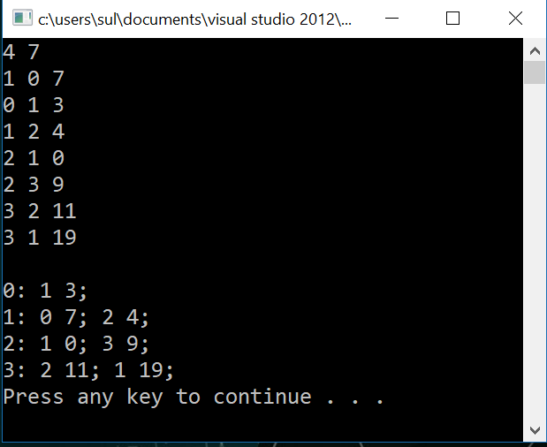
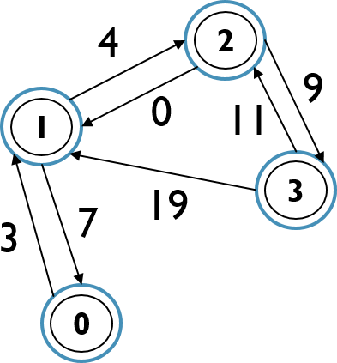
DATA STRUCTURES AND ALGORITHMS
ADJACENCY LIST WITH WEIGHT: FULFILLING AND PRINT
typedef pair<int,int> ii; typedef vector<ii> vii; vector<vii> adj;
Weighted Graph Adjacency List Fulfilling
int main(){
int n, m; // nodes, edges cin>>n>>m;
adj.assign(n, vii()); // important ! int from, to, weight;
for (int i = 0; i < m; i++){ // 2*m in undirected cin>>from>>to>>weight; adj[from].push_back(ii(to,weight));
//adj[to].push_back(ii(from,weight)); // for undirected
}
cout<<endl;
for (int i = 0; i < adj.size(); i++){
auto edges = adj[i];
cout<<i<<": ";
for (int j = 0; j < edges.size(); j++){ cout<<edges[j].first<<" "<<edges[j].second<<"; ";
}
cout<<endl;
}
system("pause");
return 0;
𝑉 = { 0, 1, 2, 3}
}

Slide 15
EDGE REPRESENTATION
DATA STRUCTURES AND ALGORITHMS
DATA STRUCTURES AND ALGORITHMS
15

Slide 16
DATA STRUCTURES AND ALGORITHMS
EDGE PRESENTATION
{ 7, 1, 0}
{ 3,
{ 4,
{ 0,
Graph
struct edge{
Edge presentation
STL version of edges:The first parameter in weighted graph represents by weight, because sorting is always done by the first parameter that will be used in Kruskal Algorithm.
In Structure version, each edge represents by structure with three parameters, but to sort them by weight need to use lambda expressions or additional function in edges structure.
0, 1}
1, 2}
2, 1}
4
2
int from; int to;
int weight;
9
0
11
1
};
vector<edge> adj;
{ 11, 3, 9}
{ 9, 2, 3}
{ 19, 3, 1}
19
3
3
7
Structure version
0
𝑉 = { 0, 1, 2, 3}
vector<pair<int, pair<int,int>> adj;
vector<pair<int,int>> adj;
STL version: unweighted graph
STL version: weighted graph

Slide 17
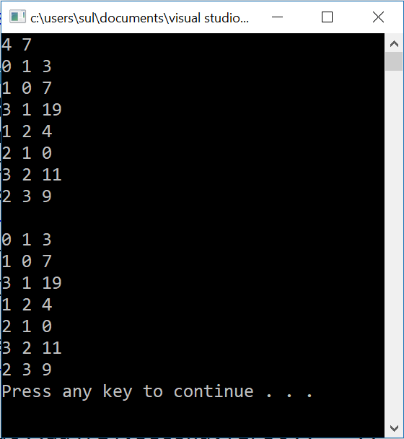
EDGE IMPLEMENTATION
DATA STRUCTURES AND ALGORITHMS
vector< pair<int, pair<int,int>>> adj;
int main(){
int n,m;
int from, to, weight; cin>>n>>m;
for (int i = 0; i < m; i++){ cin>>from>>to>>weight;
adj.push_back(make_pair( weight, make_pair(from,to)));
}
cout<<endl;
for (int i = 0; i < adj.size(); i++){ cout<<adj[i].second.first<<" "<<
adj[i].second.second<<" "<<adj[i].first<<endl;
}
system("pause");
return 0;
}

Slide 18
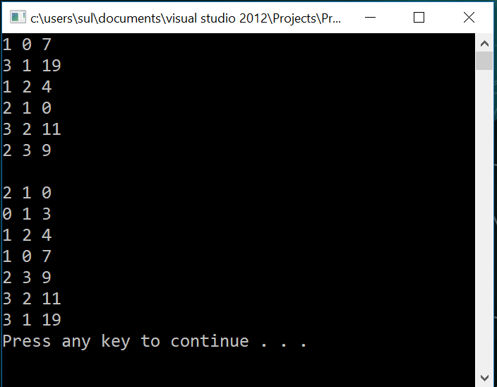
FULFILLING GRAPH BY STRUCTURE
DATA STRUCTURES AND ALGORITHMS
#include<iostream> #include<vector> #include<algorithm>
int main(){
int n,m; cin>>n>>m;
for (int i = 0; i < m; i++){ int from, to, weight; cin>>from>>to>>weight; edge e;
e.to = to; e.from = from;
e.weight = weight;
adj.push_back(e);
}
cout<<endl;
using namespace std;
struct edge{
int from; int to;
int weight;
};
vector<edge> adj;
auto lambda = [](edge e, edge e2){ return e.weight < e2.weight;};
sort(adj.begin(), adj.end(), lambda);
for(auto i: adj)
cout<<i.from<<" "<<i.to<<" "<<i.weight<<endl; system("pause");
return 0;
}
Sorted by weight.

Slide 19
TUPLE WAY (EDGE LIST)
DATA STRUCTURES AND ALGORITHMS
#include<iostream> #include<tuple> #include<vector> #include<algorithm>
vector< tuple<int, int, int>> graph;
using namespace std;
vector<tuple<int, int, int>> graph;
int main() {
int n, m;
int from, to, weight; cin >> n >> m;
for (int i = 0; i < m; i++) { cin >> from >> to >> weight;
graph.push_back(make_tuple(from, to, weight));
}
Get method also allows to update the tuple element
std::tuple<int, char> mytuple(10, 'a'); std::get<0>(mytuple) = 20;
std::cout << std::get<0>(mytuple);
for (auto &i : graph) {
cout << get<0>(i) << " " << get<1>(i) << " " << get<2>(i) << endl;
}
system("pause");
}

Slide 20
DELETING THE EDGE
DATA STRUCTURES AND ALGORITHMS
DATA STRUCTURES AND ALGORITHMS
20

Slide 21
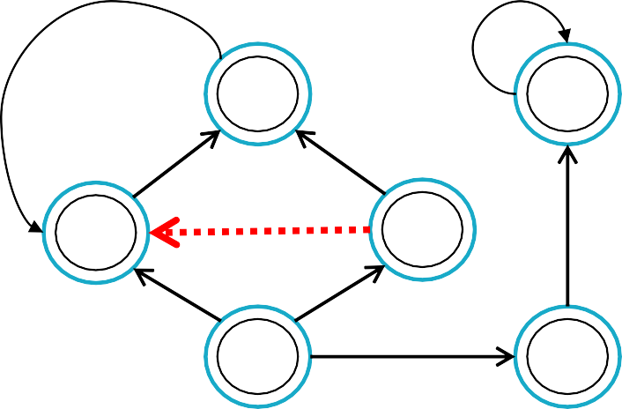
DATA STRUCTURES AND ALGORITHMS
DELETING THE EDGE
vector<vector<int>> graph;
auto it = find(graph[from].begin(), graph[from].end(), to); graph[from].erase(it, graph[from].end());
//auto it2 = find(graph[to].begin(), graph[to].end(), from); // undirected
//graph[to].erase(it2, graph[to].end()); // undirected
To delete edge from the
graph
Adj-matrix – change state to 0
Adj-list – find the edge and remove it
graph[10][10];
Change state to “0”
Find and remove
graph[from][to] = 0;
//graph[to][from] = 0; // for undirected
M | 0 | 1 | 2 | 3 | 4 | 5
0 | 0 | 1 | 0 | 1 | 1 | 0
1 | 0 | 0 | 1 | 0 | 0 | 0
2 | 0 | 1 | 0 | 0 | 0 | 0
3 | 0 | 1 | 1 | 0 | 0 | 0
4 | 0 | 0 | 0 | 0 | 0 | 1
5 | 0 | 0 | 0 | 0 | 0 | 1
L
0
1
2
3
4
5
→ 1 → 3 → 4
→ 2
→ 1
→ 1 → 2
→ 5
→ 5
2
5
1
3
0
4
Graph
Adjacency Matrix
Adjacency List

Slide 22
TASK
DATA STRUCTURES AND ALGORITHMS
Input n, m – number of nodes and edges
Create graph.
After graph is created there are two commands ‘a’ – add and ‘d’ – delete edge. Print the graph (in Adj-list way) after each update
int main() {
cin >> n >> m; graph.resize(n);
for (int i = 0; i < m; i++){ int from, to;
cin >> from >> to; graph[from].push_back(to);
}
print_graph();
while (true){
int cmd_num; cin >> cmd_num;
while (cmd_num--) { char cmd;
int from, to;
cin >> cmd >> from >> to; if (cmd == 'a')
graph[from].push_back(to);
else {
auto it = find(graph[from].begin(), graph[from].end(), to);
#include<iostream> #include<vector> #include<algorithm>
using namespace std;
vector<vector<int>> graph; int n, m;
void print_graph() {
for (int i = 0; i < n; i++){
cout << " from " << i << "| ";
for (int j = 0; j < graph[i].size(); j++){
cout << graph[i][j] << " ";
}
graph[from].erase(it, graph[from].end());
}
}
print_graph();
cout << endl;
}
}
return 0;
}
}

