Slide 1

CatChat

Slide 2
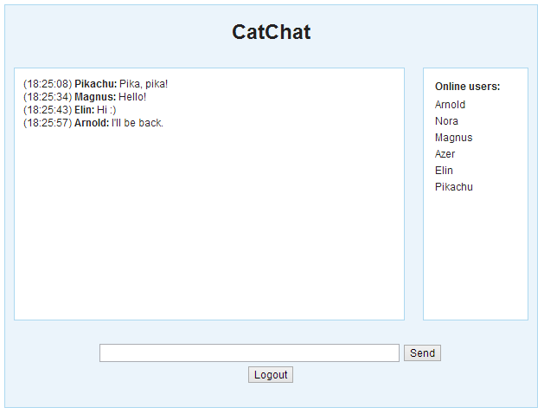
Introduction

Slide 3
Demonstration

Slide 4
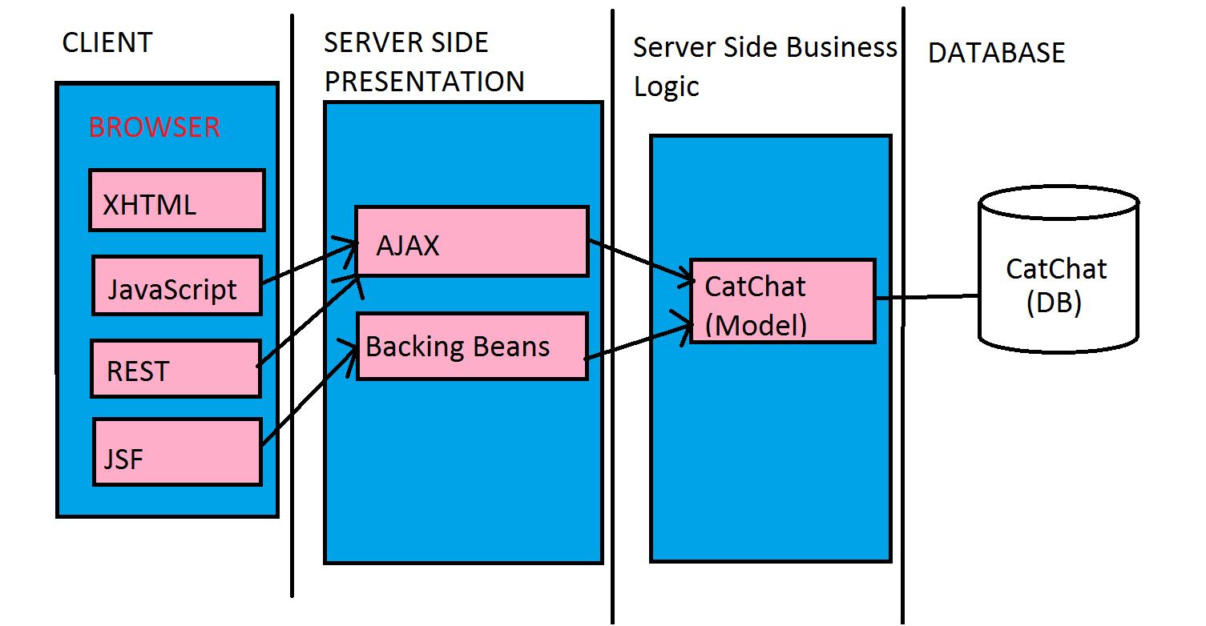
Tiers

Slide 5
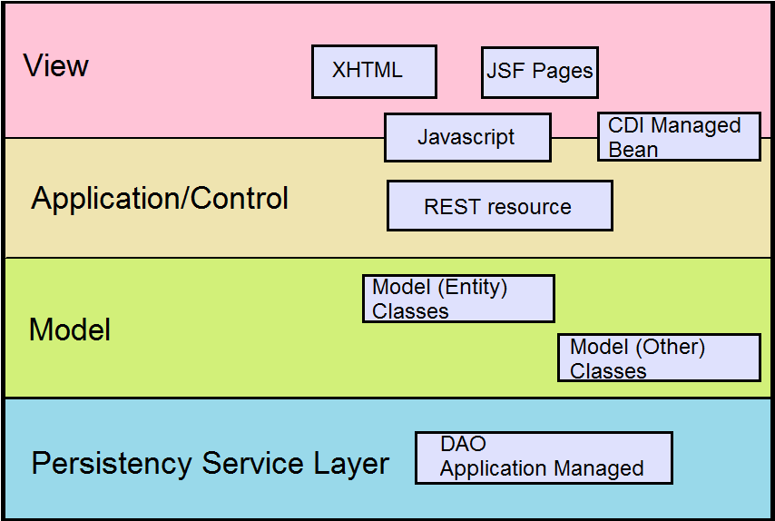
Layered view

Slide 6
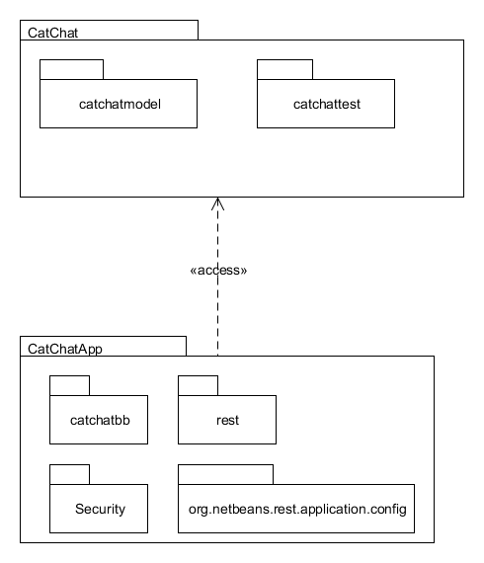
Backing Beans
Icefaces
Security
Hash function
JavaScript
RESTful Services

Slide 7

Q&A

