Slide 1
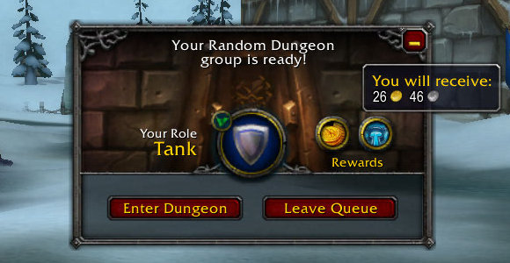
Wow-compare
Projet-libre Epitech

Slide 2
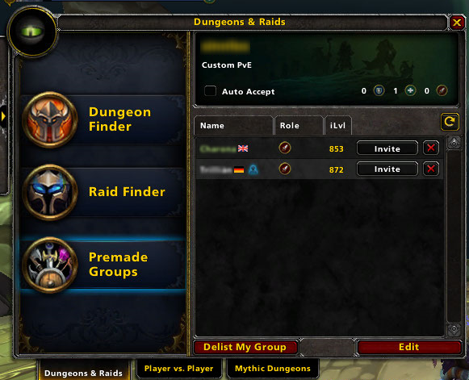
Wow-compare
Project description
Login: francois1.guergadic@epitech.eu
Stack: React.js, Redu
Competition: None
Summary: Goal is to create a “super easy to use” tools for World of Warcraft player group making.

Slide 3
Wow-compare
Project description
World of warcraft being a huge MMO game, making a group with other players to go through game content can be rude due to skill difference between players. While some website are giving some accurate informations about a specific players, it become easier to know if the player that we want to invite is the one we are looking for.
The main idea behind wow-compare is to have a tool where we can see in only one place regrouped informations about a bunch of players using API from the other website (warcraftlogs.com and raider.io).

Slide 4
Wow-compare
Learning expectation
Main stack: React.js, Redux
Other Restrictions:
Linter Airbnb
Continuous Integration: Staging and Production Mode
Analytics

