Slide 1
Stellar populations & the stellar IMF
Lecture 1 — How do you weigh a galaxy you cannot resolve?
Dr. Tereza Jeřábková
Galaxies course · Masaryk University · ÚTFA
Notes:
0:00. Welcome. Put the Slido code on the board now; everybody joins before slide 3.

Slide 2
Slido S1.1 · open text
Andromeda: how much does it weigh, and how would you find out?
slido.com · #CODE
Notes:
0:02. Show your Andromeda image (ISTA p.32) behind this if you like. Collect ideas: rotation curve, light × M/L, lensing, satellites. Keep the list: we come back to it at the end.

Slide 3
Slido S1.2 · word cloud
What can we actually measure from a galaxy we cannot resolve?
slido.com · #CODE
Notes:
0:06. Expected: colours, magnitudes, spectra, line widths, sizes. Punchline: only light. 2 minutes pair talk first, then the word cloud.

Slide 4
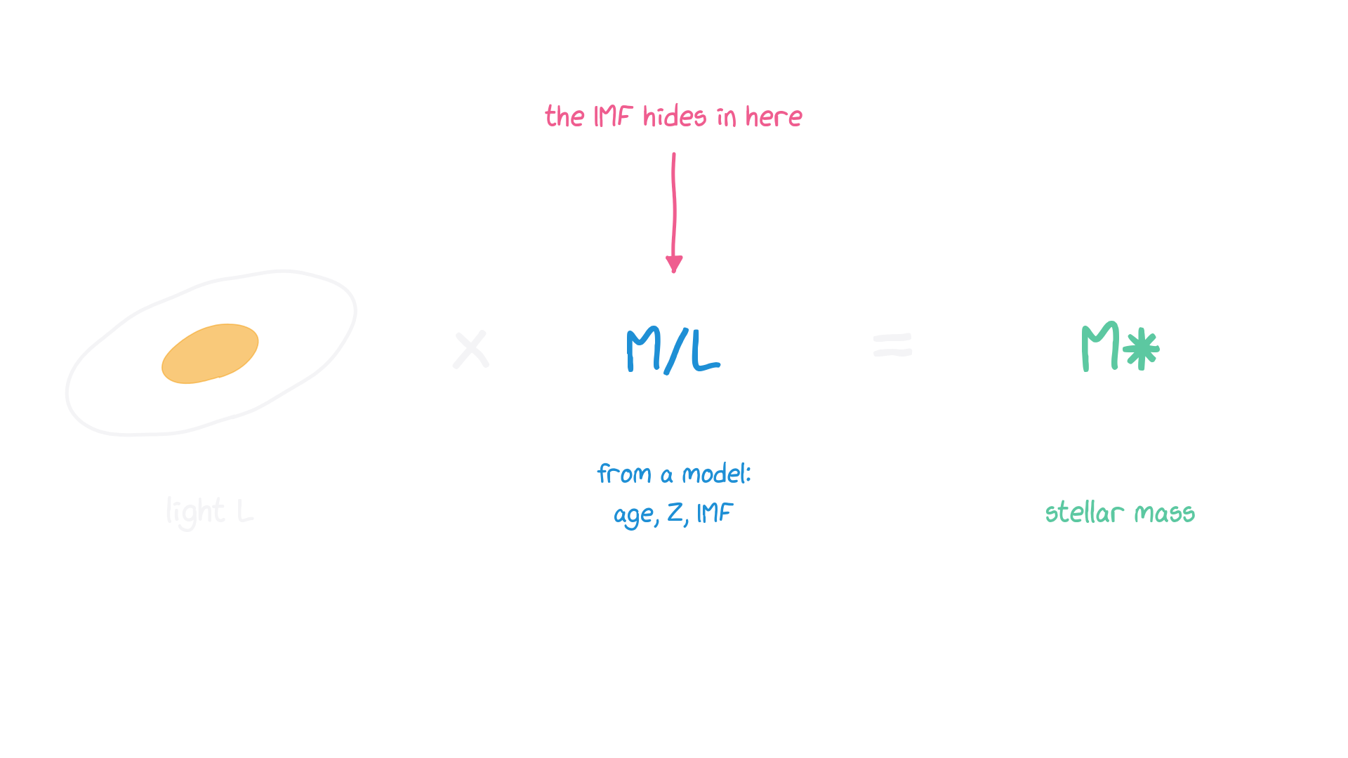
Today's story: from light to mass
Everything we say about a galaxy's mass, age or SFR goes through a model — and every model has an IMF.
4
Notes:
0:12. The roadmap. Lecture 1 builds the M/L box; Lecture 2 opens the chemistry box. The IMF hides inside both.

Slide 5
1
The IMF: counting stars like dogs
What does it mean that “the IMF has a slope of 2.35”?
Notes:
0:15

Slide 6
→ insert your slides here
the dog analogy: ‘Let's study dogs like we study stars’ → dog IMFs in different environments
from: Canva ‘ISTA seminar’, slides 21–30
Notes:
0:15–0:28. Bike ride with a camera: distance, breed (= type), age, multiplicity, cats (contaminants). Then the dog IMF and the city/village dog IMFs. Keep the house-dog joke.

Slide 7
Slido S1.3 · multiple choice
Counting dogs from a bike: which bias distorts the dog IMF most?
A far-away dogs are missed
B breeds look alike
C puppies vs adults
D dogs walk in pairs
E cats
slido.com · #CODE
Notes:
0:28. No single right answer; map each to a stellar correction: Malmquist/completeness, spectral type, age/evolution, unresolved binaries, contaminants.

Slide 8
→ insert your slides here
Salpeter 1955 and the corrections from luminosity function to IMF; ‘the IMF is a Hilfskonstrukt’
from: Canva ‘ISTA seminar’, slides 20 and 31–39
Notes:
0:30–0:40. The PDLF → IMF chain: mass–luminosity relation, scale height vs age, MS brightening, evolved stars, metallicity, unresolved binaries, extinction. Scalo (1998) quote.

Slide 9
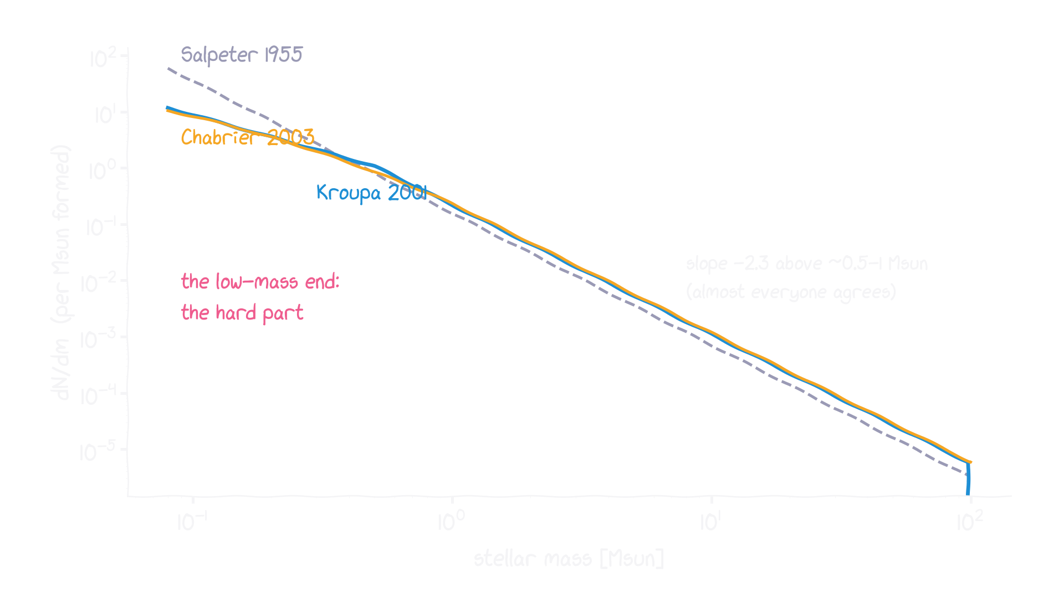
Three IMFs you will meet in papers
ξ(m) = dN/dm ∝ m^−α. Salpeter: α = 2.35. Kroupa: 1.3 below 0.5 M☉, 2.3 above. Chabrier: log-normal + power law.
9
Notes:
0:40. They agree above ~1 Msun and differ where stars are faint. Mention that 'canonical' means 'what we measured in the Solar neighbourhood', not 'proven universal'.

Slide 10
Slido S1.4 · quiz
Salpeter's slope α in dN/dm ∝ m^−α is …
A 1.35
B 2.35
C 3.5
D 0.5
slido.com · #CODE
Notes:
0:43. Answer 2.35. Trap: 1.35 is the same IMF written per log m (dN/dlog m ∝ m^−1.35).

Slide 11
Game 1 — build a star cluster
In pairs, draw 30 stars: a random number 000–999 → look up the mass.
000–431 0.13 M☉ · 432–759 0.32 · 760–901 0.68
902–959 1.4 · 960–992 3.5 · 993–997 12 · 998–999 42
Add up your cluster mass. Note your most massive star.
Send both to Slido. Did anybody get a supernova progenitor (> 8 M☉)?
11
Notes:
0:45–0:58. Random numbers: phone (e.g. 'random number 0 999'), or three d10. Expect ~18 Msun per pair and roughly one pair in five with a star > 8 Msun.

Slide 12
Slido S1.5 · open text
Your cluster: total mass and most massive star (e.g. “19 M☉, 3.5 M☉”)
slido.com · #CODE
Notes:
0:52. Read some out. Then add up the room as one cluster. Discussion: bigger clusters host bigger stars — random sampling or a physical m_max–M_cl relation? (open debate).

Slide 13
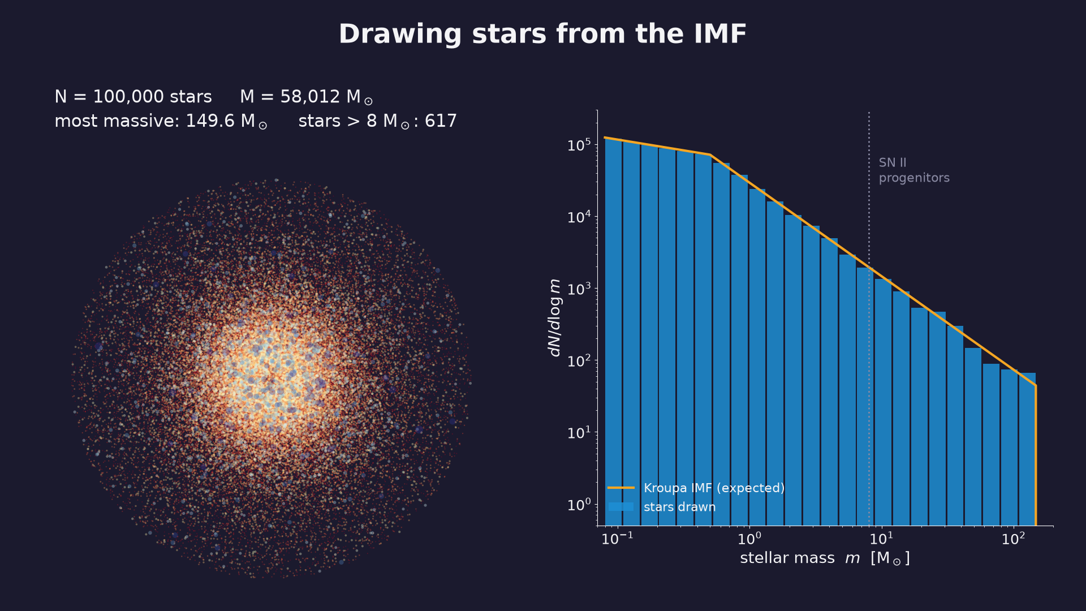
Notes:
0:55. Pause at ~300 stars (first massive stars appear) and at the end (617 stars > 8 Msun out of 100 000).
Caption: From 10 to 100 000 stars: the histogram converges to the IMF; massive stars stay rare.

Slide 14
Slido S1.6 · quiz
What fraction of newborn stars are less massive than the Sun? …and what fraction of the mass goes into stars above 8 M☉?
A 50% / 2%
B 75% / 50%
C 90% / ~20%
D 99% / 80%
slido.com · #CODE
Notes:
0:58. Answer C: 90% of stars are < 1 Msun; 23% of the mass formed is in stars > 8 Msun (Kroupa).

Slide 15
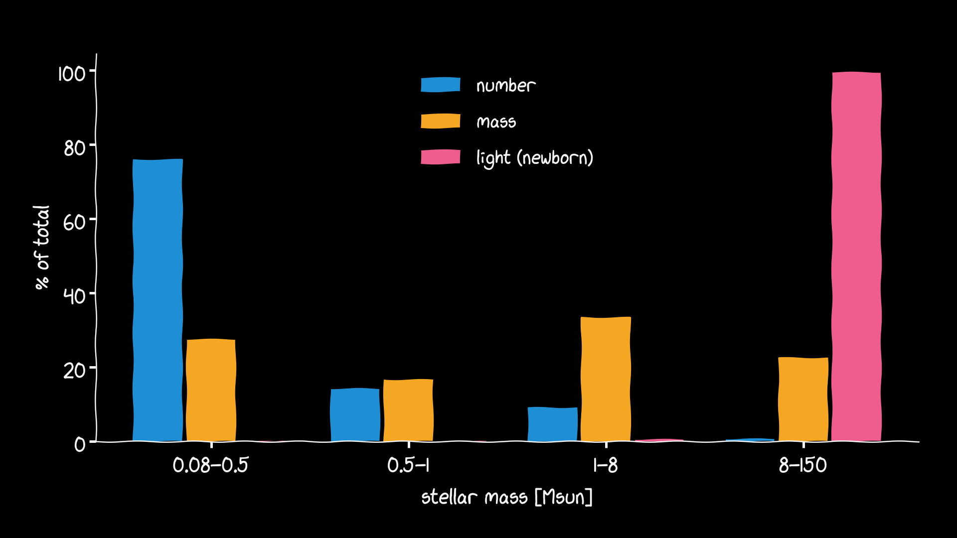
Number, mass and light live in different stars
Kroupa IMF at birth. Light: main-sequence L(m). After ~1 Gyr the light comes from red giants instead.
15
Notes:
1:00. The key slide of part 1. Low-mass stars: number. Intermediate: mass. Massive: light (when young). So the light tells you about a few stars, and you extrapolate to all the mass with the IMF.

Slide 16
10 minutes break
Puzzle for the break: a galaxy's light is 99% from <1% of its stars. How would you weigh it?
Notes:
1:05–1:15

Slide 17
2
Building a population
How does a population of stars look from far away?
Notes:
1:15

Slide 18
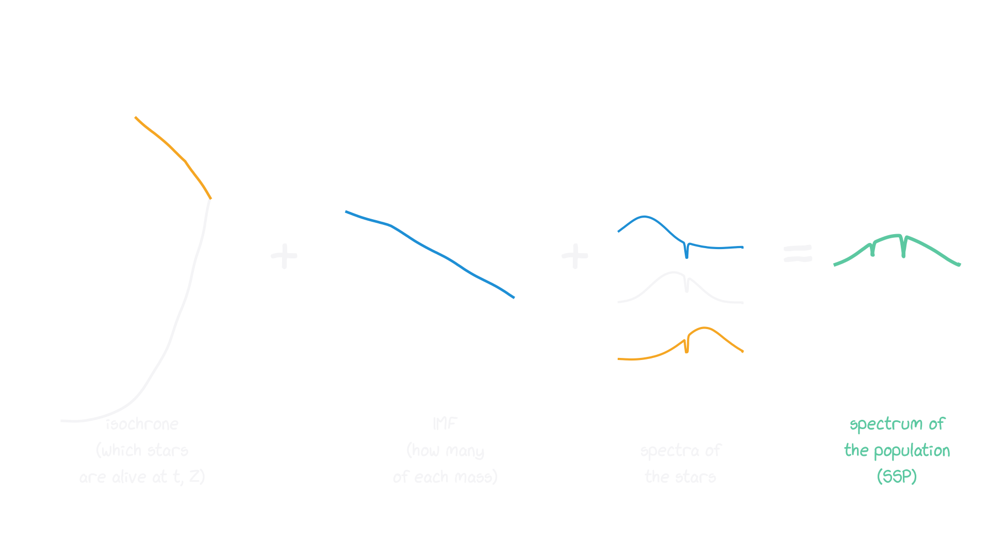
The recipe of a simple stellar population (SSP)
Fλ(t, Z) = ∫ ξ(m) fλ(m, t, Z) dm over the stars still alive
18
Notes:
1:15. One age, one metallicity. Real galaxies = sums of SSPs (star-formation history).

Slide 19
FaSTAR: SSPs at any age, metallicity and IMF
Martín-Navarro et al. 2026, A&A 711, A282 & A283
Neural-network stellar spectra + isochrones + any IMF you like
Fast and differentiable: ages 20 Myr–14 Gyr, [M/H] −2.5 to +0.3
Integrated (infinitely many stars) and semi-resolved (N stars) modes
pip install fastar-astro → notebook 02
19
Notes:
1:20. Everything in the next animations is computed with FaSTAR in notebook 02; students can redo it.

Slide 20
Slido S1.7 · multiple choice
Same mass formed: how much fainter (V band) is a 10 Gyr population than a 100 Myr one?
A 3×
B 10×
C ~35×
D 1000×
slido.com · #CODE
Notes:
1:23. Answer ~35× (FaSTAR, Kroupa, solar). Then play A2.

Slide 21
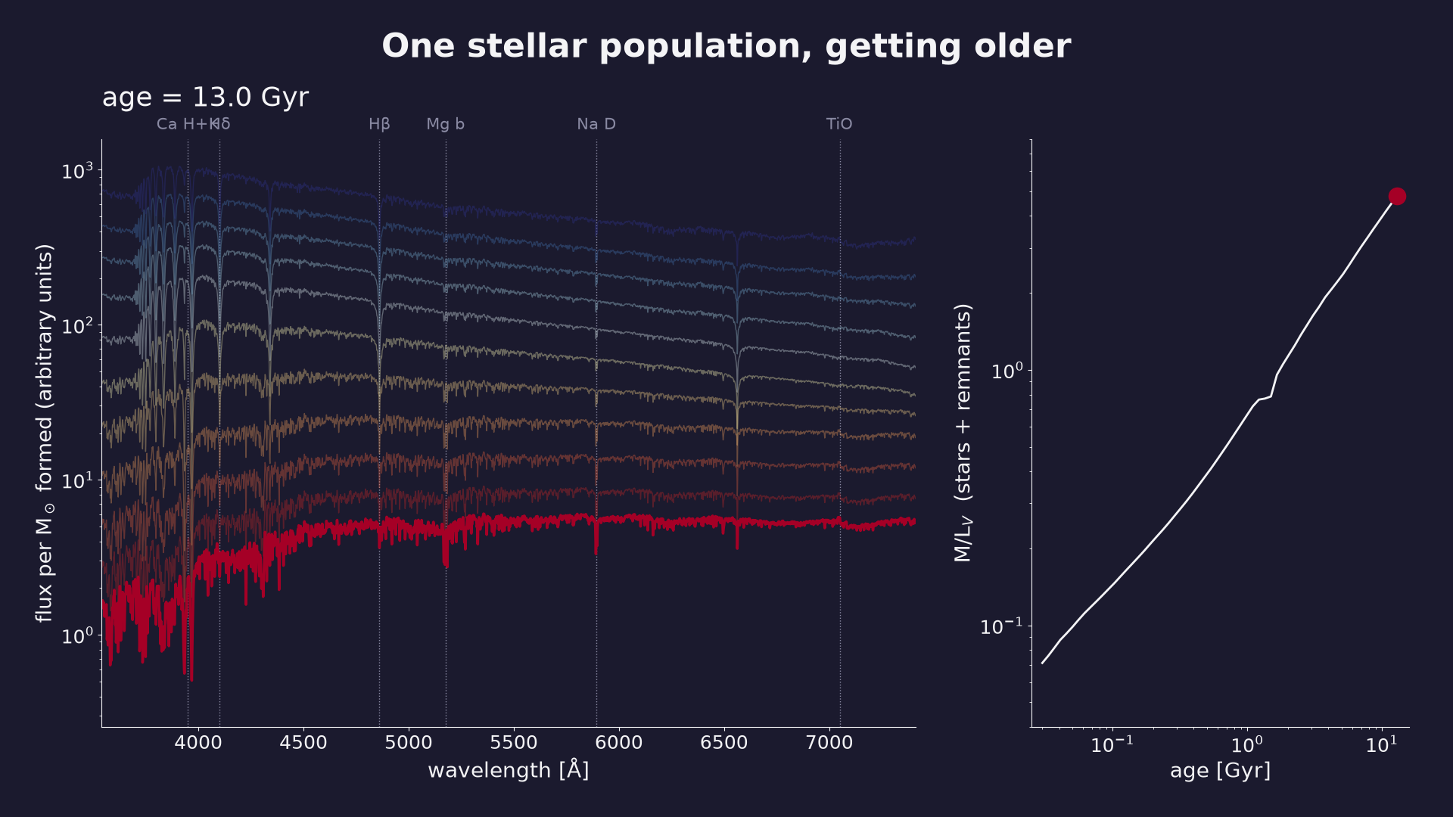
Notes:
1:25. Watch the Balmer lines grow (A stars, ~0.3–1 Gyr) and fade. Blue light disappears as massive stars die.
Caption: FaSTAR, Kroupa IMF, solar metallicity. M/L_V (stars + remnants) grows ~70× from 30 Myr to 13 Gyr.

Slide 22
Slido S1.8 · multiple choice
A galaxy's spectrum is redder than your model. The galaxy is …
A older
B more metal-rich
C dustier
D can't tell from colour alone
slido.com · #CODE
Notes:
1:32. Answer D — the age–metallicity(–dust) degeneracy. Then A3.

Slide 23
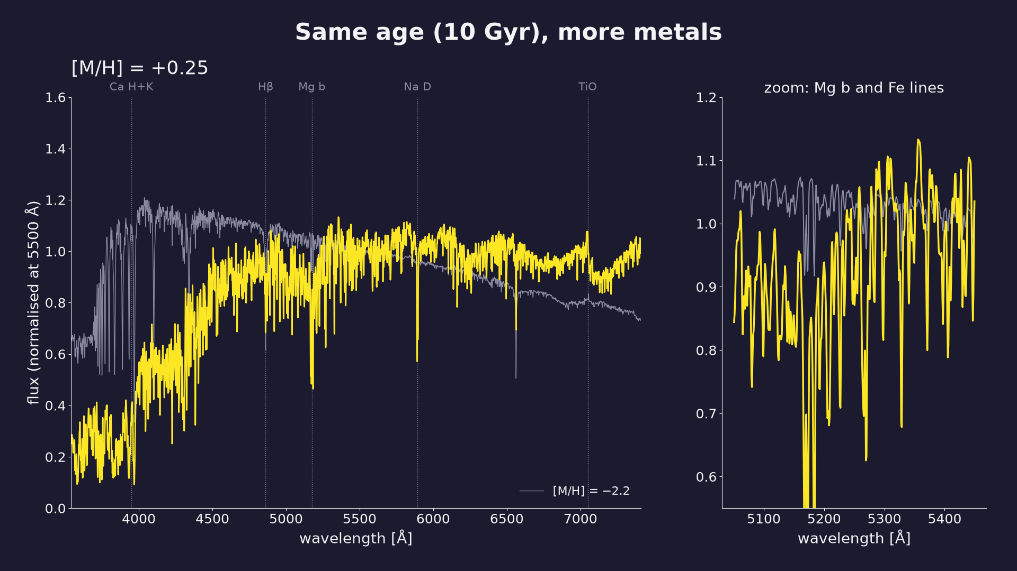
Notes:
1:34. Point at Mg b and Fe lines: index ratios break the degeneracy (Lick indices).
Caption: FaSTAR, 10 Gyr. Metal lines deepen and the continuum reddens — like getting older (Worthey's 3/2 rule).

Slide 24
Slido S1.9 · multiple choice
At 10 Gyr, which IMF has a higher M/L than Salpeter?
A top-heavy only (α = 1.3)
B bottom-heavy only (α = 3)
C both
D neither
slido.com · #CODE
Notes:
1:42. Answer C. Then A4.

Slide 25
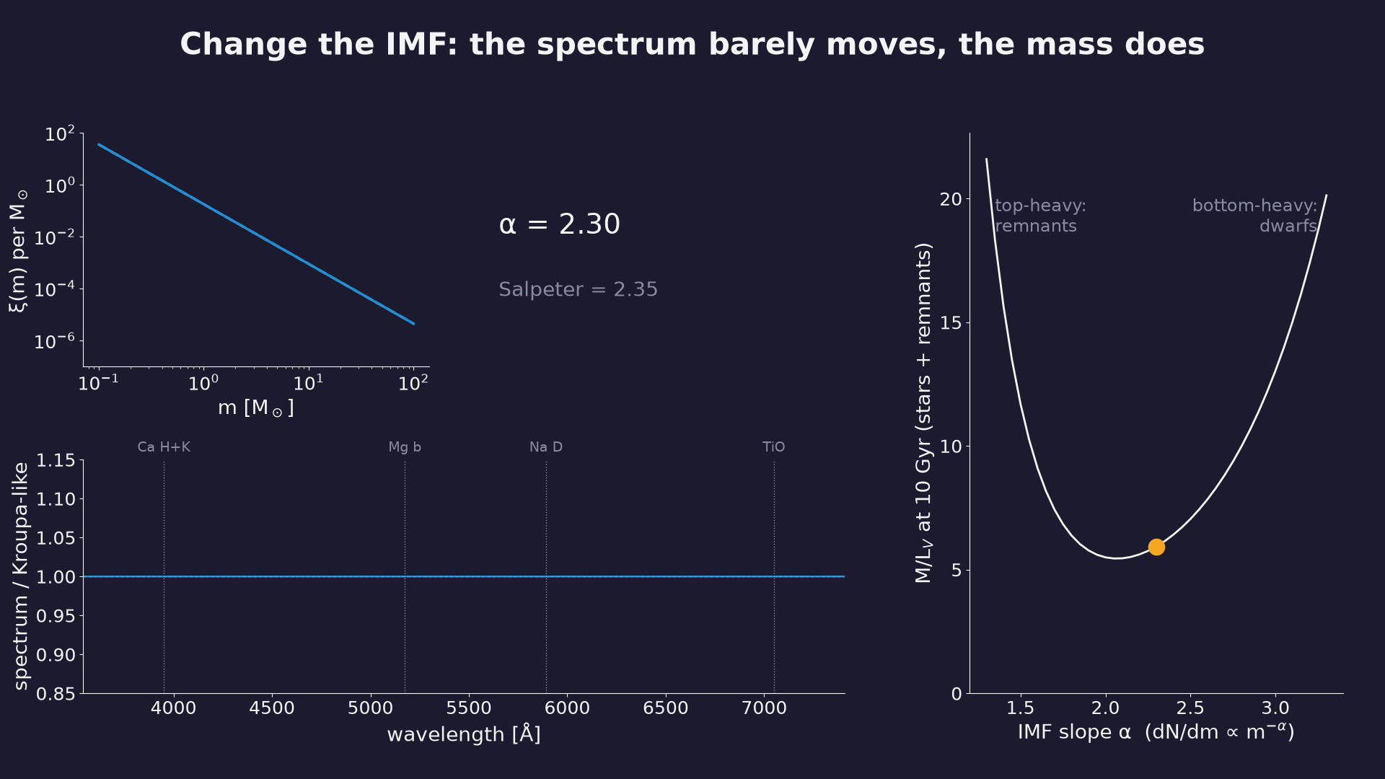
Notes:
1:44. The spectrum changes by a few per cent (Na D, TiO: dwarf-sensitive), M/L by a factor ~4. This is why IMF measurements in galaxies are hard and controversial.
Caption: Single power law 0.1–100 M☉, 10 Gyr, solar. Top-heavy: mass in remnants. Bottom-heavy: mass in faint dwarfs.

Slide 26
Slido S1.10 · multiple choice
Two clusters with 300 stars each, same age, metallicity and IMF. Same spectrum?
A yes
B no
slido.com · #CODE
Notes:
1:52. Answer no. Then A5.

Slide 27
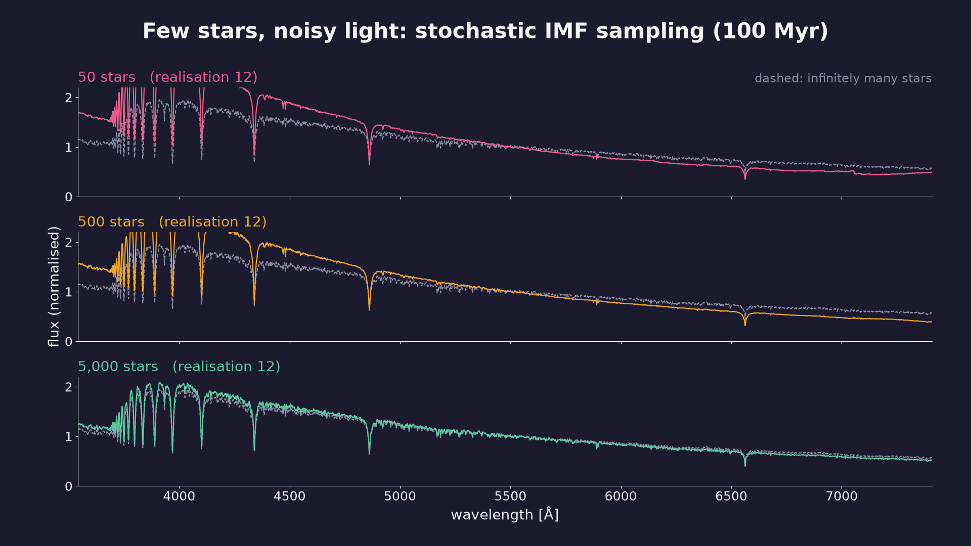
Notes:
1:54. Relevant for star clusters, dwarf galaxies and for ELT-resolution data (semi-resolved regime).
Caption: FaSTAR semi-resolved models, 100 Myr: a handful of massive or evolved stars decides the light.

Slide 28
3
So what?
Every stellar mass and SFR you read carries an IMF assumption
Notes:
2:02

Slide 29
→ insert your slides here
Hα SFR and stellar masses with a variable IMF (Haslbauer, Yan, Jeřábková 2024)
from: Canva ‘ISTA seminar’, slides 47–48
Notes:
2:03. Hα counts ionising photons = massive stars only. To get an SFR you extrapolate with the IMF.

Slide 30
Slido S1.11 · quiz
If the true IMF is top-heavy, an Hα SFR computed assuming Kroupa is …
A too high
B too low
C unchanged
slido.com · #CODE
Notes:
2:10. Answer: too high — more ionising photons per Msun formed than Kroupa assumes.

Slide 31
Take-aways
The IMF is inferred, not observed — a useful Hilfskonstrukt.
Most stars are small; the light comes from a few massive or evolved ones.
M/L depends on age, metallicity — and on the IMF (U-shape).
So every galaxy mass or SFR carries an IMF assumption.
Next time: chemistry as a clock — and the IMF again.
31
Notes:
2:14

Slide 32
Homework & exit ticket
Notebooks 01 (IMF) and 02 (SSPs with FaSTAR)
github.com/Azeret/stellar-populations-lectures [QR code]
Slido S1.12: one thing still unclear? How was the pace?
32
Notes:
2:17. Put the QR code here in Canva.

