Slide 1
Chemical evolution & the [Mg/Fe] clock
Lecture 2 — How do you read a galaxy's clock from its chemistry?
Dr. Tereza Jeřábková
Galaxies course · Masaryk University · ÚTFA
Notes:
0:00. Slido code on the board.

Slide 2
Slido S2.1 · quiz
Recap: in which year did Salpeter publish the IMF? Where is most of the stellar mass? How does M/L depend on the IMF slope?
A 1955 · low-mass stars · U-shape
B 1975 · massive stars · rising
C 1955 · massive stars · falling
slido.com · #CODE
Notes:
0:01. Three-question quiz in Slido (set up as three separate questions).

Slide 3
Slido S2.2 · word cloud
Name one element in your body — and where was it made?
slido.com · #CODE
Notes:
0:07. Expect: Big Bang (H), stars, supernovae. Then reveal the periodic table of origins.

Slide 4
→ insert your slides here
the periodic table of element origins
from: Johnson (2019, Science 363, 474) / NASA, CC BY-SA — download and place here
Notes:
0:10. Big Bang (H, He, Li), dying low-mass stars (AGB: C, N, s-process), exploding massive stars (O, Mg, Si, Ca), exploding white dwarfs (Fe, Ni), merging neutron stars (r-process).

Slide 5
Notation
[X/H] = log₁₀(N_X/N_H) − log₁₀(N_X/N_H)☉
[Mg/Fe] = [Mg/H] − [Fe/H]
[Fe/H] = −1 → one tenth of the solar iron per hydrogen
Z = mass fraction of all metals (Sun: Z ≈ 0.013–0.014, Asplund+2009)
[α/Fe] > 0 → more O, Mg, Si, Ca per Fe than the Sun
5
Notes:
0:17

Slide 6
Slido S2.3 · quiz
A star has 1/10 of the solar Fe/H. Its [Fe/H] is …
A −1
B −0.1
C 0.1
D −10
slido.com · #CODE
Notes:
0:24. Answer −1.

Slide 7
1
The galaxy as a bathtub
What goes in, what comes out, what stays?
Notes:
0:27

Slide 8
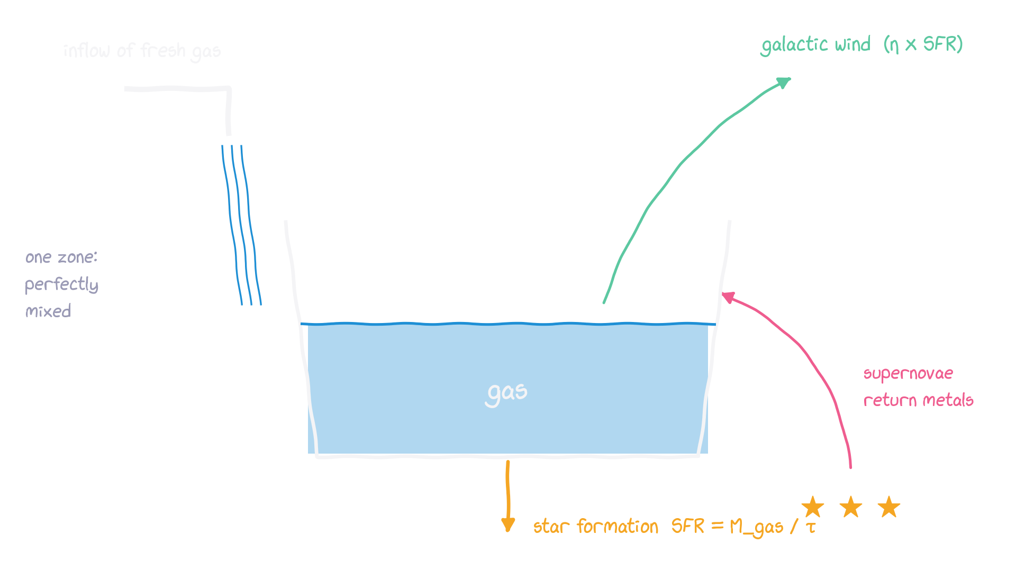
The one-zone (bathtub) model
dM_gas/dt = inflow − (1−R)·SFR − η·SFR dM_X/dt = −(1−R+η)·SFR·X_gas + yields(SN II, SN Ia, AGB)
8
Notes:
0:27–0:40. Draw it on the board together. Closed box: Z = y·ln(1/μ) → too many metal-poor G dwarfs (G-dwarf problem) → we need inflow. One sentence each.

Slide 9
2
Two kinds of supernovae
Why is the ratio of magnesium to iron a clock?
Notes:
0:40

Slide 10
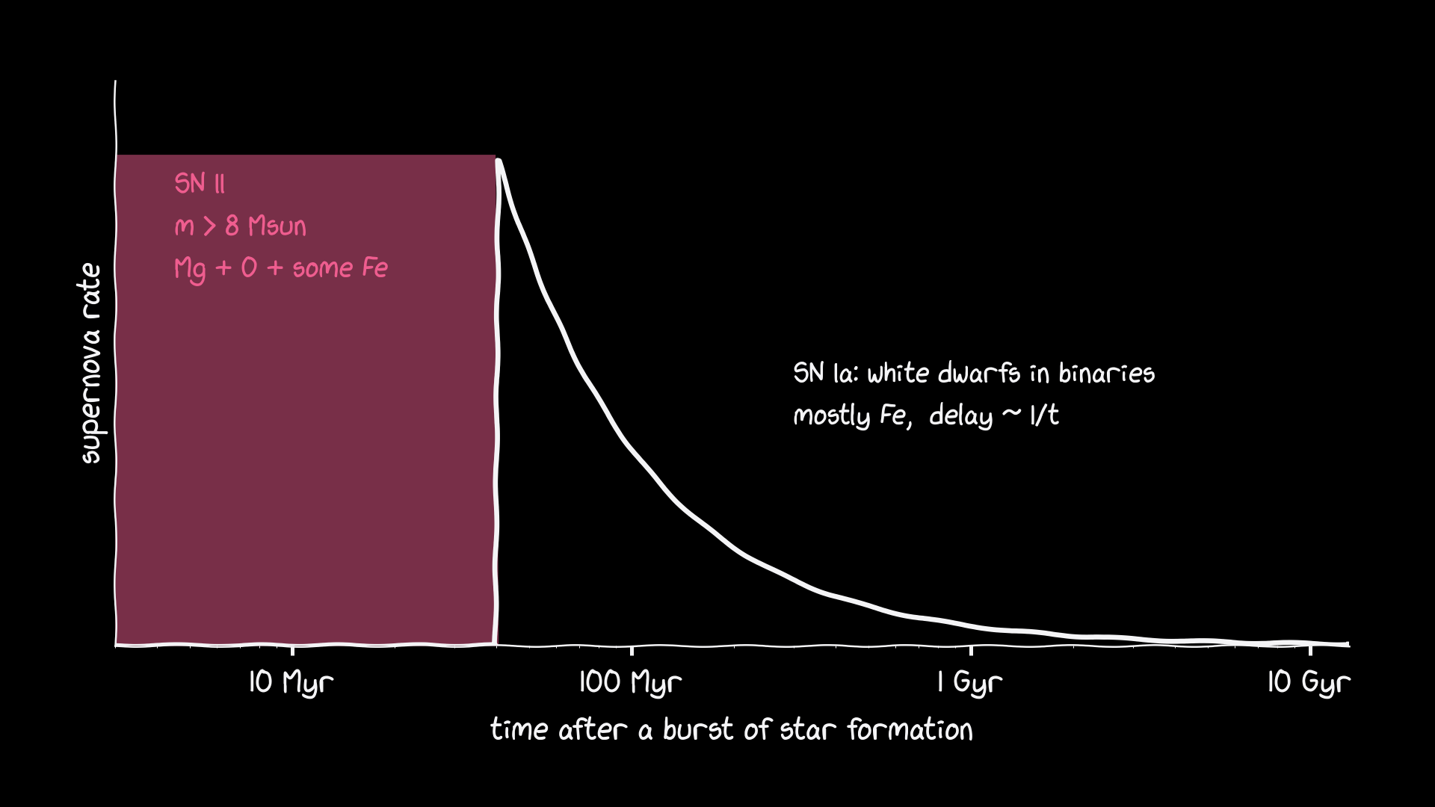
Prompt and delayed enrichment
SN II: within ~40 Myr, Mg-rich. SN Ia: delay-time distribution ~1/t from ~40 Myr to a Hubble time, Fe-rich.
10
Notes:
0:40. Before the game, so students know the rules of nature they are playing.

Slide 11
Game 2 — the cosmic kitchen
Your team is a galaxy with 8 units of star formation for 8 rounds (1 round ≈ 250 Myr).
Each round: (1) add the Fe from SN Ia due now; (2) form stars: +3 Mg and +1 Fe per unit (SN II);
book SN Ia: +1 Fe next round, +1 Fe the round after, +1 Fe four rounds later;
(3) write down Mg/Fe in your pot → [Mg/Fe] = log(Mg/Fe).
Fast: 4 + 4 units in rounds 1–2. Steady: 1 unit per round. Free: beat Fast!
11
Notes:
0:43–0:55. Hand out the tally sheet. Log table: 3→+0.48, 2→+0.30, 1.5→+0.18, 1.2→+0.08, 1→0, 0.75→−0.12.

Slide 12
Slido S2.4 · open text
Your team's mass-weighted [Mg/Fe] of the stars you formed
slido.com · #CODE
Notes:
0:53. Fast ≈ +0.40, Steady ≈ +0.18; all 8 units in round 1 gives +0.48 (the winner).

Slide 13
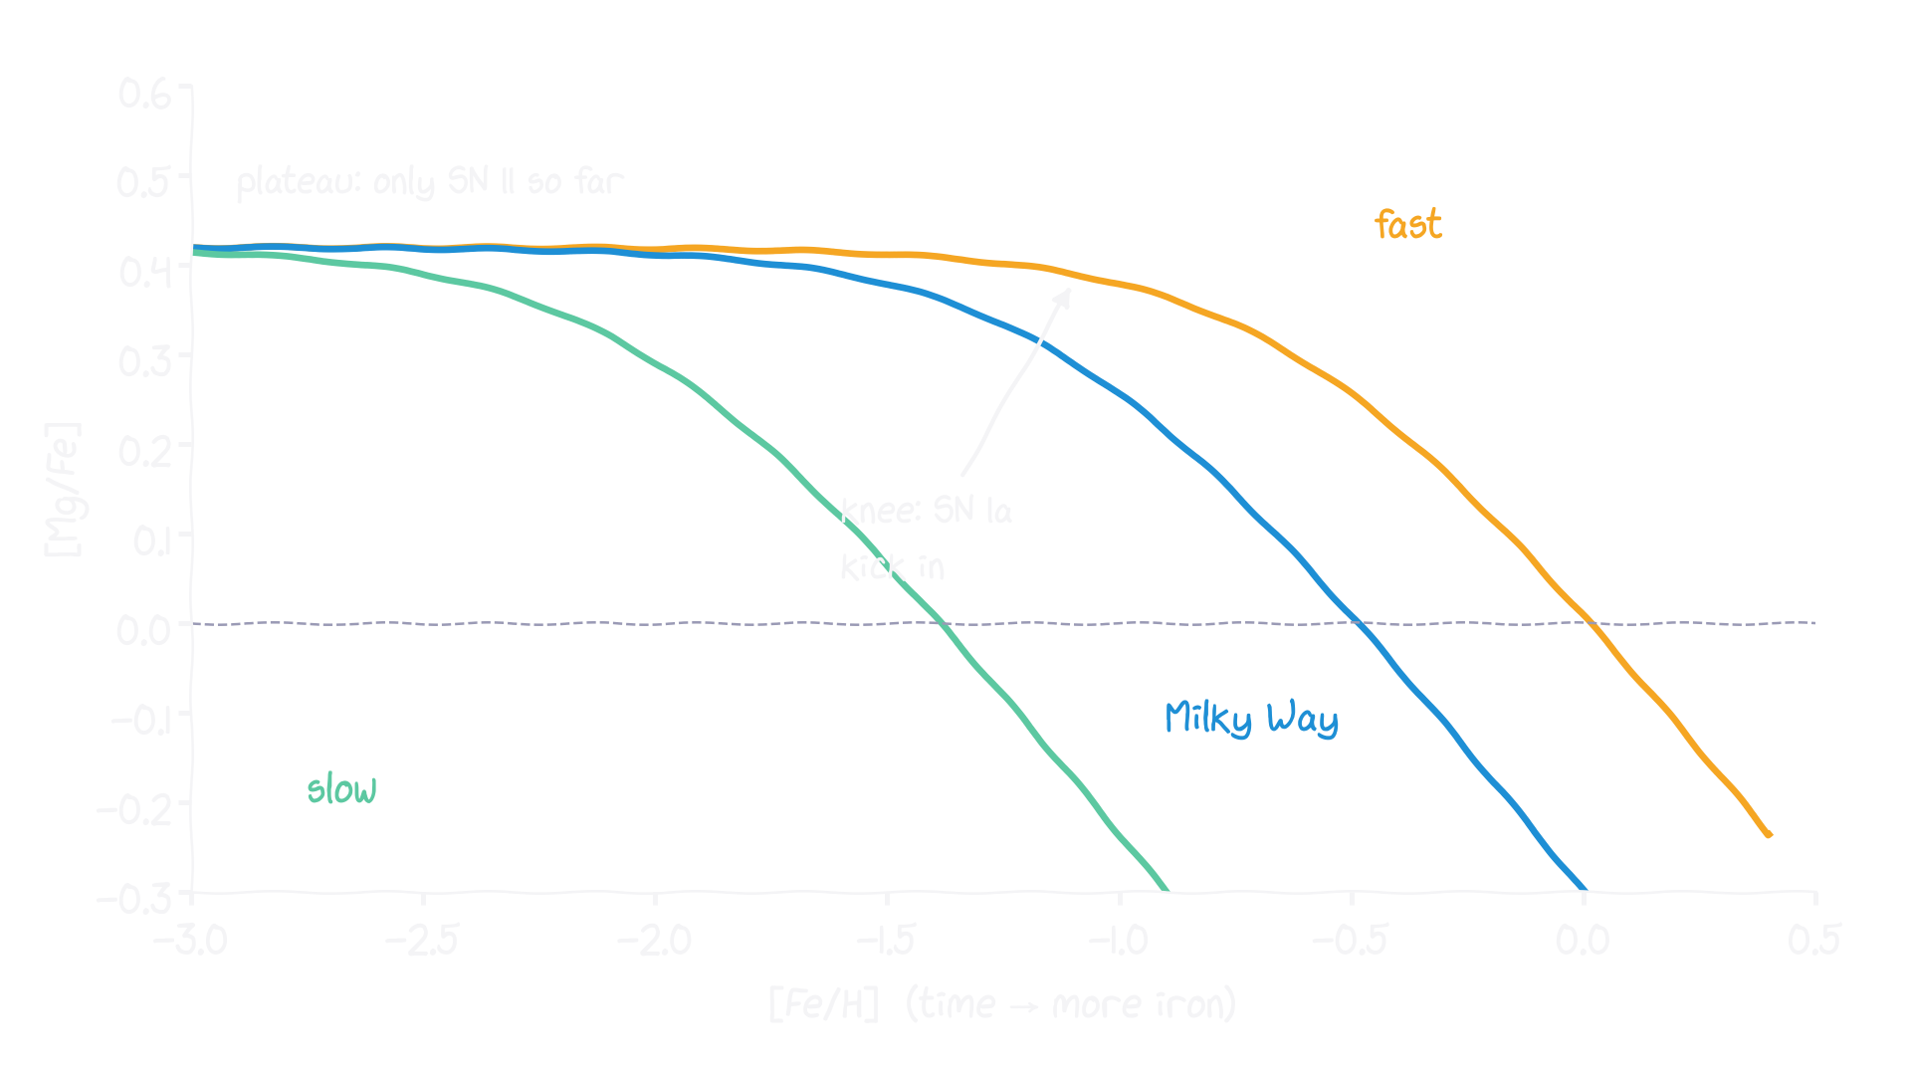
The plateau and the knee
Plateau: SN II only. Knee: SN Ia catch up. Its [Fe/H] tells how fast metals built up before ~1 Gyr.
13
Notes:
0:56

Slide 14
Slido S2.5 · multiple choice
A dwarf galaxy forms stars slowly. Its [Mg/Fe] knee sits at …
A lower [Fe/H]
B the same [Fe/H]
C higher [Fe/H]
slido.com · #CODE
Notes:
1:00. Answer: lower [Fe/H].

Slide 15
10 minutes break
Puzzle: could a galaxy have [Mg/Fe] above the SN II plateau?
Notes:
1:05–1:15

Slide 16
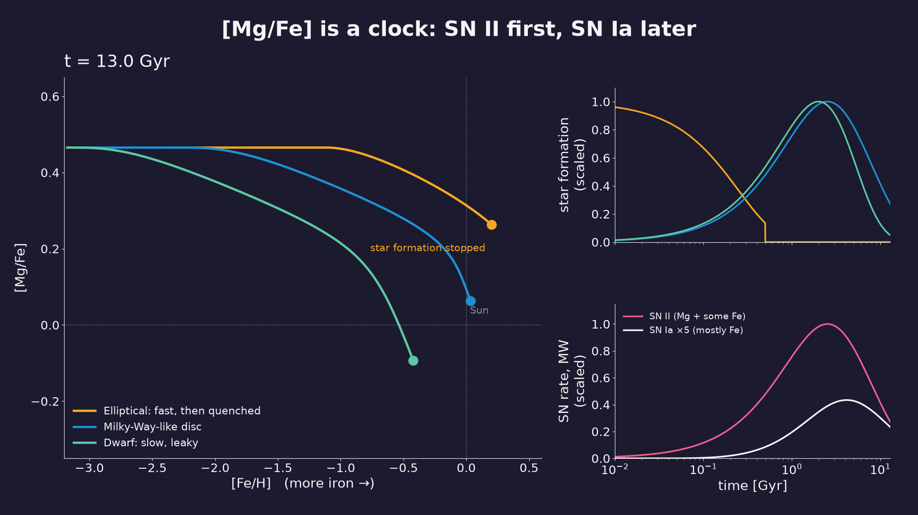
Notes:
1:15. The elliptical's stars stay α-rich because star formation stopped before SN Ia caught up.
Caption: Toy one-zone model (notebook 03): elliptical (fast, quenched at 0.5 Gyr), Milky-Way-like disc, slow leaky dwarf.

Slide 17
Slido S2.6 · multiple choice
Make the IMF top-heavy. The [Mg/Fe] plateau …
A goes up
B goes down
C stays
slido.com · #CODE
Notes:
1:22. Answer: up — more of the most massive SN II, which make the most Mg per Fe.

Slide 18
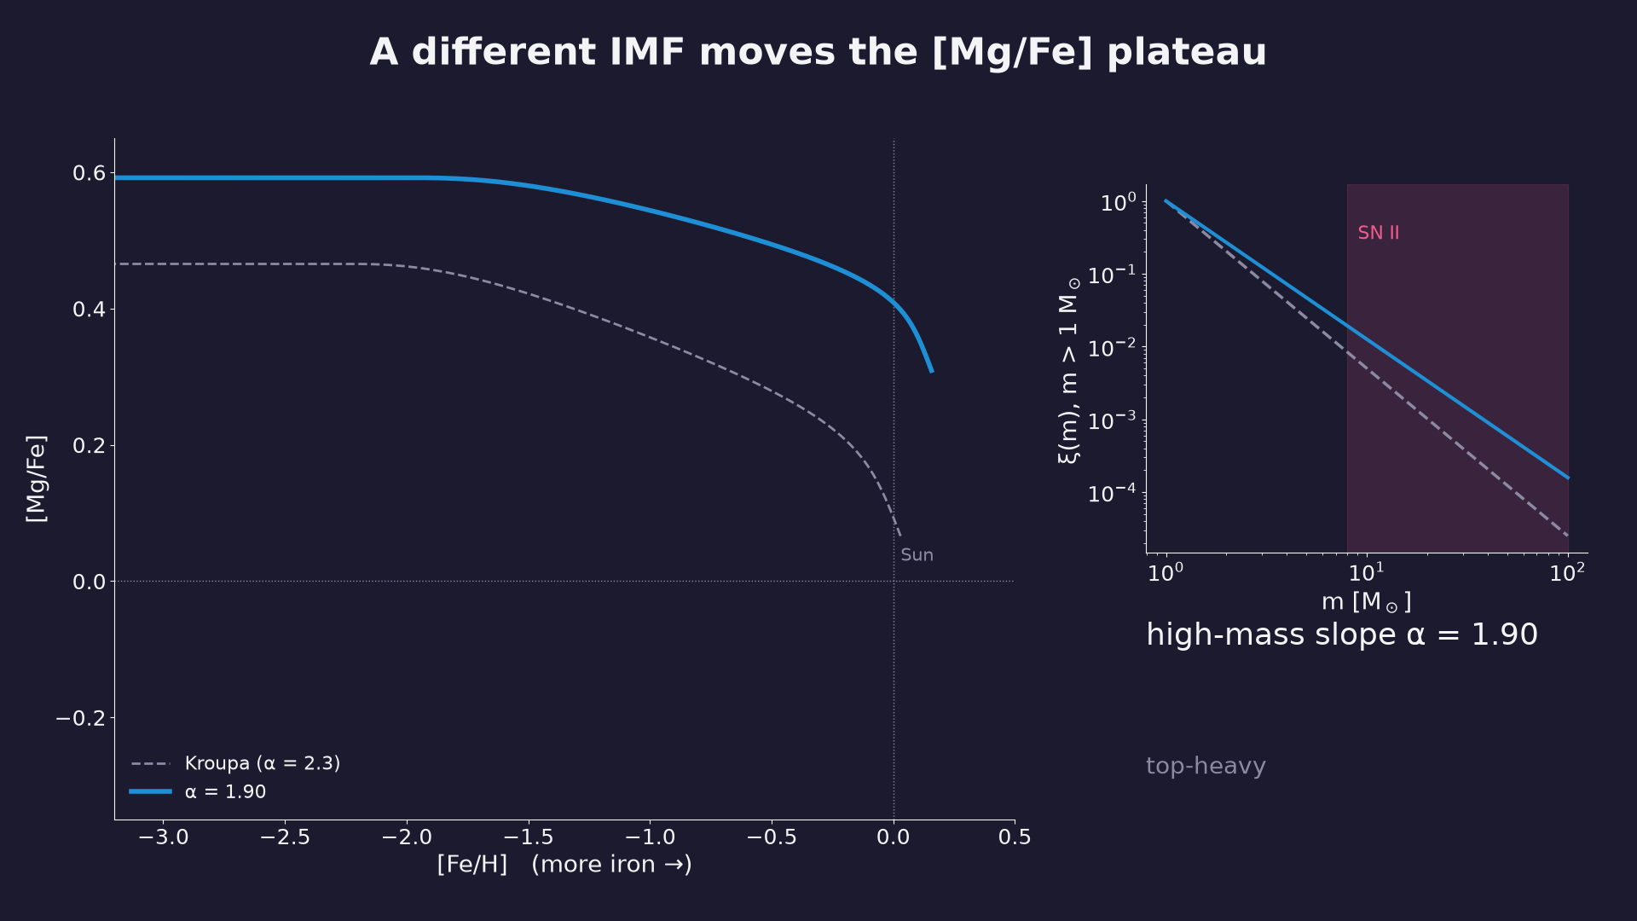
Notes:
1:24. The degeneracy: high [Mg/Fe] = fast star formation OR top-heavy IMF.
Caption: Same Milky-Way-like model, high-mass IMF slope from 1.9 (top-heavy) to 2.7 (top-light).

Slide 19
3
Real models: galevo
Does it hold up with real stellar lifetimes and yields?
Notes:
1:28

Slide 20
→ insert your slides here
GalIMF / galevo: modular open-source code, IGIMF theory
from: Canva ‘ISTA seminar’, slides 42–45 (and 48: galaxy-wide IMF variations)
Notes:
1:28. What galevo adds: lifetimes, metallicity-dependent yields, many elements, SN Ia DTD, and a galaxy-wide IMF from the IGIMF theory. github.com/Azeret/galIMF

Slide 21
[missing: a8_galevo_tracks_final.png]
Notes:
1:33
Caption: galevo, 3×10⁹ M☉ formed with a flat SFH over 30 Myr, 300 Myr, 3 Gyr; Kroupa IMF vs IGIMF.

Slide 22
Slido S2.7 · ranking
Rank by the [Mg/Fe] of their stars: formed in 30 Myr / 300 Myr / 3 Gyr
slido.com · #CODE
Notes:
1:38. Answer: 30 Myr > 300 Myr > 3 Gyr.

Slide 23
→ insert your slides here
observations: Milky Way thick vs thin disc (APOGEE), dwarf spheroidals with a low knee (Tolstoy+2009)
from: literature figures — add your favourites
Notes:
1:40. Use S2.8 here: 'Track A with a knee at [Fe/H] ≈ −2 belongs to…' (dwarf spheroidal).

Slide 24
Slido S2.8 · multiple choice
Track A has its knee at [Fe/H] ≈ −2. It belongs to …
A a dwarf spheroidal
B the Milky Way thick disc
C a giant elliptical
slido.com · #CODE
Notes:
1:45. Answer: dwarf spheroidal.

Slide 25
→ insert your slides here
ellipticals: [Mg/Fe]–mass, formation timescales, time-variable IMF (Yan, Jeřábková+2019, 2021)
from: Canva ‘ISTA seminar’, slides 52–57
Notes:
1:52. Thomas+2005: more massive ellipticals are more α-enhanced → formed faster (downsizing). With the IGIMF: top-heavy early (starburst) and bottom-heavy later (metal-rich) can do both.

Slide 26
Slido S2.9 · multiple choice
Massive ellipticals have [Mg/Fe] ≈ +0.3. Their stars formed within …
A ~1 Gyr
B ~5 Gyr
C >10 Gyr
slido.com · #CODE
Notes:
2:00. Answer ~1 Gyr — with the IMF caveat.

Slide 27
Slido S2.10 · poll (before and after)
Is the IMF universal?
A yes
B no
C it depends
slido.com · #CODE
Notes:
2:04–2:14. Debate: two camps, 3 min preparation, 2 min each, then vote again.

Slide 28
Take-aways
SN II enrich fast with α-elements; SN Ia slowly with iron.
The knee in [Mg/Fe] marks when SN Ia catch up — a clock.
Fast-forming galaxies (ellipticals) keep α-rich stars.
The IMF sets the plateau: time and IMF are degenerate.
The IMF links light → mass (Lecture 1) and chemistry → time (Lecture 2).
28
Notes:
2:14

Slide 29
Homework & exit ticket
Notebooks 03 (toy model) and 04 (galevo)
github.com/Azeret/stellar-populations-lectures [QR code]
Slido S2.11: one thing you will remember
29
Notes:
2:18

