Slide 1
Rqweetratdfgdiern
sdfFoasdfrmga
Web
Design

Slide 2
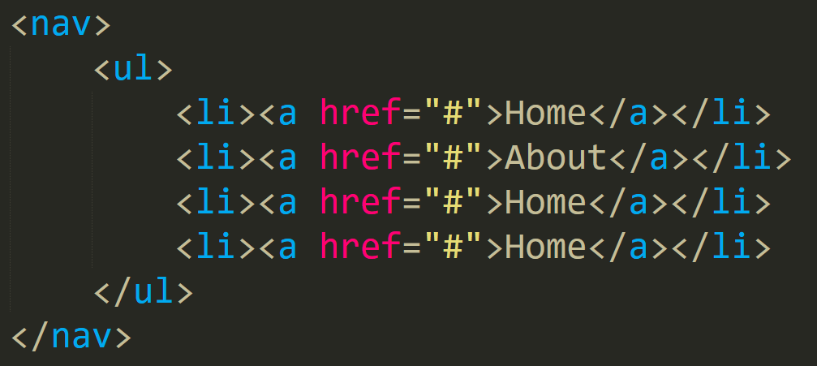
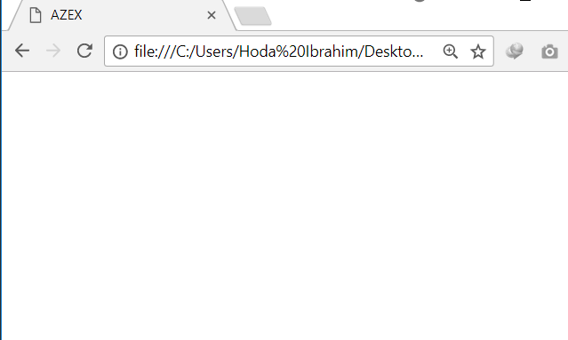




Slide 3



Slide 4
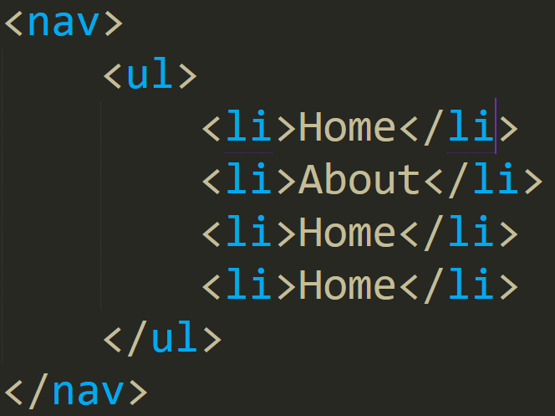


Slide 6
<body>
<ul> & <ol>
<li>

Slide 7
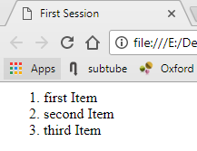
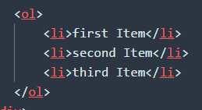

Slide 8
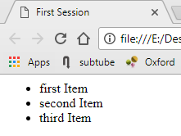
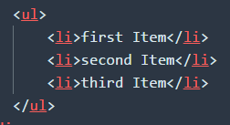

Slide 9
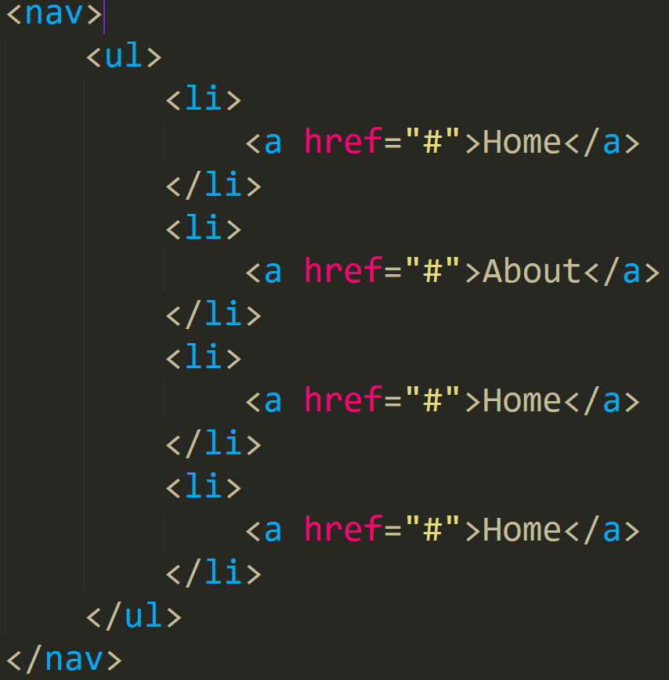
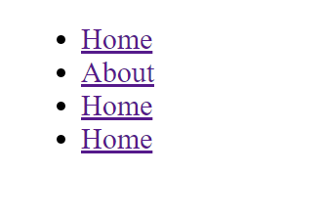

Slide 10
<body>
<a>
Attributes:
href = “ . . . “
target = “ . . . “
_blank
_self
Notes:
A for anchor.
Attributes ( target → _blank -- _self -- _top -- _parent – nameframe)
You will see it in the material!

Slide 11


Slide 12
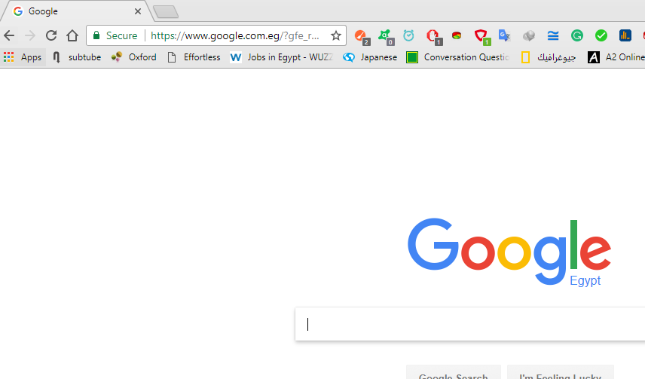


Slide 14

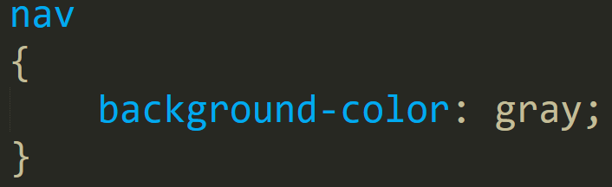

Slide 15
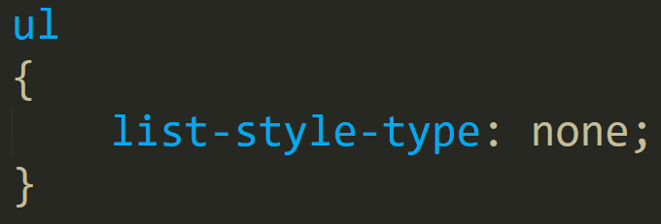


Slide 16
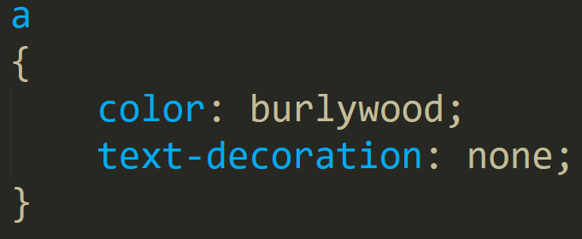


Slide 17
text-decortion: ___ ;
Line-through
overline
Underline
none

Slide 18
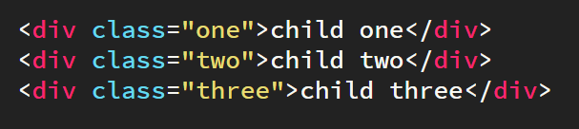

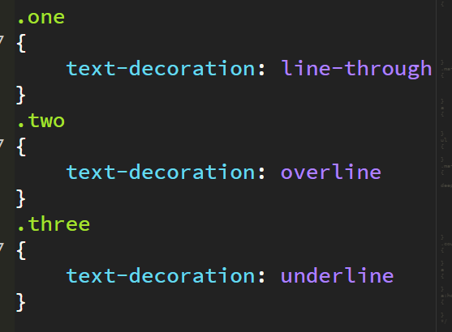
text-decortion: ___ ;

Slide 19
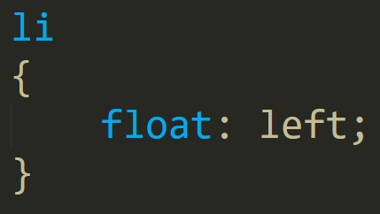


Slide 20
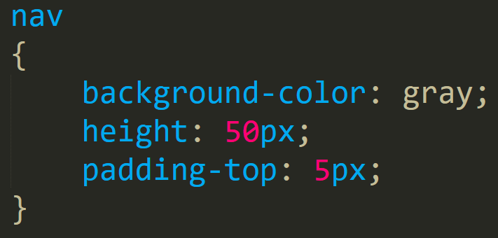


Slide 21


Slide 23
float: ___ ;
none
left
right

Slide 24
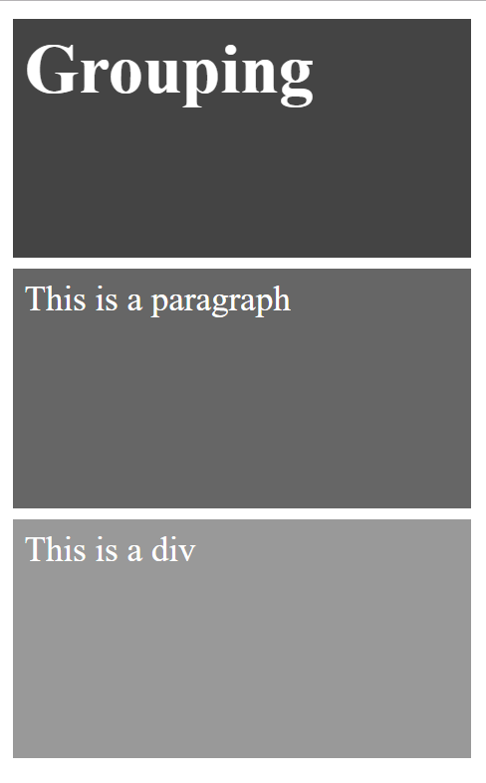
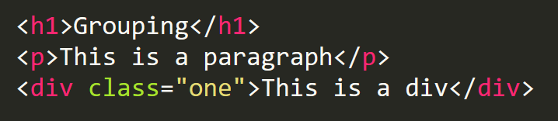
float: none;

Slide 25
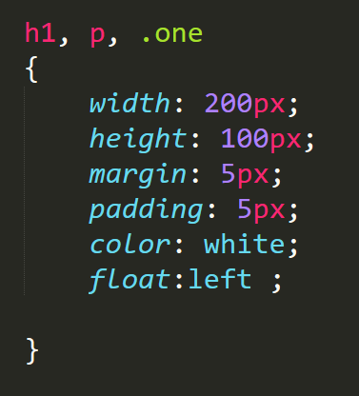

float: left;
Notes:
Margin : auto 20px
Does margin affect (width – height )
margin: 100px 40px 40px 150px;
Top and bottom of tow divs

Slide 26
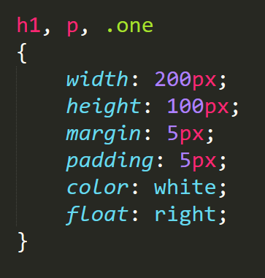

float: right;
Notes:
Margin : auto 20px
Does margin affect (width – height )
margin: 100px 40px 40px 150px;
Top and bottom of tow divs

Slide 27
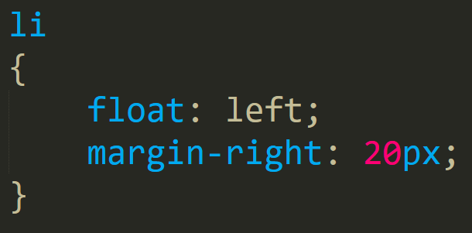


Slide 29
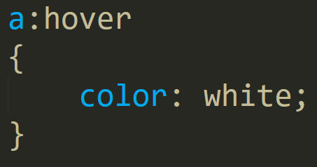



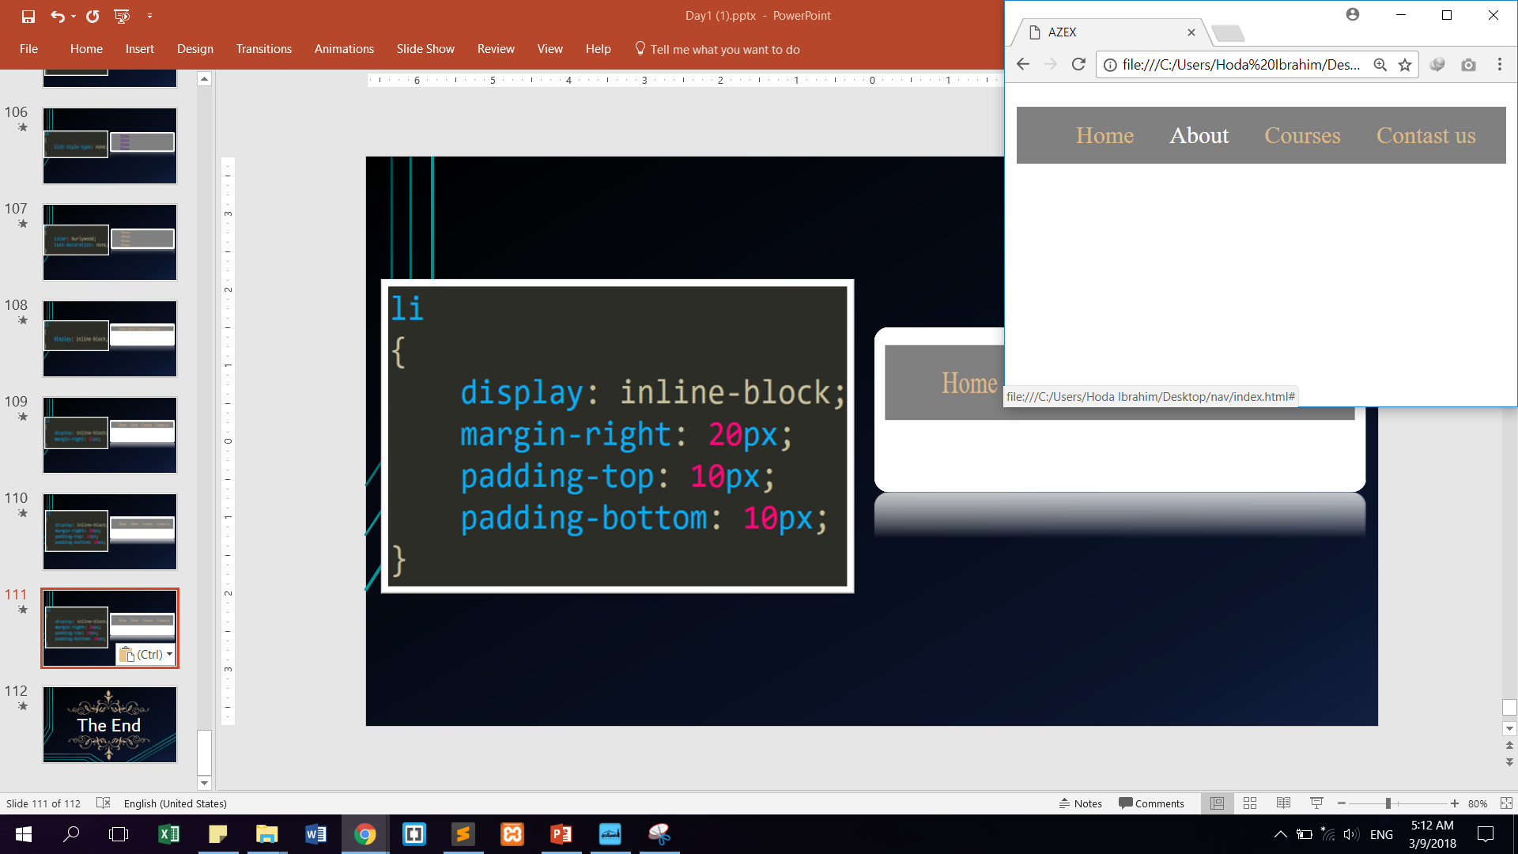

Slide 30
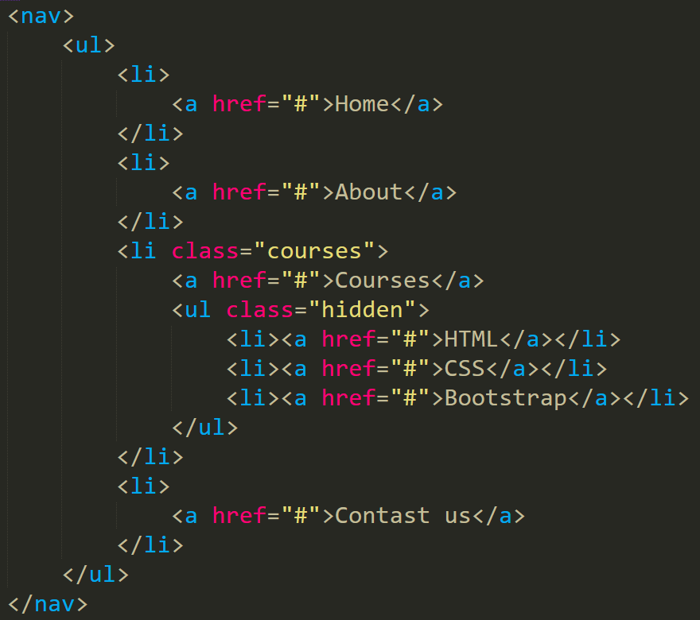

Slide 31


Slide 32
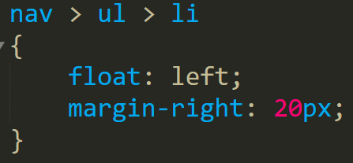


Slide 33
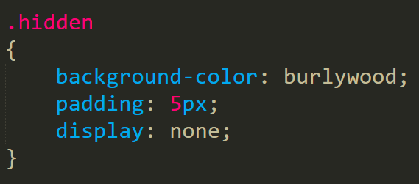


Slide 34
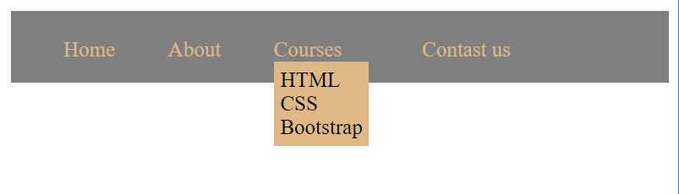

Slide 35


Slide 37
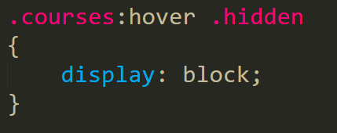

Slide 38

The End

