Slide 1
Predict Probability of Sales on Inbound Call Center Traffic
Azhaar Hussain

Slide 2
Problem Description
Predict sales conversion based on a number of factors such
Agent answering the phone
Cable company
Affiliate
Callers phone number
Toll free number advertised (TFN)
Call skill on which call got answered

Slide 3
Client
Provider of outsourced online customer acquisition services
Sells internet, cable and phone
Drives volume using
Core marketing (adwords ads on Google, Bing)
Affiliate channel
Generates about 500K calls/month
Owns and operates call centers in US and Pakistan

Slide 4
Data Set
CSV file for May 2016 containing data on calls offered
440K+ calls offered
400K+ calls answered
12 variables

Slide 5
Data Cleaning and Wrangling
Mostly clean data set
BTN variable cleaned to removed non-numeric entries
Cable Company names have lower case, misspellings etc issues
Create a variable with sale/no-sale values from disposition column

Slide 6
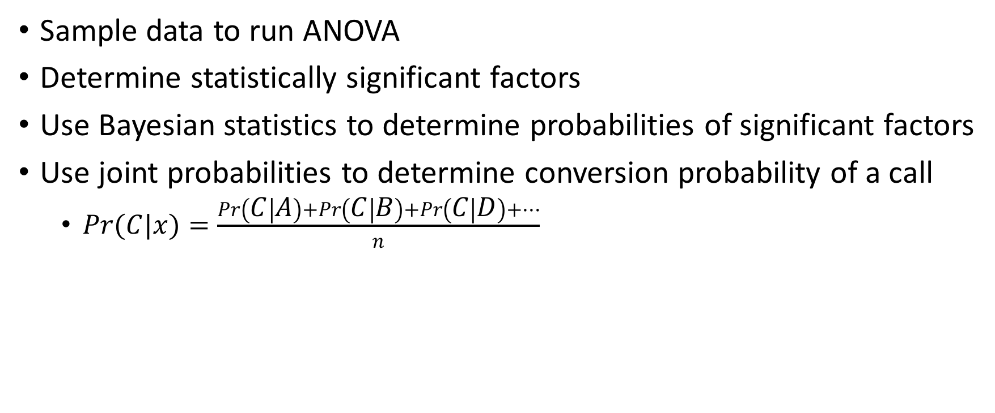
Approach – ANOVA and Bayesian Statistics
Sample data to run ANOVA
Determine statistically significant factors
Use Bayesian statistics to determine probabilities of significant factors
Use joint probabilities to determine conversion probability of a call
$Pr(C|x)=\frac{\operatorname{Pr}\left(C | A\right)+\operatorname{Pr}\left(C | B\right)+\operatorname{Pr}\left(C | D\right)+…}{n}$

Slide 7
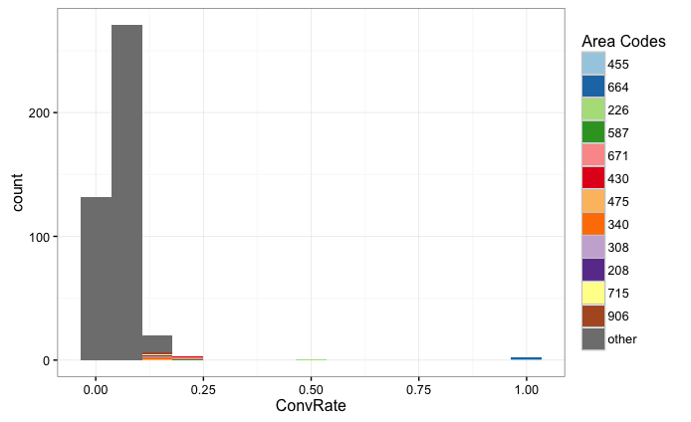
Exploratory Graphs -

Slide 8
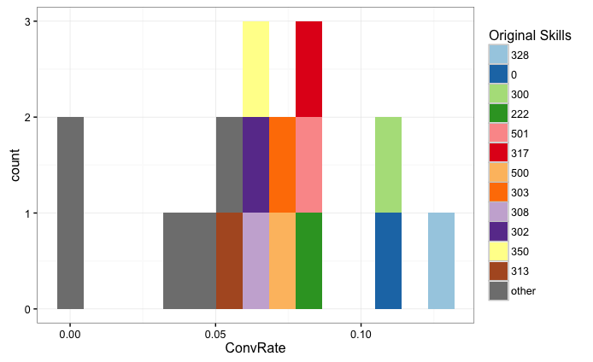
Exploratory Graphs contd…

Slide 9
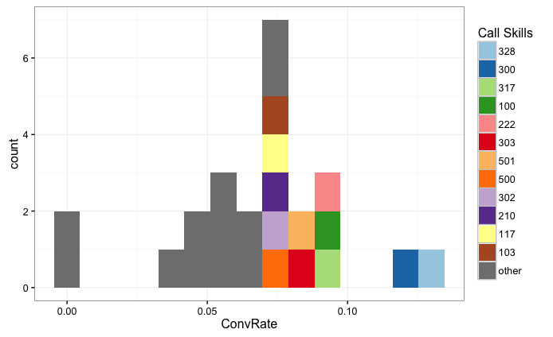
Exploratory Graphs contd…

Slide 10
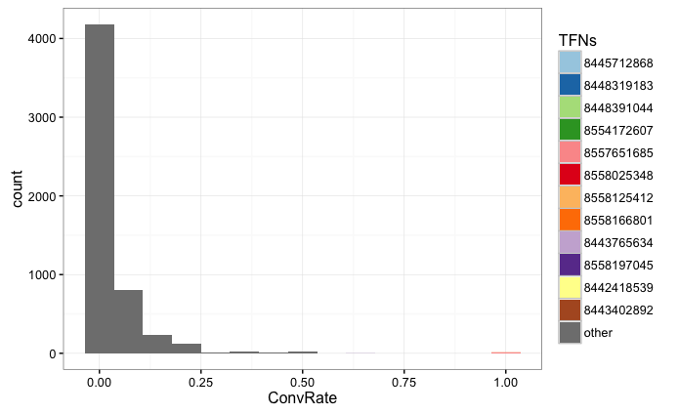
Exploratory Graphs contd…

Slide 11
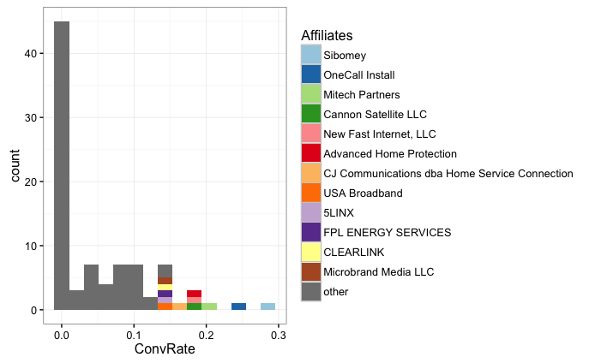
Exploratory Graphs contd…

Slide 12
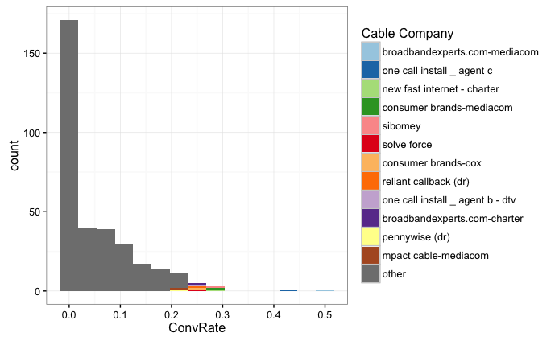
Exploratory Graphs contd…

Slide 13
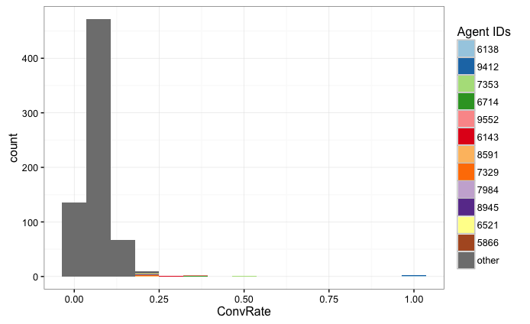
Exploratory Graphs contd…

Slide 14
Results
Area Code and Affiliates come out to be significant factors in determining sales conversion

Slide 15
Recommendations
Priority routing for increasing sales
Interactive Voice Response (IVR) for decreasing labor costs
Improve ads efficiency
Add marketing channels (adwords and bing) in the analysis to improve bidding

