Slide 1
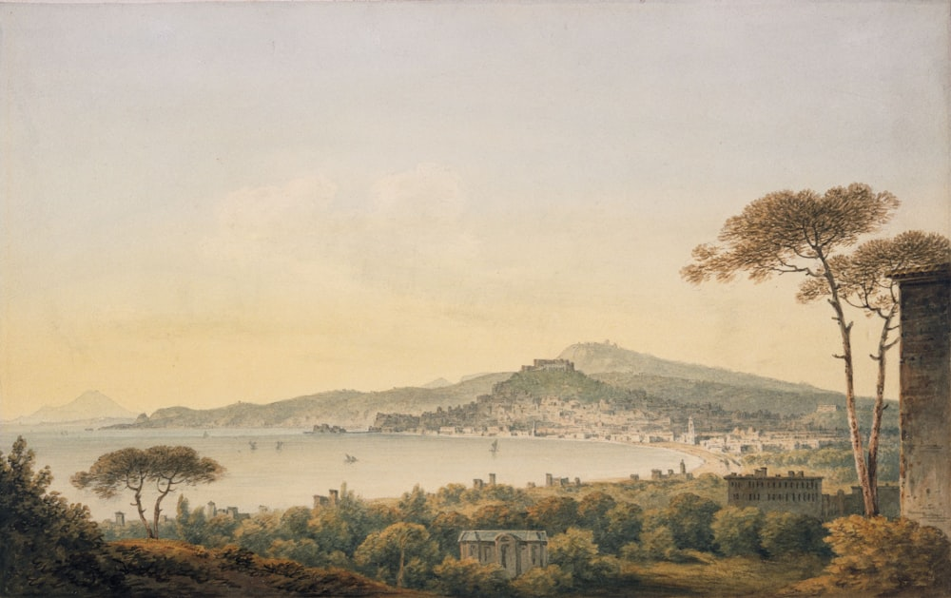
SQL PROJECT
MUSEUM AND PAINTINGS
A CASE STUDY
MUSEUM AND PAINTINGS
A CASE STUDY
BY ,
AZHAGAPAN T

Slide 2

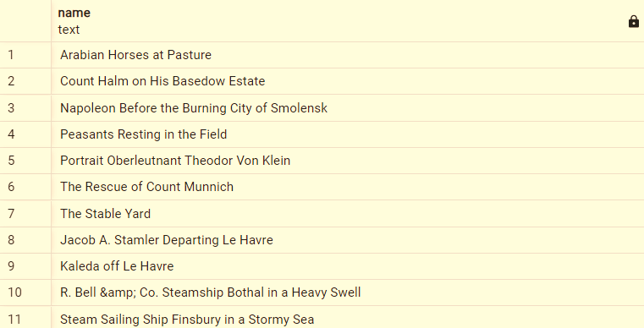
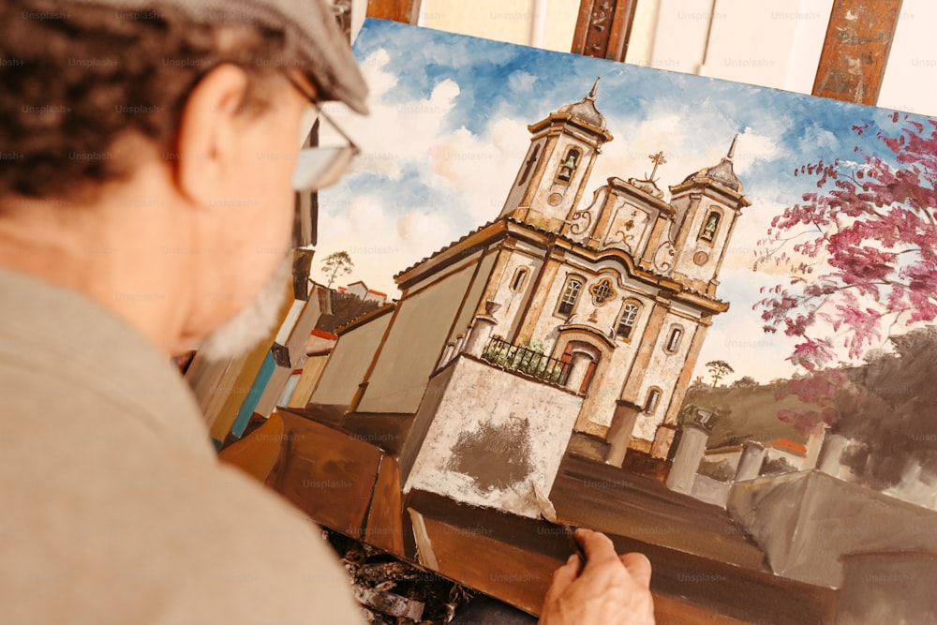
Write a query to find all the paintings which are not displayed on any museums.

Slide 3

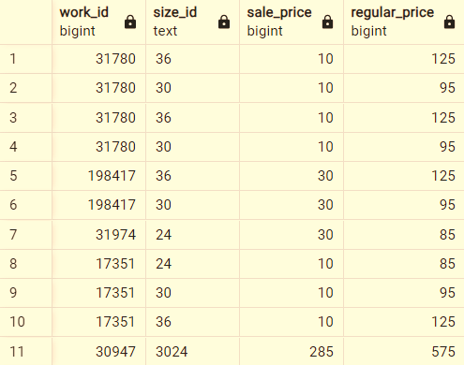
Write a query to identify the paintings whose asking price is less than 50% of its regular price.

Slide 4
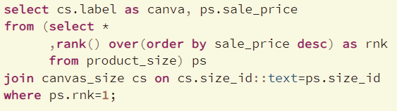

Write a query to find which canvas size costs the most.

Slide 5
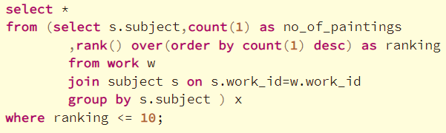
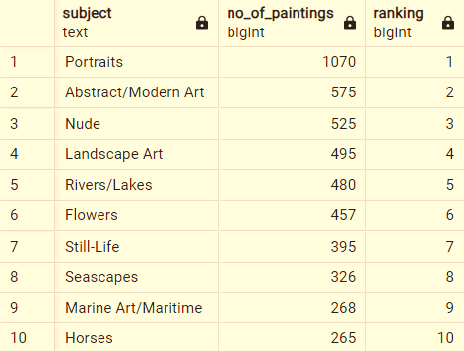
Write a query to fetch the top 10 most famous painting subject.

Slide 6
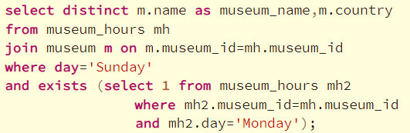
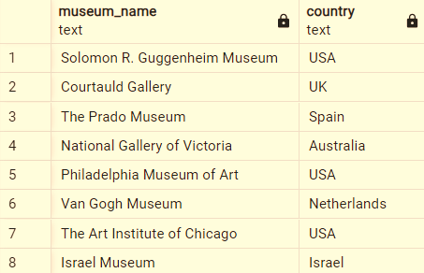
Write a query to identify the museums which are open on both Sunday and Monday. Display museum name, city.

Slide 7
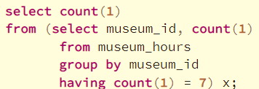

Write a query to find the number of museums open every single day.

Slide 8
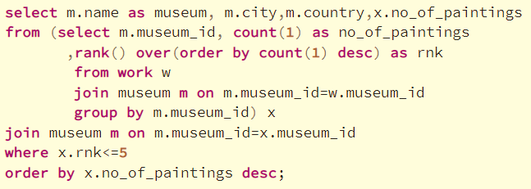
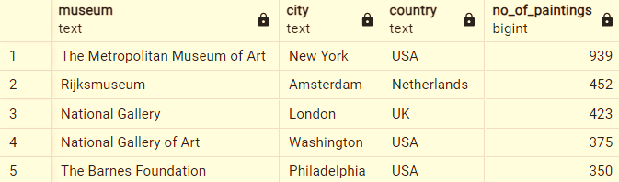
Write a query to find the top 5 most popular museum.(Popularity is defined based on most no of paintings in a museum).

Slide 9
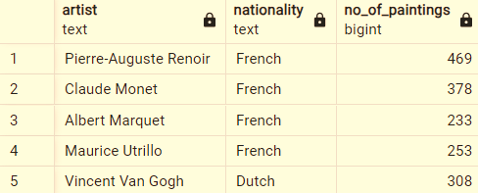
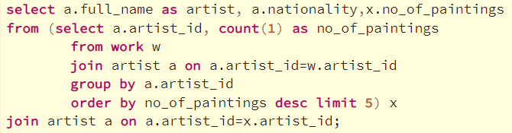
Write a query to fetch the top 5 most popular artist. (Popularity is defined based on most no of paintings done by an artist).

Slide 10
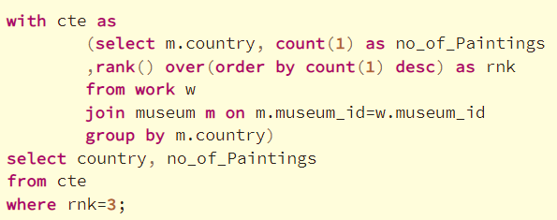

Write a query to fetch the country which has the 3rd highest no of paintings.

Slide 11
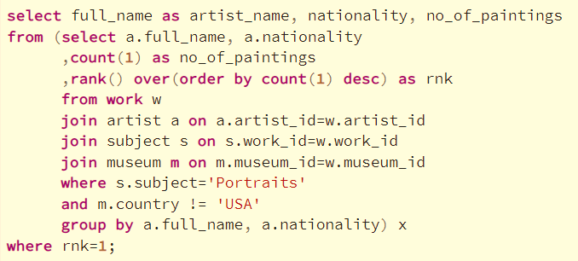
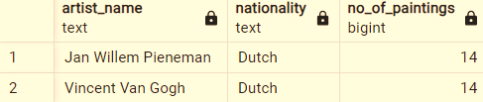
Write a query to fetch the artist who has the most no of portraits paintings outside USA. Display artist name, no of paintings and the artist nationality.

