Slide 1
Digital Portfolio
STUDENT NAME : T Mohammed Azhan
REGISTER NO AND NMID : 31924u18010/ astvu31931924u18010
DEPARTMENT : B.Sc. Computer Science
COLLEGE : Mazharul Uloom College

Slide 2
PROJECT TITLE My Portfolio

Slide 3


AGENDA
Problem Statement
Project Overview
End Users
Tools and Technologies
Portfolio design and Layout
Features and Functionality
Results and Screenshots
Conclusion
Github Link
3/21/2024 Annual Review

Slide 4

PROBLEM STATEMENT
Main problems which I have faced are: choosing right projects, cluttered design, poor responsiveness, slow performance, broken links, weak project explanations, lack of personality, outdated skills, and not updating regularly - making the portfolio look generic instead of professional.

Slide 5

PROJECT OVERVIEW
A responsive personal portfolio website showcasing My skills, education, and projects (Amazon & Microsoft clones, registration form), with sections for about, resume, contact, and a clean design for professional presentation.

Slide 6

WHO ARE THE END USERS?
Recruiters
Hiring
Managers
Clients
Peers
Collaborators
Educators
Mentors
General Audience.

Slide 7

TOOLS AND TECHNIQUES
Main Tools:
HTML
CSS
JavaScript
Techniques:
Responsive web design
Portfolio presentation
UI/UX design
Animation & interactivity
Form handling

Slide 8
POTFOLIO DESIGN AND LAYOUT
Design:
Clean, modern, and responsive design
Dark/Light background sections for contrast
Professional typography (Roboto, Poppins, Raleway)
Visual focus with images, icons, and progress bars
Layout:
Header – Logo + navigation menu
Hero section – Intro with name & role
About section – Profile, skills, and bio
Resume section – Education details
Stats section – Projects, clients, experience
Portfolio section – Project showcases (Amazon Clone, etc.)
Contact section – Address, email, phone, and form
Footer – Copyright & credits
8

Slide 9
FEATURES AND FUNCTIONALITY
Features:
Modern, responsive single-page design
Attractive hero section with typing animation
About & resume sections to showcase profile and education
Portfolio gallery for project highlights
Contact form with validation
Functionality:
Smooth navigation with sticky header
Animated progress bars & counters
Project filtering (Isotope)
Interactive image lightbox (Glightbox)
Form submission handling via PHP script

Slide 10
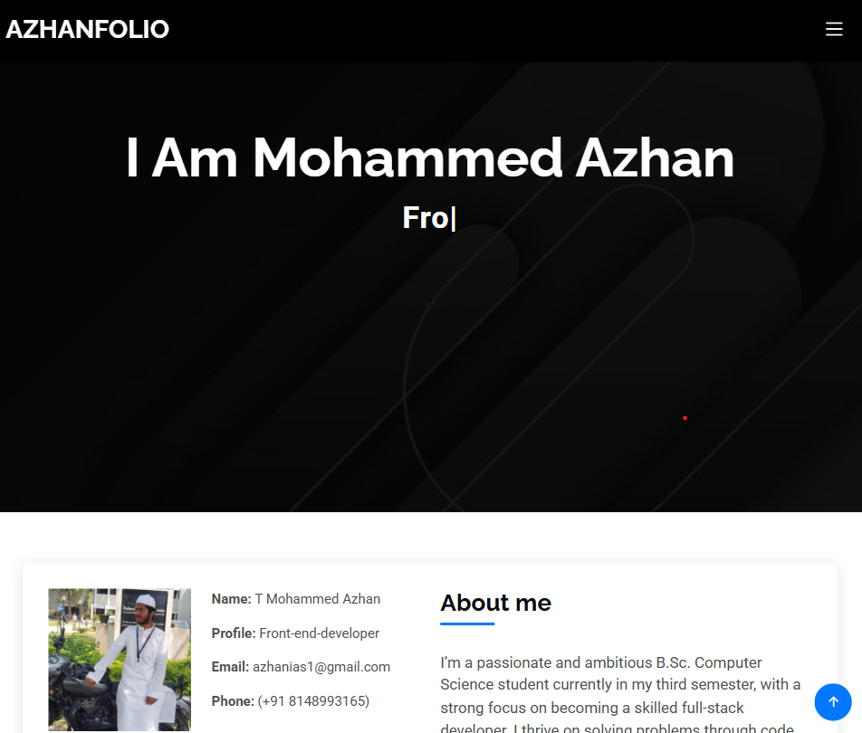

RESULTS AND SCREENSHOTS
Functionality:
Smooth navigation with sticky header
Animated progress bars & counters
Project filtering (Isotope)
Interactive image lightbox (Glightbox)
Form submission handling via PHP script
Screenshot:
3/21/2024 Annual Review
10

Slide 11
CONCLUSION
The portfolio website successfully demonstrates my skills, education, and projects in a professional and interactive way. It serves as a digital resume, helping recruiters, clients, and collaborators easily evaluate my capabilities while enhancing my online presence and career opportunities.
11

