Slide 1

Smart Doorbell Camera with Cloud-Ready Architecture
An IoT-based smart doorbell system using ESP32-CAM and ESP32 Hub that provides real-time video streaming, two-way audio communication, and instant doorbell notifications through a web-based interface.

Slide 2
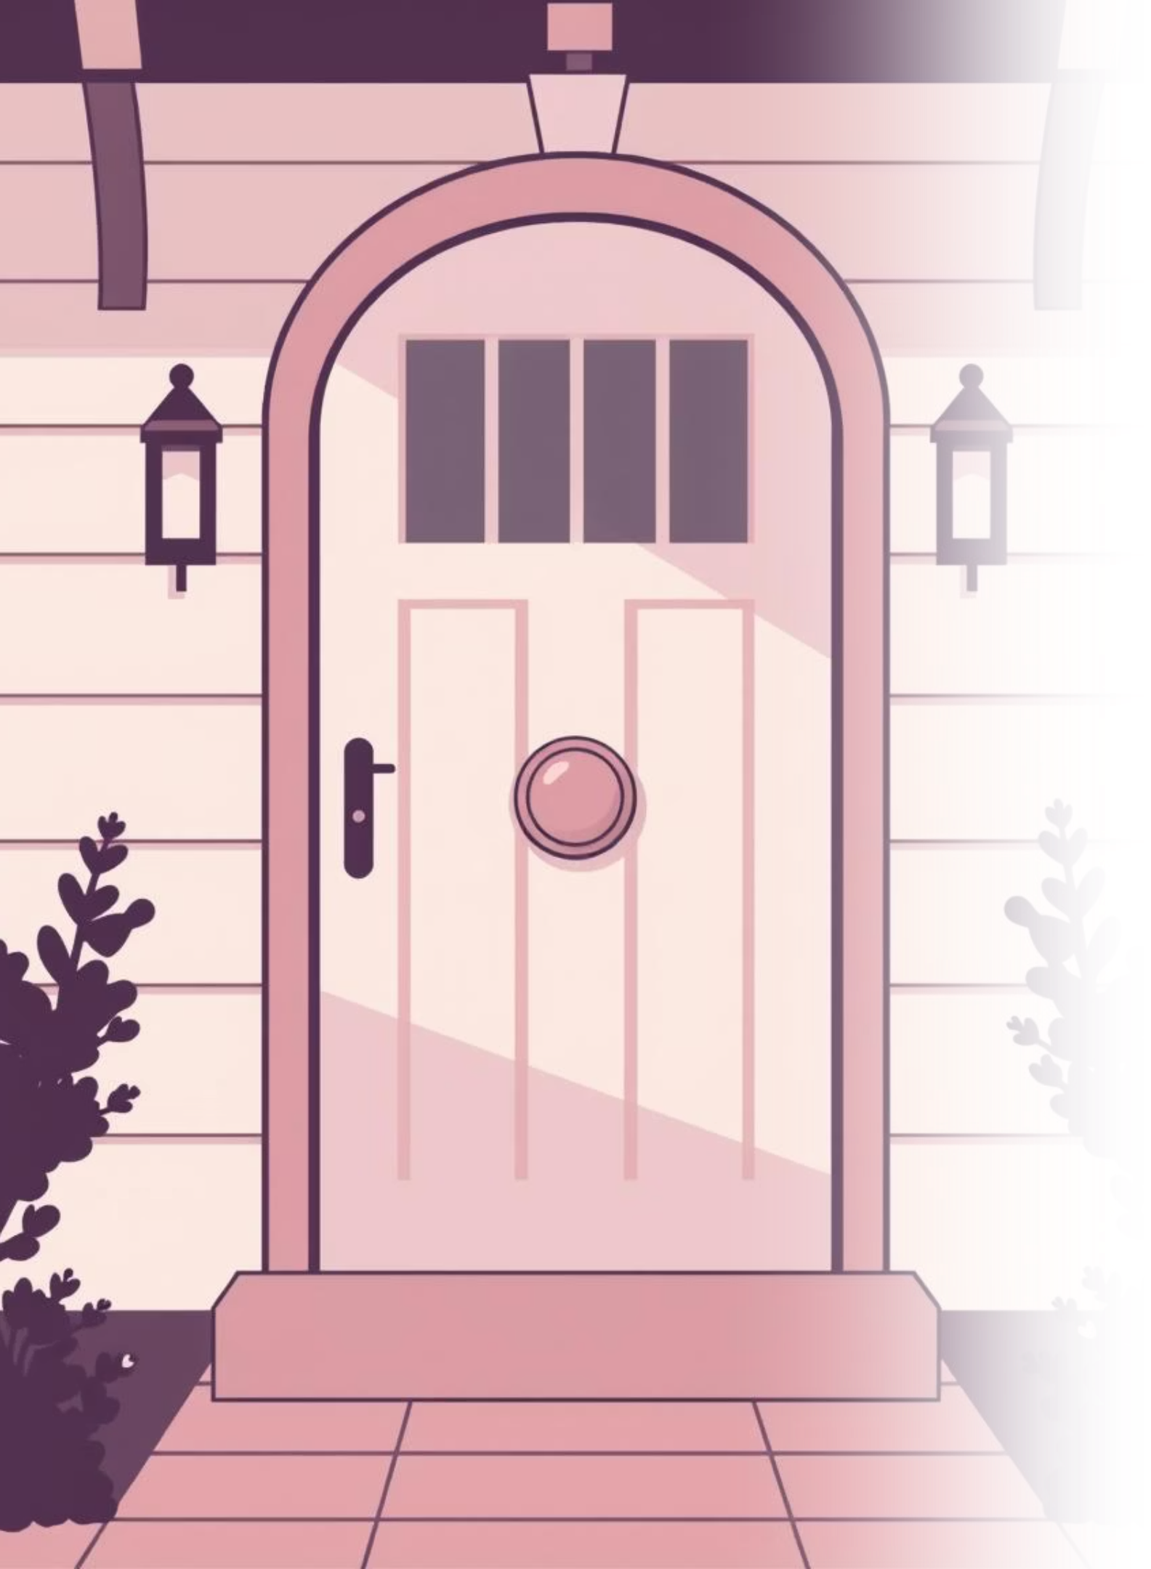
The Limitations of Traditional Doorbells
Traditional doorbell systems are limited to sound-based alerts and do not provide information about the visitor’s identity or activity, leading to significant gaps in home security and convenience.
No Remote Access
Absence of remote monitoring capabilities.
Lack of Video Verification
Inability to visually confirm visitors.
One-Way Communication
No interactive two-way dialogue.
Limited Event History
Absence of smart alerts or recorded events.
These shortcomings reduce security, convenience, and crucial situational awareness for homeowners.

Slide 3
Project Objective: Enhanced Smart Doorbell System
The primary objective is to design and implement a low-cost, real-time smart doorbell system that significantly upgrades home security and user interaction.
Live Video Feed
1
See visitors instantly through a camera.
Instant Notifications
2
Receive alerts upon doorbell presses.
Two-Way Audio
3
Communicate directly with visitors.
Web-Based Access
4
Control and monitor via any web browser.
Offline Operation
5
Functionality without internet dependency.

Slide 4
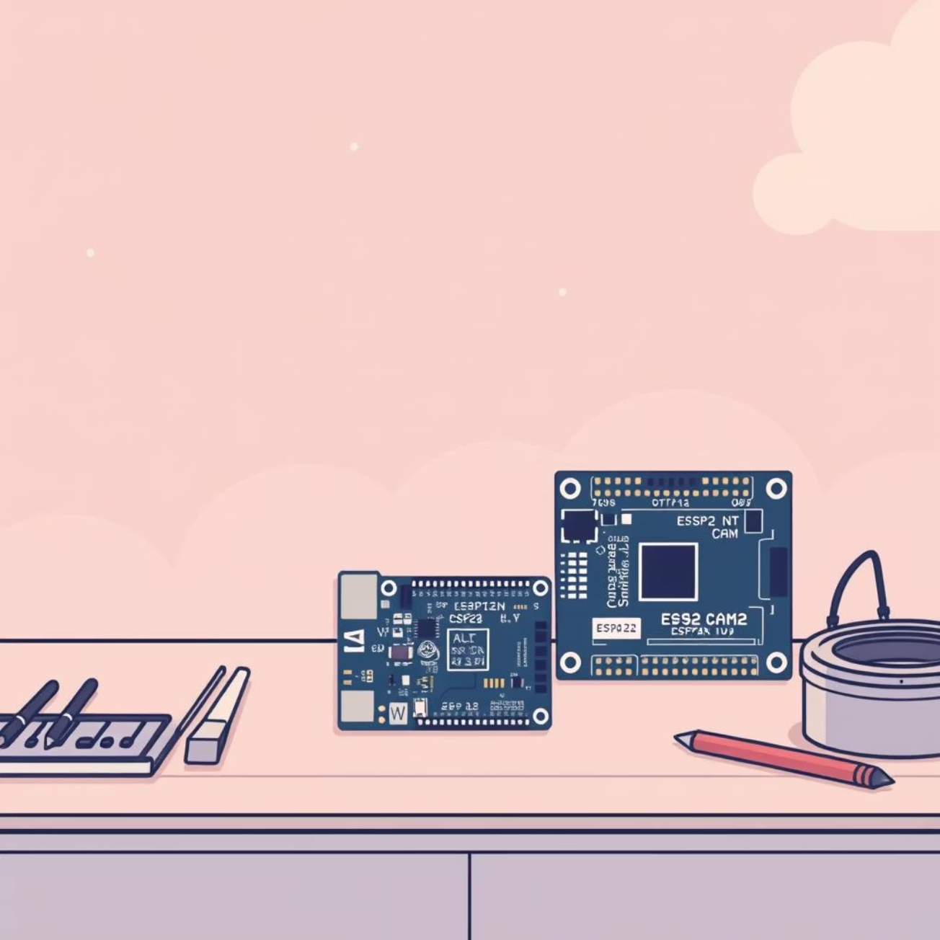
Proposed IoT-based Smart Doorbell Solution
Our solution leverages an IoT-based Smart Doorbell Camera System that integrates specialized hardware with a robust communication framework.
ESP32-CAM
ESP32 Hub
The camera doorbell unit, capturing visuals and detecting interaction.
The local server and control unit, managing all system functions.
Web Dashboard
A user-friendly interface for seamless interaction.
The system ensures real-time communication using HTTP and WebSockets, all operating within a secure, local WiFi network established by the hub.

Slide 5
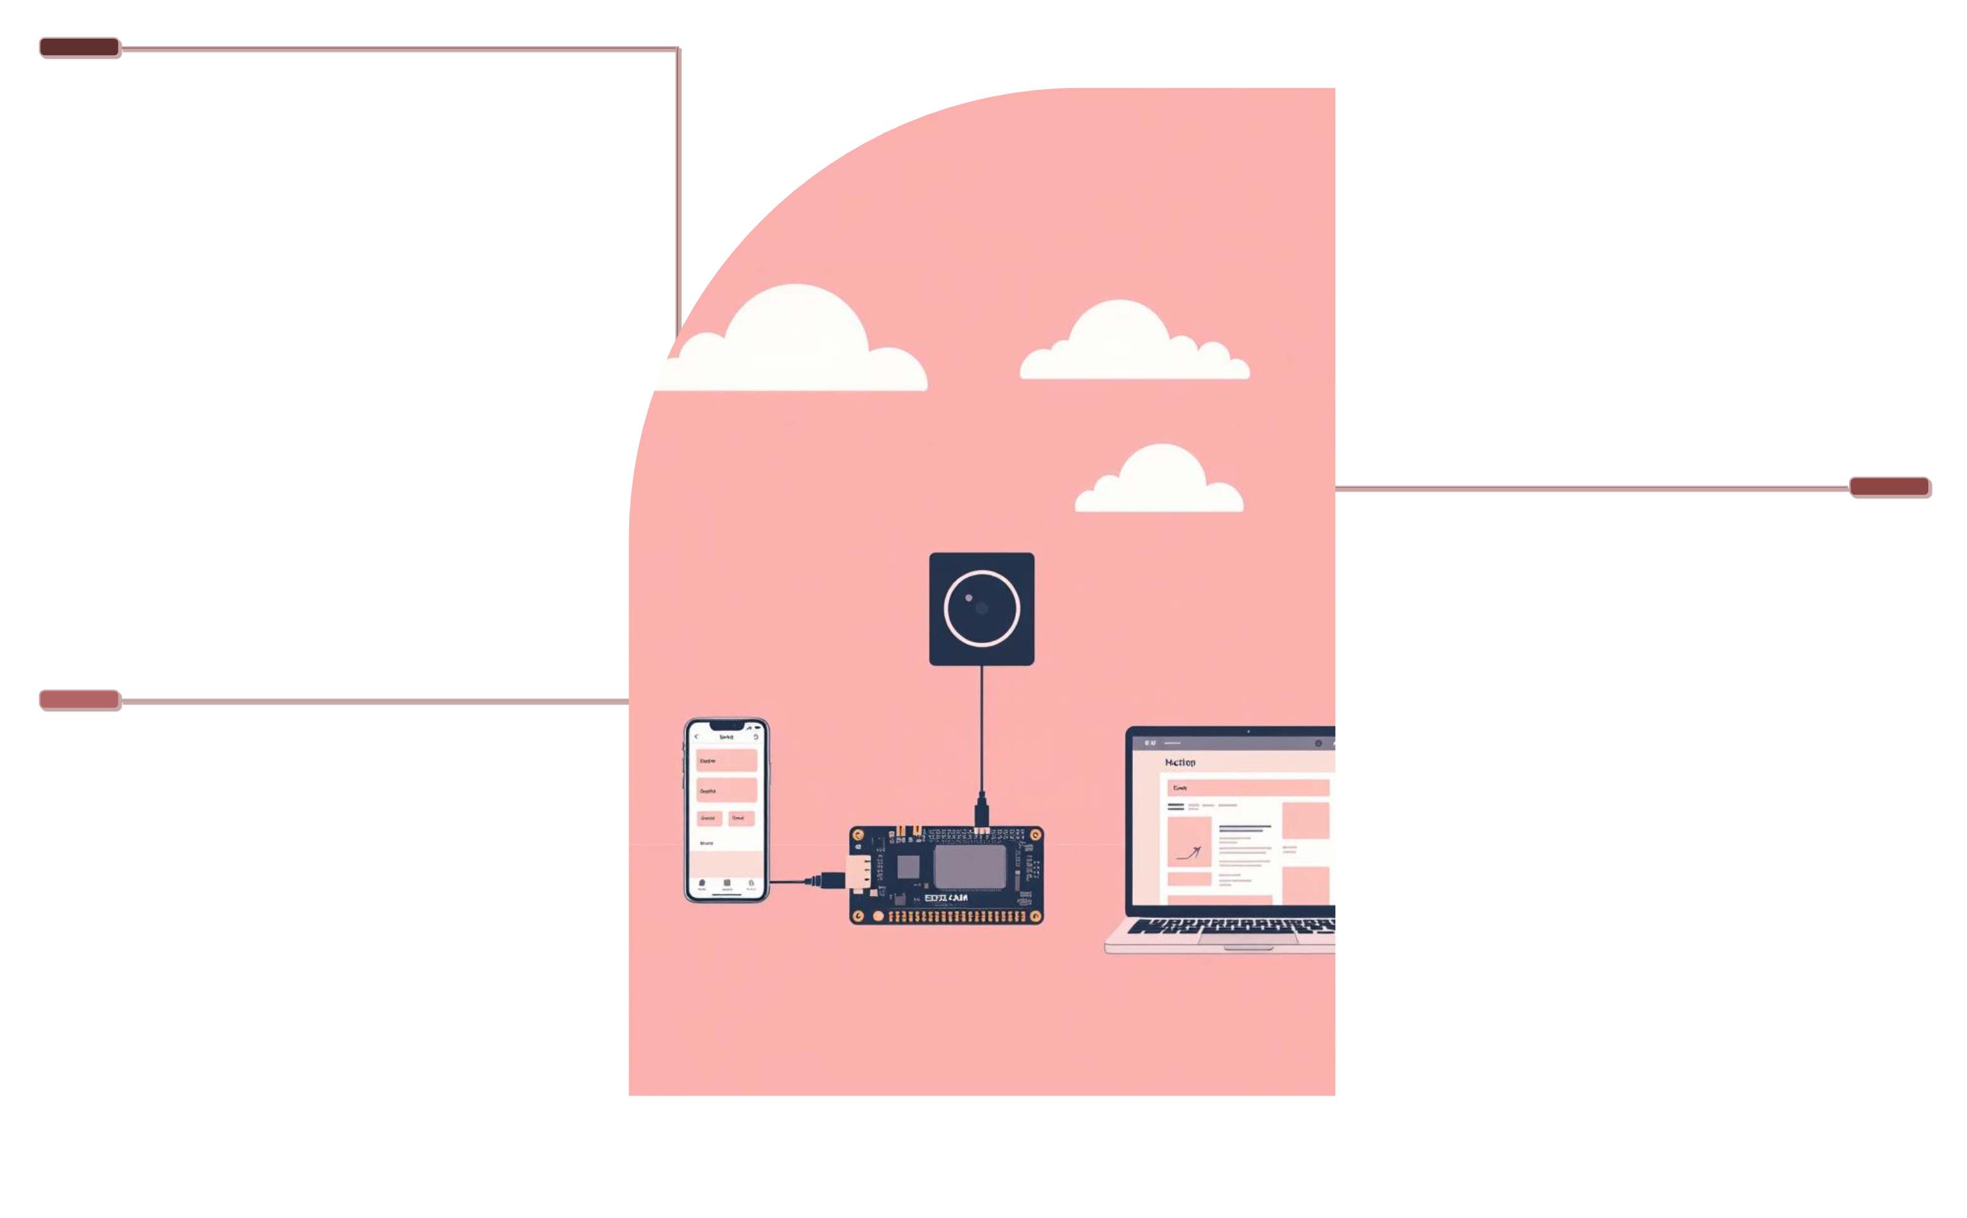
Distributed IoT System Architecture
Our system implements a distributed IoT architecture for optimal performance, ensuring modularity, reliability, and scalability across all components.
ESP32-CAM
Captures video and doorbell press events.
ESP32 Hub
Receives events, manages notifications and audio.
Web Clients
Phone or laptop view live video and audio.
This setup allows the ESP32-CAM to handle video and button presses, sending events to the ESP32 Hub. The Hub then coordinates notifications, audio, and the web interface, which users access to view live video and engage in audio communication.

Slide 6
Key Hardware Components
The smart doorbell system is built using readily available, low-cost hardware components, making it accessible for DIY enthusiasts and developers.
ESP32-CAM
ESP32 Dev Board
OV2640 Camera
Microphone
Camera module, processing unit, and doorbell button interface.
The central hub/server unit for network and control.
Captures high-quality live video streams.
Enables clear visitor audio input.
Speaker
Push Button
Delivers two-way audio and doorbell chime.
The physical trigger for doorbell events.

Slide 7
Software & Technologies Employed
The project's development relies on a robust stack of software and communication technologies, ensuring efficient and real-time operations.
1
2
Arduino / ESP32 SDK
WiFi (SoftAP)
For efficient firmware development and hardware interaction.
Access Point networking for flexible connectivity.
3
4
HTTP
WebSockets
Protocol for reliable doorbell event signaling.
Enables real-time, persistent communication.
5
6
HTML, JavaScript
MJPEG Streaming
Powers the dynamic and responsive web interface.
Provides smooth, live camera video feeds.

Slide 8
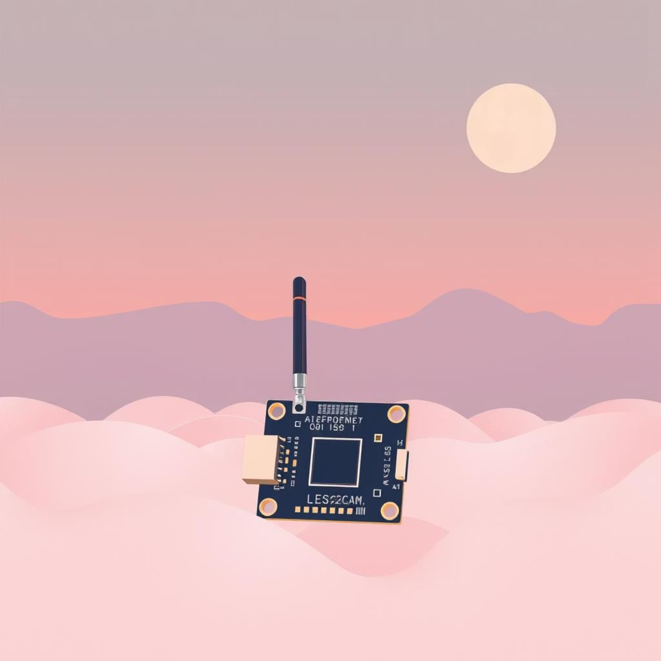

ESP32-CAM Module: The Edge Device
The ESP32-CAM acts as the intelligent edge device, responsible for capturing sensory data and initiating communication within the IoT system.
Network Connection
Connects to the hub’s dedicated WiFi network.
Camera Initialization
Optimizes resolution and JPEG compression for streaming.
Streaming Server
Hosts the camera's live video stream.
Doorbell Detection
Monitors and detects doorbell button presses.
Event Signaling
Sends an HTTP request to the hub upon doorbell activation.

Slide 9
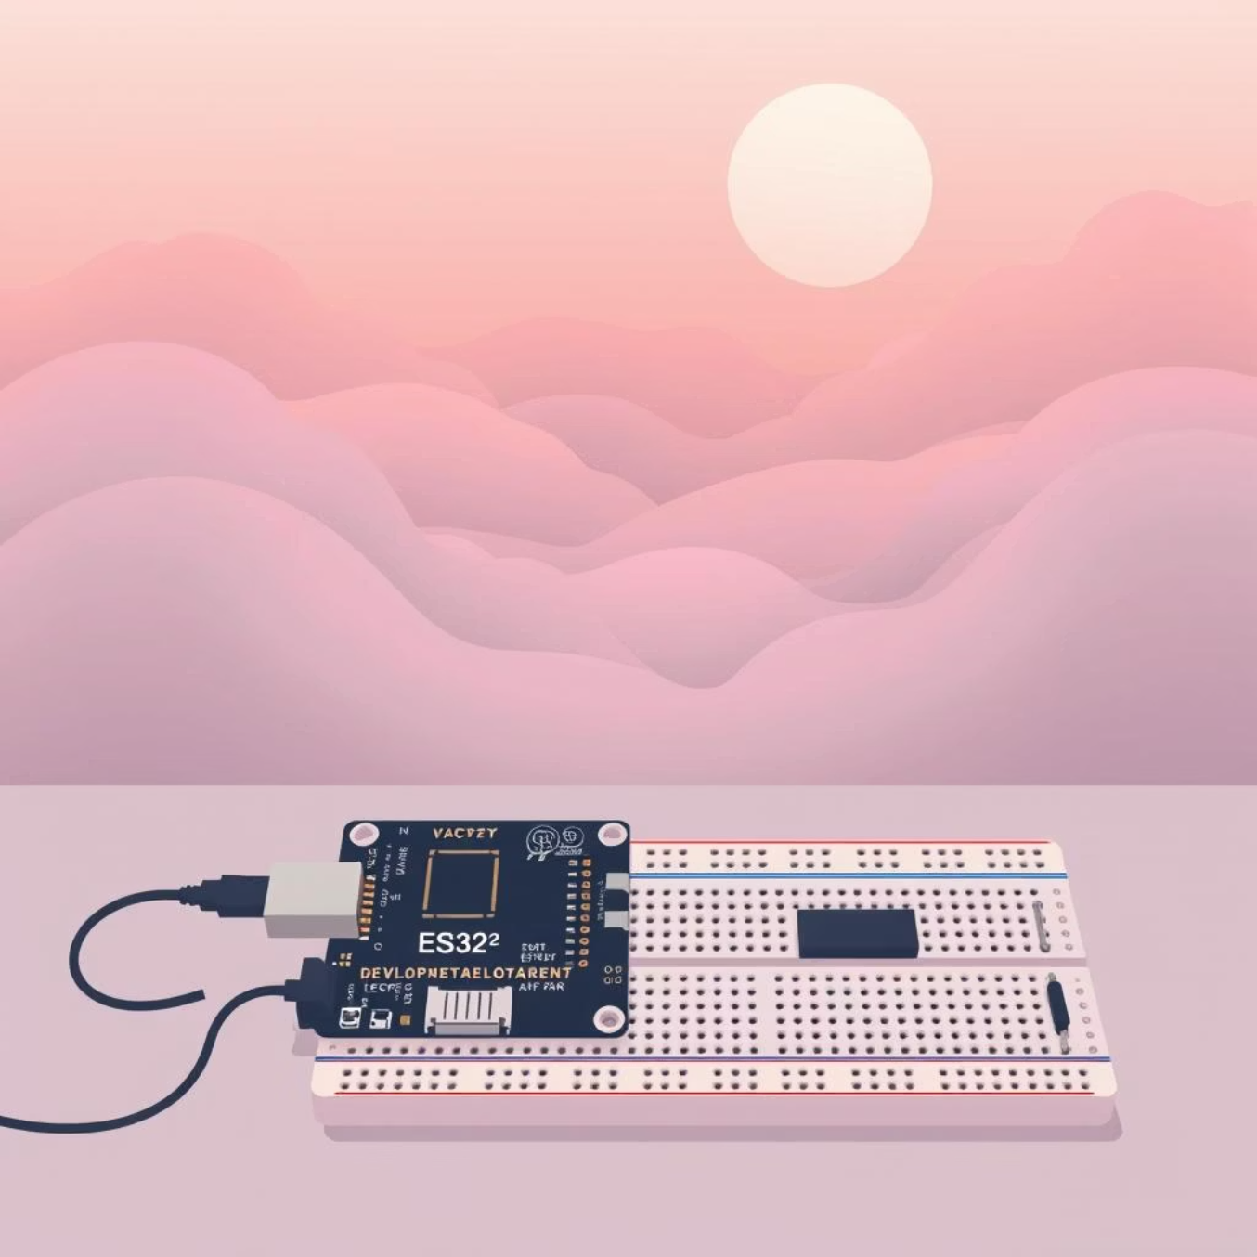
ESP32 Hub Module: Central Control
The ESP32 Hub serves as the robust central controller, coordinating all functions and communications within the smart doorbell system.
WiFi Access Point
Creates a local network for connected devices.
Web Dashboard Hosting
Provides the user-friendly interface for system management.
Doorbell Event Reception
Processes incoming doorbell ring notifications.
Physical Chime
Activates a physical doorbell chime when triggered.
Real-time Communication
Manages WebSocket connections for instant updates.
Audio Streaming
Facilitates two-way audio between visitor and user.

Slide 10



Seamless Doorbell Event Flow
The entire doorbell event is orchestrated through a precise sequence of steps, ensuring instant and reliable notification to the user.
Button Press
Visitor presses the physical doorbell button on the ESP32-CAM.
Request to Hub
ESP32-CAM sends an HTTP request to the Hub at the '/ring' endpoint.
Hub Receives
ESP32 Hub receives and processes the incoming request.
Chime & State Update
The Hub plays a physical chime and updates the system's state.
User Notification
Hub sends a real-time notification to the user interface via WebSocket.
Camera Activation
The live camera stream is automatically activated for user viewing.

