Slide 1
SLM vs LLM for Key Information Extraction
from Financial Documents
Mid-Semester
Azhar Ali - BITS ID 2024AA05791
M.Tech (AI & ML) - Course AIMLCZG628T
Dissertation (BITS ZG628T) - Supervisor: (Somiya Rout)
Birla Institute of Technology & Science, Pilani - July 2026

Slide 2
Agenda
• Introduction — problem, gap, research question, objectives, scope
• Literature Review — four papers grounding the study
• Research Methodology — the text-in extraction pipeline and framework
• Data Collection — datasets, samples, test set, and the model registry
• Results — the completed 11-model baseline
• Key Findings & Future Plan — what next phase will address

Slide 3
INTRODUCTION
Problem & Motivation
• LLMs set the standard — Large language models lead document extraction.
– but they are costly per call, high-latency, and cloud-only.
• Data cannot leave the building — Banks and firms often cannot send data out.
– confidentiality and compliance frequently prohibit sending customer documents to an external API.
• The real need — Accurate extraction that runs locally, cheaply, and privately on an organisation's own hardware.

Slide 4
INTRODUCTION
Research Gap
• The claim: Recent work argues that small models — often a few billion parameters — are “good enough” for narrow, repetitive tasks, and far cheaper to run.
• The gap: The claim is unproven for real financial-document extraction.
– It is unknown how small a model can be before extraction breaks down.
• This dissertation tests the claim empirically, end to end.

Slide 5
INTRODUCTION
Research Question & Hypothesis
• Research question: Can small, locally-run language models match large LLMs on financial key information extraction — at lower cost and latency, and with better data privacy?
• Hypothesis: SLMs match LLMs on simple documents.
– The gap widens as documents grow more complex.
– SLMs win decisively on cost, latency, and privacy.

Slide 6
INTRODUCTION
Objectives
Determine whether small, locally-run models can match large LLMs for extracting key information from financial documents, and map the accuracy–efficiency trade-off.
• Capability gap — how closely small models approach large LLMs in extraction quality (F1).
• Trade-off — how accuracy scales against cost, latency, and memory across model sizes.
• Viability limit — the complexity point where small models stop being reliable.
• Enterprise value — the cost and privacy advantages of running models locally.

Slide 7
INTRODUCTION
Scope of Work
• Task — text-in key information extraction from financial documents (PDF → text → JSON).
• Data — public datasets SROIE (simple) and Kleister-Charity (complex), both with gold labels.
• Models — eleven models — eight small, locally-run SLMs and three large open-weight reference LLMs on serverless inference.
• Conditions — zero-shot and few-shot prompting with identical settings for a fair comparison.
• Evaluation — extraction quality (precision, recall, F1) and efficiency (latency, memory, cost).

Slide 8
LITERATURE REVIEW
Literature Review — Four Papers
• Paper 1 · Small Language Models are the Future of Agentic AI (Belcak et al., NVIDIA, 2025) — motivates using SLMs for narrow tasks.
• Paper 2 · Are Small Language Models Ready to Compete with LLMs? (Sinha, Jain, Chadha, 2024) — a template for structured small-vs-large evaluation.
• Paper 3 · Kleister: KIE Datasets with Long, Complex Documents (Stanisławek et al., ICDAR 2021) — the complex financial benchmark.
• Paper 4 · SROIE: Scanned Receipt OCR and Information Extraction (Huang et al., ICDAR 2019) — the simple receipt benchmark and scoring protocol.

Slide 9
LITERATURE REVIEW · PAPER 1
Small Language Models are the Future of Agentic AI
Belcak, Heinrich, Diao, Fu, Dong, Muralidharan, Lin, Molchanov (NVIDIA) — arXiv:2506.02153, 2025
• The problem: LLMs are the default, yet most real applications run a few narrow, repetitive tasks — overkill for a giant general model.
• What they did: A position paper arguing from capability, agent architecture, and economics that SLMs are the better fit.
• Key finding: SLMs are capable enough, far cheaper (often 10–30×), lower latency, and can run on edge or on-premise devices.
• Why it matters here: Motivates testing small models for a narrow task (financial KIE) instead of defaulting to a large LLM.

Slide 10
LITERATURE REVIEW · PAPER 2
Are Small Language Models Ready to Compete with LLMs?
Sinha, Jain, Chadha — arXiv:2406.11402, 2024 (rev. 2025)
• The problem: State-of-the-art LLMs are often infeasible (cost, size, proprietary), but small models do not perform well universally.
• What they did: Proposes a framework to evaluate small open models across task types, domains, and prompt styles; compares ten SLMs.
• Key finding: Chosen appropriately, small models can beat some SOTA LLMs and even compete with GPT-4-class models.
• Why it matters here: A direct methodological template for this structured, prompt-aware small-vs-large comparison.

Slide 11
LITERATURE REVIEW · PAPER 3
Kleister: KIE Datasets with Long, Complex-Layout Documents
Stanisławek et al. — Proceedings of ICDAR 2021 — arXiv:2105.05796
• The problem: Real KIE involves long, multi-page documents with complex layouts — harder than short receipts or forms.
• What they did: Introduces the Kleister datasets (incl. Kleister-Charity from financial reports) with names, dates, and monetary values.
• Key finding: Provides gold-annotated benchmarks and shows that long-document extraction is genuinely challenging.
• Why it matters here: Kleister-Charity is the complex, financial, multi-page dataset and ground-truth source for this study.

Slide 12
LITERATURE REVIEW · PAPER 4
SROIE: Scanned Receipt OCR and Information Extraction
Huang, Chen, He, Bai, Karatzas, Lu, Jawahar — ICDAR 2019 Competition — arXiv:1905.13538
• The problem: Extracting a few key fields from scanned receipts is a common but non-trivial task, and lacked a shared, labelled benchmark.
• What they did: Introduces the SROIE task and dataset — receipts with gold labels for company, date, address, and total — and an entity-level F1 scoring protocol.
• Key finding: Establishes a widely-used benchmark; the constrained field set makes it a clean measure of extraction accuracy.
• Why it matters here: SROIE is the simple dataset and the scoring protocol used here — the complexity counterpart to Kleister.

Slide 13
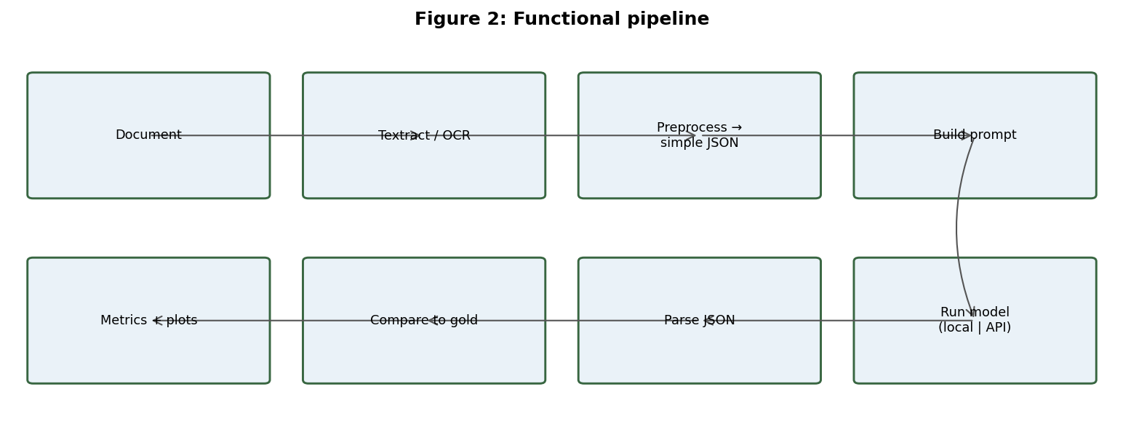
RESEARCH METHODOLOGY
Text-in Extraction Pipeline
A single document flows: extract text → build prompt (fields + JSON schema) → run model → parse JSON → compare to gold.
Text only — no image or vision input. The same prompt and settings go to every model, which isolates the language model's extraction ability from OCR quality.

Slide 14
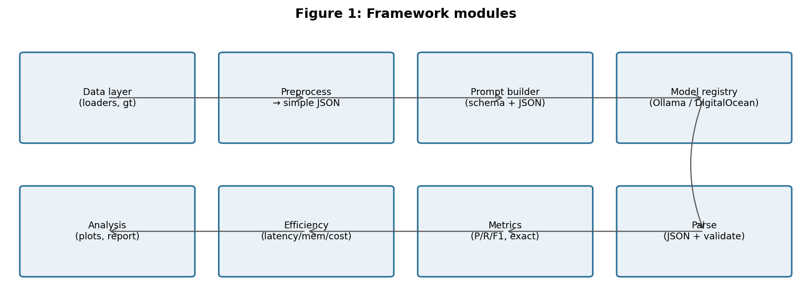
RESEARCH METHODOLOGY
Evaluation Framework Architecture
• Data layer — dataset loaders + gold handling
• Preprocess — normalise OCR output into clean lines
• Prompt builder — instruction + schema + document text
• Registry + runners — Ollama (local) and DigitalOcean (cloud)
• Parser — read JSON,
• Metrics — precision, recall, F1
• Efficiency — latency, peak memory, throughput

Slide 15
DATA COLLECTION
Datasets — Simple to Complex
• SROIE — scanned receipts · simple baseline
– 4 fields: company, date, address, total
– short, single-page documents
– scored with entity-level F1
• Kleister-Charity — UK charity annual reports · complex
– 8 fields incl. monetary amounts & dates
– long, multi-page documents
– realistic, bank-like extraction
The simple → complex pairing reveals exactly where the SLM–LLM gap opens up.

Slide 16
DATA COLLECTION
Dataset Sample & Test Set
SROIE — input → gold output
BOOK TA .K (TAMAN DAYA) SDN BHD
DATE: 25/12/2018 TOTAL: 9.00
{ "company": "BOOK TA .K ...",
"date": "25/12/2018",
"address": "NO.53 ... JOHOR BAHRU",
"total": "9.00" }
Kleister-Charity — gold fields (8)
{ "charity_name": "Smith Family Foundation",
"charity_number": "1093345",
"report_date": "2017-03-31",
"income_annually...": "1245000.00",
"spending_annually...": "1180500.00",
"address__post_town": "LONDON",
"address__postcode": "SW1A 1AA" }
• Test set — 20 documents, seed-fixed (10 SROIE + 10 Kleister), frozen across the study.

Slide 17
DATA COLLECTION
The Models — Specs & Access
Model | Vendor | Params (B) | License | Arm
SmolLM2-360M | Hugging Face | 0.36 | Apache-2.0 | Local
Qwen2.5-0.5B | Alibaba | 0.5 | Apache-2.0 | Local
Gemma-3-1B | Google | 1 | Gemma | Local
Llama-3.2-1B | Meta | 1.24 | Llama 3.2 | Local
Gemma-2-2B | Google | 2 | Gemma | Local
Phi-4-mini | Microsoft | 3.8 | MIT | Local
Gemma-3-4B | Google | 4 | Gemma | Local
Mistral-7B | Mistral AI | 7 | Apache-2.0 | Local
Gemma-4-31B | Google | 31 | Gemma | Cloud
Llama-3.3-70B | Meta | 70 | Llama 3.3 | Cloud
GPT-OSS-120B | OpenAI | 120 | Apache-2.0 | Cloud
Eight local SLMs run through Ollama on an Apple M1 (8 GB); three large open-weight models run on DigitalOcean serverless inference.

Slide 18
RESEARCH METHODOLOGY
Metrics — Quality & Efficiency
Extraction quality
Operational efficiency
• Precision — of returned fields, how many are correct.
• Recall — of the true fields, how many are found.
• F1 — balanced P/R — the KIE standard.
• Exact match — every field of a document correct.
• Latency — time taken per document.
• Memory — peak RAM/VRAM while running.
• Cost — money per 1,000 documents processed.
• Parse-fail rate — share of unparseable outputs.

Slide 19
RESULTS TO DATE · PHASE 2
Results — 11-Model Standings
Model | Params | Arm | F1 zero | F1 few | P | R | Exact | Lat (s) | Cost/doc
Llama-3.3-70B | 70 | cloud | 0.601 | 0.733 | 0.80 | 0.67 | 0.200 | 16.3 | $0.00136
Gemma-4-31B | 31 | cloud | 0.683 | 0.718 | 0.77 | 0.64 | 0.225 | 3.4 | $0.00071
Mistral-7B | 7 | local | 0.578 | 0.705 | 0.73 | 0.61 | 0.200 | 34.2 | $0.00014–0.00040*
GPT-OSS-120B | 120 | cloud | 0.646 | 0.665 | 0.72 | 0.60 | 0.050 | 14.6 | $0.00075
Gemma-2-2B | 2 | local | 0.573 | 0.650 | 0.62 | 0.60 | 0.175 | 13.4 | $0.00005–0.00017*
Gemma-3-4B | 4 | local | 0.647 | 0.632 | 0.61 | 0.59 | 0.050 | 17.1 | $0.00012–0.00024*
Phi-4-mini | 3.8 | local | 0.587 | 0.469 | 0.64 | 0.34 | 0.150 | 10.1 | $0.00011–0.00021*
Qwen2.5-0.5B | 0.5 | local | 0.337 | 0.425 | 0.37 | 0.37 | 0.000 | 4.2 | $0.00003–0.00012*
Gemma-3-1B | 1 | local | 0.428 | 0.406 | 0.34 | 0.34 | 0.025 | 4.6 | $0.00005–0.00012*
SmolLM2-360M | 0.36 | local | 0.350 | 0.263 | 0.18 | 0.18 | 0.000 | 4.1 | $0.00003–0.00013*
Llama-3.2-1B | 1 | local | 0.529 | 0.025 | 0.03 | 0.03 | 0.000 | 7.1 | $0.00006–0.00022*

Slide 20
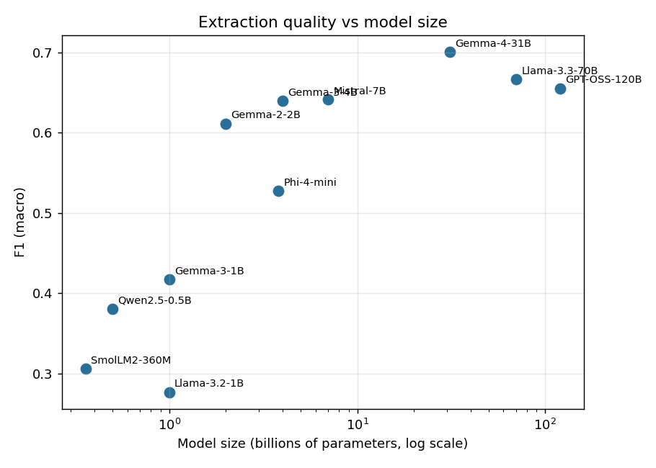
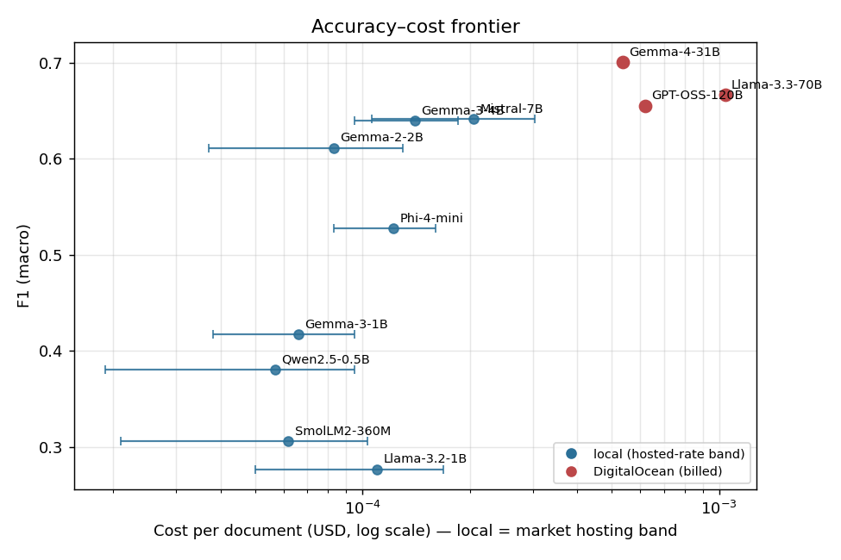
RESULTS TO DATE · PHASE 2
Results — Quality vs Size & Cost
Figure 3: F1 versus model size (log axis).
Figure 4: Quality versus cost per document.
F1 is flat past a few billion parameters; every competitive local model is several times cheaper than a cloud model of similar quality.

Slide 21
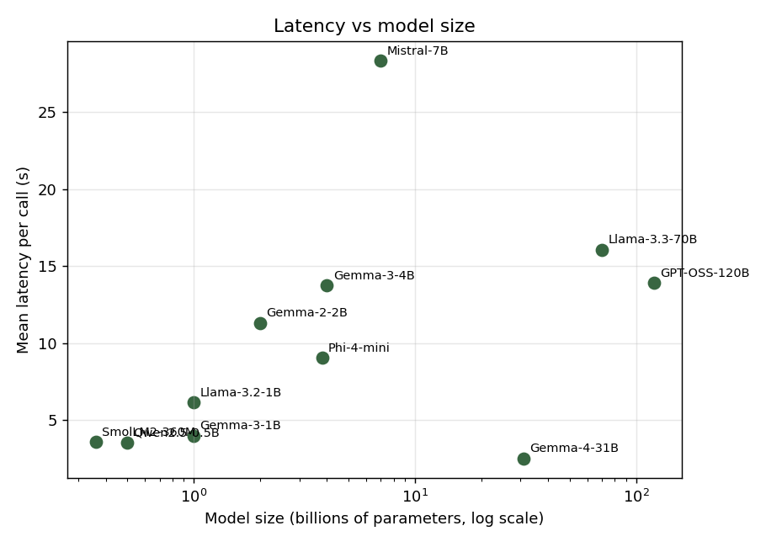
RESULTS TO DATE · PHASE 2
Results — Latency vs Size
Figure 5: Latency versus model size (local models).
.

Slide 22
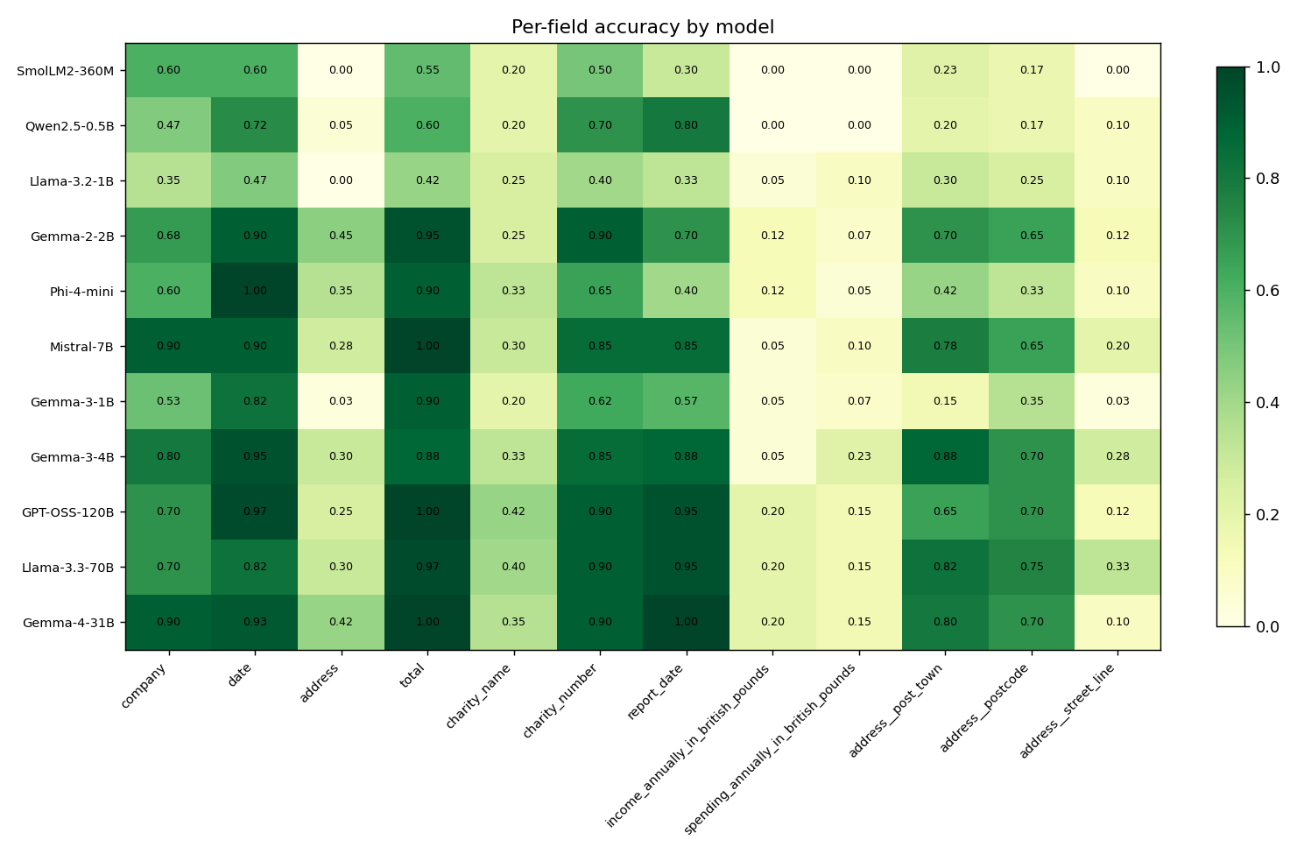
RESULTS TO DATE · PHASE 2
Results — Effects & Per-field Accuracy
• Constrained decoding — removed every output-format failure of the smallest model (31 of 80 → 0) and lifted its F1 in step.
• Few-shot — helps the larger models (Llama-3.3 +0.13) but can collapse the smallest (Llama-3.2-1B 0.53 → 0.03, copying the example).
• Per-field — simple receipt fields extract reliably; missed recall concentrates in the hard Kleister income and spending figures.
Figure 6: Per-field accuracy heatmap.

Slide 23
SUMMARY
Key Findings & Future Plan
• Parameter count ≠ quality: a 4B local model matches the 120B cloud model, and a 7B local model overtakes it.
• Constrained decoding is the equaliser: it lifts small models the most by removing malformed output.
• Local-first wins on economics: every competitive local model dominates a paid model of similar F1 on cost, with no data leaving the machine.
Phase | Window | Work | Status
Baseline (Phase 2) | Feb–Jun 2026 | Framework + 11-model baseline | COMPLETED
Fine-tuning (Phase 3) | Jul 2026 | QLoRA on phi4-mini + mistral-7b | PENDING
Recall lift (Phase 3) | July–Aug 2026 | Self-consistency + regex recovery | PENDING

Slide 24
Thank You · Questions & Discussion
Azhar Ali · 2024AA05791 · Mid-Semester, July 2026

