Slide 1
INTERNET OF THINGS

Slide 2
What is sensor?
Sensors are devices that detect external information replacing it with a signals that human & machines can distinguish.
IOT sensors used to detect & measure various physical phenomena such as heat & pressure as well as 5 human senses sight, hearing, touch, taste, & smell.

Slide 3
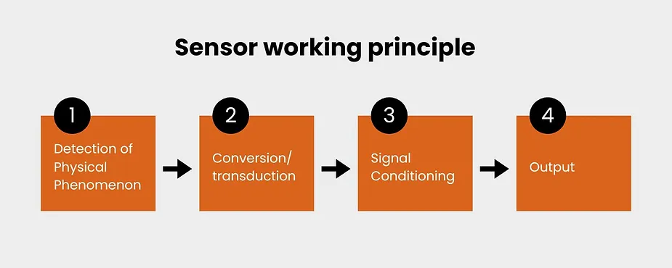

Slide 4
Classification of ensors
Based on input
Passive Sensor
Active Sensor
Based on output
Analog Sensor
Digital Sensor
Based on datatype
Scalar Sensor
Vector Sensor

Slide 5
Classification of sensors
Passive Sensor:
Cannot independently sense the input.
For example:
Water level & temperature sensors

Slide 6
ACTIVE SENSOR
Independently sense the input.
For example: Radar , sounder & laser sensors.

Slide 7
ANALOG SENSOR
The response or output of the sensor is some continuous function of its input parameter.
For example: Temperature sensors , analog pressure sensor.

Slide 8
DIGITAL SENSOR
Response in binary nature. Design to overcome the disadvantages of analog sensors. Along with the analog sensor it also comprises extra electronics for bit conversion.
For example
Digital temperature sensor

Slide 9
SCALAR SENSOR
Detects the input parameter only based on its magnitude. The answer for the sensor is a function of magnitude of some input parameter. Not affected by the direction of input parameters.
For example Temperature, Gas, Color & Smoke sensor.

Slide 10
VECTOR SENSOR
The response of the sensor depends on the magnitude of the direction & orientation of input parameter.
For example magnetic field & motion detector sensors.

Slide 11
THANKS

