Slide 1
FYP IDEAS
Empowering Cybersecurity Students: Innovative Industrial Project Ideas for Tomorrow's Guardians of Digital Security

Slide 2
00
Whoami
01
Cyber Landscape, Career in Cybersecurity
Table of Content
02
Nurturing skills for cybersecurity, Standing out
03
Key considerations while choosing a topic
04
Project Ideas

Slide 3
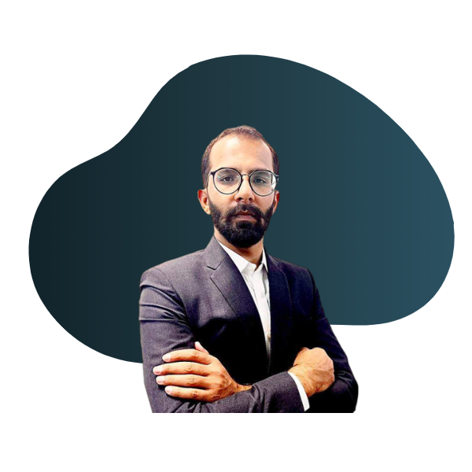
Azhar Ghafoor
Lecturer Cybersecurity
Azhar Ghafoor, dedicated Cybersecurity Lecturer, brings real-world insights from roles as a Cybersecurity Analyst at Cytomate Solutions & Services and a researcher at Cybersecurity Lab. With an MS in Information Security from COMSATS Islamabad and a BS in IT from QAU, Azhar offers practical guidance and a passion for cybersecurity education.

Slide 4
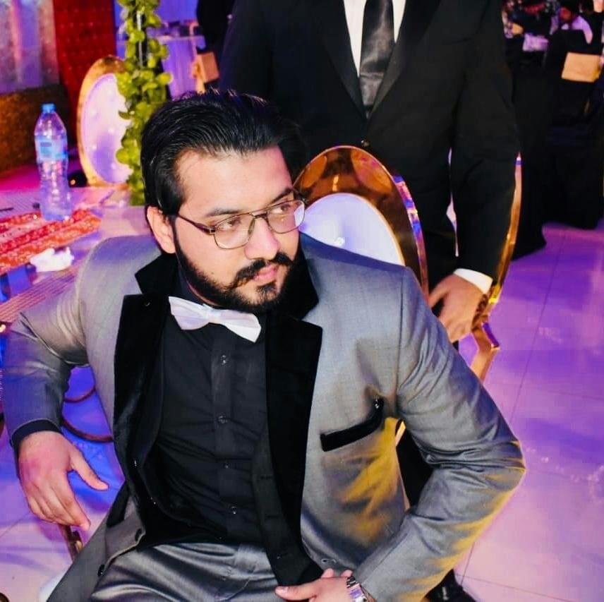
Usama Bin Amir
Lecturer Cybersecurity
Usama Bin Amir, dedicated Cybersecurity Lecturer, brings real-world insights from roles as a Secure OS Developer and Cyber Threat Analyst at NASTP and Research Associate at Device and Network Security Lab, NCCS. With an MS in Cyber Security and BS in Computer Science from C.U.S.T Islamabad, Usama offers practical guidance and a passion for and OSINT education.

Slide 5
Cyber Landscape
Businesses are increasingly reliant on digital technologies, making cybersecurity more relevant than ever
The constant evolution of cyber threats necessitates a robust cybersecurity landscape.
As businesses become data-driven, the need for secure cyber solutions is heightened.
The shift to the digital space creates a lucrative job market for cybersecurity professionals with the right skill set.

Slide 6
Career in Cybersecurity
C
E
Career Decision
Educational Preparation
Understanding if cybersecurity is the right career choice is crucial for a successful journey in the industry.
Considering educational paths, such as degrees with a cybersecurity specialization, plays a key role in shaping your career.
S
J
Skill Development
Job Readiness
Recognizing the essential skills required to thrive in the cybersecurity field is a foundational step.
The ultimate goal is to comprehend how to strategically position yourself for promising job opportunities in the cybersecurity industry.

Slide 7
Nurturing Skills for Cyber
Assets Safety
Accountability for integrating cybersecurity technologies to ensure the overall safety of the organization's network.
Proactive Security
The expectation to be proactive and prompt in detecting and mitigating malicious behavior to prevent security breaches.
Technical Knowledge
Gaining theoretical and practical knowledge in application security, data secrecy, cryptography, and network security.
Multifaceted Role
Understanding the multifaceted role of a cybersecurity software developer in integrating security tools throughout the software development lifecycle.

Slide 8
Standing Out
Resume Evaluation
Concrete Judgments
Soft Skills Enhancement
Employers scan resumes in 6 seconds; make an immediate impact.
Provide employers with concrete insights into your competency and relevance.
Projects not only demonstrate technical skills but also enhance soft skills for versatility.
Hands-on Experience
Showcasing Mini Projects
Projects serve as testimonies, showcasing hands-on experience in cybersecurity.
Mention independent cybersecurity projects for tangible proof of technical skills.
Notes:
Heading: standing Out in the Competitive Job Market

Slide 9
Key Considerations
Emphasizing a project that allows for hands-on experience, applying theoretical knowledge in real-world scenarios.
Considering projects that integrate knowledge from various cybersecurity domains for a comprehensive understanding.
Choosing a project that directly addresses current cybersecurity challenges and aligns with industry demands.
Aiming for a project that encourages innovation and potential contributions to cybersecurity advancements.
Ensuring the project aligns with learning objectives and career goals for a smooth transition to the industry.
Notes:
Key Considerations while choosing a project topic

Slide 10
Project Ideas
Sandbox
OSINT
Harvesting
Developing own sandbox to test malware samples and generate reports
Utilizing telegram channels to collect real time leaked data
Doing employees OSINT of a company
01
03
05
02
04
06
Antivirus
WAF
Log Analyzer
Signature based & Behaviour based support for any platform
Creating AI/ML enabled WAF to protect against malicious user queries
Log analysis for post attack assessments and real time anomalies detection

Slide 11
Project Ideas
Phishing Detection
Yara Mal Scanner
Stegno
Creating a tool to detect phishing emails using AI and email header
Malware scanner utilizing the Yara framework
Developing a tool that can extract hidden data in files
07
09
11
08
10
12
Cyber Deception
Vul to Compliance
Social Eng Training
System having various decoys integrated with capability of attack on attacker
Mapping different vulnerabilities to compliance standards and frameworks
Creating a simulated social engineering environment to train employees

Slide 12
Thank You
Azhar Ghafoor
azharghafoor39@gmail.com
https://azharghafoor.github.io/

