Slide 1

Digital Image Processing
- By Azhar Mithani

Slide 2
Seminar Description
Fundamental concepts and basic techniques of digital image processing.
Algorithms and recent research in image transformation, enhancement, restoration, encoding and description.
Fundamentals and basic techniques of pattern recognition.

Slide 3
Topics
Introduction to Image Processing
Acquisition, Representation and Storage of Digital Images
Geometric Transformations.
Intensity Transformations & Image Enhancement
Image Encoding (Compression & Encryption)
Segmentation & Description
Fundamental Concepts in Pattern Recognition

Slide 4


Pixels as Units of Images
Original Image Zoomed

Slide 5

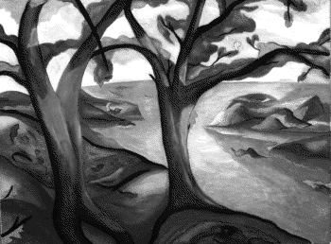
Color & Gray Scale

Slide 6
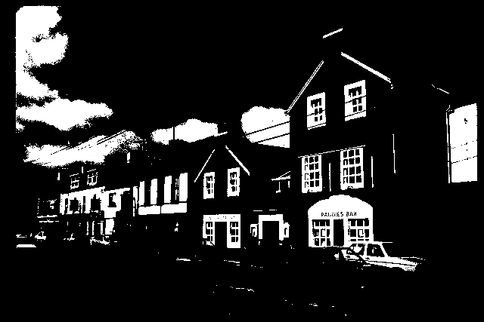
Binary Images
Binary Image (2 Levels)

Slide 7
Fundamental Steps in Image Processing
Digital Image Acquisition & Display
Image Storage
Image Preprocessing
Image Segmentation
Image Description
Object ( Pattern ) Recognition
Image Interpretation & Understanding

Slide 8
Fundamental Steps in IP
Segmentation
Representation
& Description
Preprocessing
Recognition
& Interpretation
Knowledge Base
Image Acquisition
Problem

Slide 9
Image Preprocessing
Geometric Operations
Image Transformation
Image Enhancement
Image Restoration
Image Compression
Image Encryption

Slide 10
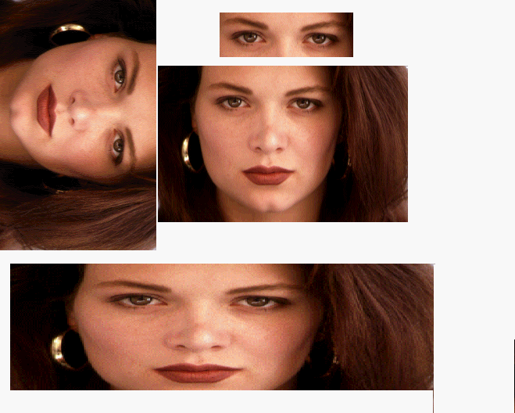
Geometric Operations

Slide 11
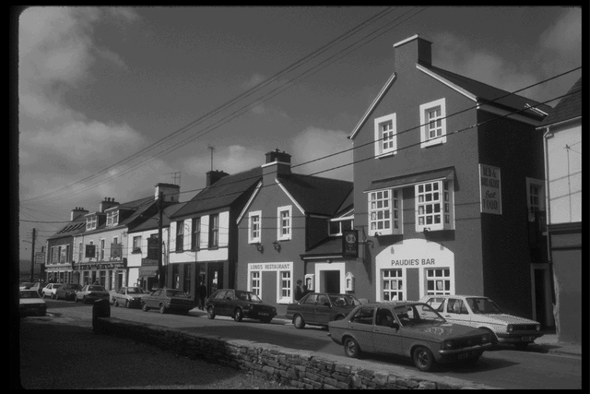
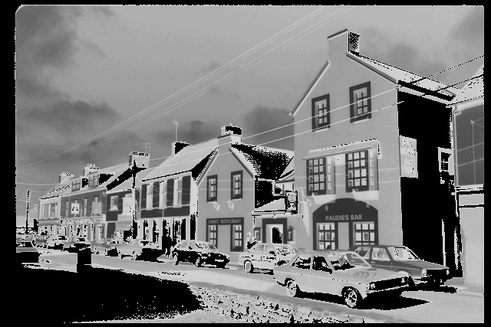
Intensity Transformation
Gray Scale (256 levels) Negative

Slide 12
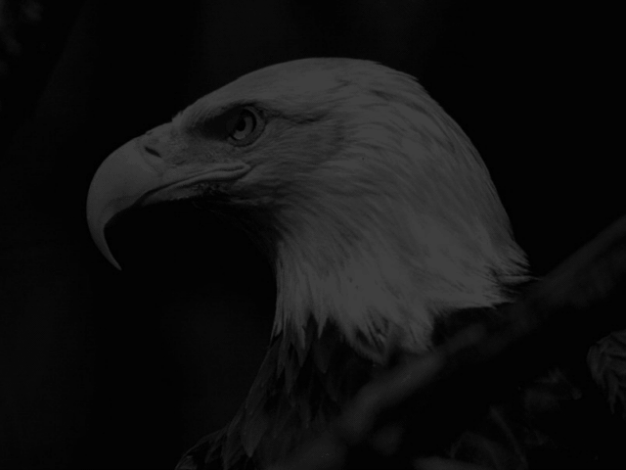
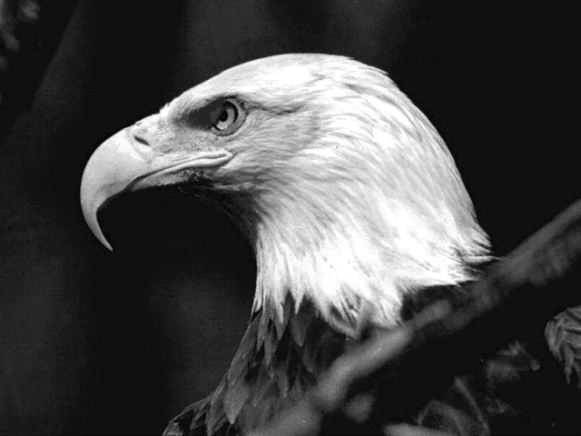
Image Enhancement

Slide 13
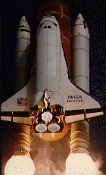

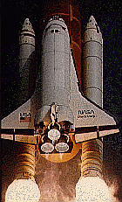
Image Enhancement
Smoothing & Sharpening Filters

Slide 14
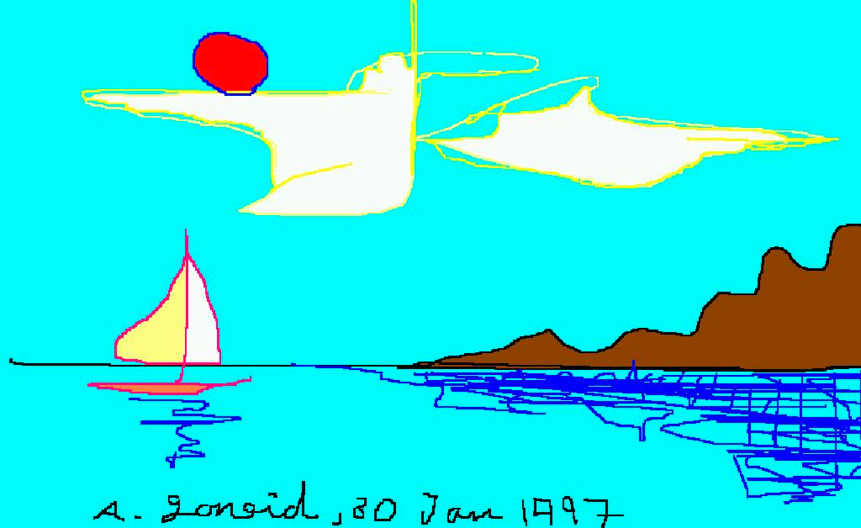
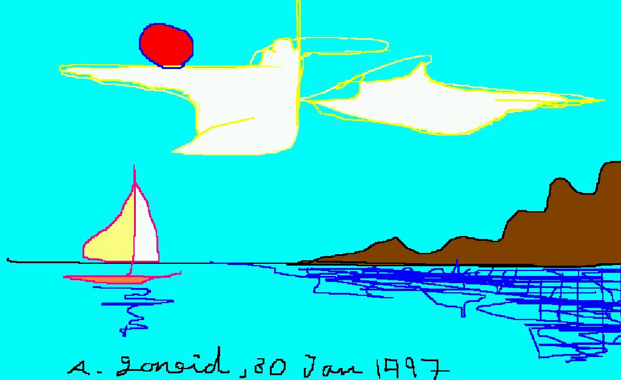
Image Compression
BMP Format (1885 Kb) JPEG Format (64 Kb)

Slide 15
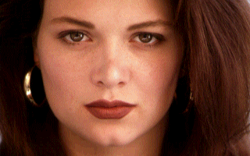
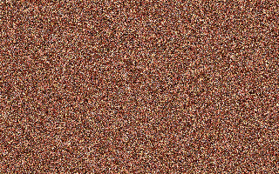
Image Encryption
Plain Encrypted

Slide 16
Image Segmentation
Point , Line and Edge Detection
Separation of Objects ( Thresholding )
Motion Detection

Slide 17
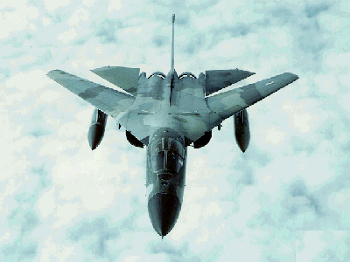
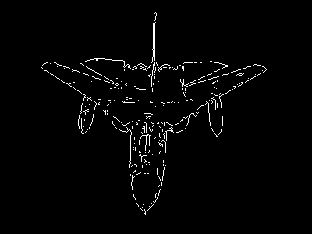
Edge Detection

Slide 18
Steps in edge detection algorithm
Edge detection algorithm runs mainly in four sequential steps:
1 – Smoothing
2 - Finding gradients
3 - Non-maximum suppression
4 - Hysteresis threshold

Slide 19
Smoothing
Images taken from a camera will contain some amount of noise.
As noise can mislead the result in finding edges, we have to reduce the noise.
Therefore the image is first smoothed by applying a Gaussian filter.

Slide 20
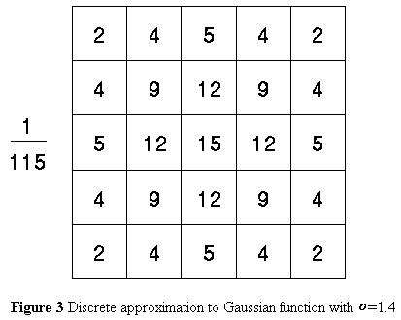
Smoothing(cont...)
The function ’Gaussian Filter’ multiplies each pixel in the image by the kernel generated. It returns the smoothed image in a two dimensional array.
𝑆=𝐼∗𝑔𝑥,𝑦
=𝑔𝑥 ,𝑦∗𝐼
𝑊ℎ𝑒𝑟𝑒,
1
−
𝑥
2
+𝑦
2
𝑔𝑥,𝑦=
𝑒
2𝜎
2
2𝜋𝜎

Slide 21
Finding Gradients
Here we will find the edge strength by taking the gradient of the image. The Del operator performs a 2-D spatial gradient measurement on an image.
The Del operator uses a pair of 3x3 convolution masks, one estimating the gradient in the x-direction and the other estimating the gradient in the y-direction.

Slide 22
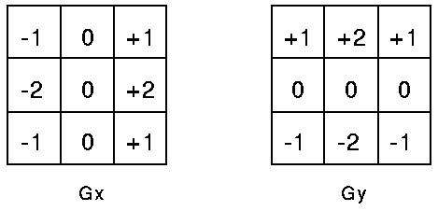
Finding Gradients(cont...)
𝛻𝑆=𝛻𝑔∗𝐼
= 𝛻𝑆(𝑔∗𝐼)
𝑔
𝑥
𝑔
𝑥
∗𝐼
𝛻𝑆=
𝑔
∗𝐼
=
𝑔
∗𝐼
𝑦
𝑦
𝜕𝑔
𝜕𝑥
𝑔
𝑥
𝑊ℎ𝑒𝑟𝑒, 𝛻𝑔=
𝜕𝑔
=
𝑔
𝑦
𝜕𝑦

Slide 23
Non-Maximum Suppression
This is necessary to convert the blurred edges in the image of the gradient magnitudes to sharp edges. Actually this is performed by considering only all local maxima in the gradient image and deleting everything rest. The algorithm is applied for each pixel in the gradient image.
Finally, only local maxima have been marked as edges. x’ and x’’ are the neighbors of x along normal detection to an edge.

Slide 24
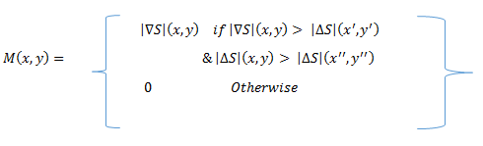
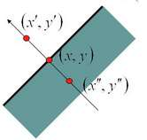
Non-Maximum Suppression(cont...)
x’ and x’’ are the neighbors of x along normal detection to an edge

Slide 25
Hysteresis Thresholding
After the non-maximum suppression step, the edge pixels are still marked with their strength pixel-by-pixel.
The received image may still contain false edge points. Using threshold, Potential edges are determined by double Thresholding (High and Low).
If the gradient at a pixel is
–above “High”, declare it as an ‘edge pixel’
–below “Low”, declare it as a “non-edge-pixel”
–between “low” and “high”

Slide 26
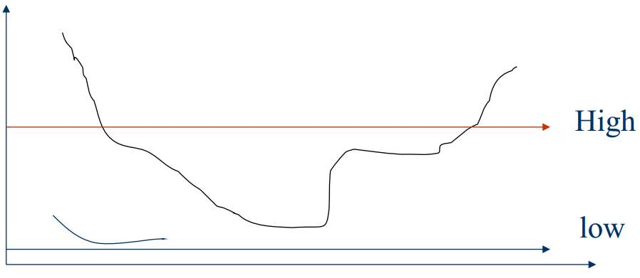
Hysteresis Thresholding(cont...)
Gradient
Magnitude
Hysteresis Thresholding

Slide 27

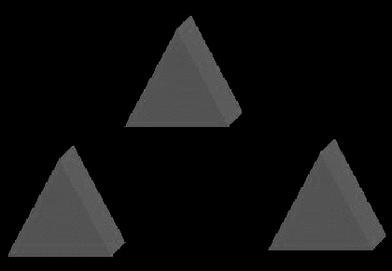
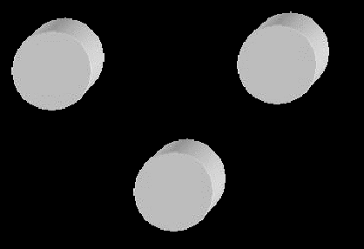
Separation of Objects

Slide 28
Image Description
Boundary Description
Region Description
Texture

Slide 29
Pattern Analysis
Pattern Classification
Matching
Neural Networks

Slide 30
Image Understanding
Image Databases (e.g. CBIR)
Knowledge Bases
Expert Systems

Slide 31
Some Applications
Line Detection (e.g. Hough Transform)
Shape Recognition
License Plate Recognition
Face Recognition
Fingerprint Identification
Many Others

Slide 32
Application of License Plate Recognition
Input vehicle image
Image acquisition
Car license plate
Image capture module
locating
Car license
Car license plate locating
Character recognition
Character recognition
plate
recognition
Character segmentation
Output result
Character recognition
License display module
Display car number

Slide 33
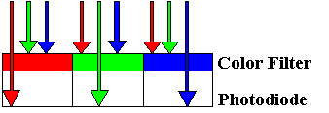


Image Acquisition
CMOS is composed of
photo-diode
Photo-diode captures
the intensity of light
Red light was filtered
through red color filter
Color Filter Array, CFA

Slide 34
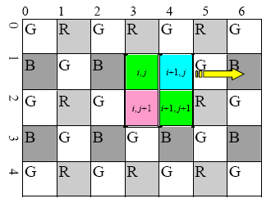
Color and Grey Scale
2/3 light intensity
to one RGB pixel
Convert CFA to gray level
Recover light intensity
Y
■
229
⋅
R
+
0
.
5
⋅
587
⋅
(
G
+
G
'
)
+
114
⋅
B
smoothing
Y
=
■
1000
Y
=
0
.
299
⋅
R
+
0
.
587
⋅
G
+
0
.
114
⋅
B
Y
1
.
024
⋅
(
229
⋅
R
+
293
.
5
⋅
(
G
+
G
'
)
+
114
⋅
B
)
=
1024
=
(
234
⋅
R
+
301
⋅
(
G
+
G
'
)
+
117
⋅
B
)
>>
10

Slide 35
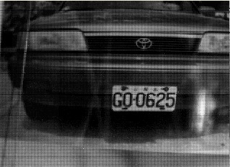
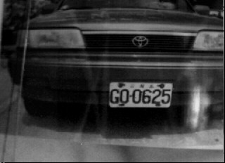
Color and Grey Scale(Output)
Before Convert
After Convert

Slide 36
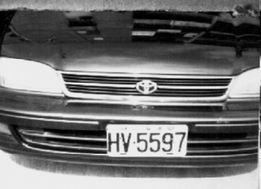
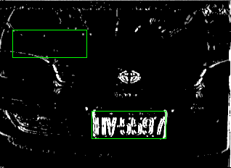
Edge Detection Car License Plate
■
Vertical edge is a
significant feature of car
license plate
■
Sobel filter enhances
edges
in the image
bh
rw
sum
_
of
_
edges
=
∑∑
f
(
x
,
y
)
y
=
th
x
=
lw
bh
,
th
:
buttom
and
top
boundary
of
sliding
window
lw
,
rw
:
left
and
right
boundary
of
sliding
window
f
(
x
,
y
)
:
gray
level
of
edge

Slide 37
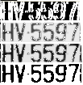

Image Segmentation
■
Gray level stretching
■
Enhance contrast
■
K-mean algorithm
■
Threshold
■
Vertical projection
■
Character
segmentation

Slide 38
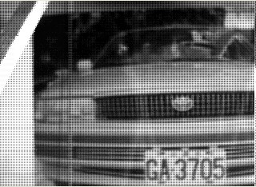
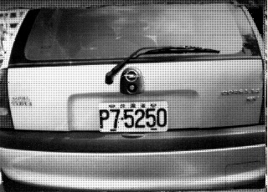
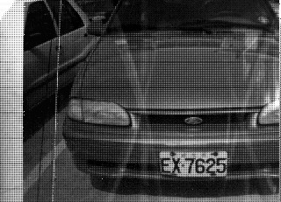
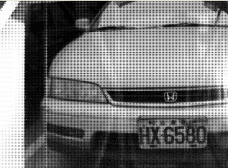
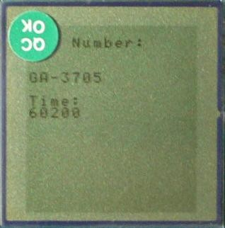
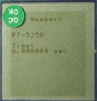
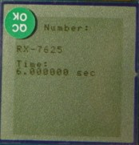
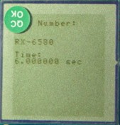
Image Segmentation(Output)
Some outputs are as follows:
GA-3705
P7-5250
EX-7625
HX-6580

Slide 39
References
B.R. Hunt, "Digital image processing", Proceedings of the IEEE, vol. 63, pp. 693-708, 1975, ISSN 0018-9219.
D.J. Granrath, "The role of human visual models in image processing", Proceedings of the IEEE, vol. 69, pp. 552-561, 1981, ISSN 0018-9219.
A. Sanz, C. Munoz, N. Garcia, "Approximation Quality Improvement Techniques in Progressive Image Transmission", Selected Areas in Communications IEEE Journal on, vol. 2, pp. 359-373, 1984, ISSN 0733-8716.
T. Weyers, J.J.D. Van Schalkwyk, "Development Of A Quality Basis For The Evaluation Of Coded Video Images", Communications and Signal Processing 1990. COMSIG 90. Proceedings. IEEE 1990 South African Symposium on, pp. 110-114, 1990.
E. Kussul, T. Baidyk, M. Kussul, "Neural network system for face recognition", Circuits and Systems 2004. ISCAS '04. Proceedings of the 2004 International Symposium on, vol. 5, pp. V-V, 2004.

Slide 40
References
Xingxing Jia, Daoshun Wang, Yu-jiang Wu, Xiangyang Luo, "A shrinking algorithm for binary images to preserve topology", Image and Signal Processing (CISP) 2010 3rd International Congress on, vol. 3, pp. 1181-1185, 2010.
Angelos Amanatiadis, Ioannis Andreadis, "An integrated architecture for adaptive image stabilization in zooming operation", Consumer Electronics IEEE Transactions on, vol. 54, 2008, ISSN 0098-3063.
Seungwon Lee, Junghyun Lee, Ewoo Chon, Monson H. Hayes, Joonki Paik, "Moving object segmentation using motion orientation histogram in adaptively partitioned blocks for consumer surveillance system", Consumer Electronics (ICCE) 2012 IEEE International Conference on, pp. 197-198, 2012, ISSN 2158-3994.
Jinhee Lee, Sangkeun Lee, Joonki Paik, "Digital image stabilization based on statistical selection of feasible regions", Consumer Electronics IEEE Transactions on, vol. 55, 2009, ISSN 0098-3063.
Shuang Li, Jinqing Qi, "Image stabilization by combining gray-scale projection and representative point matching algorithms", Awareness Science and Technology (iCAST) 2011 3rd International Conference on, pp. 128-132, 2011.

Slide 41
Thank You!
        - By Azhar Mithani

