Slide 1
Getting started with Game Development
By: @Ali_hafizji

Slide 2
Why should you make games?
To live the childhood dream
Creative expression
Give yourself something challenging
Games do better on the appstore
It’s simply more fun ☺

Slide 3
Agenda
Demo
Basics of game development
Code walkthrough
Challenges (not for the faint hearted – homework!!)

Slide 4
In the beginning of time
Math genius
Crazy knowledge of the 3D graphics pipeline
Expertise in OpenGL or DirectX
Driven to resolve issues on memory and driver compatibility

Slide 5
What is OpenGl ES?

Slide 6

Lets draw the
a
b
Frame buffer: [a, b, c, d]
Texture buffer: [1, 2, 3, 4]
1
2
c
d
3
4
I command you to draw

Slide 7
Then came game engines
Cocos2d
Cocos2d-x
Andengine
Unity
Unreal and many more..

Slide 8
SpriteKit
Uses some of the best features from other engines
Integrated with Xcode
Provides a storyboard like interface to design the game scene

Slide 9
SpriteKit classes
SKView: This is the view that displays game content.

Slide 10


SKScene
The root node for a tree of sprites and other content (children referred as nodes).
SKScene
SKSprite

Slide 11
SKNode
A class from which all spritekit node classes originate
Properties: frame, position, zPosition, scale etc.

Slide 12
SKSpriteNode
A node that draws a texture to the screen.
Creating a sprite is easy
let monkey= SKSprite(initWithImageNamed:”monkey”)

Slide 13
SKTexture & SKAction
A reusable texture Image – SKTexture
SKAction – Use to modify scene content, well suited for animations.

Slide 14
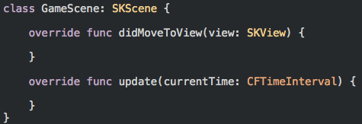
Game Scene structure
didMoveToView(view) – Called when a scene is about to be presented
update(currentTime) – This method is exactly once per frame. This is a good place
to check player health, spawn new enemies etc.

Slide 15


MonkeyJump Explained

Slide 16
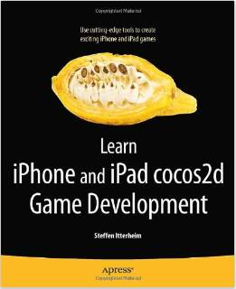
Where to go from here
Github url for demo project: https://github.com/PuneCocoa/SpriteKit-Part-1
Challenges:
Add bonus coins to the level randomly
Build a vertical scrolling game like a space shooter

