Slide 1
SmartSehat
Support for health workers
and remote doctors
Confirmed information for the doctor.
A care plan the worker can explain.
Research prototype. Fictional cases. Clinical review pending.
Notes:
Imagine a caregiver reaching a rural clinic while the doctor is remote. The worker needs enough confirmed information to ask the doctor a useful question, recognise urgent concerns and explain the response. SmartSehat supports that whole consultation. Today I will show fictional cases and simulated service delivery.
SOURCES
Local implementation and supplied consultation blueprint. Clinical validation and real service delivery remain pending.

Slide 2
Problem statement
A doctor is remote.
The information is incomplete.
Age units, danger signs, medicines and follow-up can get lost in an unstructured handoff.
SmartSehat connects confirmed local information
with a remote doctor's response and follow-up.
02 / SmartSehat
Notes:
The problem we designed for is incomplete information between the local worker and the remote doctor. A short message may leave out the age unit, danger signs, what the patient already took or whether advice was understood. The doctor must ask again, and the worker must reconnect the information. SmartSehat guides collection and keeps the response and follow-up in the same encounter. These are design goals, not measured improvements in patient outcomes.
SOURCES
Local implementation and supplied consultation blueprint. Clinical validation and real service delivery remain pending.

Slide 3
Where SmartSehat is used
Rural BHUs and outreach clinics
A health worker sees the patient locally.
A remote doctor reviews the confirmed case.
Clinic networks and district teams
Supervisors review saved cases, urgency and reported outcomes.
Intended use setting. Deployment requires clinical review and a clinic partner.
03 / SmartSehat
Notes:
The intended setting is a rural Basic Health Unit, an outreach clinic or an NGO care programme with a worker at the patient side and a doctor reviewing remotely. The same saved encounter supports the worker, doctor and district supervisor. We have built a local prototype for this workflow. These are intended users and settings, not claims of active deployments or partnerships.
SOURCES
Local implementation and supplied consultation blueprint. Clinical validation and real service delivery remain pending.

Slide 4
The consultation workflow
01 Worker collects and confirms
The worker records consent, screens danger and confirms the history and measurements.
02 Doctor reviews and requests
The doctor reviews the packet and can request a new answer, reading or test.
03 Worker explains and follows up
The worker explains the doctor's plan and records referral progress and follow-up.
04 / SmartSehat
Notes:
First, the worker collects and confirms the information. A positive danger sign can interrupt this process immediately. Next, the remote doctor reviews the case packet and asks for additional observations when needed. The worker returns those answers in the same case. Finally, the worker explains the doctor response, checks understanding and records the reported follow-up outcome.
SOURCES
Local implementation and supplied consultation blueprint. Clinical validation and real service delivery remain pending.

Slide 5
Two fictional consultation cases
Ayaan, 14 months
Sara, 28 years
Cough and fever
RR 46/min, SpO₂ 94%
Mild cough and sore throat
SpO₂ 98%
Repeat SpO₂: 89%
Doctor's medicine plan
Urgent referral and
reported admission
Counselling and a
fictional recovery follow-up
05 / SmartSehat
Notes:
These are two distinct authored examples. Ayaan is fourteen months old. His first packet is AMBER, and a later fictional oxygen reading of 89 percent triggers the prototype Emergency Lane. The recorded ending is referral and reported admission. Sara is twenty-eight years old. Her entered measurements remain in the routine pathway, and the simulated doctor enters a symptom-relief prescription. Her recovery follow-up is fictional. All applicable prototype questions were documented in both rehearsals.
SOURCES
finale/two-case-scenarios.json, finale/two-case-rehearsal.json and finale/two-case-records.json. These are authored synthetic examples, not clinical outcome evidence.

Slide 6
AI assistance and human responsibility
AI proposes
Transcription, candidate facts and constrained clinical considerations.
The worker confirms
The transcript, quoted evidence, measurements and patient read-back.
The doctor decides
Clinical interpretation, prescriptions, referrals and the final care plan.
06 / SmartSehat
Notes:
AI proposes information for review. Workers check the transcript and quoted evidence before confirming facts. A curated question bank guides history collection, while deterministic rules control prototype urgency. The doctor owns clinical interpretation, prescribing and referral. Matching a statement to the stored ledger does not establish its medical truth. Regional language accuracy and clinical content still need independent review.
SOURCES
Local implementation and supplied consultation blueprint. Clinical validation and real service delivery remain pending.

Slide 7
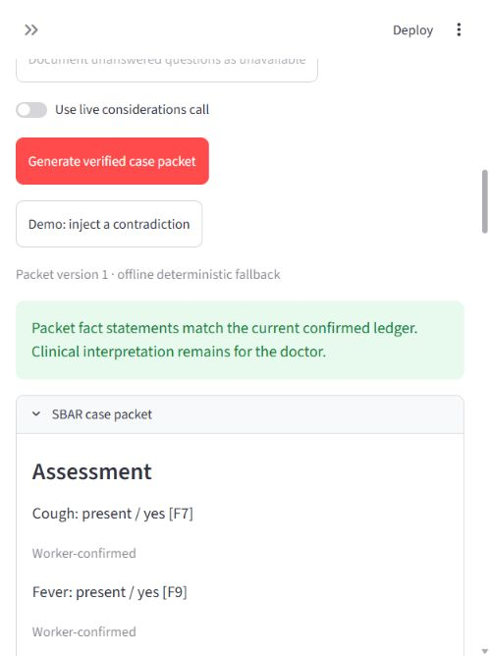
The doctor’s case packet
A structured SBAR handoff
Situation, Background, Assessment and Request.
Traceable statements
Fact IDs and provenance show where statements came from.
Visible uncertainty
Unknown answers and medicine warnings remain visible.
07 / SmartSehat
Notes:
The case packet uses SBAR: Situation, Background, Assessment and Request. The screenshot shows the actual local app and fictional data. Point to one fact reference and its source. Unknown answers and medicine warnings remain visible. After relevant changes, the app requires a new review or acknowledgement instead of silently reusing old information.
SOURCES
Actual product screenshot: finale/assets/01-case-packet.png. Implementation: smartsehat/consultation/packet.py and verify.py.

Slide 8
Dawa Check
Medicine reconciliation
Product | Ingredient
Panadol | Paracetamol
Calpol | Paracetamol
The worker confirms product details
and records the allergy history.
Warnings travel with the case
The doctor sees duplicate ingredients
and recorded medicine safety flags.
Duplicate ingredient flag
Separate fictional medicine example. Dose validation awaits reviewed data.
08 / SmartSehat
Notes:
Dawa Check records each reported medicine, its printed strength and what the patient actually took. The worker also confirms allergies. This separate fictional example uses the seeded Panadol and Calpol entries to show a duplicate paracetamol ingredient flag. It does not mean the patient should take either product. The doctor reviews the flags and authors the prescription. The dose-checking framework is present, but approved dosing rows are absent, so validated dose checking remains unavailable.
SOURCES
Project example and medicine catalogue: smartsehat/consultation/store.py load_ayaan, smartsehat/consultation/medicines.py, config/consultation_resources.json and data/brand_generic_map.json. Table reflects the authored seed, not an inspected real product pack.

Slide 9
Live consultation
Two clear outcomes
Emergency case
A repeat reading changes the plan to urgent referral.
Routine case
The doctor enters a medicine plan for the worker to explain.
09 / SmartSehat
Notes:
Switch to the app and use TWO-CASES.html as the private runbook. Show one fictional emergency case and one routine response. Keep the local fallback route selected for this rehearsed demonstration. State which stages were prepared if you start from saved information. For a shorter slot, show the packet, doctor request, returned reading, referral or prescription and patient card. The full question-by-question run of both cases needs more time. Delivery and clinician identity are simulated.
SOURCES
Local implementation and supplied consultation blueprint. Clinical validation and real service delivery remain pending.

Slide 10
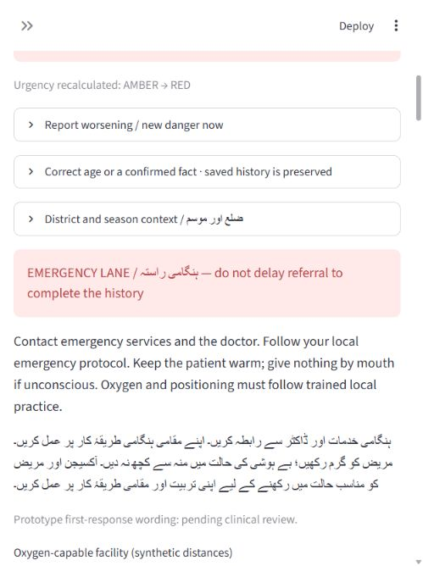
Emergency referral
94% to 89%
The new fictional oxygen reading
triggers Emergency Lane.
The worker creates a referral.
The doctor sees the updated information.
10 / SmartSehat
Notes:
Ayaan starts with a fictional oxygen reading of 94 percent. The doctor requests a repeat, and the worker enters 89 percent. The prototype reruns its urgency rules, interrupts routine collection and opens Emergency Lane. The worker records the referral without waiting to complete more history. The doctor reviews the changed information. Actual transport, facility notification and clinical rule approval remain pending.
SOURCES
Actual product screenshot: finale/assets/02-emergency.png. Full fictional rehearsal: finale/two-case-rehearsal.json.

Slide 11
Patient guidance and follow-up
The doctor's written plan
Case | Sara, 28 years
Clinical plan | Doctor-entered prescription
Counselling | Worker checks understanding
Outcome | Fictional reported recovery
Prescription, referral and return precautions
return in the same encounter.
Patient counselling
The worker explains the plan and
records reported understanding.
A continuing encounter
Reported referral progress and follow-up
remain attached to the case.
Authored role-play. No measured patient outcome.
11 / SmartSehat
Notes:
The patient card carries the exact doctor response, including the entered prescription or referral and the return precautions. The worker explains that response and records whether the patient or caregiver reports understanding. For Sara, the final record contains a doctor-entered example prescription and a fictional recovery follow-up. For Ayaan, the recorded outcome is reported admission after referral. These are demonstration records, not real clinical outcomes.
SOURCES
finale/two-case-scenarios.json, finale/two-case-rehearsal.json, finale/routine-completed-encounter.json and finale/emergency-completed-encounter.json.

Slide 12
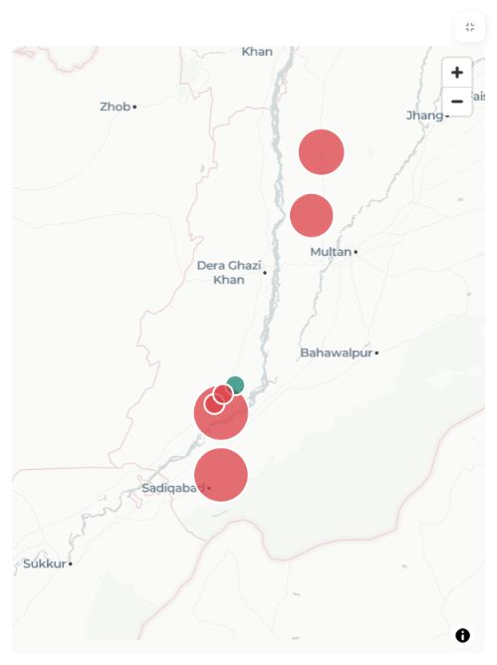
District dashboard
175
7
saved cases
consultations
7 illustrative map locations
Filter by date or urgency.
Open a saved consultation.
Export the case registry.
Demo snapshot includes seeded and rehearsal records.
12 / SmartSehat
Notes:
The district view now reads both the legacy ledger and the current consultation store. This saved snapshot contains 175 encounters: 168 legacy records and 7 consultation cases. These include seeded, draft and rehearsal records, not 175 real patients. The map groups them into 7 illustrative clinic or village locations. Supervisors can filter the same total and map by time, source or urgency, search the case registry, export it and open a consultation. The dashboard refreshes every ten seconds. Unmapped locations stay in the count.
SOURCES
Snapshot: finale/dashboard-checks.json. Actual product screenshot: finale/assets/07-district-all-cases.png. Implementation: smartsehat/dash.py, district_data.py and config/dashboard_locations.json. Captured October 24, 2026. Coordinates illustrative, not patient GPS.

Slide 13
Technical architecture
Streamlit interfaces
Worker consultation, doctor console and split-screen demonstration.
State and audit
LangGraph checkpoints, encrypted local SQLite and an append-only Fact Ledger.
Provider and delivery adapters
Optional AI calls, local fallback, portable exports and a prepared delivery gateway.
13 / SmartSehat
Notes:
The user interfaces run in Streamlit. LangGraph checkpoints and human gates support the consultation workflow, and encrypted local SQLite stores facts, drafts and audit events. The provider adapter supports optional AI services, with local fallbacks for the prepared route. Portable exports and a delivery gateway are implemented, while real delivery requires configuration and partners. Production authentication, full offline synchronisation and deployment-scale performance require more work.
SOURCES
docs/consultation_architecture.md, docs/consultation_integrations.md and smartsehat/consultation/store.py.

Slide 14
Engineering evidence
154
76 / 76
consultation checks passed
in the last full recorded run
authored urgency vignettes
matched browser and Python rules
Two complete fictional consultation workflows passed rehearsal.
The combined district dashboard passed focused checks.
Software evidence. Clinical accuracy, language accuracy and patient outcomes remain unmeasured.
14 / SmartSehat
Notes:
The last recorded full consultation run passed 154 authored software tests. The recorded urgency suite contains 76 authored cases with browser and Python parity. The two full fictional workflows were rehearsed from empty intake through all applicable questions, doctor response, counselling and follow-up. Two focused dashboard checks covered totals, filters, refresh and map coverage. This is software evidence. It does not establish clinical accuracy, language accuracy, time savings or patient benefit.
SOURCES
docs/verification.md, docs/vignette_results.json, finale/two-case-rehearsal.json, tests/test_district_dashboard.py and finale/dashboard-checks.json. Full 154-test run recorded October 22, 2026.

Slide 15
Prototype readiness
Working locally | Next requirements
Confirmed history and cited packet | Clinical and language review
Dawa flags and doctor response loop | Reviewed dose data and real stock
Emergency and referral records | Verified clinicians and live delivery
Patient guidance and district view | Production security and offline sync
Offline safety capture exists. The full consultation still needs the local server.
15 / SmartSehat
Notes:
The local consultation workflow is implemented through patient guidance, follow-up and district reporting. The medicine and language content still need independent review. We have no live delivery credentials or verified receiving clinicians, and the approved dose dataset is empty. The consultation runs on a local server. A standalone offline safety form exists, while full phone-based offline consultation and automatic sync remain incomplete. This defines the next work before a supervised pilot.
SOURCES
Local implementation and supplied consultation blueprint. Clinical validation and real service delivery remain pending.

Slide 16
Monetization
Clinic networks and NGO programmes
Proposed offer: care-team software and deployment support.
Revenue type | What the customer receives
Monthly clinic subscription | Worker and doctor workflow, Dawa and reporting
One-time onboarding | Clinic setup and staff training
Integration / support | Approved integrations and ongoing support
Proposed model. Pricing and demand require validation through a paid pilot.
16 / SmartSehat
Notes:
The proposed buyer is an institution operating clinics or outreach services, such as a clinic network or NGO programme. We would charge a recurring clinic subscription for the worker, doctor and district workflow, plus a one-time onboarding fee for setup and training. Integrations and ongoing support could form a separate contract. This is a business hypothesis: we have no validated price, revenue or signed customer contract. A paid pilot should test willingness to pay and measure hosting, AI, delivery and support costs per completed encounter before setting a sustainable price.
SOURCES
Authored proposed business model based on the implemented workflow and the project discussion. No external market size, pricing, revenue forecast or customer commitment is claimed.

Slide 17
Pilot invitation
Clinical reviewers and a clinic partner
Review the content and define a supervised care pathway.
A measured evaluation
Measure packet completeness, doctor review time and follow-up completion.
SmartSehat
Confirmed information for the doctor.
Continuous support for the local worker.
17 / SmartSehat
Notes:
The next step is independent clinical and language review with a clinic partner. A supervised evaluation would measure packet completeness, doctor review time and follow-up completion against an agreed baseline. We are looking for reviewers and a rural clinic partner to design that evaluation. SmartSehat connects confirmed information for the remote doctor with continuing support for the local worker. Thank you.
SOURCES
Local implementation and supplied consultation blueprint. Clinical validation and real service delivery remain pending.

