Slide 1



SuperStore_Sales_Dashboard
View in Power BI
Last data refresh:
5/28/2023 12:18:32 PM UTC
Downloaded at:
5/28/2023 12:47:29 PM UTC

Slide 2
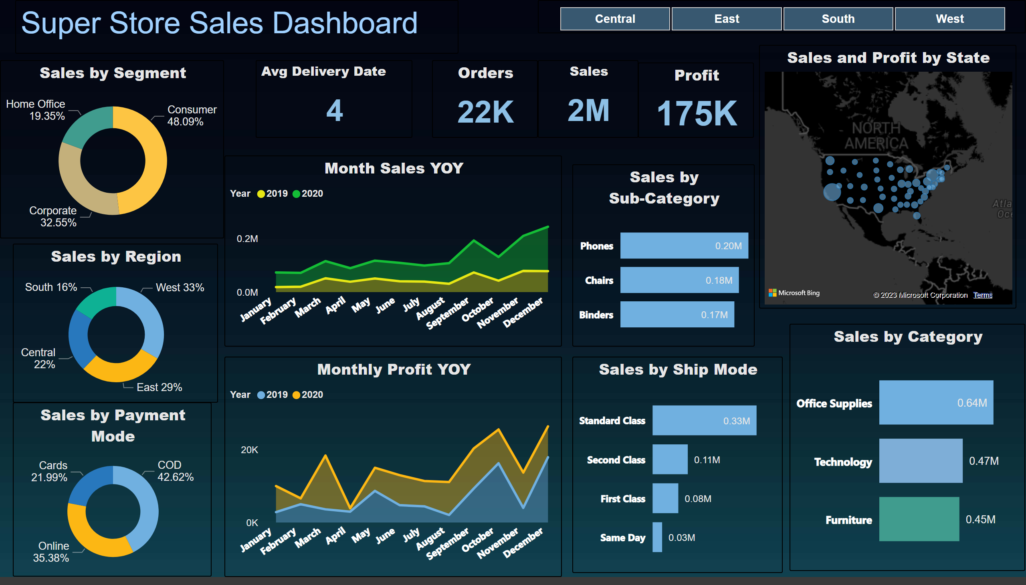
Page 1
Notes:
Sales by Category
No alt text provided
Sales by Sub-Category
No alt text provided
Sales by Ship Mode
No alt text provided
Month Sales YOY
No alt text provided
Monthly Profit YOY
No alt text provided
Sales and Profit by State
No alt text provided
Sales by Segment
No alt text provided
Sales by Payment Mode
No alt text provided
slicer
No alt text provided
textbox
No alt text provided
Profit
No alt text provided
Sales
No alt text provided
Orders
No alt text provided
Avg Delivery Date
No alt text provided
Sales by Region
No alt text provided

Slide 3
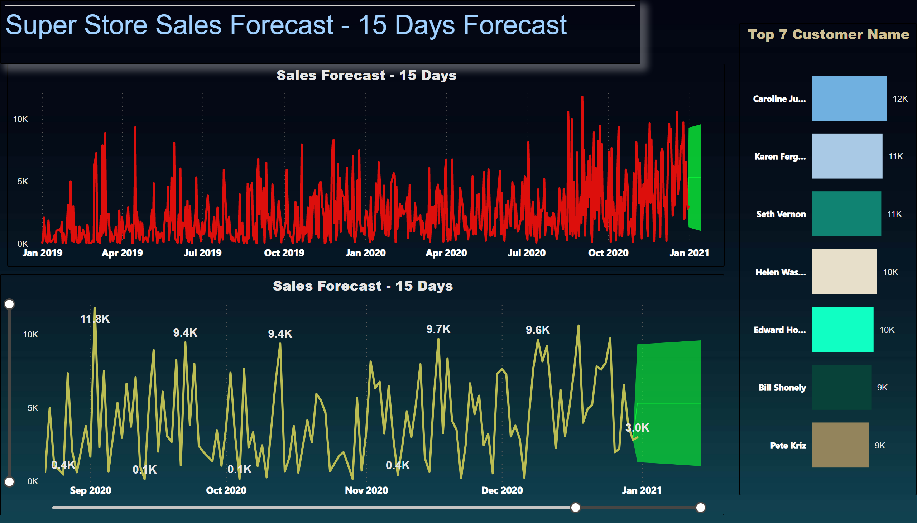
Page 2
Notes:
Sales Forecast - 15 Days
No alt text provided
Sales Forecast - 15 Days
No alt text provided
Top 7 Customer Name
No alt text provided
textbox
No alt text provided

