Slide 1
Hazards of mobile phones

Slide 2
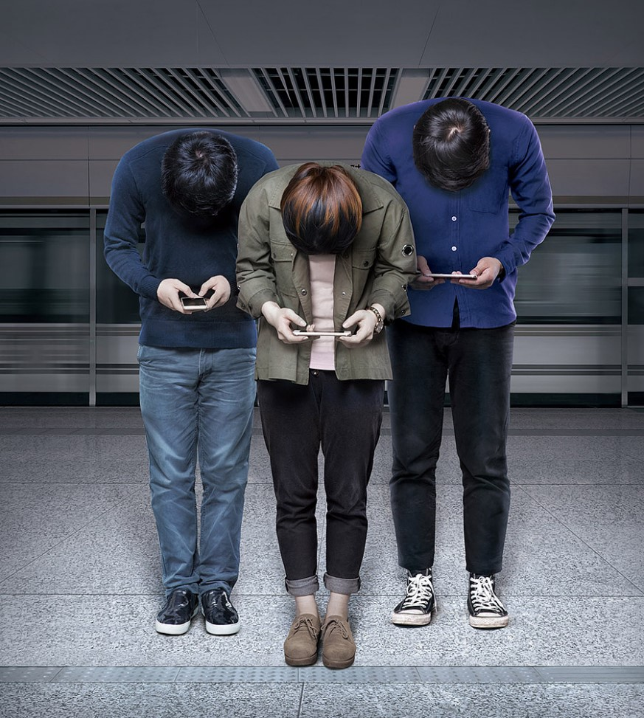
There are such a group of guys whose appearance is similar to that of humans, but one of the biggest features is that their eyes tilt forward and down, one hand or both hands are raised between the face and abdomen, and their index finger or thumb keep making regular movements.

Slide 3
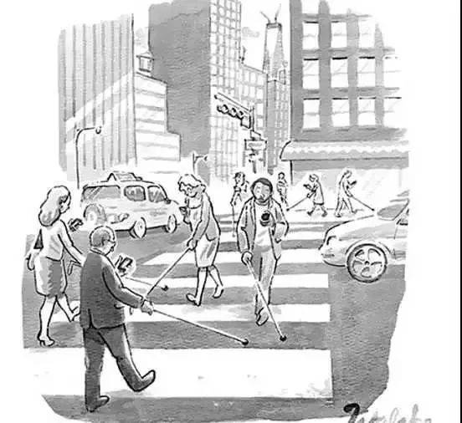
Visual loss

Slide 4
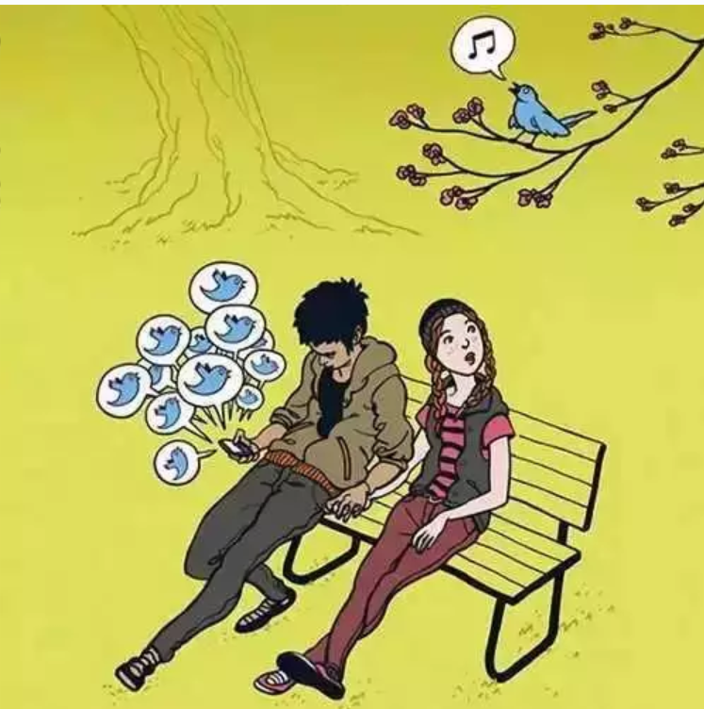
Hearing loss

Slide 5
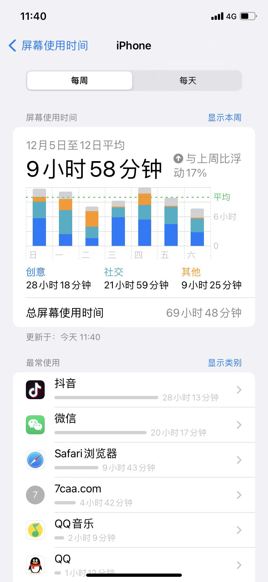
They can't make good use of their time.

Slide 6
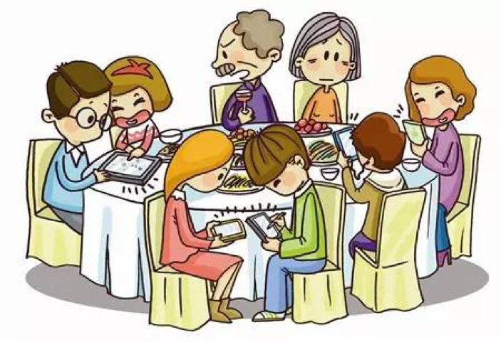
Estrangement from relatives.

Slide 7
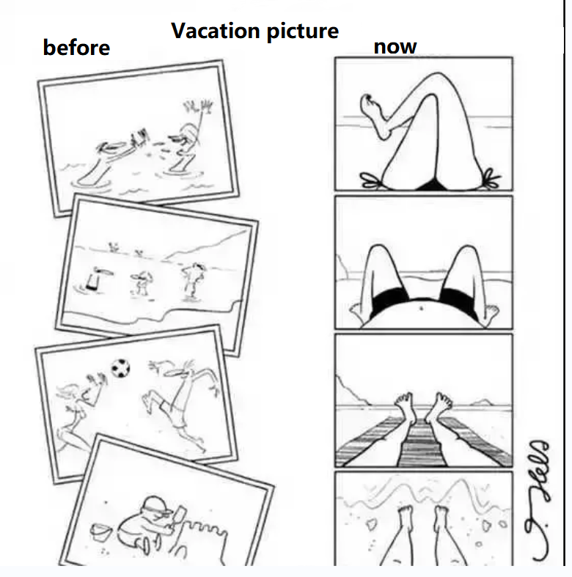
Sudden drop in camera level.

Slide 8
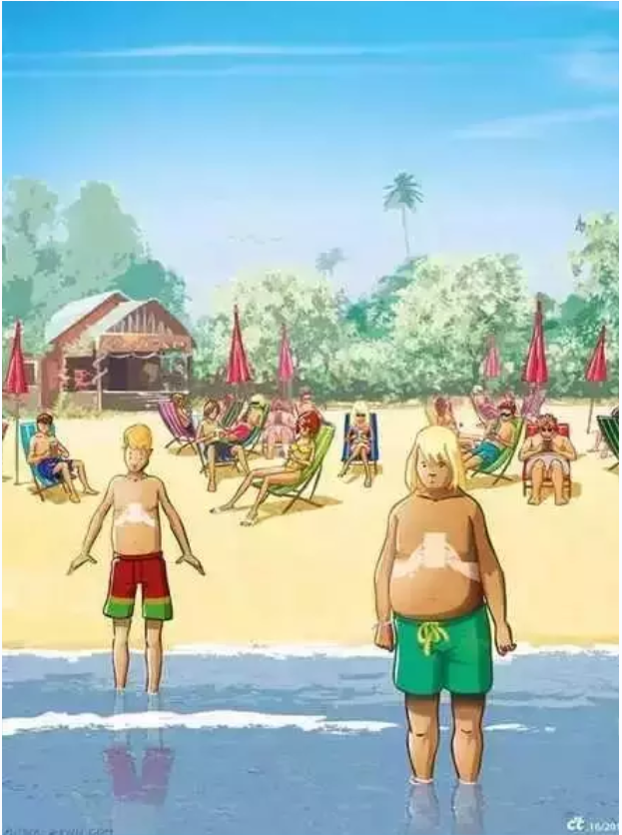
And a new "sunburn" appeared on the body.

Slide 9
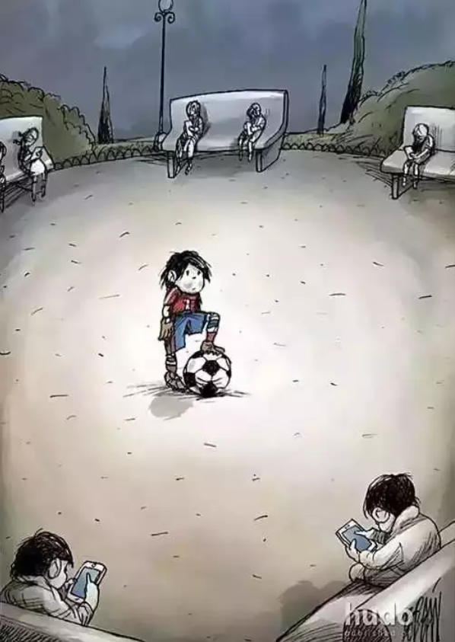
Occasionally they looked up and found no response.

Slide 10
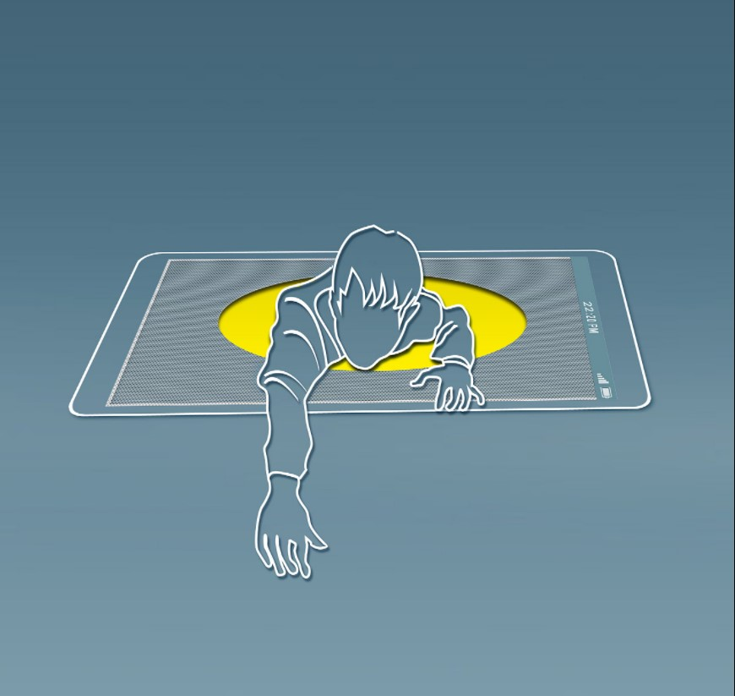
Although sometimes forced to make some changes,But because of their dependence, they can't extricate themselves

Slide 11
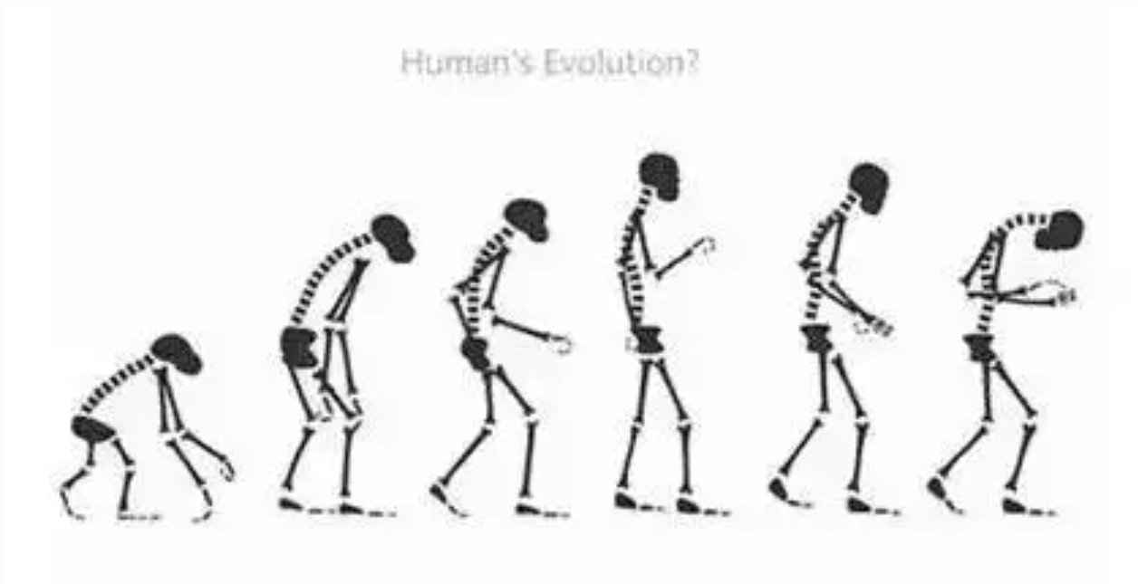
In the end, even the ultimate version of evolution.

Slide 12
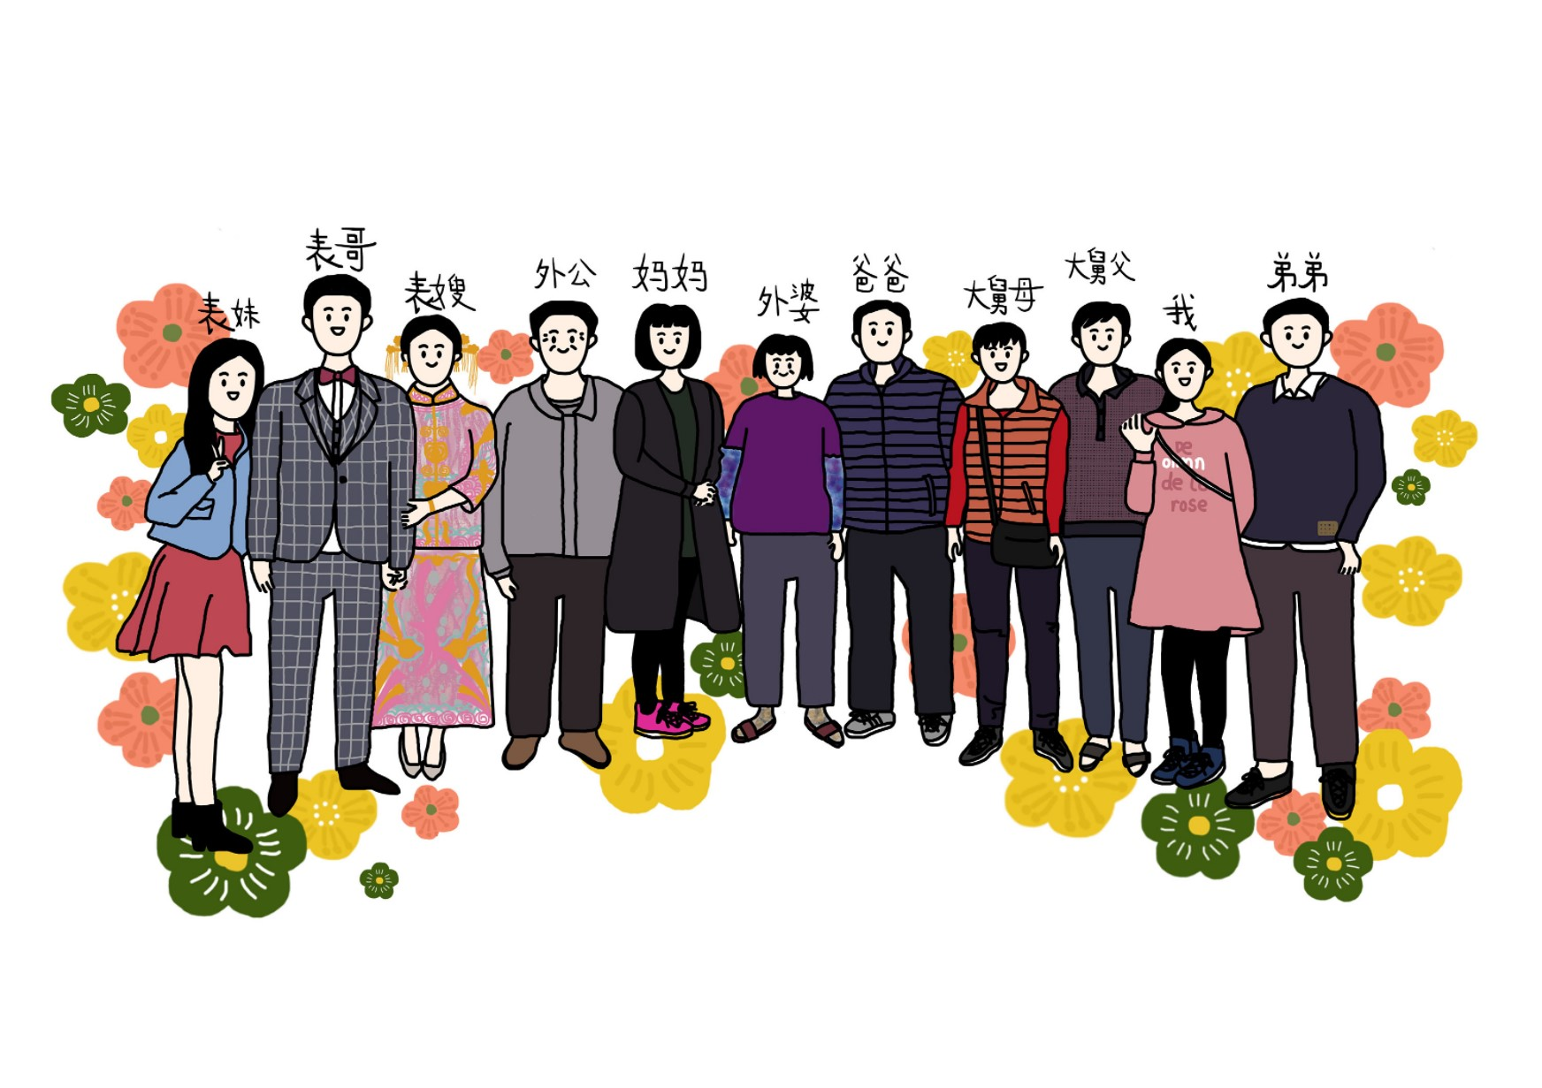
So don't miss the one who loves you because of your phone.

Slide 13
Thanks for watching

