Slide 1
PDC FINAL PROJECT
PARALLEL AND DISTRIBUTED COMPUTING
Parallel Point-in-Polygon
Classification for Large-Scale
Geospatial Data
Sequential → Shared-Memory → Distributed
Muhammad Anas Tabba 28998
Azhab Safwan Babar 29227
Ayaan Malik 29238
Tayib Bin Hisham 29087
Notes:
Good morning everyone. We're presenting our Parallel and Distributed Computing project — Parallel Point-in-Polygon Classification for Large-Scale Geospatial Data. I'm Anas, and with me are Azhab, Ayaan, and Tayib. Over the next few minutes we'll walk you through the problem, our three-stage solution, the actual code that runs it, and the benchmark numbers we got.
1

Slide 2
THE PROBLEM
Which point lies inside which region?
Given millions of GPS points and thousands of polygons, decide which point falls inside which region.
BRUTE FORCE COST
O(N × M)
Notes:
Let's start with the problem itself. Imagine you have a map covered in regions — like neighborhoods on a city map, or administrative districts in a country. And imagine you have a huge set of GPS points — millions of them — maybe from delivery drivers or mobile phones. The question we want to answer is simple: for each point, which region does it fall inside? Now the obvious solution is brute force — test every point against every polygon. But notice the cost. With one million points and ten thousand polygons, that's ten billion individual checks. On a normal CPU that's measured in hours, not seconds. So this is exactly the kind of workload that benefits from spatial indexing and parallelism.
2

Slide 3
WORKED EXAMPLE
Ray casting, step by step
STEP 1
Cast ray rightward
From point P along +x direction
P (5, 3)
STEP 2
Count edge crossings
cross 1
cross 2
Found 2 intersections with polygon edges
STEP 3
Apply odd / even rule
2 is even → point is OUTSIDE
OUTSIDE · O(edges) per polygon
Notes:
Before we go further, let me show you the actual algorithm we use to test if a single point is inside a single polygon. It's called ray casting. Pick the point you want to test — let's call it P. Now imagine shooting a ray from P horizontally to the right, going off to infinity. Count how many edges of the polygon that ray crosses. If the count is odd, the point is inside. If it's even, it's outside. In this example, the ray crosses two edges — that's even — so the point is outside. This works for any shape, including weird non-convex polygons with holes. The cost per polygon is proportional to the number of edges. Simple and reliable.
3

Slide 4




WHY IT MATTERS
Real-world use cases
Geofencing
Logistics
Trigger events when devices enter zones
Route trucks within delivery regions
Telecom Coverage
Census & Admin
Map subscribers to cell tower zones
Aggregate data into administrative areas
Notes:
Why does this matter in the real world? It shows up everywhere. Geofencing apps need to detect when a phone enters a defined zone. Logistics companies route delivery trucks within service regions. Telecom companies map subscribers to cell tower coverage areas. And government census systems aggregate data into administrative boundaries. So a fast point-in-polygon classifier is genuinely useful infrastructure.
4

Slide 5
PROJECT ROADMAP
Three milestones
M1
M2
M3
SEQUENTIAL
PARALLEL
DISTRIBUTED
Spatial Indexing
OpenMP
Multi-Process
Quadtree & strip index over ray casting
Five strategies on shared memory
Master / worker with file-based IPC
Notes:
We approached this in three milestones. Milestone one was the sequential foundation — get the algorithm correct and add spatial indexing so we're not blindly checking every polygon. Milestone two was shared-memory parallelism using OpenMP — squeeze speed out of multiple CPU cores on one machine. Milestone three was distributed execution — split the work across multiple processes using a master-worker design. Each milestone built on the last.
5

Slide 6
TEAM CONTRIBUTIONS
Who built what, milestone by milestone
Azhab Safwan Babar
Ayaan Malik
ERP 29227
ERP 29238
M1: Quadtree spatial index + bounding-box filtering
M1: Ray-casting PiP algorithm (edge, vertex, holes)
M2: Spatial partitioning (grid / hierarchical tiles)
M2: Multithreading setup — OpenMP static & dynamic
M3: Distributed execution model (multi-process IPC)
M3: Batch processing pipeline (streaming 250K chunks)
Muhammad Anas Tabba
Tayyab Bin Hisham
ERP 28998
ERP 29087
M1: Dataset generation — uniform & clustered GPS pts
M1: Correctness testing & benchmark validation
M2: Dynamic task queues & work-stealing deques
M2: Cache locality — Morton/Z-order tiled sorting
M3: Polygon replication vs spatial sharding trade-off
M3: Result aggregation (count / checksum per worker)
All members collaborated on performance benchmarking and scaling analysis.

Slide 7
END-TO-END WORKFLOW
From raw data to classified points
INPUT
Polygons
Build Index
Partition Pts
Classify
GeoJSON or synthetic grid
Quadtree over bbox
Spatially split N points
Index lookup + ray cast
M3 ONLY
OUTPUT
Aggregate
Validate
Results
Counts & checksums
Match seq baseline
point → polygon ID
Notes:
Here's the end-to-end workflow at a glance. We start with polygon input — either real-world GeoJSON or synthetic grids we generate ourselves. We build a quadtree spatial index over those polygons. For milestone three only, we then partition the points spatially across workers. Then comes the classification step itself — for each point, query the index, get a small set of candidate polygons, and run ray casting on those. Results flow back through aggregation and validation, and we get our final mapping of point ID to polygon ID. The same pipeline runs end to end across all three milestones — only the parallelism layer changes. Now Azhab will walk you through milestone one.
6

Slide 8
MILESTONE 1 · SEQUENTIAL FOUNDATION
Smarter, not just faster
RAY CASTING
QUADTREE
STRIP INDEX
Count edge crossings — odd = inside
Recursive 4-way subdivision
Horizontal bands for fast lookup
Notes:
Thanks Anas. In Milestone 1 our goal was to be smarter before being parallel. The actual point-in-polygon test is ray casting — we just saw it. But running ray casting against every polygon for every point is still ten billion operations. So we added spatial indexing. We built two of them. The first is a quadtree — it recursively subdivides 2D space into four quadrants until each leaf holds only a few polygons. The second is a strip index — it slices space into horizontal bands. Both let us skip polygons that can't possibly contain a given point, before we even run ray casting. We also handled the tricky cases — points on edges, points on vertices, polygons with holes, MultiPolygons.
7

Slide 9
CODE · MILESTONE 1
Ray casting, in C++
src/geometry/ray_casting.cpp · RayCaster::ray_cast_ring
int ray_cast_ring(const Point& p, const std::vector<Point>& ring) {
int crossings = 0;
for (size_t i = 0; i < ring.size(); ++i) {
const Point& a = ring[i];
const Point& b = ring[(i + 1) % ring.size()];
// Skip horizontal edges & out-of-y-range edges
if (std::abs(a.y - b.y) < EPSILON) continue;
if (point_on_segment(p, a, b)) return 0; // ON_BOUNDARY
// Cast ray rightward; count only valid crossings
double t = (p.y - a.y) / (b.y - a.y);
double x_intersect = a.x + t * (b.x - a.x);
if (x_intersect > p.x && (a.y > p.y) != (b.y > p.y))
crossings++;
}
return crossings; // odd = INSIDE, even = OUTSIDE
}
Notes:
Here's the actual ray casting function from our code, in geometry slash ray casting dot cpp. We loop through every edge of the polygon ring. We skip horizontal edges because the ray is also horizontal. If the point lies exactly on an edge, we return zero — that's the boundary case. Otherwise, we compute where our horizontal ray would intersect this edge mathematically, and we count it as a crossing only if the intersection is to the right of the point and the edge endpoints sit on opposite sides of the ray. That last check prevents us from double-counting at vertices. At the end, odd crossings means inside, even means outside.
8

Slide 10
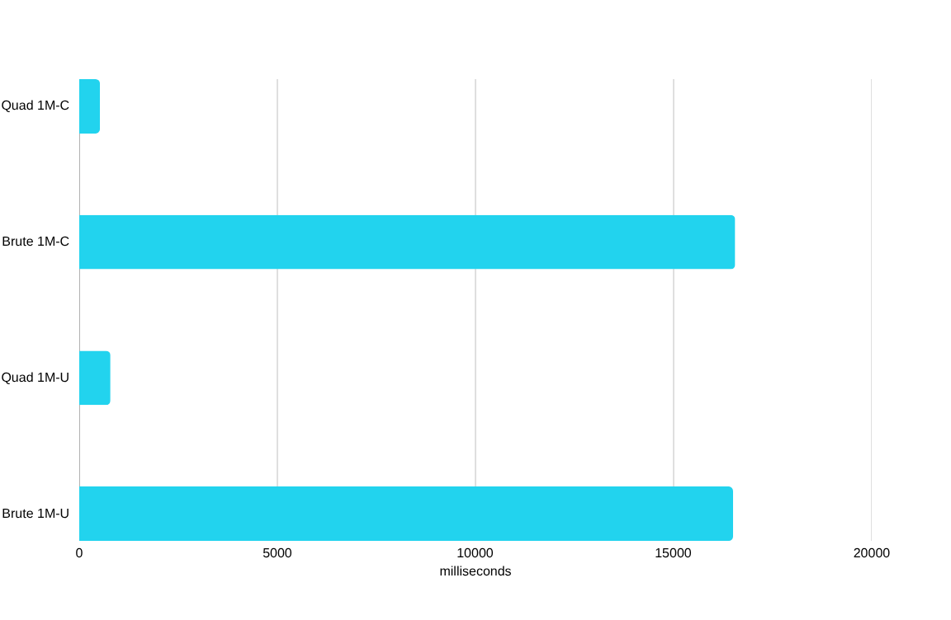
MILESTONE 1 · RESULTS
Up to 31.8× speedup over brute force
16.5s → 0.79s
1M UNIFORM POINTS
Validated against brute force on Pakistan GeoJSON: 204 polygons, 745 centroids.
Notes:
And the results were dramatic. On one million uniform points against ten thousand polygons, brute force took sixteen and a half seconds. The same job using our quadtree took seven hundred and eighty seven milliseconds — that's a twenty point nine six times speedup. On clustered data, where the points pile up in dense areas, the index is even more effective — we hit thirty one point eight times. We also validated against a real-world dataset — Pakistan's administrative GeoJSON with two hundred and four polygons and seven hundred forty five centroid points. The indexed results matched the brute force ground truth exactly. With this foundation in place, Ayaan took it parallel.
9

Slide 11
MILESTONE 2 · SHARED MEMORY
Five strategies, one machine
Static OpenMP
FORK
Dynamic OpenMP
Tiled + Morton
T1
T2
T3
T4
Work-Stealing
Hybrid (Best)
Notes:
Thanks Azhab. Milestone 2 was about shared-memory parallelism using OpenMP. Now we didn't just throw a single pragma at the loop and call it done. We benchmarked five different strategies. Static scheduling pre-assigns equal chunks of points to each thread up front. Dynamic scheduling lets threads pull chunks from a shared queue as they finish. Tiled with Morton ordering rearranges points using a Z-order space-filling curve to improve cache locality. Work-stealing gives each thread its own deque and lets idle threads steal from busy ones. And finally, a hybrid that combines static and dynamic — static gives each thread a base chunk, dynamic handles the leftovers.
10

Slide 12
CODE · MILESTONE 2
OpenMP scheduling
src/parallel/parallel_classifier.cpp · classify_dynamic
const int chunk = std::max(1,
Adaptive chunk
(int)(std::sqrt(n) / 4));
sqrt(n)/4 avoids L3 cache thrashing
#pragma omp parallel for \
schedule(dynamic, chunk) \
Dynamic schedule
if(n > 50000)
Threads pull chunks at runtime — no idle waiting
for (int i = 0; i < n; ++i) {
results[i] = {
i,
classify_one(
Skip on small N
points[i],
OpenMP overhead beats parallelism below 50K points
polygons,
index)
};
}
Notes:
Here's the actual OpenMP code from our parallel classifier. Three things to notice. First, the chunk size is square root of N divided by four — not the OpenMP default. We discovered the default chunk size of N over threads was thrashing the L3 cache, with all four threads simultaneously evicting each other's working sets. The square root heuristic gave each thread a small enough chunk that they finish quickly and interleave instead of competing. Second, we use schedule dynamic, which means threads grab chunks at runtime — no idle waiting. Third, the if clause says skip OpenMP entirely if there are fewer than fifty thousand points — below that, the overhead of spawning threads beats the benefit.
11

Slide 13
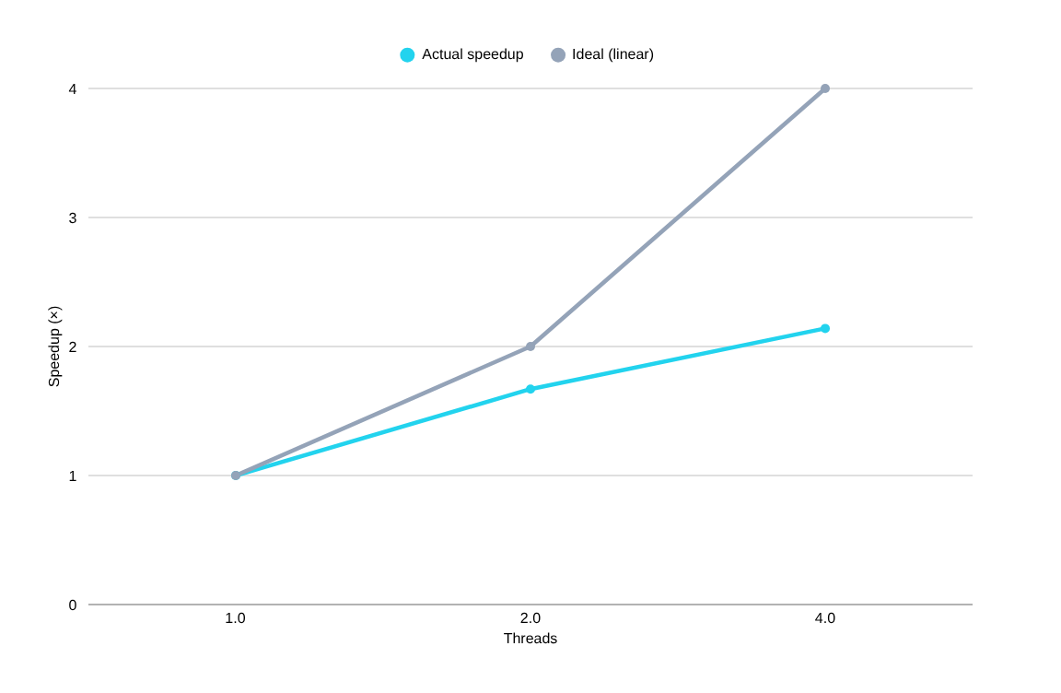
MILESTONE 2 · RESULTS
Hybrid wins — 2.49× on 4 threads
2.16×
HYBRID SPEEDUP · 1M UNIFORM
Sub-linear scaling. Quadtree traversal is memory-bound — random access dominates compute.
Notes:
And here are the speedup results. On four threads, our best strategy — the hybrid scheduler — hit two point four nine times on one hundred thousand points, and two point one six times on one million. Thread scaling was sub-linear — at two threads we got one point six seven times, at four threads two point one four times. The orange dashed line on this chart shows where ideal linear scaling would sit. We're well below it, and that's an honest result. The reason is that quadtree traversal is memory-bound — it's mostly random pointer chasing through cache. Adding more threads adds memory contention faster than it adds compute. We hit a real wall on a single machine. To go further, we needed to go distributed. Tayib will explain how.
12

Slide 14
MILESTONE 3 · DISTRIBUTED EXECUTION
Master / Worker architecture
MASTER
partition · launch · aggregate
WORKER 1
WORKER 2
WORKER 3
WORKER 4
local quadtree
classify partition
local quadtree
classify partition
local quadtree
classify partition
local quadtree
classify partition
Notes:
Thanks Ayaan. In Milestone 3 we built a master-worker distributed architecture. The master process partitions the points spatially, hands each partition to a worker, and each worker independently builds its own local quadtree, classifies its slice of the points, and reports back. Results are aggregated using compact counts and checksums — not the full result arrays — to keep communication cheap. Now there was one challenge: MPI wasn't configured on our Windows toolchain. The assignment allowed multi-process execution as an alternative, so we built a real separate worker executable — worker dot exe — that the master spawns using Windows CreateProcess. Communication happens through binary input and result files. Same architecture as MPI, just a different transport.
13

Slide 15
CODE · MILESTONE 3
Spawning worker processes
src/benchmark_m3.cpp · multi-process IPC path
STEP 1
// 1. Build worker command line
Master writes
std::string cmd = worker_exe + " " +
Binary input files per worker (points + polygons)
input_paths[w] + " " +
polygon_path + " " +
result_paths[w];
STEP 2
// 2. Launch worker as a real OS process
Spawn worker.exe
BOOL ok = CreateProcessA(
Real OS process — not a thread
nullptr, mutable_command.data(),
nullptr, nullptr, FALSE, 0,
nullptr, nullptr,
STEP 3
&startup_info, &process_info);
Aggregate
handles.push_back(process_info.hProcess);
Read result files · compare checksums
// 3. Wait for ALL workers to finish
WaitForMultipleObjects(handles.size(),
handles.data(), TRUE, INFINITE);
Notes:
Here's the actual code that does the spawning, from benchmark m three dot cpp. Step one — the master writes a binary input file for each worker, containing that worker's slice of points. Step two — the master calls CreateProcess once per worker, launching worker dot exe as a real operating system process, passing it the input file path and the output file path on the command line. Step three — once all workers are launched, the master calls WaitForMultipleObjects to block until every worker has finished. After that, it reads the result files back and aggregates them. This is a real distributed pattern — the workers don't share memory with the master, they communicate purely through files.
14

Slide 16
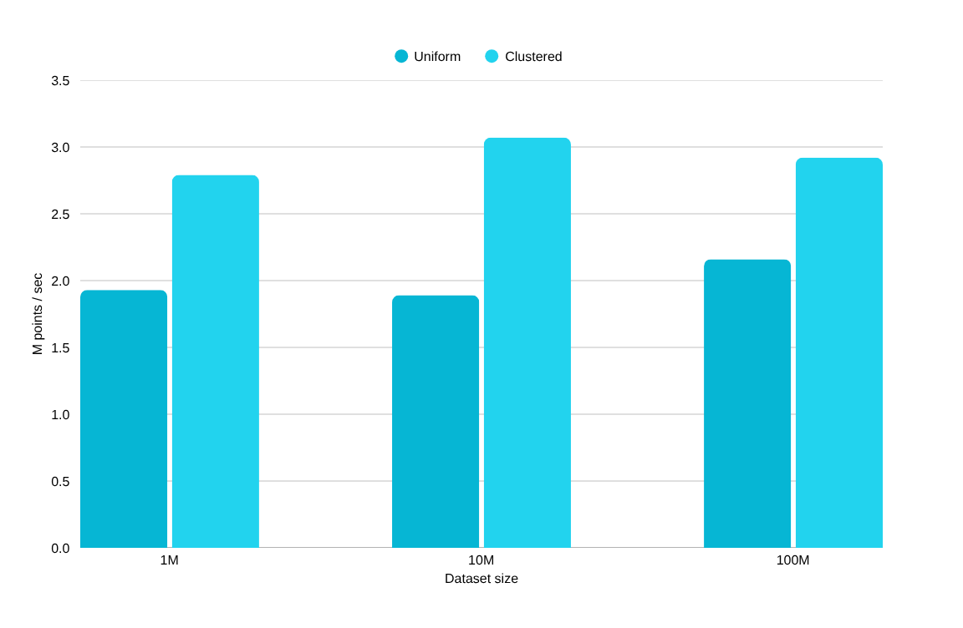
MILESTONE 3 · SCALE
Scaling to 100M points
2.92M / sec
THROUGHPUT @ 100M CLUSTERED
1M clustered · 481 ms total
10M clustered · 4.15 s total
100M clustered · 43.0 s total
Notes:
And this approach let us scale all the way to one hundred million points. We sustained roughly two point nine million points per second on clustered data at that scale. Notice that the per-point throughput actually goes up at one hundred million compared to one million — that's because the fixed setup costs get amortized across more work. So the system genuinely scales with data size.
15

Slide 17
MILESTONE 3 · TRADE-OFF
Replication vs sharding
REPLICATED
SHARDED
Every worker holds a full copy
Each worker holds a slice
40,000
10,600
POLYGON COPIES
POLYGON COPIES
Same checksum → identical classification results
Notes:
We also explored a key trade-off — replication versus sharding. In replicated mode, every worker holds a full copy of all the polygon data — that's forty thousand polygon copies across four workers. In sharded mode, each worker only holds the slice that overlaps with its spatial region — that's down to ten thousand six hundred copies. Critically, both modes produced identical checksums on every workload, which proves correctness was preserved. And on clustered data, sharding was actually faster — less memory pressure during quadtree traversal. So sharding wins when memory bandwidth is the bottleneck.
16

Slide 18
CHALLENGES
What we hit
DOCUMENTED
HONEST
Memory-bound quadtree
Sub-linear speedup
Random pointer chasing limits parallel scaling
2.14× on 4 threads — not 4×
SOLVED
MEASURED
No MPI on Windows
IPC overhead
Used multi-process with file-based IPC instead
Write & read times made explicit, not hidden
Notes:
Some honest challenges we faced. The quadtree being memory-bound limited our parallel speedup — that's documented. Sub-linear scaling on four threads — also honestly reported, not hidden. MPI wasn't available on our Windows setup — we solved that with the multi-process alternative the assignment allowed. And the IPC path has measurable overhead — file write and read times — but we made that explicit in our timing breakdown rather than burying it.
17

Slide 19
CONCLUSION
Sequential → Parallel → Distributed
31.8×
2.49×
100M
OVER BRUTE FORCE
ON 4 THREADS
POINTS HANDLED
Milestone 1
Milestone 2
Milestone 3
Spatial indexing
OpenMP parallelism
Distributed multi-process
THANK YOU · QUESTIONS?
Notes:
So in summary — we went from brute force, to a thirty one point eight times indexed speedup at the sequential stage, to a two point four nine times parallel speedup on shared memory, to a distributed system that classifies one hundred million points. Sequential, parallel, distributed — the full PDC arc. Thank you for listening. We're happy to take any questions.
18

