Slide 1
DSP
C110112127 劉豐茗
C110112165 張芫睿

Slide 2
第一次小考

Slide 3
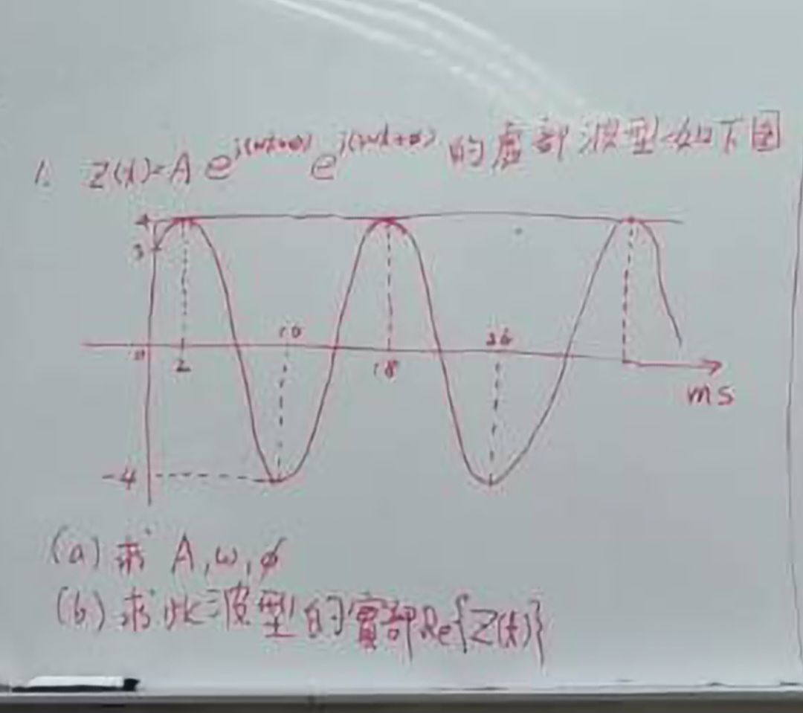
第一題

Slide 4
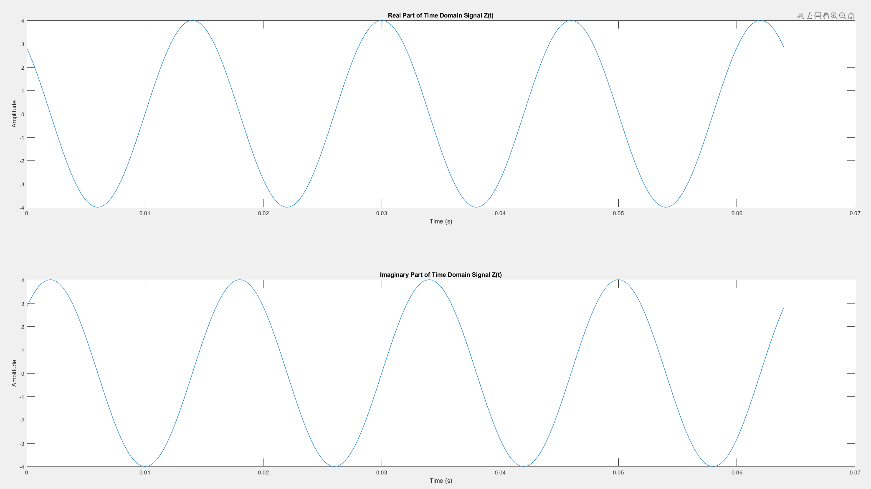
第一題
CODE
TIME DOMAIN FIGURE
clc;
clear all;
close all;
% 參數設置
T = 16e-3; % 週期為16毫秒
f0 = 1 / T; % 基頻
t = 0:1e-6:4*T; % 時間向量，從0到一個週期，以1微秒為步長
% 複數指數信號
Z = 4 * exp(1i * (125 * pi * t + pi / 4));
% 畫出時間域信號的實部和虛部
figure;
subplot(2, 1, 1);
plot(t, real(Z));
title('Real Part of Time Domain Signal Z(t)');
xlabel('Time (s)');
ylabel('Amplitude');
subplot(2, 1, 2);
plot(t, imag(Z));
title('Imaginary Part of Time Domain Signal Z(t)');
xlabel('Time (s)');
ylabel('Amplitude');

Slide 5
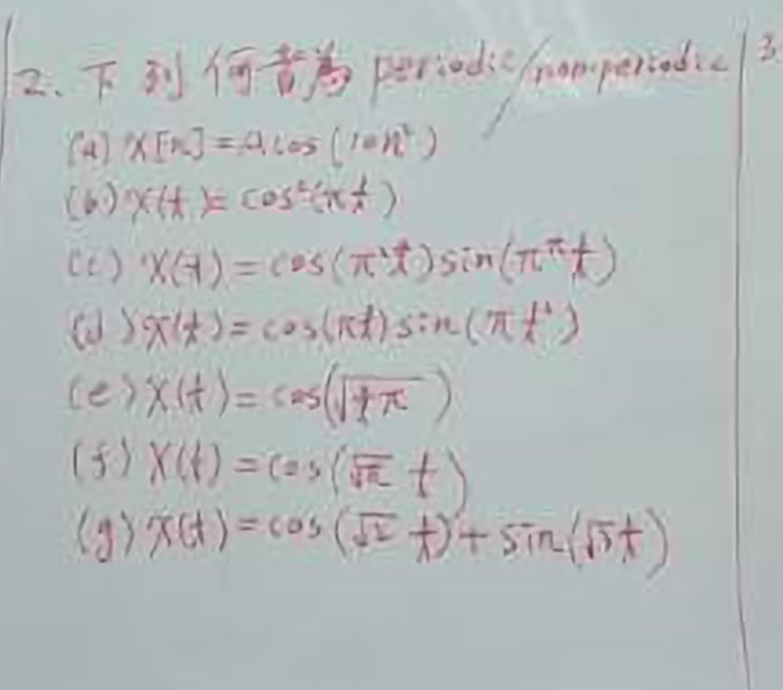
第二題

Slide 6
第二題
CODE
figure;
% (d) x(t) = \cos(\pi t) \sin(\pi t^2)
t = -1:0.001:5;
x_d = cos(pi * t) .* sin(pi * t.^2);
plot(t, x_d);
title('(d)x(t) = \cos(\pi t) \sin(\pi t^2)');
xlabel('t');
ylabel('Amplitude');
figure;
% (e) x(t) = \cos(\sqrt{\pi t})
t = -1:0.001:5;
x_e = cos(sqrt(pi * t));
plot(t, x_e);
title('(e)x(t) = \cos(\sqrt{\pi t})');
xlabel('t');
ylabel('Amplitude');
figure;
% (f) x(t) = \cos((\sqrt{\pi}) t)
t = -1:0.001:5;
x_f = cos(sqrt(pi) * t);
plot(t, x_f);
title('(f)x(t) = \cos((\sqrt{\pi}) t)');
xlabel('t');
ylabel('Amplitude');
figure;
% (g) x(t) = \cos(\sqrt{2} t) + \sin(\sqrt{3} t)
t = -1:0.001:5;
x_g = cos(sqrt(2) * t) + sin(sqrt(3) * t);
plot(t, x_g);
title('(g)x(t) = \cos(\sqrt{2} t) + \sin(\sqrt{3} t)');
xlabel('t');
ylabel('Amplitude');
clc;
clear all;
close all;
% (a) x[n] = A*cos(10*n^2)
n = -100:100;
A = 1;
x_a = A * cos(10 * n.^2);
figure;
stem(n, x_a);
title('(a)x[n] = A \cos(10n^2)');
xlabel('n');
ylabel('Amplitude');
figure;
% (b) x(t) = (\cos^2)(\pi t)
t = -1:0.001:5;
x_b = cos(pi * t).^2;
plot(t, x_b);
title('(b)x(t) = \cos^2(\pi t)');
xlabel('t');
ylabel('Amplitude');
figure;
% (c) x(t) = \cos(\pi^2 t) \sin(\pi^\pi t)
t = -1:0.001:5;
x_c = cos(pi^2 * t) .* sin(pi^pi * t);
plot(t, x_c);
title('(c)x(t) = \cos(\pi^2 t) \sin(\pi^\pi t)');
xlabel('t');
ylabel('Amplitude');

Slide 7
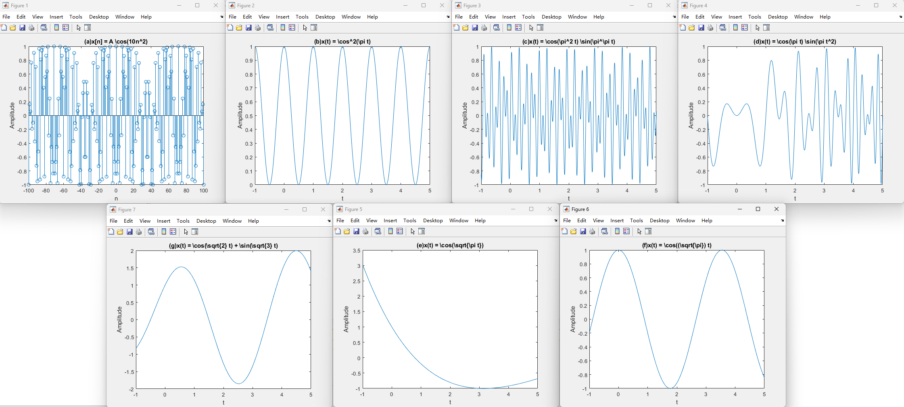
第二題

Slide 8
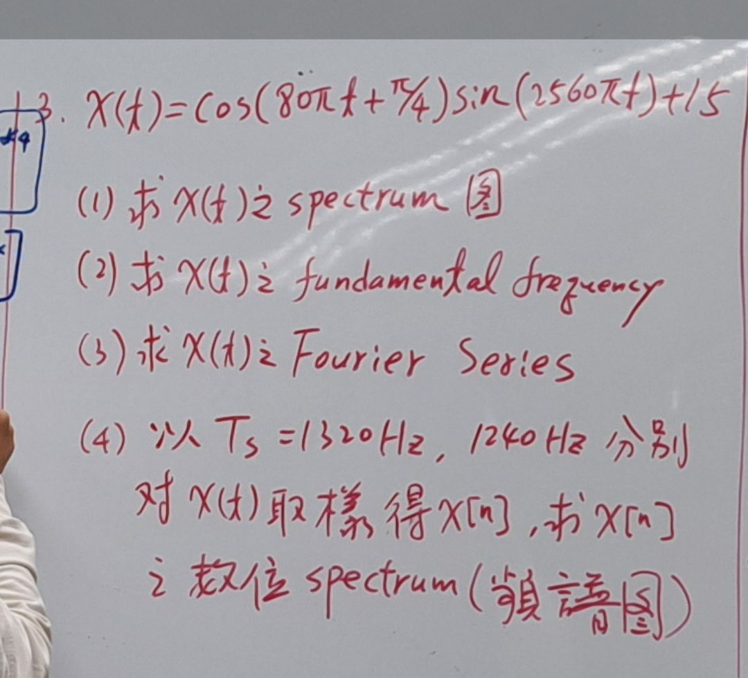
第三題

Slide 9
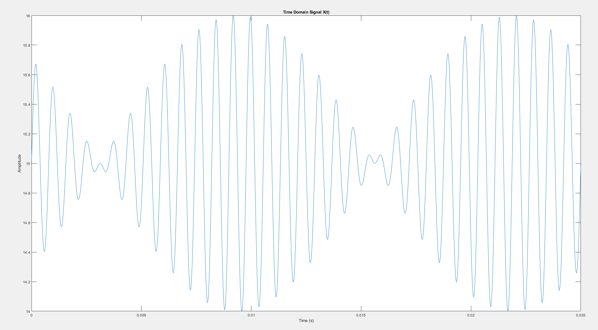
第三題
CODE
TIME DOMAIN FIGURE
clc;
clear all;
close all;
% Parameters
t = 0:0.02/2560:2/80;
x = cos(80*pi*t + 0.25*pi);
y = sin(2560*pi*t);
z = x .* y + 15;
% Plot time domain signal
figure;
plot(t, z);
title('Time Domain Signal X(t)');
xlabel('Time (s)');
ylabel('Amplitude');
% Frequency analysis
n = length(z); % Number of samples
fs = 1 / (t(2) - t(1)); % Sampling frequency
f = (-n/2:n/2-1)*(fs/n); % Frequency range
Z = fft(z); % Compute the FFT
Z_shifted = fftshift(Z); % Shift zero frequency component to center of spectrum
% Plot frequency spectrum
figure;
plot(f, abs(Z_shifted)/n);
title('Frequency Spectrum of X(t)');
xlabel('Frequency (Hz)');
ylabel('Magnitude');

Slide 10
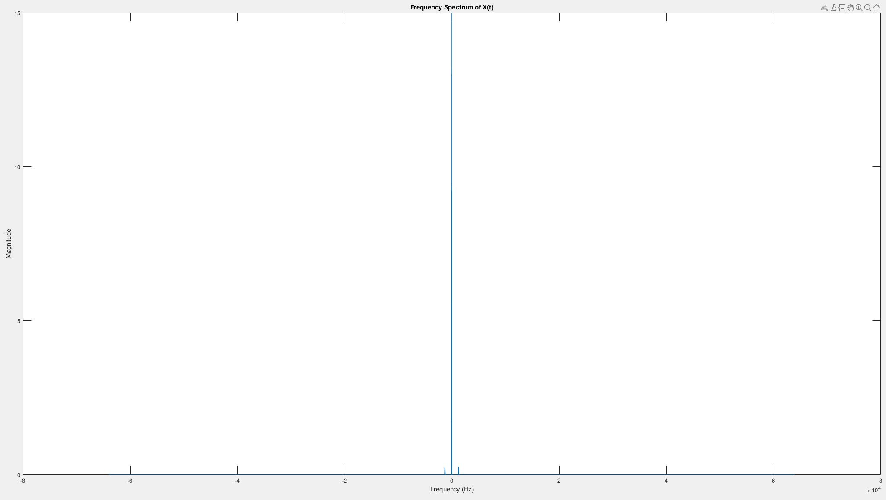
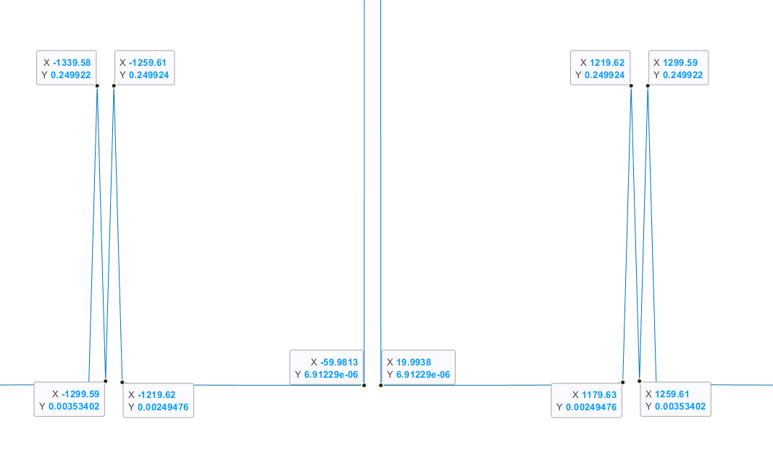
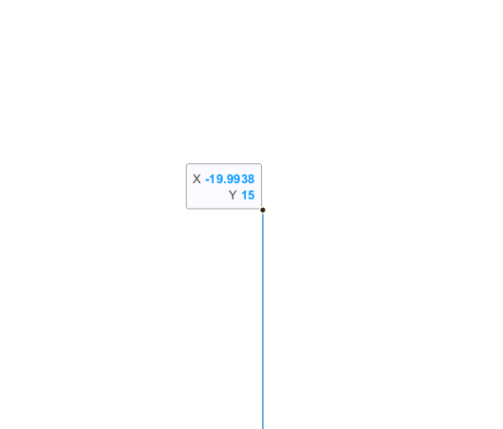
第三題
FREQUENCY DOMAIN FIGURE

Slide 11
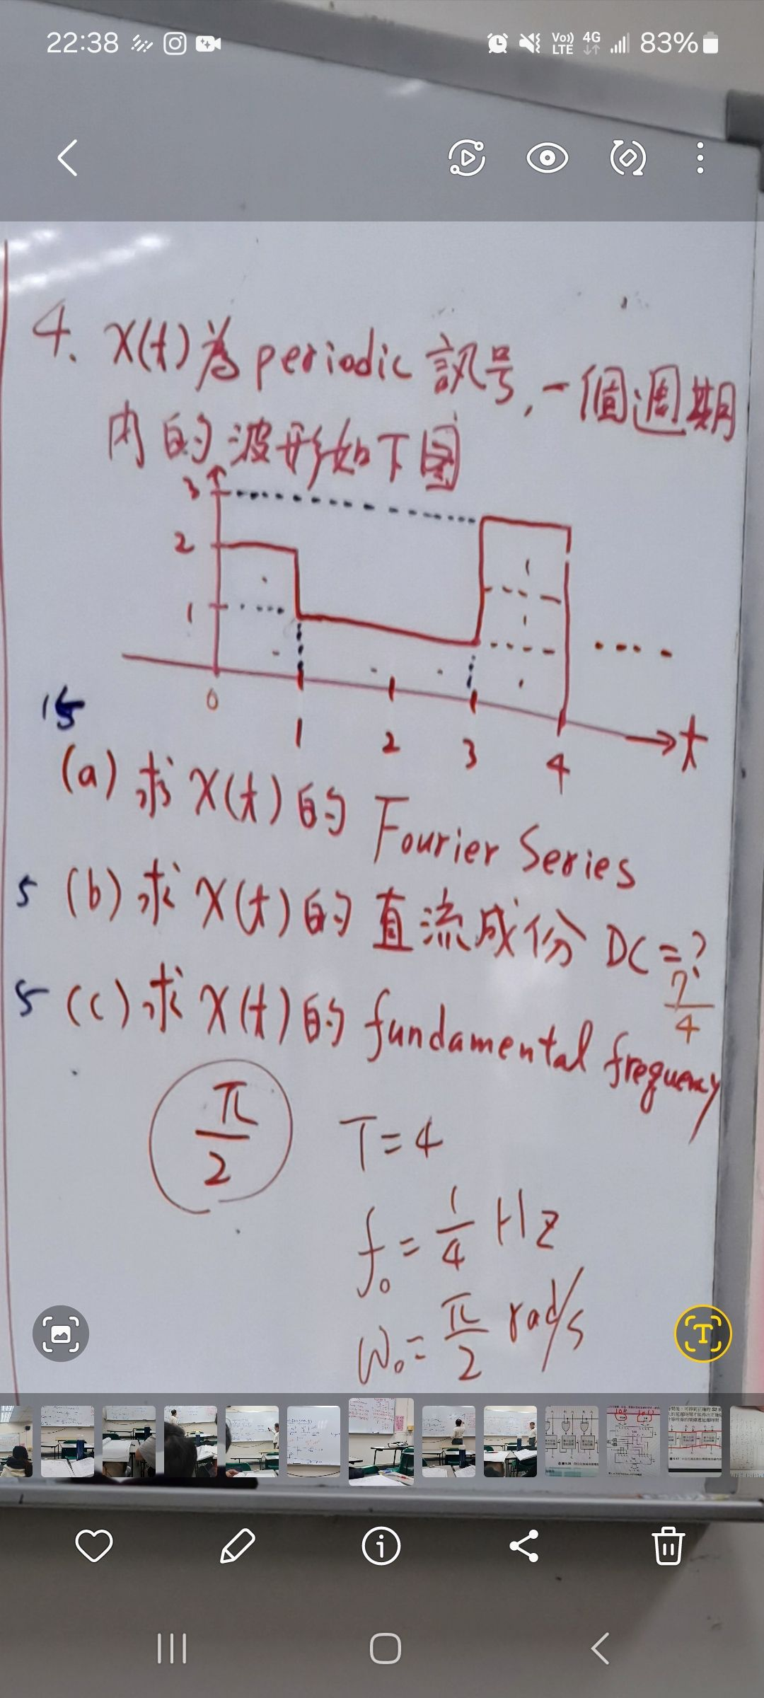
第四題

Slide 12
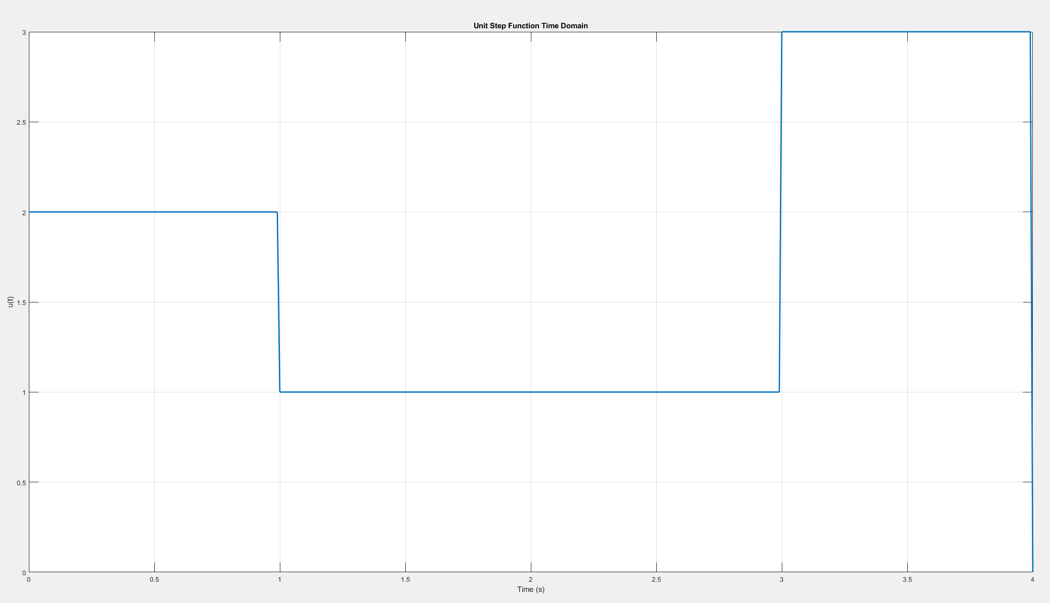
第四題
CODE
TIME DOMAIN FIGURE
clc;
clear all;
close all;
% Time vector
t = (0:0.01:4)';
% Unit step function
a = t >= 0;
b = t >= 1;
c = t >= 3;
d = t >= 4;
x = 2*a - b + 2*c - 3*d
% Plot the unit step function
figure;
plot(t, x, 'LineWidth', 2);
title('Unit Step Function Time Domain');
xlabel('Time (s)');
ylabel('u(t)');
grid on;

Slide 13
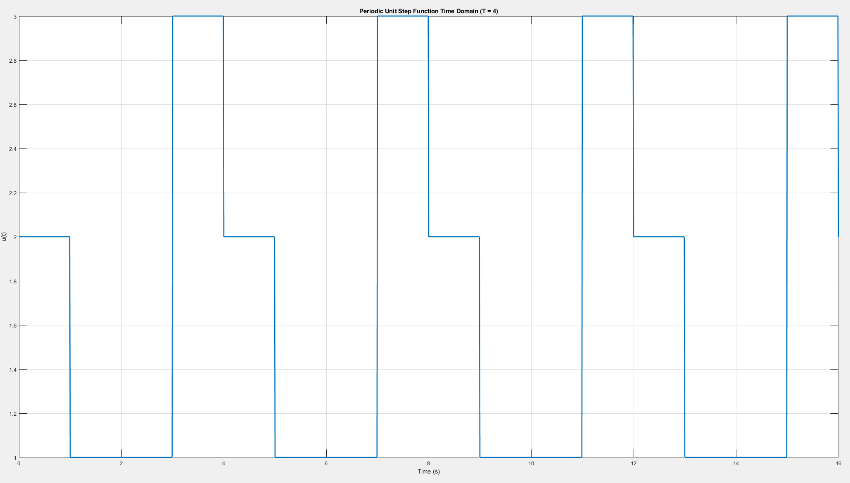
第四題
CODE
TIME DOMAIN FIGURE
clc;
clear all;
close all;
% Time vector
T = 4; % 4 periods
t = (0:0.01:4*T)'; % Extend the time vector to cover 4 periods
% Unit step function with period T=4
a = mod(t, 4) >= 0; % 0 <= t < 4
b = mod(t, 4) >= 1; % 1 <= t < 5
c = mod(t, 4) >= 3; % 3 <= t < 7
d = mod(t, 4) >= 4; % 4 <= t < 8
x = 2*a - b + 2*c - 3*d;
% Plot the periodic unit step function
figure;
plot(t, x, 'LineWidth', 2);
title('Periodic Unit Step Function Time Domain (T = 4)');
xlabel('Time (s)');
ylabel('u(t)');
grid on;

Slide 14
期中考

Slide 15
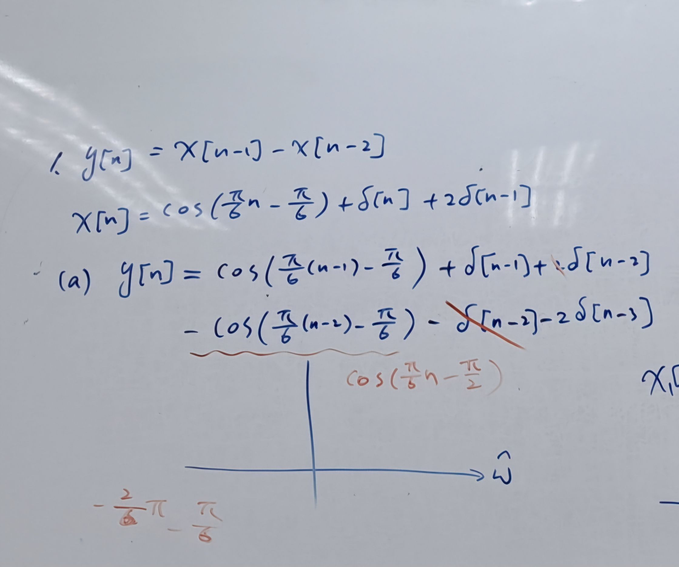
第一題

Slide 16
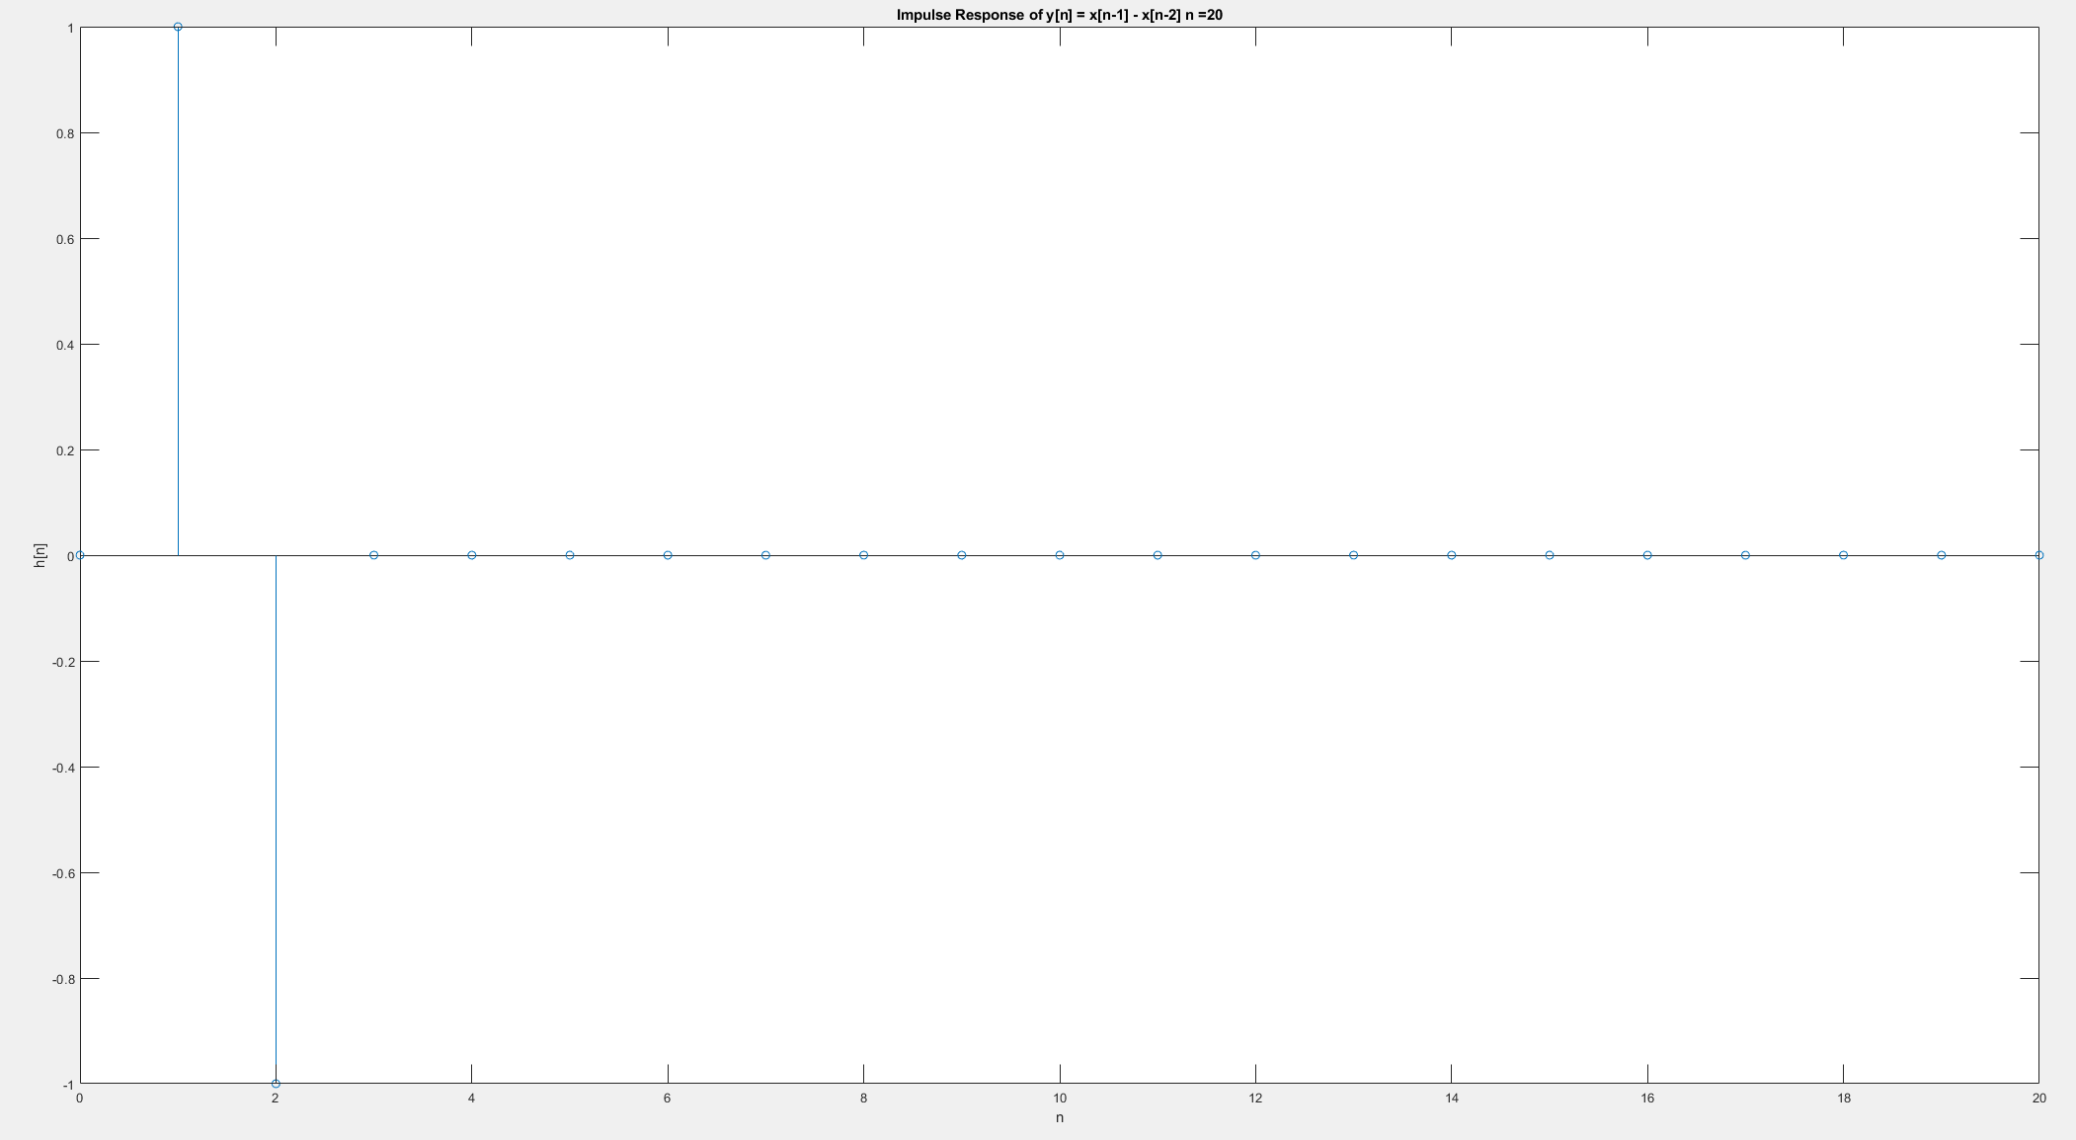
第一題
CODE
Impulse Response
clc;
clear all;
close all;
% 參數設置
b = [0, 1, -1]; % 差分方程式的分子係數
a = 1; % 差分方程式的分母係數（這裡是1，因為分母為1）
n = 0:20; % 繪製0到20的脈衝響應
h = impz(b, a, length(n)); % 計算脈衝響應
figure;
stem(n, h); % 繪製脈衝響應
xlabel('n');
ylabel('h[n]');
title('Impulse Response of y[n] = x[n-1] - x[n-2] n =20');
n = 0:100; % 繪製0到100的響應
x = cos(pi/6 * n - pi/6); % 信號x[n]
y = filter(b, a, x); % 計算響應y[n]
figure;
stem(n, y); % 繪製響應
xlabel('n');
ylabel('y[n]');
title('Response of x[n] = cos(\pi/6 * n - \pi/6) to y[n] = x[n-1] - x[n-2] n=100');

Slide 17
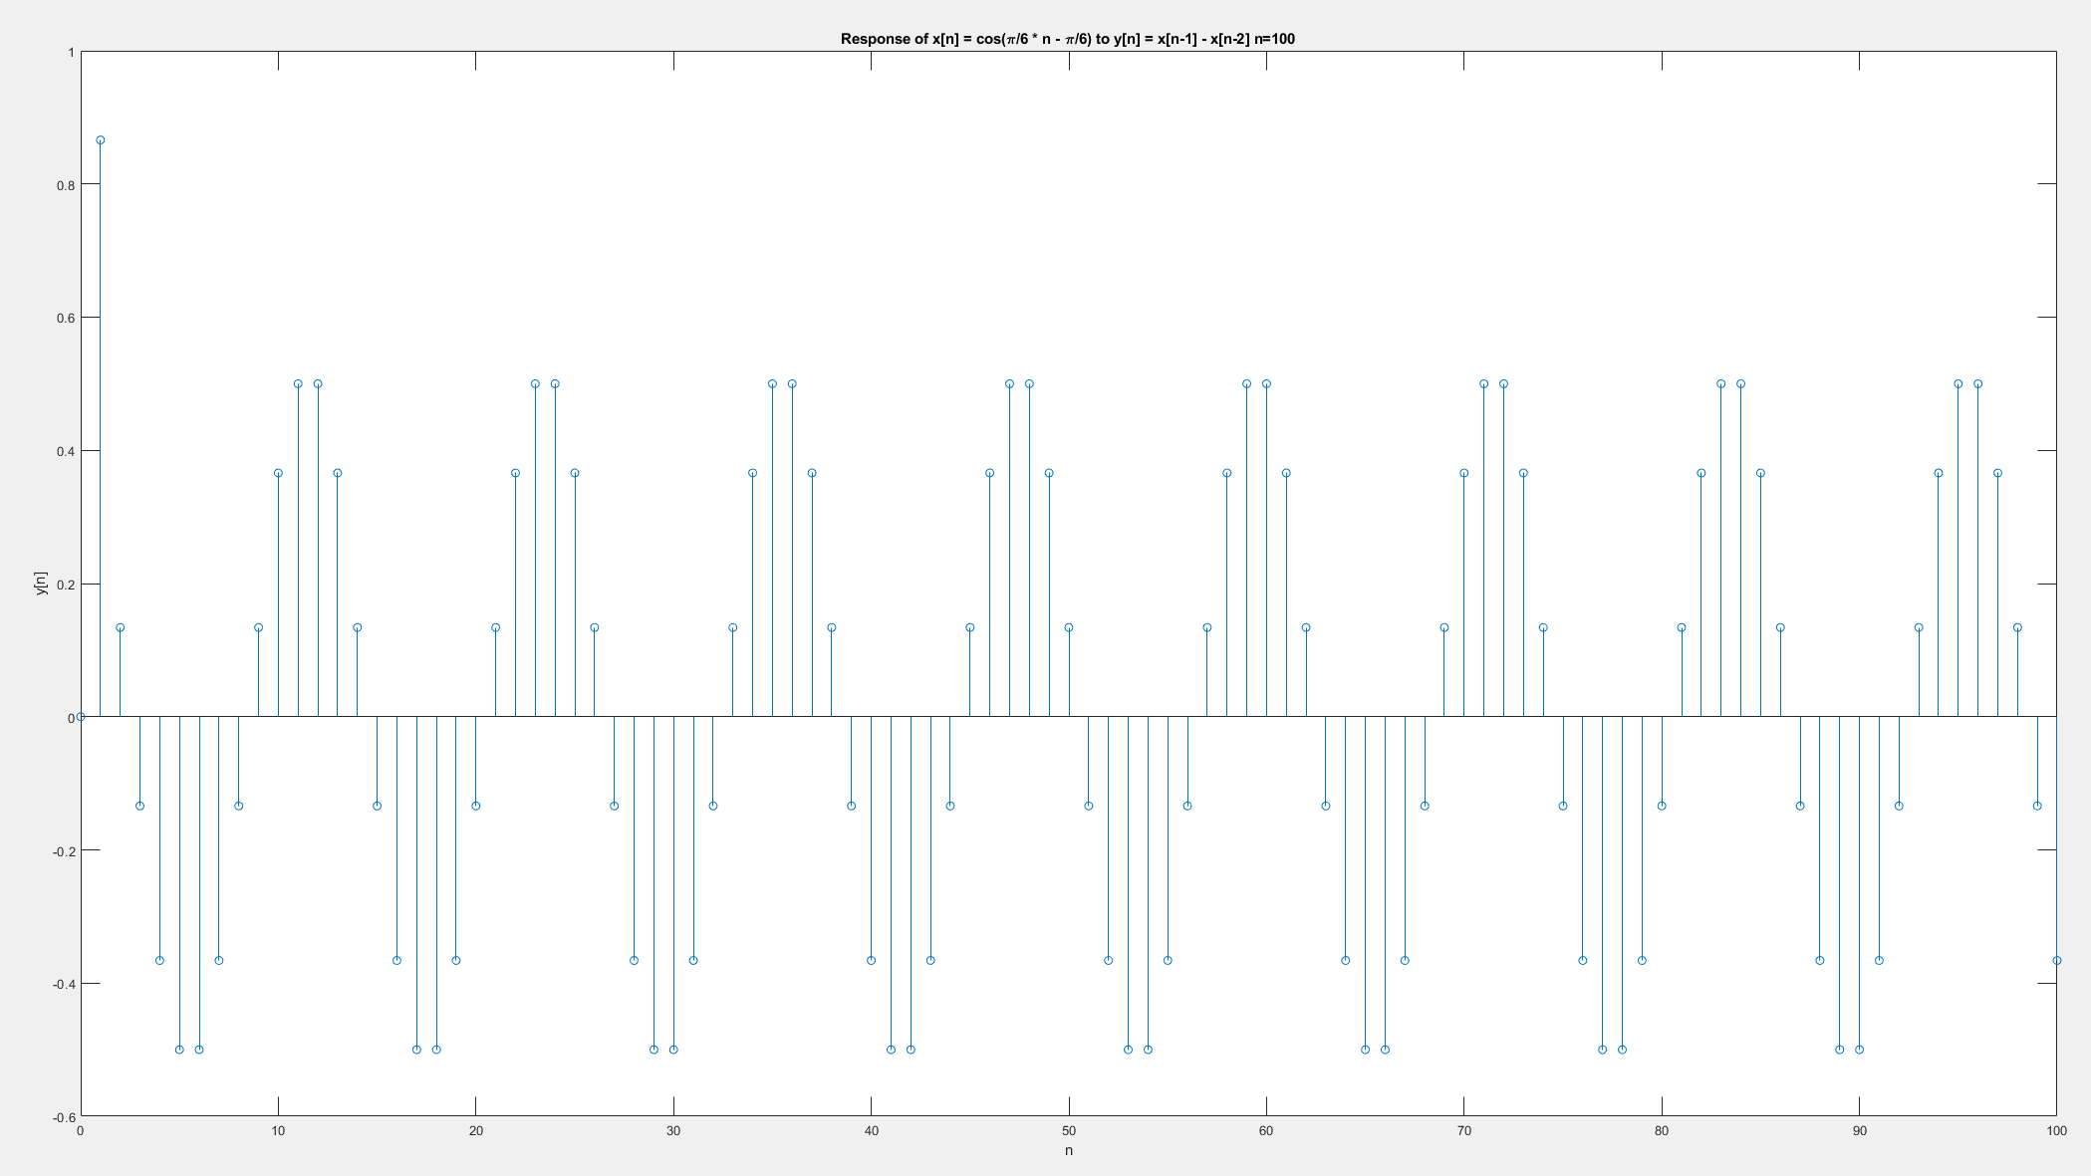
第一題
CODE
Impulse Response
clc;
clear all;
close all;
% 參數設置
b = [0, 1, -1]; % 差分方程式的分子係數
a = 1; % 差分方程式的分母係數（這裡是1，因為分母為1）
n = 0:20; % 繪製0到20的脈衝響應
h = impz(b, a, length(n)); % 計算脈衝響應
figure;
stem(n, h); % 繪製脈衝響應
xlabel('n');
ylabel('h[n]');
title('Impulse Response of y[n] = x[n-1] - x[n-2] n =20');
n = 0:100; % 繪製0到100的響應
x = cos(pi/6 * n - pi/6); % 信號x[n]
y = filter(b, a, x); % 計算響應y[n]
figure;
stem(n, y); % 繪製響應
xlabel('n');
ylabel('y[n]');
title('Response of x[n] = cos(\pi/6 * n - \pi/6) to y[n] = x[n-1] - x[n-2] n=100');

Slide 18
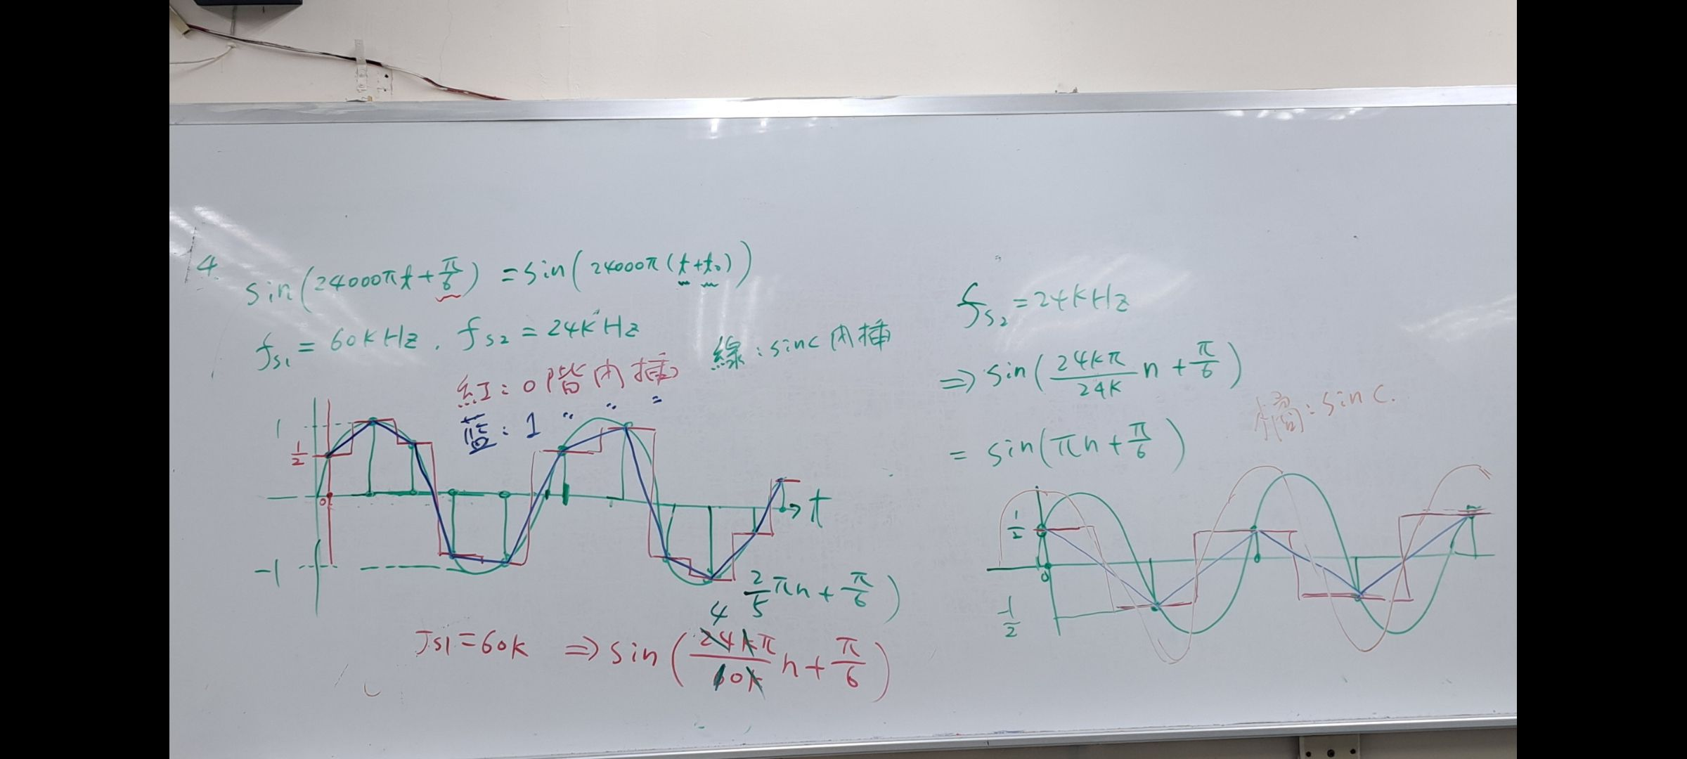
第四題

Slide 19
第四題
CODE
clc;
clear all;
close all;
% 參數設置
t = 0:1/240000:0.00024; % 以 1/fs = 1/240000 的時間間隔取樣，總共取樣 0.01 秒
x = sin(24000*pi*t + pi/6); % 信號
% 60kHz 取樣頻率下的取樣與重建
fs1 = 60000; % 取樣頻率 60kHz
n1 = 0:1/fs1:0.00024; % 取樣點
xn1 = sin(24000*pi*n1 + pi/6); % 以 60kHz 取樣後的信號
% 24kHz 取樣頻率下的取樣與重建
fs2 = 24000; % 取樣頻率 24kHz
n2 = 0:1/fs2:0.00024; % 取樣點
xn2 = sin(24000*pi*n2 + pi/6); % 以 24kHz 取樣後的信號
% 0階內插法
xn1_interp = interp1(n1, xn1, t, 'previous'); % 使用前一個取樣點的值進行內插
xn2_interp = interp1(n2, xn2, t, 'previous'); % 使用前一個取樣點的值進行內插
% 1階內插法
xn1_interp_linear = interp1(n1, xn1, t, 'linear'); % 線性內插
xn2_interp_linear = interp1(n2, xn2, t, 'linear'); % 線性內插
% 繪圖
subplot(4, 1, 1);
plot(t, x);
title('Original Signal');
xlabel('Time (s)');
ylabel('Amplitude');
subplot(4, 1, 2);
stem(n1, xn1, 'r');
hold on;
plot(t, xn1_interp, 'b');
hold off;
title('Sampled and Reconstructed Signal (fs = 60kHz)');
xlabel('Time (s)');
ylabel('Amplitude');
legend('Sampled Signal', 'Zero-order Hold Interpolation');
subplot(4, 1, 3);
stem(n2, xn2, 'r');
hold on;
plot(t, xn2_interp, 'b');
hold off;
title('Sampled and Reconstructed Signal (fs = 24kHz)');
xlabel('Time (s)');
ylabel('Amplitude');
legend('Sampled Signal', 'Zero-order Hold Interpolation');
subplot(4, 1, 4);
plot(t, xn1_interp_linear, 'b');
hold on;
plot(t, xn2_interp_linear, 'g');
hold on;
plot(t, x, 'r');
hold off;
title('Linear Interpolation');
xlabel('Time (s)');
ylabel('Amplitude');
legend('fs = 60kHz', 'fs = 24kHz', 'Original Signal');
sgtitle('Sampling and Interpolation of sin(24000\pi t + \pi/6)');

Slide 20
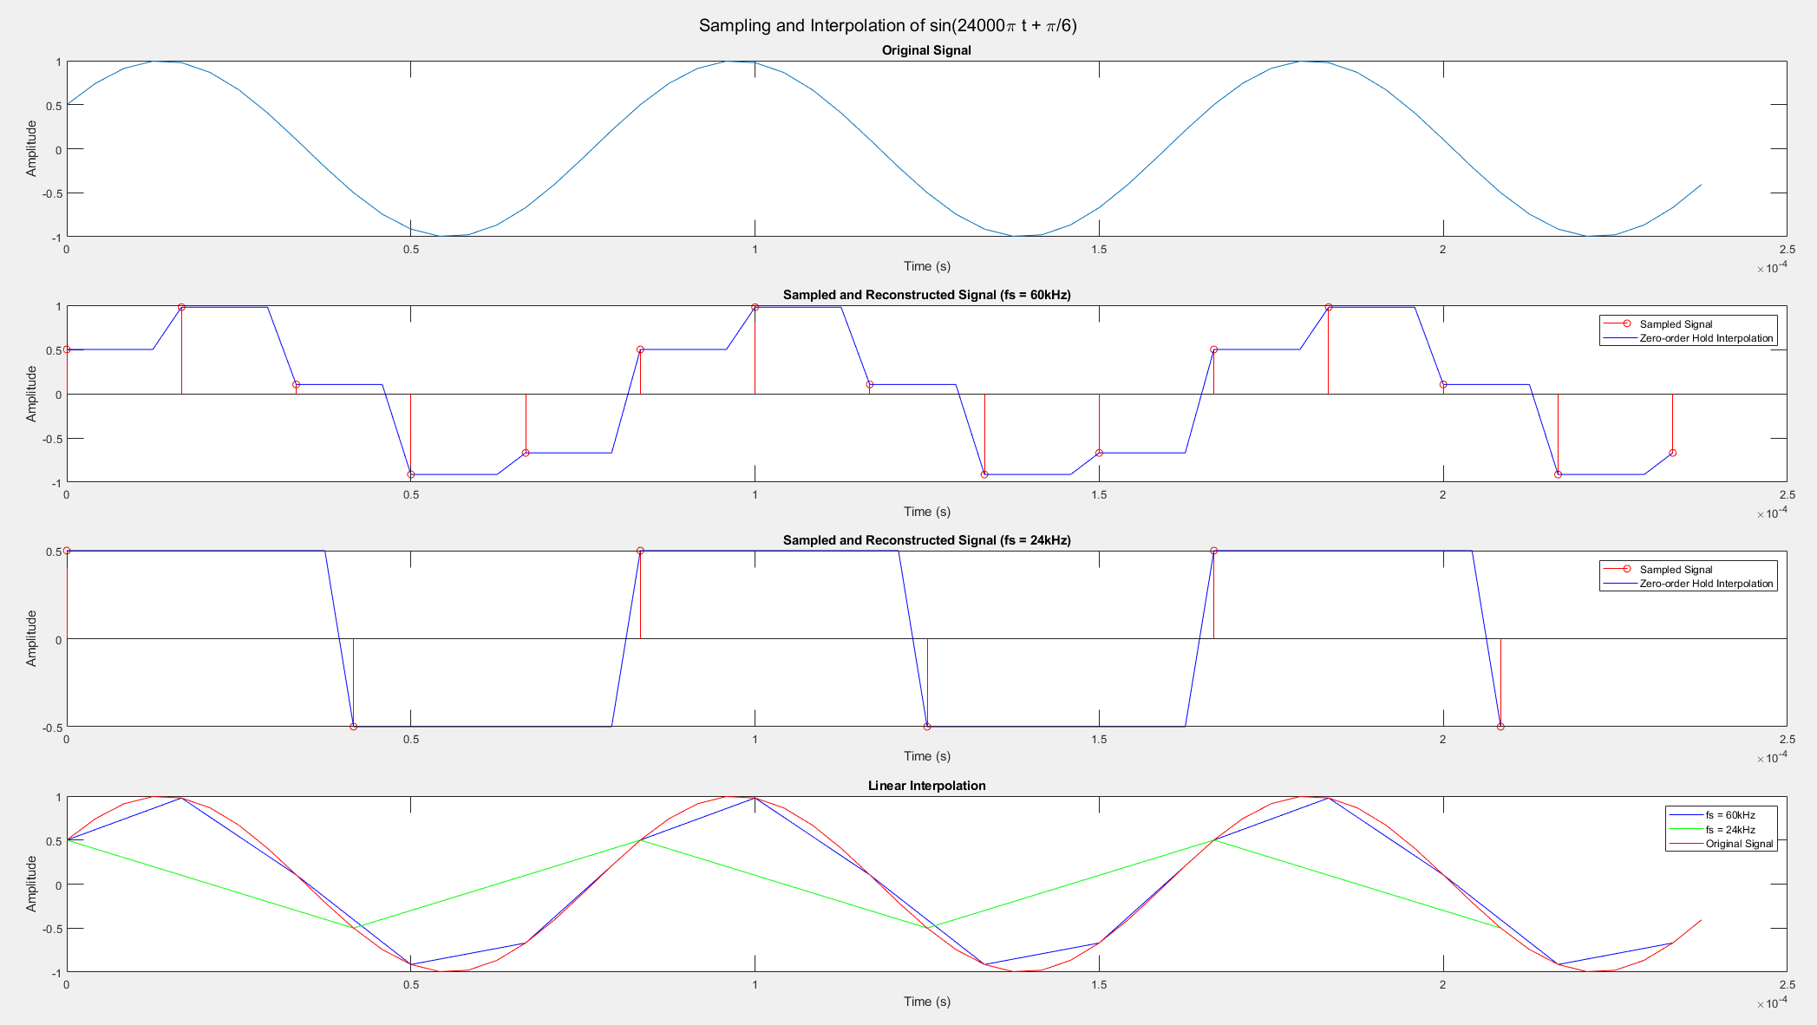
第四題

Slide 21
第二次小考

Slide 22
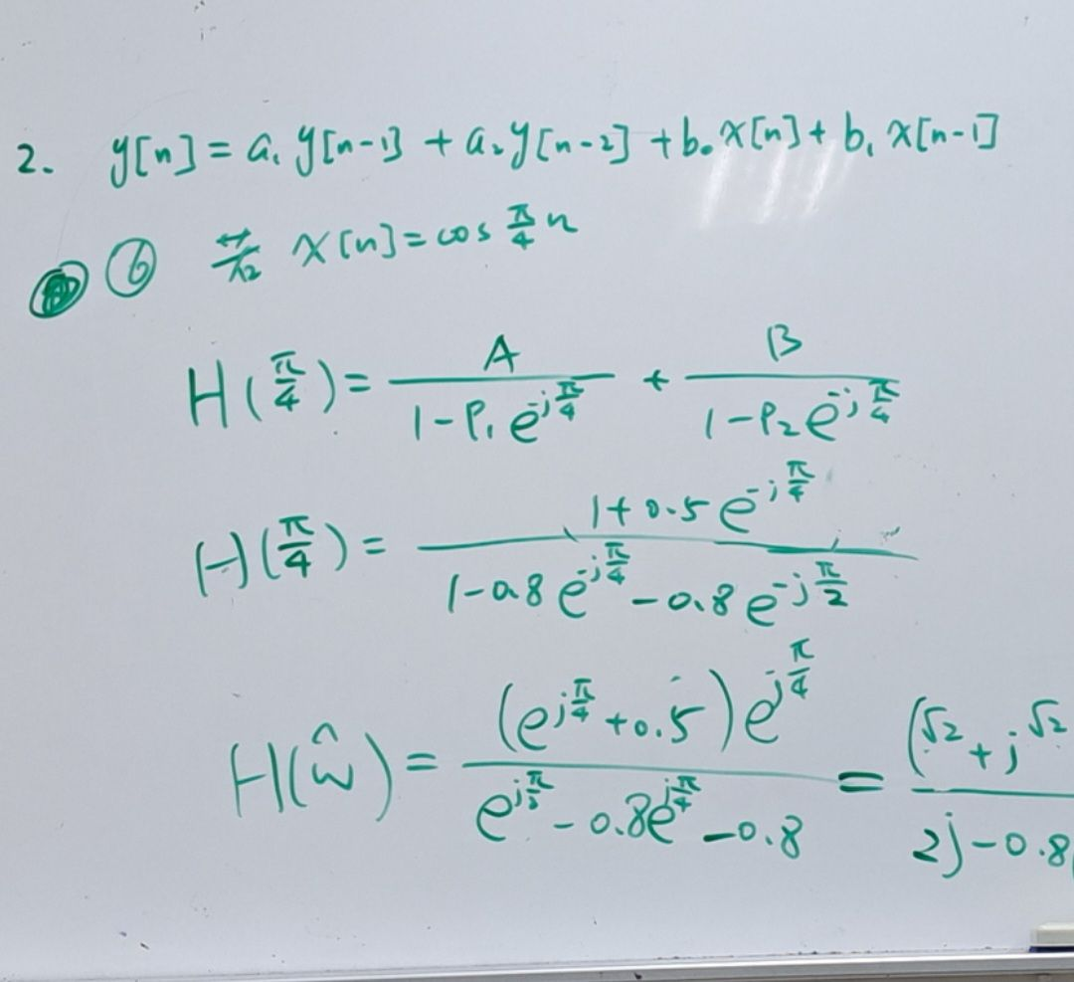
第二題

Slide 23
第二題
CODE
clc;
clear all;
close all;
% Define filter coefficients
a1 = 0.8;
a2 = 0.8;
b0 = 1;
b1 = 0.5;
% Define the filter
b = [b0 b1];
a = [1 -a1 -a2];
% 1. Compute the transfer function H(z)
[H, w] = freqz(b, a, 'half', 1024);
% 2. Compute the impulse response h[n]
h = impz(b, a, 10); % Impulse response for 10 samples
% 3. Plot the magnitude and phase response
figure;
subplot(2,1,1);
plot(w/pi, abs(H));
title('Magnitude Response');
xlabel('\omega / \pi');
ylabel('|H(e^{j\omega})|');
subplot(2,1,2);
plot(w/pi, angle(H));
title('Phase Response');
xlabel('\omega / \pi');
ylabel('\angle H(e^{j\omega})');
% 4. Apply the filter to different input signals and find y[n]
% (a) x[n] = u[n] (unit step function)
n = 0:10;
x1 = ones(size(n)); % unit step
y1 = filter(b, a, x1);
figure;
stem(n, y1);
title('Output y[n] for x[n] = u[n] n=10');
xlabel('n');
ylabel('y[n]');
% (b) x[n] = \delta[n-1] (unit impulse delayed by 1)
x2 = [0 1 zeros(1, 9)]; % impulse delayed by 1
y2 = filter(b, a, x2);
figure;
stem(n, y2);
title('Output y[n] for x[n] = \delta[n-1] n=10');
xlabel('n');
ylabel('y[n]');
% (c) x[n] = cos(pi*n/4)
x3 = cos(pi*n/4);
y3 = filter(b, a, x3);
figure;
stem(n, y3);
title('Output y[n] for x[n] = cos(\pi n / 4) n=10');
xlabel('n');
ylabel('y[n]');

Slide 24
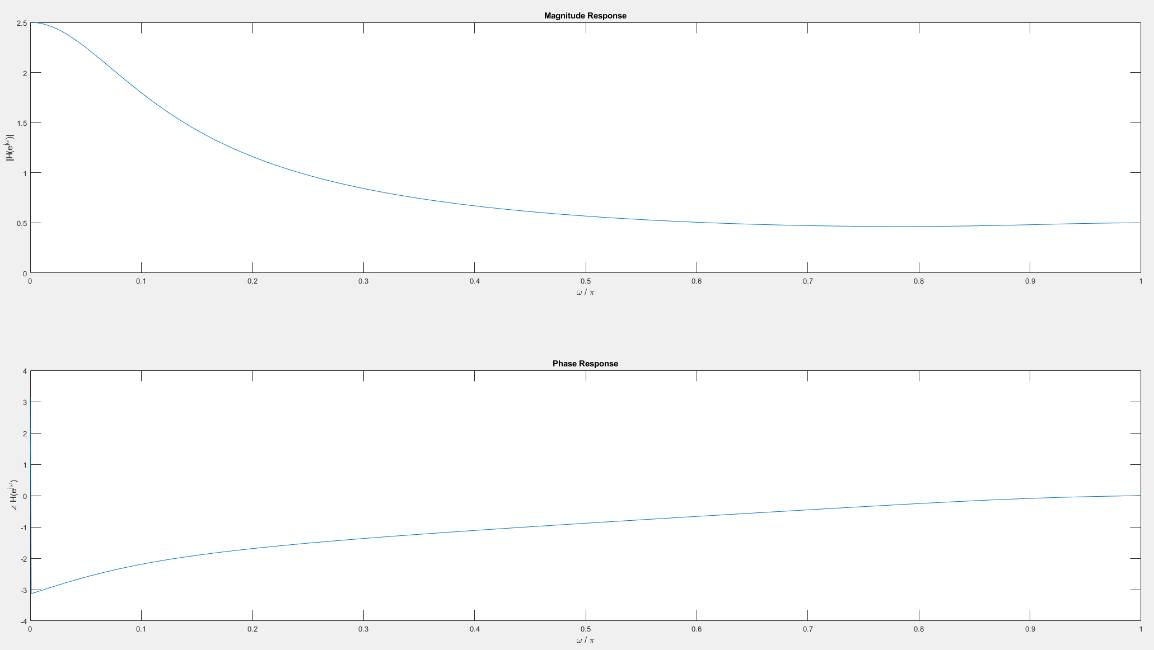
第二題
FREQUENCY RESPONSE

Slide 25
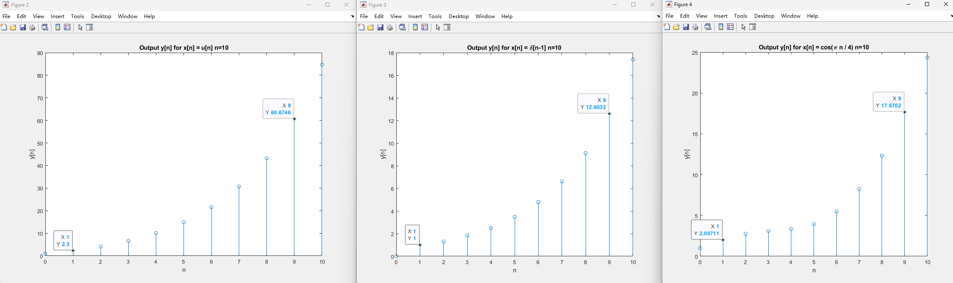
第二題
Output for n=10

Slide 26
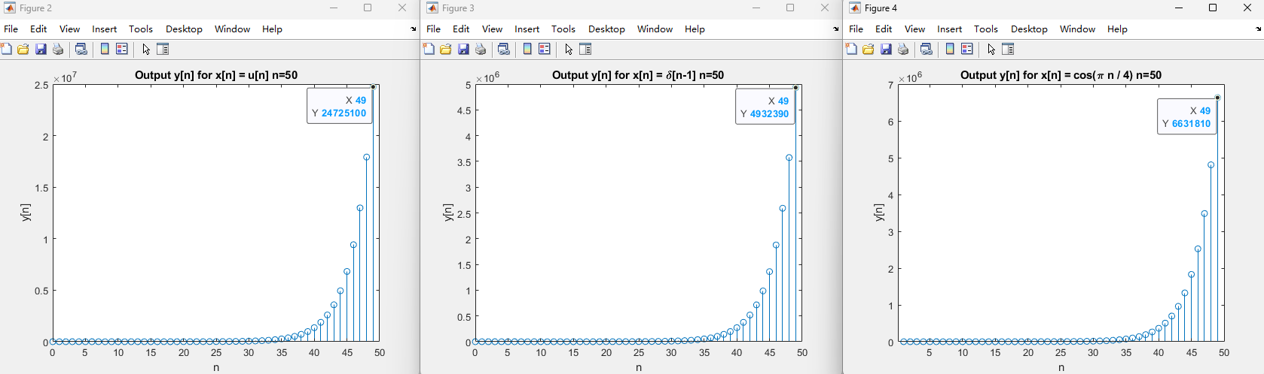
第二題
CODE
% 4. Apply the filter to different input signals and find y[n]
% (a) x[n] = u[n] (unit step function)
n = 0:49;
x1 = ones(size(n)); % unit step
y1 = filter(b, a, x1);
figure;
stem(n, y1);
title('Output y[n] for x[n] = u[n] n=50');
xlabel('n');
ylabel('y[n]');
% (b) x[n] = \delta[n-1] (unit impulse delayed by 1)
x2 = [0 1 zeros(1, 48)]; % impulse delayed by 1
y2 = filter(b, a, x2);
figure;
stem(n, y2);
title('Output y[n] for x[n] = \delta[n-1] n=50');
xlabel('n');
ylabel('y[n]');
% (c) x[n] = cos(pi*n/4)
x3 = cos(pi*n/4);
y3 = filter(b, a, x3);
figure;
stem(n, y3);
title('Output y[n] for x[n] = cos(\pi n / 4) n=50');
xlabel('n');
ylabel('y[n]');
Output for n=50
Output 發散了

