Slide 1
GridMind AI
Multi-agent circuit analysis, verified correction and data-center energy optimization
SFTW: Harness Engineering & Model Wrangling Hackathon · October 2026
17
violations found by AC power flow
179
plans evaluated by the agents
0
violations left after verification
Notes:
GridMind AI is a working web application, not a mock-up. It draws a real distribution network, calculates it with an AC power-flow solver, finds every violation, lets ten agents diagnose and correct it, and proves the fix with an independent verification. Every number in this deck comes from a stored simulation result.

Slide 2
AI data centers push distribution grids past their limits
The demo network is the public CIGRE MV benchmark: two 20 kV feeders supplied by 25 MVA transformers.
We connected a 4 MW AI data-center campus at Bus 14. At the evening peak the solver finds undervoltage along feeder 1 and at the data center, and both supply transformers overloaded.
Engineers need to know where, why, what to change, and proof that the change works.
0.895 pu
Lowest bus voltage (limit 0.95 pu)
104.5 %
Transformer T0-12 loading (limit 100 %)
17
Violations at the evening peak
Notes:
The problem is real and growing: AI campuses add megawatts of mostly inflexible load to feeders built for homes and shops. On our network the solver reports 17 violations: 14 undervoltages down to 0.895 per unit and three overloaded transformers, including the data-center transformer.

Slide 3
One workflow from circuit model to verified fix
1
2
3
4
5
6
7
Model
Solve
Detect
Diagnose
Correct
Verify
Learn
75 components loaded and validated from MongoDB
AC Newton-Raphson power flow
Every limit at peak and light load
Path voltage-drop split and counterfactuals
Remedies sized by simulation, ranked by cost
Re-solved independently from the database
Verified lessons reused in the next run
Design principle the language model never calculates electrical values. Voltages, currents, loadings and losses always come from the power-flow solver; Claude explains evidence through read-only tools. Nothing is applied to real equipment without engineer approval.
Notes:
Seven steps, all automatic once you press Run. The loop of Correct and Verify repeats until verification passes or the iteration budget is used. The key design rule is that the solver does the engineering math and the model only explains it.

Slide 4
Architecture: solver-grounded agents on MongoDB Atlas
Web interface
React · TypeScript · React Flow · Recharts
12 pages; interactive single-line diagram; live agent view
REST API
FastAPI · Pydantic
Validates every input; thin routes over a repository layer
Electrical engine
pandapower AC NR · SciPy HiGHS LP
Power flow, violations, sizing, beam-search optimisation, 24 h time series
Agents
10 agents + orchestrator · Claude (optional)
Dependency graph, bounded fix-and-verify loop, resume after restart
Database
MongoDB Atlas · 12 collections
Model, results, faults, recommendations, agent tasks, memory, audit
Notes:
Five layers. The browser never sees database credentials; everything goes through the validated FastAPI layer. The engine is pure Python with pandapower. Agents persist every task to MongoDB, which is what makes the run resumable and auditable.

Slide 5
Ten agents in four stages, with a loop until verified
Model & solve
Diagnose (parallel)
Correct · loop
Learn & report
1 Circuit Modeling
4 Root Cause
5 Corrective Action
9 Learning: store
2 Power Flow
6 Data Center
7 Optimization
10 Engineering Report
3 Violation Detection
9 Learning: retrieve
8 Independent Verification
Corrective Action → Optimization → Verification repeats until no violation remains at peak and light load, the budget of 3 iterations is used, or no improving action exists. Every task is written to the agent_runs collection.
Notes:
These are real agents with distinct jobs. The three diagnosis agents run in parallel threads. The correction loop is bounded and the verification agent is independent: it re-reads the model from MongoDB rather than trusting the optimizer's numbers.

Slide 6
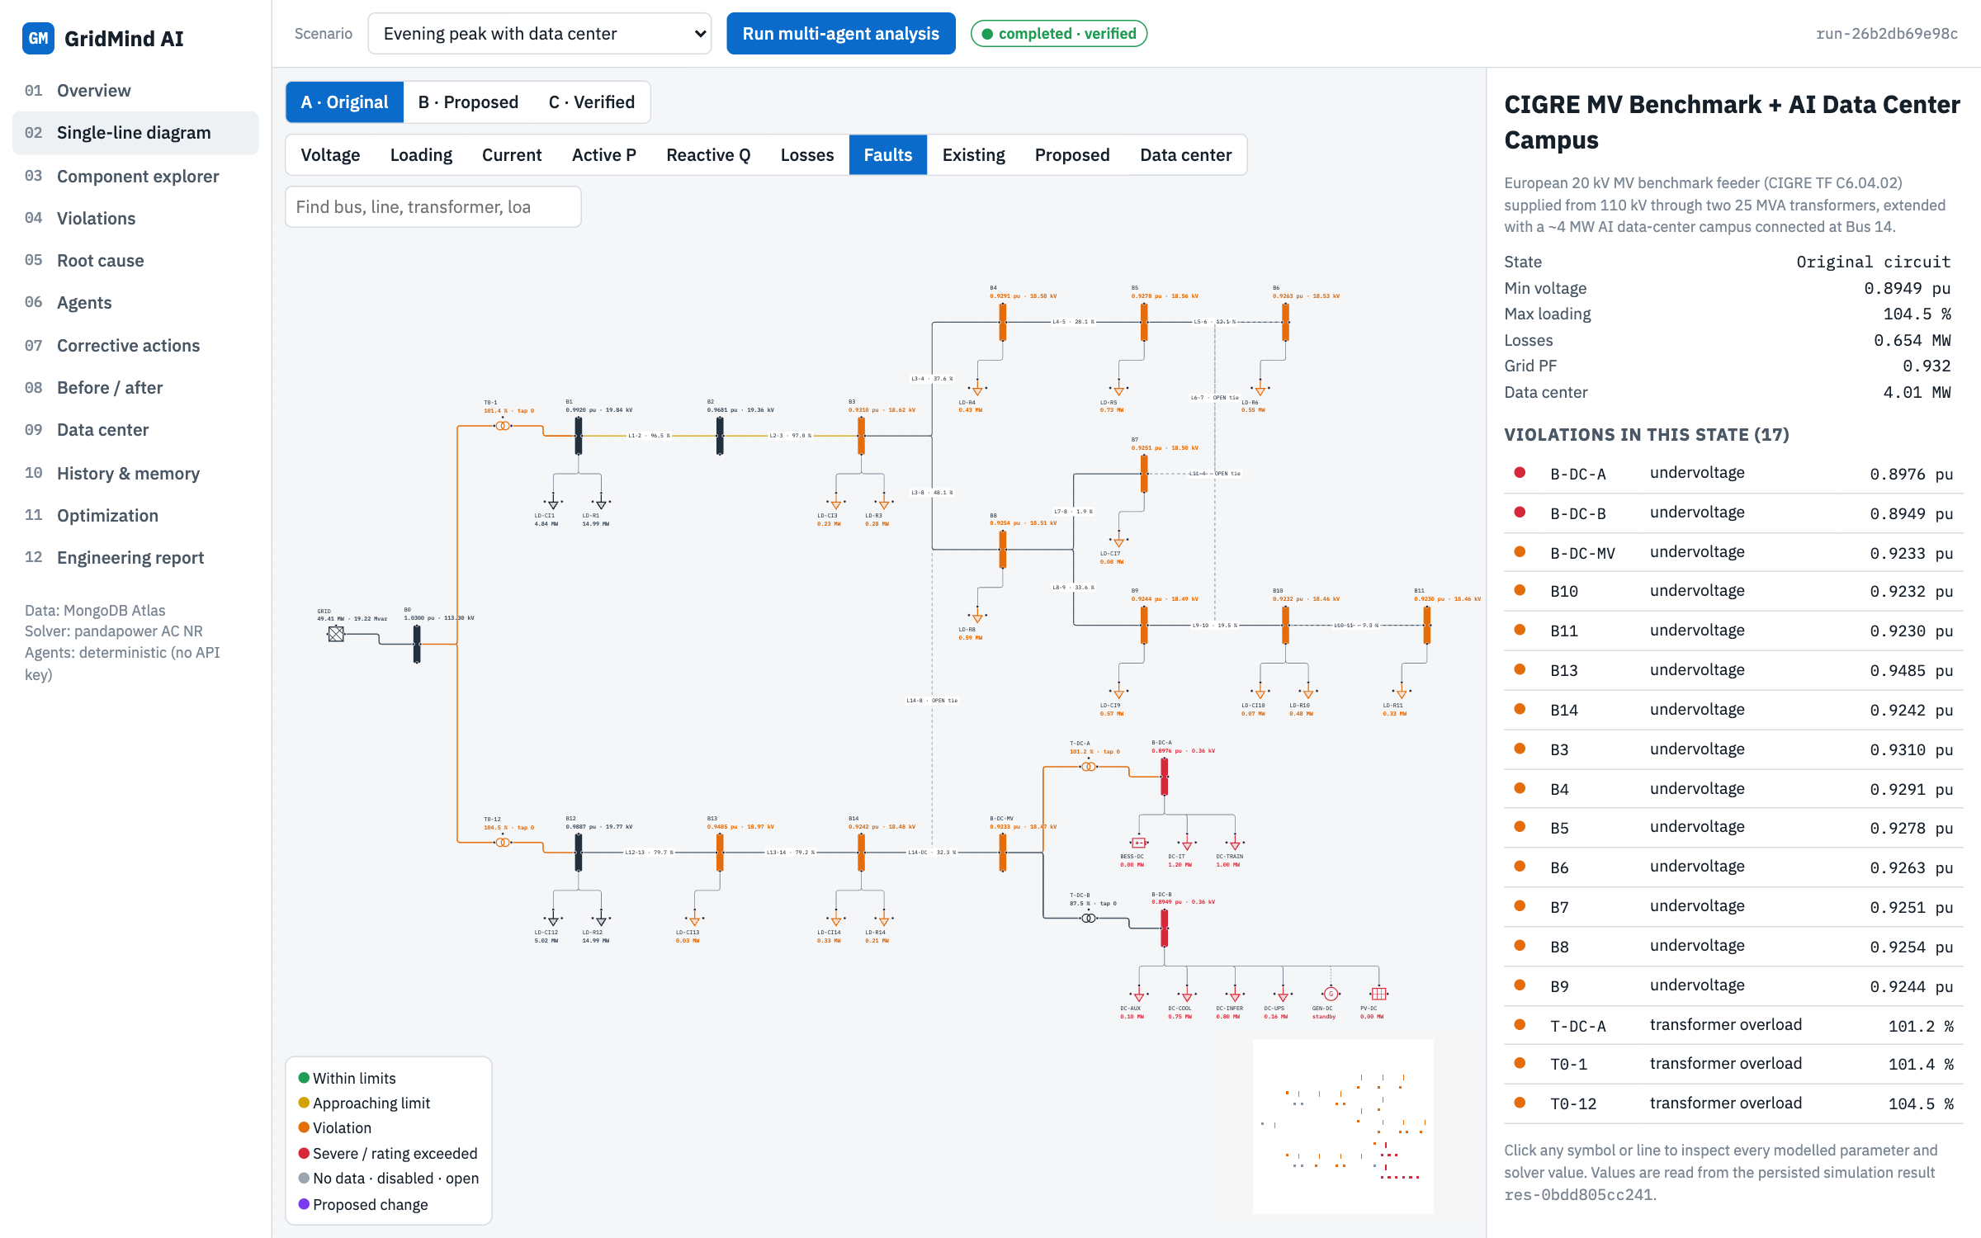
Built on a public benchmark and public data
1
CIGRE MV benchmark network
Parameters copied from the public model; a test matches its reference voltages.
2
SimBench load profiles
Residential and commercial shapes for the 24-hour study (CC BY 4.0).
3
Open-Meteo weather
Hourly temperature and solar data for San Jose drive cooling and PV.
4
Assumptions are labelled
Data-center sizes, tap data and costs are flagged as assumed.
Notes:
We did not invent the network. It is the CIGRE medium-voltage benchmark, and our model reproduces its published power flow exactly. Public SimBench profiles and live Open-Meteo weather feed the time series. Anything assumed is tagged in the data and visible in the detail panel.

Slide 7
The single-line diagram is the heart of the app
1
Generated from the model
Every bus, line, transformer, load and DC device, laid out from the topology.
2
Violations in place
Orange and red where limits are broken; open ties dashed.
3
3 states, 10 layers
Original, Proposed, Verified × voltage, loading, current, P, Q, losses and more.
Notes:
This is page 2, the main screen. The diagram is drawn from the stored circuit model, not an image. Switching the layer recolours the same diagram; switching the state shows the original, the proposed plan and the verified result in the same layout.

Slide 8
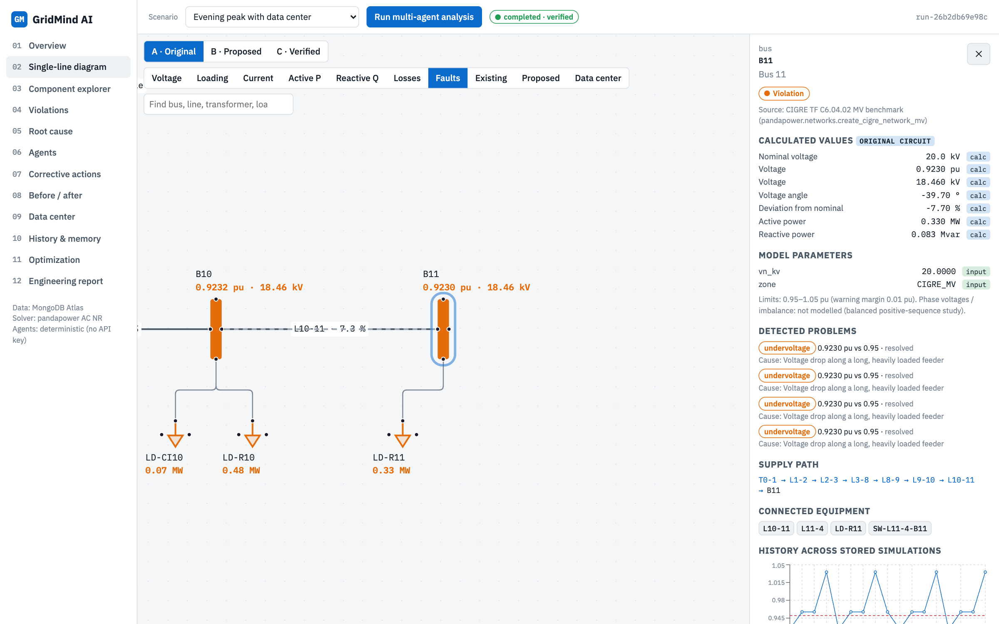
Click any component to see every parameter and value
1
Inputs vs assumptions
Each parameter tagged input, assumed or missing.
2
Calculated values
Voltage in pu and kV, angle, P and Q from the solver.
3
Context
Detected problems with root cause, supply path from the grid, and history.
Notes:
Clicking bus B11 opens the detail panel: 0.9230 per unit, 18.46 kV, the cause of its undervoltage, the exact supply path from the 110 kV grid, and its voltage history across all stored simulations.

Slide 9
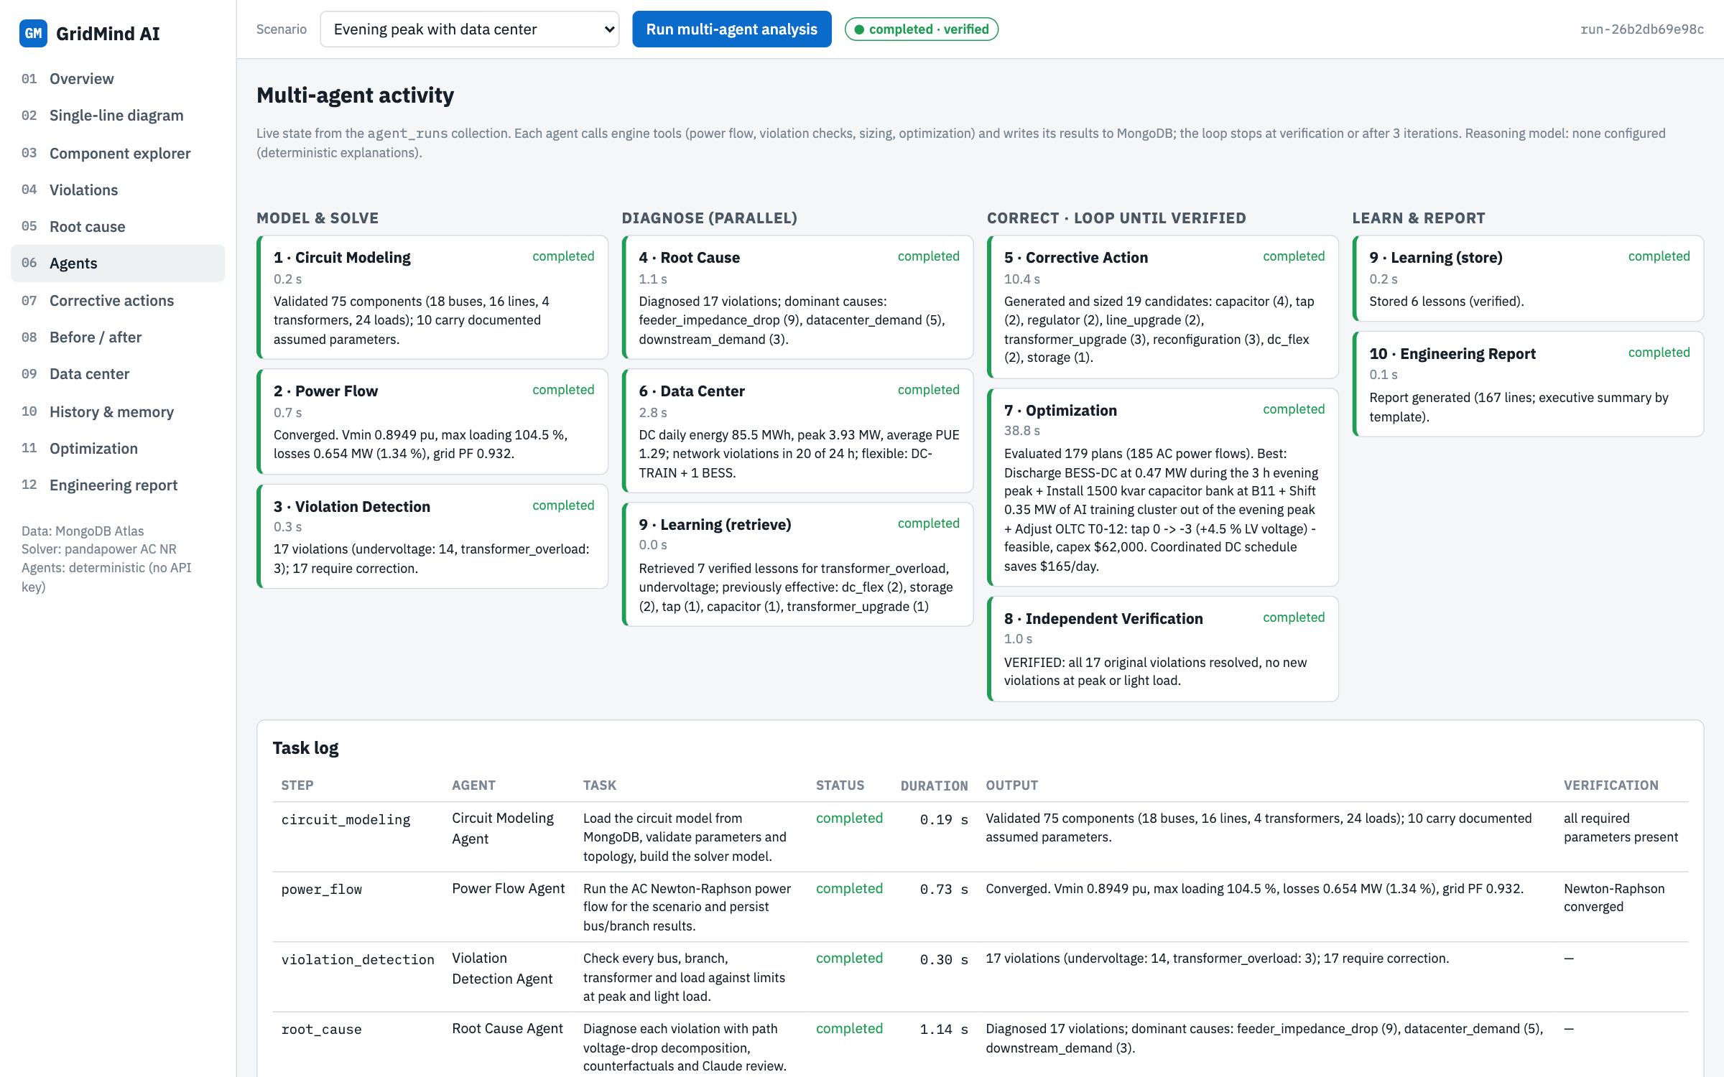
Agents work live, and every task is recorded
1
Real outputs
Each card shows the agent's actual result and duration.
2
Parallel diagnosis
Root Cause, Data Center and Learning run at the same time.
3
Resumable
Run state is saved after every step in MongoDB.
Notes:
The agents page refreshes every two seconds. In this run the optimizer evaluated 179 plans with 185 AC power flows in about 39 seconds, and the verification agent confirmed all 17 violations resolved.

Slide 10
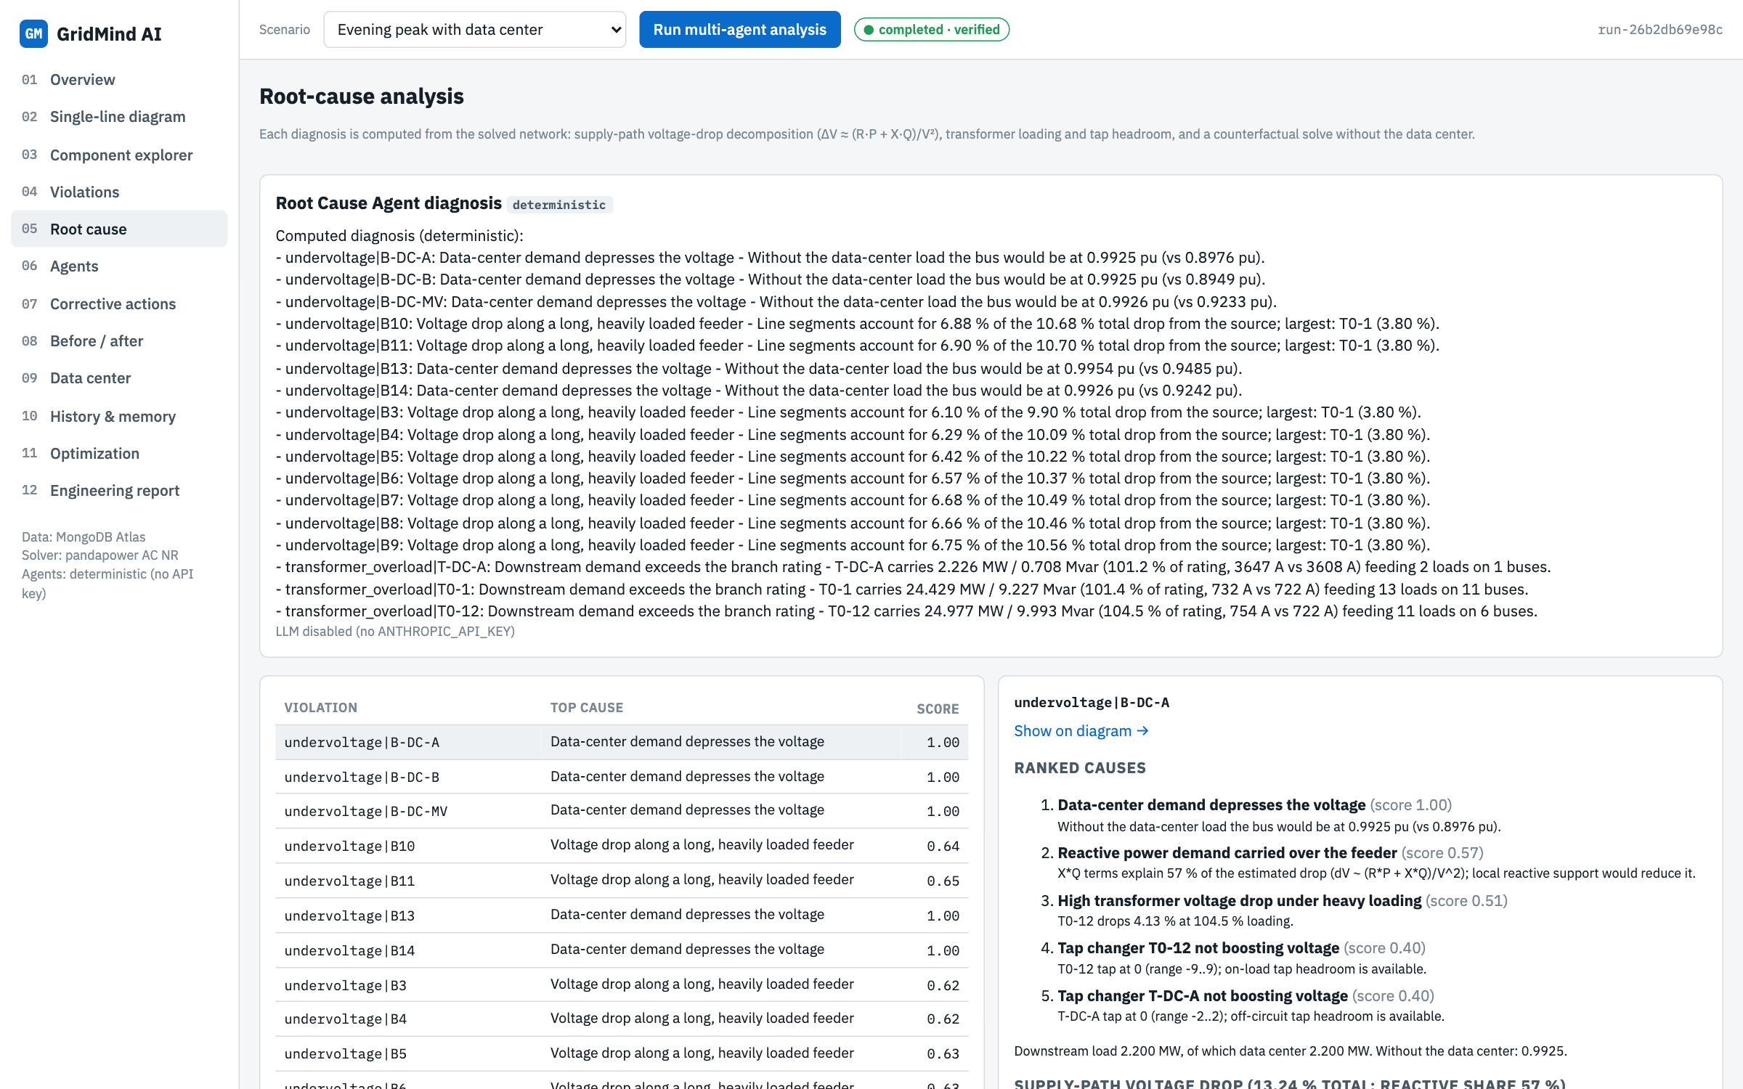
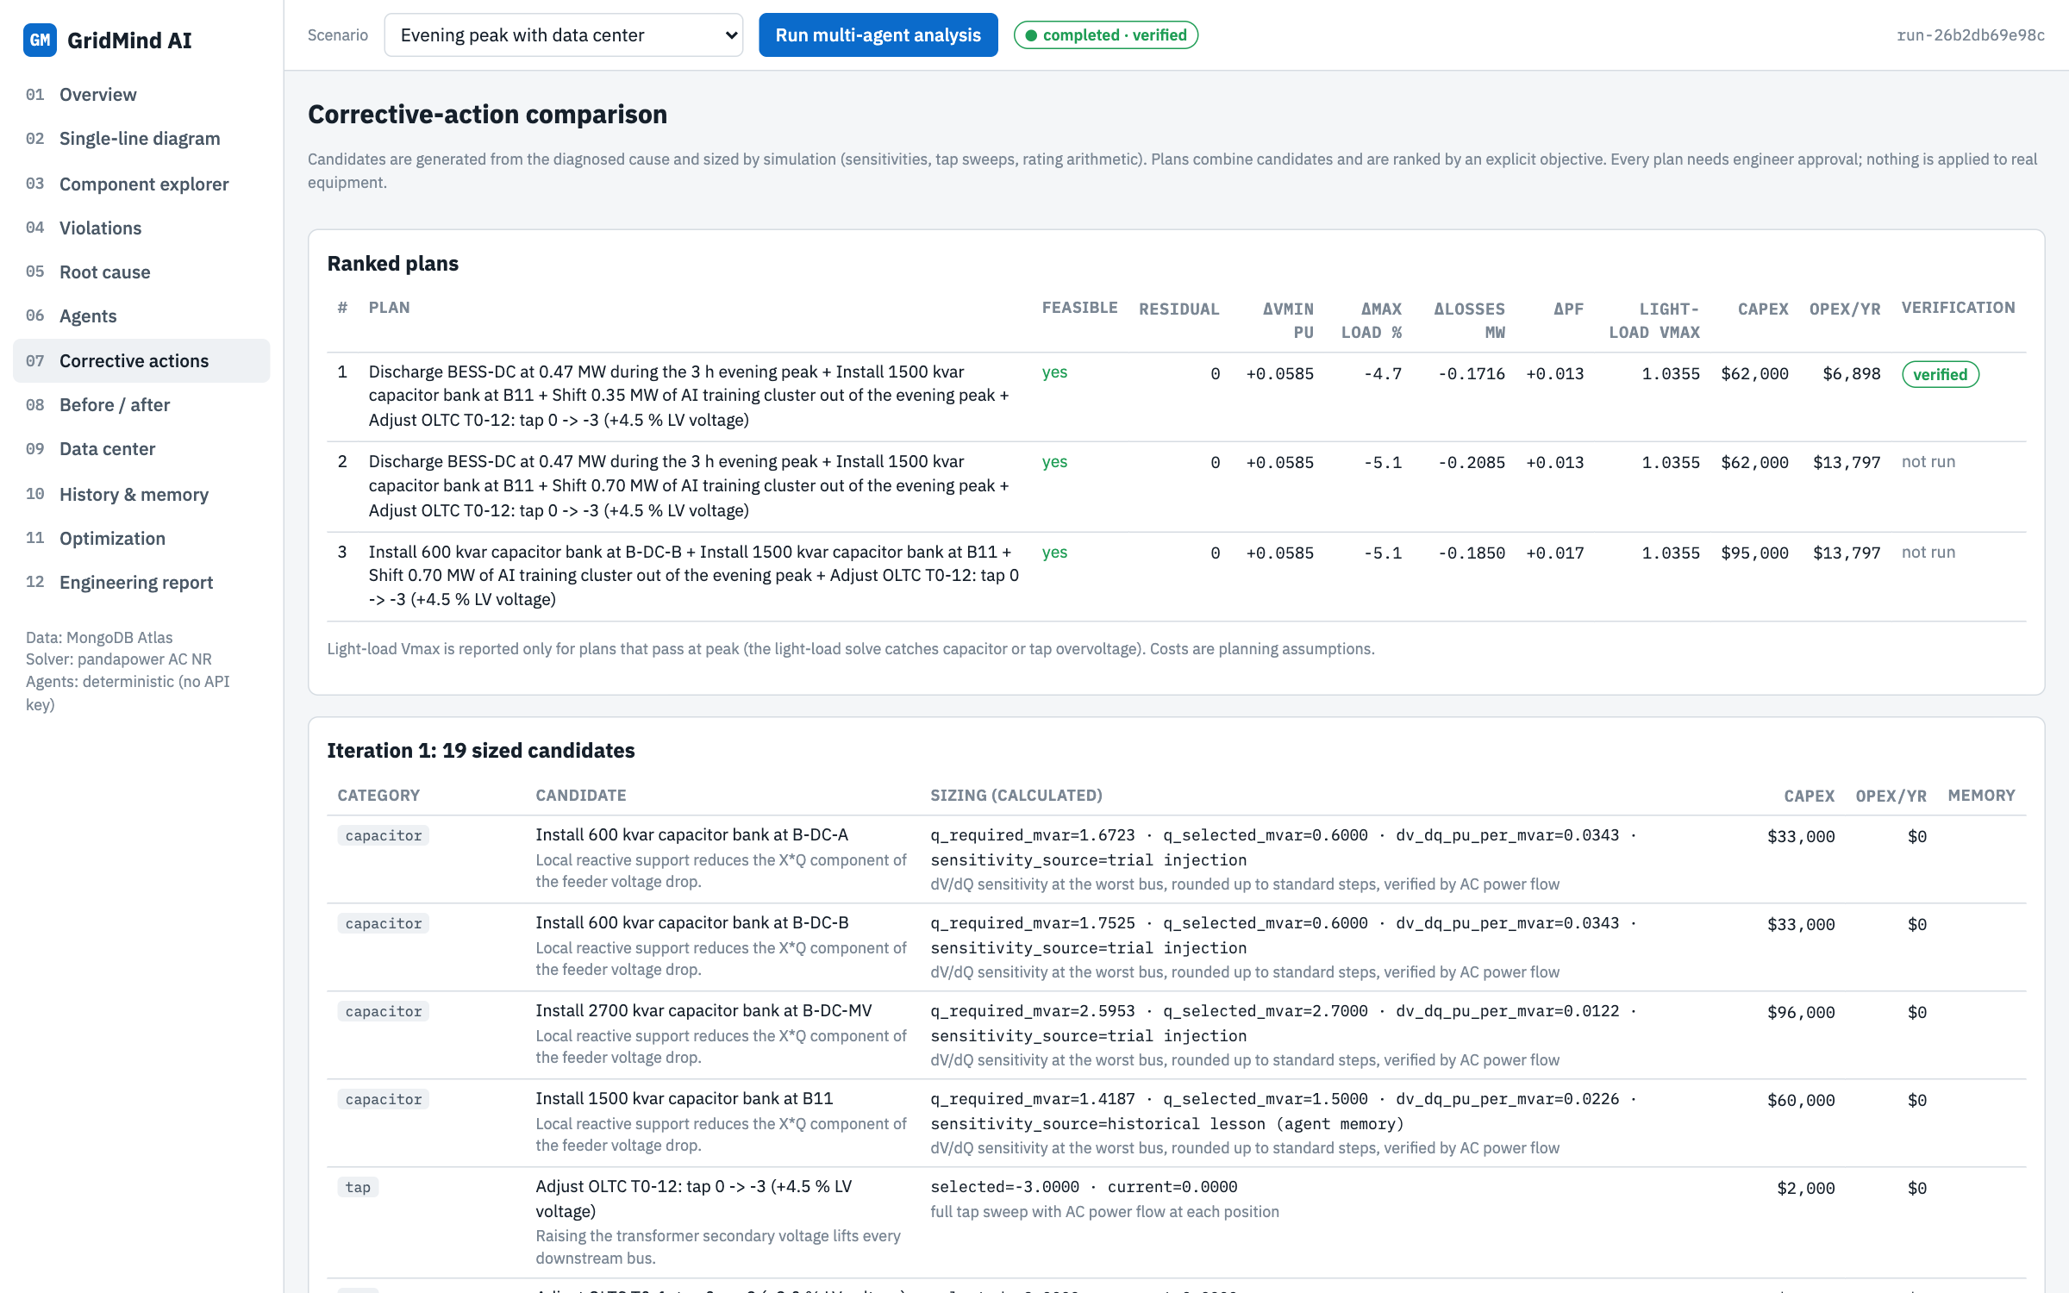
Diagnosis explains why; remedies are sized by simulation
Root cause: voltage drop on each supply-path segment split into R×P and X×Q parts
Corrective actions: 19 sized candidates and ranked plans with trade-offs
Capacitors are used only for undervoltage or reactive flow; taps are chosen by sweeping every position; transformers go to the next standard size.
Notes:
Feeder 1 undervoltage is driven by line impedance; the data-center buses by the data-center load itself, which the counterfactual run without the data center proves. Remedies depend on the cause, and every size comes from a simulation, for example the capacitor from a measured voltage-per-Mvar sensitivity.

Slide 11
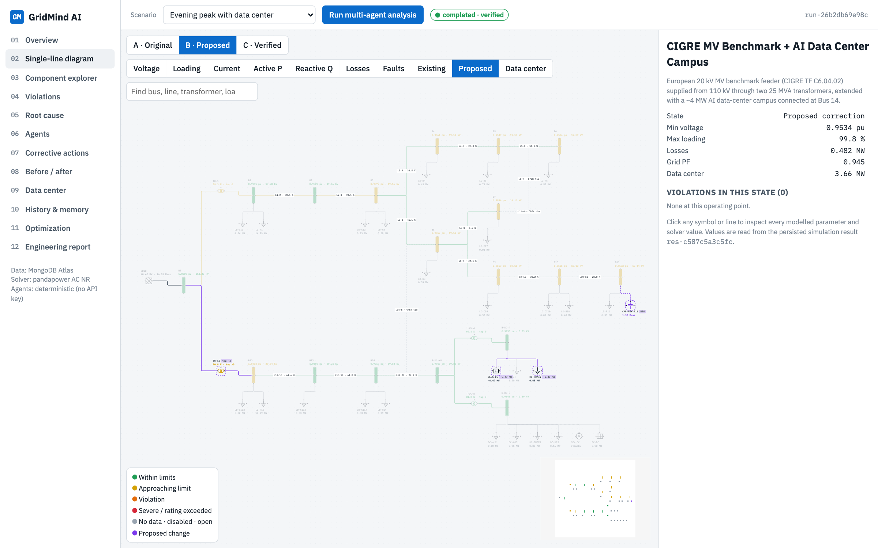
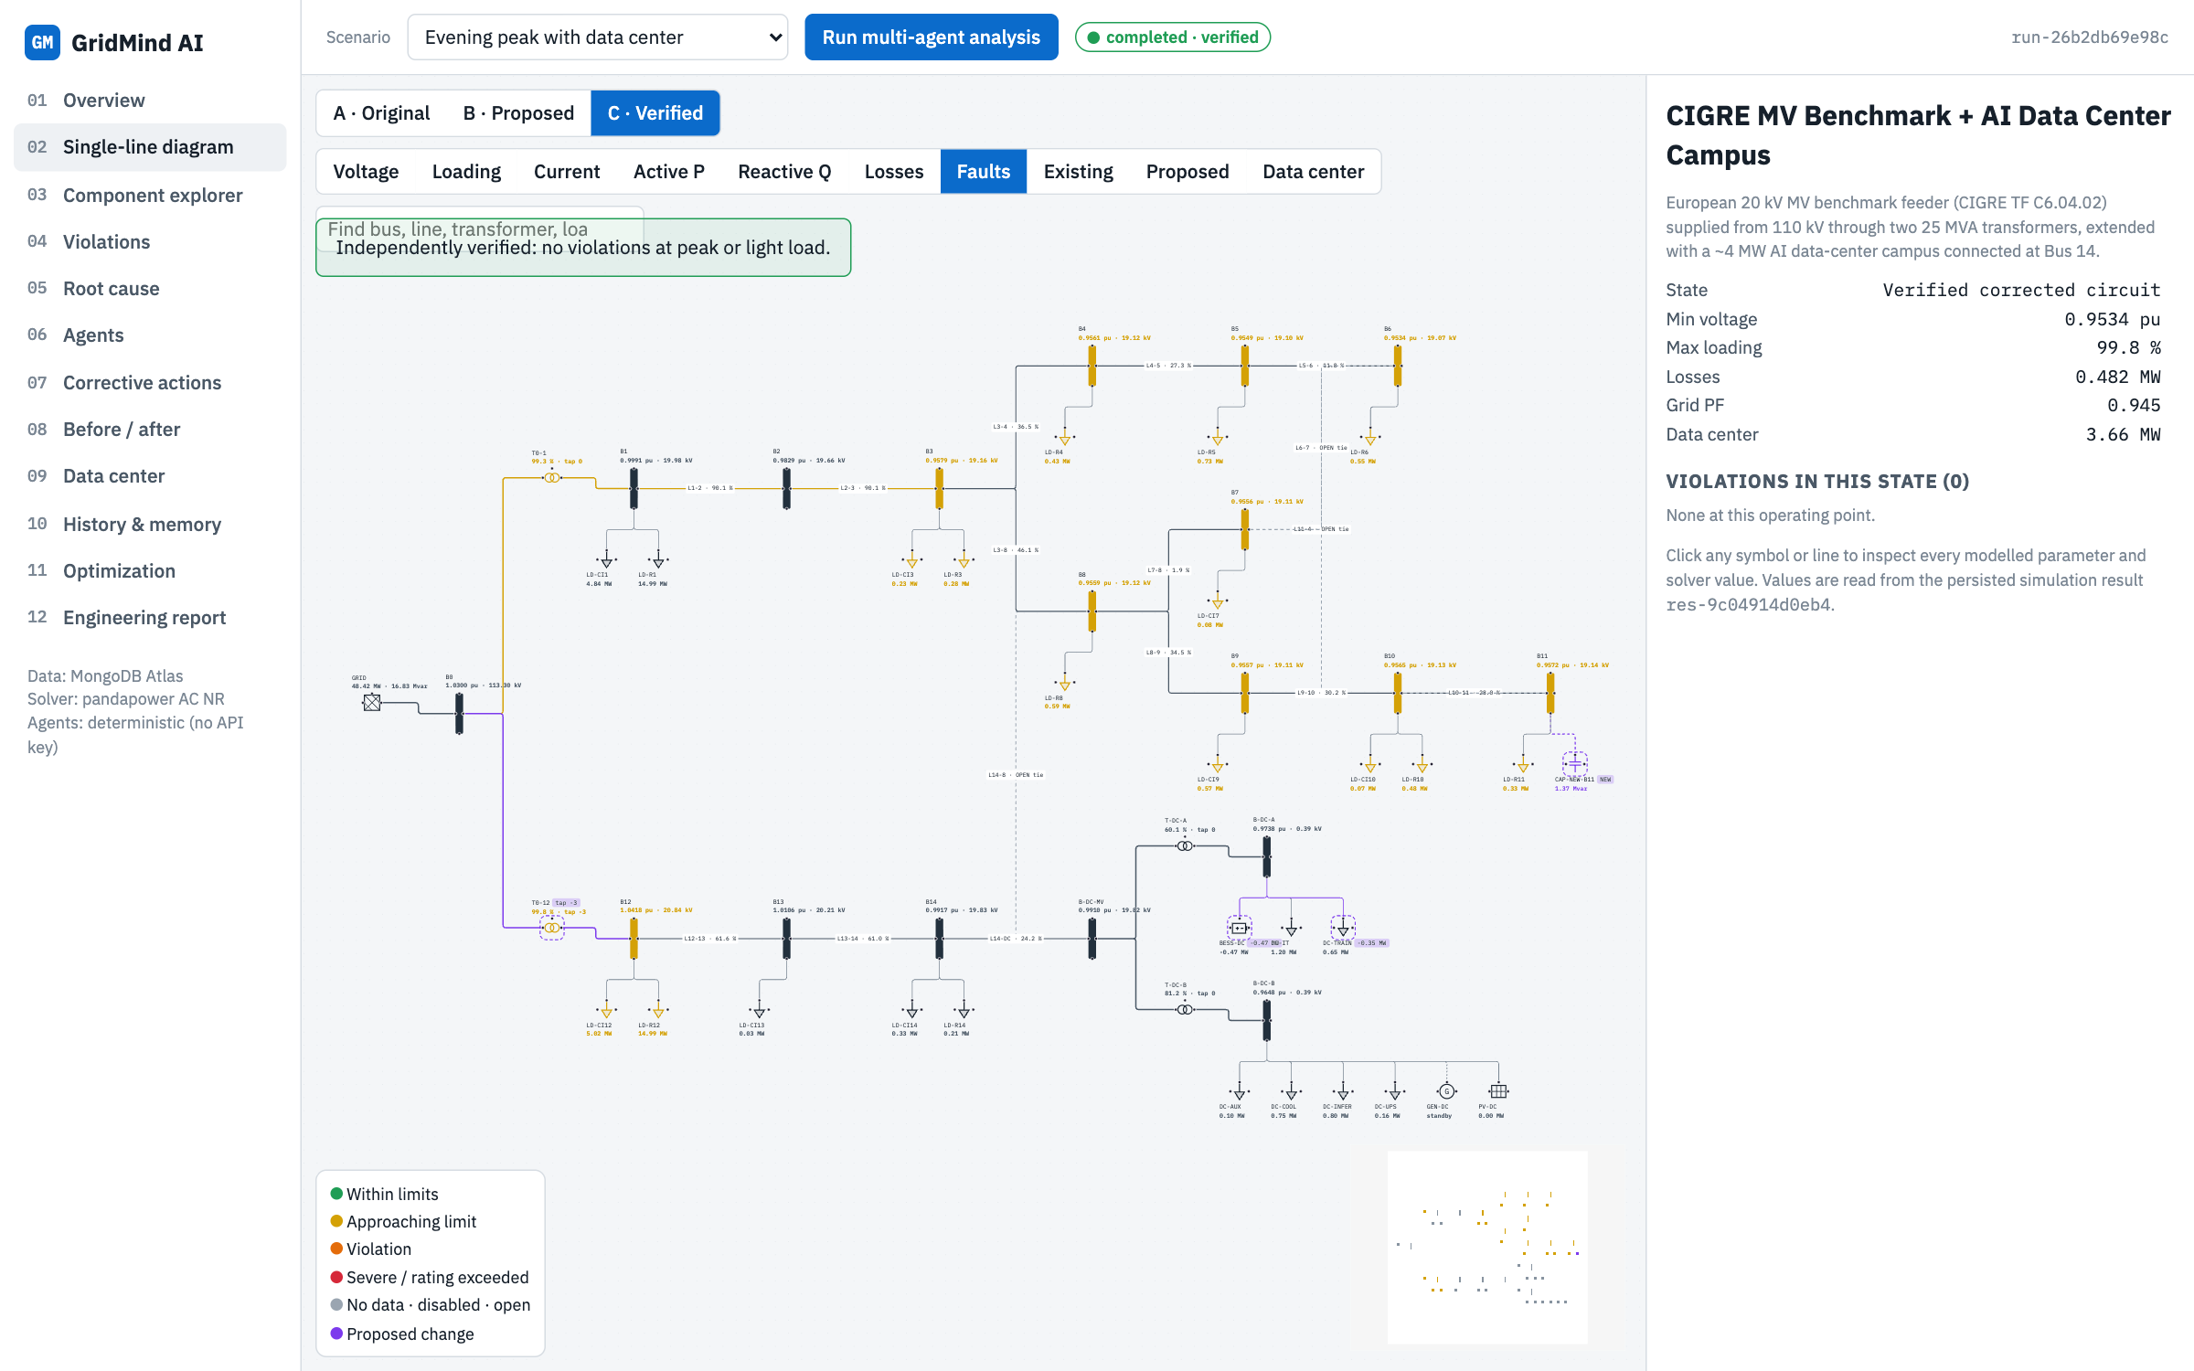
Proposed changes are drawn, then verified independently
B · Proposed: new capacitor, tap change, DC load shift and battery in purple
C · Verified: re-solved from MongoDB at peak and light load, 0 violations
Install a 1,500 kvar capacitor bank at bus B11 · Raise the OLTC of transformer T0-12 by 3 steps (tap 0 to -3, about +4.5 % voltage) · Shift 0.35 MW of the AI-training cluster out of the evening peak · Discharge the on-site battery (BESS-DC) at 0.47 MW for the 3-hour peak
Notes:
The proposed plan costs $62,000: a 1,500 kvar capacitor, three tap steps on T0-12, shifting 0.35 MW of AI training and discharging the battery for the peak. The verified state is a separate simulation; the app only says fixed when it really is.

Slide 12
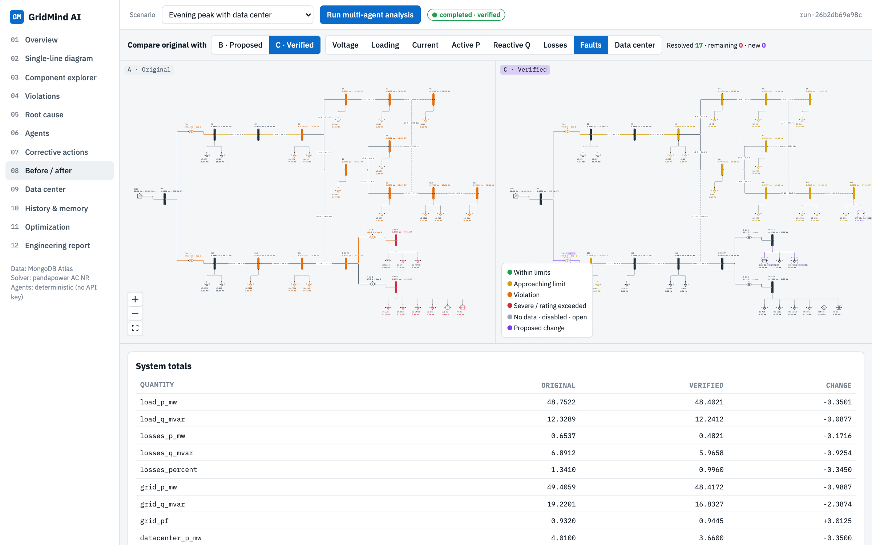
Before / after: 17 resolved, 0 remaining, 0 new
0.9534
Min voltage (was 0.8949 pu)
0.482 MW
Network losses (was 0.654 MW)
99.8 %
Max loading (was 104.5 %)
Notes:
Same layout on both sides, so the difference is obvious. The table underneath lists every bus and branch with original value, new value, change and status. Losses drop by a quarter as a side benefit of the reactive support.

Slide 13
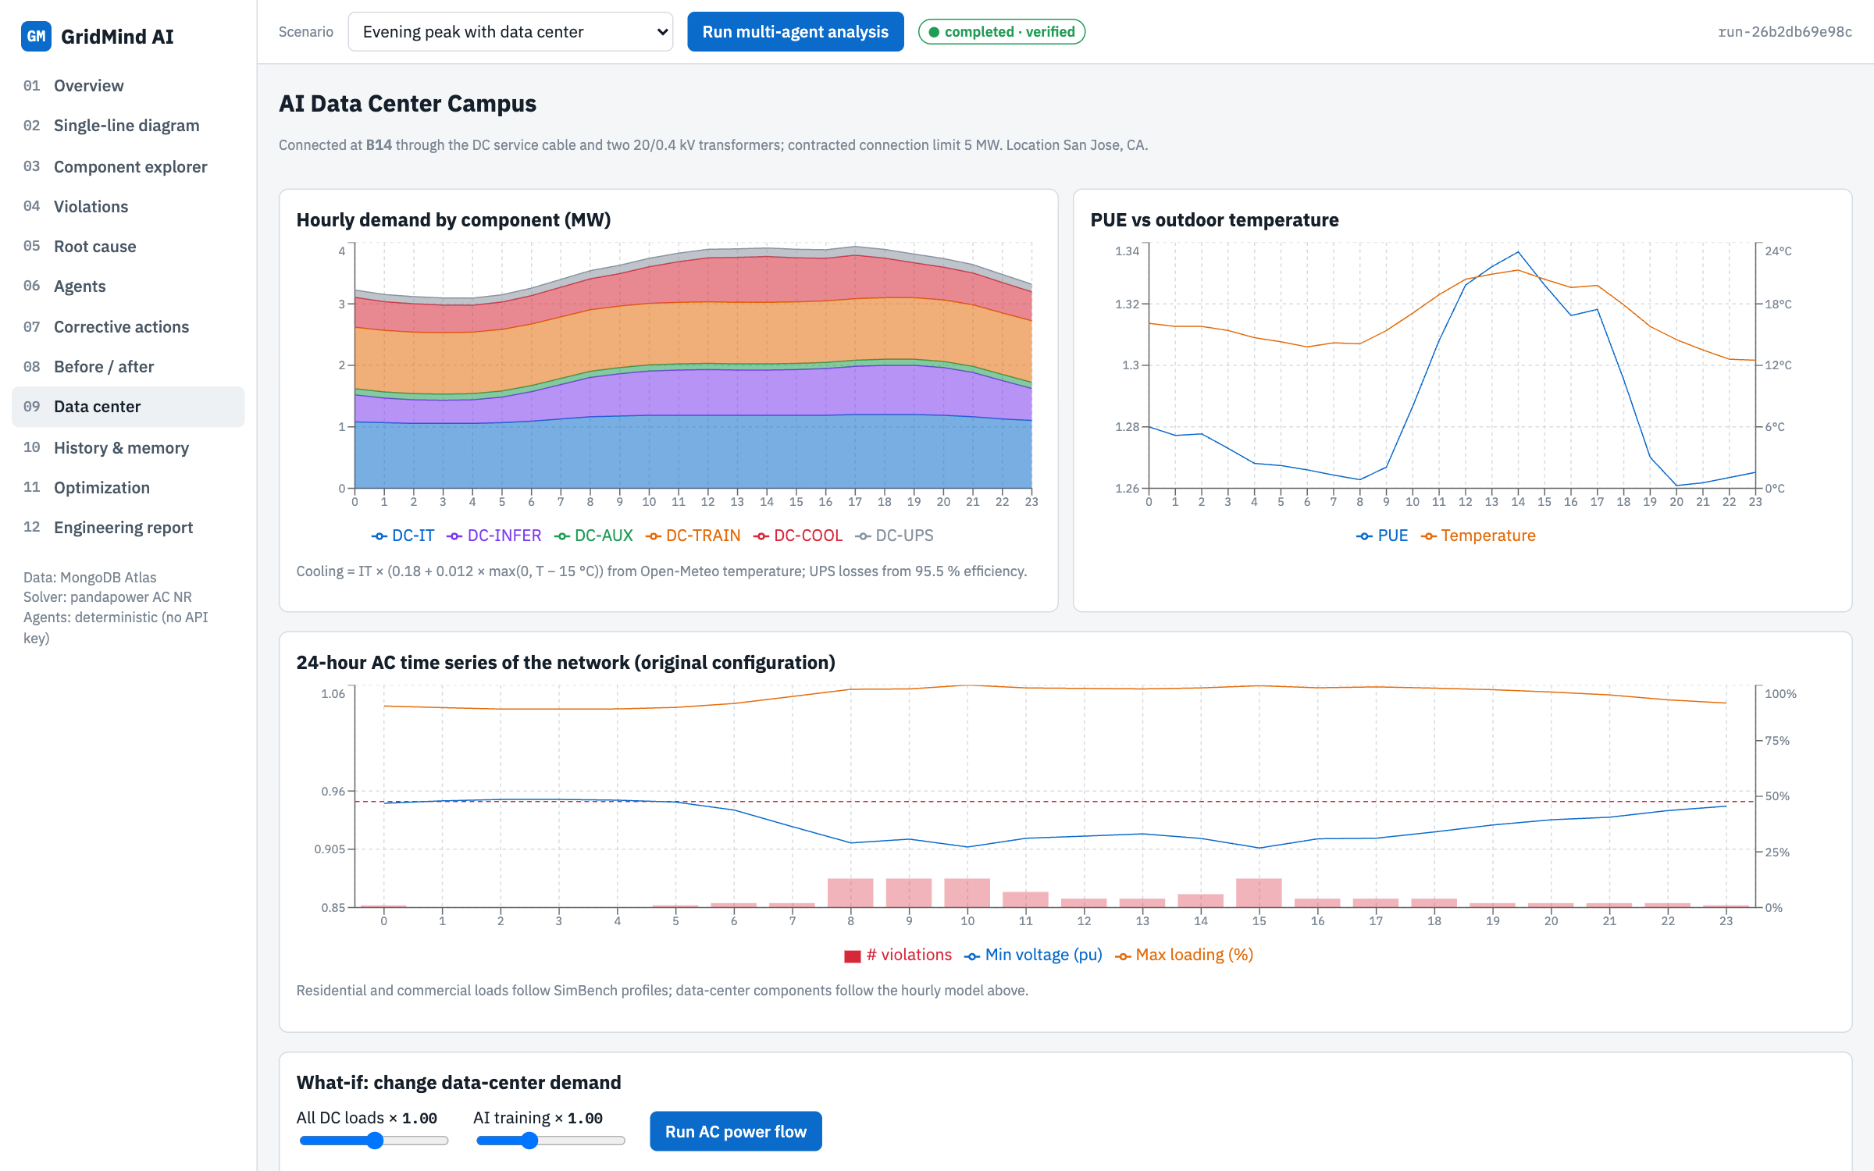
The data center is part of the same network
1
Component model
IT, AI training and inference, cooling from weather, UPS losses.
2
24-hour AC time series
Voltage, loading and violations hour by hour.
3
Coordinated schedule
LP shifts 1.38 MWh of training: $10,302 → $10,137 per day, 0 violation hours.
Notes:
The data center is not a separate dashboard: its loads sit on buses in the same model. The what-if slider re-solves the whole network for a demand change. The Optimization Agent schedules deferrable training with a linear program and then checks every hour with full AC power flow.

Slide 14
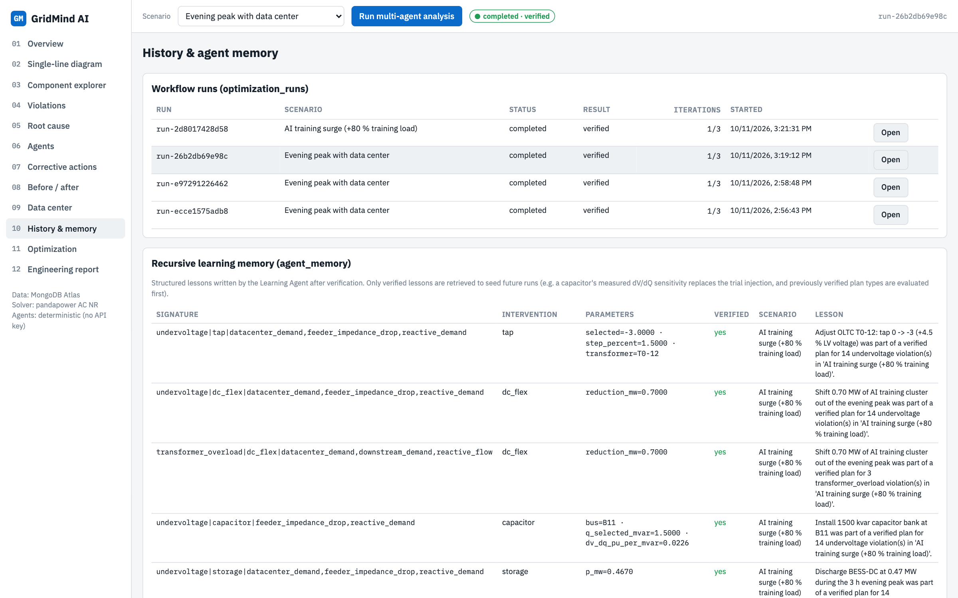
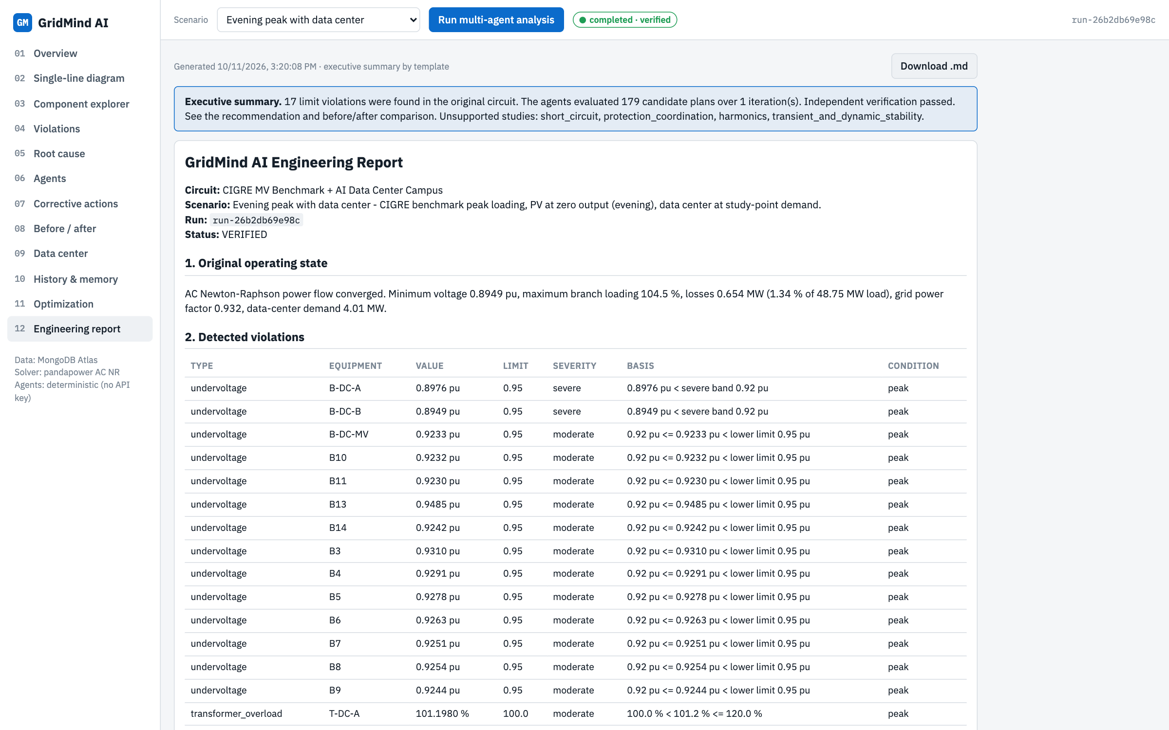
It learns across runs and writes the engineering report
History & memory: runs, verified lessons in agent_memory, audit log
Engineering report: evidence, calculations, verification tables, limitations
The AI-training-surge scenario retrieved the lessons from the evening-peak run, evaluated that plan type first, and was also verified.
Notes:
Recursive learning is concrete: lessons store the remedy, its parameters such as the measured capacitor sensitivity, and whether it was verified. The next run reuses them. The report agent writes a full technical report from stored results that can be downloaded.

Slide 15
Verified result: every limit met for $62,000 of capital
Minimum voltage
Maximum loading
Network losses
Grid power factor
0.8949 pu
104.5 %
0.654 MW
0.932
↓ verified
↓ verified
↓ verified
↓ verified
0.9534 pu
99.8 %
0.482 MW
0.945
Selected plan (requires engineer approval)
Install a 1,500 kvar capacitor bank at bus B11
Raise the OLTC of transformer T0-12 by 3 steps (tap 0 to -3, about +4.5 % voltage)
Shift 0.35 MW of the AI-training cluster out of the evening peak
Discharge the on-site battery (BESS-DC) at 0.47 MW for the 3-hour peak
Notes:
The optimizer compared this operational plan with equipment upgrades: replacing transformer T0-12 alone would cost about 1.4 million dollars. Coordinating the data center's flexible load with a capacitor and a tap change solves everything for $62,000.

Slide 16
Honest limits and next steps
What it does not claim
Next steps
Steady-state balanced model: short circuit, protection, harmonics and dynamics are flagged unsupported
Plan is the best of the evaluated combinations, not a proven optimum
Costs and data-center sizes are labelled assumptions
Add a Claude API key for written diagnoses over solver tools
Import utility models and measured SCADA / AMI data
Add a short-circuit and protection study engine
Thank you · GridMind AI runs locally at http://127.0.0.1:8000
Notes:
We are explicit about scope: the app labels what it cannot compute instead of guessing. The natural next steps are enabling Claude reasoning with an API key, importing real utility data, and adding a fault-level study.

