Slide 1
实 验
线程的状态和转换

Slide 2

实 验 目 的
调试线程在各种状态间的转换过程，熟悉线程的状态和转换。
通过为线程增加挂起状态，加深对线程状态的理解。

Slide 3
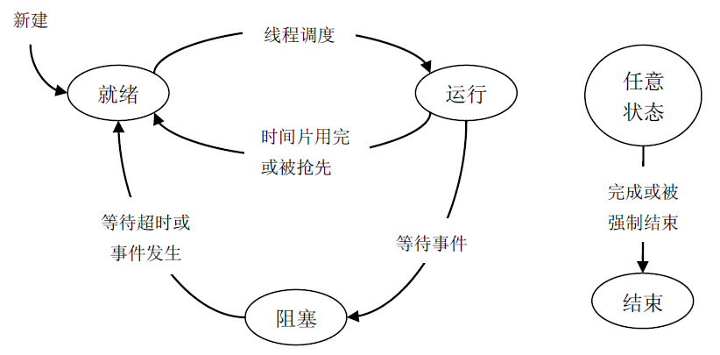
线程的状态和其转换过程

Slide 4
线程控制块中的状态域
及线程状态的枚举定义
typedef struct _THREAD {
……
UCHAR State; // 线程当前状态
……
} THREAD;
typedef enum _THREAD_STATE {
Zero, // 线程状态转换过程中的中间状态
Ready, // 就绪
Running, // 运行
Waiting, // 等待（阻塞）
Terminated // 结束
} THREAD_STATE;

Slide 5
线程处于运行、就绪、阻塞状态时
线程控制块的位置
线程控制块都是从系统内存池中分配的！
运行状态：全局变量PspCurrentThread指向处于运行状态线程的线程控制块。
就绪状态：线程控制块在其优先级对应的就绪队列中。
阻塞状态：线程控制块在同步对象的等待队列中。
线程状态转换包括：线程控制块中状态域的变化，线程控制块位置的变化等。

Slide 6
线程由阻塞状态进入就绪状态的源代码
PTHREAD
PspWakeThread(
IN PLIST_ENTRY WaitListHead,
IN STATUS WaitStatus
)
{
PTHREAD Thread;
if (!ListIsEmpty(WaitListHead)) {
Thread = CONTAINING_RECORD(WaitListHead->Next, THREAD, StateListEntry);
PspUnwaitThread(Thread);
PspReadyThread(Thread);
Thread->WaitStatus = WaitStatus;
} else {
Thread = NULL;
}
return Thread;
}

Slide 7
VOID
PspUnwaitThread(
IN PTHREAD Thread
)
{
ASSERT(Waiting == Thread->State);
ListRemoveEntry(&Thread->StateListEntry);
Thread->State = Zero;
if (STATUS_TIMEOUT == Thread->WaitStatus) {
KeUnregisterTimer(&Thread->WaitTimer);
}
}

Slide 8
VOID
PspReadyThread(
PTHREAD Thread
)
{
ASSERT(NULL != Thread);
ASSERT(Zero == Thread->State || Running == Thread->State);
//
// 将线程插入其优先级对应的就绪队列的队尾，并设置就绪位图中对应的位。
// 最后将线程的状态修改为就绪状态。
//
ListInsertTail(&PspReadyListHeads[Thread->Priority], &Thread->StateListEntry);
BIT_SET(PspReadyBitmap, Thread->Priority);
Thread->State = Ready;
}

Slide 9
线程由运行状态进入就绪状态的源代码
PCONTEXT
PspSelectNextThread(
VOID
)
{
……
if (NULL != PspCurrentThread && Running == PspCurrentThread->State) {
if (0 != PspReadyBitmap && HighestPriority > PspCurrentThread->Priority) {
ListInsertHead( &PspReadyListHeads[PspCurrentThread->Priority],
&PspCurrentThread->StateListEntry );
BIT_SET(PspReadyBitmap, PspCurrentThread->Priority);
PspCurrentThread->State = Ready;
}
……
}
……
}

Slide 10
线程由就绪状态进入运行状态的源代码
PCONTEXT
PspSelectNextThread(
VOID
)
{
……
PspCurrentThread = CONTAINING_RECORD(PspReadyListHeads[HighestPriority].Next, THREAD, StateListEntry);
ObRefObject(PspCurrentThread);
PspUnreadyThread(PspCurrentThread);
PspCurrentThread->State = Running;
……
}

Slide 11
VOID
PspUnreadyThread(
PTHREAD Thread
)
{
ASSERT(NULL != Thread && Ready == Thread->State);
ListRemoveEntry(&Thread->StateListEntry);
if(ListIsEmpty(&PspReadyListHeads[Thread->Priority])) {
BIT_CLEAR(PspReadyBitmap, Thread->Priority);
}
Thread->State = Zero;
}

Slide 12
线程由运行状态进入阻塞状态的源代码
STATUS
PspWait(
IN PLIST_ENTRY WaitListHead,
IN ULONG Milliseconds
)
{
……
ListInsertTail(WaitListHead, &PspCurrentThread->StateListEntry);
PspCurrentThread->State = Waiting;
// 当前线程进入等待状态后需要让出处理器（让权等待），执行线程调度。
PspThreadSchedule();
// zzZ...
……
}

Slide 13
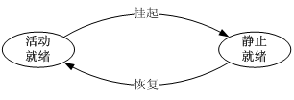
为线程增加挂起状态
命令：suspend ThreadID 和 resume ThreadID
API函数：SuspendThread 和 ResumeThread
内核函数：PsSuspendThread 和 PsResumeThread

Slide 14
挂起线程的源代码
LIST_ENTRY SuspendListHead = {&SuspendListHead, &SuspendListHead};
STATUS PsSuspendThread(IN HANDLE hThread)
{
STATUS Status;
BOOL IntState;
PTHREAD Thread;
Status = ObRefObjectByHandle(hThread, PspThreadType, (PVOID*)&Thread);
if (EOS_SUCCESS(Status)) {
IntState = KeEnableInterrupts(FALSE); // 关中断
if (Ready == Thread->State) {
PspUnreadyThread(Thread);
ListInsertTail(&SuspendListHead, &Thread->StateListEntry);
Status = STATUS_SUCCESS;
} else {
Status = STATUS_NOT_SUPPORTED;
}
KeEnableInterrupts(IntState); // 开中断
ObDerefObject(Thread);
}
return Status;
}

Slide 15
恢复线程的源代码
STATUS PsResumThread(IN HANDLE hThread)
{
STATUS Status;
BOOL IntState;
PTHREAD Thread;
Status = ObRefObjectByHandle(hThread, PspThreadType, (PVOID*)&Thread);
if (EOS_SUCCESS(Status)) {
IntState = KeEnableInterrupts(FALSE); // 关中断
if (Zero == Thread->State) {
// 在此添加代码将线程恢复为就绪状态
Status = STATUS_SUCCESS;
} else {
Status = STATUS_NOT_SUPPORTED;
}
KeEnableInterrupts(IntState); // 开中断
ObDerefObject(Thread);
}
return Status;
}

