Slide 1
Two methodes to manage data
File system Method
Database Method
Notes:
1

Slide 2
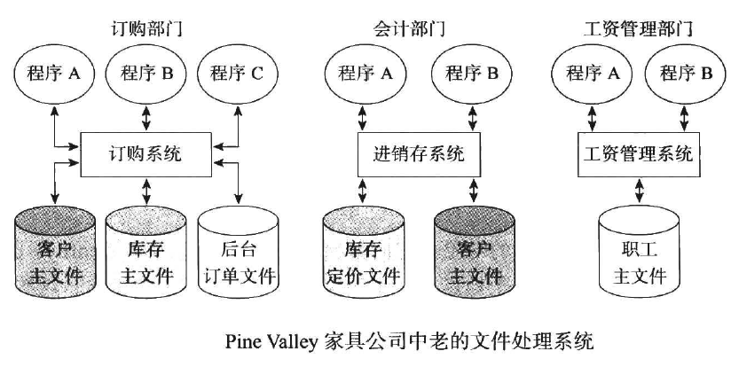
using file system to manage data
Notes:
2

Slide 3
Drawbacks of using file systems to manage data
Data redundancy and inconsistency
Multiple file formats, duplication of information in different files
Difficulty in accessing data
Need to write a new program to carry out each new task
Data isolation — multiple files and formats
Integrity problems
Integrity constraints (e.g., account balance > 0) become “buried” in program code rather than being stated explicitly
Hard to add new constraints or change existing ones
Notes:
3

Slide 4
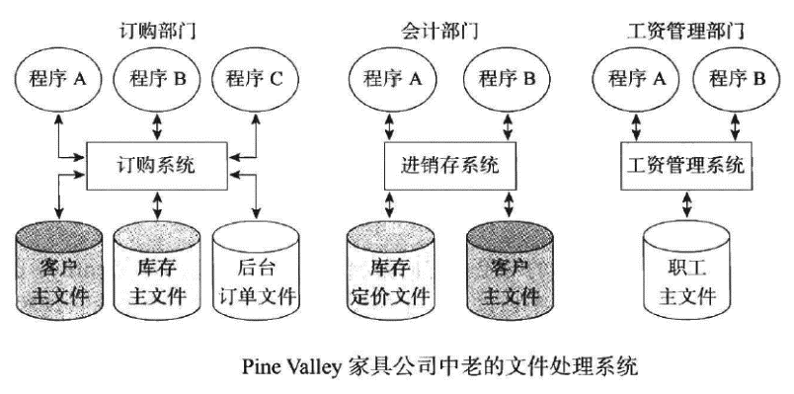
Drawbacks of using file systems to manage data
Atomicity of updates
Failures may leave database in an inconsistent state with partial updates carried out
Example: Transfer of funds from one account to another should either complete or not happen at all
Concurrent access by multiple users
Concurrent access needed for performance
Uncontrolled concurrent accesses can lead to inconsistencies
Example: Two people reading a balance (say 100) and updating it by withdrawing money (say 50 each) at the same time
Security problems
Hard to provide user access to some, but not all, data
Database systems offer solutions to all the above problems
Notes:
4

Slide 5

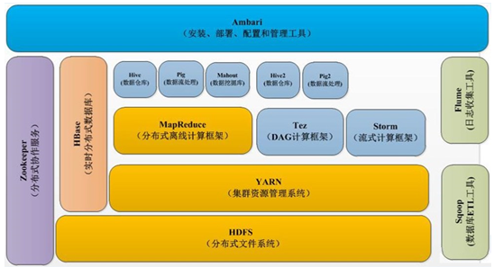
BIG DATA ——using file systems to manage data
Hadoop
MapReduce
HDFS
Notes:
5

Slide 6
Database Method Database
数据库(Database简称DB)的定义
数据库是长期储存在计算机内、有组织的、可共享的大量数据集合。
数据库包含了某个组织机构的信息
Oracle Database consists 3 type files Stored on Hard Disks
Datafile
Control file
Redo logfile

Slide 7
Database Method Database
数据库的特征
数据按一定的数据模型组织、描述和储存
可为各种用户共享
冗余度较小
数据独立性较高
易扩展

Slide 8
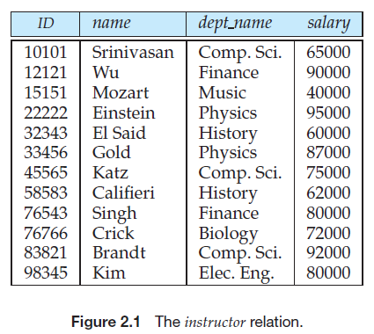
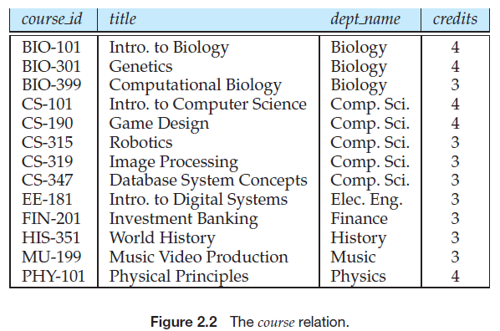
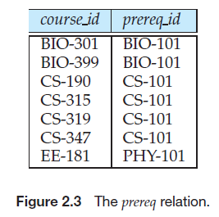
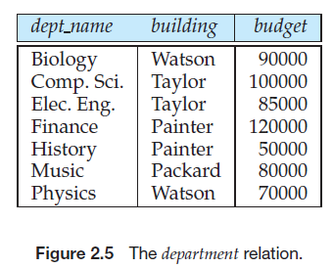
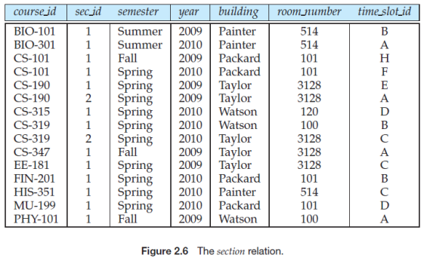
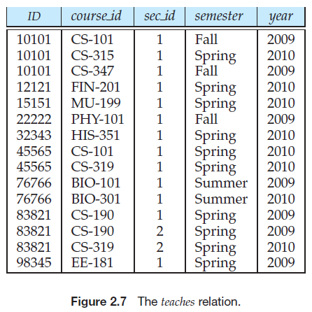
Database Method Database
Example：采用关系模型的大学数据库（University Database）
由一系列的带有数据的表组成

Slide 9
Database Method Database Management System (DBMS)
什么是数据库管理系统(DBMS)
DBMS是由一个互相关联的数据的集合（database）和一组用以访问这些数据的程序组成。
位于用户与操作系统之间的一层数据管理软件。
是基础软件，是一个大型复杂的软件系统 。
DBMS的主要目标
是要提供一种可以方便、高效地存取数据库信息的途径
Notes:
A database-management system (DBMS) is a collection of interrelated data and a set
of programs to access those data.
The collection of data, usually referred to as the database, contains information
relevant to an enterprise.
The primary goal of a DBMS is to provide a way to store and retrieve database
information that is both convenient and efficient.

Slide 10
Database Method Database Management System (DBMS)
数据库管理系统的功能：
定义信息的存储结构；
提供操作数据库中所存储的信息的机制；
保证所存储信息的安全，即使在系统崩溃或有人企图越权访问时，也应保障信息的安全性；
提供并发控制的机制，当数据被多用户共享时，避免可能产生的异常结果。

Slide 11
Database Method Database Management System (DBMS)
当前市场上主要的RDBMS厂商
Oracle
Oracle：9i，10g，11g，12c，18c
MySQL：5.7，8.0
Microsoft
MS SQL Server：2008 2012 2014 2016 2017
IBM：DB2
SAP：Sybase
PostgreSQL

Slide 12
Database Method Database Management System (DBMS)
主要的国产数据库厂商
南大通用Gbase
人大金仓Kingbase
武汉达梦
神州通用

Slide 13

Database Method DB and DBMS
问题：我们公司购买了Oracle数据库，这个说法对么?

Slide 14
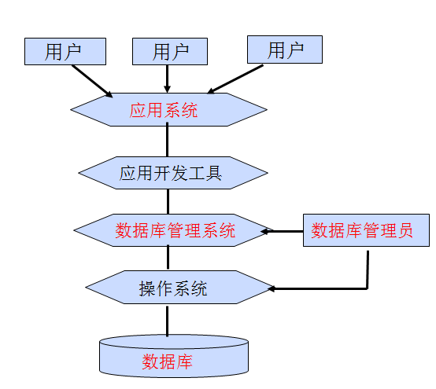
Database Method Database System(DBS)
数据库系统（Database System，简称DBS）的定义
是指在计算机系统中引入数据库后的系统构成。
数据库系统的构成

Slide 15
Database Method Database Users and Administrators
The functions of a DBA
Schema definition. The DBA creates the original database schema by executing a set of data definition statements in the DDL.
Storage structure and access-method definition.
Schema and physical-organization modification. The DBAcarries out changes to the schema and physical organization to reflect the changing needs of the organization, or to alter the physical organization to improve performance.
Granting of authorization for data access. By granting different types of authorization, the database administrator can regulate which parts of the database various users can access. The authorization information is kept in a special system structure that the database system consults whenever someone attempts to access the data in the system.
Routine maintenance.
Periodically backing up the database, either onto tapes or onto remote servers, to prevent loss of data in case of disasters such as flooding.
Ensuring that enough free disk space is available for normal operations,and upgrading disk space as required.
Monitoring jobs running on the database and ensuring that performance is not degraded by very expensive tasks submitted by some users.
Notes:
15

Slide 16
Database Method Databases touch all aspects of our lives
Banking: transactions
Airlines: reservations, schedules
Universities: registration, grades
Sales: customers, products, purchases
Online retailers: order tracking,customized recommendations
Manufacturing: production, inventory, orders, supply chain
Human resources:employee records, salaries, tax deductions
Notes:
16

Slide 17
Database Method University Application Example
University Applicaion functions
Add new students, instructors, and courses
Register students for courses, and generate class rosters
Assign grades to students, compute grade point averages (GPA) and generate transcripts
In the early days, applications were built directly on top of file systems
Note：
Rosters 花名册
Transcripts 成绩单
Notes:
17

