Slide 1
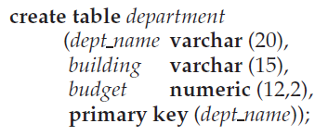


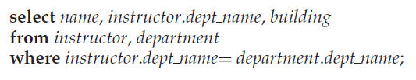

Database Languages
A database system provides
a data-definition language(DDL) to specify the database schema
a data-manipulation language(DML) to express database queries and updates.
In practice, the data-definition and data-manipulation languages are not two separate languages; instead they simply form parts of a single database language,such as the widely used SQL language.
Notes:
1

Slide 2
Database Languages Data Manipulation Language (DML)
What can DML do?
Retrieval of information stored in the database
Insertion of new information into the database
Deletion of information from the database
Modification of information stored in the database
Select 从技术上来看
归类到DML，并不正确！
Notes:
2

Slide 3
Database Languages Data Manipulation Language (DML)
Two classes of DML languages
Procedural
user specifies what data is required and how to get those data
Declarative (nonprocedural)
user specifies what data is required without specifying how to get those data
Notes:
3

Slide 4
Database Languages Data Definition Language (DDL)
What can DDL do?
Specification notation for defining the database schema
Example: create table instructor ( ID char(5), name varchar(20), dept_name varchar(20), salary numeric(8,2))
specify the storage structure and access methods used by the database system（data storage and definition language of DDL）
Index Organized Table（IOT）
Cluster table
Specify database Integrity constraints（Stored in Data Dictionary）
Domain Constraints
Primary key
Referential Integrity
Assertions(每个学期一个系至少开设5门课)
Authorization
Notes:
4

Slide 5
Database Languages Data Definition Language (DDL)
Data Dictioinary
The DDL gets as input some instructions (statements) and generates some output.
The output of the DDL is placed in the data dictionary,which contains metadata—that is, data about data.
The data dictionary is considered to be a special type of table that can only be accessed and updated by the database system itself (not a regular user).
The database system consults the data dictionary before reading or modifying actual data.
Notes:
5

