Slide 1
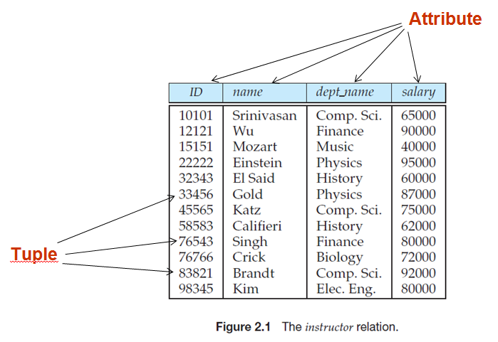
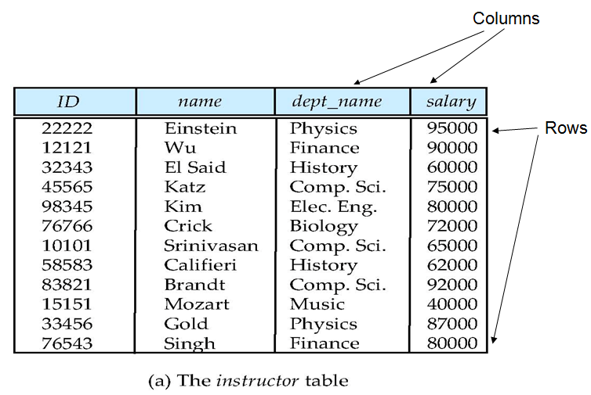
Relational Database (Data Structure)
Relational Database is based on Relational model
关系模型术语
Relation
Tuple
Attribute
关系数据库术语
Table
Row
Column
Notes:
1

Slide 2
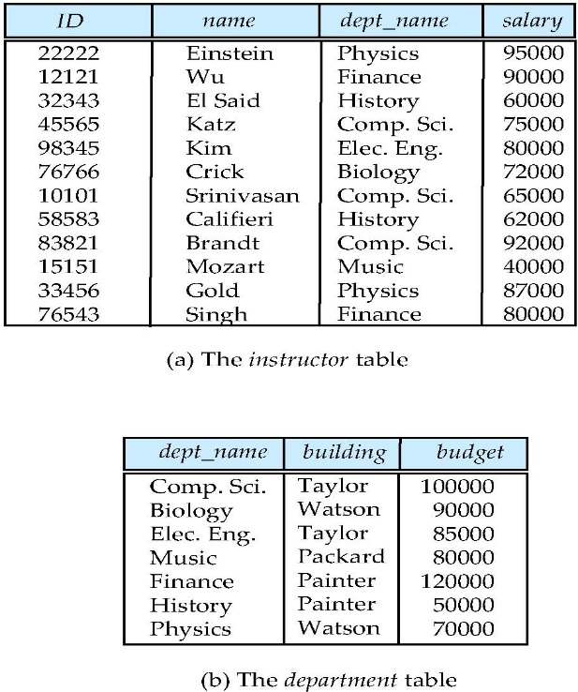
Relational Database
A Sample Relational Database
Tables
Constraints
Data Manipulation
SQL
Notes:
2

Slide 3
Relational Database (Data Operations)
DML of Relational Database （SQL）
Example: Find the name of the instructor with ID 22222
select name from instructor where instructor.ID = ‘22222’
Example: Find the ID and building of instructors in the Physics dept.
select instructor.ID, department.building from instructor, department where instructor.dept_name = department.dept_name and department.dept_name = ‘Physics’
insert语句
update语句
delete语句
Notes:
3

Slide 4
Relational Database (Data Operations)
DDL of Relational Database （ SQL ）
Example: Create department table
create table department
( dept_name char (20),
building char (15),
budget numeric (12,2) );
Notes:
4

Slide 5
Relational Database (Data Integrity Constraint)
Domain constraint
Primary Key
Referential Integrity
NULL or NOT NULL
UNIQUE
Check
语句？
Notes:
5

Slide 6
Programming with Database
How do Application programs access databases?
precompile
Language extensions to allow embedded SQL（PRO*C/C++）
Application program interface(API)
Open Database Connectivity(ODBC)
Java Database Connectivity(JDBC)
Notes:
6

