Slide 1
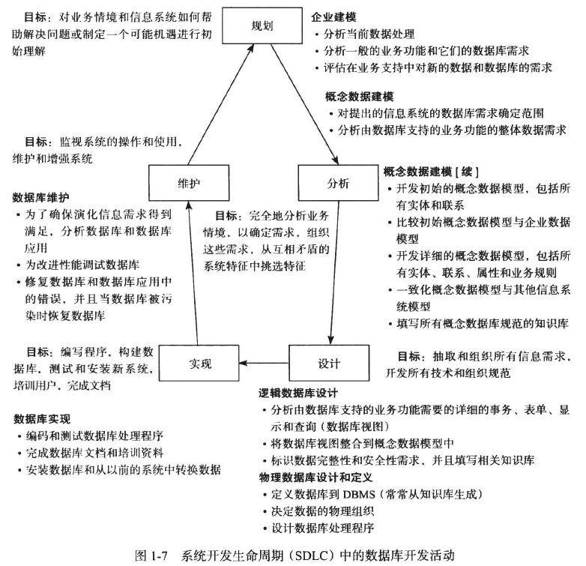
Database Design (The process of database design) SDLC：System Development Life Cycle
Notes:
1

Slide 2
Database Design (The process of database design)
Phase 1 ：to characterize fully the data needs of the prospective database users.
The database designer needs to interact extensively with domain experts and users to carry out this task.
outcome of this phase： a specification of user requirements.
Notes:
2

Slide 3
Database Design (The process of database design)
Phase 2 ： Concept Database Design——chooses a data model, and by applying the concepts of the chosen data model, translates these requirements into a conceptual schema of the database
The schema developed at this phase provides a detailed overview of the enterprise.
The designer reviews the schema to confirm that all data requirements are indeed satisfied and are not in conflict with one another.
The designer can also examine the design to remove any redundant features.
The focus at this point is on describing the data and their relationships,rather than on specifying physical storage details.
In terms of the relational model, this phase involves decisions on :
what attributes captured in the database (a business decision)
how to group these attributes to form the various tables. (a computer-science problem)
outcome of this phase： E-R diagram
A fully developed conceptual schema indicates the functional requirements of the enterprise.
In a specification of functional requirements, users describe the kinds of operations (or transactions) that will be performed on the data:
modifying or updating data
searching for and retrieving specific data
deleting data
At this stage of conceptual design, the designer can review the schema to ensure it meets functional requirements.
Notes:
3

Slide 4
Database Design (The process of database design)
Phase 3 ： logical-design phase —— Deciding on the database schema
the designer maps the high-level conceptual schema onto the implementation data model of the database system that will be used.
Such as Relation Database
outcome of this phase： database schema
Phase 4： physical-design phase ——Deciding on the physical layout of the database
The designer implement Database Schema on DBMS
Oracle
MS SQL Server
MySQL
……
On DBMS(Oracle、MS SQL Server、MySQL) you can specify the physical features of the database
the form of file organization （File Locaion——On which Disk）
the internal storage structures（IOT、Cluster）
Notes:
4

Slide 5
Database Design Example：for a University Organization
specification of user requirements (Phrase 1)
The university is organized into departments. Each department is identified by a unique name (dept name), is located in a particular building, and has a budget.
Each department has a list of courses it offers. Each course has associated with it a course id, title, dept name, and credits, and may also have have associated prerequisites.
Instructors are identified by their unique ID. Each instructor has name, associated department (dept name), and salary.
Students are identified by their unique ID. Each student has a name, an associated major department (dept name), and tot cred (total credit hours the student earned thus far).
Notes:
5

Slide 6
Database Design Example：for a University Organization
specification of user requirements (Phrase 1)
The university maintains a list of classrooms, specifying the name of the building, room number, and room capacity.
The university maintains a list of all classes (sections) taught. Each section is identified by a course id, sec id, year, and semester, and has associated with it a semester, year, building, room number, and time slot id (the time slot when the class meets).
The department has a list of teaching assignments specifying, for each instructor, the sections the instructor is teaching.
The university has a list of all student course registrations, specifying, for each student, the courses and the associated sections that the student has taken (registered for).
Notes:
6

Slide 7
Database Design Example：for a University Organization
Conceptual Database Design（ Phrase 2）
The Entity-Relationship Model
Models an enterprise as a collection of entities and relationships
Entity: a “thing” or “object” in the enterprise that is distinguishable from other objects
Described by a set of attributes
Entity Set： The set of all entities of the same type
Relationship: an association among several entities
Relationship Set：the set of all relationships of the same type
Notes:
7

Slide 8
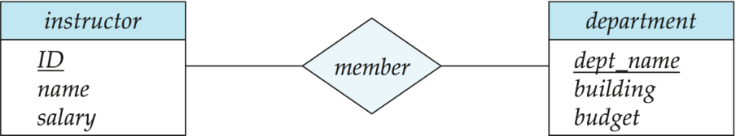
Database Design Example：for a University Organization
Conceptual Database Design（ Phrase 2）
The Entity-Relationship Model:E-R diagram(UML)
Entity sets are represented by a rectangular box with the entity set name in the header and the attributes listed below it.
Relationship sets are represented by a diamond connecting a pair of related entity sets. The name of the relationship is placed inside the diamond.
two entity sets： instructor and department
a relationship ：member between instructor and department
Notes:
8

Slide 9
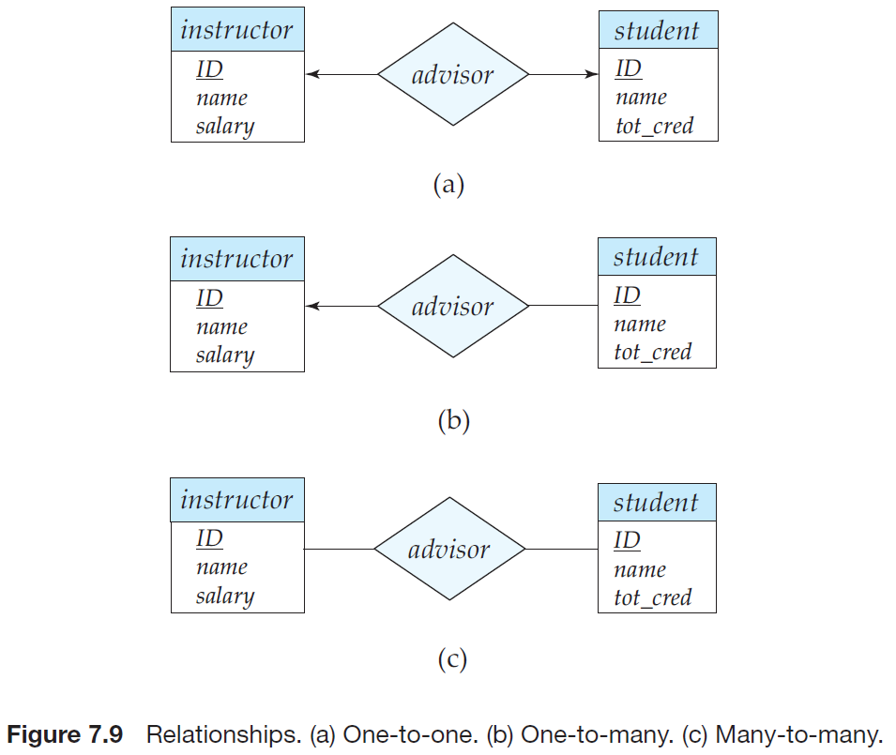
Database Design Example：for a University Organization
Conceptual Database Design（ Phrase 2）
The Entity-Relationship Model:E-R diagram(UML)
Can represents certain constraints
Example:mapping cardinalities :which express the number of entities to which another entity can be associated via a relationship set
Notes:
9

Slide 10
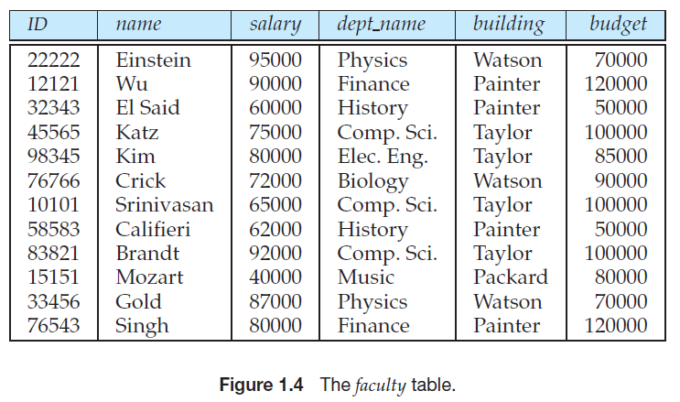
Database Design Example：for a University Organization
Normalization （ Phrase 3）
Is there any problem with this design?
Notes:
10

Slide 11
Database Design Example：for a University Organization
Normalization （ Phrase 3）
The goal is to generate a set of relation schemas that allows us to store information without unnecessary redundancy, yet also allows us to retrieve information easily.
The approach is to design schemas that are in an appropriate normal form.
To determine whether a relation schema is in one of the desirable normal forms, we need additional information about the real-world enterprise that we are modeling with the database.
The most common approach is to use functional dependencies
Notes:
11

Slide 12
Database Design Example：for a University Organization
Normalization （ Phrase 3）
Suppose that instead of having the two separate tables instructor and department,we have a single table, faculty, that combines the information from the two tables (as shown in Figure 1.4).
Repetition of information
Inability to represent certain information
Notice that there are two rows in faculty that contain repeated information about the History department, specifically, that department’s building and budget.
Wastes space
Update difficultly
inability to represent certain information
Insert difficultly
Delete abnormally
Notes:
12

Slide 13
Database Design Example：for a University Organization
Normalization （Phrase 3）
inability to represent certain information
Suppose we are creating a new department in the university. In the alternative design above,we cannot represent directly the information concerning a department (dept name, building, budget) unless that department has at least one instructor at the university.
This is because rows in the faculty table require values for ID, name, and salary. This means that we cannot record information about the newly created department until the first instructor is hired for the new department.
Notes:
13

Slide 14
Database Design Example：for a University Organization
Normalization （Phrase 3）
inability to represent certain information
One solution to this problem is to introduce null values
The null value indicates the value does not exist
The null value indicates the value is not known
(1) may be either missing (the value does exist, but we do not have that information)
(2) not known (we do not know whether or not the value actually exists)
Notes:
14

Slide 15
Database Design Example：for a University Organization
Normalization （Phrase 3）
inability to represent certain information
null values are difficult to handle
If we are not willing to deal with null values, then we can create a particular item of department information only when the department has at least one instructor associated with the department.
Furthermore, we would have to delete this information when the last instructor in the department departs.
Notes:
15

Slide 16
Database Design Example：for a University Organization
Normalization （Phrase 3）
Clearly, this situation is undesirable, since, under our original database design,the department information would be available regardless of whether or not there is an instructor associated with the department, and without resorting to null values.
An extensive theory of normalization has been developed that helps formally define:
what database designs are undesirable
how to obtain desirable designs.
Chapter 8 covers relational-database design, including normalization
Notes:
16

Slide 17
Database Design Example：for a University Organization
Physical Database Design （Phrase 4）
Select DBMS
Oracle
DB2
MS SQL Server
MySQL
Design
Index
IOT
Cluster Table
Storage of data
Notes:
17

