Slide 1
Database System Architecture
Database systems can be
Centralized
Client-server
Parallel computer architectures.
Distributed databases
Notes:
1

Slide 2
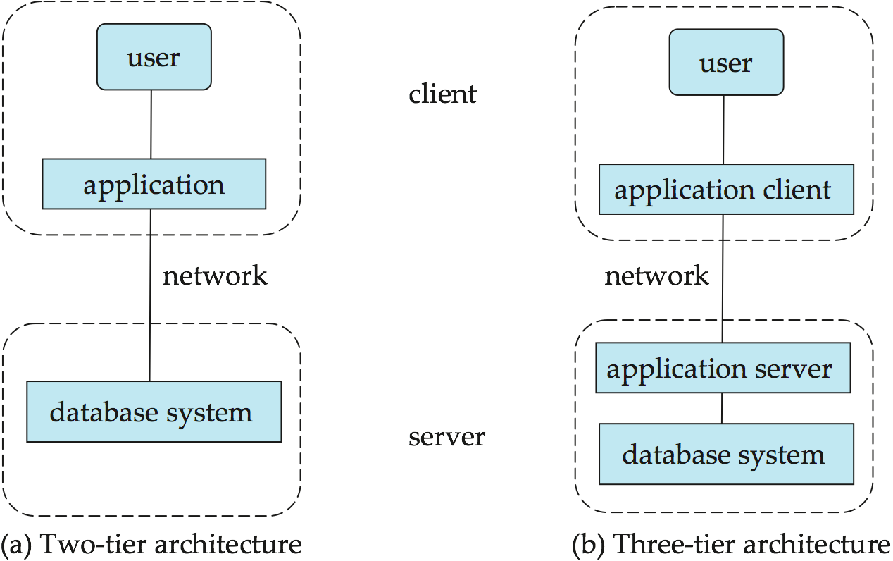
Database System Architecture
Two-tier architecture
Client
Database Server
Tree-tier architecture
Client
Application server
Database Server
并行数据库系统
分布式数据库系统
Notes:
2

Slide 3
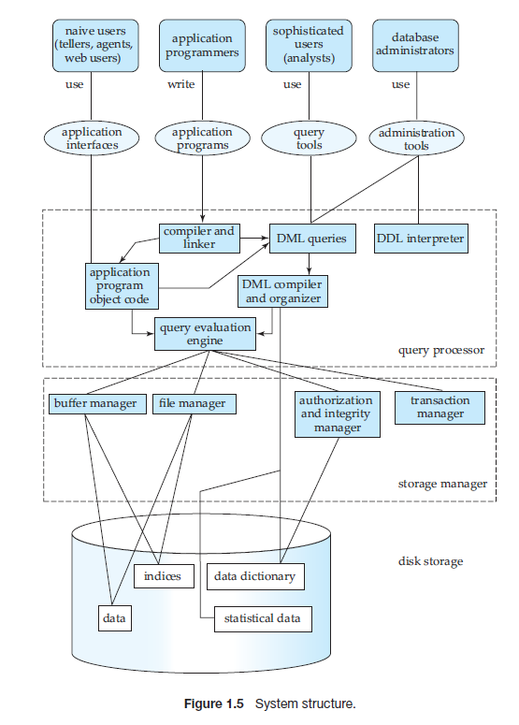
DBMS System Structure （Storage Management）
Storage Manager
Authorization and Integrity Manager
Transaction Manager
File Manager
Buffer Manager
Storage Manager implements the following Data Structure
Data file
Data Dictionary
index
Notes:
3

Slide 4
DBMS System Structure （Storage Management）
Storage manager is a program module that provides the interface between the low-level data stored in the database and the application programs and queries submitted to the system.
The storage manager is responsible to the following tasks:
Interaction with the file manager
Efficient storing, retrieving and updating of data
Issues:
Storage access
File organization
Indexing and hashing
Notes:
4

Slide 5
DBMS System Structure （Query Processor）
Query Processor
DDL interpreter
DML Compiler
Query Evaluation Engine
Notes:
5

Slide 6
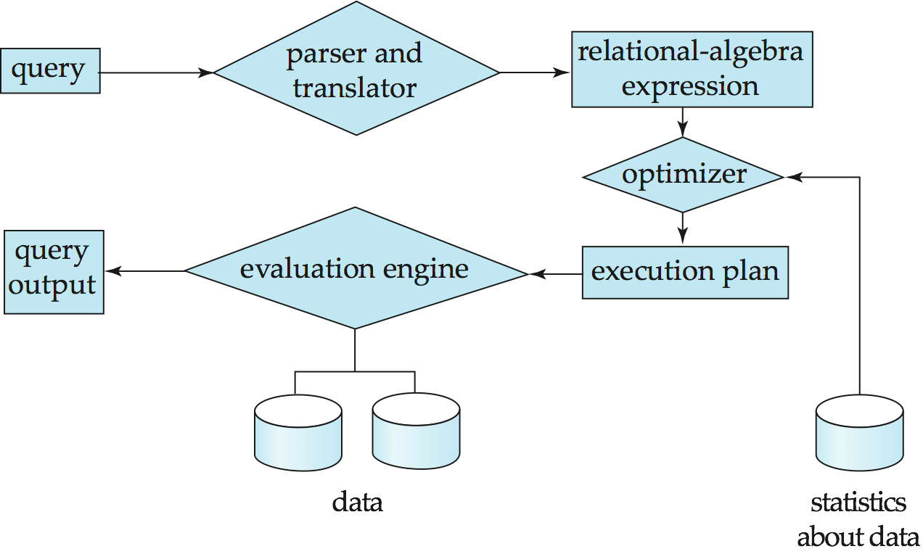
DBMS System Structure （Query Processor：Query Processing）
1. Parsing and translation
2. Optimization
3. Evaluation
Notes:
6

Slide 7
DBMS System Structure （Query Processor：Query Processing）
Alternative ways of evaluating a given query
Equivalent expressions
Different algorithms for each operation
Cost difference between a good and a bad way of evaluating a query can be enormous
Need to estimate the cost of operations
Depends critically on statistical information about relations which the database must maintain
Need to estimate statistics for intermediate results to compute cost of complex expressions
Notes:
7

Slide 8
DBMS System Structure （Transaction Management）
What if the system fails?
What if more than one user is concurrently updating the same data?
A transaction is a collection of operations that performs a single logical function in a database application
Transaction-management component ensures that the database remains in a consistent (correct) state despite system failures (e.g., power failures and operating system crashes) and transaction failures.
Concurrency-control manager controls the interaction among the concurrent transactions, to ensure the consistency of the database.
Notes:
8

Slide 9
DBMS System Structure （Transaction Management）
ACID of A Transaction—— Atomicity
Often, several operations on the database form a single logical unit of work.(Transaction)
An example is a funds transfer
one department account (say A) is debited
another department account (say B) is credited.
Clearly, it is essential that either both the credit and debit occur, or that neither occur. That is, the funds transfer must happen in its entirety or not at all.
This all-or-none requirement is called Atomicity
Notes:
9

Slide 10
DBMS System Structure （Transaction Management）
ACID of A Transaction—— consistency
It is essential that the execution of the funds transfer preserve the consistency of the database.
That is, the value of the sum of the balances of A and B must be preserved.
This correctness requirement is called consistency.
Notes:
10

Slide 11
DBMS System Structure （Transaction Management）
ACID of A Transaction—— durability
Finally, after the successful execution of a funds transfer,the new values of the balances of accounts A and B must persist, despite the possibility of system failure.
This persistence requirement is called durability.
Notes:
11

Slide 12
DBMS System Structure （Transaction Management）
ACID of A Transaction—— Isolation
Even if the consistency and atomicity properties are ensured for each transaction, if several transactions are executed concurrently, their operations may interleave in some undesirable way, resulting in an inconsistent state.
For example, as we saw earlier, the database is temporarily inconsistent while the transaction to transfer funds from A to B is executing, with the deducted total written to A and the increased total yet to be written to B.
If a second concurrently running transaction reads A and B at this intermediate point and computes A+B, it will observe an inconsistent value.
Furthermore, if this second transaction then performs updates on A and B based on the inconsistent values that it read, the database may be left in an inconsistent state even after both transactions have completed.
Notes:
12

Slide 13
DBMS System Structure （Transaction Management）
ACID of A Transaction—— Isolation
A way to avoid the problem of concurrently executing transactions is to execute transactions serially—that is, one after the other. However, concurrent execution of transactions provides significant performance benefits.
Other solutions have therefore been developed;they allow multiple transactions to execute concurrently.We discuss the problems caused by concurrently executing transactions in Section 14.5.
The isolation property of a transaction ensures that the concurrent execution of transactions results in a system state that is equivalent to a state that could have been obtained had these transactions executed one at a time in some order. Ensuring the isolation property is the responsibility of a component of the database system called the concurrency-control system
Notes:
13

