Slide 1
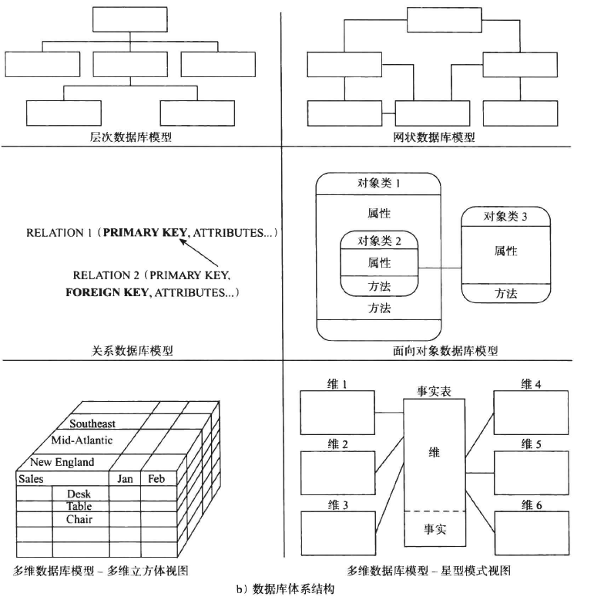
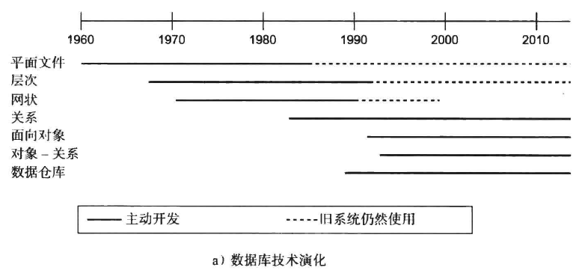
History of Database Systems
Notes:
1

Slide 2


History of Database Systems
1950s and early 1960s:
Data processing using magnetic tapes for storage
Tapes provided only sequential access
Punched cards for input
Late 1960s and 1970s:
Hard disks allowed direct access to data
Network and hierarchical data models in widespread use
Ted Codd defines the relational data model
Would win the ACM Turing Award for this work
IBM Research begins System R prototype
UC Berkeley begins Ingres prototype
High-performance (for the era) transaction processing
Notes:
2

Slide 3

History of Database Systems
1980s:
Research relational prototypes evolve into commercial systems
SQL becomes industrial standard
Parallel and distributed database systems
Object-oriented database systems
1990s:
Large decision support and data-mining applications
Large multi-terabyte data warehouses
Emergence of Web commerce
Notes:
3

Slide 4
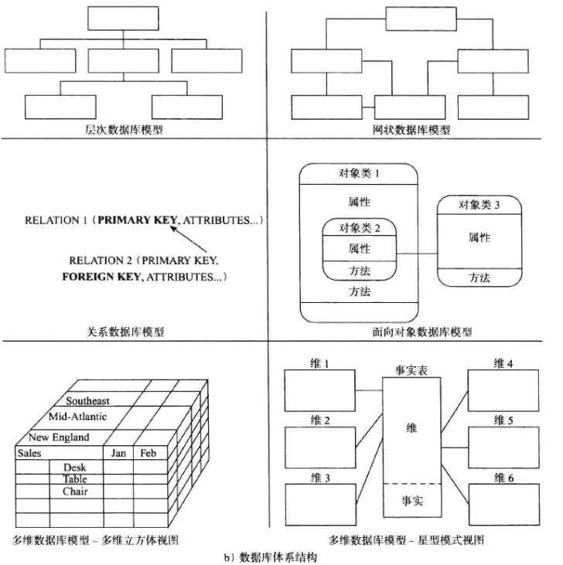
History of Database Systems
Early 2000s:
XML and XQuery standards
Automated database administration
Later 2000s:
Giant data storage systems
Google BigTable, Yahoo PNuts, Amazon, .
Now:
Relation Database
NoSQL
KV：Redis
Document：MongoDB
Column Family：Hbase
Graph：Neo4J
Notes:
4

Slide 5
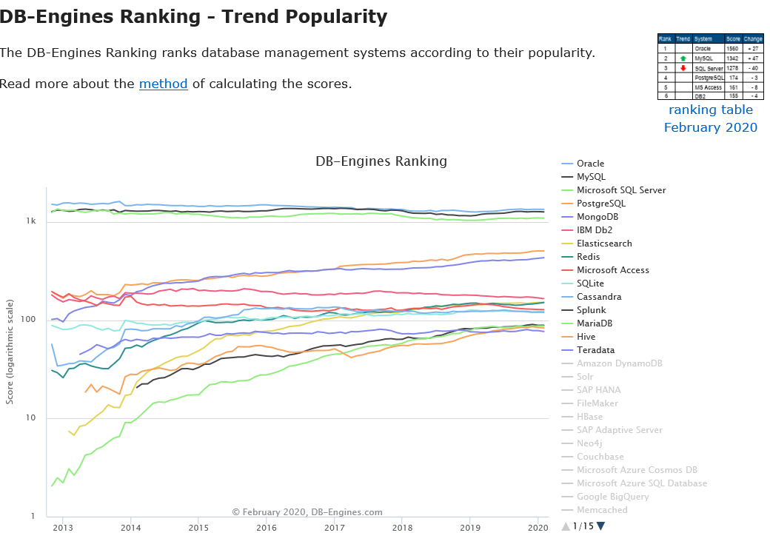
Trend http://db-engines.com/en/ranking_trend
Notes:
5

