Slide 1

数据库系统原理
Chapter 3: SQL简介

Slide 2
Overview of the SQL Query Language
History of SQL and its Standard
IBM Sequel language developed as part of System R project at the IBM San Jose Research Laboratory，Renamed Structured Query Language (SQL)
ANSI and ISO standard SQL:
SQL-86, SQL-89, SQL-92
SQL：1999， SQL：2003，SQL：2008 ， SQL：2011
最新的标准是SQL：2016
Commercial systems offer most, if not all, SQL-92 features, plus varying feature sets from later standards and special proprietary features.
Not all examples here may work on your particular system.

Slide 3
Overview of the SQL Query Language
SQL：2016
9个部分
第1部分(ISO/IEC 9075-1)：框架（SQL/框架）
第2部分(ISO/IEC 9075-2)：基本原则（SQL/基本原则）
第3部分(ISO/IEC 9075-3)：调用级接口（SQL/CLI）
第4部分(ISO/IEC 9075-4)：持久存储模块（SQL/PSM）
第9部分(ISO/IEC 9075-9)：外部数据管理（SQL/MED）
第10部分(ISO/IEC 9075-10)：对象语言绑定（SQL/OLB）
第11部分(ISO/IEC 9075-11)：信息与定义概要（SQL/Schemata）
第13部分(ISO/IEC 9075-13)：使用Java编程语言的SQL程序与类型（SQL/JRT）
第14部分(ISO/IEC 9075-14)：XML相关规范（SQL/XML）

Slide 4
Overview of the SQL Query Language
SQL：2016 新特征
行模式识别（row pattern recognition）
行模式识别使用MATCH_RECOGNIZE子句指定一个匹配多行的模式（正则表达式），可以对这些匹配的行组进行过滤、分组和聚合操作。
MATCH_RECOGNIZE支持两种形式：
ONE ROW PER MATCH：对于每次匹配返回单行摘要
ALL ROWS PER MATCH：对于每次匹配中的每一行数据返回一行输出
行模式匹配可以用于分析时间序列数据
股票行情收录器日志或事件日志

Slide 5
Overview of the SQL Query Language
SQL：2016 新特征
支持JSON对象
JSON对象由标签和数据组成。它为一些应用提供了极大的灵活性
提供了以下功能：
JSON对象的存储与检索
将JSON对象表示成SQL数据
将SQL数据表示成JSON对象
添加JSON对象的SQL支持允许将JSON数据与已有的应用进行集成，可以
提高安全性
集成数据库事务
提高开发者效率

Slide 6
Overview of the SQL Query Language
SQL：2016 新特征
多态表函数（Polymorphic Table Functions, PTF）
表函数是指返回结果为一个表的函数
多态表函数是一种用户定义的函数，可以在FROM子句中使用。
多态表函数可以处理在定义时没有声明行的类型的表，也可以生成一个在定义时声明了或者没有声明行的类型的结果表。
多态表函数允许开发人员利用动态SQL创建强大而复杂的自定义函数

Slide 7
Overview of the SQL Query Language
SQL：2016 新特征
额外的分析功能
三角函数
sin、cos、tan、sinh、cosh、tanh、asin、acos、atan
对数函数
一般对数函数log(<base>, <value>)
常用对数函数log10(<value>)
自然对数函数ln(<value>)
这些分析函数支持在已有的SQL应用中进行复制的计算，同时可以为以后的多维数组提供支持

Slide 8
Overview of the SQL Query Language
商业化的数据库管理系统
Oracle
MS SQL Server
DB2
Sybase
MySQL
开源数据库
PostgreSQL
MariaDB（MySQL的一个分支）
国产数据库管理系统
达梦
华中理工冯玉才教授创办，完全自主研发
以Oracle为参照、追赶对象
人大金仓
由人民大学王珊教授创办，自主研发
普通的关系型数据库
南大通用（Gbase）
购买了informix源代码
普通的关系型数据库Gbase 8t
面向数据分析、数据仓库的数据库Gbase 8a
神舟通用
更多地用于数据分析领域。

Slide 9
Overview of the SQL Query Language
Main Part of SQL
Data-definition language (DDL)
defining relation schemas
deleting relations
modifying relation schemas.
Data-manipulation language (DML)
query information from the database
insert tuples into the database
delete tuples from the database
modify tuples in the database.
Integrity
specifying integrity constraints that the data stored in the database must satisfy.
Updates that violate integrity constraints are disallowed

Slide 10
Overview of the SQL Query Language
Main Part of SQL
View definition： The SQL DDL includes commands for defining views.
Transaction control： SQL includes commands for specifying the beginning and ending of transactions
Embedded SQL and dynamic SQL.
Embedded and dynamic SQL define how SQL statements can be embedded within general-purpose programming languages, such as C, C++, and Java.
Authorization： The SQL DDL includes commands for specifying access rights to relations and views.

Slide 11
Data Definition Language
The SQL data-definition language (DDL) allows the specification of information about relations, including:
The schema for each relation.
The domain of values associated with each attribute.
Integrity constraints
And as we will see later, also other information such as
The set of indices to be maintained for each relations.
Security and authorization information for each relation.
The physical storage structure of each relation on disk.

Slide 12
Data Definition Language
Domain Types in SQL
char(n). Fixed length character string, with user-specified length n.
varchar(n). Variable length character strings, with user-specified maximum length n.
int. Integer (a finite subset of the integers that is machine-dependent).
smallint. Small integer (a machine-dependent subset of the integer domain type).
numeric(p,d). Fixed point number, with user-specified precision of p digits, with n digits to the right of decimal point.
real, double precision. Floating point and double-precision floating point numbers, with machine-dependent precision.
float(n). Floating point number, with user-specified precision of at least n digits.
More are covered in Chapter 4 (Time and Date)
char(10) 固定10个字符长度
varchar(10) 最长10个字符
nvarchar(10) 存放使用Unicode表示的多语言字符数据
number(5,2) 总共5个数字，小数点后有2个数字（0.01~999.99）

Slide 13
Data Definition Language
Basic Schema Definition
Create Table Statement
An SQL relation is defined using the create table command:
create table r (A₁ D₁,
A₂ D₂,
......,
A_{n} D_{n} , (integrity-constraint₁), ......, (integrity-constraint_{k}) )
r is the name of the relation
each A_{i} is an attribute name in the schema of relation r
D_{i} is the data type of values in the domain of attribute A_{i}

Slide 14
Data Definition Language
Basic Schema Definition
Example 1：
create table instructor (
ID varchar(5) primary key ,
name varchar(20) not null,
dept_name varchar(20),
salary numeric(8,2));
Example 2：
create table department
( dept_name varchar (20),
building varchar (15),
budget numeric (12,2),
primary key (dept_name)
);
Example 3：
create table student (
ID varchar(5),
name varchar(20) not null,
dept_name varchar(20),
tot_cred numeric(3,0),
primary key (ID),
foreign key(dept_name) references department );
Example 4：
create table course (
course_id varchar(8) primary key,
title varchar(50),
dept_name varchar(20),
credits numeric(2,0),
foreign key (dept_name) references department );
Notes:
create user student identified by student;
grant create session,resource to student;
connect student/student
drop table instructor;
create table instructor (
ID varchar(5) primary key ,
name varchar(20) not null,
dept_name varchar(20),
salary numeric(8,2));

Slide 15
Data Definition Language
Basic Schema Definition
Example 5：
create table section
( course_id varchar (8),
sec_id varchar (8),
semester varchar (6),
year numeric (4,0),
building varchar (15),
room_number varchar (7),
time_slot_id varchar (4),
primary key (course_id, sec_id, semester, year),
foreign key (course_id) references course);
Example 6：
create table takes (
ID varchar(5),
course_id varchar(8),
sec_id varchar(8),
semester varchar(6),
year numeric(4,0),
grade varchar(2),
primary key (ID, course_id, sec_id, semester, year),
foreign key (ID) references student,
foreign key (course_id, sec_id, semester, year) references section );
Example 7：
create table teaches (
ID varchar (5),
course_id varchar (8),
sec_id varchar (8),
semester varchar (6),
year numeric (4,0),
primary key (ID, course_id, sec_id, semester, year),
foreign key (course_id, sec_id, semester, year) references section,
foreign key (ID) references instructor);
Notes:
create user student identified by student;
grant create session,resource to student;
connect student/student
drop table instructor;
create table instructor (
ID varchar(5) primary key ,
name varchar(20) not null,
dept_name varchar(20),
salary numeric(8,2));

Slide 16
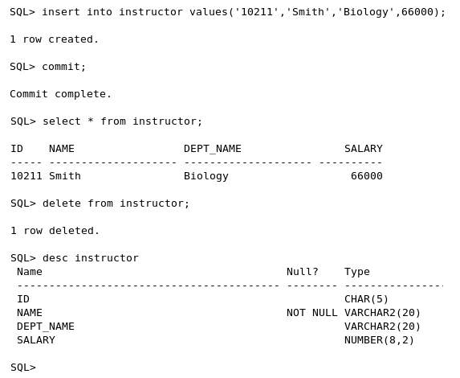
Data Definition Language
Basic Schema Definition
Add Data Record for a new table
insert into instructor values('10211','Smith','Biology',66000);
Delete Data Record for a table
delete from instructor;
注意：本张ppt中SQL语句
不是DDL语句，
是DML语句

Slide 17
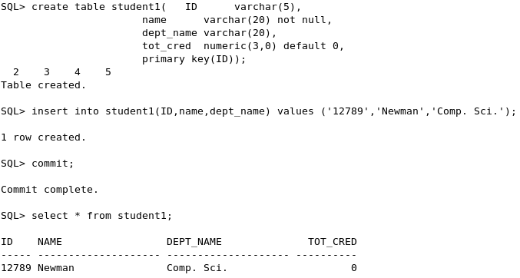
Data Definition Language
属性的Default Value
create table student ( ID varchar (5), name varchar (20) not null, dept_name varchar (20), tot_cred numeric (3,0) default 0, primary key (ID)
)
insert into student(ID, name, dept_name)
values('12789', 'Newman', 'Comp. Sci.');
未提供属性tot_cred的值，插入的新记录，在该属性上取默认值0
Notes:
create table student
( ID varchar (5),
name varchar (20) not null,
dept_name varchar (20),
tot_cred numeric (3,0) default 0,
primary key (ID)
);
insert into student(ID, name, dept_name)
values ('12789','Newman','Comp. Sci.');
Select * from student;
======
create table student1
( ID varchar (5),
name varchar (20) not null,
dept_name varchar (20),
tot_cred numeric (3,0) default 0,
primary key (ID)
);
insert into student1(ID, name, dept_name)
values ('12789','Newman','Comp. Sci.');
Select * from student1;

Slide 18
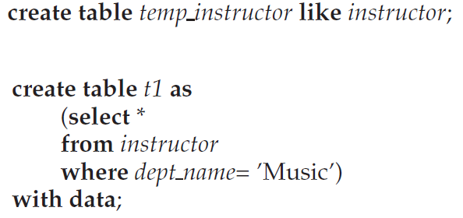
Create table Extensions
Oracle的语法：
create table temp2_instructor as select * from instructor where 1=2;
create table temp1_instructor as select * from instructor;
Notes:
create table temp1_instructor as select * from instructor;
create table temp2_instructor as select * from instructor where 1=2;

Slide 19
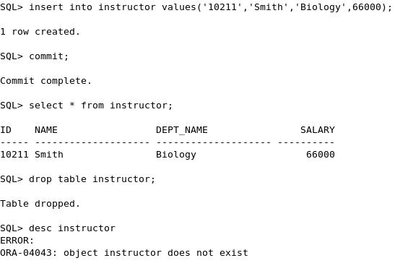
Data Definition Language
Basic Schema Definition
Drop Table
drop table instructor;
Notes:
清除数据库!
create table instructor (
ID varchar(5) primary key ,
name varchar(20) not null,
dept_name varchar(20),
salary numeric(8,2));
insert into instructor values('10211','Smith','Biology',66000);
commit;
Select * from instructor;
drop table instructor;
Desc instructor

Slide 20
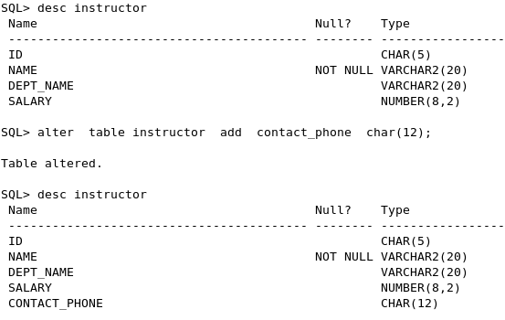
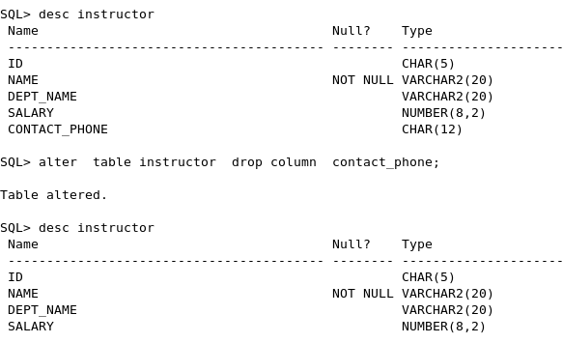
Data Definition Language
Basic Schema Definition
Alter Table Constructs
alter table r add A D
where A is the name of the attribute to be added to relation r and D is the domain of A.
All tuples in the relation are assigned null as the value for the new attribute.
Example ：alter table instructor add contact_phone char(12);
alter table r drop A
where A is the name of an attribute of relation r
Dropping of attributes not supported by many databases
Example ：alter table instructor drop column contact_phone;

Slide 21
Data Manipulation Language
Function of DML
为数据库表增加记录(insert)
从数据库表中删除记录(delete)
修改数据库表中的记录(update)

Slide 22
Data Manipulation Language Modification of the Database – Deletion
Delete all instructors
delete from instructor;
Delete all instructors from the Finance department
delete from instructor
where dept_name='Finance’;
Delete all tuples in the instructor relation for those instructors associated with a department located in the Watson building.
delete from instructor
where dept_name in (select dept_name
from department
where building='Watson');
Notes:
delete from instructor;
Rollback;
delete from instructor
where dept_name='Finance';
Rollback;
delete from instructor
where dept_name in (select dept_name
from department
where building='Watson');

Slide 23
Data Manipulation Language Modification of the Database – Deletion
Delete all instructors whose salary is less than the average salary of instructors
delete from instructor
where salary< (select avg (salary) from instructor);
Problem: as we delete tuples from deposit, the average salary changes
Solution used in SQL:
1. First, compute avg salary and find all tuples to delete
2. Next, delete all tuples found above (without recomputing avg or retesting the tuples)
Notes:
delete from instructor
where salary< (select avg (salary) from instructor);

Slide 24
Data Manipulation Language Modification of the Database – Insertion
Add a new tuple to course
insert into course
values ('CS-437','Database Systems','Comp. Sci.', 4);
or equivalently insert into course (course_id, title, dept_name, credits)
values ('CS-437','Database Systems','Comp. Sci.', 4);
Add a new tuple to student with tot_creds set to null
insert into student
values ('3003','Green','Finance',null);
Notes:
insert into course
values ('CS-437','Database Systems','Comp. Sci.', 4);
insert into course (course_id, title, dept_name, credits)
values ('CS-438','Database Systems1','Comp. Sci.', 5);
insert into student
values ('3003','Green','Finance',null);

Slide 25
Data Manipulation Language Modification of the Database – Insertion
Add all instructors to the student relation with tot_creds set to 0
insert into student select ID, name, dept_name, 0 from instructor
The select from where statement is evaluated fully before any of its results are inserted into the relation
otherwise queries like insert into table1 select * from table1 would cause problems, if table1 did not have any primary key defined.
Notes:
重新初始化数据库
select ID from student
Intersect
select ID from instructor;
Delete from student where id='76543';
Commit;
insert into student
select ID, name, dept_name, 0
from instructor;

Slide 26
Data Manipulation Language Modification of the Database – Updates
Increase salaries of instructors whose salary is over $100,000 by 3%, and all others receive a 5% raise
Write two update statements:
update instructor
set salary = salary * 1.03
where salary > 100000;
update instructor
set salary = salary * 1.05
where salary <= 100000;
The order is important！（颠倒顺序将会造成有些人加了两次薪水！）
Can be done better using the case statement
update instructor
set salary = case
when salary <= 100000 then salary * 1.05
else salary * 1.03
end;
Notes:
update instructor
set salary = salary * 1.03
where salary > 80000;
update instructor
set salary = salary * 1.05
where salary <= 80000;

Slide 27
Data Manipulation Language Modification of the Database – Updates with Scalar Subqueries
Recompute and update tot_creds value for all students
update student S
set tot_cred = ( select sum(credits)
from takes natural join course
where S.ID= takes.ID and
takes.grade <> 'F' and
takes.grade is not null);
如果学生没有选修任何一门课程，上面的语句将会把该生的tot_creds设置为 null
下面的语句，使用case表达式代替sum(credits) ，将没有选修任何一门课程的学生的tot_creds设置为 0
update student S
set tot_cred = ( select case
when sum(credits) is not null then sum(credits)
else 0
end
from takes natural join course
where S.ID= takes.ID and
takes.grade <> 'F' and
takes.grade is not null);
Notes:
update student S
set tot_cred = ( select sum(credits)
from takes natural join course
where S.ID= takes.ID and
takes.grade <> 'F' and
takes.grade is not null);
更新学分：通过的增加学分（不是考试未通过的或者缺考的）

Slide 28
Basic Query Structure
The SQL data-manipulation language (DML) provides the ability to query information, and insert, delete and update tuples
A typical SQL query has the form: select A₁, A₂, ..., A_{n} from r₁, r₂, ..., r_{m} where P
A_{i} represents an attribute
R_{i} represents a relation
P is a predicate.
The result of an SQL query is a relation.

Slide 29
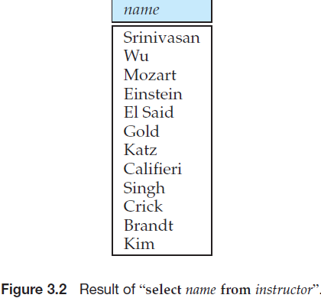
Basic Query Structure
The select Clause
The select clause list the attributes desired in the result of a query
corresponds to the projection operation of the relational algebra
Example: find the names of all instructors: select name from instructor
NOTE: SQL names are case insensitive (i.e., you may use upper- or lower-case letters.)
E.g. Name ≡ NAME ≡ name
Some people use upper case wherever we use bold font.
Notes:
select name
from instructor;

Slide 30
Basic Query Structure
The select Clause
SQL allows duplicates in relations as well as in query results.
To force the elimination of duplicates, insert the keyword distinct after select.
Find the names of all departments with instructor, and remove duplicates
select distinct dept_name from instructor
The keyword all specifies that duplicates not be removed.
select all dept_name from instructor
Notes:
select distinct dept_name from instructor;
select all dept_name from instructor;

Slide 31
Basic Query Structure
The select Clause
An asterisk in the select clause denotes “all attributes”
select * from instructor
The select clause can contain arithmetic expressions involving the operation, +, –, ∗, and /, and operating on constants or attributes of tuples.
The query:
select ID, name, salary/12 from instructor
would return a relation that is the same as the instructor relation, except that the value of the attribute salary is divided by 12.
Notes:
select * from instructor;
select ID, name, salary/12 from instructor;

Slide 32
Basic Query Structure
The where Clause
The where clause specifies conditions that the result must satisfy
Corresponds to the selection predicate of the relational algebra.
To find all instructors in Comp. Sci. dept with salary > 80000
select name from instructor where dept_name = ‘Comp. Sci.' and salary > 80000
Comparison results can be combined using the logical connectives and, or, and not.
Comparisons can be applied to results of arithmetic expressions.
Notes:
select name
from instructor
where dept_name ='Comp. Sci.' and salary > 80000;

Slide 33
Basic Query Structure
The from Clause
The from clause lists the relations involved in the query
Corresponds to the Cartesian product operation of the relational algebra.
Find the Cartesian product instructor X teaches
select ∗ from instructor, teaches
generates every possible instructor – teaches pair, with all attributes from both relations
Cartesian product not very useful directly, but useful combined with where-clause condition (selection operation in relational algebra)
学生表X 点名次数表（笛卡尔积）的物理意义表示：点名应到学生
Notes:
Column name format a10
Column dept_name format a15
Set linesize 120
Set pagesize 100
select *
from instructor,teaches;

Slide 34
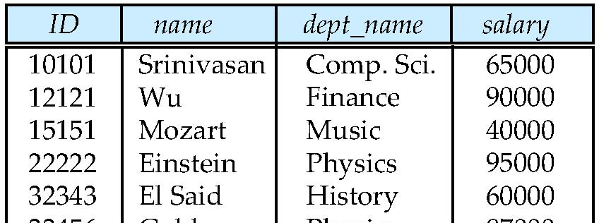
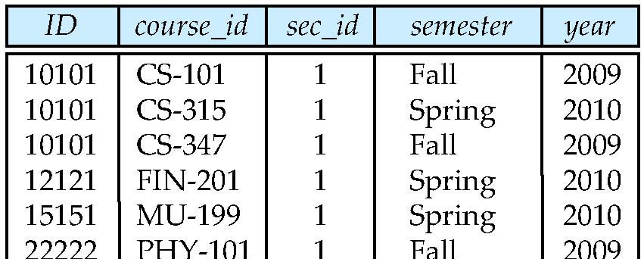
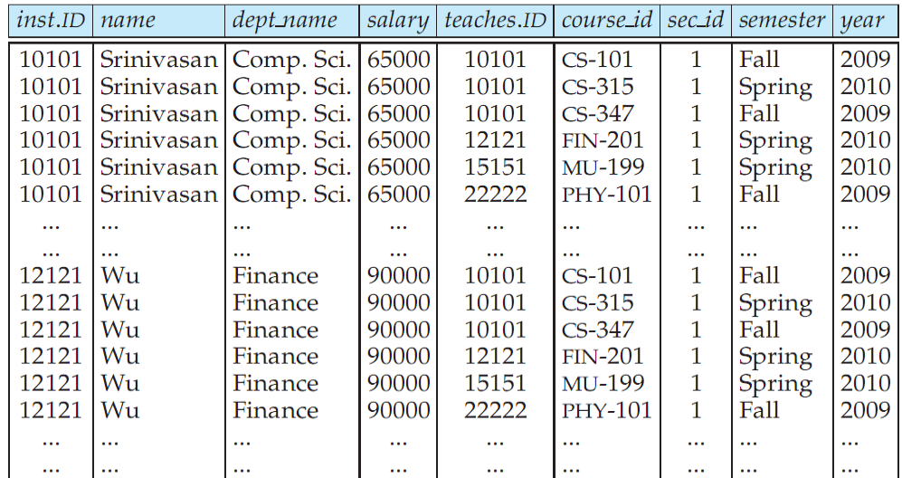
Basic Query Structure
The from Clause
Find the Cartesian product instructor X teaches
select ∗ from instructor, teaches
instructor
teaches
Notes:
Column name format a10
Column dept_name format a15
Set linesize 120
Set pagesize 100
select *
from instructor,teaches;

Slide 35
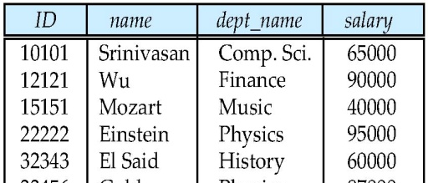
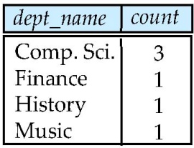
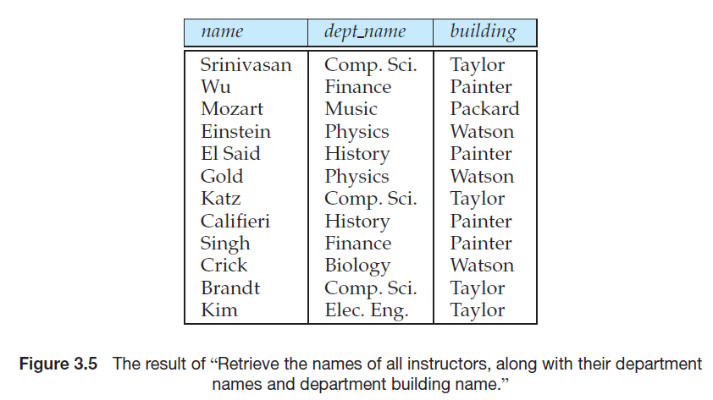
Basic Query Structure
Multy Relation Query（Join）
select A₁, A₂, . . . , A_{n}
from r₁, r₂, . . . , r_{m}
where P;
σ_{P}(r₁×r₂ ×…… ×r_{m})
Example
select name, instructor.dept_name, building
from instructor, department
where instructor.dept_name=department.dept_name;

Slide 36
Basic Query Structure
Multy Relation Query（Join）
For all instructors who have taught some course, find their names and the course ID of the courses they taught.
select name, course_id from instructor, teaches where instructor.ID = teaches.ID
两个表连接只需要一个连接条件
N个表连接需要N-1个连接条件，每个表至少在这些连接条件中出现一次，否则就会产生笛卡尔积！
Notes:
Set linesize 120
Set pagesize 100
column course_id format a12
select name, course_id
from instructor, teaches
where instructor.ID= teaches.ID;

Slide 37
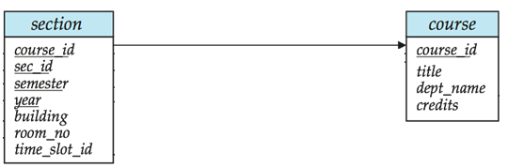
Basic Query Structure
Multy Relation Query（Join）
Find the course ID, semester, year and title of each course offered by the Comp. Sci. department
select section.course_id, semester, year, title from section, course where section.course_id = course.course_id and dept_name = ‘Comp. Sci.’
连接条件section.course_id = course.course_id
过滤条件dept_name = ‘Comp. Sci.'
Notes:
Set linesize 120
Set pagesize 100
column course_id format a12
select name, course_id
from instructor, teaches
where instructor.ID= teaches.ID;

Slide 38

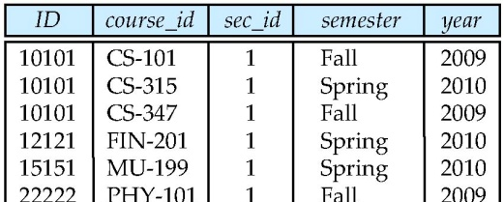
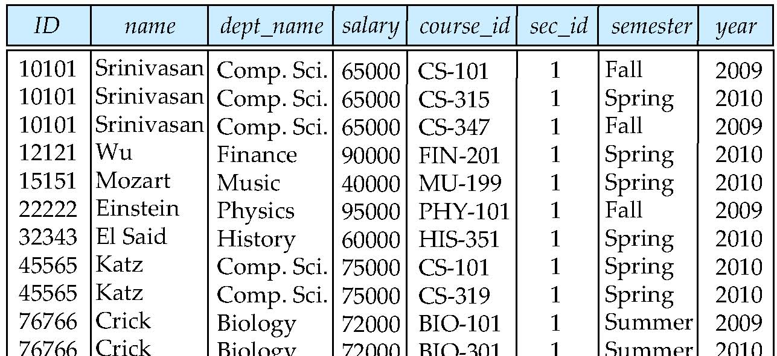
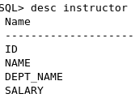
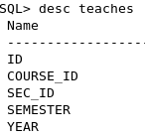
Basic Query Structure
Natural Join
Natural join matches tuples with the same values for all common attributes, and retains only one copy of each common column
List the names of instructors along with the course ID of the courses that they taught.
select name, course_id from instructor, teaches where instructor.ID = teaches.ID;
select name, course_id from instructor natural join teaches;
select * from instructor natural join teaches;
Notes:
Set linesize 120
Set pagesize 100
column course_id format a12
select *
from instructor natural join teaches;
select *
from instructor, teaches
where instructor.ID= teaches.ID;
这两条语句的区别?
第一条语句:公共列只显示1次;
第二条语句:先显示第一个表的列,然后显示第二个表的列,公共列显示2次)

Slide 39
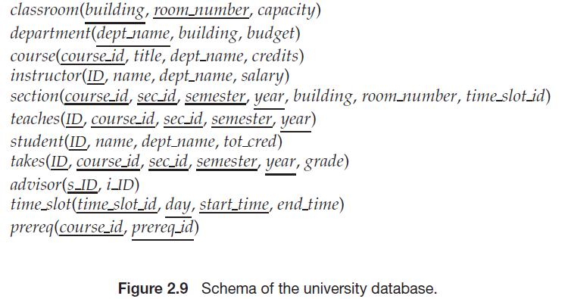
Basic Query Structure
Natural Join
Danger in natural join:两个关系表，虽然有同名的属性，但语义不同相，这两个关系表使用同名属性进行自然连接，没有现实意义，结果肯定不对！
course(course_id, title, dept_name, credits)
instructor(ID, name, dept_name, salary)
teaches(ID, cours_id, sec_ id, semester, year)
course表的每一行表示：编号为course_id的课程，课程名为title，编号为course_id的课程是由dept_name系开设的，该课程有credits个学分
instructor表的每一行表示：编号为ID的老师，名字为name，编号为ID的教师在dept_name系工作，工资为salary
teaches表示实体instructor和实体course之间的联系， teaches表上的一行表示：教工号为ID的讲师，讲授某个course_id的课程
instructor关系表的dept_name和course关系表的dept_name物理意义是有差别的！
自然连接需要在外键上来进行!这样可以避免本例中dept_name同名产生的问题!
Notes:
自然连接需要在外键上来进行!
教师教课程这两个实体集之间的联系是多对对,
因此其联系可以用一个联系集来表示,
该联系集的码由教师和课程这两个实体集的码组合而成
并参照引用这两个实体集形成外码关系!

Slide 40

Basic Query Structure
Natural Join
Danger in natural join:
List the names of instructors along with the the titles of courses that they teach
查询讲师的名字，并显示他所教的课程
Incorrect version (makes course.dept_name = instructor.dept_name)
select name, title from instructor natural join teaches natural join course;
Correct version
select name, title from instructor natural join teaches, course where teaches.course_id = course.course_id;
Another correct version
select name, title from (instructor natural join teaches) join course using(course_id);
Notes:
错误的版本
select name, title
from instructor natural join teaches natural join course;
正确的版本1
select name, title
from instructor natural join teaches, course
where teaches.course_id = course.course_id;
正确的版本2
select name, title
from (instructor natural join teaches)
join course using(course_id);

Slide 41
Additional Basic Query Structure
The Rename Operation
需要更名运算的原因
首先， frorn 子句的两个关系中可能存在同名属性，在这种情况下，结果中就会出现重复的属性名;
其次，如果我们在select 子句中使用算术表达式，那么结果属性就没有名字;
再次，属性名可以从基关系导出，但我们也许想要改变结果中的属性名字
SQL允许重命名表名或者属性名，语法都是一样，具有如下形式：
old-name as new-name

Slide 42
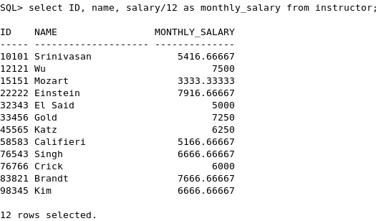
Additional Basic Query Structure
The Rename Operation
在select子句中重命名属性
select ID, name, salary/12 as monthly_salary from instructor;
Notes:
select ID, name, salary/12 as monthly_salary
from instructor;

Slide 43
Additional Basic Query Structure
The Rename Operation
在from子句中重命名属性
Find the names of all instructors who have a higher salary than some instructor in‘Comp. Sci’
select distinct T.name
from instructor as T, instructor as S
where T.salary > S.salary and S.dept_name = 'Comp. Sci.'
Keyword as is optional and may be omitted instructor as T ≡ instructor T
Keyword as in from statement must be omitted in Oracle！
select distinct T.name
from instructor T, instructor S
where T.salary > S.salary and S.dept_name = 'Comp. Sci.';
Notes:
Oracle不支持在From字句中的as,需要将其省略!
select distinct T.name
from instructor T, instructor S
where T.salary > S.salary and S.dept_name = 'Comp. Sci.';

Slide 44
Additional Basic Query Structure
String Operations
SQL includes a string-matching operator for comparisons on character strings. The operator “like” uses patterns that are described using two special characters:
percent (%)： The % character matches any substring.
underscore (_)：The _ character matches any character.
Find the names of all instructors whose name includes the substring “dar”.
Select name
From instructor
Where name like '%dar%’;
Match the string “100%”： like ‘100\%' escape ‘\’
Patters are case sensitive.
Pattern matching examples:
‘Intro%’ matches any string beginning with “Intro”.
‘%Comp%’ matches any string containing “Comp” as a substring.
‘_ _ _’ matches any string of exactly three characters.
‘_ _ _ %’ matches any string of at least three characters.
Notes:
Select name
From instructor
Where name like '%dar%';
Select name
From instructor
Where name like '%st%';
Select name
From instructor
Where name like '100\%';

Slide 45
Additional Basic Query Structure
String Operations
SQL supports a variety of string operations such as
concatenation (using “||”)
converting from upper to lower case (and vice versa)
upper（s）
lower（s）
finding string length
lengthb(s)：返回字符串s所占的字节长度，单位是字节
length(s) ：返回字符串s所占的字符长度，单位是字符
对于单字节字符，length(s)和lengthb(s)是一样的.
如可以用length(s)=lengthb(s)判断字符串是否含有中文
Notes:
增加SQL使用例子！

Slide 46
Additional Basic Query Structure
String Operations
SQL supports a variety of string operations such as
extracting substrings： substr( string, start_position, [ length ] )
string源字符串
start_position是提取的位置。字符串中的第一个位置始终为1
length 可选的。它是提取的字符数。如果省略该参数，SUBSTR将返回从开始位置到结尾的字符串。
substr('This is a test', 6, 2) would return 'is'
substr('This is a test', 6) would return 'is a test'
substr('TechOnTheNet', 1, 4) would return 'Tech
substr('TechOnTheNet', -3, 3) would return 'Net'
substr('TechOnTheNet', -6, 3) would return 'The'
substr('TechOnTheNet', -8, 2) would return 'On’

Slide 47
Additional Basic Query Structure
String Operations
SQL supports a variety of string operations such as
trim（s） 去掉字符串后的空格
SELECT TRIM(' dd df ') FROM dual;
SELECT LTRIM(' dd df ') FROM dual;
SELECT RTRIM(' dd df ') FROM dual;
SELECT TRIM(leading|trailing|both string1 FROM string2) FROM dual;
SELECT trim(leading 'd' from 'dfssa') FROM dual;
SELECT trim(both '1' from '123sfd111') FROM dual;
SELECT trim(trailing '2' from '213dsq12') FROM dual;
Notes:
oracle中trim，ltrim，rtrim函数用法
该函数共有两种作用：
第一种，即大家都比较熟悉的去除空格。
例子：
--TRIM去除指定字符的前后空格
SQL> SELECT TRIM(' dd df ') FROM dual;
TRIM('DDDF')
------------
dd df
--LTRIM去除指定字符的前面空格
SQL> SELECT LTRIM(' dd df ') FROM dual;
LTRIM('DDDF')
-------------
dd df
--RTRIM去除指定字符后面后空格
SQL> SELECT RTRIM(' dd df ') FROM dual;
RTRIM('DDDF')
-------------
dd df
第二种，去除指定的字符。trim只能去除单个字符，而ltrim和rtrim可以去除多个字符。
trim去除字符的写法：
--表示字符串string2去除前面|后面|前后面（leading|trailing|both）的字符string1，默认去除方式为both
SELECT TRIM(leading|trailing|both string1 FROM string2) FROM dual;
例子：
SQL> SELECT trim(leading 'd' from 'dfssa') FROM dual;
TRIM(LEADING'D'FROM'DFSSA')
---------------------------
fssa
SQL> SELECT trim(both '1' from '123sfd111') FROM dual;
TRIM(BOTH'1'FROM'123SFD111')
----------------------------
23sfd
SQL> SELECT trim(trailing '2' from '213dsq12') FROM dual;
TRIM(TRAILING'2'FROM'213DSQ12'
------------------------------
213dsq1
注：trim去除字符只能是单个字符，如下，要去除的字符若为字符集则报错
SQL> SELECT trim(trailing '12' from '123dsq12') FROM dual;
SELECT trim(trailing '12' from '123dsq12') FROM dual
ORA-30001: 截取集仅能有一个字符
ltrim和rtrim去除字符的写法：
--表示字符串string1去除前面与string2字符集匹配的，若无匹配则结束返回
SELECT ltrim(string1,string2) FROM dual;
--rtrim与ltrim类似，只是去除的是右边算起匹配的字符
SELECT rtrim(string1,string2) FROM dual;
例子：
--如下，由于从右边算起，第一个字母是b没有与'main'匹配的字符，因此返回结果仍是'aaaaminb'
SQL> SELECT rtrim('aaaaminb','main') FROM dual;
RTRIM('AAAAMINB','MAIN')
------------------------
aaaaminb
--如下返回结果为空
SQL> SELECT rtrim('aaaaminb','mainb') FROM dual;
RTRIM('AAAAMINB','MAINB')
-------------------------
SQL> SELECT ltrim('ccbcminb','cb') FROM dual;
LTRIM('CCBCMINB','CB')
----------------------
minb

Slide 48
Additional Basic Query Structure
Attribute Specification in Select Clause
The asterisk symbol “ * ” can be used in the select clause to denote “all attributes.”
不推荐这样使用！
会导致速度慢，因为需要查询数据字典来获取这个关系表的属性名！
select instructor.*
from instructor, teaches
where instructor.ID= teaches.ID;
Notes:
select instructor.*
from instructor, teaches
where instructor.ID= teaches.ID;

Slide 49
Additional Basic Query Structure
Ordering the Display of Tuples
List in alphabetic order the names of all instructors select distinct name from instructor order by name
We may specify desc for descending order or asc for ascending order, for each attribute; ascending order is the default.
Example: order by name desc
Can sort on multiple attributes
Example: order by dept_name, name
select *
from instructor
order by salary desc, name asc;
Notes:
select distinct name
from instructor
order by name;
select distinct name
from instructor
order by name asc;
select distinct name
from instructor
order by name desc;
select *
from instructor
order by salary desc, name asc;

Slide 50
Additional Basic Query Structure
Where Clause Predicates（between ）
between Number1 and Number2
not between Number1 and Number2
Number1 must be less than Number2
Example: Find the names of all instructors with salary between $90,000 and $100,000 .
That is， ≥ $90,000 and ≤ $100,000 .
以上两句等价！
select name
from instructor
where salary between 90000 and 100000;
select name
from instructor
where salary <= 100000 and salary >= 90000;
Notes:
select name
from instructor
where salary between 90000 and 100000;
select name
from instructor
where salary <= 100000 and salary >= 90000;

Slide 51
Additional Basic Query Structure
Where Clause Predicates（Tuple comparison）
SQL中记号（v₁，v₂，……，v_{n}）来表示一个分量值为v₁，v₂，……，v_{n}的n维元组。
在元组上可以运用比较运算符，按字典顺序进行比较运算。例如：
(a1, a2) <= (b1, b2) 在a1 <= b1 和 a2 <= b2 的情况下为真！
(a1, a2) = (b1, b2) 在 a1 = b1 和 a2 = b2 的情况下为真！
以下两个语句等价
select name, course_id
from instructor, teaches
where instructor.ID= teaches.ID and dept_name = 'Biology’;
select name, course_id
from instructor, teaches
where (instructor.ID, dept_name) = (teaches.ID, 'Biology');
注意：Oracle不支持第2种写法

Slide 52
Set Operations
Find courses that ran in Fall 2009 or in Spring 2010
(select course_id from section where semester ='Fall' and year = 2009)
union
(select course_id from section where semester ='Spring' and year = 2010);
Find courses that ran in Fall 2009 and in Spring 2010
(select course_id from section where semester ='Fall' and year = 2009)
intersect
(select course_id from section where semester ='Spring' and year = 2010);
Find courses that ran in Fall 2009 but not in Spring 2010
(select course_id from section where semester ='Fall' and year = 2009)
except
(select course_id from section where semester ='Spring' and year = 2010);
(select course_id from section where semester ='Fall' and year = 2009)
minus
(select course_id from section where semester ='Spring' and year = 2010);
Oracle使用minus表示差运算
Notes:
(select course_id from section where semester ='Fall' and year = 2009)
union
(select course_id from section where semester ='Spring' and year = 2010);
(select course_id from section where semester ='Fall' and year = 2009)
intersect
(select course_id from section where semester ='Spring' and year = 2010);

Slide 53
Set Operations
Set operations union, intersect, and except（minus）
Each of the above operations automatically eliminates duplicates
To retain all duplicates use the corresponding multiset versions union all, intersect all and except all. Suppose a tuple occurs m times in r and n times in s, then, it occurs:
m + n times in r union all s
min(m,n) times in r intersect all s
max(0, m – n) times in r except all s

Slide 54
Set Operations
Find courses that ran in Fall 2009 or in Spring 2010
(select course_id from section where semester ='Fall' and year = 2009)
union all
(select course_id from section where semester ='Spring' and year = 2010);
Find courses that ran in Fall 2009 and in Spring 2010
(select course_id from section where semester ='Fall' and year = 2009)
intersect all
(select course_id from section where semester ='Spring' and year = 2010);
Find courses that ran in Fall 2009 but not in Spring 2010
(select course_id from section where semester ='Fall' and year = 2009)
except all
(select course_id from section where semester ='Spring' and year = 2010);
(select course_id from section where semester ='Fall' and year = 2009)
minus all
(select course_id from section where semester ='Spring' and year = 2010);
Oracle不支持语句 minus all和intersect all
Notes:
(select course_id from section where semester ='Fall' and year = 2009)
union all
(select course_id from section where semester ='Spring' and year = 2010);
Oracle不支持以下语句 intersect all！
(select course_id from section where semester ='Fall' and year = 2009)
intersect all
(select course_id from section where semester ='Spring' and year = 2010);

Slide 55
SQL语句中处理Null值
元组的某些属性的值为Null
NULL是任何域的成员(因此NULL不是值，是一个记号)，也就是说任何属性都有可能取NULL值
属性取值为NULL的含义可能是
值存在，但暂时不知道：墨镜下眼睛的颜色；女人的年龄（是秘密）；雇员的工资（也是秘密）
不适用（值根本不存在）：汽车的眼睛的颜色；相声演员岳云鹏的大学学历（根本没上过大学啊！）
值存不存在不知道，介于前面两者之间：新房的电话号码（如果安装了，就是第1种情况；如果没安装，属于第2种）
完整性约束可以禁止让属性取null值
主键约束
not null约束

Slide 56
SQL语句中处理Null值
NULL !=NULL(为什么?因为NULL可能有三种含义！)
测试一个值是否为NULL，不能用=符号，必须使用 谓词is null 或 is not null
Example: Find all instructors whose salary is null.
select name
from instructor
where salary is null;
算术表达式计算种，含有NULL时，结果为NULL
Example: 5 + null returns null
在比较中含有NULL时，结果为unknown
Example: 5 < null or null <> null or null = null
Notes:
select name
from instructor
where salary is null;

Slide 57
SQL语句中处理Null值
三值逻辑（Three-valued logic ）：true、false、unknown
OR: (unknown or true) = true, (unknown or false) = unknown (unknown or unknown) = unknown
AND: (true and unknown) = unknown, (false and unknown) = false, (unknown and unknown) = unknown
NOT: (not unknown) = unknown
“P is unknown” evaluates to true if predicate P evaluates to unknown
如果where子句中的谓词计算结果为unknown，则被当成false来处理

Slide 58
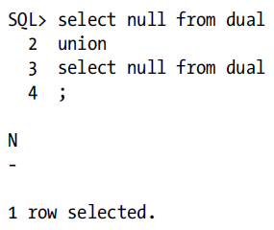
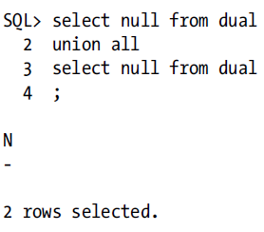
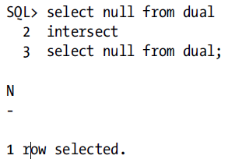
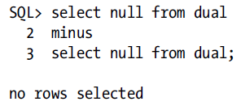
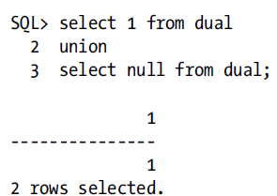
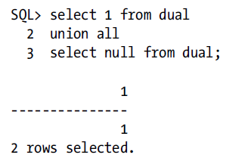
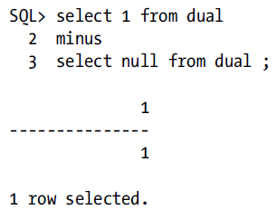
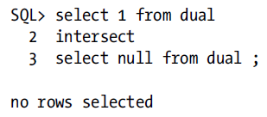
SQL语句中处理Null值
元组中的null值
Select查询结果集中2条元组，如{ (‘A’,null) , (‘A’,null) }，被认为是相同的元组！如果select子句中使用了distinct，将只保留一个拷贝
集合运算Union、Intersection、Except（minus）结果集元组含有null值时，规则也一样

Slide 59
Aggregate Functions
组函数的输入是表的多个行，并返回一个结果值
avg: average value min: minimum value max: maximum value sum: sum of values count: number of values
avg和sum的输入必须是一组数值数据
其他的函数可以对非数值数据类型（如字符串）操作

Slide 60
Aggregate Functions
Find the average salary of instructors in the Computer Science department
select avg (salary)
from instructor
where dept_name=‘Comp. Sci.';
Find the total number of instructors who teach a course in the Spring 2010 semester
select count (distinct ID)
from teaches
where semester='Sprint' and year=2010;
Find the number of tuples in the course relation
select count (*)
from course;
SQL不允许在用count（*）中使用distinct
在max和min时可以使用distinct（结果无差别）
可以使用all来代替distinct来说明保留重复元组，但All是默认的，没必要这么做
Notes:
select avg(salary)
from instructor
where dept_name='Comp. Sci.';
select count (distinct ID)
from teaches
where semester='Sprint' and year=2010;
select count (*)
from course;

Slide 61
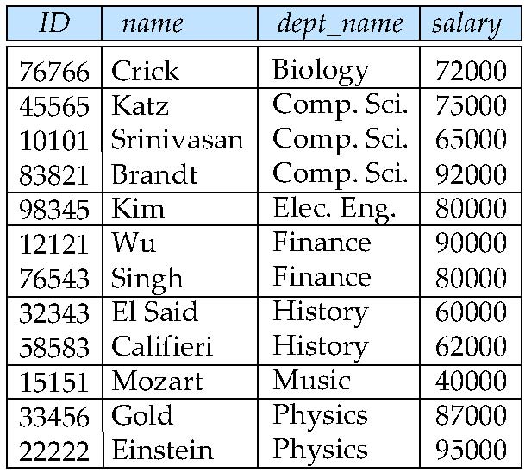
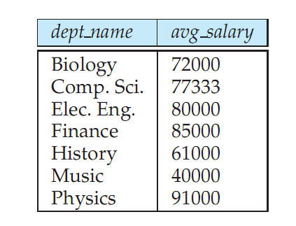
Aggregate Functions – Group By
Find the average salary of instructors in each department
select dept_name, avg (salary)
from instructor
group by dept_name;
Note: departments with no instructor will not appear in result
Notes:
select dept_name, avg (salary)
from instructor
group by dept_name;

Slide 62
Aggregation
Attributes in select clause outside of aggregate functions must appear in group by list
以下语句错误
select dept_name, ID, avg (salary) from instructor group by dept_name;
ID不是group by子句中列出的属性,不能单独出现在Select子句中,只能出现在组函数中!
Salary虽然没有出现在group by子句中,但salary出现在组函数中!
以下语句正确
select dept_name, count(distinct ID) as instr_count
from instructor natural join teaches
where semester='Spring' and year = 2010
group by dept_name;
SQL不允许在用count（*）中使用distinct
但可以count(distinct ID)中使用distinct

Slide 63
Aggregate Functions – Having Clause
Find the names and average salaries of all 的departments whose average salary is greater than 42000
select dept_name, avg (salary)
from instructor
group by dept_name
having avg (salary) > 42000;
For each course section offered in 2009, find the average total credits (tot_cred) of all students enrolled in the section, if the section had at least 2 students.
select course_id, semester, year, sec_id, avg (tot_cred)
from takes natural join student
where year = 2009
group by course_id, semester, year,sec_id
having count (ID) >= 2;
Note:
predicates in the where clause are applied before forming groups
predicates in the having clause are applied after the formation of groups
Notes:
select dept_name, avg (salary)
from instructor
group by dept_name
having avg (salary) > 42000;

Slide 64
Aggregate Functions – null Values and Aggregates
Total all salaries
select sum (salary )
from instructor
Above statement ignores null amounts
Result is null if there is no non-null amount
All aggregate operations except count(*) ignore tuples with null values on the aggregated attributes
What if collection has only null values?
count returns 0
all other aggregates return null
Notes:
计算所有教师的工资总额
select sum (salary )
from instructor;
Sum函数会忽略NULL值，如果所有值是null，则结果为NULL
Count（*）不忽略NULL值
Count（salary）会忽略NULL值
如果都是NULL值，count返回0，其它的组函数返回null

Slide 65
Aggregate Functions – Boolean data type and Aggregates
SQL:1999引入了布尔类型，其值可以为true, false或unknown
组函数some和every可以用来处理布尔值的集合

Slide 66
Nested Subqueries
SQL provides a mechanism for the nesting of subqueries.
A subquery is a select-from-where expression that is nested within another query.
子查询的主要用途是:
集合成员测试(tests for set membership)
集合比较(tests for set comparisons)
集合基数测试(tests for set cardinality)

Slide 67
Nested Subqueries – tests for set membership(in 、not in)
Find courses offered in Fall 2009 and in Spring 2010
select distinct course_id
from section
where semester = 'Fall' and year= 2009 and
course_id in ( select course_id
from section
where semester ='Spring' and year= 2010);
Find courses offered in Fall 2009 but not in Spring 2010
select distinct course_id
from section
where semester = 'Fall' and year= 2009 and
course_id not in ( select course_id
from section
where semester ='Spring' and year= 2010);
Notes:
select distinct course_id
from section
where semester = 'Fall' and year= 2009 and
course_id in (select course_id
from section
where semester ='Spring' and year= 2010);
select distinct course_id
from section
where semester = 'Fall' and year= 2009 and
course_id not in (select course_id
from section
where semester ='Spring' and year= 2010);

Slide 68
Nested Subqueries – tests for set membership(in 、not in)
The in and not in operators can also be used on enumerated sets.
Find the names of instructors whose names are neither “Mozart” nor “Einstein”.
select distinct name
from instructor
where name not in ('Mozart', 'Einstein');
Notes:
select distinct name
from instructor
where name not in ('Mozart', 'Einstein');

Slide 69
Nested Subqueries – tests for set membership(in 、not in)
Find the total number of (distinct) students who have taken course sections taught by the instructor with ID 10101
select count (distinct ID)
from takes
where (course_id, sec_id, semester, year) in
(select course_id, sec_id, semester, year
from teaches
where teaches.ID= 10101);
想想以上的语句还有什么简单的写法？
Notes:
select count (distinct ID)
from takes
where (course_id, sec_id, semester, year) in
(select course_id, sec_id, semester, year
from teaches
where teaches.ID= 10101);

Slide 70
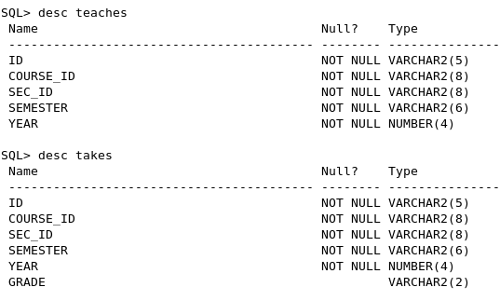
Nested Subqueries – tests for Set Comparison
Find the total number of (distinct) students who have taken course sections taught by the instructor with ID 10101
另一种写法（使用连接）
注意：两个表的ID表示不同的意思！
Teaches中ID是教师的工号；
Takes中的ID表示学生的学号；
因此不能把这两个表通过ID关联
select count (distinct takes.ID)
from takes,teaches
where (teaches.course_id =takes.course_id and
teaches.sec_id =takes.sec_id and
teaches.semester =takes.semester and
teaches.year =takes.year and
teaches.ID= 10101);
Notes:
select count (distinct takes.ID)
from takes,teaches
where (teaches.course_id=takes.course_id and
teaches.sec_id=takes.sec_id and
teaches.semester=takes.semester and
teaches.year=takes.year and
teaches.ID= 10101);
如果把两个表的ID也连接了，则结果是错误的！
select count (distinct takes.ID)
from takes,teaches
where (teaches.id=takes.id and
teaches.course_id=takes.course_id and
teaches.sec_id=takes.sec_id and
teaches.semester=takes.semester and
teaches.year=takes.year and
teaches.ID= 10101);

Slide 71
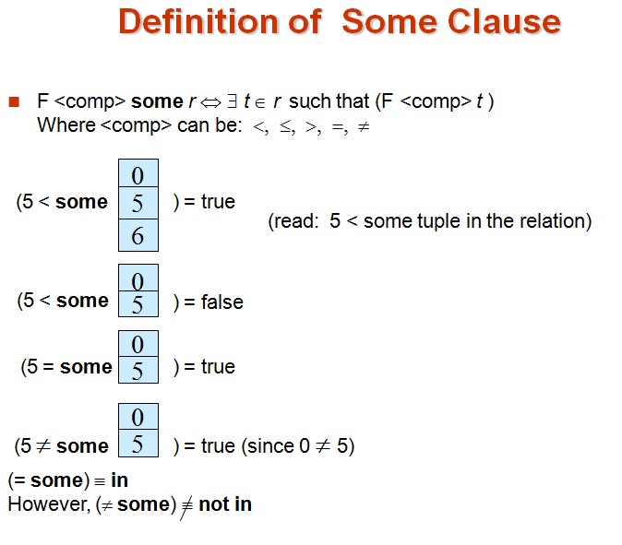
Nested Subqueries – tests for Set Comparison
Find names of instructors with salary greater than that of some (at least one) instructor in the Biology department.
select distinct T.name
from instructor T, instructor S
where T.salary>S.salary and S.dept_name='Biology’;
Same query using > some clause
select name
from instructor
where salary>some (select salary
from instructor
where dept_name='Biology');
Notes:
select distinct T.name
from instructor T, instructor S
where T.salary>S.salary and S.dept_name='Biology';
select name
from instructor
where salary>some (select salary
from instructor
where dept_name='Biology');

Slide 72
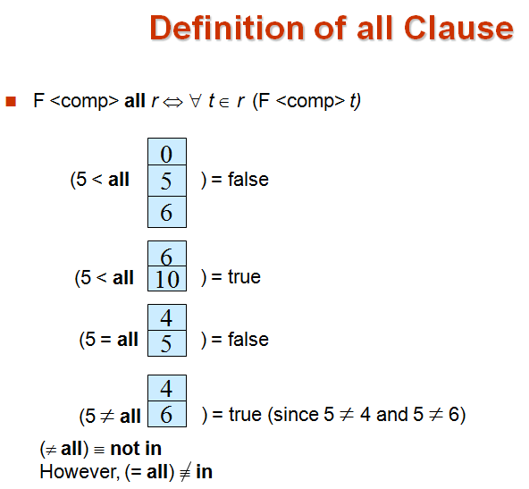
Nested Subqueries – tests for Set Comparison
Find the names of all instructors whose salary is greater than the salary of all instructors in the Biology department.
select name
from instructor
where salary > all (select salary
from instructor
where dept_name='Biology');
Notes:
找出所有老师的姓名，他的工资要比Biology系的每一个老师的工资都要高
select name
from instructor
where salary>all (select salary
from instructor
where dept_name ='Biology');
采用这种方式SQL语句比较贴近自然语言
Find the names of all instructors whose salary
is greater than the salary of all instructors
in the Biology department.

Slide 73
Nested Subqueries – tests for Set Member
exists测试集合是空集还是非空集
exists r：如果关系实例r不是空集（r ≠ Ø），则exists r为真，否则为假
not exists r：如果关系实例r 是空集（r = Ø），则not exists r为真，否则为假
Find all courses taught in both the Fall 2009 semester and in the Spring 2010 semester
select course_id
from section S
where semester='Fall' and year=2009 and
exists ( select *
from section T
where semester='Spring' and year=2010 and
S.course_id=T.course_id);
相关子查询（Correlated subquery）：外层查询的结果，和内查询进行比较
相关变量（correlation variable）：又作相关名称（Correlation name ）
相关变量的作用域：本例中的S和T，S的作用域为整个语句，T的作用域为子查询中
本例的解释：对于外查询（查出在2009年秋季开设的课程）查出的每一门课程，用这些课程的course_id进行测试，如果在内查询（查出的在2010年春季开设课程）也查到相同的course_id的话，则将外查询查到的该课程，放到结果集中！
更通俗的解释：对应外查询（查出在2009年秋季开设的课程）查出的每一门课程，看看是否也是在2010年春节开设的课程（内查询）。

Slide 74
Nested Subqueries – tests for Set Member
相关变量（Correlation Variables）
Find all courses taught in both the Fall 2009 semester and in the Spring 2010 semester
select course_id
from section S
where semester='Fall' and year=2009 and
exists ( select *
from section T
where semester='Spring' and year=2010 and
S.course_id=T.course_id);
等价的SQL语句
(select course_id from section where semester ='Fall' and year = 2009)
intersect
(select course_id from section where semester ='Spring' and year = 2010);
Notes:
对于2009年秋季开设的每一门课程，进行测试，
如果这门课程在2010年春季也开设，
则把结果放在结果集中！

Slide 75
Nested Subqueries – tests for Set Member
Not Exists
Find all students who have taken all courses offered in the Biology department.
select distinct S.ID, S.name
from student S
where not exists (
(select course_id
from course
where dept_name='Biology')
minus
(select T.course_id
from takes T
where S.ID = T.ID));
Note that X – Y = Ø ⇔ X ⊆ Y （还需要一个条件X不能为Ø ）
Note: Cannot write this query using = all and its variants
Notes:
insert into section values ('BIO-399','1','Fall','2010','Painter','514','A');
insert into teaches values ('76766','BIO-399','1','Fall','2010');
insert into takes values ('98988', 'BIO-399', '1', 'Fall', '2010', null);
commit;
select distinct S.ID, S.name
from student S
where not exists (
( select course_id
from course
where dept_name='Biology')
minus
( select T.course_id
from takes T
where S.ID = T.ID)
);
对于任何一个学生，在内循环中进行测试
在内循环中，
用生物系开设的所有的课程
减去
该学生选修的课程
如果内循环的测试为空集，
则将这个学生的ID放到结果集中！

Slide 76
Nested Subqueries – tests for Absence of Duplicate Tuples
The unique construct tests whether a subquery has any duplicate tuples in its result.
(Evaluates to “true” on an empty set)
Find all courses that were offered at most once in 2009
select T.course_id from course T where unique (select R.course_id from section R where T.course_id= R.course_id and R.year = 2009);
Oracle只有unique约束，不能通过unique测试元组是否重复

Slide 77
Nested Subqueries – Subqueries in the From Clause
SQL允许在from子句中使用子查询（内联视图）
Find the average instructors’ salaries of those departments where the average salary is greater than $42,000.
select dept_name, avg_salary from ( select dept_name, avg (salary) as avg_salary from instructor group by dept_name ) where avg_salary > 42000;
注意：此处过滤不再使用 having 子句，而是用where子句
Another way to write above query
（Oracle 语法）
select dept_name, avg_salary
from ( select dept_name, avg (salary) as avg_salary from instructor group by dept_name) dept_avg
where avg_salary > 42000;
（非Oracle语法）
select dept_name, avg_salary from ( select dept_name, avg (salary) from instructor group by dept_name ) as dept_avg (dept_name, avg_salary) where avg_salary > 42000;
Notes:
select dept_name, avg_salary
from (select dept_name, avg (salary) as avg_salary
from instructor
group by dept_name)
where avg_salary > 42000;

Slide 78
Nested Subqueries – Subqueries in the From Clause
Find the maximum across all departments of the total salary at each department.
/* Non Oracle */
select max (tot_salary)
from ( select dept_name, sum(salary)
from instructor
group by dept_name) as dept_total (dept_name, tot_salary);
/* oracle */
select max(tot_salary)
from ( select dept_name, sum(salary) as tot_salary
from instructor
group by dept_name ) ;
Notes:
select max(tot_salary)
from (select dept_name, sum(salary) as tot_salary
from instructor
group by dept_name) ;

Slide 79
Nested Subqueries – Subqueries in the From Clause
We note that nested subqueries in the from clause cannot use correlation variables from other relations in the from clause.
SQL:2003 allows a subquery in the from clause that is prefixed by the lateral keyword to access attributes of preceding tables or subqueries in the from clause.
Example,we wish to print the names of each instructor, along with their salary and the average salary in their department
select I1.name, I1.salary, avg_salary from instructor I1, lateral (select avg(salary) as avg_salary from instructor I2 where I2.dept_name= I1.dept_name);
Lateral clause permits later part of the from clause (after the lateral keyword) to access correlation variables from the earlier part.
Note: lateral is part of the SQL standard, but is not supported on many database systems; some databases such as SQL Server offer alternative syntax
Notes:
我们注意到在from 子句嵌套的子查询中不能使用来自from 子句其他关系的相关变量。
然而SQL:2003 允许from 子句中的子查询用关键词lateral 作为前缀，以便访问from
子句中在它前面的表或子查询中的属性。
select I1.name, I1.salary, avg_salary
from instructor I1, lateral(select avg(salary) as avg_salary
from instructor I2
where I2.dept_name= I1.dept_name);

Slide 80
Nested Subqueries – With Clause
The with clause provides a way of defining a temporary view whose definition is available only to the query in which the with clause occurs.
Find all departments with the maximum budget
with max_budget (value) as
(select max(budget)
from department)
select budget
from department, max_budget
where department.budget = max_budget.value;
Notes:
找出具有最大预算值的系
with max_budget (value) as
(select max(budget)
from department)
select budget
from department, max_budget
where department.budget = max_budget.value;

Slide 81
Nested Subqueries – With Clause
With clause is very useful for writing complex queries
Supported by most database systems, with minor syntax variations
Find all departments where the total salary is greater than the average of the total salary at all departments
with
dept_total (dept_name, value) as
(select dept_name, sum(salary)
from instructor
group by dept_name),
dept_total_avg(value) as
(select avg(value)
from dept_total)
select dept_name
from dept_total, dept_total_avg
where dept_total.value >= dept_total_avg.value;
Notes:
查出所有工资总额大于所有系平均工资总额的系
with
dept_total (dept_name, value) as
(select dept_name, sum(salary)
from instructor
group by dept_name),
dept_total_avg(value) as
(select avg(value)
from dept_total)
select dept_name
from dept_total, dept_total_avg
where dept_total.value >= dept_total_avg.value;

Slide 82
Scalar Subquery（标量子查询）
标量子查询：只返回单个元组的单个属性值的子查询
查询如果返回多于1个元组，标量子查询将返回运行错误
标量子查询可以出现在任何希望出现单值的地方！
select子句
where子句
having子句中
例子1：
select dept_name,
( select count(*)
from instructor
where department.dept_name = instructor.dept_name )
as num_instructors
from department;
例子2：
select name
from instructor
where salary * 10 >
( select budget
from department
where department.dept_name = instructor.dept_name);
Notes:
select dept_name,
(select count(*)
from instructor
where department.dept_name = instructor.dept_name)
as num_instructors
from department;

