Slide 1

数据库系统原理
Chapter 4: Advanced SQL

Slide 2
Chapter 5: Advanced SQL
Accessing SQL From a Programming Language
Dynamic SQL
JDBC and ODBC
Embedded SQL
SQL Data Types and Schemas
Functions and Procedural Constructs
Triggers
Advanced Aggregation Features
OLAP
Notes:
1

Slide 3
JDBC and ODBC
API (application-program interface) for a program to interact with a database server
Application makes calls to
Connect with the database server
Send SQL commands to the database server
Fetch tuples of result one-by-one into program variables
ODBC (Open Database Connectivity) works with C, C++, C#, and Visual Basic
Other API’s such as ADO.NET sit on top of ODBC
JDBC (Java Database Connectivity) works with Java

Slide 4
JDBC
JDBC is a Java API for communicating with database systems supporting SQL.
JDBC supports a variety of features for querying and updating data, and for retrieving query results.
JDBC also supports metadata retrieval, such as querying about relations present in the database and the names and types of relation attributes.
Model for communicating with the database:
Open a connection
Create a “statement” object
Execute queries using the Statement object to send queries and fetch results
Exception mechanism to handle errors

Slide 5
JDBC Code
public static void JDBCexample(String dbid, String userid, String passwd)
{
try {
Class.forName ("oracle.jdbc.driver.OracleDriver");
Connection conn = DriverManager.getConnection( "jdbc:oracle:thin:@db.yale.edu:2000:univdb", userid, passwd);
Statement stmt = conn.createStatement();
… Do Actual Work ….
stmt.close();
conn.close();
}
catch (SQLException sqle) {
System.out.println("SQLException : " + sqle);
}
}

Slide 6
JDBC Code (Cont.)
Update database
try { stmt.executeUpdate("insert into instructor values(’77987’, ’Kim’, ’Physics’, 98000)"); } catch (SQLException sqle){ System.out.println("Could not insert tuple. " + sqle); }

Slide 7
JDBC Code (Cont.)
Execute query and fetch and print results
ResultSet rset = stmt.executeQuery( "select dept_name, avg (salary) from instructor group by dept_name");
while (rset.next()) { System.out.println(rset.getString("dept_name") + " " + rset.getFloat(2)); }
Getting result fields:
rs.getString(“dept_name”) and rs.getString(1) equivalent if dept_name is the first argument of select result.
Dealing with Null values
int a = rs.getInt(“a”);
if (rs.wasNull())
Systems.out.println(“Got null value”);

Slide 8
Prepared Statement
PreparedStatement pStmt = conn.prepareStatement( "insert into instructor values(?,?,?,?)");
pStmt.setString(1, "88877");
pStmt.setString(2, "Perry");
pStmt.setString(3, "Finance");
pStmt.setInt(4, 125000);
pStmt.executeUpdate();
pStmt.setString(1, "88878");
pStmt.executeUpdate();
For queries, use pStmt.executeQuery(), which returns a ResultSet

Slide 9
Prepared Statement
WARNING: always use prepared statements when taking an input from the user and adding it to a query
NEVER create a query by concatenating strings which you get as inputs
"insert into instructor values(’ " + ID + " ’, ’ " + name + " ’, " + " ’ + dept name + " ’, " ’ balance + ")“
What if name is “D’Souza”?

Slide 10
SQL Injection
Suppose query is constructed using
"select * from instructor where name = ’" + name + "’"
Suppose the user, instead of entering a name, enters:
X’ or ’Y’ = ’Y
then the resulting statement becomes:
"select * from instructor where name = ’" + "X’ or ’Y’ = ’Y" + "’"
which is:
select * from instructor where name = ’X’ or ’Y’ = ’Y’
User could have even used
X’; update instructor set salary = salary + 10000; --
Prepared statement internally uses: "select * from instructor where name = ’X\’ or \’Y\’ = \’Y’
Always use prepared statements, with user inputs as parameters

Slide 11
Metadata Features
ResultSet metadata
E.g., after executing query to get a ResultSet rs:
ResultSetMetaData rsmd = rs.getMetaData();
for(int i = 1; i <= rsmd.getColumnCount(); i++) {
System.out.println(rsmd.getColumnName(i));
System.out.println(rsmd.getColumnTypeName(i));
}
How is this useful?

Slide 12
Metadata (Cont)
Database metadata
DatabaseMetaData dbmd = conn.getMetaData();
ResultSet rs = dbmd.getColumns(null, "univdb", "department", "%");
// Arguments to getColumns: Catalog, Schema-pattern, Table-pattern,
// and Column-Pattern
// Returns: One row for each column; row has a number of attributes
// such as COLUMN_NAME, TYPE_NAME
while( rs.next()) {
System.out.println(rs.getString("COLUMN_NAME"),
rs.getString("TYPE_NAME");
}
And where is this useful?

Slide 13
Transaction Control in JDBC
By default, each SQL statement is treated as a separate transaction that is committed automatically
bad idea for transactions with multiple updates
Can turn off automatic commit on a connection
conn.setAutoCommit(false);
Transactions must then be committed or rolled back explicitly
conn.commit(); or
conn.rollback();
conn.setAutoCommit(true) turns on automatic commit.

Slide 14
Other JDBC Features
Calling functions and procedures
CallableStatement cStmt1 = conn.prepareCall("{? = call some function(?)}");
CallableStatement cStmt2 = conn.prepareCall("{call some procedure(?,?)}");
Handling large object types
getBlob() and getClob() that are similar to the getString() method, but return objects of type Blob and Clob, respectively
get data from these objects by getBytes()
associate an open stream with Java Blob or Clob object to update large objects
blob.setBlob(int parameterIndex, InputStream inputStream).

Slide 15
SQLJ
JDBC is overly dynamic, errors cannot be caught by compiler
SQLJ: embedded SQL in Java
#sql iterator deptInfoIter ( String dept name, int avgSal);
deptInfoIter iter = null;
#sql iter = { select dept_name, avg(salary) from instructor
group by dept name };
while (iter.next()) {
String deptName = iter.dept_name();
int avgSal = iter.avgSal();
System.out.println(deptName + " " + avgSal);
}
iter.close();

Slide 16
ODBC
Open DataBase Connectivity(ODBC) standard
standard for application program to communicate with a database server.
application program interface (API) to
open a connection with a database,
send queries and updates,
get back results.
Applications such as GUI, spreadsheets, etc. can use ODBC
Was defined originally for Basic and C, versions available for many languages.

Slide 17
ODBC (Cont.)
Each database system supporting ODBC provides a "driver" library that must be linked with the client program.
When client program makes an ODBC API call, the code in the library communicates with the server to carry out the requested action, and fetch results.
ODBC program first allocates an SQL environment, then a database connection handle.
Opens database connection using SQLConnect(). Parameters for SQLConnect:
connection handle,
the server to which to connect
the user identifier,
password
Must also specify types of arguments:
SQL_NTS denotes previous argument is a null-terminated string.

Slide 18
ODBC Code
int ODBCexample()
{
RETCODE error;
HENV env; /* environment */
HDBC conn; /* database connection */
SQLAllocEnv(&env);
SQLAllocConnect(env, &conn);
SQLConnect(conn, “db.yale.edu", SQL_NTS, "avi", SQL_NTS, "avipasswd", SQL_NTS);
{ …. Do actual work … }
SQLDisconnect(conn);
SQLFreeConnect(conn);
SQLFreeEnv(env);
}

Slide 19
ODBC Code (Cont.)
Program sends SQL commands to database by using SQLExecDirect
Result tuples are fetched using SQLFetch()
SQLBindCol() binds C language variables to attributes of the query result
When a tuple is fetched, its attribute values are automatically stored in corresponding C variables.
Arguments to SQLBindCol()
ODBC stmt variable, attribute position in query result
The type conversion from SQL to C.
The address of the variable.
For variable-length types like character arrays,
The maximum length of the variable
Location to store actual length when a tuple is fetched.
Note: A negative value returned for the length field indicates null value
Good programming requires checking results of every function call for errors; we have omitted most checks for brevity.

Slide 20
ODBC Code (Cont.)
Main body of program
char deptname[80]; float salary; int lenOut1, lenOut2; HSTMT stmt; char * sqlquery = "select dept_name, sum (salary) from instructor group by dept_name"; SQLAllocStmt(conn, &stmt); error = SQLExecDirect(stmt, sqlquery, SQL_NTS); if (error == SQL SUCCESS) { SQLBindCol(stmt, 1, SQL_C_CHAR, deptname , 80, &lenOut1); SQLBindCol(stmt, 2, SQL_C_FLOAT, &salary, 0 , &lenOut2); while (SQLFetch(stmt) == SQL_SUCCESS) { printf (" %s %g\n", deptname, salary); } } SQLFreeStmt(stmt, SQL_DROP);

Slide 21
ODBC Prepared Statements
Prepared Statement
SQL statement prepared: compiled at the database
Can have placeholders: E.g. insert into account values(?,?,?)
Repeatedly executed with actual values for the placeholders
To prepare a statement SQLPrepare(stmt, <SQL String>);
To bind parameters SQLBindParameter(stmt, <parameter#>, … type information and value omitted for simplicity..)
To execute the statement retcode = SQLExecute( stmt);
To avoid SQL injection security risk, do not create SQL strings directly using user input; instead use prepared statements to bind user inputs

Slide 22
More ODBC Features
Metadata features
finding all the relations in the database and
finding the names and types of columns of a query result or a relation in the database.
By default, each SQL statement is treated as a separate transaction that is committed automatically.
Can turn off automatic commit on a connection
SQLSetConnectOption(conn, SQL_AUTOCOMMIT, 0)}
Transactions must then be committed or rolled back explicitly by
SQLTransact(conn, SQL_COMMIT) or
SQLTransact(conn, SQL_ROLLBACK)

Slide 23
ODBC Conformance Levels
Conformance levels specify subsets of the functionality defined by the standard.
Core
Level 1 requires support for metadata querying
Level 2 requires ability to send and retrieve arrays of parameter values and more detailed catalog information.
SQL Call Level Interface (CLI) standard similar to ODBC interface, but with some minor differences.

Slide 24
ADO.NET
API designed for Visual Basic .NET and C#, providing database access facilities similar to JDBC/ODBC
Partial example of ADO.NET code in C# using System, System.Data, System.Data.SqlClient; SqlConnection conn = new SqlConnection( “Data Source=<IPaddr>, Initial Catalog=<Catalog>”); conn.Open(); SqlCommand cmd = new SqlCommand(“select * from students”, conn); SqlDataReader rdr = cmd.ExecuteReader(); while(rdr.Read()) { Console.WriteLine(rdr[0], rdr[1]); /* Prints result attributes 1 & 2 */ } rdr.Close(); conn.Close();
Can also access non-relational data sources such as
OLE-DB, XML data, Entity framework

Slide 25
Embedded SQL
The SQL standard defines embeddings of SQL in a variety of programming languages such as C, Java, and Cobol.
A language to which SQL queries are embedded is referred to as a host language, and the SQL structures permitted in the host language comprise embedded SQL.
The basic form of these languages follows that of the System R embedding of SQL into PL/I.
EXEC SQL statement is used to identify embedded SQL request to the preprocessor
EXEC SQL <embedded SQL statement > END_EXEC
Note: this varies by language (for example, the Java embedding uses # SQL { …. }; )

Slide 26
Example Query
From within a host language, find the ID and name of students who have completed more than the number of credits stored in variable credit_amount.
Specify the query in SQL and declare a cursor for it
EXEC SQL
declare c cursor for select ID, name from student where tot_cred > :credit_amount
END_EXEC

Slide 27
Embedded SQL (Cont.)
The open statement causes the query to be evaluated
EXEC SQL open c END_EXEC
The fetch statement causes the values of one tuple in the query result to be placed on host language variables.
EXEC SQL fetch c into :si, :sn END_EXEC Repeated calls to fetch get successive tuples in the query result
A variable called SQLSTATE in the SQL communication area (SQLCA) gets set to ‘02000’ to indicate no more data is available
The close statement causes the database system to delete the temporary relation that holds the result of the query.
EXEC SQL close c END_EXEC
Note: above details vary with language. For example, the Java embedding defines Java iterators to step through result tuples.

Slide 28
Updates Through Cursors
Can update tuples fetched by cursor by declaring that the cursor is for update
declare c cursor for select * from instructor where dept_name = ‘Music’ for update
To update tuple at the current location of cursor c
update instructor set salary = salary + 100 where current of c

Slide 29
Procedural Extensions and Stored Procedures
SQL provides a module language
Permits definition of procedures in SQL, with if-then-else statements, for and while loops, etc.
Stored Procedures
Can store procedures in the database
then execute them using the call statement
permit external applications to operate on the database without knowing about internal details
Object-oriented aspects of these features are covered in Chapter 22 (Object Based Databases)

Slide 30
Functions and Procedures
SQL:1999 supports functions and procedures
Functions/procedures can be written in SQL itself, or in an external programming language.
Functions are particularly useful with specialized data types such as images and geometric objects.
Example: functions to check if polygons overlap, or to compare images for similarity.
Some database systems support table-valued functions, which can return a relation as a result.
SQL:1999 also supports a rich set of imperative constructs, including
Loops, if-then-else, assignment
Many databases have proprietary procedural extensions to SQL that differ from SQL:1999.

Slide 31
SQL Functions
Define a function that, given the name of a department, returns the count of the number of instructors in that department.
create function dept_count (dept_name varchar(20)) returns integer begin declare d_count integer; select count (* ) into d_count from instructor where instructor.dept_name = dept_name return d_count; end
Find the department name and budget of all departments with more that 12 instructors.
select dept_name, budget from department where dept_count (dept_name ) > 1

Slide 32
Table Functions
SQL:2003 added functions that return a relation as a result
Example: Return all accounts owned by a given customer
create function instructors_of (dept_name char(20)
returns table ( ID varchar(5), name varchar(20), dept_name varchar(20), salary numeric(8,2))
return table (select ID, name, dept_name, salary from instructor where instructor.dept_name = instructors_of.dept_name)
Usage
select * from table (instructors_of (‘Music’))

Slide 33
SQL Procedures
The dept_count function could instead be written as procedure:
create procedure dept_count_proc (in dept_name varchar(20), out d_count integer) begin
select count(*) into d_count from instructor where instructor.dept_name = dept_count_proc.dept_name
end
Procedures can be invoked either from an SQL procedure or from embedded SQL, using the call statement.
declare d_count integer; call dept_count_proc( ‘Physics’, d_count);
Procedures and functions can be invoked also from dynamic SQL
SQL:1999 allows more than one function/procedure of the same name (called name overloading), as long as the number of arguments differ, or at least the types of the arguments differ

Slide 34
Procedural Constructs
Warning: most database systems implement their own variant of the standard syntax below
read your system manual to see what works on your system
Compound statement: begin … end,
May contain multiple SQL statements between begin and end.
Local variables can be declared within a compound statements
Whileand repeat statements :
declare n integer default 0;
while n < 10 do
set n = n + 1
end while
repeat
set n = n – 1
until n = 0
end repeat

Slide 35
Procedural Constructs (Cont.)
For loop
Permits iteration over all results of a query
Example: declare n integer default 0; for r as select budget from department where dept_name = ‘Music’ do set n = n - r.budget end for

Slide 36
Procedural Constructs (cont.)
Conditional statements (if-then-else) SQL:1999 also supports a case statement similar to C case statement
Example procedure: registers student after ensuring classroom capacity is not exceeded
Returns 0 on success and -1 if capacity is exceeded
See book for details
Signaling of exception conditions, and declaring handlers for exceptions
declare out_of_classroom_seats condition declare exit handler for out_of_classroom_seats begin … .. signal out_of_classroom_seats end
The handler here is exit -- causes enclosing begin..end to be exited
Other actions possible on exception

Slide 37
External Language Functions/Procedures
SQL:1999 permits the use of functions and procedures written in other languages such as C or C++
Declaring external language procedures and functions
create procedure dept_count_proc(in dept_name varchar(20), out count integer) language C external name ’ /usr/avi/bin/dept_count_proc’ create function dept_count(dept_name varchar(20)) returns integer language C external name ‘/usr/avi/bin/dept_count’

Slide 38
External Language Routines (Cont.)
Benefits of external language functions/procedures:
more efficient for many operations, and more expressive power.
Drawbacks
Code to implement function may need to be loaded into database system and executed in the database system’s address space.
risk of accidental corruption of database structures
security risk, allowing users access to unauthorized data
There are alternatives, which give good security at the cost of potentially worse performance.
Direct execution in the database system’s space is used when efficiency is more important than security.

Slide 39
Security with External Language Routines
To deal with security problems
Use sandbox techniques
that is use a safe language like Java, which cannot be used to access/damage other parts of the database code.
Or, run external language functions/procedures in a separate process, with no access to the database process’ memory.
Parameters and results communicated via inter-process communication
Both have performance overheads
Many database systems support both above approaches as well as direct executing in database system address space.

Slide 40
Triggers
A trigger is a statement that is executed automatically by the system as a side effect of a modification to the database.
To design a trigger mechanism, we must:
Specify the conditions under which the trigger is to be executed.
Specify the actions to be taken when the trigger executes.
Triggers introduced to SQL standard in SQL:1999, but supported even earlier using non-standard syntax by most databases.
Syntax illustrated here may not work exactly on your database system; check the system manuals

Slide 41
Trigger Example
E.g. time_slot_id is not a primary key of timeslot, so we cannot create a foreign key constraint from section to timeslot.
Alternative: use triggers on section and timeslot to enforce integrity constraints
create trigger timeslot_check1 after insert on section referencing new row as nrow for each row when (nrow.time_slot_id not in ( select time_slot_id from time_slot)) /* time_slot_id not present in time_slot */ begin rollback end;

Slide 42
Trigger Example Cont.
create trigger timeslot_check2 after delete on timeslot referencing old row as orow for each row when (orow.time_slot_id not in ( select time_slot_id from time_slot) /* last tuple for time slot id deleted from time slot */ and orow.time_slot_id in ( select time_slot_id from section)) /* and time_slot_id still referenced from section*/ begin rollback end;

Slide 43
Triggering Events and Actions in SQL
Triggering event can be insert, delete or update
Triggers on update can be restricted to specific attributes
E.g., after update of takes on grade
Values of attributes before and after an update can be referenced
referencing old row as : for deletes and updates
referencing new row as : for inserts and updates
Triggers can be activated before an event, which can serve as extra constraints. E.g. convert blank grades to null.
create trigger setnull_trigger before update of takes referencing new row as nrow for each row when (nrow.grade = ‘ ‘) begin atomic set nrow.grade = null; end;

Slide 44
Trigger to Maintain credits_earned value
create trigger credits_earned after update of takes on (grade) referencing new row as nrow referencing old row as orow for each row when nrow.grade <> ’F’ and nrow.grade is not null and (orow.grade = ’F’ or orow.grade is null) begin atomic update student set tot_cred= tot_cred + (select credits from course where course.course_id= nrow.course_id) where student.id = nrow.id; end;

Slide 45
Statement Level Triggers
Instead of executing a separate action for each affected row, a single action can be executed for all rows affected by a transaction
Use for each statement instead of for each row
Use referencing old table or referencing new table to refer to temporary tables (called transition tables) containing the affected rows
Can be more efficient when dealing with SQL statements that update a large number of rows

Slide 46
When Not To Use Triggers
Triggers were used earlier for tasks such as
maintaining summary data (e.g., total salary of each department)
Replicating databases by recording changes to special relations (called change or delta relations) and having a separate process that applies the changes over to a replica
There are better ways of doing these now:
Databases today provide built in materialized view facilities to maintain summary data
Databases provide built-in support for replication
Encapsulation facilities can be used instead of triggers in many cases
Define methods to update fields
Carry out actions as part of the update methods instead of through a trigger

Slide 47
When Not To Use Triggers
Risk of unintended execution of triggers, for example, when
loading data from a backup copy
replicating updates at a remote site
Trigger execution can be disabled before such actions.
Other risks with triggers:
Error leading to failure of critical transactions that set off the trigger
Cascading execution

Slide 48
Recursion in SQL
SQL:1999 permits recursive view definition
Example: find which courses are a prerequisite, whether directly or indirectly, for a specific course with recursive rec_prereq(course_id, prereq_id) as ( select course_id, prereq_id from prereq union select rec_prereq.course_id, prereq.prereq_id, from rec_rereq, prereq where rec_prereq.prereq_id = prereq.course_id ) select ∗ from rec_prereq;
This example view, rec_prereq, is called the transitive closure of the prereq relation
Note: 1st printing of 6th ed erroneously used c_prereq in place of rec_prereq in some places

Slide 49
The Power of Recursion
Recursive views make it possible to write queries, such as transitive closure queries, that cannot be written without recursion or iteration.
Intuition: Without recursion, a non-recursive non-iterative program can perform only a fixed number of joins of prereq with itself
This can give only a fixed number of levels of managers
Given a fixed non-recursive query, we can construct a database with a greater number of levels of prerequisites on which the query will not work
Alternative: write a procedure to iterate as many times as required
See procedure findAllPrereqs in book

Slide 50
The Power of Recursion
Computing transitive closure using iteration, adding successive tuples to rec_prereq
The next slide shows a prereq relation
Each step of the iterative process constructs an extended version of rec_prereq from its recursive definition.
The final result is called the fixed point of the recursive view definition.
Recursive views are required to be monotonic. That is, if we add tuples to prereq the view rec_prereq contains all of the tuples it contained before, plus possibly more

Slide 51
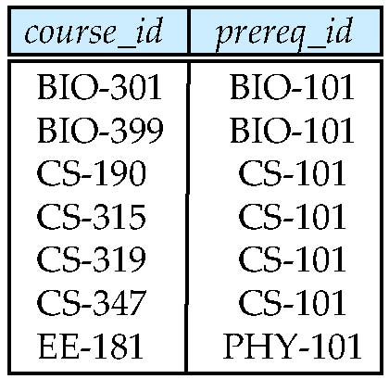
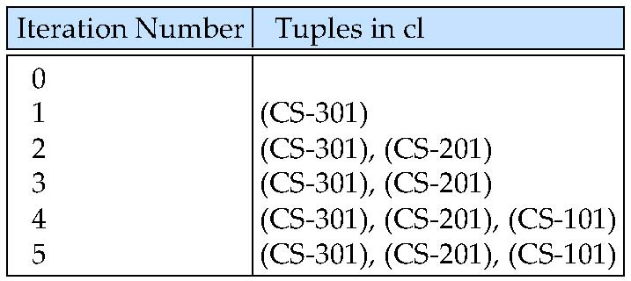
Example of Fixed-Point Computation

Slide 52
Ranking
Ranking is done in conjunction with an order by specification.
Suppose we are given a relation student_grades(ID, GPA) giving the grade-point average of each student
Find the rank of each student.
select ID, rank() over (order by GPA desc) as s_rank from student_grades
An extra order by clause is needed to get them in sorted order
select ID, rank() over (order by GPA desc) as s_rank from student_grades order by s_rank
Ranking may leave gaps: e.g. if 2 students have the same top GPA, both have rank 1, and the next rank is 3
dense_rank does not leave gaps, so next dense rank would be 2

Slide 53
Ranking
Ranking can be done using basic SQL aggregation, but resultant query is very inefficient
select ID, (1 + (select count(*) from student_grades B where B.GPA > A.GPA)) as s_rank from student_grades A order by s_rank;

Slide 54
Ranking (Cont.)
Ranking can be done within partition of the data.
“Find the rank of students within each department.”
select ID, dept_name, rank () over (partition by dept_name order by GPA desc) as dept_rank from dept_grades order by dept_name, dept_rank;
Multiple rank clauses can occur in a single select clause.
Ranking is done after applying group by clause/aggregation
Can be used to find top-n results
More general than the limit n clause supported by many databases, since it allows top-n within each partition

Slide 55
Ranking (Cont.)
Other ranking functions:
percent_rank (within partition, if partitioning is done)
cume_dist (cumulative distribution)
fraction of tuples with preceding values
row_number (non-deterministic in presence of duplicates)
SQL:1999 permits the user to specify nulls first or nulls last
select ID, rank ( ) over (order by GPA desc nulls last) as s_rank from student_grades

Slide 56
Ranking (Cont.)
For a given constant n, the ranking the function ntile(n) takes the tuples in each partition in the specified order, and divides them into n buckets with equal numbers of tuples.
E.g.,
select ID, ntile(4) over (order by GPA desc) as quartile from student_grades;

Slide 57
Windowing
Used to smooth out random variations.
E.g., moving average: “Given sales values for each date, calculate for each date the average of the sales on that day, the previous day, and the next day”
Window specification in SQL:
Given relation sales(date, value)
select date, sum(value) over (order by date between rows 1 preceding and 1 following) from sales

Slide 58
Windowing
Examples of other window specifications:
between rows unbounded preceding and current
rows unbounded preceding
range between 10 preceding and current row
All rows with values between current row value –10 to current value
range interval 10 day preceding
Not including current row

Slide 59
Windowing
Can do windowing within partitions
E.g., Given a relation transaction (account_number, date_time, value), where value is positive for a deposit and negative for a withdrawal
“Find total balance of each account after each transaction on the account”
select account_number, date_time, sum (value) over (partition by account_number order by date_time rows unbounded preceding) as balance from transaction order by account_number, date_time

Slide 60
Data Analysis and OLAP
Online Analytical Processing (OLAP)
Interactive analysis of data, allowing data to be summarized and viewed in different ways in an online fashion (with negligible delay)
Data that can be modeled as dimension attributes and measure attributes are called multidimensional data.
Measure attributes
measure some value
can be aggregated upon
e.g., the attribute number of the sales relation
Dimension attributes
define the dimensions on which measure attributes (or aggregates thereof) are viewed
e.g., attributes item_name, color, and size of the sales relation

Slide 61
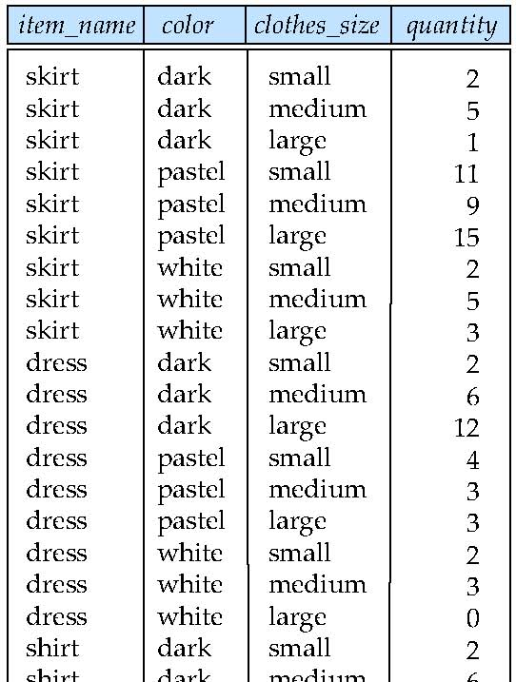
Example sales relation
...
...
...
...
...
...
...
...

Slide 62
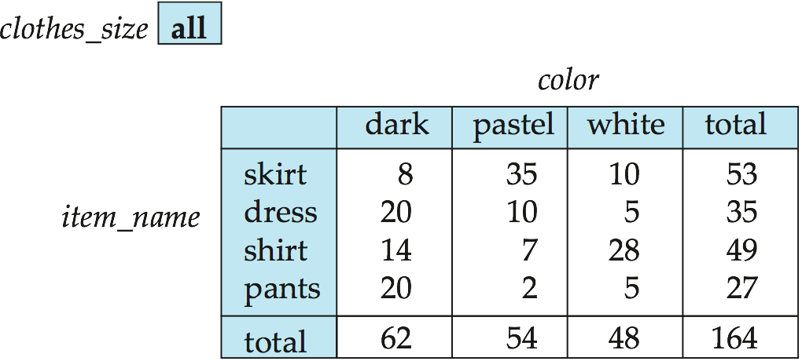
Cross Tabulation of sales by item_name and color
The table above is an example of a cross-tabulation (cross-tab), also referred to as a pivot-table.
Values for one of the dimension attributes form the row headers
Values for another dimension attribute form the column headers
Other dimension attributes are listed on top
Values in individual cells are (aggregates of) the values of the dimension attributes that specify the cell.

Slide 63
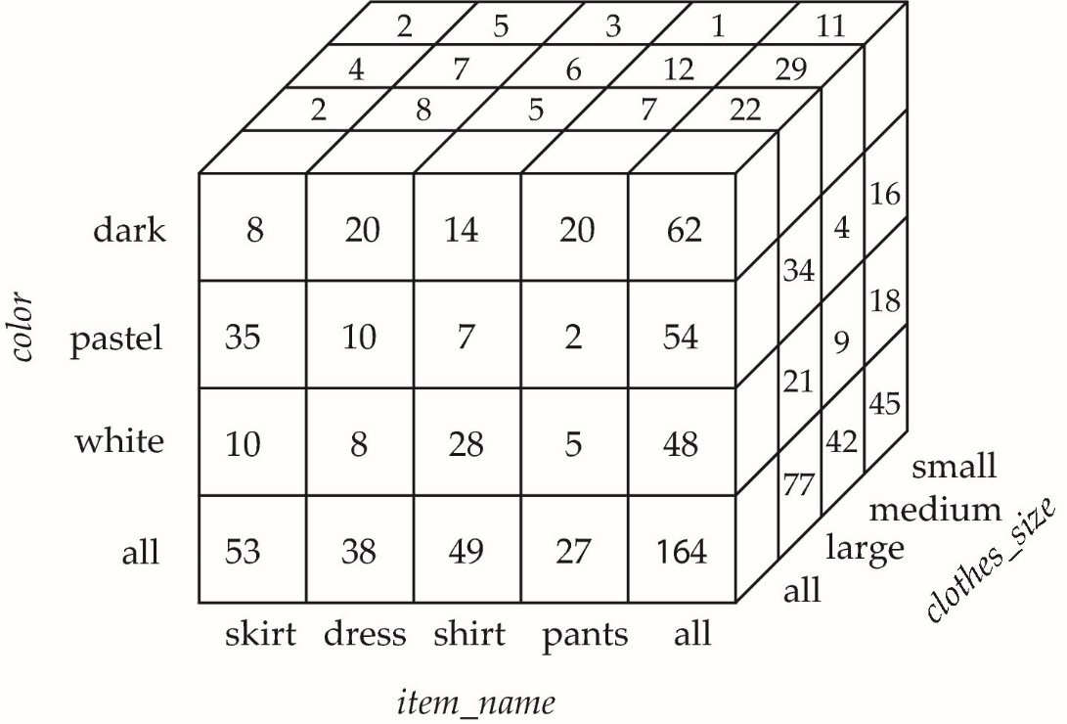
Data Cube
A data cube is a multidimensional generalization of a cross-tab
Can have n dimensions; we show 3 below
Cross-tabs can be used as views on a data cube

Slide 64
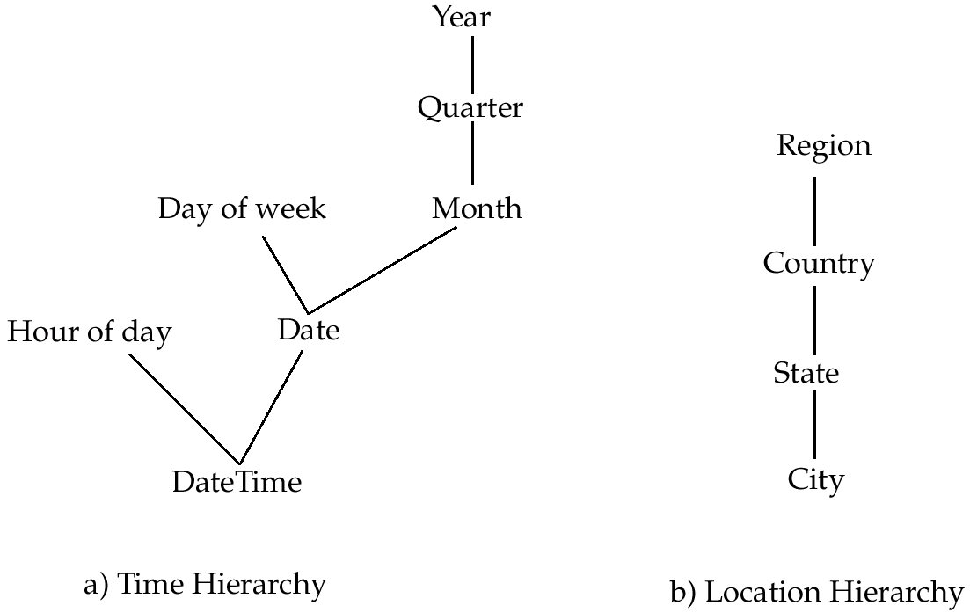
Hierarchies on Dimensions
Hierarchy on dimension attributes: lets dimensions to be viewed at different levels of detail
E.g., the dimension DateTime can be used to aggregate by hour of day, date, day of week, month, quarter or year

Slide 65
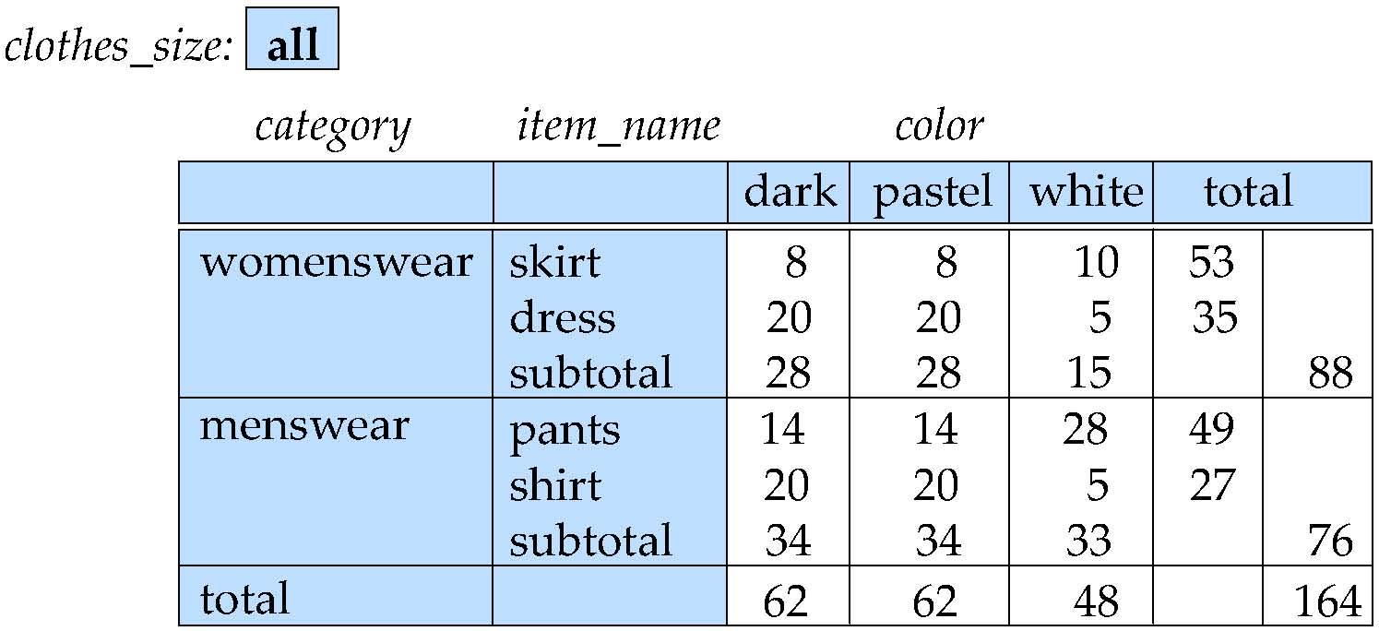
Cross Tabulation With Hierarchy
Cross-tabs can be easily extended to deal with hierarchies
Can drill down or roll up on a hierarchy

Slide 66
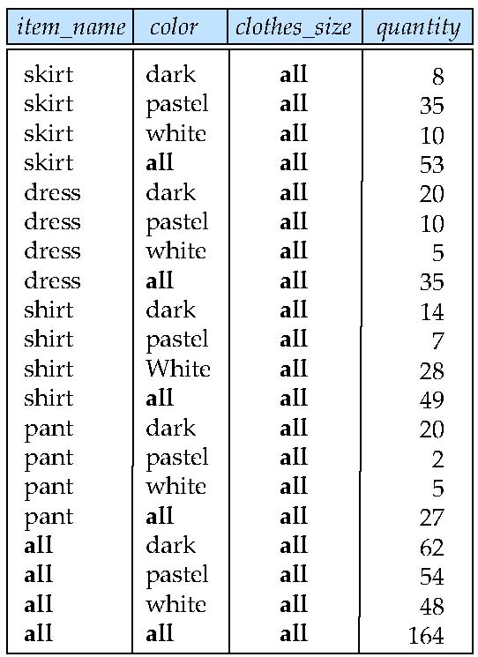
Relational Representation of Cross-tabs
Cross-tabs can be represented as relations
We use the value all is used to represent aggregates.
The SQL standard actually uses null values in place of all despite confusion with regular null values.

Slide 67
Extended Aggregation to Support OLAP
The cube operation computes union of group by’s on every subset of the specified attributes
Example relation for this section sales(item_name, color, clothes_size, quantity)
E.g. consider the query
select item_name, color, size, sum(number) from sales group by cube(item_name, color, size)
This computes the union of eight different groupings of the sales relation:
{ (item_name, color, size), (item_name, color), (item_name, size), (color, size), (item_name), (color), (size), ( ) }
where ( ) denotes an empty group by list.
For each grouping, the result contains the null value for attributes not present in the grouping.

Slide 68
Online Analytical Processing Operations
Relational representation of cross-tab that we saw earlier, but with null in place of all, can be computed by
select item_name, color, sum(number) from sales group by cube(item_name, color)
The function grouping() can be applied on an attribute
Returns 1 if the value is a null value representing all, and returns 0 in all other cases.
select item_name, color, size, sum(number), grouping(item_name) as item_name_flag, grouping(color) as color_flag, grouping(size) as size_flag, from sales group by cube(item_name, color, size)

Slide 69
Online Analytical Processing Operations
Can use the function decode() in the select clause to replace such nulls by a value such as all
E.g., replace item_name in first query by decode( grouping(item_name), 1, ‘all’, item_name)

Slide 70
Extended Aggregation (Cont.)
The rollup construct generates union on every prefix of specified list of attributes
E.g.,
select item_name, color, size, sum(number) from sales group by rollup(item_name, color, size)
Generates union of four groupings:
{ (item_name, color, size), (item_name, color), (item_name), ( ) }
Rollup can be used to generate aggregates at multiple levels of a hierarchy.
E.g., suppose table itemcategory(item_name, category) gives the category of each item. Then
select category, item_name, sum(number) from sales, itemcategory where sales.item_name = itemcategory.item_name group by rollup(category, item_name)
would give a hierarchical summary by item_name and by category.

Slide 71
Extended Aggregation (Cont.)
Multiple rollups and cubes can be used in a single group by clause
Each generates set of group by lists, cross product of sets gives overall set of group by lists
E.g.,
select item_name, color, size, sum(number) from sales group by rollup(item_name), rollup(color, size)
generates the groupings
{item_name, ()} X {(color, size), (color), ()}
= { (item_name, color, size), (item_name, color), (item_name), (color, size), (color), ( ) }

Slide 72
Online Analytical Processing Operations
Pivoting: changing the dimensions used in a cross-tab is called
Slicing: creating a cross-tab for fixed values only
Sometimes called dicing, particularly when values for multiple dimensions are fixed.
Rollup: moving from finer-granularity data to a coarser granularity
Drill down: The opposite operation - that of moving from coarser-granularity data to finer-granularity data

Slide 73
OLAP Implementation
The earliest OLAP systems used multidimensional arrays in memory to store data cubes, and are referred to as multidimensional OLAP (MOLAP) systems.
OLAP implementations using only relational database features are called relational OLAP (ROLAP) systems
Hybrid systems, which store some summaries in memory and store the base data and other summaries in a relational database, are called hybrid OLAP (HOLAP) systems.

Slide 74
OLAP Implementation (Cont.)
Early OLAP systems precomputed all possible aggregates in order to provide online response
Space and time requirements for doing so can be very high
2^{n} combinations of group by
It suffices to precompute some aggregates, and compute others on demand from one of the precomputed aggregates
Can compute aggregate on (item_name, color) from an aggregate on (item_name, color, size)
For all but a few “non-decomposable” aggregates such as median
is cheaper than computing it from scratch
Several optimizations available for computing multiple aggregates
Can compute aggregate on (item_name, color) from an aggregate on (item_name, color, size)
Can compute aggregates on (item_name, color, size), (item_name, color) and (item_name) using a single sorting of the base data

Slide 75
End of Chapter

Slide 76
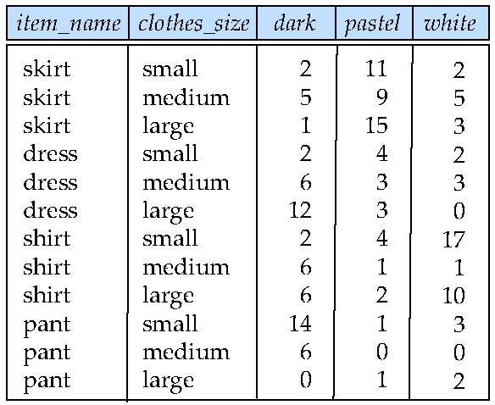
Figure 5.22

Slide 77
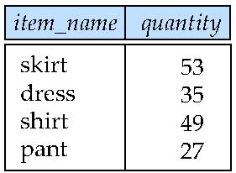
Figure 5.23

Slide 78
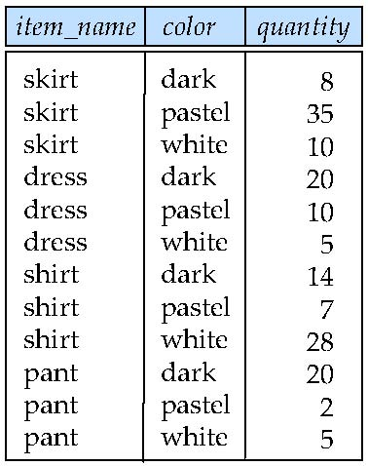
Figure 5.24

Slide 79
Another Recursion Example
Given relation manager(employee_name, manager_name)
Find all employee-manager pairs, where the employee reports to the manager directly or indirectly (that is manager’s manager, manager’s manager’s manager, etc.) with recursive empl (employee_name, manager_name ) as ( select employee_name, manager_name from manager union select manager.employee_name, empl.manager_name from manager, empl where manager.manager_name = empl.employe_name) select * from empl
This example view, empl, is the transitive closure of the manager relation
Notes:
79

Slide 80
Merge statement (now in Chapter 24)
Merge construct allows batch processing of updates.
Example: relation funds_received (account_number, amount ) has batch of deposits to be added to the proper account in the account relation
merge into account as A using (select * from funds_received as F ) on (A.account_number = F.account_number ) when matched then update set balance = balance + F.amount
Notes:
80

