Slide 1
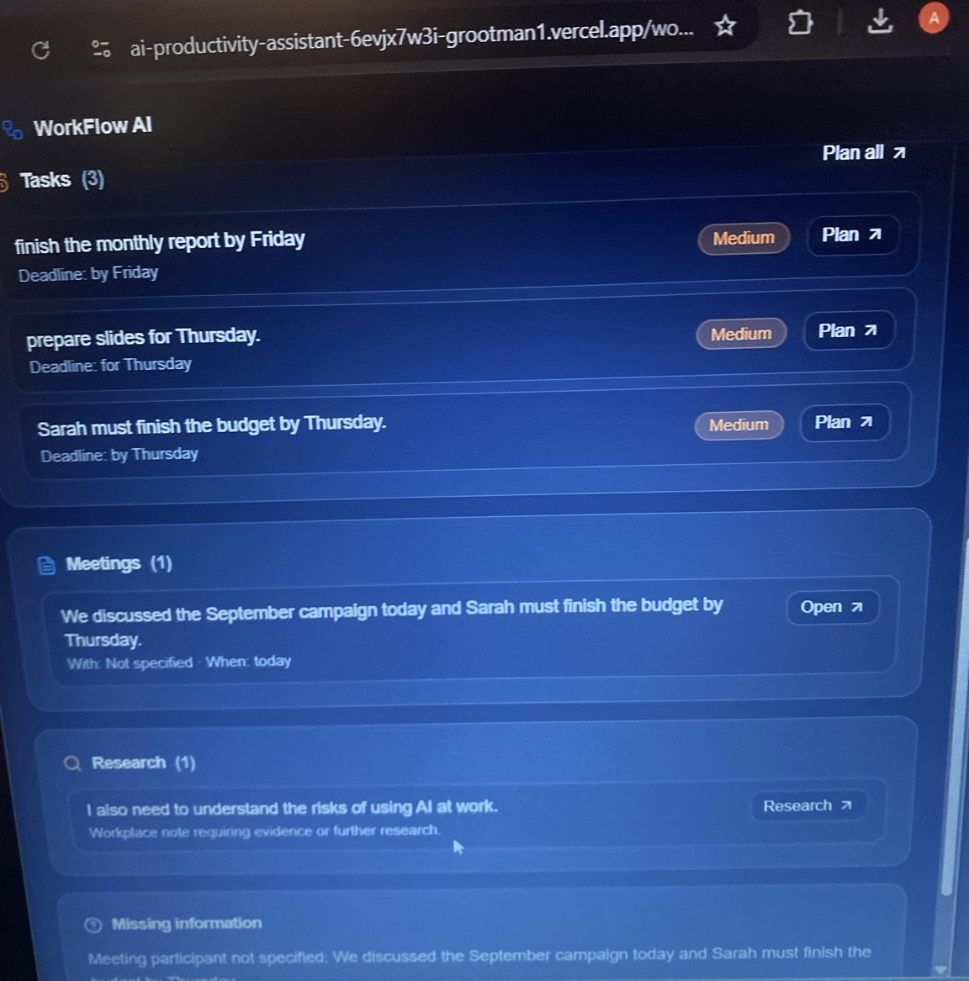
WorkFlow AI
Workplace Productivity Assistant
CAPACITI AI Skills Programme Portfolio Project
Azile Gomomo
Live no-API productivity prototype
Azile Gomomo | WorkFlow AI | 1/8

Slide 2
The workplace problem
Repetitive work is easy to delay, misread, or organize poorly.
People often need help with:
Project goal
Drafting professional emails quickly
Build a practical assistant that improves productivity while staying transparent, safe, and free to run without paid API services.
Turning meeting notes into actions
Prioritizing tasks around fixed commitments
Summarizing research without fake claims
No external API key required. Outputs are generated locally from structured rules and templates.
Converting messy notes into clear next steps
No fake statistics
No fabricated sources
Azile Gomomo | WorkFlow AI | 2/8

Slide 3
Solution overview
A single productivity dashboard with specialist workplace tools.
Smart Workspace
Email Generator
Meeting Summarizer
Classifies messy notes
Drafts professional emails
Extracts decisions and actions
Task Planner
Research Assistant
Activity History
Schedules around commitments
Grounded briefs
Stores outputs locally
All tools share the same responsible logic: use supplied information, mark missing details, avoid invented claims, and remind the user to review important outputs.
Azile Gomomo | WorkFlow AI | 3/8

Slide 4
Prompt-engineering strategy
The project applies prompt logic through structured local rules.
Role
Objective
Inputs
Instructions
Output format
Constraints
Responsible AI
Missing details
Why this matters
Final implementation
Structured prompting improves consistency, reduces hallucination risk, controls format, and makes the assistant easier to test.
No external API is required. The prototype uses local rules and templates to demonstrate AI-style workplace workflows safely and freely.
Azile Gomomo | WorkFlow AI | 4/8

Slide 5
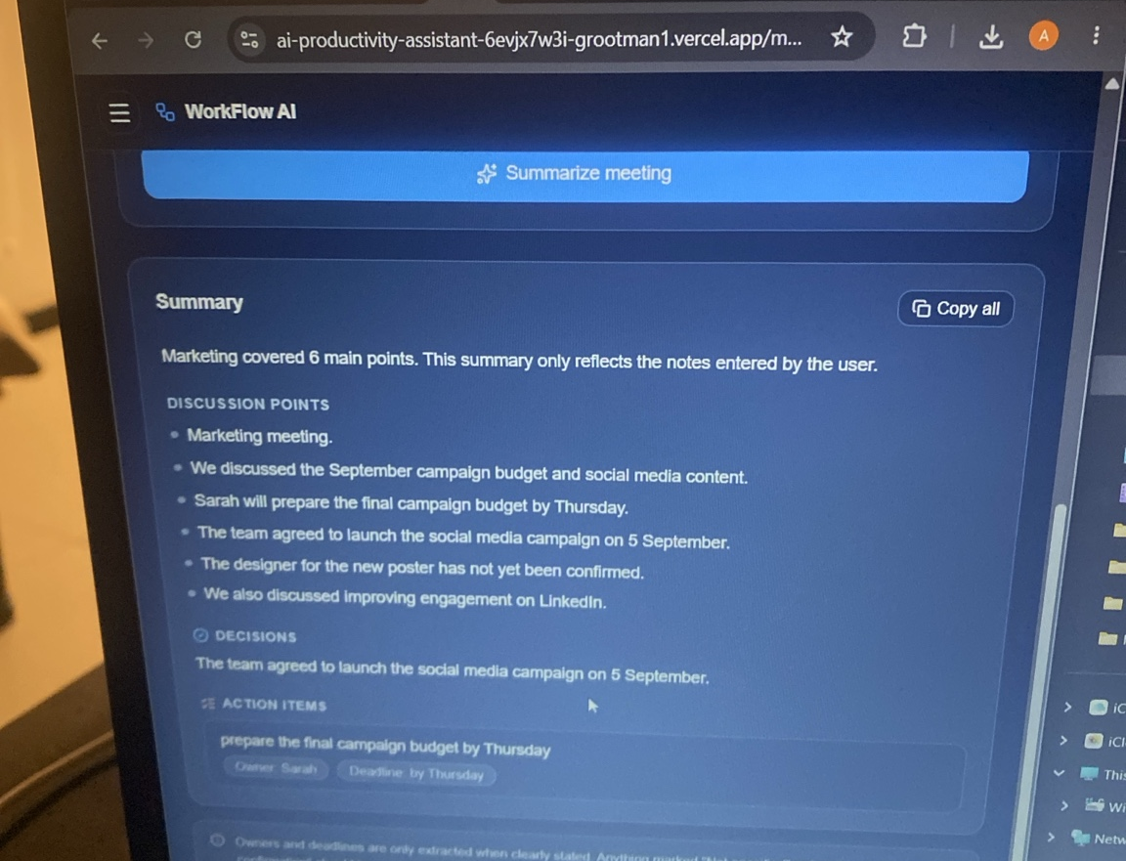
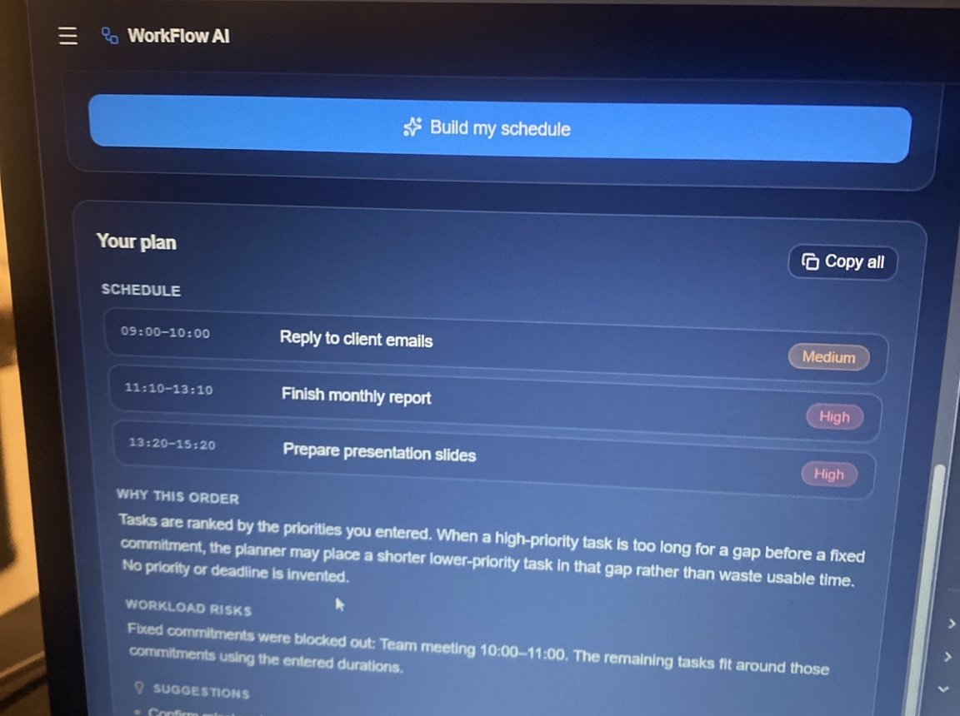
Core tools in action
Email, meeting and planning workflows were tested with realistic workplace inputs.
Meeting Summarizer now separates confirmed decisions from unconfirmed information.
Task Planner blocks fixed commitments and schedules work around them.
Azile Gomomo | WorkFlow AI | 5/8

Slide 6
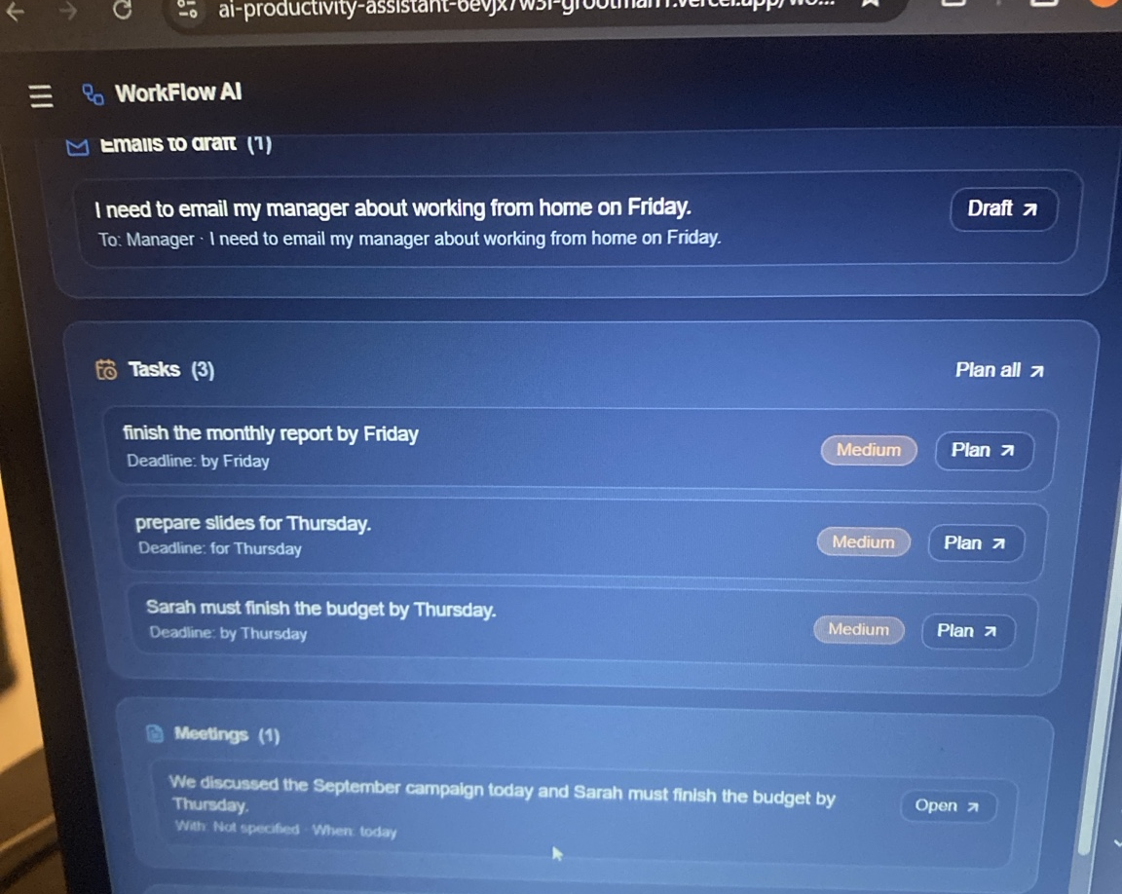
Smart Workspace: the innovation layer
Messy workplace notes become categorized action items.
What it extracts
Emails to draft
Tasks to schedule
Meeting information
Research needed
Missing information
This feature shows how individual productivity tools can work together in one workflow without sending emails or changing external systems.
Azile Gomomo | WorkFlow AI | 6/8

Slide 7
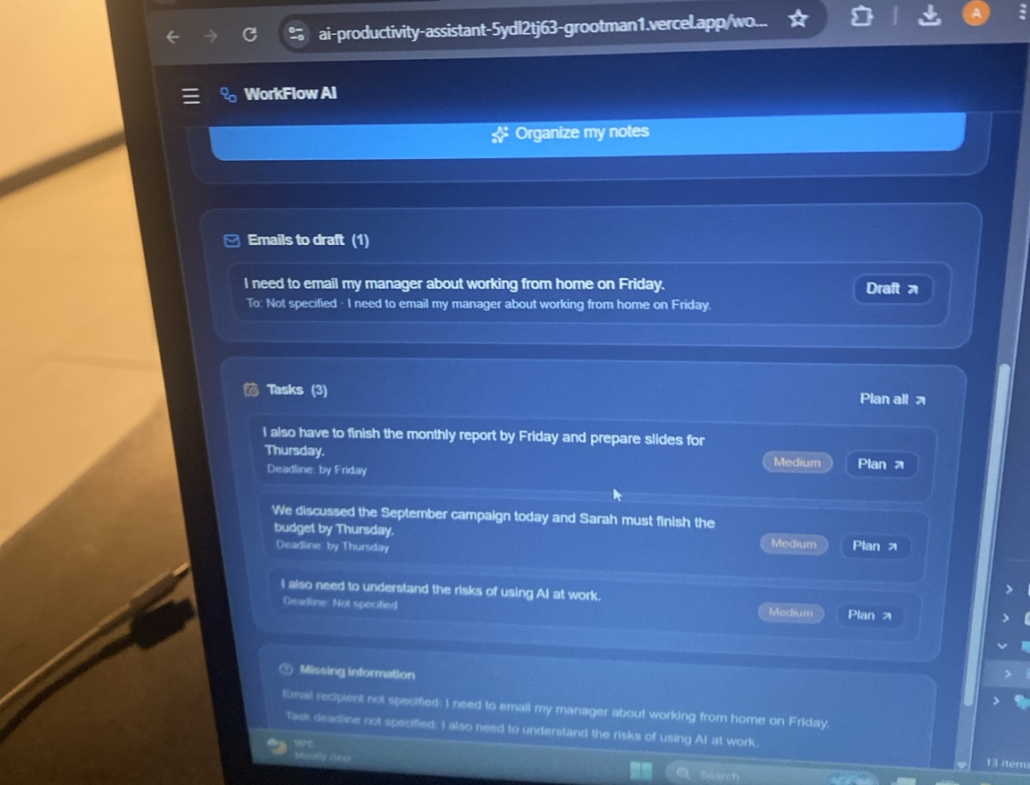
Responsible AI by design
The assistant is honest about what it can and cannot do.
Human review
Outputs may miss context; important information must be verified.
No external API dependency
No paid model account or secret key is required.
Missing details are marked
Owners, deadlines and recipients are not guessed.
Research stays grounded
No fake citations, sources, statistics or browsed-web claims.
Azile Gomomo | WorkFlow AI | 7/8

Slide 8
Final submission links
Live prototype, GitHub repository and demo readiness.
Live prototype
https://ai-productivity-assistant-6evjx7w3i-grootman1.vercel.app/
GitHub repository
https://github.com/Azile-cell/AI-Productivity-Assistant
Demo checklist
• Open Smart Workspace and classify messy notes.
• Generate an email draft and copy it.
• Summarize meeting notes with decisions/actions.
• Build a plan around a fixed meeting.
• Show Responsible AI and Activity History.
Azile Gomomo | WorkFlow AI | 8/8

