Slide 1


MCAIT 2026
Graph-Grounded Generative User Interfaces for Learning: Retrieval Structure Determines Interface Expressiveness
Fakhrul Azim Bin Ahmed Mardzukie · Universiti Teknologi PETRONAS, Malaysia
Presenter: Fakhrul Azim · Parallel Session 6 (Virtual), Track 2
3–5 NOVEMBER 2026 · TAIBAH UNIVERSITY · MADINAH
Notes:
Good afternoon. I am Fakhrul Azim from Universiti Teknologi PETRONAS. My paper asks why learners working across their own documents still get a chat box, and what it would take to give them something better.

Slide 2

OVERVIEW
The claim of this paper
The components an interface can honestly offer are bounded by what retrieval can supply.
1
2
3
4
5
6
Problem
Gap
Approach
Bound
Evaluation
Conclusion
Learners get prose
What the literature leaves open
Compose, do not write
Retrieval limits the catalogue
Protocol and results
Limits and next steps
2
Notes:
Here is the claim in one sentence. The components a learning interface can honestly offer are bounded by what its retrieval can supply. I will take you through the problem, the method with one real worked question, the bound, and what we measured.

Slide 3
BACKGROUND AND PROBLEM
Learners ask relational questions and get prose
What a learner asks across their documents
What they get back
Which of these papers agree?
Where do they conflict?
What does the set not cover?
d = 0.83
Why these views are missing
A flat answer asserts relations it never retrieved, and hands the synthesis back as more text to read [4].
Someone must author each one per topic
Retrieval has nothing structured to fill it
pooled effect of interactive representations, 20 physics studies, human-authored [5]
3
Notes:
When you study across documents, the useful questions are about relationships: which sources agree, where they conflict, what is missing. Current tools answer with a paragraph. Interactive views can work very well, with a pooled effect of 0.83 in physics, but someone has to author them, and retrieval has nothing structured to fill them with.

Slide 4
BACKGROUND AND PROBLEM
Three learners hit the same wall
A
Aisha
D
Daniel
M
Mei
Final-year undergraduate writing a literature review
Master's student with a growing thesis corpus
Undergraduate revising dense modules for exams
THEIR QUESTION
THEIR QUESTION
THEIR QUESTION
How do 15 to 20 papers relate, agree and conflict?
What does my corpus not cover yet?
Summaries help me read. How do I remember?
THE VIEW IT CALLS FOR
THE VIEW IT CALLS FOR
THE VIEW IT CALLS FOR
Comparison grid, contradiction view
Connected knowledge base, gap view
Quizzes, flashcards, Socratic questions
Design personas from the project requirements, not study participants.
4
Notes:
Picture three learners. Aisha is writing a literature review across twenty papers and connects them by hand. Daniel keeps a growing thesis corpus and keeps losing context. Mei is revising, and summaries help her read but not remember. Each needs a different view of the same documents, and each gets the same chat box.

Slide 5
BACKGROUND AND PROBLEM
Flat retrieval has no way to represent a relation
Passage, scored alone
Flat retrieval
Query
Cited prose
Relations asserted, never retrieved
Passage, scored alone
Passage, scored alone
Collision frequency
Activation energy
Graph-hybrid retrieval
Query
Relational components
Grid, concept map, contradiction alert
Temperature
Effective collisions
Reaction rate
Blue: from one document. Gold: from another. A shared entity brings them into one retrieved set. Similarity encodes how alike texts are, not how entities connect [3].
5
Notes:
The cause sits in retrieval. Standard retrieval scores every passage on its own. It holds no record that two passages disagree or that one concept depends on another. Graph retrieval changes what is stored, so a shared entity can bring passages from different documents together.

Slide 6
RELATED WORK
Four literatures, and the gap between them
Area | What it establishes | What it leaves open
Retrieval [1-3, 14-17] | Hybrid and graph retrieval, schema-free extraction | Never treats retrieved structure as a substrate for presentation
Generative UI [6, 18-20] | Feasible, preferred to markdown, protocols for typed intent | None asks whether the content is supported by a source
Generated artifacts in education [7-9, 21, 22] | Authoring-time generation with a human reviewer | None generates for the learner at request time from evidence
Verification and risk [10-13, 23-25] | Adversarial checks for code; risks of generated instruction | Oracles do not transfer; the safety objection stands unanswered
Gap: a learning interface composed at request time, from retrieved evidence, with a stated bound on what it may assert.
6
Notes:
Four literatures touch this. Graph retrieval is evaluated as retrieval. Generative interfaces are evaluated by preference. Educational systems keep a human reviewer. Verification relies on oracles a learning view does not have. One recent paper argues runtime generation is unsafe because it cannot be verified at scale, and that objection stands unanswered.

Slide 7
RELATED WORK
Generative interfaces are reaching the market
 | Gemini Notebook (formerly NotebookLM) | ChatGPT Intelligent UI | Gemini dynamic view | This paper
Described input | the learner's uploaded sources and instructions | the question | the prompt, with tools such as web search | evidence retrieved from the learner's corpus
How the view arises | the learner picks an output: mind map, data table, flashcards | the model chooses the format automatically | the model designs and codes it per prompt | the model selects from a typed catalogue
Stated rule linking a view to retrieved structure | not stated | not stated | not stated | a precondition on every component
This compares public descriptions only. Not stated does not mean absent, and no product was tested.
Sources, checked 1 Nov 2026: Gemini Notebook Help; OpenAI release notes, 7 Oct 2026; Google Research blog, 18 Nov 2025.
7
Notes:
Products are moving the same way. Gemini Notebook answers from your sources. ChatGPT chooses a format automatically. Gemini's dynamic view writes code per prompt. I report only what vendors publish, and I did not test them. None of these public descriptions states a rule linking a view to the retrieved structure behind it. Stating that rule is this paper's work.

Slide 8
THIS PAPER
Contributions
Architecture
Verified interface layer
1
Graph-native hybrid retrieval coupled to a typed generative interface. Evidence fills components, not prose.
2
Composed at request time. One schema, fail-closed validation, registry-only rendering, provenance on every claim.
A formal bound
Committed evaluation
3
A definition, with a component-by-component mapping to study activities, that retrieval bounds expressiveness.
4
Ablation harness, paired test and extraction audit fixed before any run, with a pilot reported as found.
Arcana is this paper in practice: a learning workspace where the ideas above run, and can be measured.
8
Notes:
The paper makes four contributions: the architecture, a verified interface layer, the formal bound, and a committed evaluation. Arcana is these ideas in practice. The claims belong to the paper, and Arcana is where they can be run and checked.

Slide 9
APPROACH
Three regimes for producing a learning interface
 | Authored ahead | Markup emitted at runtime | Composed at request time
Coverage | what was anticipated | any question | any question
Produced by | a person | the model, as code | the model, as typed selections
Correctness rests on | human review | post-hoc verification | retrieved evidence and schema
Expressiveness | fixed catalogue | unbounded | combinatorial over a vocabulary
Failure mode | no answer exists | confident wrong artifact | closest available component
The components are fixed. What is generated per question is which components, and the evidence that fills them.
Table I of the paper. Runtime markup: assessed as unverifiable at scale [10].
9
Notes:
Authoring ahead is safe, but covers only what someone anticipated. Emitting markup at runtime covers anything, but is hard to verify. We take a third route: the model composes from a verified vocabulary. The price is expressiveness, because a question gets the closest available component.

Slide 10
METHODOLOGY
From document to rendered component
Ingestion, one pass
Hybrid retrieval
Generative interface
Learner's documents
Dense similarity
Task agents, one routing function
Sparse keyword (BM25)
Typed component selection
Parse, chunk, embed
Extract entities and relations
Graph traversal, 1 hop
Fail-closed validation
Vector index
Knowledge graph
Reciprocal rank fusion
Registry-only rendering
RRF(d) = Σr∈R 1 / (k + r(d)), k = 60 Fusing by rank, because cosine, keyword and traversal scores are not comparable [26].
10
Notes:
Here is the design. Ingestion writes a vector index and a graph in one pass. Three signals are fused by rank. Task agents hand off through one routing function, and every path ends at validated components. Let me now walk one real question through this.

Slide 11
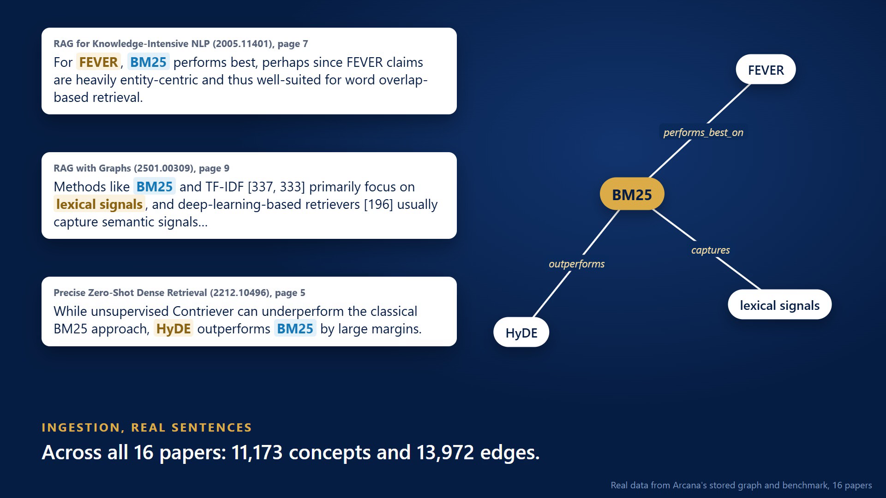
METHODOLOGY
Ingestion: a sentence becomes an edge
After the paper
Schema-free
Entities and relations are extracted with no fixed ontology, so any discipline works.
One pass
The vector index and the graph are written together, over the same passages.
One concept, three papers
BM25 is one node reached from all three passages, across document boundaries.
Click to play. Real sentences and edges from the stored graph of 16 papers. Extraction by one model, one pass per passage.
11
Notes:
Let me follow one real question through the system, starting with ingestion. Here are real sentences from three papers in the corpus. Extraction turns each stated relation into an edge. The same concept, BM25, appears in all three, so three documents become connected. Nobody defined these relation types in advance.

Slide 12
METHODOLOGY
What the extracted graph really holds
After the paper
From 13,972 edges to those stated in one sentence
13,972
All edges
9,821
Both labels in the source passage
4,830
Stated in one sentence
11.6%
of concepts appear in 2 or more papers
20.4%
of concepts have no edge at all
1,604
relation strings; authorship alone is spelled four ways
3
nodes for one idea: "Large Language Models", "LLMs", "LLM"
Structure only, not correctness. 'Stated' is a strict lexical test, so the rest are not necessarily wrong. 16 papers, 1,570 passages, one extraction.
12
Notes:
This is what that produces at scale: over eleven thousand concepts and nearly fourteen thousand edges. On the left, the biggest hubs. On the right, the honest part. Only about a third of edges are stated in one sentence of their passage. Only eleven point six percent of concepts appear in more than one paper, and one idea can be several nodes. So the cross-document structure is real, but thin.

Slide 13
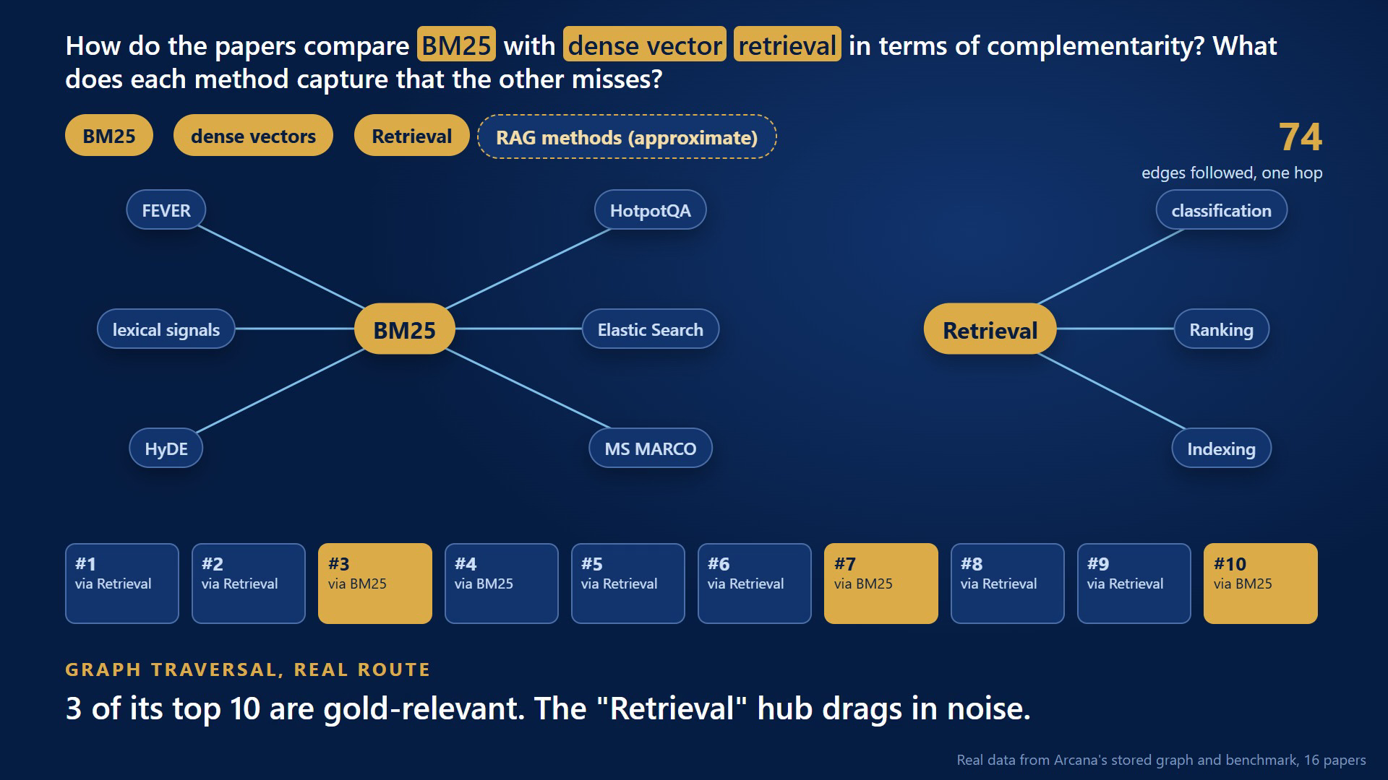
METHODOLOGY
Graph traversal: one real route
After the paper
Across 20 questions
111 concepts resolved, 37% by approximate match. 16 to 755 edges followed per question.
How passages are reached
87% mention a resolved concept. 13% come only through a neighbour.
Hubs are noisy
Broad seeds such as "Retrieval" pull in passages that are not relevant.
Click to play. Real route for question q-cross-06. Gold-relevant means covering an approved gold passage under the frozen rule.
13
Notes:
Now the question: how do the papers compare BM25 with dense retrieval? Its words resolve to four concepts. From those, the system follows seventy-four edges, one hop out. Passages that mention those concepts are then ranked. Three of the top ten are relevant, and they all came through BM25. The broad concept Retrieval drags in noise. That is resolution quality showing through.

Slide 14
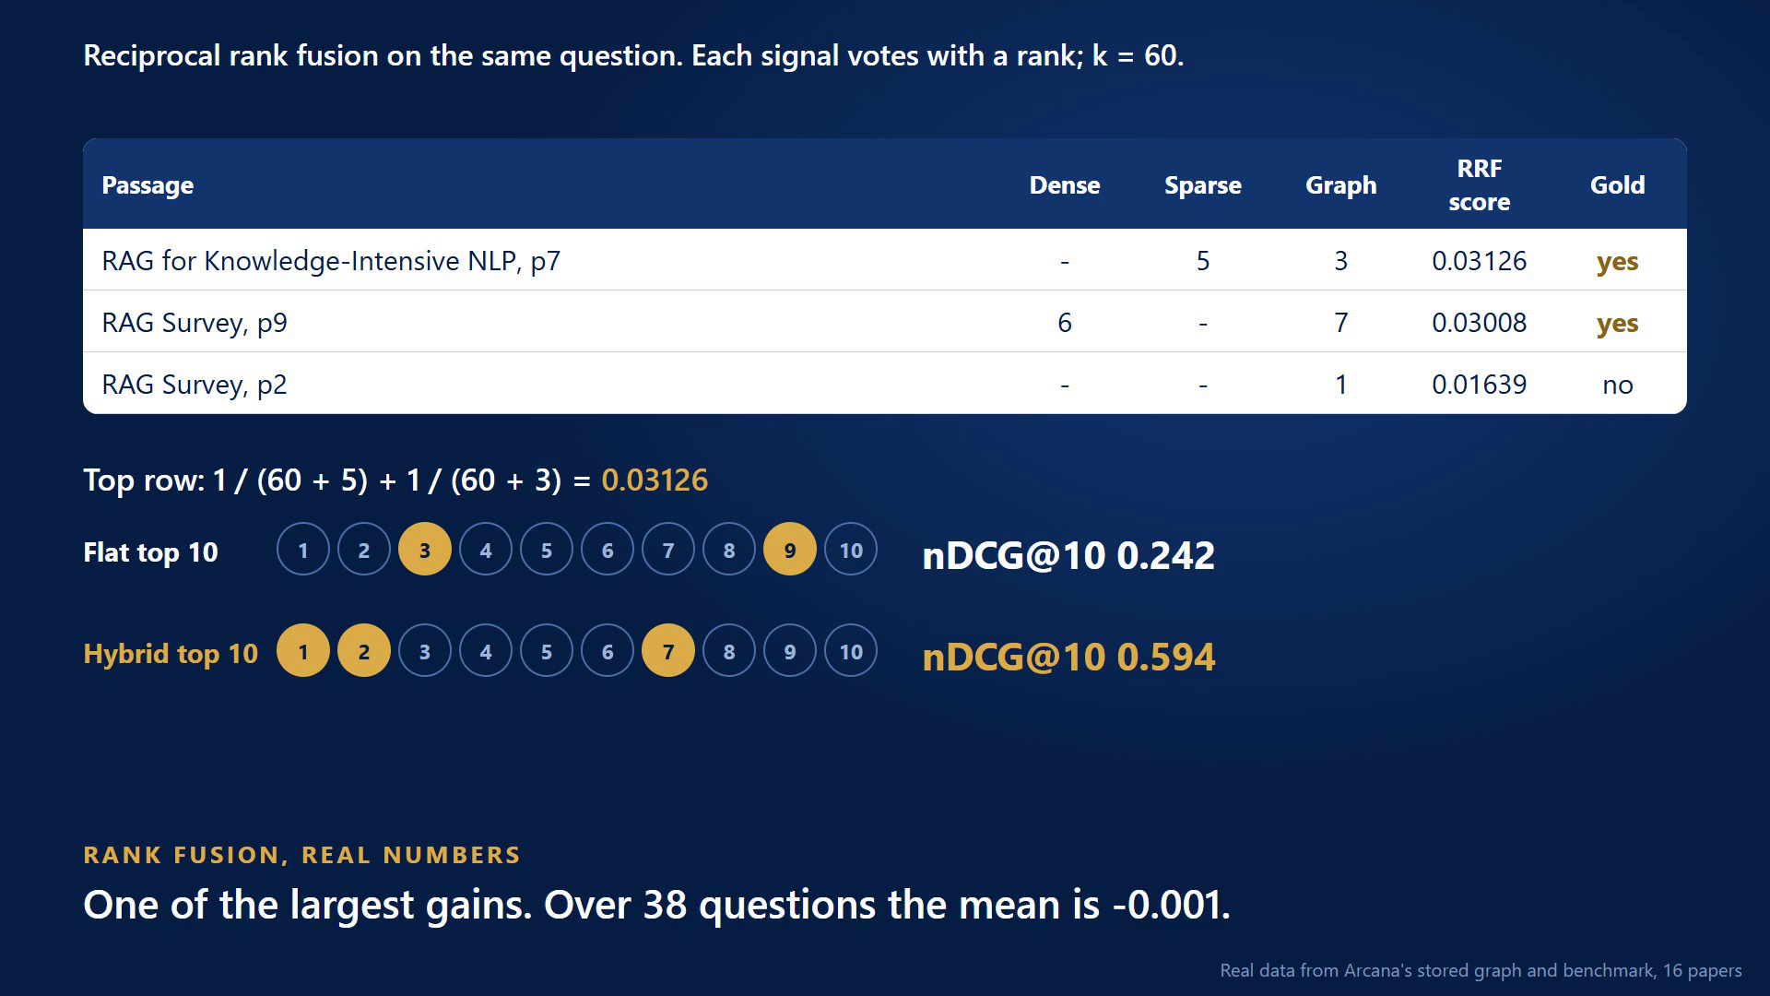
METHODOLOGY
Rank fusion: why a second vote matters
After the paper
Comparable by rank
Cosine, keyword and traversal scores differ in kind, so only ranks are combined [26].
A second vote
The rank 2 passage: dense 6, graph 7. Flat ranked it outside its top 10.
Chosen as an example
This is one of the largest gains. The next slides show the whole distribution.
Click to play. Scores recomputed from the stored rankings at k = 60; ties keep the stored order. Question q-cross-06.
14
Notes:
Here is the fusion, with real numbers. The FEVER passage gets a vote from keywords and one from the graph, and rises to first. The second passage was not in the flat top ten at all, and got in only because the graph gave it a second vote. nDCG goes from point two four to point five nine. But this is one of the largest gains. Averaged over all questions, the difference is zero.

Slide 15
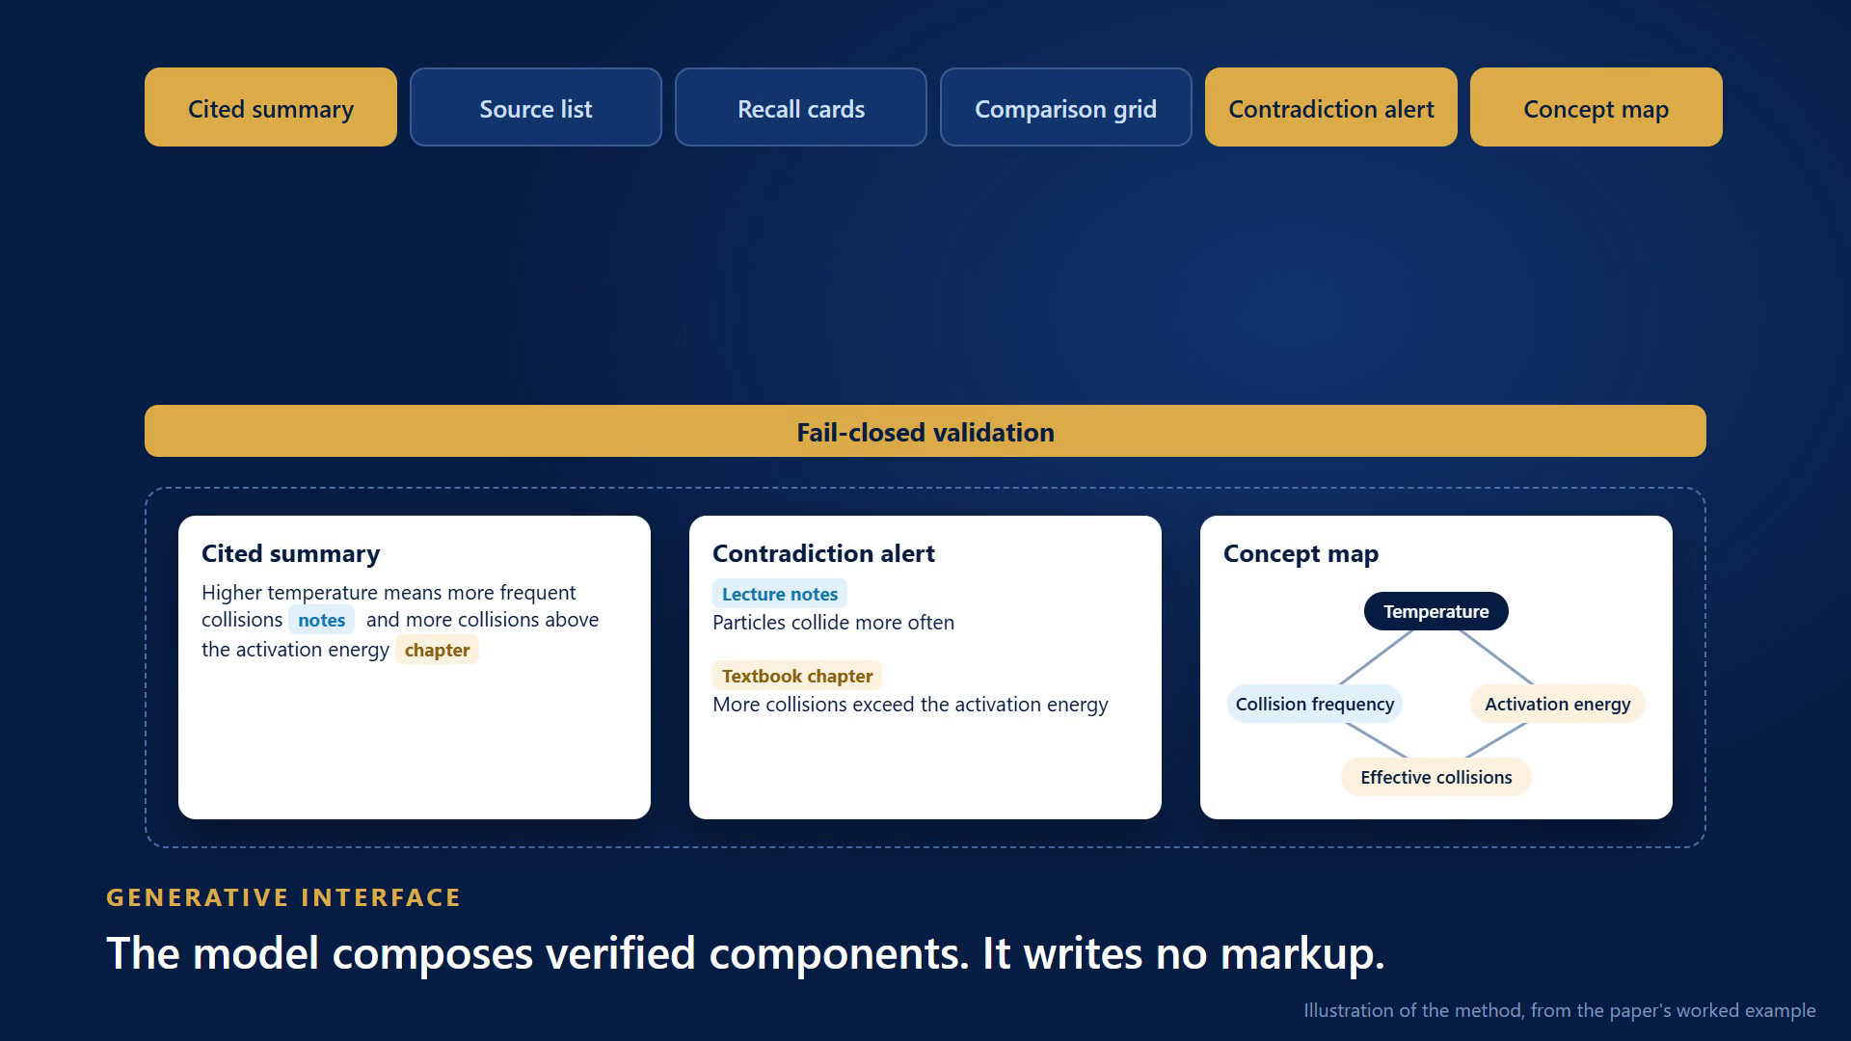
METHODOLOGY
Composition: verified components, nothing else
In the paper
Fails closed
One schema generates both sides of the wire. Any violation becomes an error, not a partial render.
Registry only
An unregistered block has no path to the screen, and omitting one fails the build.
Stated in the paper
Claim checking fails open on a provider error. Contradiction quotes are not yet matched verbatim.
Click to play. Illustration of the method, using the paper's worked example. 24 of 24 components registered, 645 tests passing in CI.
15
Notes:
With evidence in hand, the model composes. It picks typed components and fills them from what was retrieved. It writes no markup. A malformed block hits the validator on the server and is rejected, not repaired. We fail closed on purpose: a visible error can be recovered from, a confident wrong presentation cannot. The paper also states the gaps, shown here.

Slide 16
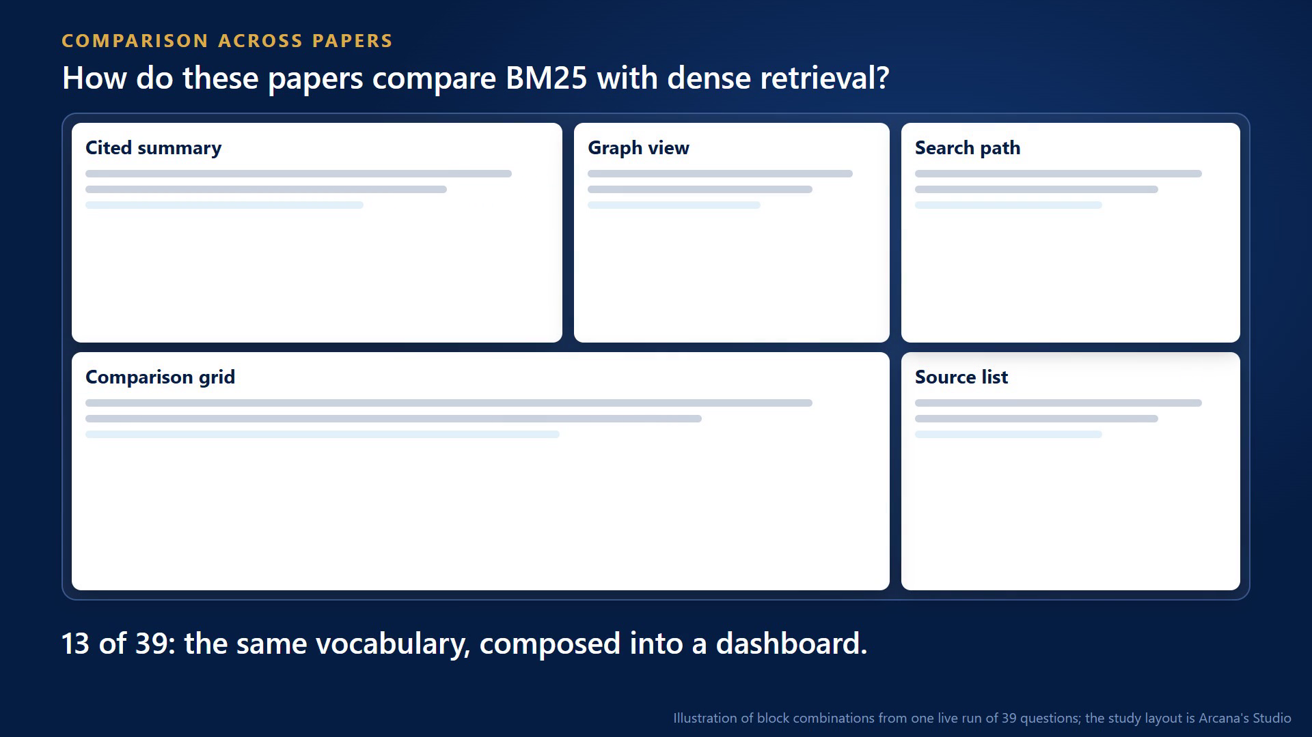
METHODOLOGY
Adaptive interface: where expressiveness shows
In the paper
Combinatorial
An ordered selection of k from n components, with payload structure derived per query.
The workspace reshapes
Surveying, revising, drafting and Socratic questioning need different components. Mode is inferred.
Bounded by retrieval
Which layouts are honest depends on the evidence. Expressiveness is the bound's other face.
Click to play. Section IV-A of the paper. Counts in the video are block combinations from one live run of 39 questions.
16
Notes:
This is where expressiveness becomes visible. The paper's claim is that the space of interfaces is combinatorial: an ordered choice of components from a vocabulary, with payloads decided per question. So the interface adapts. A single-paper question gets an answer and sources. A comparison gets a dashboard. A connected path adds a concept map. And the workspace reshapes with the task, including study. Nobody authored these layouts in advance.

Slide 17
METHODOLOGY
One request, traced end to end
After the paper
Orchestrator
routes: compare
Graph
structure, alignment
Research
8 passages, 6 quotes
Fact Checker
removed 1 of 6
Composer
5 blocks
Question q-cross-01: 11.1 seconds, about US$0.02
7 combinations of components across 39 questions
Routing across 39 questions
29
9
1
compare
single
relate
Agents never import each other. Every hand-off goes through one routing function, within hop and token budgets.
One live run, real model, no repeat. Route = TraversalView. Every combination also includes a cited summary and a source list.
17
Notes:
This is one real turn from the live run. The Orchestrator routes it, the Graph agent and Research gather evidence, and the Fact Checker removed one of six claims. Agents never call each other directly, and every path ends at composition. And across thirty-nine questions, there were seven different combinations of components. That is the interface following the question.

Slide 18
METHODOLOGY
A worked request from the paper
In the paper
Learner asks: Why does raising the temperature increase the rate of a reaction?
Cited summary
Contradiction alert
Concept map
Higher temperature gives more frequent collisions [notes], and a larger share of collisions above the activation energy [chapter].
Lecture notes
Particles collide more often
Temperature
Textbook chapter
More collisions exceed the activation energy
Collision frequency
Activation energy threshold
Effective collisions
Each claim carries a citation to its source.
Each side shows its document and stance, side by side.
Concepts linked across the corpus.
Section IV-B of the paper. An illustration of what is composed, not captured output.
18
Notes:
Here is the paper's teaching example. A chemistry learner asks why temperature raises reaction rate. Their notes stress collision frequency, and the chapter stresses activation energy. That difference is what a learner reproduces in an exam. The response composes three blocks, none authored for this question. A language model detects the disagreement, not a typed edge.

Slide 19
CENTRAL CLAIM
Retrieval structure bounds interface expressiveness
In the paper
X(R) = { c ∈ C | P(c) satisfiable from E(R, q) } X(flat) ⊂ X(graph-hybrid)
Component | Structural precondition | Supplied by | Study activity
Cited summary | ranked passages with sources | flat retrieval | reading, orientation
Recall cards | atomic facts with sources | flat retrieval | retrieval practice
Comparison grid | documents aligned on shared dimensions | cross-document entity alignment | comparison
Contradiction alert | claim pairs on one entity that disagree | co-retrieval via the graph | reconciling sources
Concept map | concept-to-concept relations | graph traversal | organising knowledge
The catalogue a generative learning interface can honestly offer is a function of the retrieval beneath it.
19
Notes:
Formally: a component is a claim about the shape of an answer, and its precondition is what must hold in the evidence. Expressiveness is the set of components a retrieval layer can satisfy. So the catalogue you can honestly offer is a function of the retrieval beneath it.

Slide 20
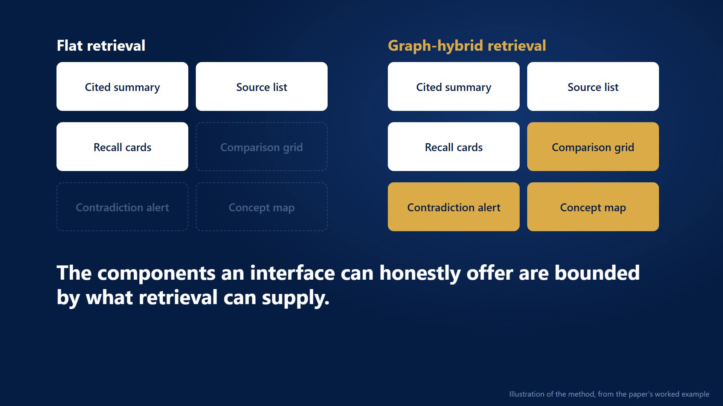
CENTRAL CLAIM
The bound, as a picture
In the paper
Not a rendering limit
Any renderer can draw a grid. The question is what fills it.
A design rule
Admit a component only once retrieval can satisfy what it asserts.
Why it matters
A rich catalogue on flat retrieval is filled by the model, not by evidence.
Click to play. Illustration of Table III of the paper.
20
Notes:
Here is the bound as a picture. Each retrieval layer can honestly fill only some components. Flat retrieval lights up three. Graph-hybrid lights up all six. The dark ones on the left could still be drawn, but the model would have to supply the relation itself.

Slide 21
EVALUATION
Committed protocol, and a pilot reported as found
In the paper
Protocol, fixed 9 June 2026
Arm | Mean distinct sources | Median latency (ms)
Dense only | 2.50 | 670
Sparse only | 3.35 | 208
Graph only | 0.60 | 2,500
Flat (dense + sparse) | 3.15 | 897
Hybrid (all three) | 3.15 | 900
20 questions: 12 cross-document, 4 single-document, 4 contradiction
16 public papers, 1,570 chunks
5 arms: dense, sparse, graph, flat, hybrid
Metrics: distinct sources, latency
Paired Wilcoxon, hybrid against flat
Null: tied on 18 of 20 questions (p = 1.0). Traversal returned nothing on 15 of 20. The pilot locates the ceiling in query entity resolution.
Pilot index: 4 of 16 documents (796 nodes, 859 edges). Table V of the paper.
21
Notes:
The protocol was committed before any run. A provider quota stopped extraction, so the paper reports a pilot on four of sixteen documents. The result was null, and traversal returned nothing on fifteen questions, because entities needed an exact match. So the pilot located the ceiling: query entity resolution.

Slide 22
FROM PAPER TO PRACTICE
Where Arcana began: VERA AI
 | VERA AI | Arcana
Knowledge | Flat vector chunks, one silo per document | Entities and relations across all documents
Retrieval | BM25 + vector, fused by RRF | BM25 + vector + graph traversal, fused by RRF
Agents | Six fixed, independent agents | Task agents, routed through one function
Interface | Static three-panel layout | Typed components composed per question
Domain | Enterprise knowledge base | Learners working across their own documents
VERA could cite its answers, but had nothing structured to show how sources relate. That limit is what this paper formalises.
A design comparison, not a benchmark: different domains and corpora.
22
Notes:
A word on where this began. Arcana grew out of VERA AI, an enterprise assistant from my internship, which already cited its answers. But documents were silos and the layout was fixed. It could cite well, yet had nothing structured to show how sources relate. This compares designs, not results.

Slide 23
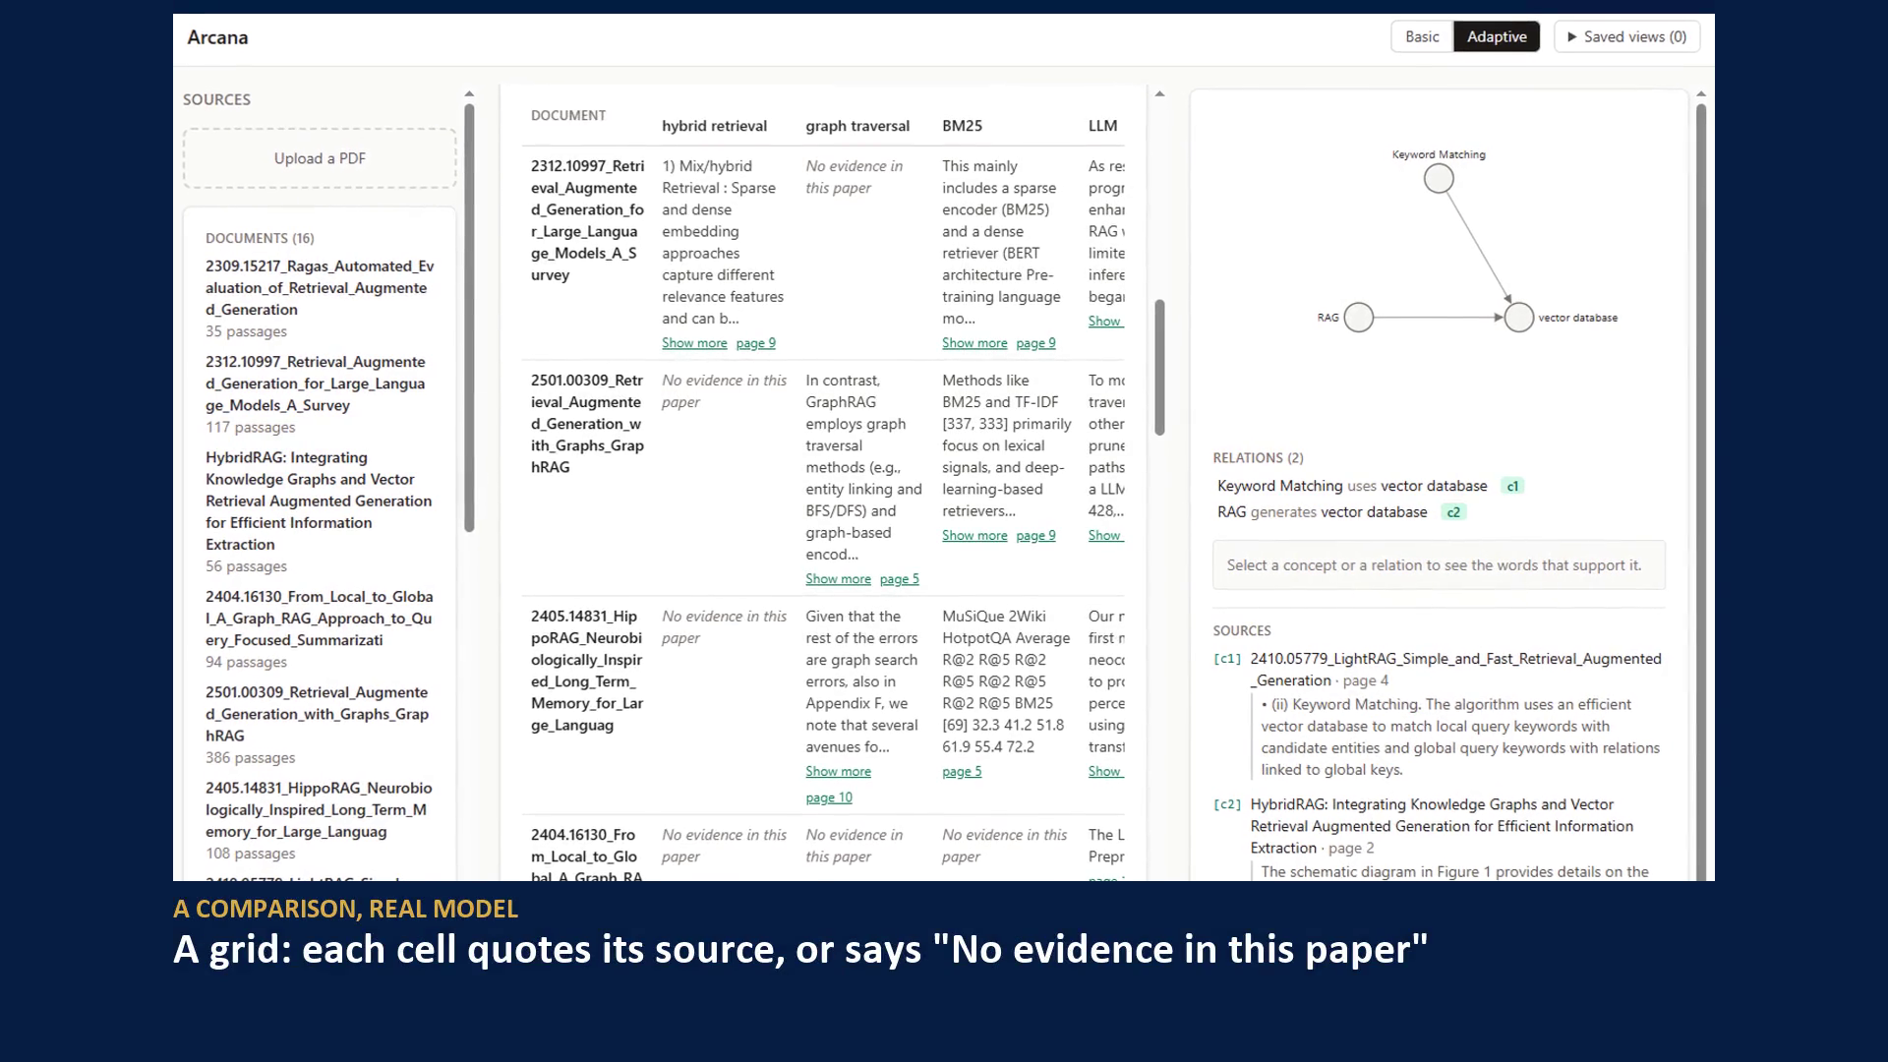
FROM PAPER TO PRACTICE
Demo: same corpus, different questions
After the paper
Relational question
A cited summary, and relations that each cite their sentence.
Comparison
A grid. Each cell quotes its source, or says "No evidence in this paper".
Unanswerable
It says so, instead of inventing an answer.
Click to play. Real-model run on 16 papers.
23
Notes:
This is Arcana on the sixteen papers, with a real model. A relational question gets a cited summary and a graph. A comparison gets a grid, where a cell says no evidence if a paper has nothing. A question the papers cannot answer gets a refusal. Nobody designed these screens in advance.

Slide 24
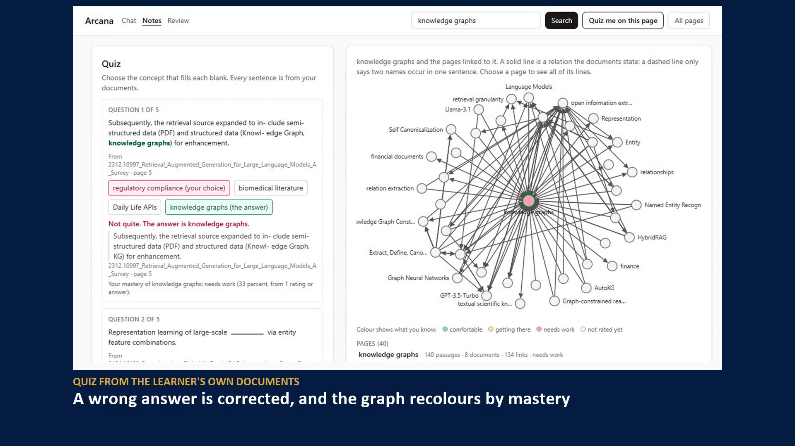
FROM PAPER TO PRACTICE
Demo: from answers to learning
After the paper
Concept pages
Built from the graph. Every stated link shows its sentence and page.
Quiz and mastery
A wrong answer is corrected with its source, and the graph recolours.
Verified lab
Offered only where a passage states the formula. 120 of 120 planted defects refused.
Click to play. No model call in these tools. The lab's function is a test fixture, passed through the real verifier. Planted set written by the project.
24
Notes:
And the learning side. Concept pages are built from the graph, and each stated link shows its sentence and page. The quiz comes from the learner's own documents. A wrong answer is corrected, and the graph recolours by mastery. And a lab is offered only where a stored passage states the formula, verified across every slider setting.

Slide 25
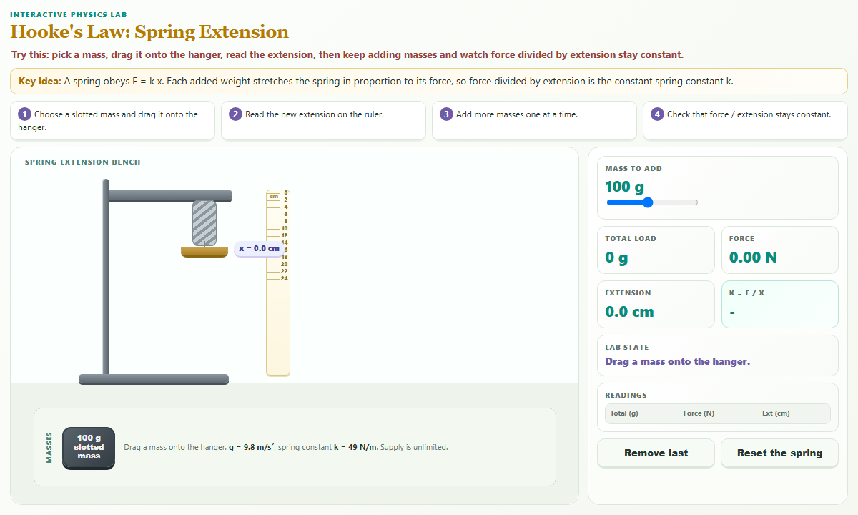
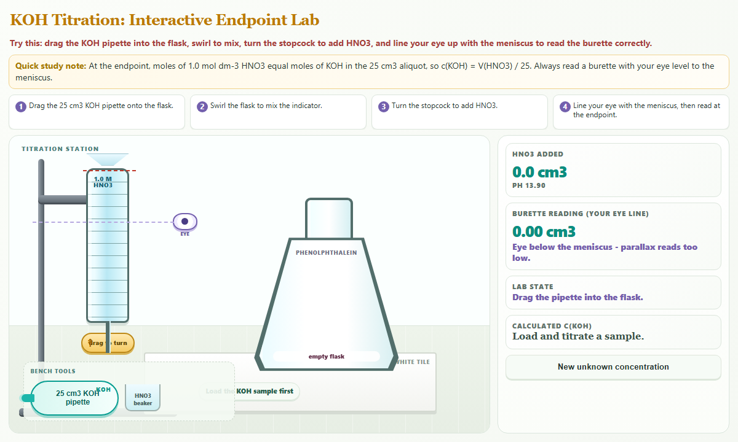
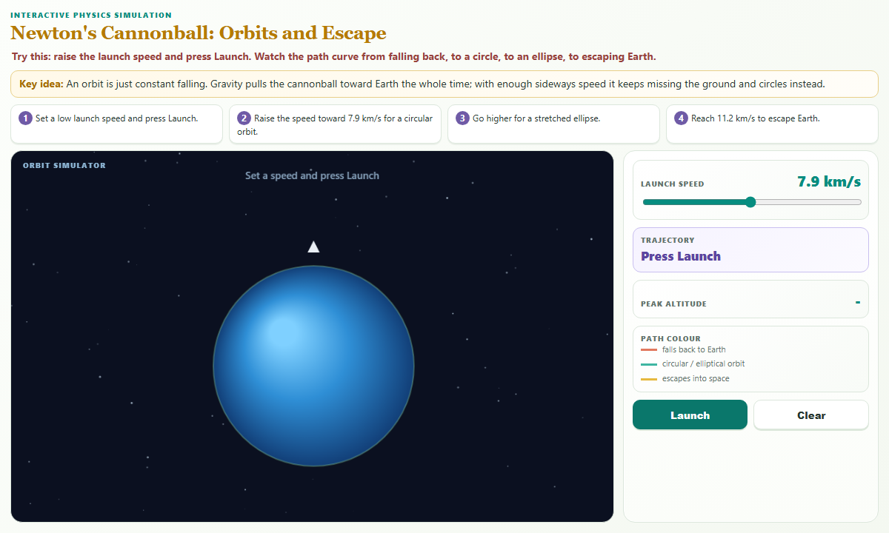
FROM PAPER TO PRACTICE
Beyond the catalogue: generated, then verified
After the paper
Level 1: typed components
Fixed, verified, filled from evidence
Level 2: adaptive layout
Arranged per question and task
Level 3: generated component
Written per question, shown only if verified
219 of 224
planted defects refused, 0 of 30 false alarms
20 of 20
Hooke's law
Acid-base titration
Newton's cannonball
hostile attack shapes blocked
The trust path: the model plans over an audited kit, a real browser moves every control, only the verifier can mint the deliverable, and it runs in a sandbox.
13 of 14
new questions built a lab, labelled model-checked
Synapse, by Team EduNova (UTP), Form 4 and 5 science. Prototype screens. Planted sets written by the team. No teacher review or learner study yet.
25
Notes:
The paper names a cost: the catalogue is a ceiling. A question whose best answer is an interactive experiment gets the closest component. Our team's system, Synapse, explores the way past that ceiling for school science. The model plans a lab over an audited kit, and a verifier runs it in a real browser before a student can see it. Arcana's formula labs use the same discipline. This is a different domain, so I do not compare results.

Slide 26
NEW FINDINGS
On the full corpus, a retrieval gain is not shown
After the paper
Question set | Hybrid minus flat | Better / tied / worse | p
Original 19, cross-document | +0.039 | 7 / 8 / 4 | 0.15
New 19, declared extension | -0.042 | 2 / 6 / 11 | 0.068
Pooled 38 | -0.001 | 9 / 14 / 15 | 0.69
No pair reaches p < 0.05. Not shown to help is not the same as shown not to help.
nDCG@10 against gold passages, 16 papers, 1,570 passages, paired Wilcoxon. A different metric from the pilot. Not peer reviewed.
26
Notes:
After the paper we completed the study: all sixteen papers, repaired matching, and a gold set. On the harder original questions the hybrid is ahead, not significantly. On new questions it falls behind. Pooled, the difference is zero. So I claim no retrieval gain. Not shown to help is not the same as shown not to help.

Slide 27
NEW FINDINGS
Every question: the graph helps some and hurts others
After the paper
Hybrid minus flat, nDCG@10, 38 questions sorted
9
14
15
better
tied
worse
Set, category | n | Flat | Hybrid
Original, cross-document | 12 | 0.126 | 0.197
Original, single-document | 3 | 0.399 | 0.363
Original, contradiction | 4 | 0.124 | 0.124
New, cross-document | 11 | 0.268 | 0.217
New, single-document | 8 | 0.566 | 0.537
Range: -0.343 to +0.420. Mean nDCG@10 per set. No pair reaches p < 0.05. Questions were not randomly sampled. Not peer reviewed.
27
Notes:
Here is every question, sorted. Nine improve with the graph, fourteen tie, fifteen get worse. So the average hides large swings in both directions. The table shows where. On the original cross-document questions the hybrid is ahead. On single-document questions, it is behind. A good system would know when to use the graph, and that is a direction this suggests.

Slide 28
NEW FINDINGS
What we tried, and what did not hold up
After the paper
Change | Looked like | When tested | Verdict
30 candidates per signal | Recall@10 +0.093, 19 questions (p = 0.094) | -0.007 on 19 new questions (p = 1.0) | Reversed, by a rule fixed in advance
Graph signal at larger scale | -0.022 at 285 passages, +0.039 at 1,570 | -0.042 on new questions, -0.001 pooled | Did not replicate
Pretrained cross-encoder re-ranker | Standard next step | -0.007 nDCG@10 (p = 0.90), about 5 s per query | Left off
Cleaner atomic-note graph | 61% of the nodes, 40% of the edges | +0.010 fused, pooled (p = 0.86) | About level from a smaller graph
The rule for the new questions was fixed before they ran, so a result could not be quietly kept.
Descriptive, 38 questions in two differently drawn sets, one corpus. Not peer reviewed.
28
Notes:
Evaluation also killed some of our own ideas. On the original questions, deeper retrieval looked like a real gain, but a rule fixed in advance reversed it when it failed on new questions. The graph seemed to help more as the corpus grew, and that did not replicate either. A trained re-ranker did not help. A cleaner graph with forty percent of the edges did about as well. I report these because negative results are part of the evidence.

Slide 29
NEW FINDINGS
The graph does extend the interface: 2 components against 5
After the paper
What is measured
How often the evidence for each component exists, of 20 questions.
What is by construction
Flat admits none of the three. The preconditions read graph structure.
What it does not show
Admitted is not correct or useful. The grid is not yet selective.
Admission over 20 questions, one graph, five components measured. Not peer reviewed.
29
Notes:
The other half. Flat retrieval admits two of five measured components, and the hybrid all five. That flat cannot admit the other three follows from the definitions. What we measured is how often the evidence exists: sixteen questions for a graph, three for a multi-hop path. Admitted does not mean useful.

Slide 30
NEW FINDINGS
Grounding holds with a real model, relevance is not yet shown
After the paper
38 of 38
1 of 1
125 of 125
10 of 140
answerable questions answered
unanswerable control refused
quotes verbatim from the stored passage
claims removed as unsupported by the judge
0.21
citation precision
0.21
gold recall
19 of 38
answers cite no gold-relevant passage
Nothing appears without a verbatim source. Grounded and relevant are different things.
One live run, one model, no repeat. The gold set is a floor, not a full list. Not peer reviewed.
30
Notes:
With a real model, all answerable questions were answered, the unanswerable one was refused, and every quote was verbatim. But citation precision is about 0.21. The gold set is incomplete, so this does not show the answers are wrong. It does show that grounded and relevant are different things.

Slide 31
NEW FINDINGS
We tested the checkers too
After the paper
Fact-check defects detected, of 50 each, word-overlap rule only
The blind spot
Word overlap cannot see a negated or altered claim: 0 of 50.
Why a judge is needed
In the live run the model judge removed 10 of 140 claims under valid quotes.
Clean answers
50 of 50 clean answers were kept, so the rule did not over-refuse.
A planted set written by the project: known shapes, not an unbiased rate. The judge's own accuracy is not yet measured.
31
Notes:
A checker you have not tested is just a claim, so we planted defects. Fake quotes and wrong citations were caught every time. Invented claims nearly always. But a negated claim, zero out of fifty. A word-overlap rule cannot see the word not. That is why claim checking needs a model judge, and in the live run the judge removed ten claims that a real quote did not support. These defects were written by the project, so they show known shapes, not a general rate.

Slide 32
CONCLUSION
What this does and does not show
Established
Not shown
Next
Interface guarantees hold by construction
The bound follows from preconditions
Grounding held in one live run
A retrieval gain from the graph
Correctness of what is admitted
Extraction quality, by human audit
Any learning outcome
Human audit of graph links
Check each block against its own edges at build time
Make components more selective
Run the interface study
The components an interface can honestly offer are those whose preconditions retrieval can satisfy.
32
Notes:
To conclude. The guarantees hold by construction, and the bound follows from the preconditions. The empirical picture is more modest: no retrieval gain shown, and no learning outcome, because no user study has run. The point to keep: the components an interface can honestly offer are those whose preconditions retrieval can satisfy.

Slide 33
REFERENCES
Selected references
[1] Y. Gao et al., RAG for large language models: a survey, arXiv:2312.10997, 2024.
[2] B. Sarmah et al., HybridRAG, arXiv:2408.04948, 2024.
[3] D. Edge et al., From local to global: a graph RAG approach, arXiv:2404.16130, 2024.
[4] R. E. Mayer, Cognitive theory of multimedia learning, Educ. Psychol. Rev., 2024.
[5] M. A. Fadillah et al., Meta-analysis of PhET simulations, Int. J. Online Biomed. Eng., 2026.
[6] Y. Leviathan et al., Generative UI, arXiv:2604.09577, 2026.
[7] S. Tu et al., MAIC-UI, arXiv:2604.25806, 2026.
[8] T. Calò and C. J. MacLellan, Educator-driven tutor authoring, L@S '24, 2024.
[9] X. J. Wang et al., LearnMate², DIS '26, 2026.
[10] S. P. Neshaei et al., The missing layer, arXiv:2606.15902, 2026.
[11] J. Irigoyen et al., EduEVAL-DB, arXiv:2602.15531, 2026.
[12] A. Shoufan and A. A. A. Esmaeil, AI hallucination from students' perspective, arXiv:2602.17671, 2026.
[13] J. Liao et al., Code monitor red teaming, arXiv:2607.20852, 2026.
[14] H. Han et al., RAG with graphs (GraphRAG), arXiv:2501.00309, 2024.
[15] B. J. Gutiérrez et al., HippoRAG, NeurIPS, 2024.
[16] Z. Guo et al., LightRAG, arXiv:2410.05779, 2024.
[17] T. Zhang and H. Soh, Extract, define, canonicalize, EMNLP, 2024.
[18] Y. Liu et al., AlignUI, arXiv:2601.17614, 2026.
[19] Y. Liu et al., CrowdGenUI, arXiv:2411.03477, 2024.
[20] Agent2UI, technical specification, 2025. Not peer reviewed.
[21] Y. Ben-Zion et al., AI for rapid generation of physics simulations, arXiv:2412.07482, 2024.
[22] T. N.-D. Tran et al., ChemersiveLLM, VRST '25, 2025.
[23] X. Li et al., Beyond superficial tests, Findings of ACL 2026.
[24] Q. Li et al., AdverMCTS, arXiv:2604.10449, 2026.
[25] J. Kwok et al., LLM-as-a-verifier, arXiv:2607.05391, 2026.
[26] G. V. Cormack et al., Reciprocal rank fusion, SIGIR, 2009.
33
Notes:
These are the references cited on the slides, numbered as in the paper. The full list is in the proceedings.

Slide 34
MCAIT 2026
Thank you
Questions are welcome.
Fakhrul Azim Bin Ahmed Mardzukie
fakhrul_22012087@utp.edu.my
github.com/Azimlearning/Arcana
3–5 NOVEMBER 2026 · TAIBAH UNIVERSITY · MADINAH
Notes:
Thank you. The code and protocol are public, and I am happy to take questions.

Slide 35
BACKUP
Backup slides, for questions
Rank fusion: the full top 10 for the worked example
Admission by question: which components each question could support
The wire contract, and how a component is added
Cost and latency
The real graph and a comparison grid
Safeguards, and what each contains
35
Notes:
Backup only. Use these if a question calls for them.

Slide 36
BACKUP
Rank fusion: the full top 10
After the paper
# | Passage | Dense | Sparse | Graph | RRF | Gold | In flat top 10
1 | RAG for Knowledge-Intensive NLP, p7 | - | 5 | 3 | 0.03126 | yes | yes
2 | RAG Survey, p9 | 6 | - | 7 | 0.03008 | yes | no
3 | RAG Survey, p2 | - | - | 1 | 0.01639 | no | no
4 | LightRAG, p5 | - | 1 | - | 0.01639 | no | yes
5 | Precise Zero-Shot Dense Retrieval, p1 | 1 | - | - | 0.01639 | no | yes
6 | RAG Survey, p3 | - | - | 2 | 0.01613 | no | no
7 | RAG Survey, p9 | 2 | - | - | 0.01613 | yes | yes
8 | From Local to Global, p7 | - | 2 | - | 0.01613 | no | yes
9 | From Local to Global, p7 | - | 3 | - | 0.01587 | no | yes
10 | Precise Zero-Shot Dense Retrieval, p8 | 3 | - | - | 0.01587 | no | yes
Question q-cross-06, k = 60. Scores recomputed from stored rankings; ties keep the stored order.
36
Notes:
Backup. The full fused list for the worked question.

Slide 37
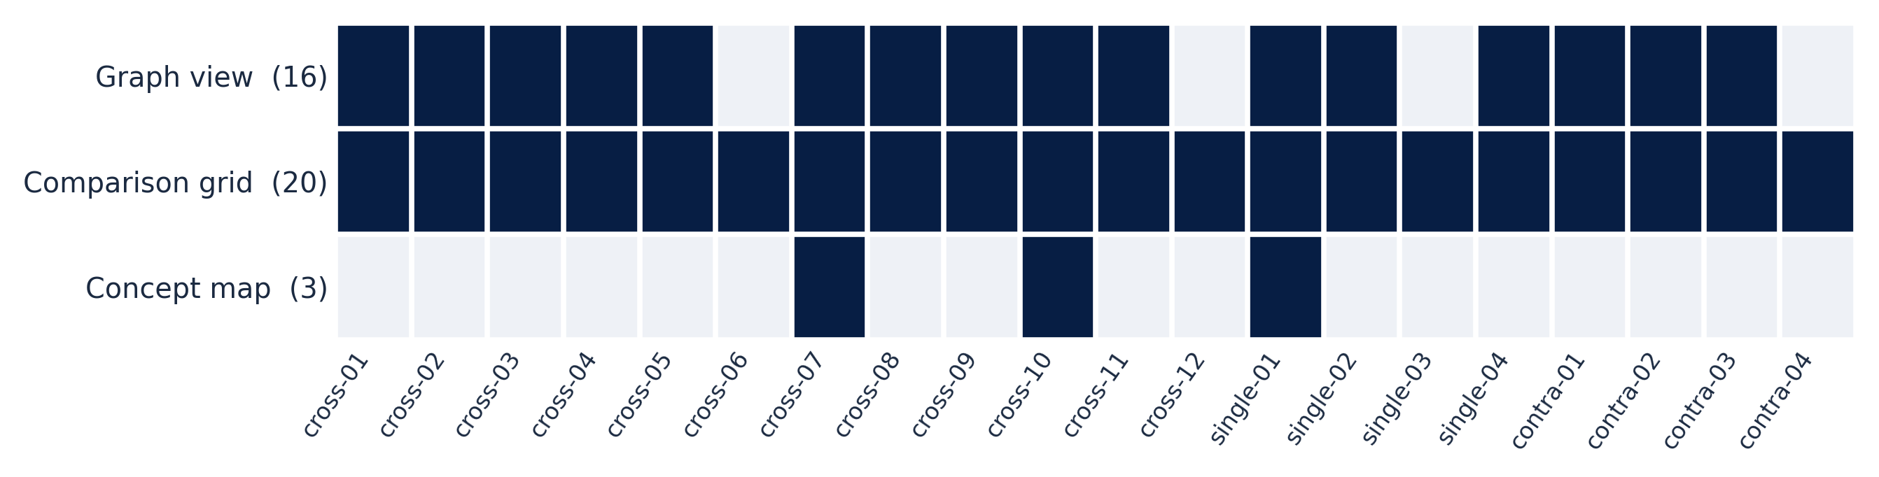
BACKUP
Admission by question
After the paper
Dark = admitted. Availability, not quality. The worked example q-cross-06 has no graph view here: none of the edges returned by the Graph agent had a quote naming both ends.
37
Notes:
Backup. Each question and which graph components its evidence could support.

Slide 38
BACKUP
The wire contract
After the paper
export interface ComparisonGrid {
type: "ComparisonGrid";
id: string;
meta: BlockMeta;
data: ComparisonGridData;
}
export type UIBlock =
| CitedSummary
| SourceList
| GraphView
| ComparisonGrid
| ...
Adding a component is three steps
1
Add the schema variant, and regenerate the server models
2
Implement the component, with its four states
3
Add one line to the registry
A payload change not reflected on both sides is a compile error. Generated models are strict and forbid unknown fields, so they fail closed.
From the shared schema package. Four states: empty, loading, partial, error.
38
Notes:
Backup. The block type as declared in the shared schema, and the three steps to add a component.

Slide 39
BACKUP
Cost and latency
After the paper
US$5.81
US$0.0037
15 of 1,570
to ingest 16 papers, 1,570 passages
per passage: extraction plus embedding
passages failed extraction (0.95%)
US$0.017
US$0.045
481 ms
mean per question, real model
mean per writing turn
mean hybrid retrieval, against 296 ms flat
One ingestion, one live run, original 19 questions for latency. Embedding price is an assumption until reconciled with the provider.
39
Notes:
Backup. What it costs to build and run.

Slide 40
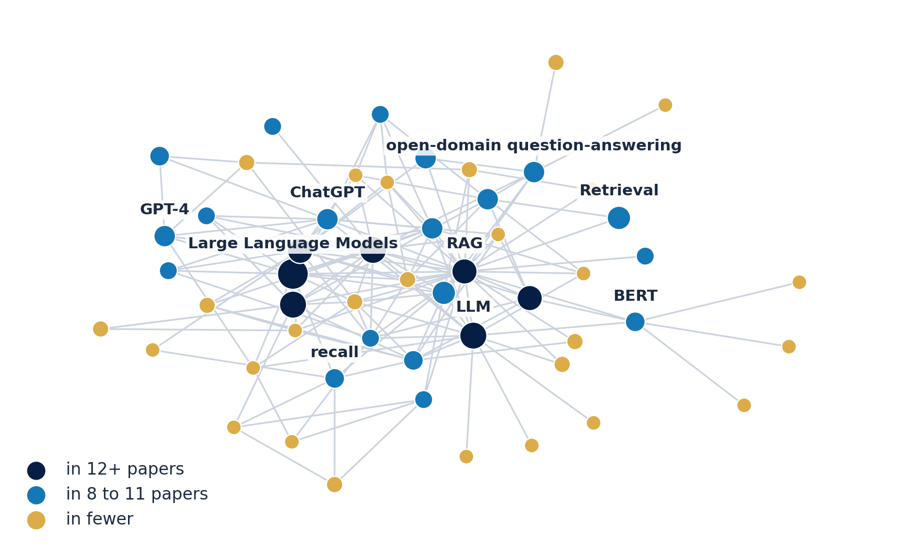
FROM PAPER TO PRACTICE
What retrieval structure makes possible
After the paper
Paper | BM25 | Graph traversal
RAG Survey | "a sparse encoder (BM25) and a dense retriever" (page 9) | No evidence in this paper
RAG with Graphs | "Methods like BM25 and TF-IDF primarily focus on lexical signals" (page 9) | "GraphRAG employs graph traversal methods" (page 5)
From Local to Global | No evidence in this paper | No evidence in this paper
11,173 concepts, 13,972 edges, 11.6% of concepts in 2+ papers
A real comparison grid: quote and page, or an honest gap
Real graph, 16 papers. Drawn: the most widely shared concepts. About a third of edges are stated in one sentence. Grid simplified from Arcana, quotes shortened.
40
Notes:
Backup. Part of the real graph, and a comparison grid filled from it.

Slide 41
METHODOLOGY
The model composes the interface. It does not write it.
In the paper
Fixed
Safeguard | Failure it contains
One schema generates both sides of the wire | producer and consumer drift
Retrieval before synthesis | assertions from outside retrieved material
Per-claim checking [25] | unsupported citations
Server-side validation that fails closed | malformed presentations
Registry-only rendering | unregistered presentations
Components, layout, typography, interaction
Chosen per question
Which components, in what order
From retrieved evidence
Every payload that fills them
Stated in the paper: claim checking fails open on a provider error, and a contradiction quote is not yet matched verbatim. Status: 24 of 24 components registered, 645 tests passing in CI.
41
Notes:
Backup. The safeguards and the failure each contains.

