Slide 1


MCAIT 2026
Graph-Grounded Generative User Interfaces for Learning: Retrieval Structure Determines Interface Expressiveness
Fakhrul Azim Bin Ahmed Mardzukie · Universiti Teknologi PETRONAS, Malaysia
Presenter: Fakhrul Azim · Parallel Session 6 (Virtual), Track 2
3–5 NOVEMBER 2026 · TAIBAH UNIVERSITY · MADINAH
Notes:
Good afternoon. I am Fakhrul Azim from Universiti Teknologi PETRONAS. My paper asks why learners working across their own documents still get a chat box, and what it would take to give them something better.

Slide 2
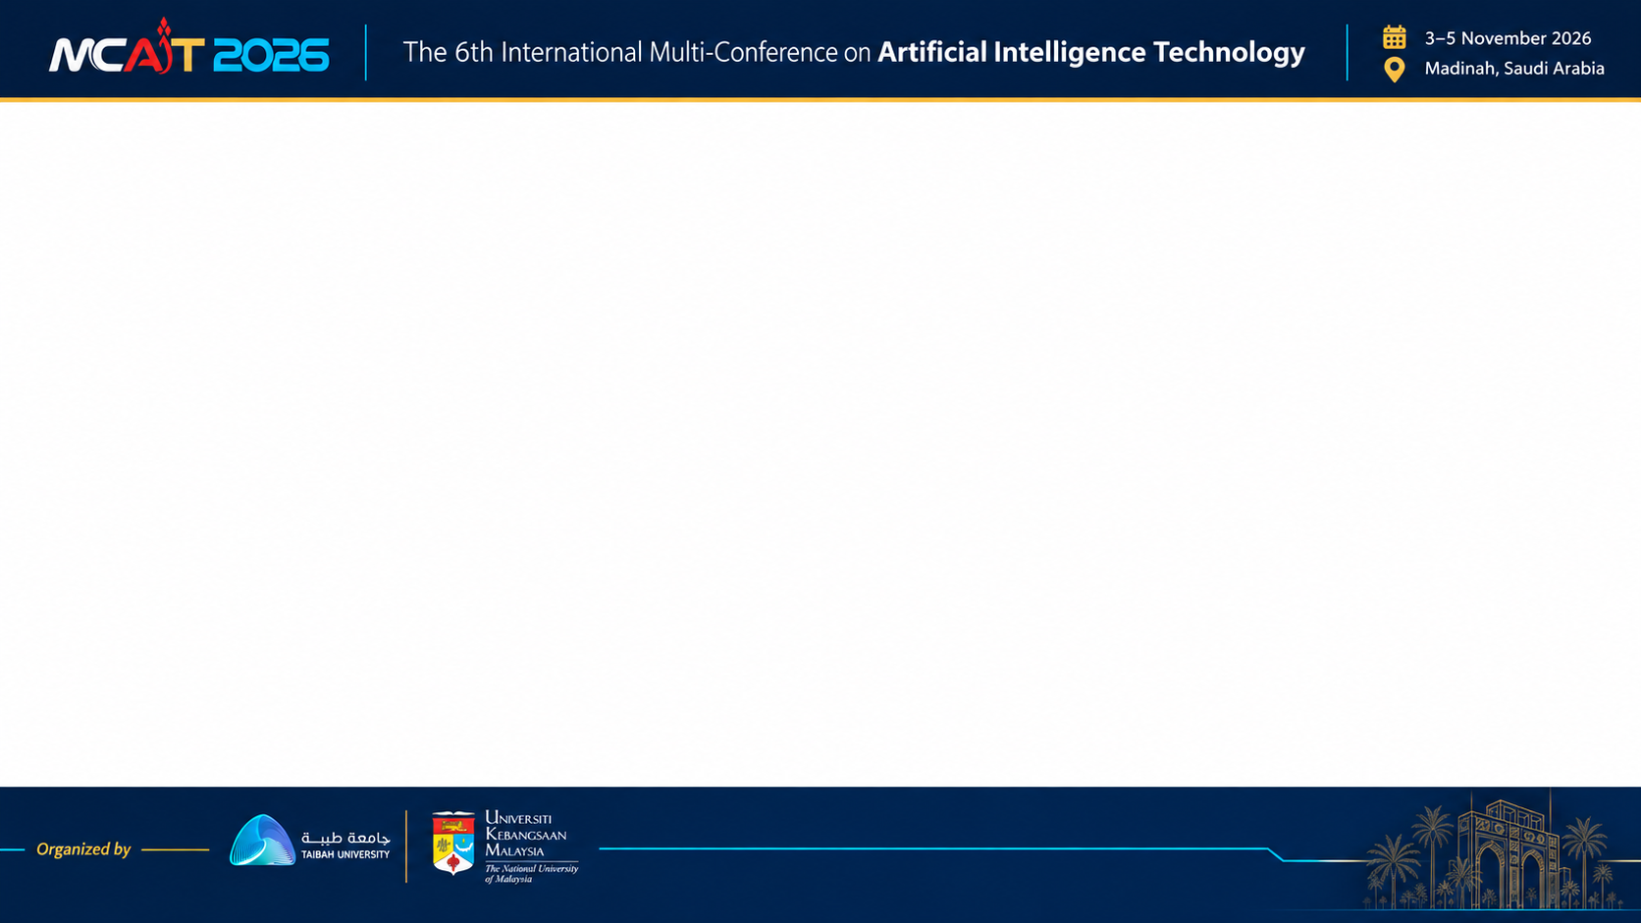
OVERVIEW
The claim of this paper
The components an interface can honestly offer are bounded by what retrieval can supply.
1
2
3
4
5
6
Problem
Gap
Approach
Bound
Evaluation
Conclusion
Learners get prose
What the literature leaves open
Compose, do not write
Retrieval limits the catalogue
Protocol and results
Limits and next steps
2
Notes:
Here is the claim in one sentence. The interface components a learning system can honestly offer are bounded by what its retrieval layer can supply. I will go through the problem, the gap in the literature, the approach, the formal bound and the evaluation. I will also show Arcana, which is this paper put into practice, and what we measured on it after the paper was accepted.

Slide 3
BACKGROUND AND PROBLEM
Learners ask relational questions and get prose
What a learner asks across their documents
What they get back
Which of these papers agree?
Where do they conflict?
What does the set not cover?
d = 0.83
Why these views are missing
A flat answer asserts relations it never retrieved, and hands the synthesis back as more text to read [4].
Someone must author each one per topic
Retrieval has nothing structured to fill it
pooled effect of interactive representations, 20 physics studies, human-authored [5]
3
Notes:
When you study across many documents, the useful questions are about relationships: which sources agree, where they conflict, what is missing. Current tools answer with a paragraph, which hands the work of connecting the sources back to the learner. Interactive representations can work very well: one meta-analysis found a pooled effect of 0.83 across twenty physics studies. But that material was authored by people. Comparison grids and concept maps are absent from corpus tools for two reasons: someone must build them per topic, and the retrieval layer has nothing structured to fill them with.

Slide 4
BACKGROUND AND PROBLEM
Flat retrieval has no way to represent a relation
Passage, scored alone
Flat retrieval
Query
Cited prose
Relations asserted, never retrieved
Passage, scored alone
Passage, scored alone
Collision frequency
Activation energy
Graph-hybrid retrieval
Query
Relational components
Grid, concept map, contradiction alert
Temperature
Effective collisions
Reaction rate
Blue: from one document. Gold: from another. A shared entity brings them into one retrieved set. Similarity encodes how alike texts are, not how entities connect [3].
4
Notes:
The cause sits in retrieval. Standard retrieval scores every chunk independently. It finds the passage most similar to the question, but holds no record that two passages disagree or that one concept depends on another. A larger embedding model does not fix this, because similarity measures how alike two texts are, not how the things inside them connect. Graph retrieval changes what is stored. Entities and relations are extracted, so a shared entity can bring passages from different documents together.

Slide 5
RELATED WORK
Four literatures, and the gap between them
Area | What it establishes | What it leaves open
Retrieval [1-3, 14-17] | Hybrid and graph retrieval, schema-free extraction | Never treats retrieved structure as a substrate for presentation
Generative UI [6, 18-20] | Feasible, preferred to markdown, protocols for typed intent | None asks whether the content is supported by a source
Generated artifacts in education [7-9, 21, 22] | Authoring-time generation with a human reviewer | None generates for the learner at request time from evidence
Verification and risk [10-13, 23-25] | Adversarial checks for code; risks of generated instruction | Oracles do not transfer; the safety objection stands unanswered
Gap: a learning interface composed at request time, from retrieved evidence, with a stated bound on what it may assert.
5
Notes:
Four bodies of work touch this problem. Graph retrieval is evaluated as retrieval, by answer quality. Generative interface work is evaluated by preference, and preference is not correctness in instruction. Educational systems keep a human between generation and learner, so they are safe but limited to what an educator anticipated. And verification work relies on oracles and executable contracts, which a learning presentation does not have. One recent paper argues that runtime generation is unsafe because it cannot be verified at scale. No existing mechanism answers that, and that is the gap.

Slide 6
RELATED WORK
Generative interfaces are reaching the market
 | Gemini Notebook (formerly NotebookLM) | ChatGPT Intelligent UI | Gemini dynamic view | This paper
Described input | the learner's uploaded sources and instructions | the question | the prompt, with tools such as web search | evidence retrieved from the learner's corpus
How the view arises | the learner picks an output: mind map, data table, flashcards | the model chooses the format automatically | the model designs and codes it per prompt | the model selects from a typed catalogue
Stated rule linking a view to retrieved structure | not stated | not stated | not stated | a precondition on every component
This compares public descriptions only. Not stated does not mean absent, and no product was tested.
Sources, checked 1 Nov 2026: Gemini Notebook Help; OpenAI release notes, 7 Oct 2026; Google Research blog, 18 Nov 2025.
6
Notes:
This is no longer only a research question, because products are moving the same way. Gemini Notebook, formerly NotebookLM, answers from your sources, and the learner picks an output such as a mind map or a data table. ChatGPT's Intelligent UI chooses the format automatically. Gemini's dynamic view writes custom code for each prompt. I am only reporting what the vendors publish, and I have not tested these systems. The paper makes no claim about how they work inside. What I can say is that none of these public descriptions states a rule linking a view to the retrieved structure that justifies it. Stating that rule is what this paper does.

Slide 7
THIS PAPER
Contributions
Architecture
Verified interface layer
1
Graph-native hybrid retrieval coupled to a typed generative interface. Evidence fills components, not prose.
2
Composed at request time. One schema, fail-closed validation, registry-only rendering, provenance on every claim.
A formal bound
Committed evaluation
3
A definition, with a component-by-component mapping to study activities, that retrieval bounds expressiveness.
4
Ablation harness, paired test and extraction audit fixed before any run, with a pilot reported as found.
Arcana is this paper in practice: a learning workspace where the ideas above run, and can be measured.
7
Notes:
The paper makes four contributions. First, an architecture that couples graph-native hybrid retrieval to a typed generative interface. Second, an interface composed at request time, held to the standard developed for verified generated artifacts. Third, a formal statement that retrieval structure bounds interface expressiveness. Fourth, an evaluation protocol committed before any run, with a pilot reported as found. Arcana is what these ideas look like in practice. The claims belong to the paper, and Arcana is where they can be run and checked.

Slide 8
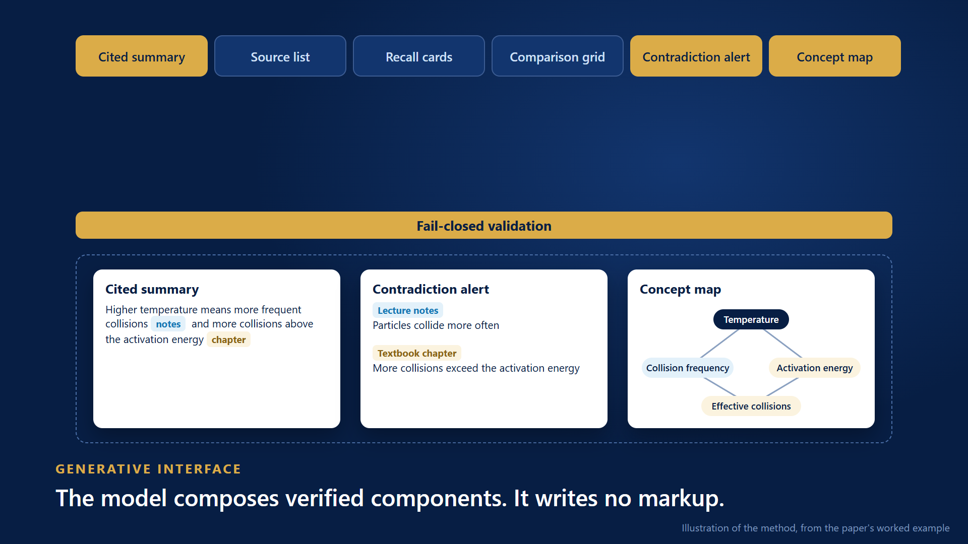
APPROACH
The method in thirty seconds
Click the video to play. An illustration of the method, using the worked example from the paper. Not captured output.
8
Notes:
Here is the whole method in thirty seconds. A learner asks a relational question and today gets a paragraph. Instead, documents become entities and relations, so sources can connect. Three signals are fused by rank, so evidence from different documents arrives together. The model then composes verified components, and writes no markup. A malformed block is rejected at the gate. And what retrieval can supply sets the limit: flat retrieval can honestly fill three of these, and graph-hybrid retrieval can fill all six.

Slide 9
APPROACH
Three regimes for producing a learning interface
 | Authored ahead | Markup emitted at runtime | Composed at request time
Coverage | what was anticipated | any question | any question
Produced by | a person | the model, as code | the model, as typed selections
Correctness rests on | human review | post-hoc verification | retrieved evidence and schema
Expressiveness | fixed catalogue | unbounded | combinatorial over a vocabulary
Failure mode | no answer exists | confident wrong artifact | closest available component
The components are fixed. What is generated per question is which components, and the evidence that fills them.
Table I of the paper. Runtime markup: assessed as unverifiable at scale [10].
9
Notes:
This table is the core of the approach. Authoring ahead is safe, but only covers what someone anticipated. Emitting markup at runtime covers anything, but the field regards it as unverifiable at scale. We take a third route. The model composes from a verified vocabulary, so we keep the coverage of runtime generation and the accountability of authoring. The price is expressiveness: a question whose best answer is an unimplemented view gets the closest available component.

Slide 10
METHODOLOGY
From document to rendered component
Ingestion, one pass
Hybrid retrieval
Generative interface
Learner's documents
Dense similarity
Task agents, one routing function
Sparse keyword (BM25)
Typed component selection
Parse, chunk, embed
Extract entities and relations
Graph traversal, 1 hop
Fail-closed validation
Vector index
Knowledge graph
Reciprocal rank fusion
Registry-only rendering
RRF(d) = Σr∈R 1 / (k + r(d)), k = 60 Fusing by rank, because cosine, keyword and traversal scores are not comparable [26].
10
Notes:
Here is the system design. A document is parsed, chunked and embedded. In the same pass, entities and relations are extracted with no fixed ontology, because a learner's documents can come from any discipline. At query time there are three signals: dense similarity, keyword matching and graph traversal. They are fused by rank using reciprocal rank fusion, because their raw scores are not comparable. The model then selects components and fills them from that evidence. Every request ends at this stage, so no agent can reply to the learner directly, and everything passes validation first.

Slide 11
METHODOLOGY
The model composes the interface. It does not write it.
In the paper
Fixed
Safeguard | Failure it contains
One schema generates both sides of the wire | producer and consumer drift
Retrieval before synthesis | assertions from outside retrieved material
Per-claim checking [25] | unsupported citations
Server-side validation that fails closed | malformed presentations
Registry-only rendering | unregistered presentations
Components, layout, typography, interaction
Chosen per question
Which components, in what order
From retrieved evidence
Every payload that fills them
Stated in the paper: claim checking fails open on a provider error, and a contradiction quote is not yet matched verbatim. Status: 24 of 24 components registered, 645 tests passing in CI.
11
Notes:
This is what makes it defensible. The model outputs typed component selections, with payloads built from retrieved evidence. Layout and interaction are not under its control. Each safeguard names the failure it contains. One schema generates both sides of the wire, so a mismatch is a compile error. The validator runs on the server and rejects on any violation. We fail closed on purpose: a visible error can be recovered from, a confident wrong presentation cannot. The paper states the limits too. Malformed interfaces are prevented, but one that misreads a source is still possible.

Slide 12
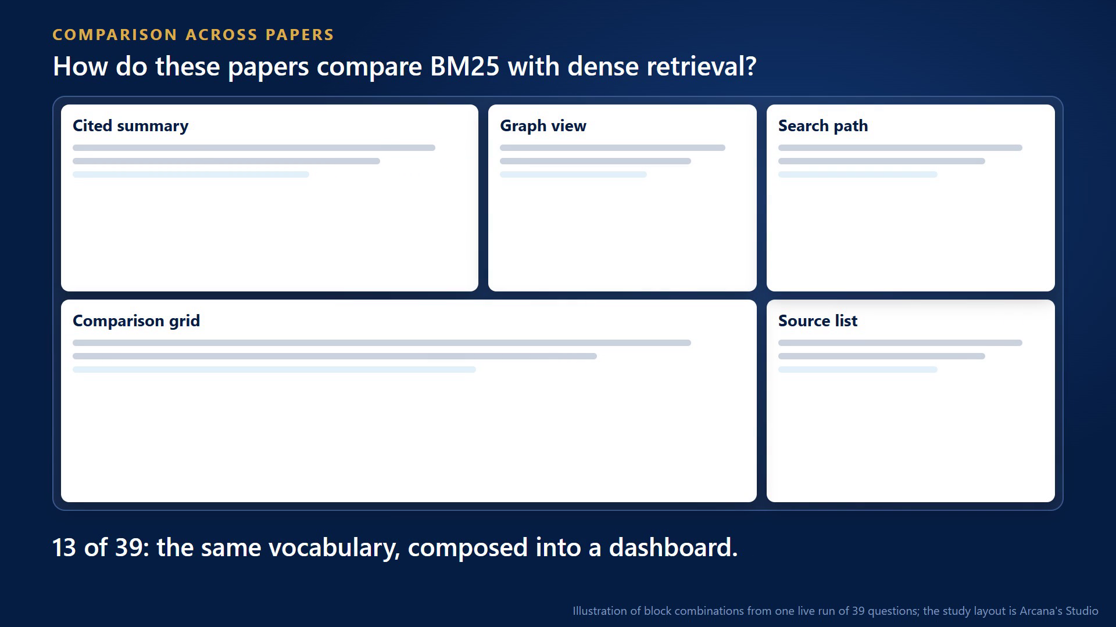
METHODOLOGY
Adaptive interface: where expressiveness shows
In the paper
Combinatorial
An ordered selection of k from n components, with payload structure derived per query.
The workspace reshapes
Surveying, revising, drafting and Socratic questioning need different components. Mode is inferred.
Bounded by retrieval
Which layouts are honest depends on the evidence. Expressiveness is the bound's other face.
Click to play. Section IV-A of the paper. Counts in the video are block combinations from one live run of 39 questions.
12
Notes:
This is where expressiveness becomes visible. The paper's claim is that the space of interfaces is combinatorial: an ordered choice of components from a vocabulary, with payloads decided per question. So the interface adapts. A single-paper question gets an answer and sources. A comparison gets a dashboard. A connected path adds a concept map. And the workspace reshapes with the task, including study. Nobody authored these layouts in advance.

Slide 13
METHODOLOGY
A worked request from the paper
In the paper
Learner asks: Why does raising the temperature increase the rate of a reaction?
Cited summary
Contradiction alert
Concept map
Higher temperature gives more frequent collisions [notes], and a larger share of collisions above the activation energy [chapter].
Lecture notes
Particles collide more often
Temperature
Textbook chapter
More collisions exceed the activation energy
Collision frequency
Activation energy threshold
Effective collisions
Each claim carries a citation to its source.
Each side shows its document and stance, side by side.
Concepts linked across the corpus.
Section IV-B of the paper. An illustration of what is composed, not captured output.
13
Notes:
Here is the example from the paper. A learner revising chemistry asks why raising the temperature increases reaction rate. Their notes attribute it to particles colliding more often. The textbook chapter attributes it mainly to more collisions exceeding the activation energy. Both are real, and the difference in emphasis is what a learner reproduces in an exam without noticing. The graph brings both passages into one retrieved set. A language model then detects the disagreement. It is not read from a typed edge. The response composes three blocks, none authored for this question. A biology question would get a comparison grid instead.

Slide 14
CENTRAL CLAIM
Retrieval structure bounds interface expressiveness
In the paper
X(R) = { c ∈ C | P(c) satisfiable from E(R, q) } X(flat) ⊂ X(graph-hybrid)
Component | Structural precondition | Supplied by | Study activity
Cited summary | ranked passages with sources | flat retrieval | reading, orientation
Recall cards | atomic facts with sources | flat retrieval | retrieval practice
Comparison grid | documents aligned on shared dimensions | cross-document entity alignment | comparison
Contradiction alert | claim pairs on one entity that disagree | co-retrieval via the graph | reconciling sources
Concept map | concept-to-concept relations | graph traversal | organising knowledge
The catalogue a generative learning interface can honestly offer is a function of the retrieval beneath it.
14
Notes:
This is the central idea. A component is a claim about the shape of an answer. A comparison grid claims that documents line up on shared dimensions. A concept map claims that concepts stand in labelled relations. So we define expressiveness as the set of components whose preconditions a retrieval layer can satisfy from evidence alone. Flat retrieval can of course draw a grid. But to fill it, the model must supply a relation retrieval never returned. A rich catalogue on flat retrieval is not richer. Its extra components are filled by the model, in a more convincing package than prose.

Slide 15
EVALUATION
Committed protocol, and a pilot reported as found
In the paper
Protocol, fixed 9 June 2026
Arm | Mean distinct sources | Median latency (ms)
Dense only | 2.50 | 670
Sparse only | 3.35 | 208
Graph only | 0.60 | 2,500
Flat (dense + sparse) | 3.15 | 897
Hybrid (all three) | 3.15 | 900
20 questions: 12 cross-document, 4 single-document, 4 contradiction
16 public papers, 1,570 chunks
5 arms: dense, sparse, graph, flat, hybrid
Metrics: distinct sources, latency
Paired Wilcoxon, hybrid against flat
Null: tied on 18 of 20 questions (p = 1.0). Traversal returned nothing on 15 of 20. The pilot locates the ceiling in query entity resolution.
Pilot index: 4 of 16 documents (796 nodes, 859 edges). Table V of the paper.
15
Notes:
The protocol was committed before any run: twenty questions, with signals switched off one at a time across five arms. Extraction was interrupted by a provider quota, so the paper reports a pilot on four of sixteen documents. The result was null. Hybrid and flat tied on eighteen of twenty questions. The reason is the finding: traversal returned nothing on fifteen questions, because query entities needed an exact match to a graph node. On those questions the hybrid simply was flat retrieval. So the pilot does not test the graph. It shows that the ceiling on the graph signal is query entity resolution.

Slide 16
FROM PAPER TO PRACTICE
Where Arcana began: VERA AI
 | VERA AI | Arcana
Knowledge | Flat vector chunks, one silo per document | Entities and relations across all documents
Retrieval | BM25 + vector, fused by RRF | BM25 + vector + graph traversal, fused by RRF
Agents | Six fixed, independent agents | Task agents, routed through one function
Interface | Static three-panel layout | Typed components composed per question
Domain | Enterprise knowledge base | Learners working across their own documents
VERA could cite its answers, but had nothing structured to show how sources relate. That limit is what this paper formalises.
A design comparison, not a benchmark: different domains and corpora.
16
Notes:
Before the results, a word on where this came from. Arcana grew out of VERA AI, an enterprise knowledge assistant from my internship. VERA already had hybrid retrieval and a no-citation, no-answer policy. But documents were separate silos, the layout was fixed, and the agents did not work together. Working on it showed me the limit this paper formalises: a system with flat retrieval can cite its answers well, but it has nothing structured to show how sources relate. This is a comparison of designs, not of results, because the domains and corpora are different.

Slide 17
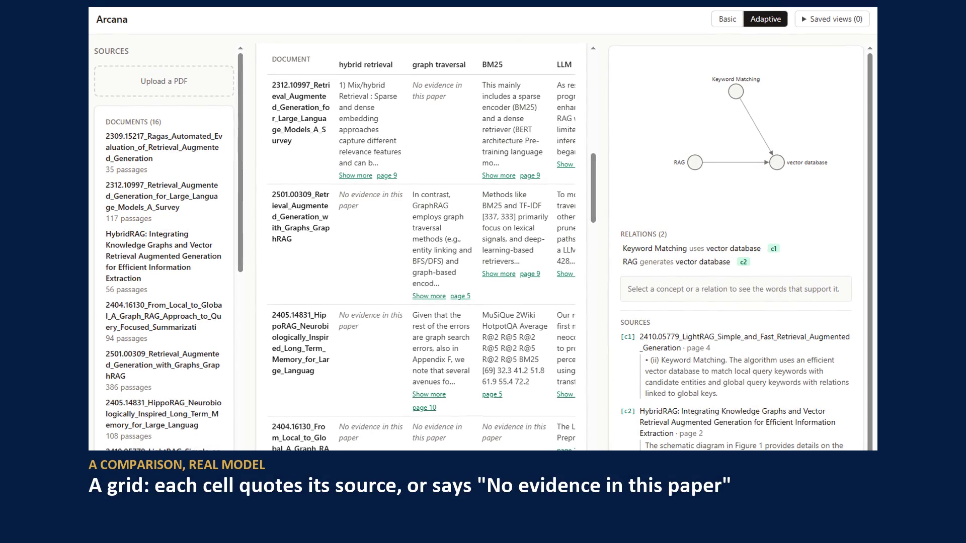
FROM PAPER TO PRACTICE
Arcana: the paper in practice
After the paper
Same corpus, different shapes
A summary with a graph, a comparison grid, or a refusal, depending on the question.
Grounded relations
Each stated relation shows the sentence and page behind it.
Beyond answers
A quiz, mastery on the graph, and a lab verified on every slider setting.
Click to play. First three screens: real-model run. Learning tools: no model call. The lab's function is a test fixture, passed through the real verifier.
17
Notes:
This is Arcana on the sixteen retrieval papers. First, three questions with a real model. A relational question gets a cited summary and a graph. A comparison gets a grid. A question the papers cannot answer gets a refusal. Nobody designed these screens for these questions. Then the learning tools. Concept pages show the sentences behind each link. A wrong quiz answer is corrected, and the graph recolours by mastery. And a lab appears only where a passage states the formula.

Slide 18
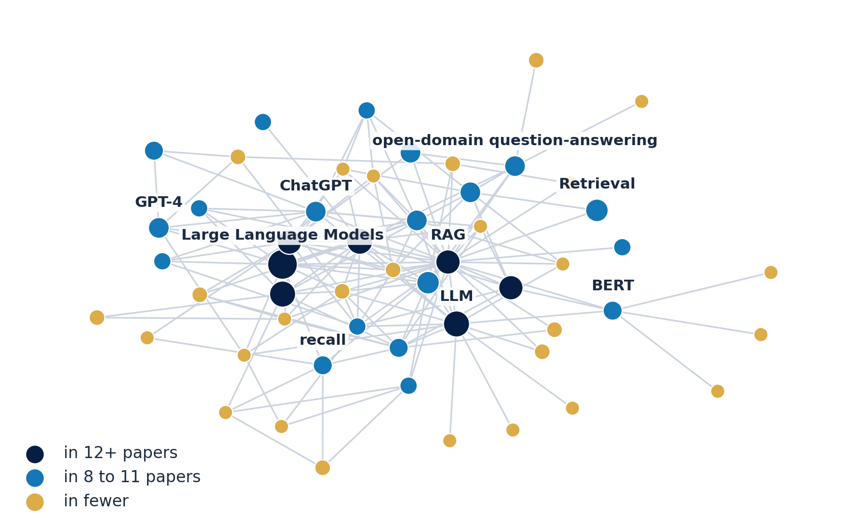
FROM PAPER TO PRACTICE
What retrieval structure makes possible
After the paper
Paper | BM25 | Graph traversal
RAG Survey | "a sparse encoder (BM25) and a dense retriever" (page 9) | No evidence in this paper
RAG with Graphs | "Methods like BM25 and TF-IDF primarily focus on lexical signals" (page 9) | "GraphRAG employs graph traversal methods" (page 5)
From Local to Global | No evidence in this paper | No evidence in this paper
11,173 concepts, 13,972 edges, 11.6% of concepts in 2+ papers
A real comparison grid: quote and page, or an honest gap
Real graph, 16 papers. Drawn: the most widely shared concepts. About a third of edges are stated in one sentence. Grid simplified from Arcana, quotes shortened.
18
Notes:
Here is what that structure looks like. On the left is part of the real graph extracted from the sixteen papers, showing the concepts found across the most papers. About one in nine concepts appears in two or more papers, and those are the points where documents connect. You can also see an extraction weakness: LLM and LLMs are separate nodes. On the right is part of a comparison grid filled from that structure. Each cell is a quote from that paper with its page. Where a paper has nothing to say, the cell says so instead of inventing an answer.

Slide 19
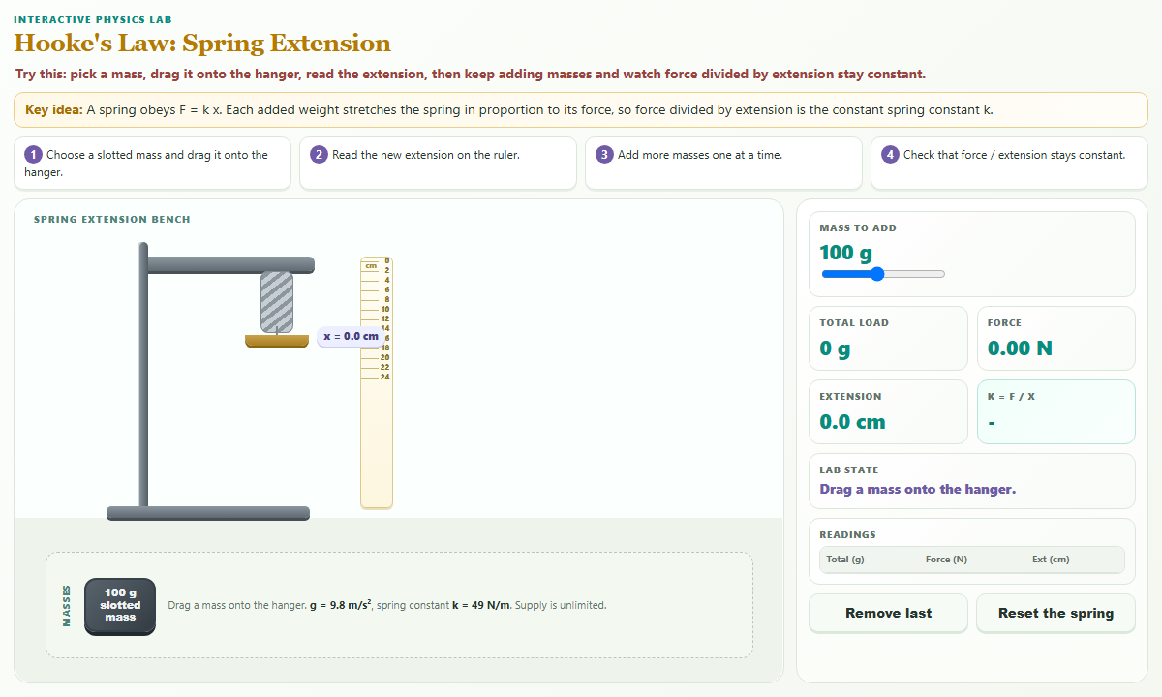
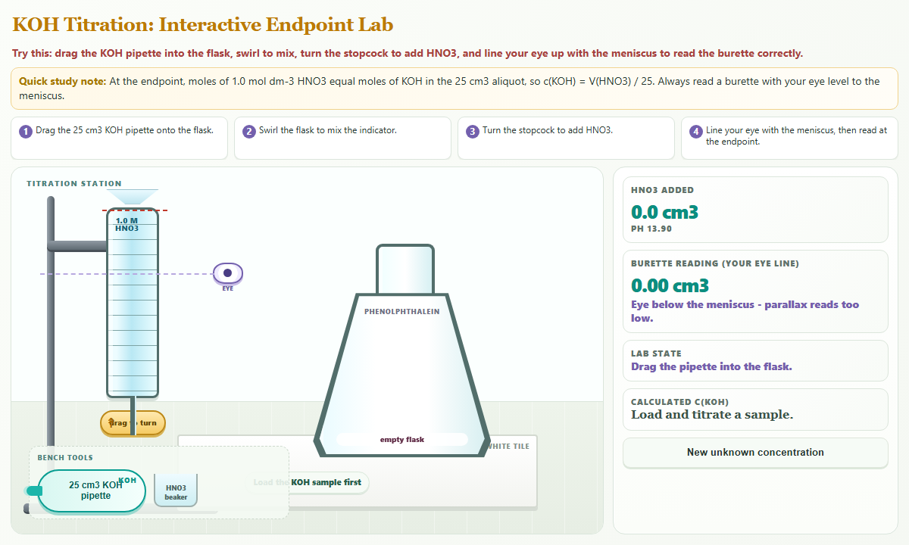
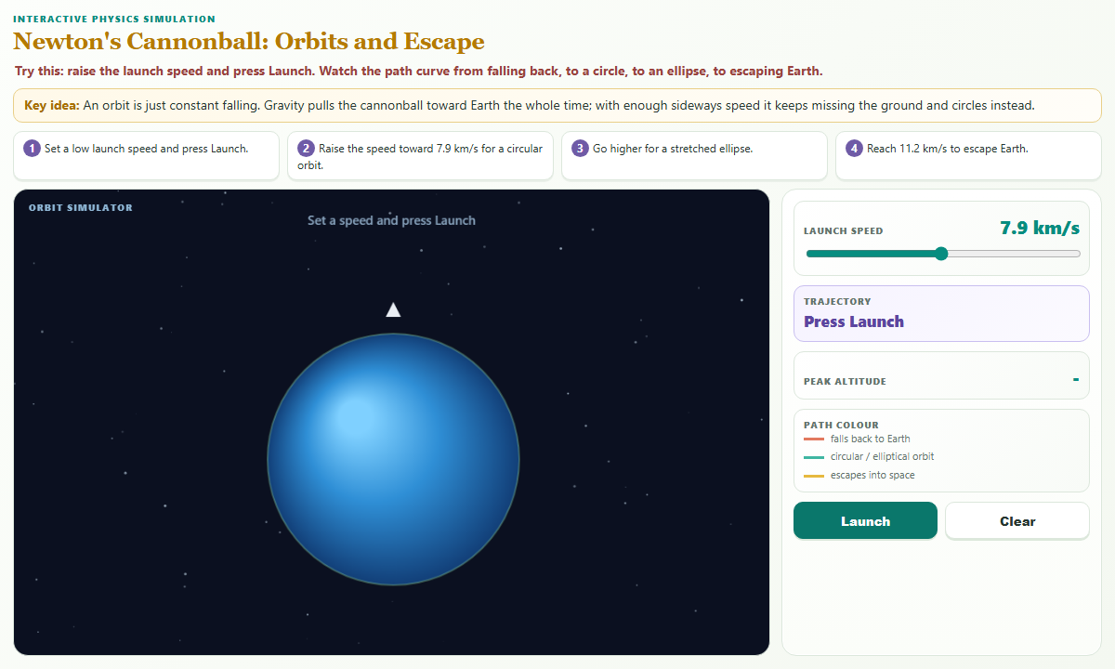
FROM PAPER TO PRACTICE
Beyond the catalogue: generated, then verified
After the paper
Level 1: typed components
Fixed, verified, filled from evidence
Level 2: adaptive layout
Arranged per question and task
Level 3: generated component
Written per question, shown only if verified
219 of 224
planted defects refused, 0 of 30 false alarms
20 of 20
Hooke's law
Acid-base titration
Newton's cannonball
hostile attack shapes blocked
The trust path: the model plans over an audited kit, a real browser moves every control, only the verifier can mint the deliverable, and it runs in a sandbox.
13 of 14
new questions built a lab, labelled model-checked
Synapse, by Team EduNova (UTP), Form 4 and 5 science. Prototype screens. Planted sets written by the team. No teacher review or learner study yet.
19
Notes:
The paper names a cost: the catalogue is a ceiling. A question whose best answer is an interactive experiment gets the closest component. Our team's system, Synapse, explores the way past that ceiling for school science. The model plans a lab over an audited kit, and a verifier runs it in a real browser before a student can see it. Arcana's formula labs use the same discipline. This is a different domain, so I do not compare results.

Slide 20
NEW FINDINGS
On the full corpus, a retrieval gain is not shown
After the paper
Question set | Hybrid minus flat | Better / tied / worse | p
Original 19, cross-document | +0.039 | 7 / 8 / 4 | 0.15
New 19, declared extension | -0.042 | 2 / 6 / 11 | 0.068
Pooled 38 | -0.001 | 9 / 14 / 15 | 0.69
No pair reaches p < 0.05. Not shown to help is not the same as shown not to help.
nDCG@10 against gold passages, 16 papers, 1,570 passages, paired Wilcoxon. A different metric from the pilot. Not peer reviewed.
20
Notes:
Now the findings since the paper. We completed the study the paper called for: all sixteen papers, the repaired entity matching, and a gold set of relevant passages. The graph signal now fires. On the original harder, cross-document questions, the hybrid is ahead, but not significantly. On nineteen new questions, which lean towards single papers, it falls behind. Pooled, the difference is essentially zero. So I do not claim a retrieval gain. Not shown to help is not the same as shown not to help, but this corpus gives no support for that claim. The metric here is nDCG, so please do not compare it with the pilot.

Slide 21
NEW FINDINGS
The graph does extend the interface: 2 components against 5
After the paper
What is measured
How often the evidence for each component exists, of 20 questions.
What is by construction
Flat admits none of the three. The preconditions read graph structure.
What it does not show
Admitted is not correct or useful. The grid is not yet selective.
Admission over 20 questions, one graph, five components measured. Not peer reviewed.
21
Notes:
Here is the other half of the argument. For each question, we counted which components had their preconditions met by the evidence. Flat retrieval admits two. The hybrid layer realises all five. Please read this carefully. That flat cannot admit the other three follows from how the preconditions are defined, so it is not a discovery. What the measurement adds is how often the evidence exists: a connection graph on sixteen questions, and a multi-hop path on only three, because every hop must be grounded in a stored sentence. And admitted does not mean useful. The grid was admitted on every question, so it is not yet selective.

Slide 22
NEW FINDINGS
Grounding holds with a real model, relevance is not yet shown
After the paper
38 of 38
1 of 1
125 of 125
10 of 140
answerable questions answered
unanswerable control refused
quotes verbatim from the stored passage
claims removed as unsupported by the judge
0.21
citation precision
0.21
gold recall
19 of 38
answers cite no gold-relevant passage
Nothing appears without a verbatim source. Grounded and relevant are different things.
One live run, one model, no repeat. The gold set is a floor, not a full list. Not peer reviewed.
22
Notes:
We also ran the whole system with a real model. All thirty-eight answerable questions were answered. The one question the corpus cannot answer was refused. All one hundred and twenty-five citations were verbatim. And the judge removed ten claims that had a real citation under them but were not supported by it, which is the case for checking each claim. But look at the second row. Citation precision is about 0.21, and half the answers cite nothing in the gold set. The gold set is incomplete, so this does not show the answers are wrong. It does show that grounded and relevant are different things.

Slide 23
CONCLUSION
What this does and does not show
Established
Not shown
Next
Interface guarantees hold by construction
The bound follows from preconditions
Grounding held in one live run
A retrieval gain from the graph
Correctness of what is admitted
Extraction quality, by human audit
Any learning outcome
Human audit of graph links
Check each block against its own edges at build time
Make components more selective
Run the interface study
The components an interface can honestly offer are those whose preconditions retrieval can satisfy.
23
Notes:
To conclude. The interface guarantees hold by construction, and the bound follows from the preconditions. The empirical picture is more modest. There is no evidence of a retrieval gain from the graph on this corpus, and no evidence yet about learning, because no user study has been run. Next comes a human audit of the graph's links, checking each block against its specific evidence at build time, and the interface study itself. The point I would like you to keep is this: the components an interface can honestly offer are those whose preconditions retrieval can satisfy.

Slide 24
REFERENCES
Selected references
[1] Y. Gao et al., RAG for large language models: a survey, arXiv:2312.10997, 2024.
[2] B. Sarmah et al., HybridRAG, arXiv:2408.04948, 2024.
[3] D. Edge et al., From local to global: a graph RAG approach, arXiv:2404.16130, 2024.
[4] R. E. Mayer, Cognitive theory of multimedia learning, Educ. Psychol. Rev., 2024.
[5] M. A. Fadillah et al., Meta-analysis of PhET simulations, Int. J. Online Biomed. Eng., 2026.
[6] Y. Leviathan et al., Generative UI, arXiv:2604.09577, 2026.
[7] S. Tu et al., MAIC-UI, arXiv:2604.25806, 2026.
[8] T. Calò and C. J. MacLellan, Educator-driven tutor authoring, L@S '24, 2024.
[9] X. J. Wang et al., LearnMate², DIS '26, 2026.
[10] S. P. Neshaei et al., The missing layer, arXiv:2606.15902, 2026.
[11] J. Irigoyen et al., EduEVAL-DB, arXiv:2602.15531, 2026.
[12] A. Shoufan and A. A. A. Esmaeil, AI hallucination from students' perspective, arXiv:2602.17671, 2026.
[13] J. Liao et al., Code monitor red teaming, arXiv:2607.20852, 2026.
[14] H. Han et al., RAG with graphs (GraphRAG), arXiv:2501.00309, 2024.
[15] B. J. Gutiérrez et al., HippoRAG, NeurIPS, 2024.
[16] Z. Guo et al., LightRAG, arXiv:2410.05779, 2024.
[17] T. Zhang and H. Soh, Extract, define, canonicalize, EMNLP, 2024.
[18] Y. Liu et al., AlignUI, arXiv:2601.17614, 2026.
[19] Y. Liu et al., CrowdGenUI, arXiv:2411.03477, 2024.
[20] Agent2UI, technical specification, 2025. Not peer reviewed.
[21] Y. Ben-Zion et al., AI for rapid generation of physics simulations, arXiv:2412.07482, 2024.
[22] T. N.-D. Tran et al., ChemersiveLLM, VRST '25, 2025.
[23] X. Li et al., Beyond superficial tests, Findings of ACL 2026.
[24] Q. Li et al., AdverMCTS, arXiv:2604.10449, 2026.
[25] J. Kwok et al., LLM-as-a-verifier, arXiv:2607.05391, 2026.
[26] G. V. Cormack et al., Reciprocal rank fusion, SIGIR, 2009.
24
Notes:
These are the references cited on the slides, numbered as in the paper. The full list is in the proceedings.

Slide 25
MCAIT 2026
Thank you
Questions are welcome.
Fakhrul Azim Bin Ahmed Mardzukie
fakhrul_22012087@utp.edu.my
github.com/Azimlearning/Arcana
3–5 NOVEMBER 2026 · TAIBAH UNIVERSITY · MADINAH
Notes:
Thank you. The code and protocol are public, and I am happy to take questions.

