Slide 1
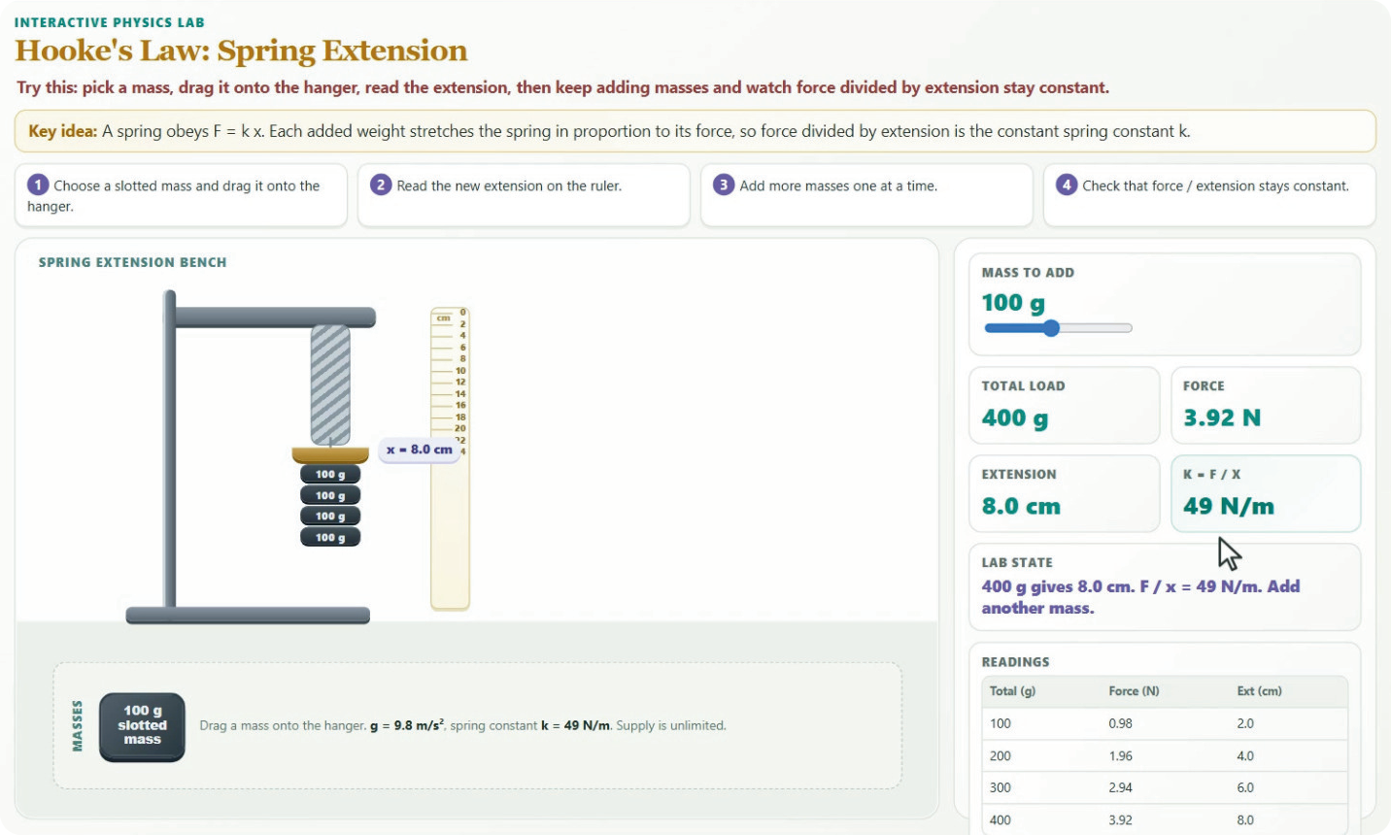


HACKASTONE 2026 · GRAND FINAL · AMSTERDAM
Synapse
by Team EduNova
Don't read about the experiment.
Run it.
An AI science tutor that answers a question with a live, interactive experiment built on the spot, with the textbook source and an honest trust label beside it.
Hooke's law, built from one question
Universiti Teknologi PETRONAS, Malaysia
Notes:
SAY:
Good day, everyone. We are Team EduNova from Universiti Teknologi PETRONAS in Malaysia, and this is Synapse. Our line is: don't read about the experiment, run it. Synapse is an AI science tutor. You ask a science question and instead of a paragraph you get a live, interactive experiment, built on the spot, with the textbook source and an honest trust label beside it.
WATCH OUT:
Name the presenter and the person driving the demo now. On official forms the project title is "EduNova"; on slides we say "Synapse by Team EduNova". Hold this slide about ten seconds, then move on.
CRITERIA: All four

Slide 2

WHO WE ARE
Team EduNova
FA
K
PJ
AS
Fakhrul Azim
Khaidhir
Por Jie Hao
Azrain Shawn
CEO
CEO
CTO
CTO
DI
AI
NF
AF
Danish Iskandar
Adam Iman
Nur Farah
Alif Fadhil
President
General Manager
General Manager
Team lead
Advisor: Assoc. Prof. Ts. Dr. Ahmad Sobri bin Hashim
Universiti Teknologi PETRONAS students, building Synapse for high-school science.
Notes:
SAY:
We are eight students from UTP, advised by Associate Professor Dr Ahmad Sobri bin Hashim. I will present, and my teammate will drive the demo.
WATCH OUT:
Confirm every role and spelling with the owner of each name before the day. Skip this slide in a short version and just introduce the two speakers.
CRITERIA: Technical readiness (credibility)

Slide 3
BACKGROUND: WHY NOW
A curriculum reform meets an access gap
Exams moved from recall to reasoning
In Malaysia, high school ends with a national exam, SPM (Sijil Pelajaran Malaysia, taken at about 17). The curriculum now rewards higher-order thinking: apply, analyse and predict in situations students have not seen.
Policy is moving the same way
The Malaysia Education Plan 2026 to 2035 puts AI, digital skills and STEM at the centre. The National AI Action Plan 2026 to 2030 asks for AI-fluent students, rural schools included.
37.32% vs 97.73%
Students vs teachers active on DELIMa, Malaysia's learning platform
1 Jan to 21 Jul 2026. MOE via Bernama, 23 Jul 2026
416 vs 485
PISA 2022 science: Malaysia vs OECD average
OECD via The Edge Malaysia, 4 Dec 2023
Two forces are converging
The need for accessible practical science, and the maturation of generative AI. Synapse sits at that intersection.
The lab is where the gap bites
Rural schools and schools serving low-income families (the B40, the bottom 40% of households) often lack apparatus, staff or timetable slots, so practicals shrink to a teacher demo or a textbook diagram.
Notes:
SAY:
Some context. In Malaysia, students finish high school with a national exam called SPM, taken at about seventeen. The curriculum behind it has been reformed to test reasoning, not recall: apply, analyse, predict in situations you have not seen. Policy is pushing the same way: the national education plan and AI action plan both put AI and STEM at the centre, rural schools included. But look at the gap. Only 37 percent of students were active on the national learning platform, against 98 percent of teachers. Malaysia scored 416 in PISA science, against an OECD average of 485. And the lab is where this bites: rural schools and schools serving low-income families often lack apparatus, staff or timetable slots.
WATCH OUT:
Source of the figures: our UTP CodeFest deck. DELIMa numbers are MOE via Bernama, 23 Jul 2026 (1 Jan to 21 Jul 2026). PISA 2022 is OECD via The Edge Malaysia, 4 Dec 2023. Re-check them if a judge asks. Do not say "Form 4 and 5": say "high school".
CRITERIA: Educational significance

Slide 4
THE PROBLEM
Science without the lab behind it
1
A curriculum that assumes labs
2
Unequal access to labs
Malaysia's reform expects high-school Physics, Chemistry and Biology students to reason from hands-on experiments.
Rural and low-income schools often lack apparatus, staff or timetable slots, so results are memorised from diagrams.
3
Flat AI answers
4
Unverifiable AI interactives
Chatbots reply in text. A paragraph cannot let a student drag a slider and watch a wrong idea fail.
An AI-written simulation can be confidently wrong, and a wrong simulation teaches a wrong mental model.
A student can recite osmosis and still believe water moves toward "more water". A quiz never catches it. A lab does.
Notes:
SAY:
Four problems stack up. The reform assumes students work with real experiments. Many schools cannot provide them. A chatbot answers in text, and a paragraph cannot let you drag a slider and watch a wrong idea fail. And an AI-written simulation can be confidently wrong, which teaches a wrong mental model. Here is the one that matters most: a student can recite the definition of osmosis and still believe water moves toward "more water". A quiz never catches it. A lab does.
WATCH OUT:
The osmosis example is a well-documented misconception in the science education literature. Do not claim Synapse has proved it fixes it: we have no learner study yet.
CRITERIA: Educational significance, Innovation

Slide 5
OBJECTIVES
What we set out to do
Main objective: give every high-school science student an interactive, textbook-grounded experiment for any question, whether or not their school has a lab.
1
Generate an interactive environment from a plain-language question in Physics, Chemistry and Biology.
2
Guarantee that every number on screen comes from an audited, cited science model, never from the AI.
3
Verify every environment by running it in a real browser, so nothing unverified reaches the student.
4
Ground each environment in the national textbook and show the source, the checks and an honest trust label.
5
Reach students on shared mid-range phones: 360 px layout, no account, an offline file, cents per lab.
Notes:
SAY:
Our one objective: give every high-school science student an interactive, textbook-grounded experiment for any question, whether or not their school has a lab. Five goals follow. Generate the lab from plain language. Keep every number out of the AI's hands. Verify it in a real browser. Show the source, the checks and an honest label. And reach students on shared mid-range phones, with no account and about a few cents per lab.
WATCH OUT:
A good slide to skip in a short version, because slides 6 and 15 say the same thing with more force.
CRITERIA: Educational significance, Technical readiness

Slide 6
OUR SOLUTION
Environments, not answers
"The AI designs the experiment. It never supplies a number."
The AI decides what to build and how to lay it out. A library of 34 audited building blocks supplies the parts and the science, so the result is creative and correct.
A student asks. Synapse builds a bounded interactive world where a verified science model responds to what they do.
Hooke's law, generated from one question. Every number comes from an audited science model.
Model
Scene
Instruments
Task
Evidence
audited science
what you see
controls and readouts
predict, hint, check
source and trust label
Notes:
SAY:
Here is the idea. The AI designs the experiment. It never supplies a number. The AI decides what to build and how to lay it out, and a library of thirty-four audited building blocks supplies the parts and the science, so the result is both creative and correct. Every environment has five parts: an audited science model, a scene you can see, instruments you control, a task such as predict, hint and check, and the evidence, meaning the source and an honest trust label.
WATCH OUT:
This is where a judge decides whether this is "a chatbot with a plotting library". The difference: the numbers cannot come from the model, and the page is checked in a real browser before the student sees it.
CRITERIA: Innovation and novelty

Slide 7
A STUDENT'S JOURNEY
Ask, build, predict, check
1
2
3
4
Ask in your own words
Watch it build
Predict, then explore
Check and consolidate
For example: "How does a spring stretch when I add masses?"
An explanation streams instantly while the lab is built and checked, in about 20 seconds.
"What if you double the load?" Guess first, then drag the masses and watch the numbers.
See the source and trust label, answer a concept check, save an offline copy.
How does a spring stretch when I add masses?
Build it
The explanation streams at once while the lab is built and checked (about 20 seconds).
Notes:
SAY:
A student's journey is four steps. They ask in their own words, for example how a spring stretches when you add masses. They watch it build: an explanation streams at once while the lab is built and checked, about twenty seconds. Then they predict, because we make them guess before they see any numbers, and they explore by dragging the masses. Finally they check: they see the source and trust label, answer a concept check and can save an offline copy.
WATCH OUT:
The "about 20 seconds" is for a newly composed lab. A lab already in our library opens in seconds with no model call.
CRITERIA: Educational significance

Slide 8
LIVE DEMO
Let's run it.
Type a real question. Watch a lab get built, checked and handed over.
SUGGESTED QUESTIONS
Physics
Chemistry
Physics
Why does a spring stretch when I hang a weight on it?
How do I find the concentration of an alkali by titration?
What launch speed makes a cannonball orbit the Earth?
Notes:
SAY:
Let us run it. Type a real question. [Driver types] Watch what appears: the explanation streams, the progress card shows the lab being built and checked, and then the lab arrives with its label and its source.
WATCH OUT:
Order: Hooke's law (predict, drag masses, hint, concept check), then titration, then the cannonball. Point at: the progress card, the "Kit verified" label, the textbook citation, Present, Share and Save offline. Fallbacks, in order: the offline lab file on the laptop, then the recorded demo video. Do not promise a public URL: the API stays private until the deploy gate is met.
CRITERIA: Technical readiness

Slide 9
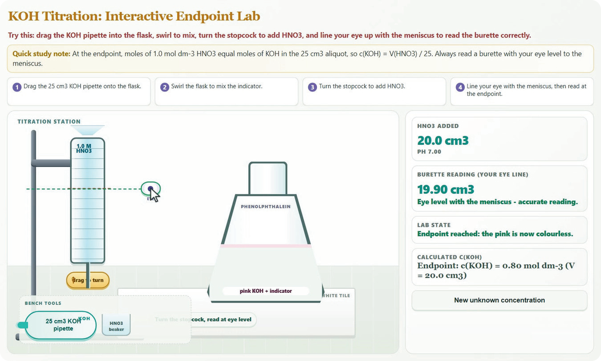
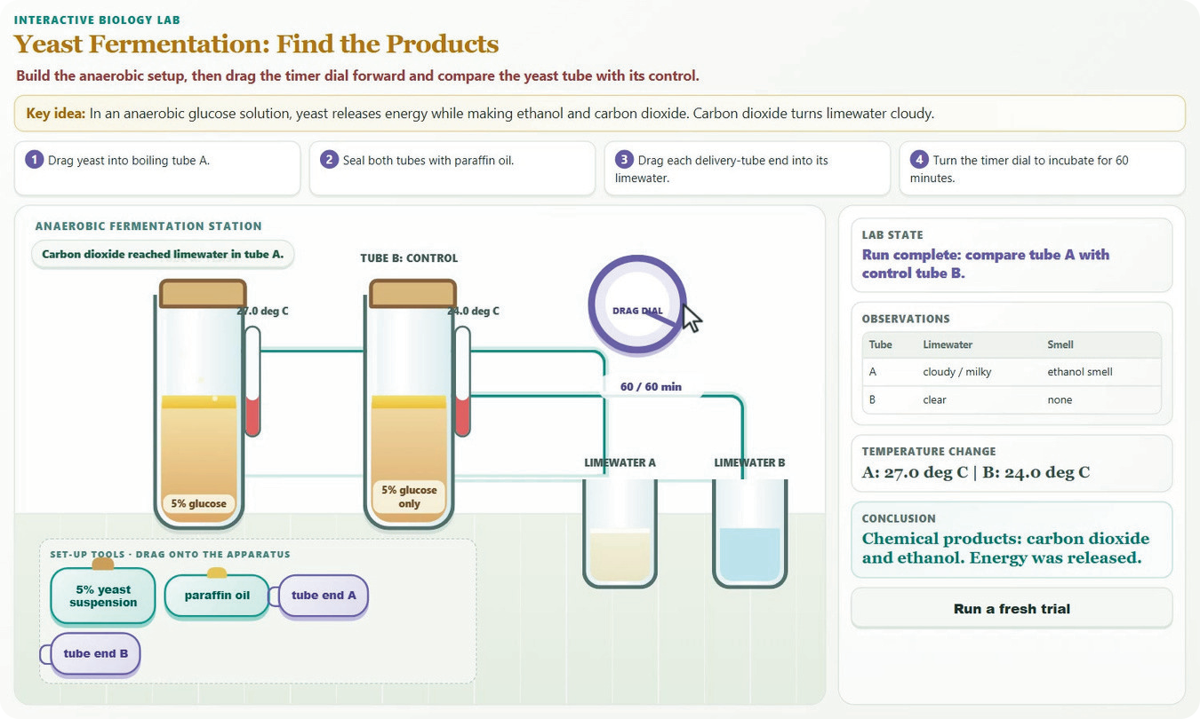
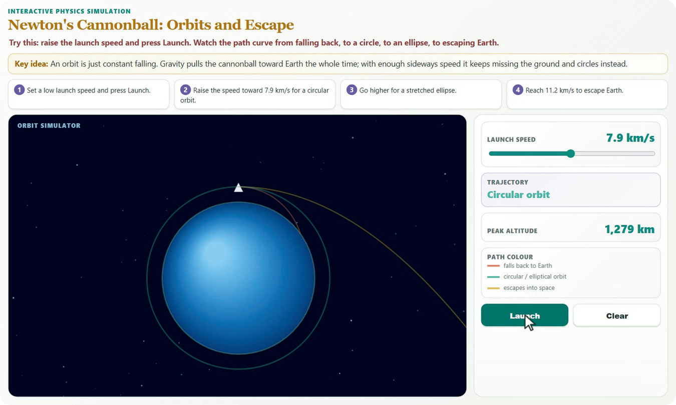
WHAT IT BUILDS
One pipeline, three sciences
Physics
Chemistry
Hooke's law
Acid-base titration
Drag the masses onto the hanger and watch the extension and F/x respond live.
Pipette, swirl, open the stopcock and read the burette at eye level to find the end point.
Biology
Physics
Yeast fermentation
Newton's cannonball
Build the anaerobic setup, run the timer and compare the test tube with the control.
Raise the launch speed and watch the path go from falling back, to orbit, to escape.
Lab screenshots are from the Synapse prototype labs. The current pipeline rebuilds each one from audited Kit parts.
Notes:
SAY:
One pipeline, three sciences. Hooke's law: drag masses onto the hanger and watch the extension and force over extension respond. Titration: pipette, swirl, open the stopcock and read the burette at eye level. Fermentation: build the anaerobic setup, run the timer and compare with the control tube. And Newton's cannonball: raise the launch speed and watch the path go from falling back, to orbit, to escape.
WATCH OUT:
Be honest if asked: these screenshots are from the prototype labs. The prototype titration used KOH and nitric acid; the current build uses sodium hydroxide and hydrochloric acid.
CRITERIA: Innovation, Technical readiness

Slide 10
RELATED WORK
What exists, and what we add
Tool | What it does | What Synapse adds
DELIMa 3.0 (Malaysia's Ministry of Education) | AI assistant DETa and a personalised pathway. 37.32% of students active. | Answers and routes. We make the student do something every minute.
ChatGPT Study Mode, Gemini Guided Learning | Guided questions in text. No curriculum or learner history by default. | Text only. We ground in the national textbooks and cite the page.
Kelas Sekejap (Malaysia) | Gamified English speaking practice, plus exam prep for Malaysian secondary students. | Language focus. We cover Physics, Chemistry and Biology experiments.
Tupai.ai (Malaysia) | Chat tutor for Malaysia's SPM maths exam (source dated Nov 2024). | One subject, chat first. We build interactive environments.
Our angle: verified, generated, interactive environments. Not a chatbot, not another platform.
Notes:
SAY:
Other tools exist, and they are good. Malaysia's national platform answers questions and routes students. ChatGPT Study Mode and Gemini Guided Learning ask guided questions in text. A popular Malaysian app focuses on language, another is a maths chat tutor. What none of them does is make the student run an experiment whose numbers are verified. Our angle: verified, generated, interactive environments. Not a chatbot, not another platform.
WATCH OUT:
Related-work facts come from our CodeFest deck. Re-check before quoting numbers. Do not criticise the Ministry's platform: say we complement it.
CRITERIA: Innovation and novelty

Slide 11
HOW IT WORKS
Our generative UI pipeline
AI step
Deterministic step
Trust gate
1
2
3
4
5
6
7
Route
Retrieve
Plan
Check
Assemble
Verify
Gate and delivery
A local classifier picks the topic and experiment type
Finds the matching textbook passages
The AI writes a short typed blueprint, not code
16 rules validate the blueprint before any page exists
A deterministic builder turns it into a live interface
A real browser moves every control and checks every number
Only verified environments are sent. Citations are re-proved.
Plan as data
Sixteen deterministic checks run before any HTML exists, so a bad plan is cheap to catch and retry.
Never a blank screen
If a step fails the ladder is: a stored environment, then a composed one with fills, then a written answer.
Notes:
SAY:
This is our generative UI pipeline, in seven steps. A small local classifier routes the question to a topic and experiment type. We retrieve the matching textbook passages. Then comes the only creative AI step: the model writes a short, typed blueprint. Not code. Sixteen rules check that blueprint before any page exists. A deterministic builder assembles the interface. A real browser then moves every control and checks every number. And the gate sends only verified environments, re-proving the citations on the way out. If any step fails, the student never sees a blank screen: we fall back from a stored lab, to a composed one, to a written answer.
WATCH OUT:
This answers "is it agentic?": it routes, plans and checks its own work, and a gate no agent can bypass. The poster says "16 rules"; the repository has since added more plan checks, so say "sixteen rules" only if you keep the poster wording.
CRITERIA: Innovation, Technical readiness

Slide 12
THREE LANES
Each lane carries an honest label
Instantiate
Compose
Free
A stored, re-verified environment is served.
A plan as data, built by a deterministic assembler.
A labelled last resort. Every one is logged as a Kit gap.
THE MODEL WRITES
THE MODEL WRITES
THE MODEL WRITES
Nothing.
A short typed plan over audited Kit parts. Never code.
The whole page, written by a model.
COST AND TIME
COST AND TIME
COST AND TIME
Almost nothing, a few seconds.
About US$0.03 to 0.06 per new lab, about 20 seconds.
Every paid call is capped by the spend ledger.
TRUST LABEL
TRUST LABEL
TRUST LABEL
kit-verified
kit-verified or model-checked
Written whole by a model
Library first: a repeat question, or a topic our local router recognises, is answered with no model call.
Notes:
SAY:
Every lab is built in one of three lanes and wears that lane's label. Instantiate serves a stored, re-verified lab: the model writes nothing, so it costs almost nothing. Compose is the main path: the model writes a plan over audited parts, and a deterministic assembler builds the page, for roughly three to six US cents. Free is a labelled last resort, where a model writes the whole page. It is never canonical without a human, and every one is logged as a gap in our component library. And because the library is consulted first, a repeat question needs no model call at all.
WATCH OUT:
Cost figures: US$0.027 measured on 3 questions and US$0.057 per delivered lab on a 14-question run. Both are small samples, say so. The Free lane is built but we have not measured it.
CRITERIA: Innovation, Commercial viability

Slide 13
UNDER THE HOOD
Our generative UI pipeline: architecture
Web shell
API: Python 3.13, FastAPI, Pydantic v2
LLM seam
Claude Sonnet 5.5 plans, Haiku 5.5 routes. Every paid call goes through a spend cap.
Next.js, phone first
Chat, Peek, Stage
Re-hashes every environment before showing it
1 Route
2 Retrieve
3 Plan
4 Check
Kit (TypeScript)
5 Assemble
6 Verify
7 Gate and delivery
34 audited building blocks, 17 science models, sha-256 locked.
iframe sandbox = allow-scripts
Gold is the only AI step. Green is the trust gate: only the verifier can mint, and the gate re-checks before anything is sent. Three lanes: Instantiate, Compose, Free. Never a blank screen.
Evidence (local)
National textbook corpus, BM25 retrieval. Never committed to the repository.
Schema (TypeScript)
Stores (SQLite, local)
Local models
One definition of every wire type, generated into strict Pydantic.
Signed environment library, spend ledger, traces. Student progress is not here: it stays on the student's device.
Router: topic, domain, pattern, complexity.
The API and the web shell never import each other. Environment pages reach the Kit only as a script tag on our own origin: no runtime CDN. It runs on an ordinary Windows laptop, with no Docker and no database server.
Notes:
SAY:
Here is the same pipeline as software. A phone-first web shell. A Python API running the seven steps. An LLM layer where Claude plans and a smaller model routes, with a spend cap on every paid call. A TypeScript library of audited parts. A local textbook corpus for evidence. And local stores, where student progress is deliberately not kept: it stays on the student's device. It runs end to end on an ordinary Windows laptop, with no Docker and no database server.
WATCH OUT:
Technical judges may ask about the stack: Next.js, React and Tailwind on the web; Python 3.13, FastAPI, Pydantic v2 and SQLite on the API; Playwright with headless Chromium for verification; one shared TypeScript schema generated into Python. Do not read the stack aloud.
CRITERIA: Technical readiness

Slide 14
THE KIT
34 audited building blocks
34
hash-locked parts
17
science models
6
pedagogy
5
UI
What it takes to add a science model
1
A written precondition for when the formula is true
2
A textbook citation, units and a domain
Semver versioned, sha-256 locked
4
core
2
interaction
3
An independent, hand-written reference in Python
4
A suite that refuses every planted defect, about 180 across 17 models
5
An accessibility fence and a 360 px layout test
The key rule: readouts accept only observables
Every number on screen comes from a science model or a control. A page cannot type "extension = 4.2 cm": the verifier probes numeric text in readouts, sentences, attributes and canvas.
Notes:
SAY:
The Kit is why the science is right. Thirty-four audited, hash-locked parts: seventeen science models and the rest for pedagogy, interface and interaction. To add a science model we require a written precondition, a textbook citation with units, an independent hand-written reference, and a test suite that must refuse about a hundred and eighty planted bugs. And one rule matters most: readouts accept only observables. A page cannot just type "extension equals 4.2 centimetres". Every number comes from a model or a control.
WATCH OUT:
The poster and our CodeFest deck say 34 parts and 17 models. The current build manifest lists more (62 components, 26 apparatus parts). If a judge asks for the repo count, say the poster counts the audited core Kit and the repo has grown since.
CRITERIA: Technical readiness, Innovation

Slide 15
TRUST AND VERIFICATION
Nothing unverified reaches the student
Plan checks
16 rules
›
L0 scan
APIs, CSP
›
L1 source
Kit only
›
L2 render
Real Chromium
›
L3 numbers
Reference
›
Mint
Verifier only
›
Gate
Re-prove
›
Student
Sandbox
Verifier-only mint
Delivery gate
Exact sandbox
The deliverable type cannot be built outside the verifier. Shipping unverified output is a type error, not a skipped check.
Re-derives, re-hashes and re-proves every citation word for word. The browser re-hashes again before rendering.
allow-scripts only, never allow-same-origin. Strict CSP, scripts from our own origin, no runtime CDN.
219 of 224 planted bugs refused, 0 of 30 false alarms. 20 of 20 hostile attacks blocked.
Notes:
SAY:
Nothing unverified reaches the student, and that is mechanism, not policy. After the plan checks, the page is scanned, its source must use only audited parts, and it is rendered in a real browser that moves every control across its range. Every number is compared with an independent calculation. Only then can the verifier mint the deliverable, and the type cannot be built anywhere else, so shipping unverified output is a type error, not a skipped check. The gate re-proves the citations on delivery, and the page runs in a locked sandbox. We tested this with planted bugs: 219 of 224 refused, with no false alarms, and 20 of 20 hostile attacks blocked.
WATCH OUT:
Say "219 of 224", never "every bug". These are our own regression baselines, written by the same team that wrote the verifier. The hostile attacks are known shapes written by the defenders.
CRITERIA: Technical readiness, Innovation

Slide 16
PROVENANCE
An honest label beside every lab
The trust ladder
Hooke's law
✓ Kit verified
model-checked
Passed the checks, no verified source
WHAT WAS CHECKED
✓
It runs in a real browser and its controls work
kit-verified
Plus every citation proved word for word
✓
Controls moved across their range, including the extremes
✓
Values compared with an independent calculation
A teacher has checked it
reviewed
✓
Every number comes from an audited science model
needs a person
canonical
Approved as the reference version
Source: national Physics textbook, page 36
Limits: A person has not reviewed it yet, and it says so.
needs a person
The label never claims more than was checked.
Notes:
SAY:
Every lab shows its provenance: the label, what was checked, the source page and the limits. This is the card a student sees for Hooke's law. On the right is the trust ladder. Model-checked means it passed the checks but has no verified source. Kit-verified adds that every citation was proved word for word. Reviewed and canonical need a human. No teacher has reviewed our labs yet, so none is labelled reviewed, and the app says so. The label never claims more than was checked.
WATCH OUT:
If a judge asks "what if the AI is wrong?", this slide is the answer. Be explicit that kit-verified is not a teacher's review.
CRITERIA: Educational significance, Innovation

Slide 17
EVIDENCE
Grounded in the national textbooks
26
30 of 30
0
national textbook PDFs ingested locally
English environments kit-verified
textbook passages in the repository
Indexed with BM25
Every citation proved at delivery
Textbooks stay local
How a citation is proved
Textbook pages are indexed with BM25 and retrieved before anything is generated
A claimed quotation must appear word for word on the stated page of the stated book
The gate re-proves it at delivery, every time
Students see the source and page beside the environment
What a citation does not prove
A quotation proves the words are in the book, not that the environment's formula, units and scope match them. That is why kit-verified is not the top of the ladder, and why a teacher's review is the next step.
Notes:
SAY:
We ground before we generate. We ingested twenty-six national textbook PDFs, locally. Every one of our thirty English environments carries citations that the delivery gate re-proves: a quotation must appear word for word on the stated page. None of the textbook text is stored in our repository. And to be candid about the limit: a citation proves the words are in the book, not that our formula, units and scope match them. That is why kit-verified is not the top of the ladder, and why a teacher's review is our next step.
WATCH OUT:
Copyright: textbooks stay on the local machine; the app shows a source and page, and a short quotation. If asked who owns the content, say the textbooks belong to the Ministry and the publisher, and we only cite them.
CRITERIA: Technical readiness, Educational significance

Slide 18
PEDAGOGY
Learning by doing, not answer-dumping
Component | What the student does | Learning principle
Predict card | Commits to a prediction, then explores | Prediction before feedback
Controls and readouts | Changes a quantity and sees every number respond | Immediate feedback
Hint ladder | Gets progressively more specific hints | Fading scaffolds
Concept check | Answers one question after exploring | Testing effect
Worked solution | Sees the exam-style calculation after trying | Worked examples
Practical (Amali) card and lab report | Sees aim, variables and apparatus, then saves a report from the recorded rows | Scientific practice
Misconception probe | Answers a short check on five common wrong ideas | Targeted feedback
Exam mirror | Answers an exam-style question and is marked by keywords | Exam practice, not a grade
Marking points and probes are the assistant’s own wording; no teacher has reviewed them. Progress stays on the device, with an export code and no account.
Notes:
SAY:
A lab only helps if students learn from it, so every environment carries pedagogy. The predict card makes the student commit before they see feedback. Hints fade from general to specific. A concept check uses the testing effect. A worked solution shows the exam-style calculation after they try. A practical card and lab report mirror real scientific practice, and an exam-style question gives practice, marked by keywords. Progress stays on the device, with no account.
WATCH OUT:
Honest limit: the exam marking is keyword-based, not like a teacher, and the marking points and misconception probes are our own wording that no teacher has reviewed.
CRITERIA: Educational significance

Slide 19
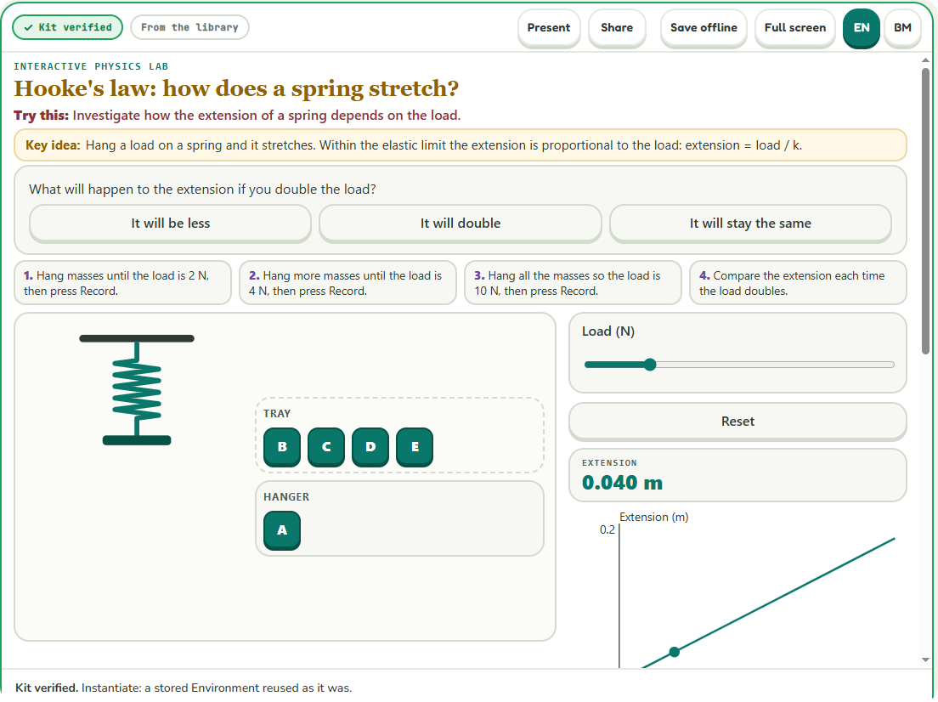
REACH
Built for the phone students already own
360 px
Phone first: 44 px touch targets, reduced motion respected, a text equivalent for every visual
No login
No accounts. Progress stays on the device, with an export code
1 file
Save offline: one hash-checked file that runs without a network
Present
Present mode projects the lab to a class. Share copies a link
Packs
Chapter packs put several labs in one offline file for school PCs
EN | BM
Bahasa Melayu switch built. Translations are drafts awaiting review by a fluent reviewer
The current Synapse shell: label, Present, Share, Save offline and EN | BM in one header.
Notes:
SAY:
Built for the phone students already own. The layout is designed for a 360-pixel screen with large touch targets, reduced motion respected, and a text equivalent for every visual. No accounts: progress stays on the device. A lab can be shared as a link, projected to a class with Present mode, or saved as one offline file that runs with no network. Chapter packs put several labs in one file for school computers. We have also built a Bahasa Melayu switch, but those translations are drafts that still need a fluent reviewer.
WATCH OUT:
Honest limits: no real-phone or screen-reader pass yet; keyboard and reduced-motion checks were done in a real browser. Say the Malay is draft, plainly.
CRITERIA: Educational significance, Technical readiness

Slide 20
EVIDENCE
What we measured
30
219 / 224
20 / 20
verified Environments: Physics 14, Chemistry 9, Biology 7
planted defects refused, with 0 of 30 false alarms
hostile attack shapes blocked by two layers
Hand-written plans, no teacher review yet
A regression baseline, not an unbiased rate
Known shapes, written by the defenders
13 / 14
US$0.027
92.6%
unseen Biology and Chemistry questions built, no example shown to the AI
per new lab, measured live, about 21 seconds
local router accuracy on subject, 83.0% on topic
About US$0.057 per lab. Small sample
Sample of 3 questions, not a pass rate
Agreement with an LLM teacher, English only
Notes:
SAY:
What we measured, with the limits beside each number. Thirty verified environments across physics, chemistry and biology. 219 of 224 planted defects refused with no false alarms, which is a regression baseline we wrote ourselves, not an unbiased rate. 20 of 20 hostile attacks blocked. On cost: about two and a half US cents per new lab, measured live on three questions, and on a later fourteen-question run, thirteen produced a lab at about six cents each. Both are small samples. Our local router agrees with an LLM teacher 92.6 percent of the time on subject.
WATCH OUT:
Source: the Synapse status ledger and evidence notes dated 28 Oct 2026. Re-run the eval scripts if anything changed. Never convert "13 of 14" into a pass rate.
CRITERIA: Technical readiness

Slide 21
ADOPTION
A path from prototype to adoption
Students
US$0.03 to 0.06
to build a new lab (measured)
About US$0
to reopen a saved lab
Each new audited model makes every later question in that topic cheaper and safer.
1
Free, no account, any phone, works offline. The reason the product exists.
Teachers and schools
2
Offline lab files and chapter packs for school PCs, Present mode for the class. A teacher's review lifts a lab from kit-verified to reviewed.
Districts, ministries and publishers
3
A licensed library of teacher-reviewed, textbook-cited labs aligned to the national curriculum, growing from measured topic gaps.
Next: teacher review of the 30 Environments, a school pilot with a learner study, then the deploy gate. Planned, not done: no pilot schools or revenue yet.
Notes:
SAY:
The logic is simple. Students pay nothing and need no account. Teachers and schools get offline lab files and chapter packs for school computers, Present mode for the class, and a teacher's review that lifts a lab from kit-verified to reviewed. The paying route is districts, ministries and publishers: a licensed library of teacher-reviewed, textbook-cited labs aligned to the national curriculum. It is cheap to run: about three to six US cents to build a lab, and about nothing to reopen one. And it compounds: each new audited model makes every later question in that topic cheaper and safer. This is a plan, not traction: we have no pilot schools or revenue yet.
WATCH OUT:
This is our thinnest criterion, so be straight. The content of this slide is our own planning, not sourced from a market study. Add any real conversations or letters of interest the team has. Do not quote market-size figures unless you can source them.
CRITERIA: Commercial viability

Slide 22
HONESTY
Limits, and what comes next
Limitations we state up front
No learner study yet, so no outcome claims
No teacher has reviewed an environment, so labels stop at kit-verified
30 Environments, from a census of 53 curriculum topics
Bahasa Melayu strings are drafts awaiting review
Not publicly hosted: the API stays private until the deploy gate is met
No real-phone or screen-reader pass yet; planted bugs refused are 219 of 224, not all
What comes next
Teacher review of every Environment
School pilot with a pre and post learner study
Grow the Kit from measured topic gaps
Reviewed Bahasa Melayu for every lab
Learner model with spaced practice and difficulty adaptation
Deploy gate: isolation, limits, hosting, licence
Notes:
SAY:
We would rather tell you our limits than have you find them. We have no learner study yet, so we make no outcome claims. No teacher has reviewed a lab, so our labels stop at kit-verified. Thirty environments, from a census of fifty-three curriculum topics. The Malay is a draft. The API stays private until our deploy gate is met. And our planted-bug refusal is 219 of 224, not all. What comes next: teacher review of every lab, a school pilot with a pre and post learner study, growing the Kit from measured gaps, reviewed Bahasa Melayu, and the deploy gate.
WATCH OUT:
This is also the Q&A slide. If a judge asks "has a real student used it?" the honest answer is: not yet in a study, and that is our next step.
CRITERIA: Educational significance, Technical readiness

Slide 23
SUMMARY
Against the four judging criteria
1
Innovation and novelty
2
Technical readiness
Originality of concept
Build quality and execution
The AI designs the experiment and never supplies a number. Audited parts, a verifier-only mint and a delivery gate make the result correct by construction.
30 verified environments, each run in a real browser. 219 of 224 planted bugs refused, 20 of 20 hostile attacks blocked, an offline file and a 360 px phone layout.
3
Commercial viability
4
Educational significance
Market potential
Pedagogical impact
US$0.03 to 0.06 to build a lab and about nothing to reopen. Schools and districts adopt teacher-reviewed chapter packs. A pilot is the next step.
Predict first, graded hints, concept checks and the textbook source on every lab, for students who have no lab. A learner study comes next.
Notes:
SAY:
Against your four criteria. Innovation: the AI designs the experiment and never supplies a number, so the result is correct by construction. Technical readiness: thirty verified environments, each run in a real browser, with measured refusal rates. Commercial viability: cents to build, almost nothing to reopen, and a licensed, teacher-reviewed library as the route. Educational significance: predict first, graded hints, concept checks and the textbook source on every lab, for students who have no lab.
WATCH OUT:
Keep this under 45 seconds. It is the summary the judges will score against.
CRITERIA: All four

Slide 24
Don't read about the experiment.
Run it.
Synapse by Team EduNova
Por Jie Hao · Fakhrul Azim · Azrain Shawn · Khaidhir
Alif Fadhil · Adam Iman · Danish Iskandar · Nur Farah
Thank you. Questions?
Come and run a lab at our booth.
Notes:
SAY:
Don't read about the experiment. Run it. Thank you. We are Team EduNova from Universiti Teknologi PETRONAS, and we will be at our booth all day, where you can type your own question and run a lab yourself. We are happy to take your questions.
WATCH OUT:
Q&A: assign one primary answerer per topic before the day so there is no pause and no two people start at once. Prepared answers are in the booth notes section of this guide.
CRITERIA: All four

