Slide 1
Diamonds Prediction

Slide 2
Preprocessing
Reading Data.
Dropping "Id" Column.
Display information about the train and test data , such as the number of non-null values and data types.
Display descriptive statistics of the preprocessed training data.

Slide 3
Key Points for Describe:
Carat: The average weight of diamonds is 0.798 carats, with a range from 0.2 to 5.01 carats.
Depth: The average depth percentage is 61.75%, with most diamonds ranging between 43% and 79%.
Table: The average table percentage is 57.46%, with values ranging from 43% to 95%.
Price: The average price of diamonds is $3,929.49, ranging from $326 to $18,823.
Dimensions: The average dimensions of diamonds (x, y, z) are approximately 5.73 mm, 5.74 mm, and 3.54 mm, respectively. Notably, there are some diamonds with zero dimensions indicating potential errors or missing values.

Slide 4
Feature Extraction:
Dropping any raw with ‘x’ or’y’ or ‘z’
that contains a 0 because these values are n noise
Valume : Created a new feature by multiplying dimensions “x” ,”y”,”z”.
Mean of Dimensions: Created a feature as the average of “x” ,”y”,”z”.
Density: Created a feature representing the density of the diamond.
Dropped original dimensions (“x” ,”y”,”z”) as they are now represented by new features.

Slide 5
Displaying Value Counts:
Display the count of each unique value in the categorical features(“cut”,”color”,”clarity”) in the preprocessed training data to understand the distribution of these categories.

Slide 6
Encoding Categorical Features:
Cut:
Defined the order: Fair, Good, Very Good, Premium, Ideal.
Encoded the “cut” feature into numerical values based on this order.
Color:
Defined the order: J, I, H, G, F, E, D (J being the lowest and D being the highest quality).
Encoded the “color” feature into numerical values based on this order.
Clarity:
Defined the order: I1, SI2, SI1, VS2, VS1, VVS2, VVS1, IF (I1 being the lowest and IF being the highest quality).
Encoded the “clarity” feature into numerical values based on this order.

Slide 7
Visualization
Pair Plot Visualization: Visualized relationships between features using pair plot.
Correlation Matrix: Calculated and visualized the correlation matrix to understand relationships between numerical features.
There is a strong positive correlation between "carat" and "price" (0.92), as well as between "carat" and "z" (0.96), and "y" (0.95), and "x" (0.98).
There is a notable correlation between "price" and "x" (0.89), "y" (0.86), and "z" (0.86).
Strong correlations were observed between "x" and "z" (0.97), "y" (0.97), and "price" (0.89).
Additionally, there is a strong correlation between "y" and "z" (0.95).

Slide 8
Visualization
Re-calculated and visualized the correlation matrix including new features.
There is a strong positive correlation between "carat" and "price" (0.92), as well as between "carat" and “Mean_xyz" (0.97), and “valume" (0.97)
There is a notable correlation between "price" and " Mean_xyz " (0.88), " valume " (0.90).

Slide 9
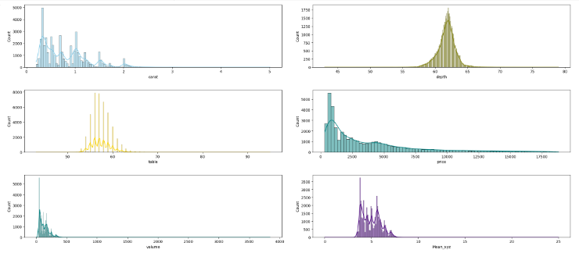
Visualization
Based on the results of the histograms:
Carat: The data indicates that the concentration is highest between 0.5 and 1.
Depth: The concentration appears to be highest approximately between 60 and 65.
Table: The concentration is most prominent between 50 and 60.
Price: The concentration is highest between 1000 and 2000.
Volume: The concentration seems to be highest between 0 and 400.
Mean_xyz: The concentration is most prominent around 3 or 4 to 5.
Notes:
Interpreting these findings can provide valuable insights into the distribution and central tendencies of each variable. For instance:
Understanding the concentration of carat values can help in identifying the most common weight ranges of diamonds.
Depth and table measurements provide insights into the proportions of diamonds, which are crucial factors affecting their appearance and value.
Price concentration indicates the most common price range for diamonds within the dataset.
Volume distribution gives an idea of the spatial dimensions of diamonds, which can be useful in assessing their quality and value.
Mean_xyz provides information about the average size of the diamonds in terms of their dimensions.
These insights can aid in various aspects of diamond analysis, such as pricing, quality assessment, and market trends. Additionally, they can guide decision-making processes related to diamond trading, manufacturing, and retail.

Slide 10
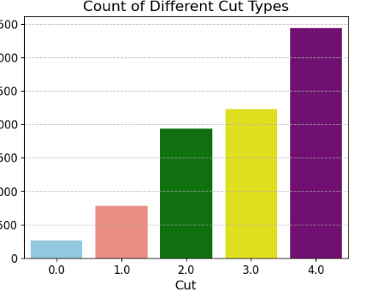
Visualization
This plot contains different cut types: Ideal, Premium, Very Good, Good, and Fair. The majority of the data points appear to belong to the 'Ideal' category."
Notes:
This insight can be utilized in various analyses, such as understanding market trends, guiding marketing strategies, or identifying production and supply needs.

Slide 11
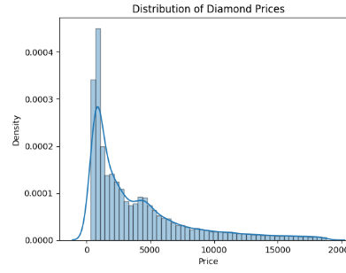
Visualization
Based on this plot, it appears that the concentration of diamond prices is primarily between 1000 and 2000, with a smaller peak occurring around 15000 to 20000.
Notes:
If the density is high within a specific price range, this indicates a strong concentration or clustering of prices in that area. Additionally, density can be used to identify time periods or standard ranges where price fluctuations occur. This can help analyze market trends and understand fluctuations in demand and supply.
In general, understanding the relationship between price and density can aid in making informed decisions regarding pricing, marketing, and inventory management in the diamond industry.

Slide 12
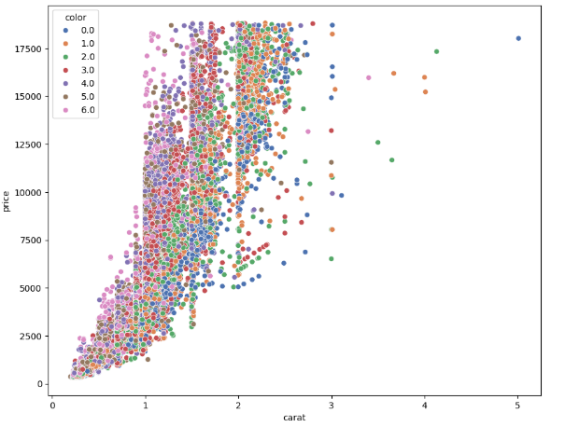
Visualization
Based on the results, the plot illustrates outliers between the 'price' and 'carat' variables. The concentration of values around 6 is between approximately 0.5 and 1.5, with a low proportion of values at 5 and a higher proportion at 4, which are concentrated between approximately 1 and 1.5. The value 2 is scattered without a specific concentration point, ranging between approximately 1 and 3.8. The value 1 is concentrated between 2 and 2.5, while 0 is concentrated between approximately 1.2 and 2.6.
Notes:
Analyzing this plot could help in understanding the relationship between the carat weight of diamonds and their prices across different colors. It also highlights any potential outliers or patterns in the data distribution that could be further explored or analyzed.

Slide 13
Training and Evaluation
Data Preparation and Model Evaluation:
Defines a function “evaluate_model” that takes a machine learning model as input, fits it to the training data, and then predicts on both the training and testing sets then print the model name and the RMSE.
List the models evaluated: Linear Regression, Decision Tree Regressor, Random Forest Regressor, and Support Vector Regressor and compare them using the previous method.

Slide 14
Training and Evaluation
Model Performance Results:
Present the RMSE results for each model.
Highlight the key findings:
Linear Regression has balanced performance but may not capture all complexities.
Decision Tree Regressor overfits the training data.
Random Forest Regressor provides a better balance between training and testing performance.
SVR has high RMSE values, indicating it may not be suitable for this dataset.

Slide 15
Tuning and Evaluating a RandomForestRegressor Model using GridSearchCV
define the RMSE (Root Mean Squared Error) metric as the scorer to be used for model evaluation. Setting “greater_is_better=False” indicates that lower RMSE values represent better performance.
define the range of values for different hyperparameters that will be tested during the tuning process

Slide 16
Tuning and Evaluating a RandomForestRegressor Model using GridSearchCV
we set up and train the GridSearchCV object, which will test all possible combinations of the specified hyperparameters using 5-fold cross-validation and evaluate the models using the RMSE metric.
Then we print the best combination of hyperparameters found by GridSearchCV and the best RMSE score achieved.
The final result obtained from GridSearchCV is -570.4410744505499, indicating that the best model found has an RMSE equal to this value

Slide 17
Optimizing RandomForest Model Using Grid Search
Finding the Best Model Using Grid Search.
Combined hyperparameters and mean test scores, sorted to find the top 5 models.
Evaluating the Top 5 Models:
Listed the top 5 models with their parameters and mean test scores.
Displayed evaluation results for each model (Train RMSE and Test RMSE).
Feature Importance and Removal:
Identified features in the training data.
Removed the 'Mean_xyz' feature and re-evaluated the top 5 models without this feature.
Displayed the evaluation results after feature removal.

Slide 18
Data Preparation and Splitting
=
Data Preparation:
preprocessed training data into DataFrame “data”.
Feature Engineering:
Created a new feature “volume” by multiplying “x”,”y”,”z”.
Dropped original “x”,”y” and ”z” columns.
Dataset Splitting:
Split data into training (80%) and testing (20%) sets.
Ensured reproducibility with “random_state=42”

Slide 19
Model Training and Evaluation
Preprocessing Pipeline:
Created a “ColumnTransformer”:
“MinMaxScaler “for numerical features.
“OrdinalEncoder” for categorical features with predefined categories.
Constructed “base_pipline” with the preprocessing steps

Slide 20
Model Training and Evaluation
Data Transformation:
Transformed “X_train” and “X_test” using the pipeline.
RandomForest Model Training and Evaluation:
Model: “RandomForestRegressor” with specified hyperparameters.
Results:
train_rmse=461.34
test_rmse=539.48

Slide 21
Model Training and Evaluation
XGBoost Model Training and Evaluation:
Model: “XGBRegressor” with specified hyperparameters.
Results:
train_rmse=467.68
test_rmse=524.00
Results on Full Dataset:
train_rmse=470.61

Slide 22
Generating Predictions for Test Data
The test data was preprocessed by creating a new feature (volume) and dropping the original dimensions (x, y, z).
Predictions were generated using the trained pipeline.
Results were mapped to IDs and saved into a CSV file for submission.

Slide 23
Leen emad addin abdulaleem alsayed hatem yousef aziz ayadi safa’a ghnaneem
Work with:

