Slide 1

King Abdulaziz University
Faculty of Computing & Information Technology — Rabigh
AMS
Attendance Management System
Team
Supervisor
Abdulaziz Othman · 1935680
Ali Almejalli · 2244549
Dr. Nashwan Alromema
Alwaleed Alghamdi · 2342305
Graduation project · B.Sc. Computer Science · 2025–2026

Slide 2




The Problem
Manual & Error-Prone
Wastes Class Time
Paper sheets get lost, misread, or forgotten — attendance records are unreliable.
Calling names or passing sheets eats into valuable lecture minutes every session.
No Centralised Record
Zero Real-Time Insight
Grades/reports need history that doesn't exist or lives in a spreadsheet no one trusts.
Instructors can't see attendance patterns or flag at-risk students early.

Slide 3



Our Solution
A mobile-first attendance system that replaces paper with a timed activation code.
1
2
3
Instructor
Code Shared
Student
Sets a timer duration and generates a one-time activation code for the session.
The code is displayed on screen — students enter it in the app within the time window.
Submits the code. System validates timing and marks Present or Late automatically.

Slide 4
System Architecture
One student tap becomes a database record — and back — in a single HTTPS round-trip.
▶ REQUEST POST attend/ · -H student_id -H section_id -H code:81238
1
2
3
4
Android App
REST API
PL/SQL Logic
Oracle DB
Kotlin · Retrofit · ViewBinding
Oracle ORDS · HTTPS · Headers
Code-gen · Timer · Validate
Users · Sections · Attendance
◀ RESPONSE { "body": { "status": "P" } } → Marked Present
All API calls pass parameters via HTTP headers · ORDS wraps every response in a {body} envelope

Slide 5
Key Technical Decisions
Why HTTP Headers?
Two-step validate → mark
Oracle ORDS PL/SQL handlers bind parameters from headers natively — no body parsing for POST calls, keeping the API simple.
Validate returns Present/Late instantly; mark then commits the record — separating feedback from persistence.
-H "code: 81238"
validate/ → mark/
Timer-controlled sessions
BaseActivity for locale
The start/ endpoint computes expires_at = now + N min; attend/ checks SYSTIMESTAMP against that window.
Every activity extends BaseActivity, applying saved language (AR/EN) and notification settings on each onCreate.
expires_at = now + N·min
class X : BaseActivity()

Slide 6
App Walkthrough
Tap any feature to see it in the real app ▸
Student
Instructor
Home · my courses
›
Home · my classes
›
Mark attendance
›
Take attendance
›
My history
›
Session history
›
Settings
›
Settings
›

Slide 7
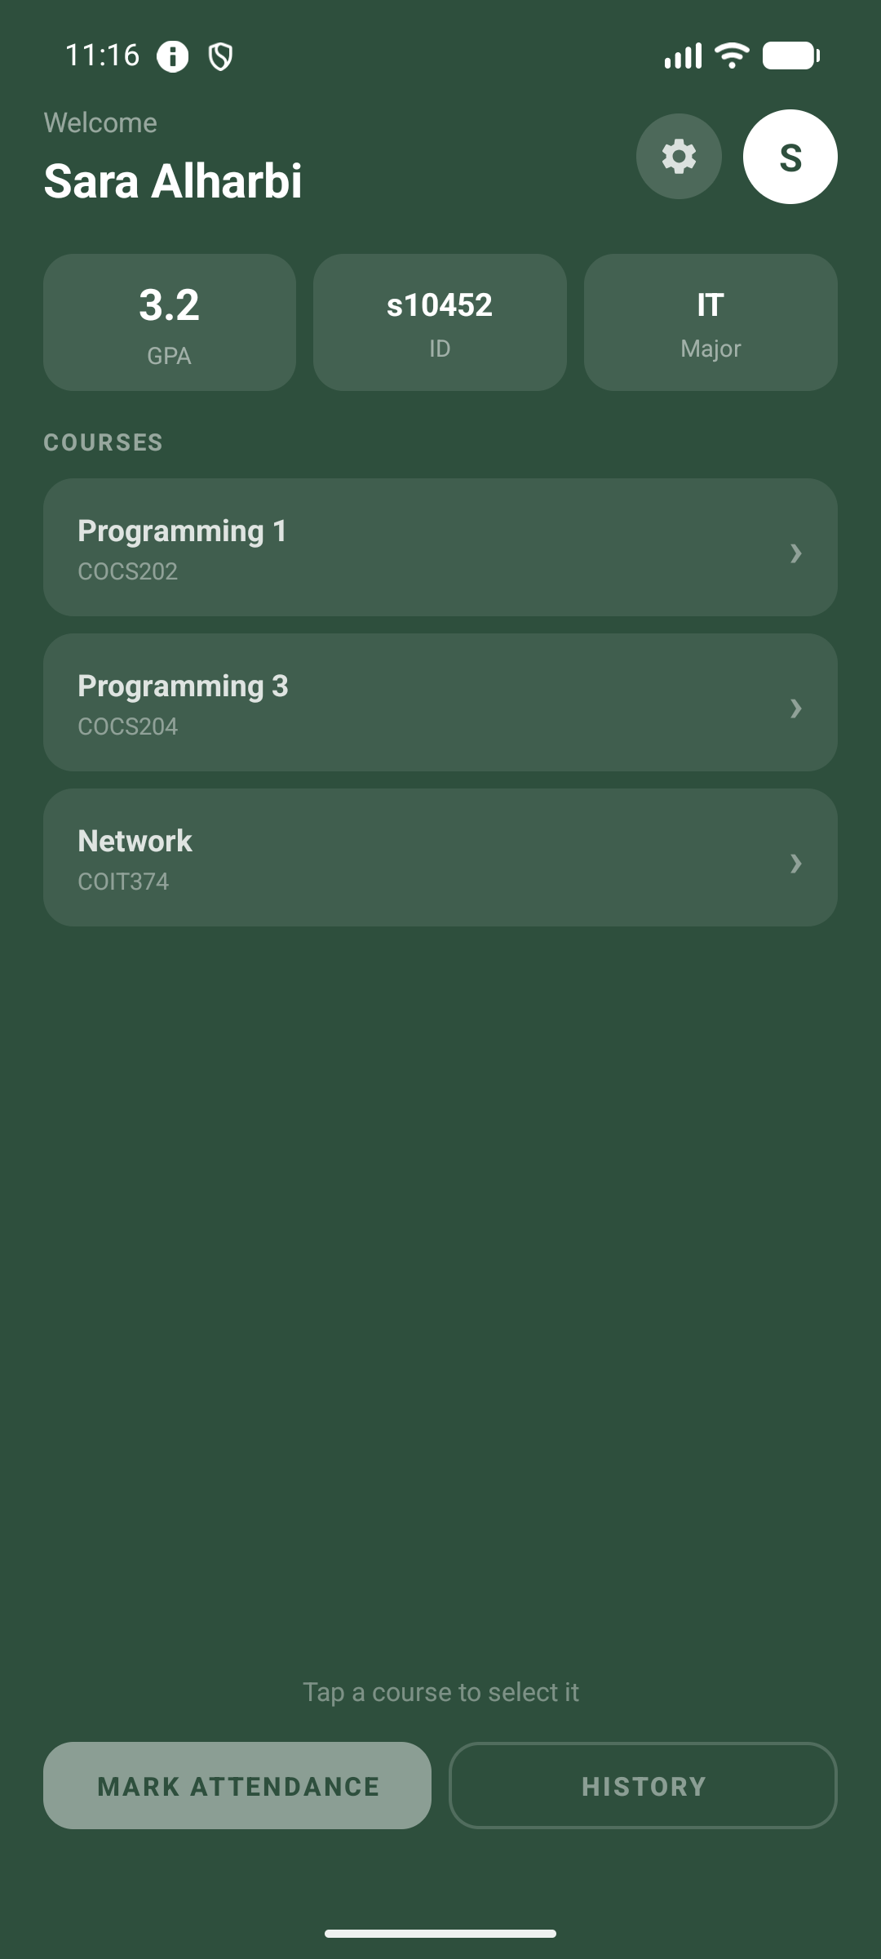
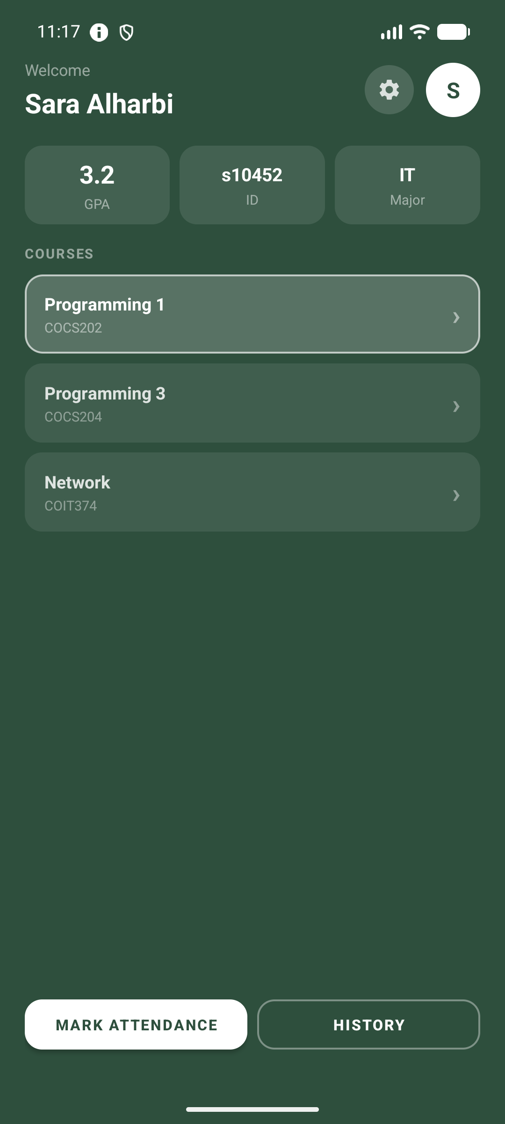
Student · Home
‹ Back to map
See enrolled courses and pick one to act on.
Your enrolled courses
Tap a course to select

Slide 8
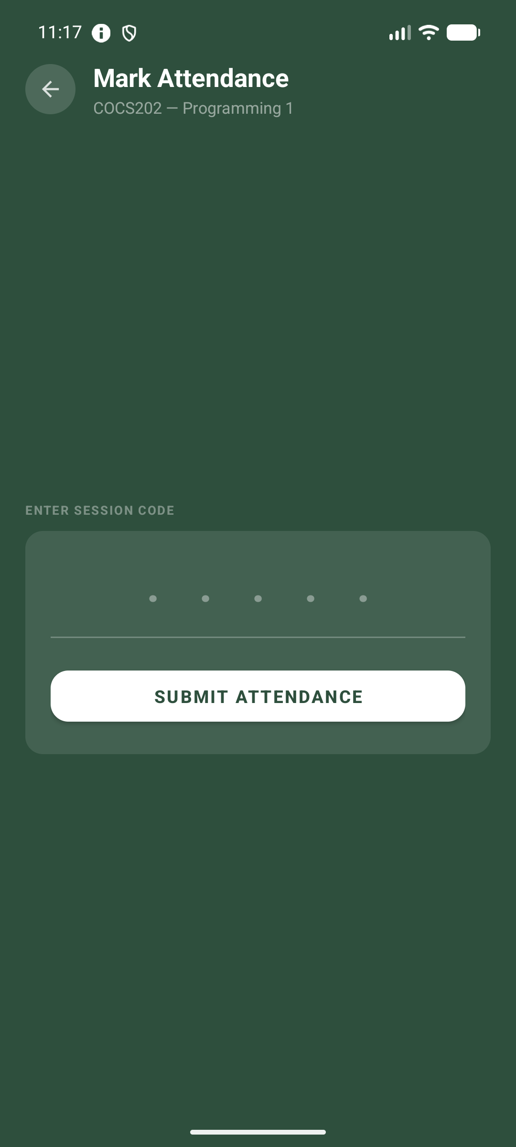

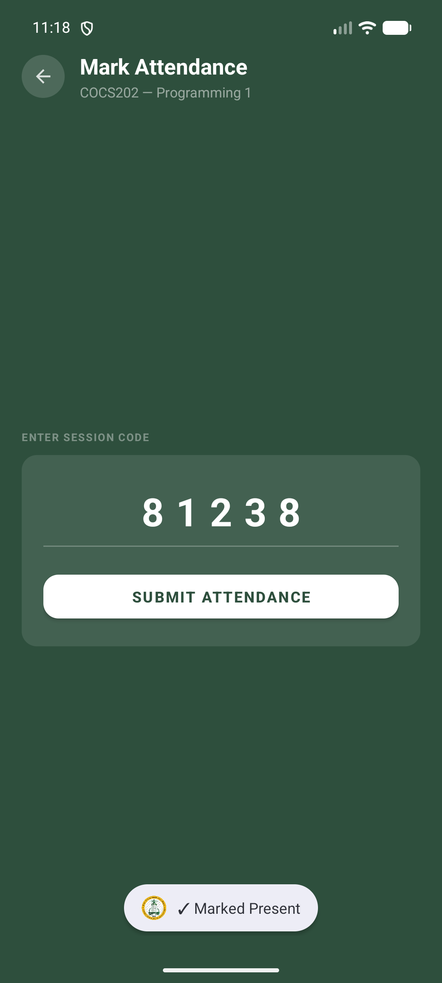
Student · Mark attendance
‹ Back to map
Enter the instructor's code to record your presence.
1 · Open Mark Attendance
2 · Enter the code
3 · ✓ Marked Present

Slide 9
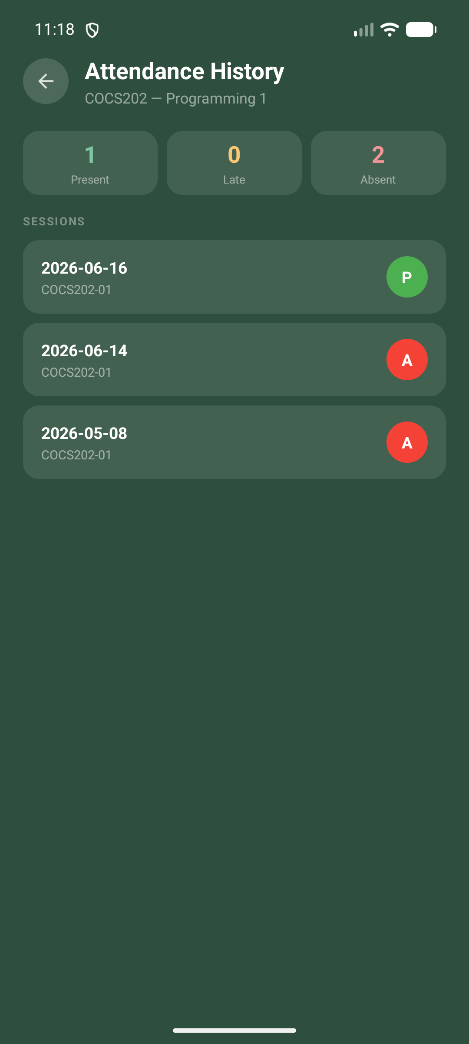
Student · My history
‹ Back to map
Track your attendance across every course.
Present / Late / Absent summary chips
Per-course session list with dates
Color-coded status — P / L / A
Updates the moment you're marked

Slide 10
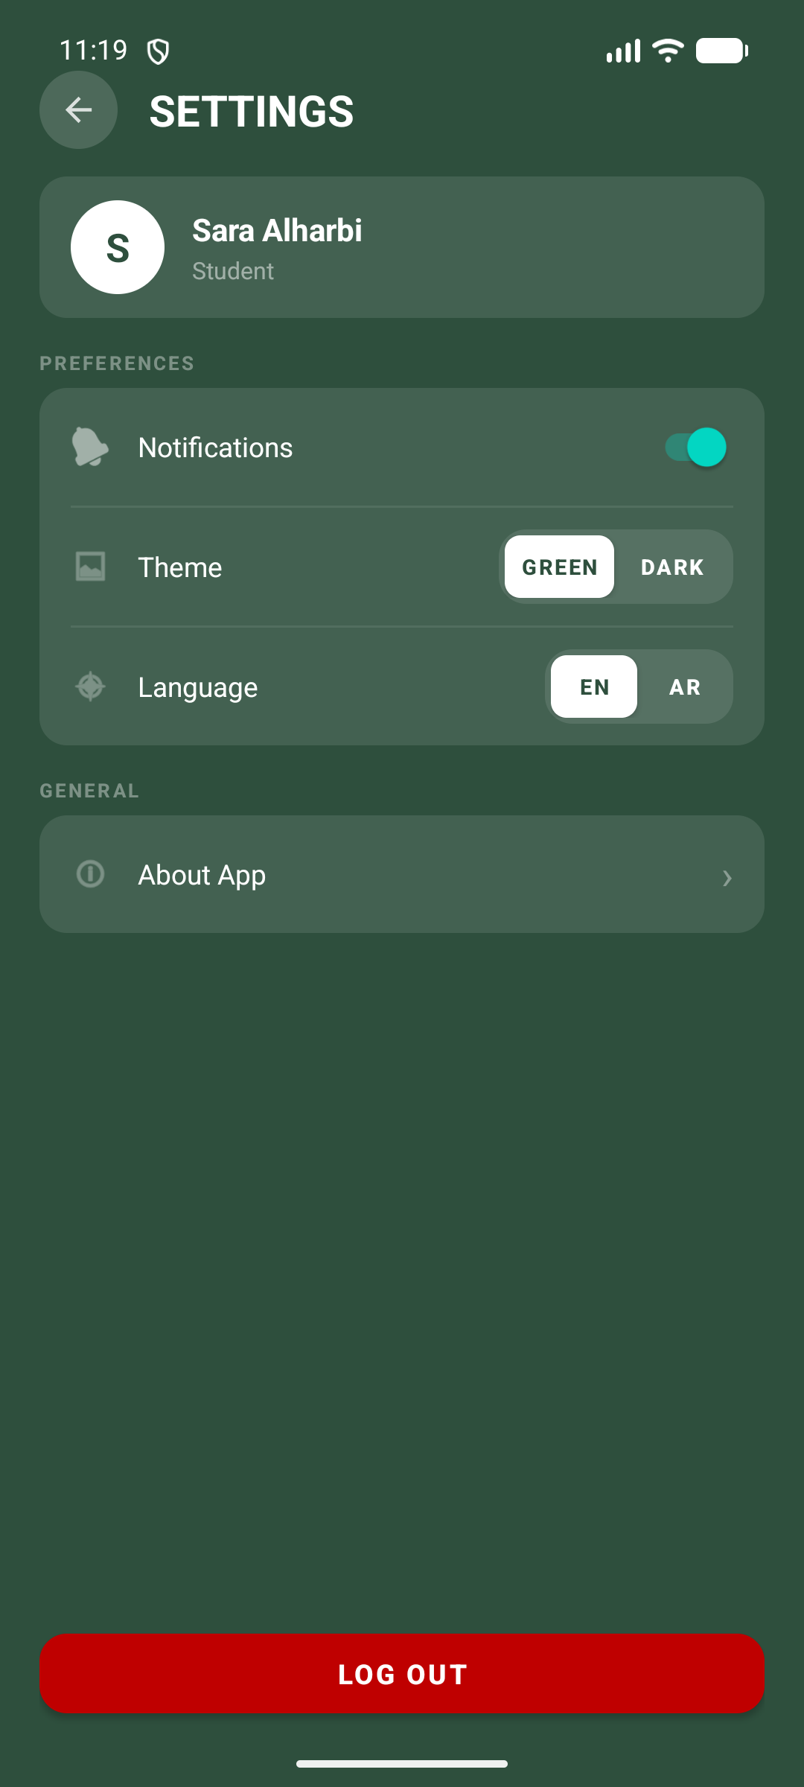
Student · Settings
‹ Back to map
Personalise the app and manage your account.
Profile card with name & role
Light / Dark theme toggle
Language switch: English / العربية
Notifications on / off
Secure logout

Slide 11
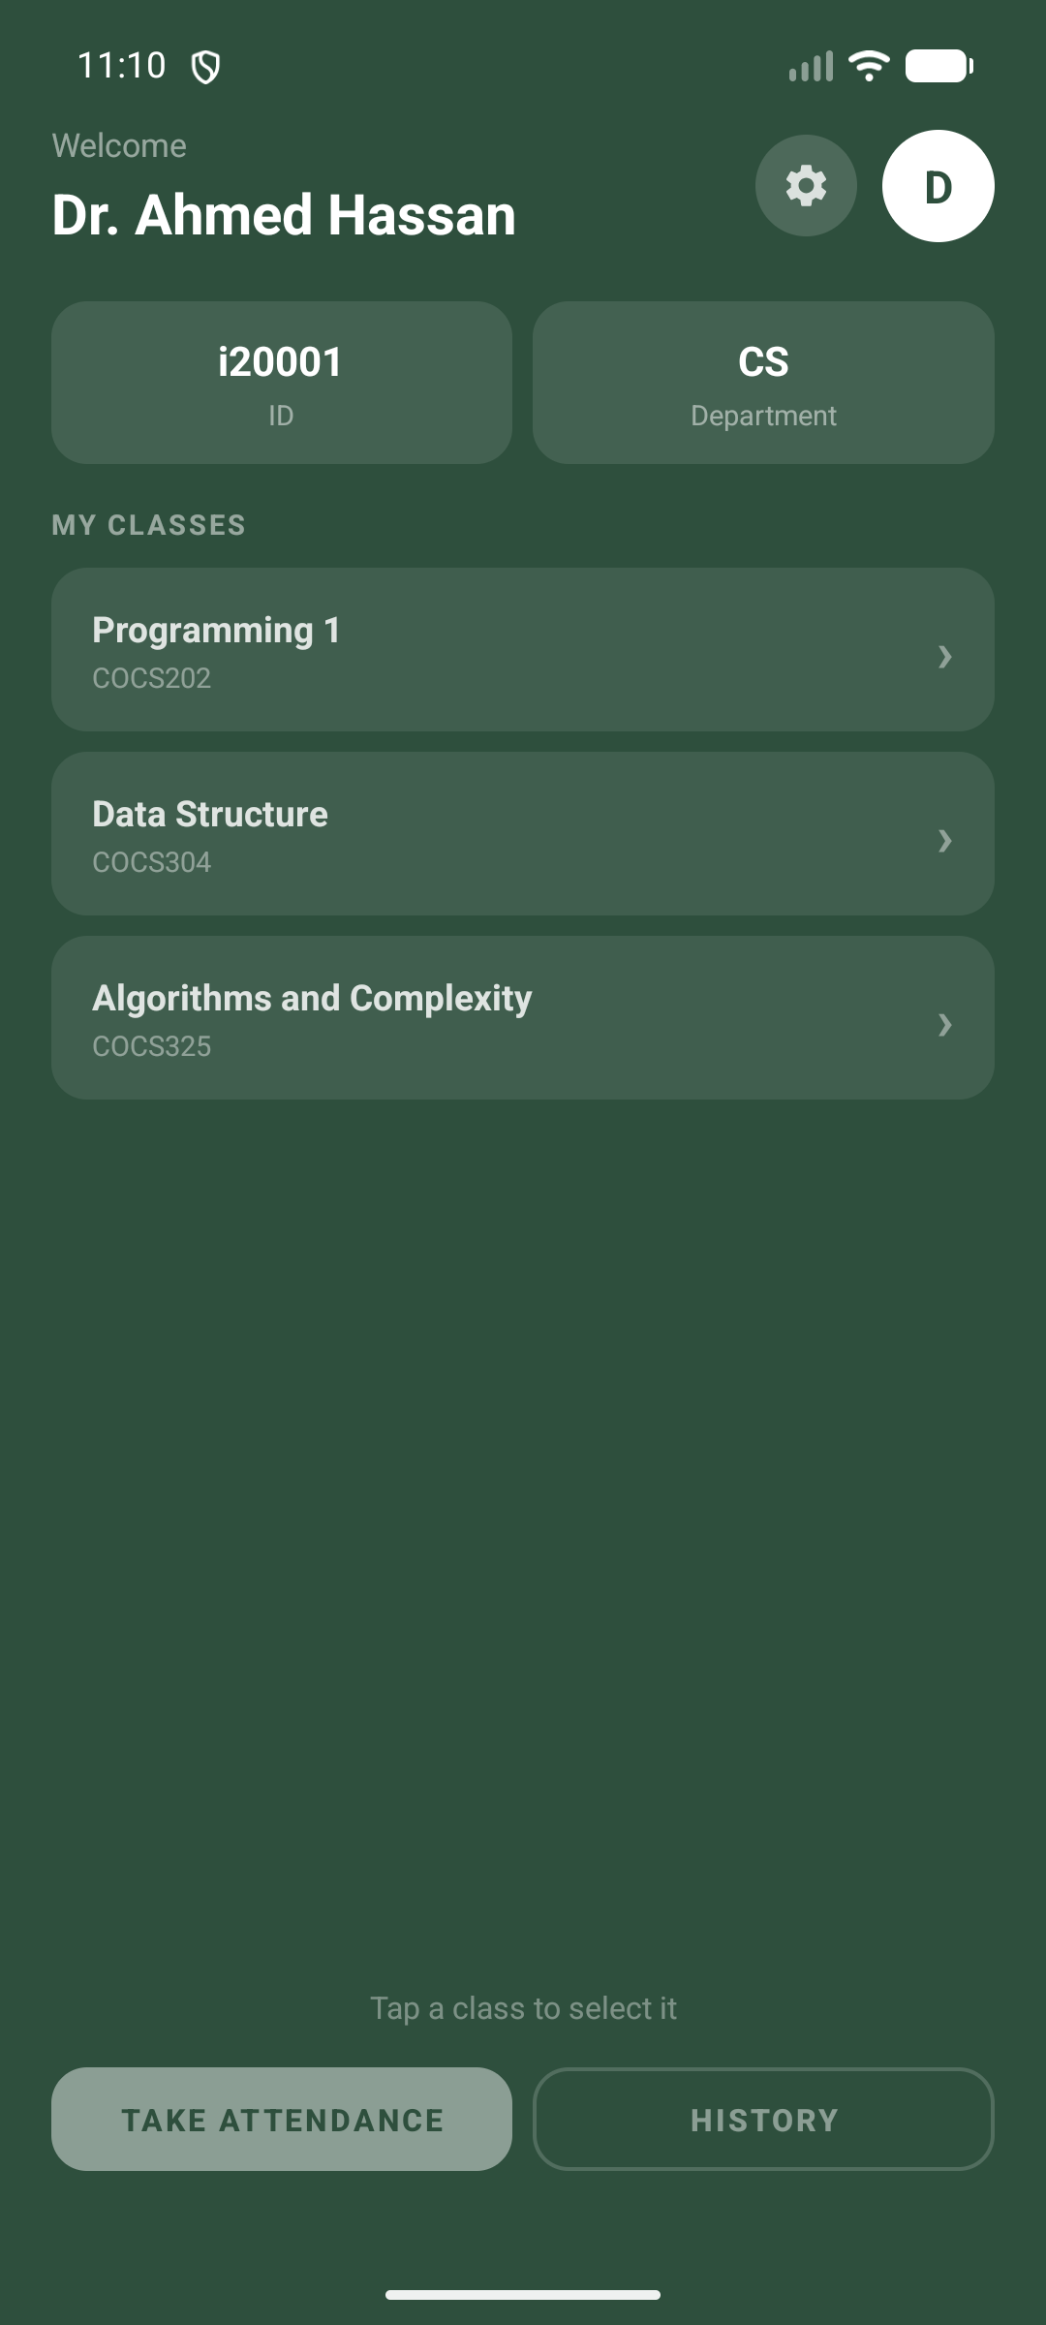
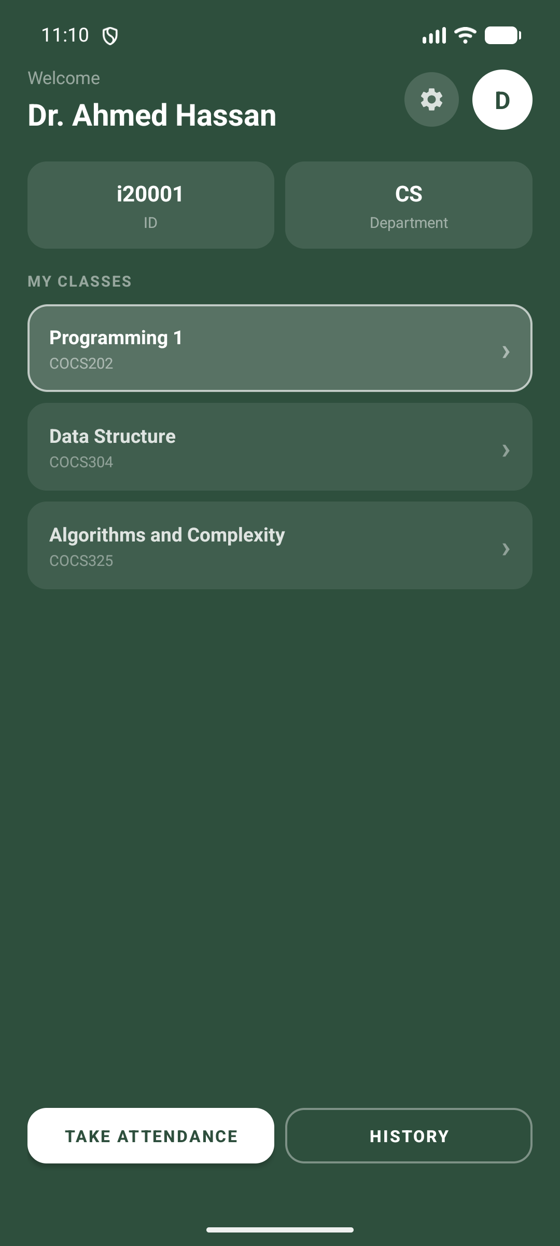
Instructor · Home
‹ Back to map
See the classes you teach and pick a section.
Classes you teach
Tap a class to select

Slide 12
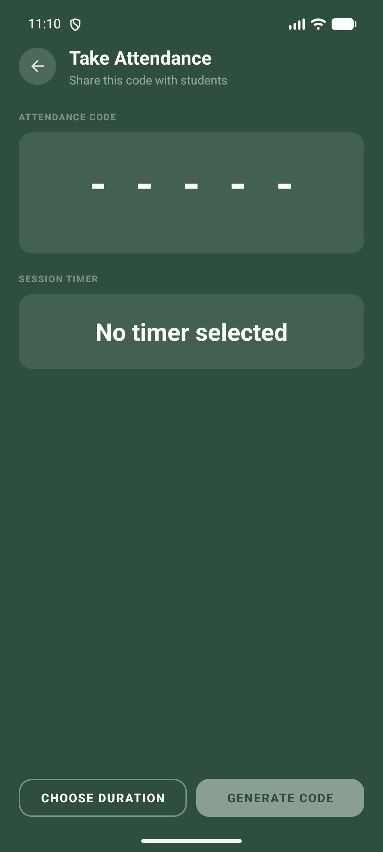
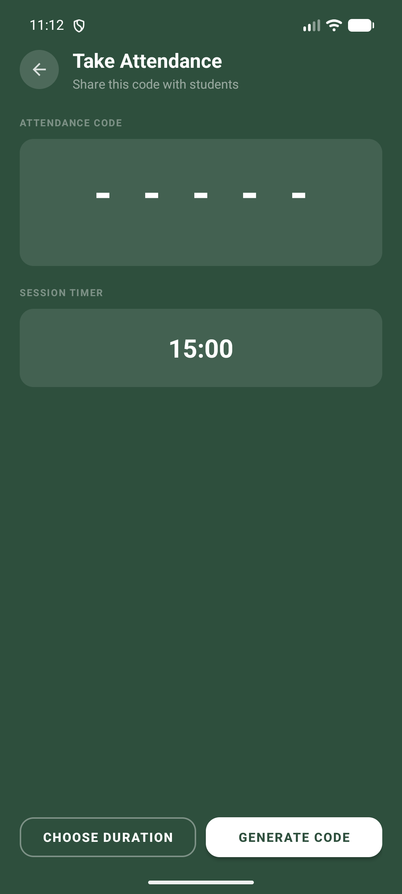
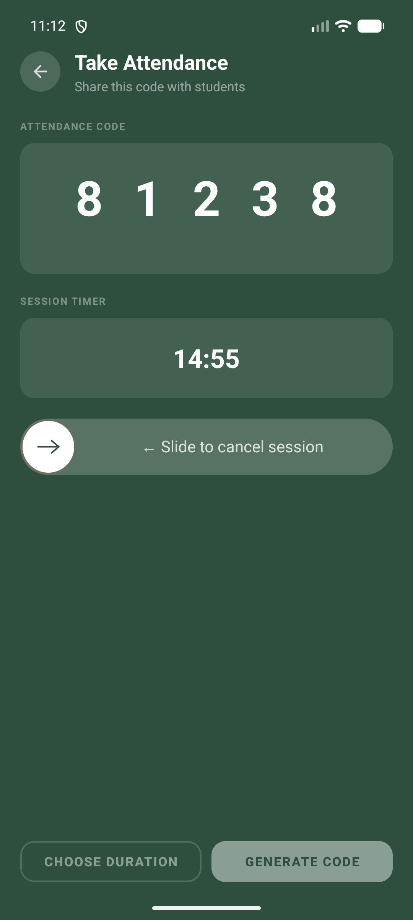
Instructor · Take attendance
‹ Back to map
Pick a duration, generate a code, share the live countdown.
1 · Open Take Attendance
2 · Choose duration
3 · Share the live code

Slide 13
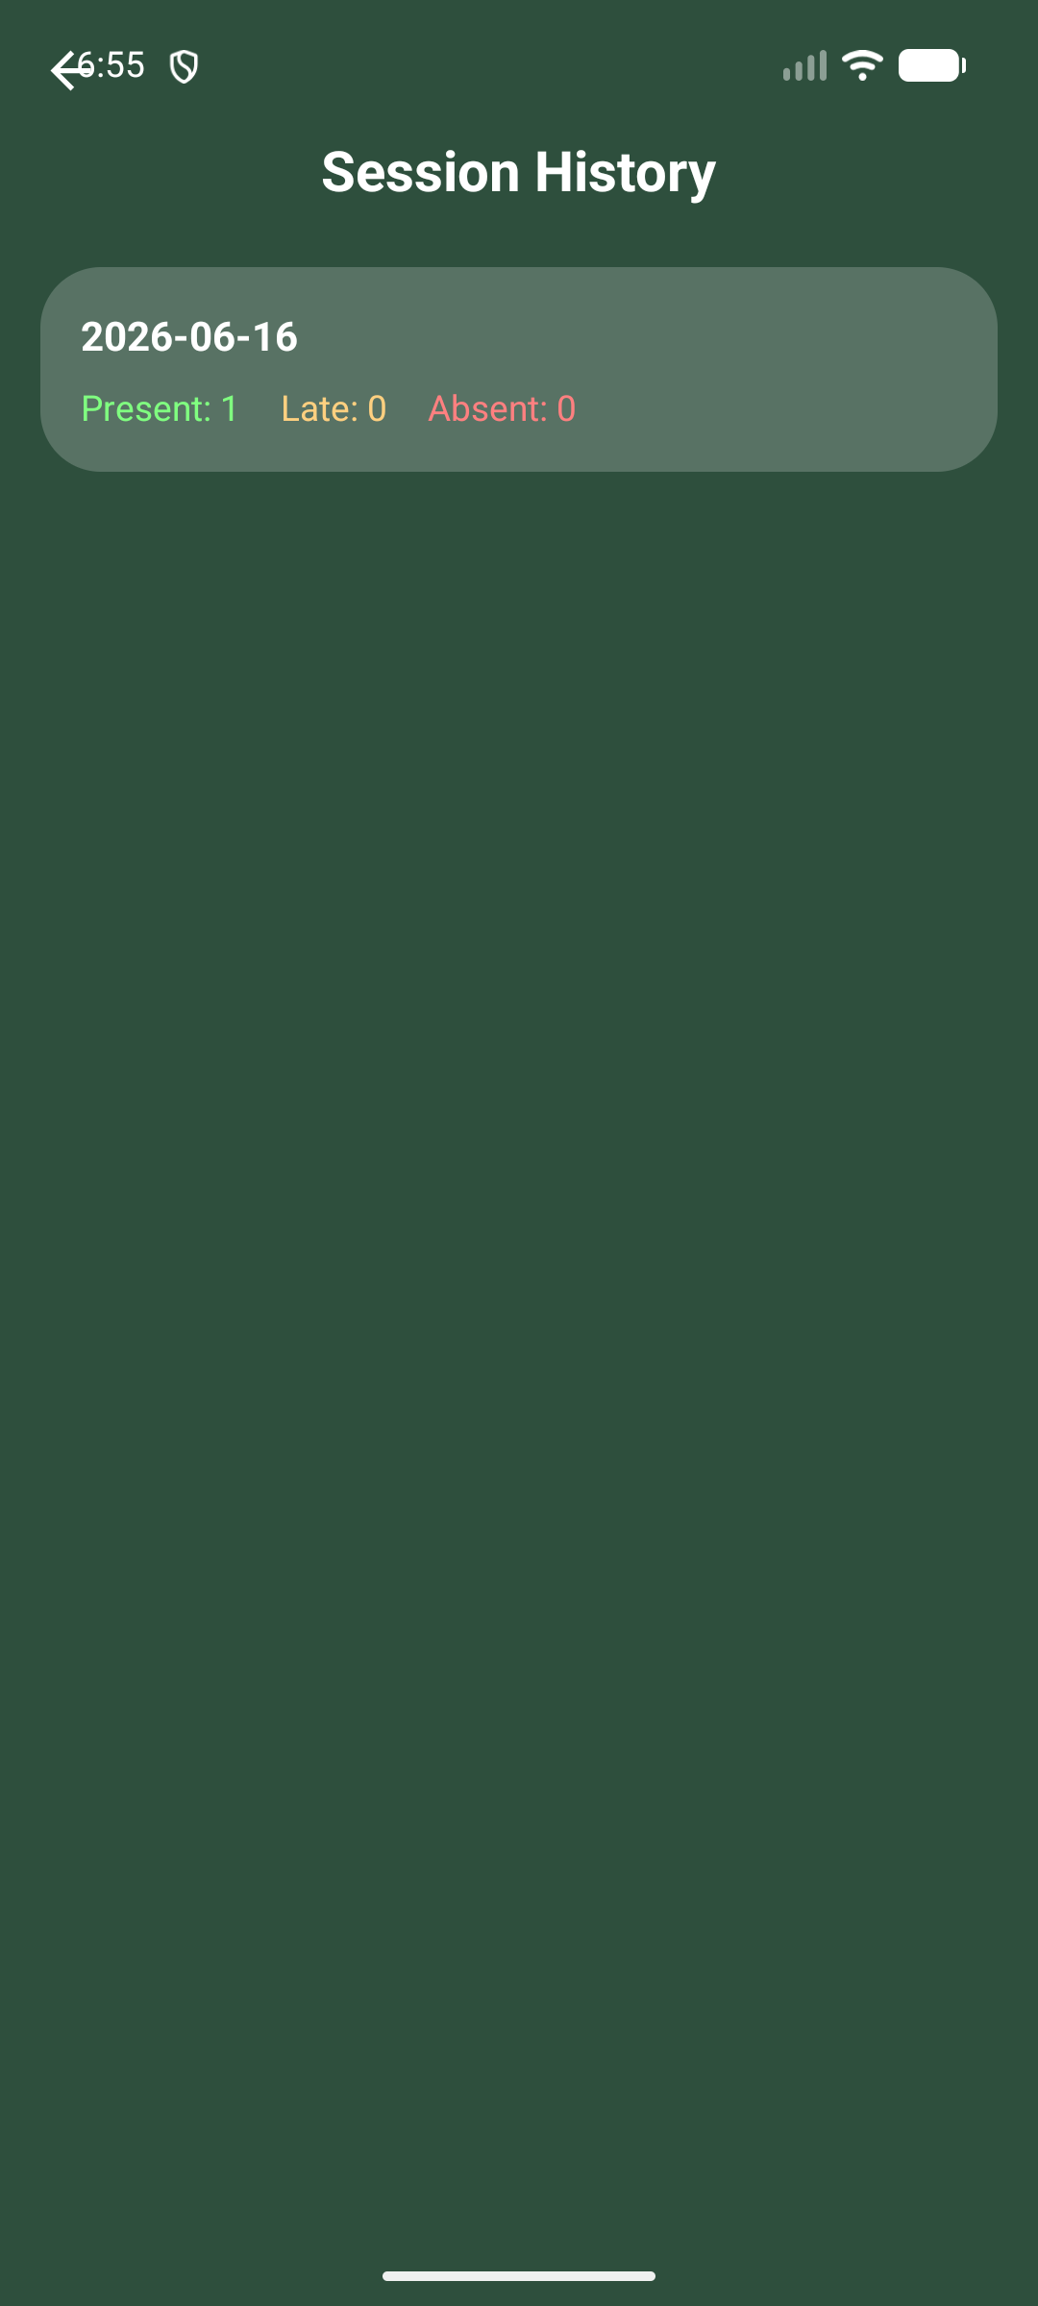
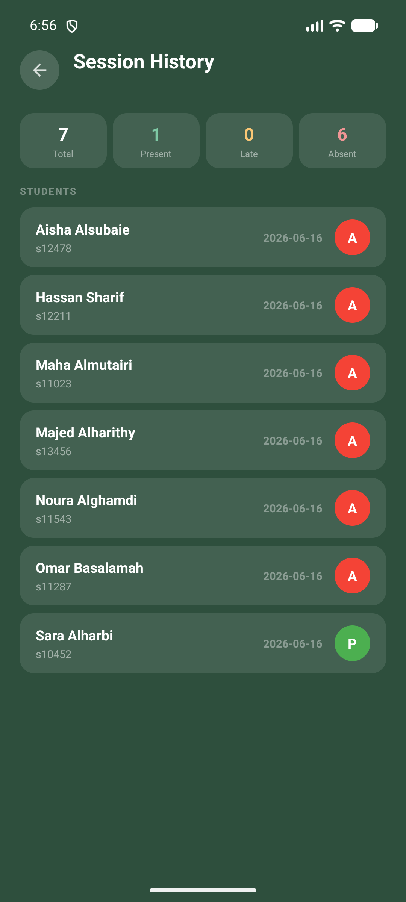
Instructor · Session history
‹ Back to map
See who's Present, Late, or Absent per session.
All sessions, with P/L/A
Tap a session → full roster

Slide 14
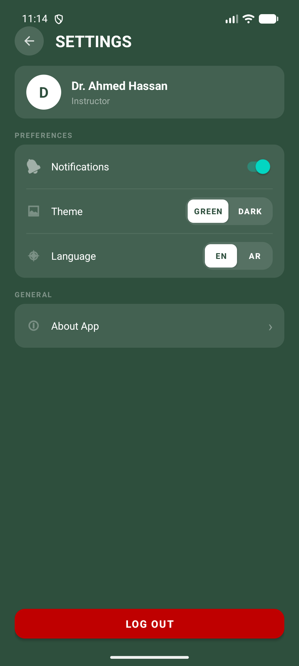
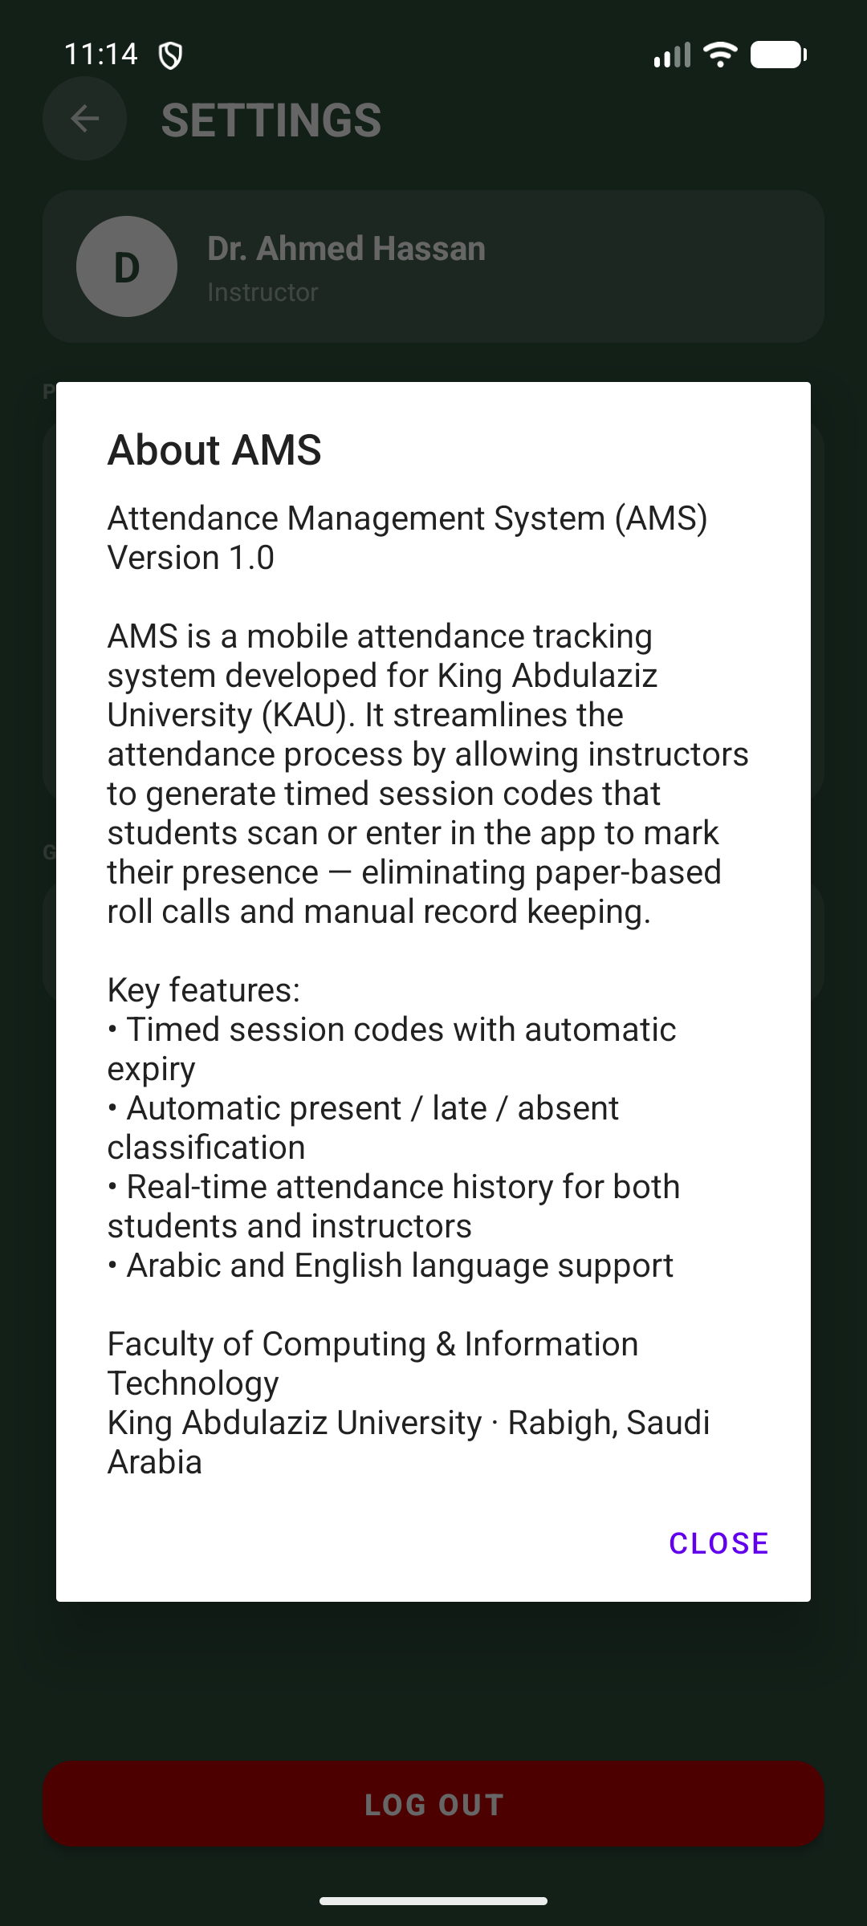
Instructor · Settings
‹ Back to map
Personalise the app and manage your account.
Profile · theme · language
About AMS

Slide 15
What We Learned
BACKEND
ORDS wraps everything in a {body} envelope — raw JSON parsing was essential; Retrofit's Gson alone wasn't enough.
TIMING
SYSTIMESTAMP (UTC) vs device time caused silent bugs — always normalise to UTC before comparing.
ARCHITECTURE
A shared BaseActivity removed repetition across 10+ activities and made language switching seamless.
UX
Separating validate from mark gave instant feedback before the record was committed to the DB.
DESIGN
Designing for two roles from day one kept navigation clear and API endpoints focused.

Slide 16
Scaling Plan
From working prototype to production — in four phases.
1
2
3
4
PHASE 1
PHASE 2
PHASE 3
PHASE 4
Security
Experience
Engagement
Insight
Hashed passwords
QR code check-in
Push notifications
Analytics dashboard
Replace plaintext with Bcrypt / SHA-256 — the first hardening step.
Scan instead of typing — faster and less error-prone.
Alert students when a session opens; warn instructors on low turnout.
Trends per student / course / week to flag at-risk students early.

Slide 17
Thank You
AMS · Attendance Management System
Built with Kotlin · Oracle ORDS · PL/SQL
Questions?
Abdulaziz Othman · Ali Almejalli · Alwaleed Alghamdi
Supervised by Dr. Nashwan Alromema

