Slide 1

ATTENDANCE MANAGEMENT SYSTEM
How AMS Works — A Technical Guide
Taking Attendance · Present / Late / Absent Logic · Database Design
KAU · FCITR | Android (Kotlin) + Oracle APEX REST + Oracle DB

Slide 2



What this guide covers
01
02
03
Taking Attendance
Present / Late / Absent
Database Design
The end-to-end flow — from the instructor generating a code to the student's confirmation and auto-absent marking.
One timing rule — the 80% / 100% split — decided on the server using stored cutoff timestamps.
Six Oracle tables, how they relate, and the key design decisions behind the schema.
AMS Technical Guide
2

Slide 3
01
Walking Through Taking Attendance
From the instructor's code to the student's confirmation
AMS Technical Guide
3

Slide 4





The flow at a glance
1
2
3
Start the session
Create the code
Notify the student
Instructor picks 1–15 min and taps Generate.
APEX issues a 5-digit code with 80% & 100% cutoffs.
App polls (~5 s) and shows a heads-up alert.
POST start/
ATTENDANCE_CODES
GET active_session/
4
5
6
Submit the code
Present or Late
Auto-absent at end
Auto-filled code is validated and recorded.
Set by the submit time vs the cutoffs.
Non-attendees are marked Absent.
POST attend/
status = P / L
POST close_session/
AMS Technical Guide
4

Slide 5
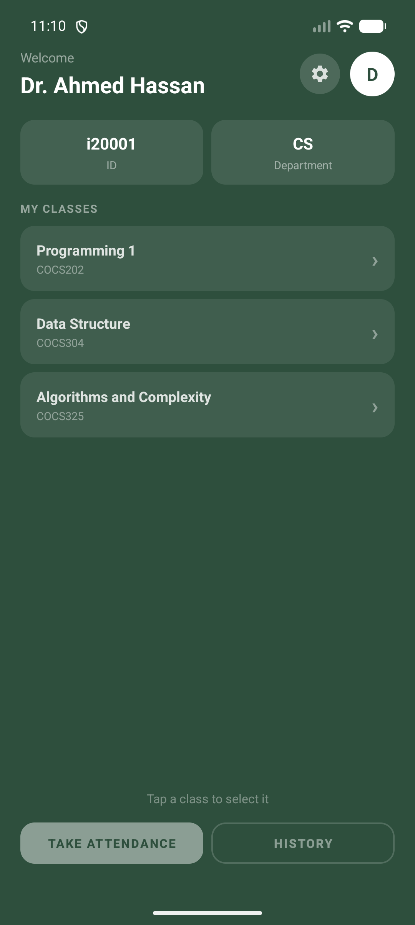
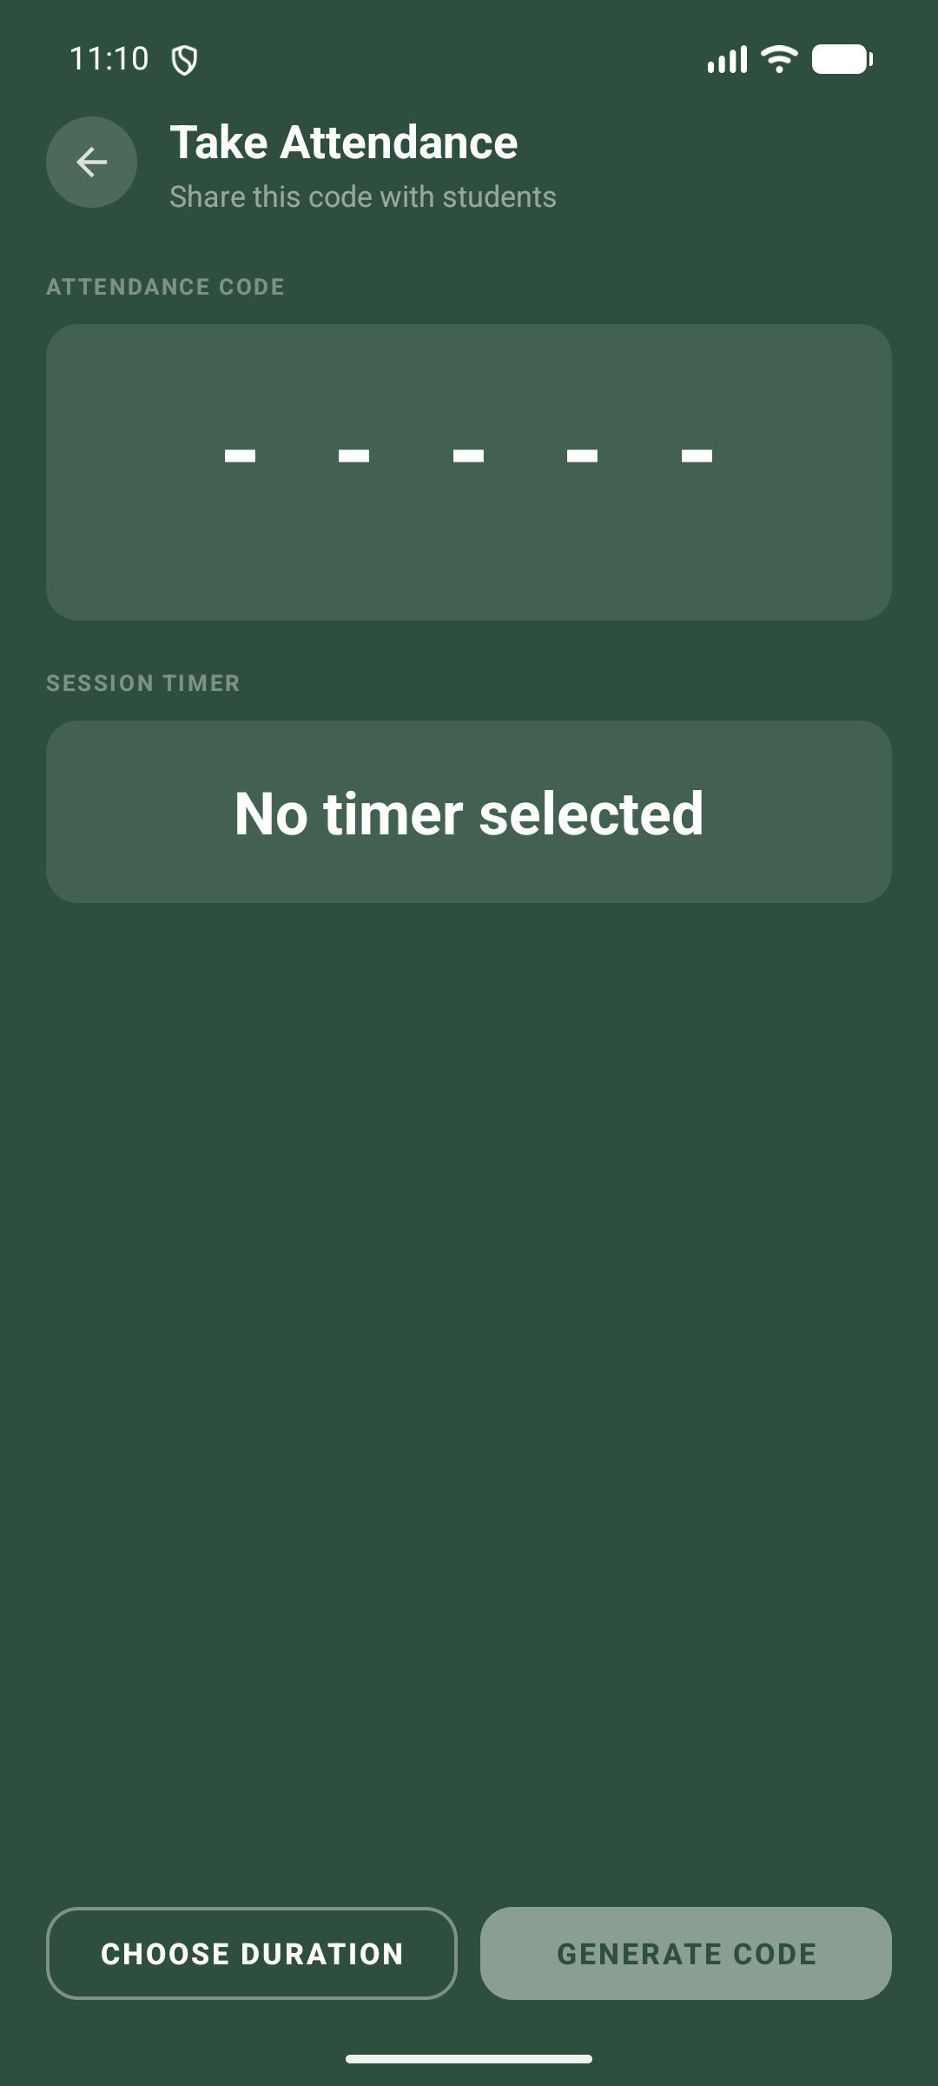
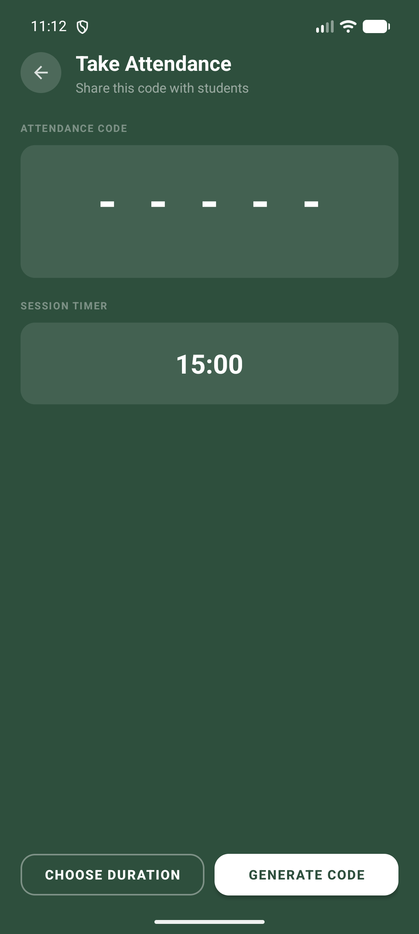
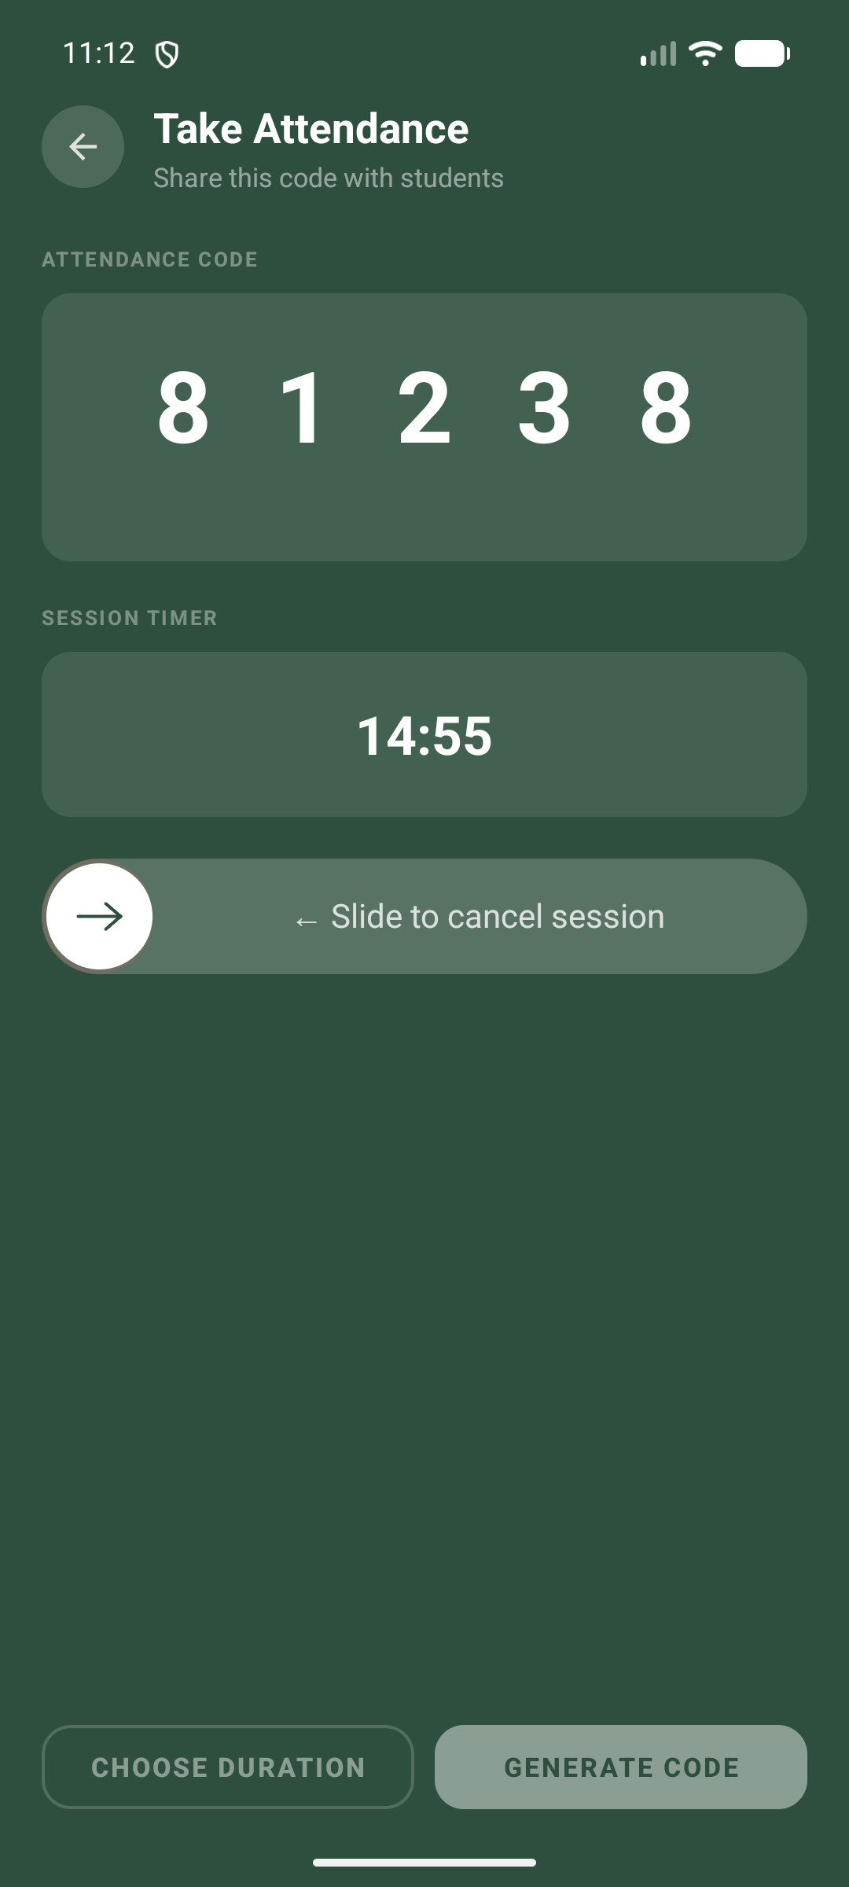
Instructor: starting a session
1
2
3
4
Pick a class
Open Take Attendance
Choose duration
Code + live countdown
Behind the scenes: the timer runs in a foreground service, so the countdown survives screen changes — and slide-to-cancel ends a session early (cancel_session/).
AMS Technical Guide
5

Slide 6
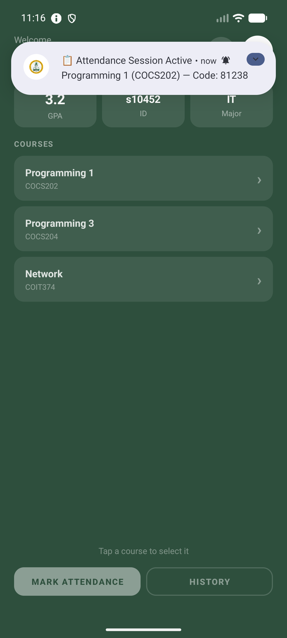
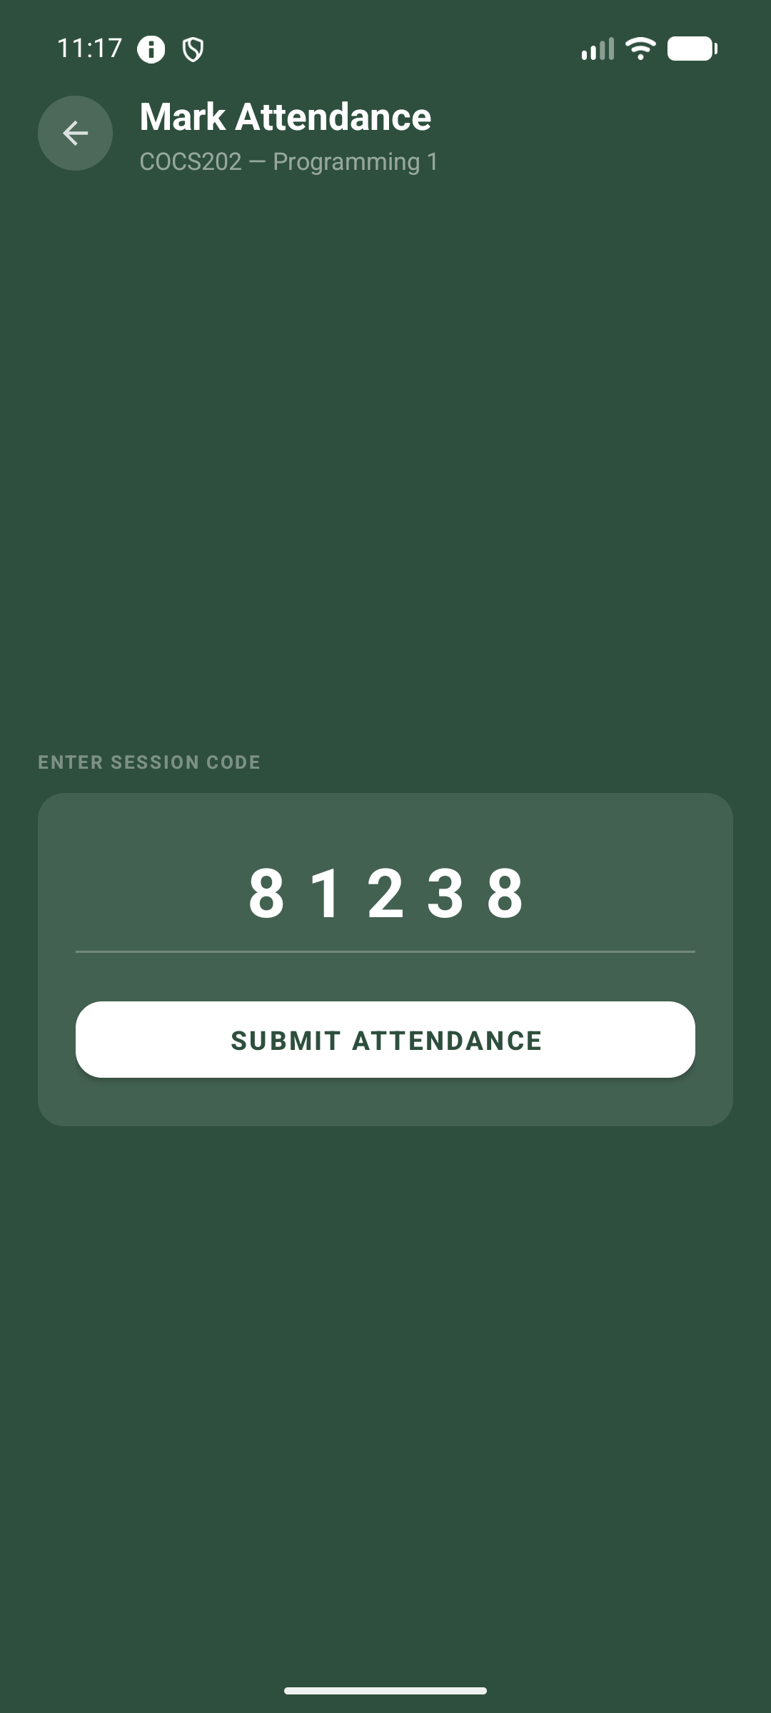
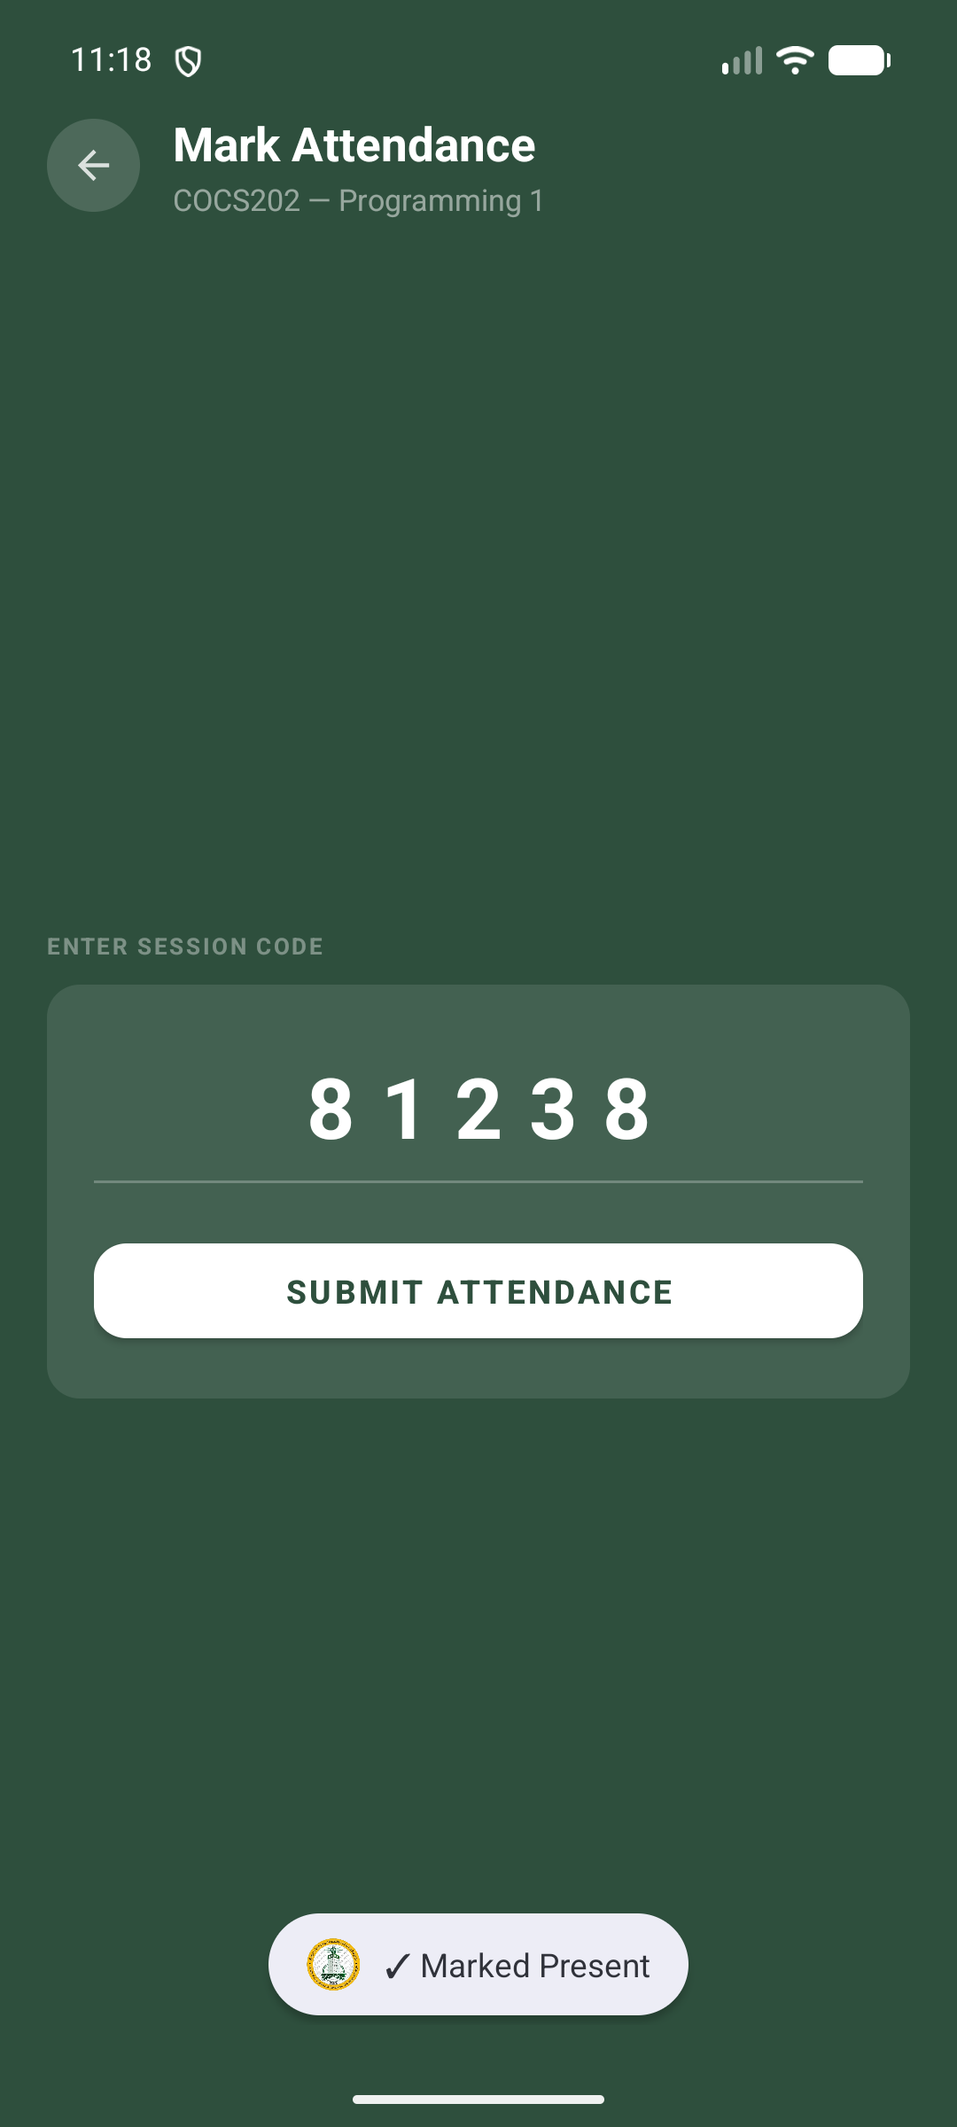
Student: marking attendance
1
2
3
Notification drops in
Code auto-filled
Confirmed — Present
One tap on the notification opens the submit screen with the code pre-filled; a silent receipt confirms Present or Late.
AMS Technical Guide
6

Slide 7

Under the hood: what each step calls
Action | Endpoint | What the server does
Start a session | POST start/ | Inserts a code row; sets the 80% and 100% cutoff times
Notify students | GET active_session/ | Returns the active code — the student app polls every ~5 s
Mark attendance | POST attend/ | Validates the code and records P / L in one transaction
End & auto-absent | POST close_session/ | Bulk-inserts Absent for every student who didn't attend
Cancel early | POST cancel_session/ | Deletes the session's records and expires the code
All requests run over HTTPS; every PL/SQL response is wrapped as {"body": …} and parsed outer-first.
AMS Technical Guide
7

Slide 8
02
How Present / Late / Absent Is Decided
One timing rule, enforced on the server
AMS Technical Guide
8

Slide 9

The 80% / 100% timing rule
0%
80%
100%
PRESENT (P)
LATE (L)
REJECTED
start_time
end_time
expires_at
→ invalid / expired
The two cutoffs (end_time and expires_at) are written to the database when the session starts — so the student's phone clock can't change the outcome.
AMS Technical Guide
9

Slide 10
The four statuses
P
L
A
–
Present
Late
Absent
Pending
Submitted before the 80% cutoff.
Submitted between 80% and 100%.
Never submitted — set when the session closes.
Shown while a session is still active.
Worked example — a 10-minute session
0:00 – 8:00 → Present
8:00 – 10:00 → Late
after 10:00 → Rejected
no submit → Absent at close
AMS Technical Guide
10

Slide 11




Why the rule is reliable
Decided on the server
Atomic submission
The status comes from stored cutoffs, not the client — a student can't fake Present.
attend/ validates and records in one transaction; duplicates are blocked by code.
One time zone
Auto-absent on close
All timestamps use Asia/Riyadh (SYSTIMESTAMP AT TIME ZONE) — no DST drift.
Non-attendees are marked Absent automatically — fair, with no manual roll-call.
AMS Technical Guide
11

Slide 12
03
Database Design
Six related tables on Oracle Database
AMS Technical Guide
12

Slide 13

The six tables
USERS
COURSES
SECTIONS
Accounts & profiles
Course catalog
A course taught by an instructor
id · role · email · name · gpa
course_code · name
section_id · course_code · instructor_id
SECTION_ENROLLMENTS
ATTENDANCE_CODES
ATTENDANCE_RECORDS
Students in each section
One row per session
One row per mark
section_id · student_id
code · section_id · end_time · expires_at
student_id · section_id · code · status · "TIMESTAMP"
AMS Technical Guide
13

Slide 14

How the tables relate
USERS
COURSES
id (PK) role · first/last_name
email · gpa · major
course_code (PK)
name
student / instructor → USERS
SECTIONS
italic = foreign key
section_id (PK) course_code · instructor_id
SECTION_ENROLLMENTS
ATTENDANCE_CODES
ATTENDANCE_RECORDS
enrollment_id (PK) section_id · student_id
code (PK) section_id · end_time · expires_at
id (PK) · student_id · section_id · status
AMS Technical Guide
14

Slide 15

Design decisions & gotchas
Junction table for many-to-many
code is the primary key of the codes table
SECTION_ENROLLMENTS links students ↔ sections — keeps the schema normalized.
Every session is its own row, so the app keeps full per-session history.
"TIMESTAMP" is a reserved word
All times in Asia/Riyadh
It is always quoted in PL/SQL, or Oracle silently fails the insert.
Stored via CAST(SYSTIMESTAMP AT TIME ZONE 'Asia/Riyadh') — consistent & DST-free.
AMS Technical Guide
15

Slide 16
In summary
01
Taking attendance — Instructor generates a timed code → student submits → auto-absent at close.
02
Present / Late / Absent — Decided server-side by the 80% / 100% cutoffs stored when the session starts.
03
Database design — Six related Oracle tables, with code-per-session history and Riyadh timestamps.
5-digit code
80 / 100 split
6 tables
Retrofit + Gson
HTTPS
AMS · King Abdulaziz University — FCITR

