Slide 1
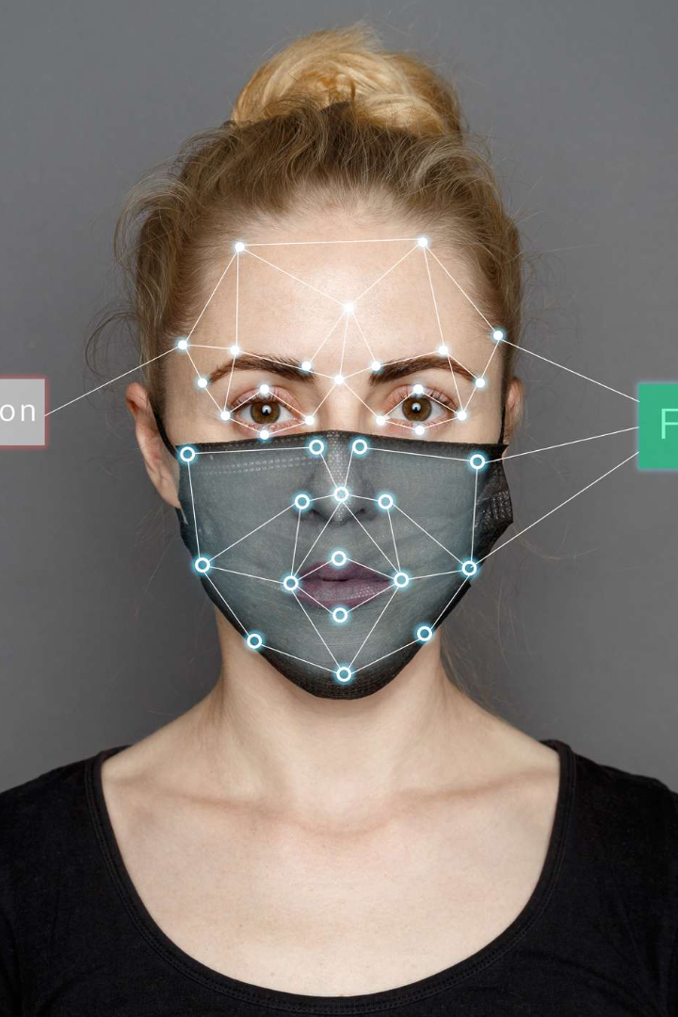
Introduction: Mask Detection with Raspberry Pi
Welcome to our presentation on mask detection using Raspberry Pi. Today, we will introduce our project and team members, as well as give an overview of the goals and implementation details.
AA
by TEAM 8(Code Clan)

Slide 2
Group Members
Azizjon Askarov ID 12214751
Shahzod Jabborov ID 12214744
Group Leader
Product Designer
Firdavs Baxtiyorov ID 12214762
Researcher

Slide 3
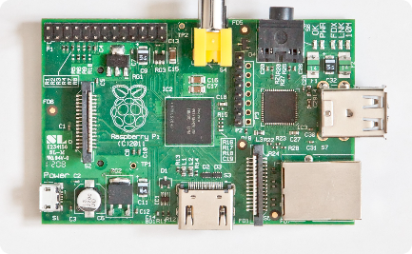
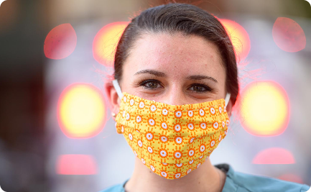
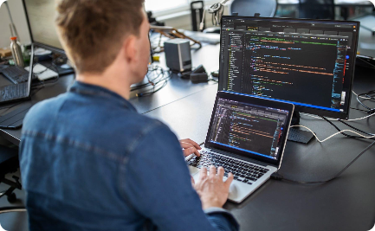
Project Overview
Objectives
Goals
Approach
Design and implement a mask detection system using Raspberry Pi.
Contribute to public health and safety by providing a reliable and efficient solution for mask compliance monitoring.
Utilize computer vision algorithms to detect and analyze the presence of masks in real-time.

Slide 4
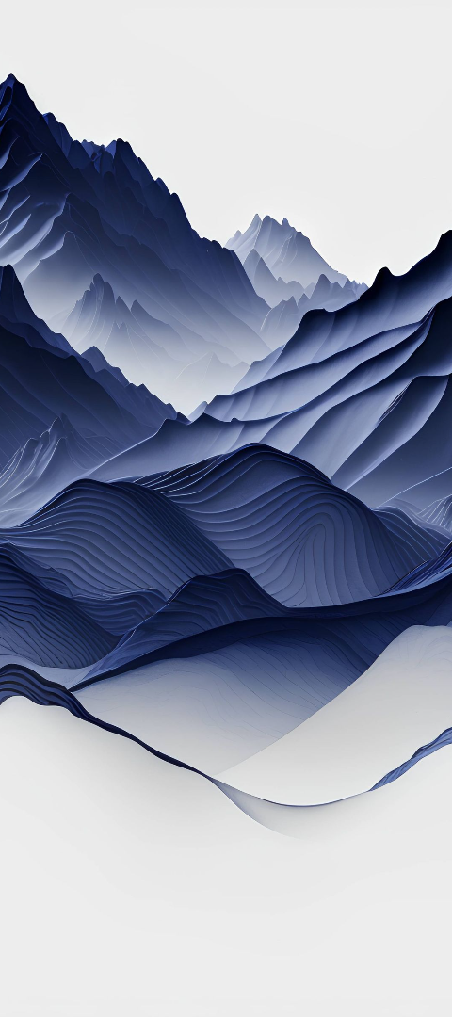
Advanatges
Real-time Monitoring:
Our system offers instantaneous detection and notification of mask compliance, enabling swift responses in public spaces. Using computer vision and machine learning, the system processes live video feeds, identifying individuals without masks or with improper mask usage in real-time. This rapid response capability is crucial for maintaining a safe and healthy environment.A
1
Enhanced Public Safety:
Our project actively contributes to community
health by promoting and enforcing mask-wearing measures. By automatically
identifying and addressing instances of non-compliance, our system acts as a proactive tool in
mitigating the spread of infectious diseases. This emphasis on public safety aligns with current health guidelines and
supports community well-being
2

Slide 5
Results and Impact
Results
Impact
Accuracy of 95% in mask detection
Promoting public health and safety
Real-time notifications for non-compliance
Potential application in various settings, such as schools, airports, and workplaces

Slide 6

Now time to the coding part
import cv2
import numpy as np
# Load face detection model
face_net = cv2.dnn.readNetFromCaffe('deploy.prototxt', 'res10_300x300_ssd_iter_140000.caffemodel')
# Load mask detection model
mask_net = cv2.dnn.readNetFromCaffe('mask_deploy.prototxt', 'res10_300x300_ssd_iter_140000.caffemodel')
# Open the default camera (index 0)
cap = cv2.VideoCapture(0)
while True:
# Capture frame-by-frame
ret, frame = cap.read()
# Resize the frame for faster processing
frame = cv2.resize(frame, (300, 300))
# Perform face detection
blob = cv2.dnn.blobFromImage(frame, 1.0, (300, 300), (104.0, 177.0, 123.0))
face_net.setInput(blob)
detections = face_net.forward()
# Loop over the detections
for i in range(detections.shape[2]):
confidence = detections[0, 0, i, 2]
if confidence > 0.5: # Confidence threshold
box = detections[0, 0, i, 3:7] * np.array([300, 300, 300, 300])
(startX, startY, endX, endY) = box.astype("int")
# Extract the face region
face = frame[startY:endY, startX:endX]
# Perform mask detection
mask_blob = cv2.dnn.blobFromImage(face, 1.0, (224, 224), (104.0, 177.0, 123.0))
mask_net.setInput(mask_blob)
mask_predictions = mask_net.forward()
# Get the index of the prediction with the highest confidence
mask_index = np.argmax(mask_predictions[0])
# Define classes for mask and no mask
classes = ["Mask", "No Mask"]
# Display the result
label = classes[mask_index]
color = (0, 255, 0) if mask_index == 0 else (0, 0, 255)
cv2.putText(frame, label, (startX, startY - 10), cv2.FONT_HERSHEY_SIMPLEX, 0.5, color, 2)
cv2.rectangle(frame, (startX, startY), (endX, endY), color, 2)
# Display the resulting frame
cv2.imshow('Mask Detection', frame)
# Break the loop if 'q' key is pressed
if cv2.waitKey(1) & 0xFF == ord('q'):
break
# Release the camera and close all windows
cap.release()
cv2.destroyAllWindows()

Slide 7
blob = cv2.dnn.blobFromImage(frame, 1.0, (300, 300), (104.0, 177.0, 123.0))
face_net.setInput(blob)
detections = face_net.forward()
# Loop over the detections
for i in range(detections.shape[2]):
confidence = detections[0, 0, i, 2]
if confidence > 0.5: # Confidence threshold
box = detections[0, 0, i, 3:7] * np.array([300, 300, 300, 300])
(startX, startY, endX, endY) = box.astype("int")
# Extract the face region
face = frame[startY:endY, startX:endX]
# Perform mask detection
mask_blob = cv2.dnn.blobFromImage(face, 1.0, (224, 224), (104.0, 177.0, 123.0))
mask_net.setInput(mask_blob)
mask_predictions = mask_net.forward()
# Get the index of the prediction with the highest confidence
mask_index = np.argmax(mask_predictions[0])
# Define classes for mask and no mask
classes = ["Mask", "No Mask"]
# Display the result
label = classes[mask_index]
color = (0, 255, 0) if mask_index == 0 else (0, 0, 255)
cv2.putText(frame, label, (startX, startY - 10), cv2.FONT_HERSHEY_SIMPLEX, 0.5, color, 2)
cv2.rectangle(frame, (startX, startY), (endX, endY), color, 2)
# Display the resulting frame
cv2.imshow('Mask Detection', frame)
# Break the loop if 'q' key is pressed
if cv2.waitKey(1) & 0xFF == ord('q'):
break
# Release the camera and close all windows
cap.release()
cv2.destroyAllWindows()

Slide 8
# Define classes for mask and no mask
classes = ["Mask", "No Mask"]
# Display the result
label = classes[mask_index]
color = (0, 255, 0) if mask_index == 0 else (0, 0, 255)
cv2.putText(frame, label, (startX, startY - 10), cv2.FONT_HERSHEY_SIMPLEX, 0.5, color, 2)
cv2.rectangle(frame, (startX, startY), (endX, endY), color, 2)
# Display the resulting frame
cv2.imshow('Mask Detection', frame)
# Break the loop if 'q' key is pressed
if cv2.waitKey(1) & 0xFF == ord('q'):
break
# Release the camera and close all windows
cap.release()
cv2.destroyAllWindows()

