Slide 1

Todoism
Azizjon

Slide 2
Project Outline
— Introduction
— Data Familiarization
— Data analysis (EDA)
— Preprocessing the data
— Model Development / ML
— Deployment & MLOPS
----Monetization Strategy
— Future Trends and Conclusion

Slide 3
— Introduction
Todoism is a productivity app that helps users organize tasks and increase productivity.
Key areas of focus:
User demographics (age, gender)
User activity (subscription rate, task completion)
Predictive modeling to forecast churn rates and understand factors influencing user retention.

Slide 4
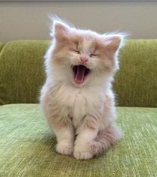
Problem and Solution
Highlight the pain points people face when managing tasks: difficulty staying organized, forgetting tasks, or struggling to prioritize effectively.
Present how Todoism solves these issues by offering a personalized,easy-to-use platform for task management, helping users stay on top of their responsibilities.

Slide 5

Advantages of my todo list
Growth Potential:
The app can evolve with new features, like AI task suggestions or integrations with other productivity tools.
User-Friendly Interface:
Simple and easy-to-use design that allows users to manage their tasks effortlessly.
Personalized Task Management:
Users can categorize tasks, set importance levels, and add notes, providing a tailored experience for managing their to-do lists.
Easy To use even CATS can use it!

Slide 6

Data Familiarization: Data Columns and types
Data Collection and Features:A dataset of 1,000 users with key features:
User ID: Unique identifier for each user.
Gender: User's gender (Male, Female, Other).
Age: User's age (ranging from 18 to 70).
Subscription Rate: Frequency of subscription renewal (e.g., monthly, quarterly).
Contract Length: Duration of subscription (e.g., 6 months, 12 months, etc.).
Completed Tasks: Number of tasks the user has completed.
Total Tasks: Total tasks assigned to the user.
Usage Hours per Week: Average number of hours per week the user spends on the app.
Churned: Whether the user has unsubscribed.
Data Shape:
1,000 rows (users) and 8 columns (features).

Slide 7
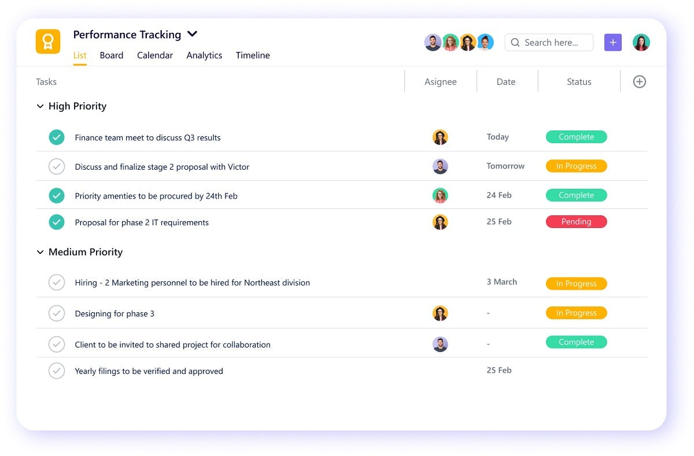

Slide 8
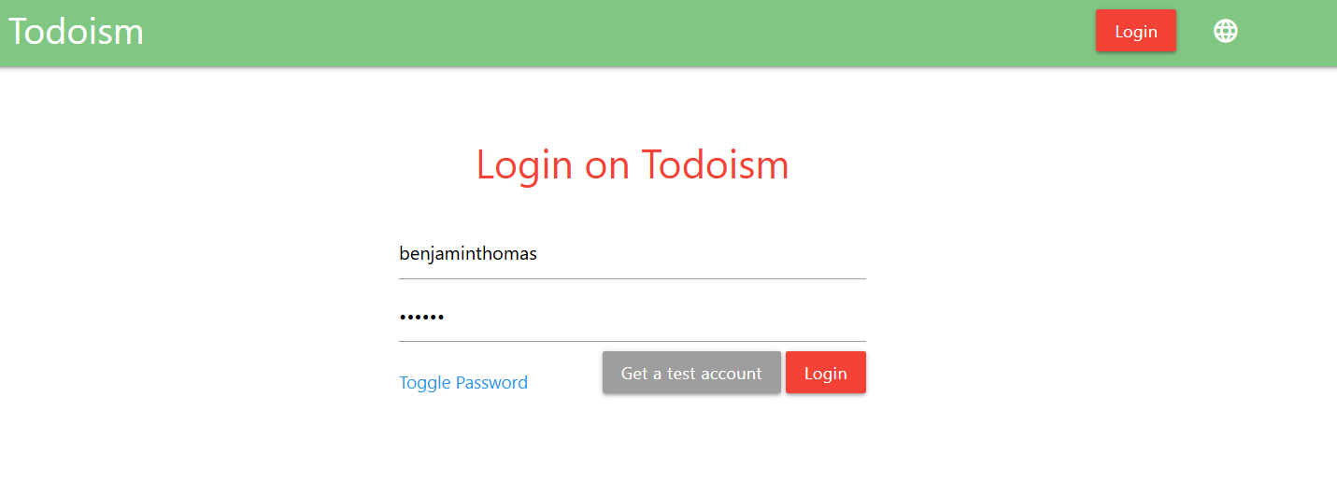
Login informations

Slide 9
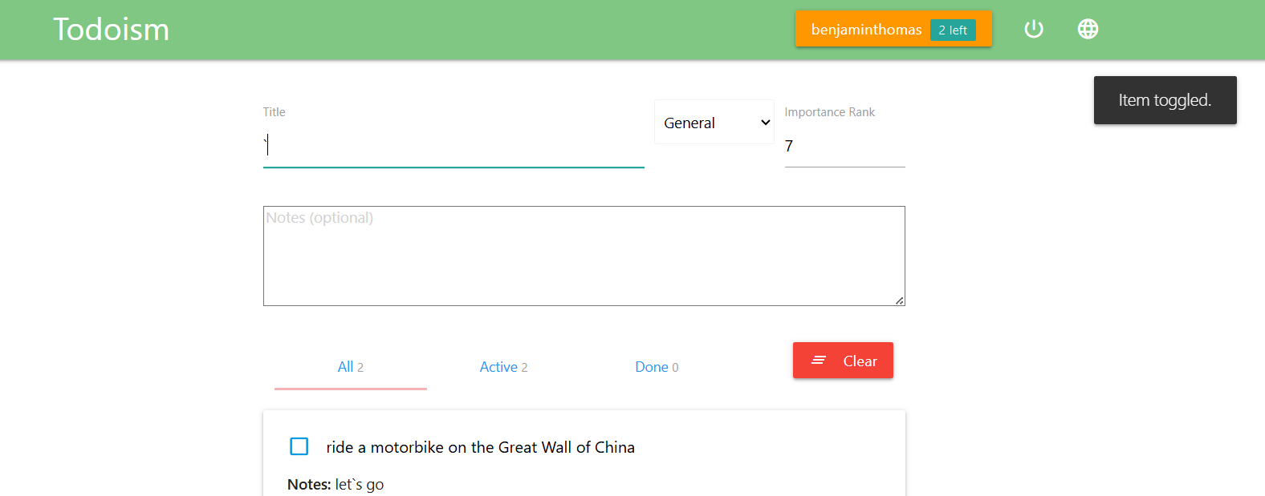
How it works

Slide 10
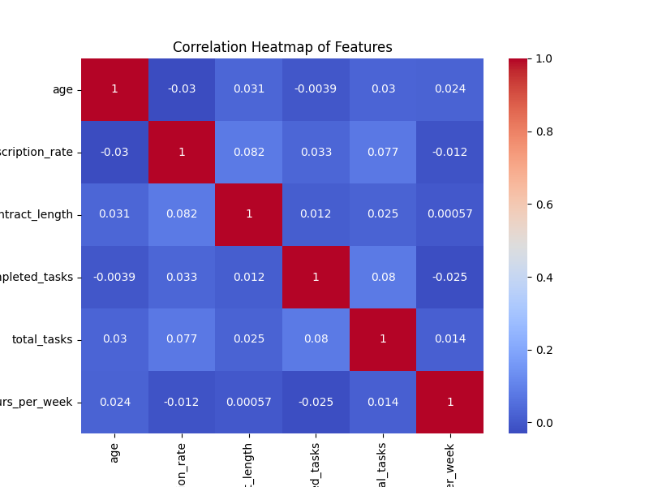
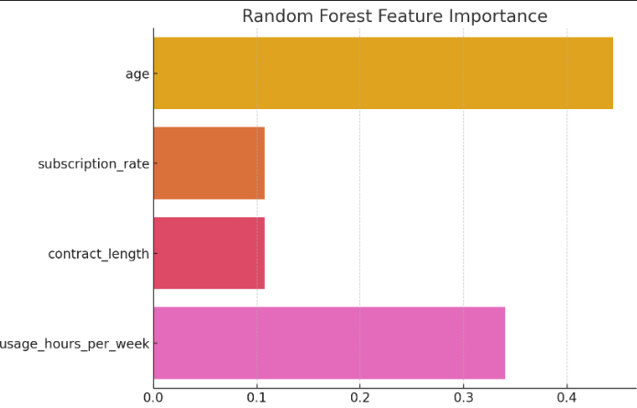
Usage time

Slide 11
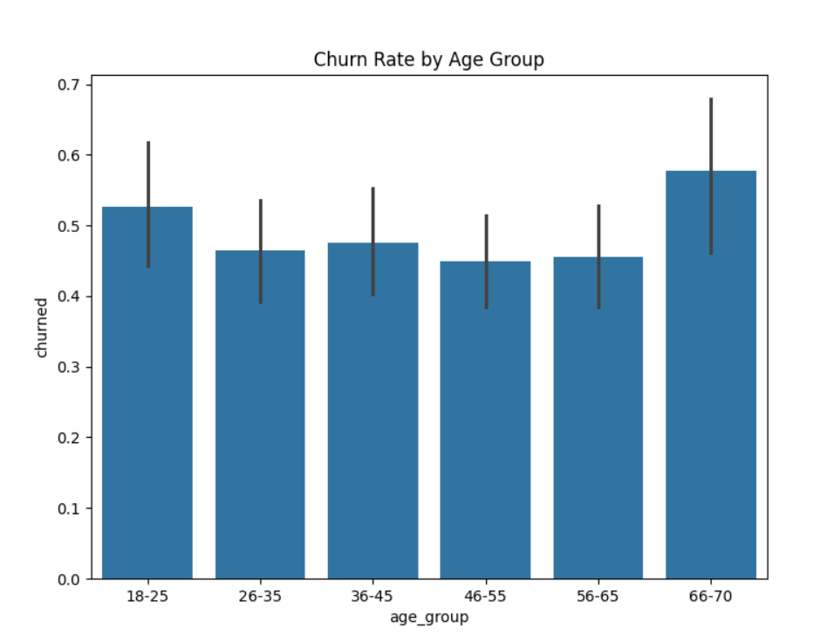
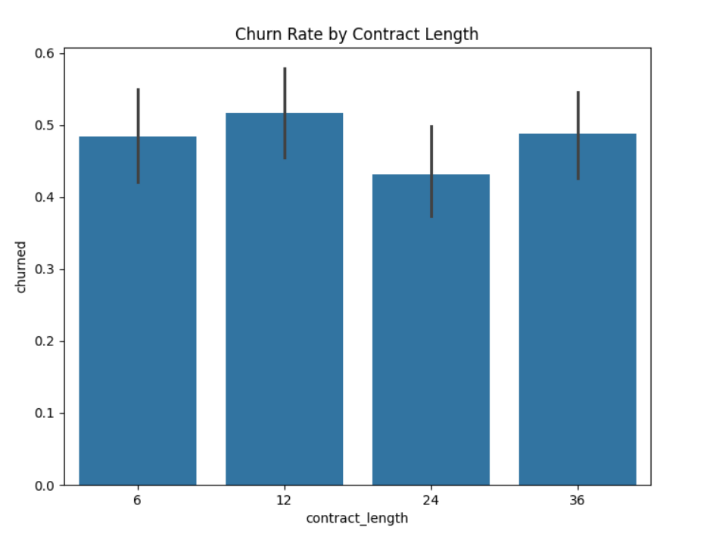
Age group

Slide 12
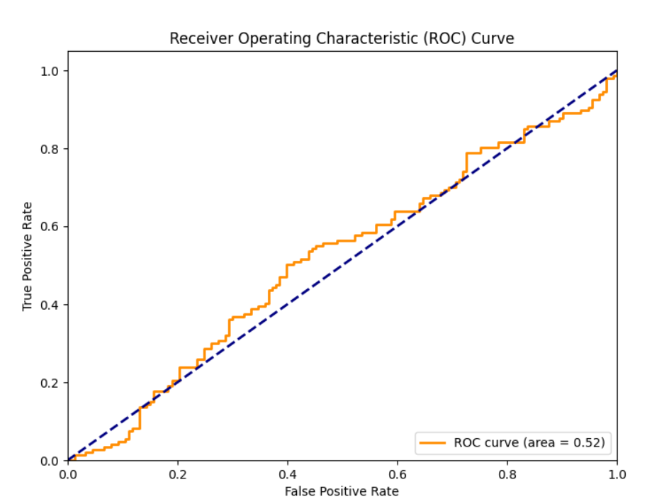
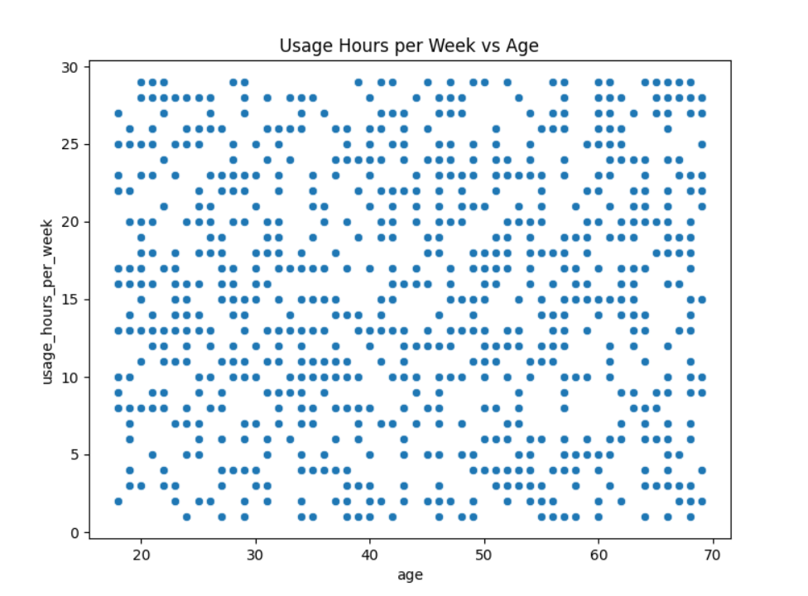
Usage time more precisely

Slide 13
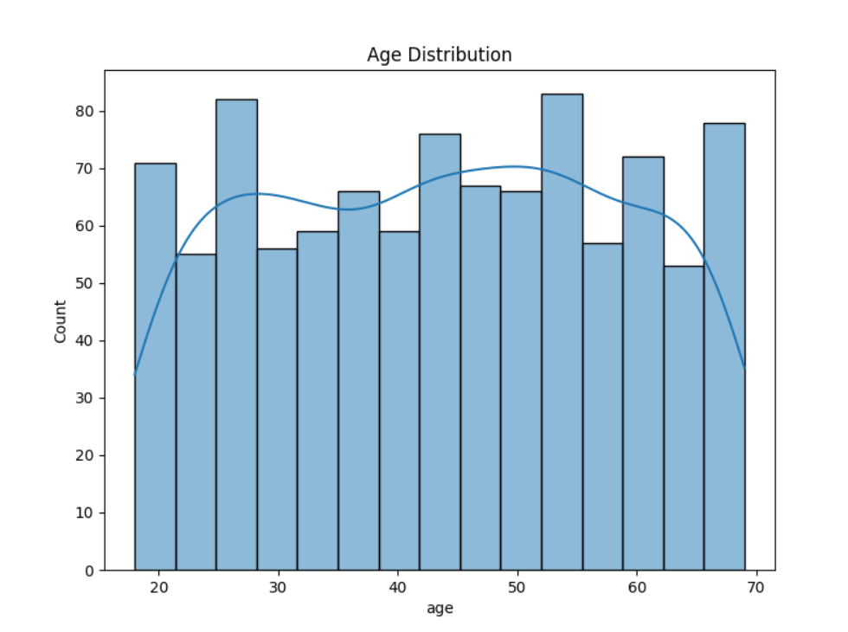
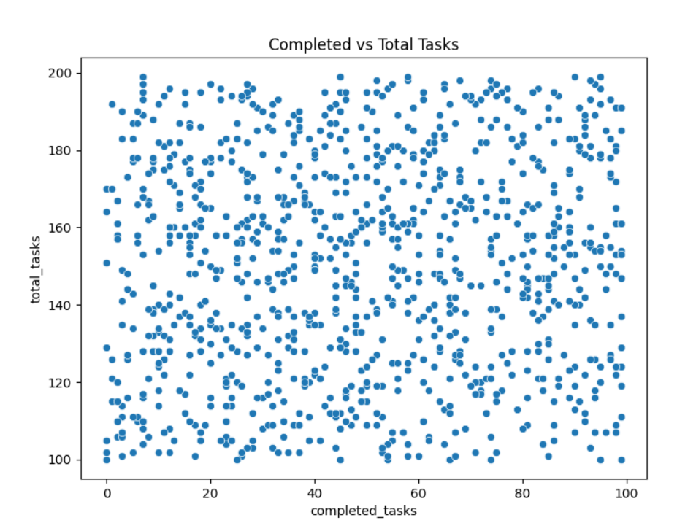
Completed tasks

Slide 14
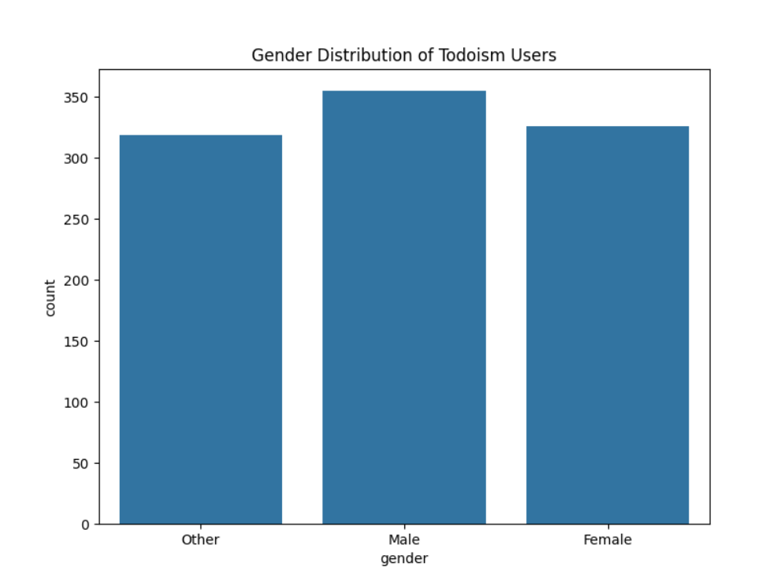
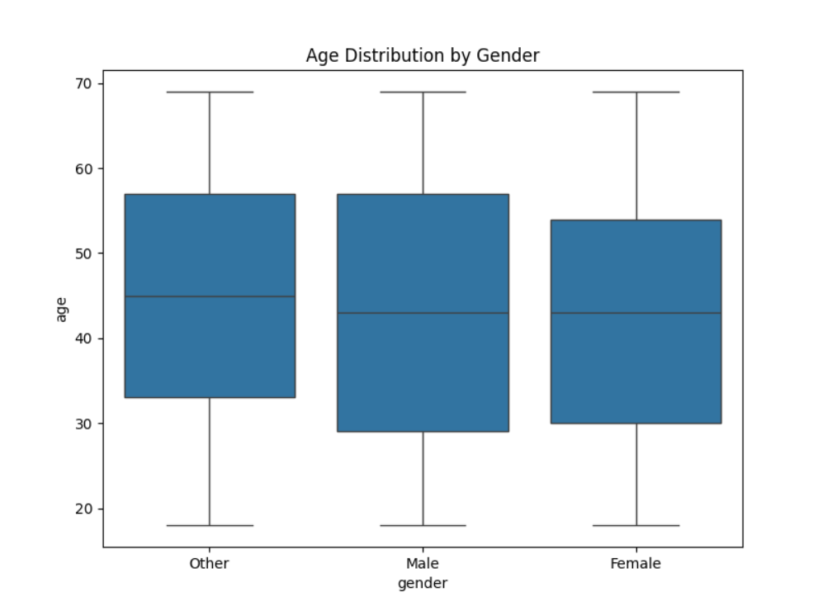
Age distribution by gender

Slide 15
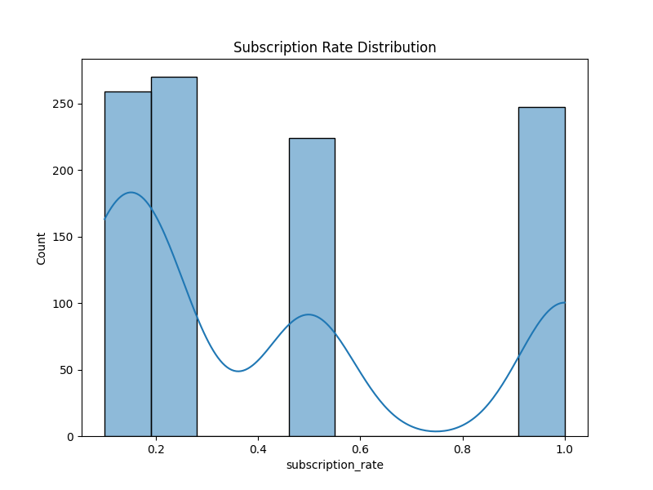
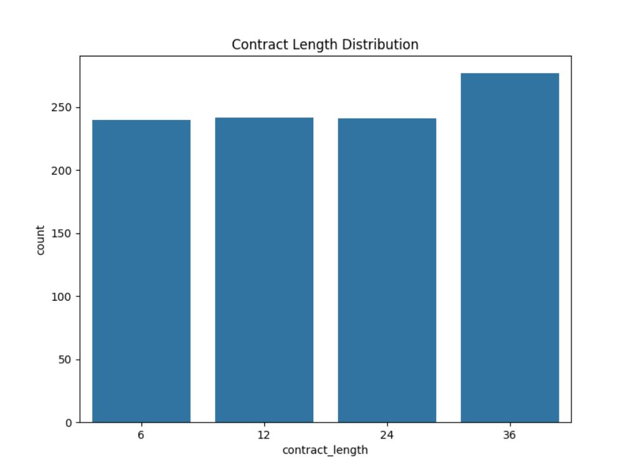
Subscription rate

Slide 16
Coding is like a humor it goes bad when you explain it -unknown

Slide 17

The End

Slide 18
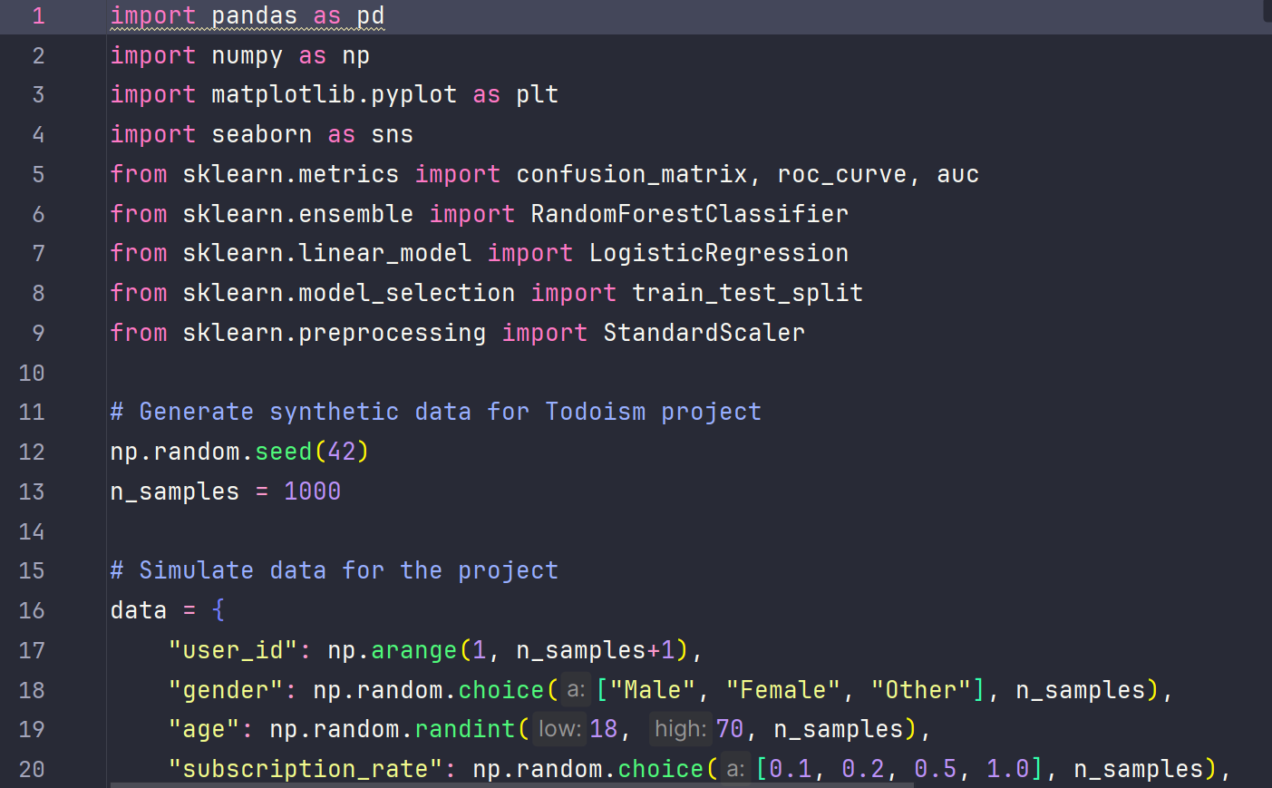
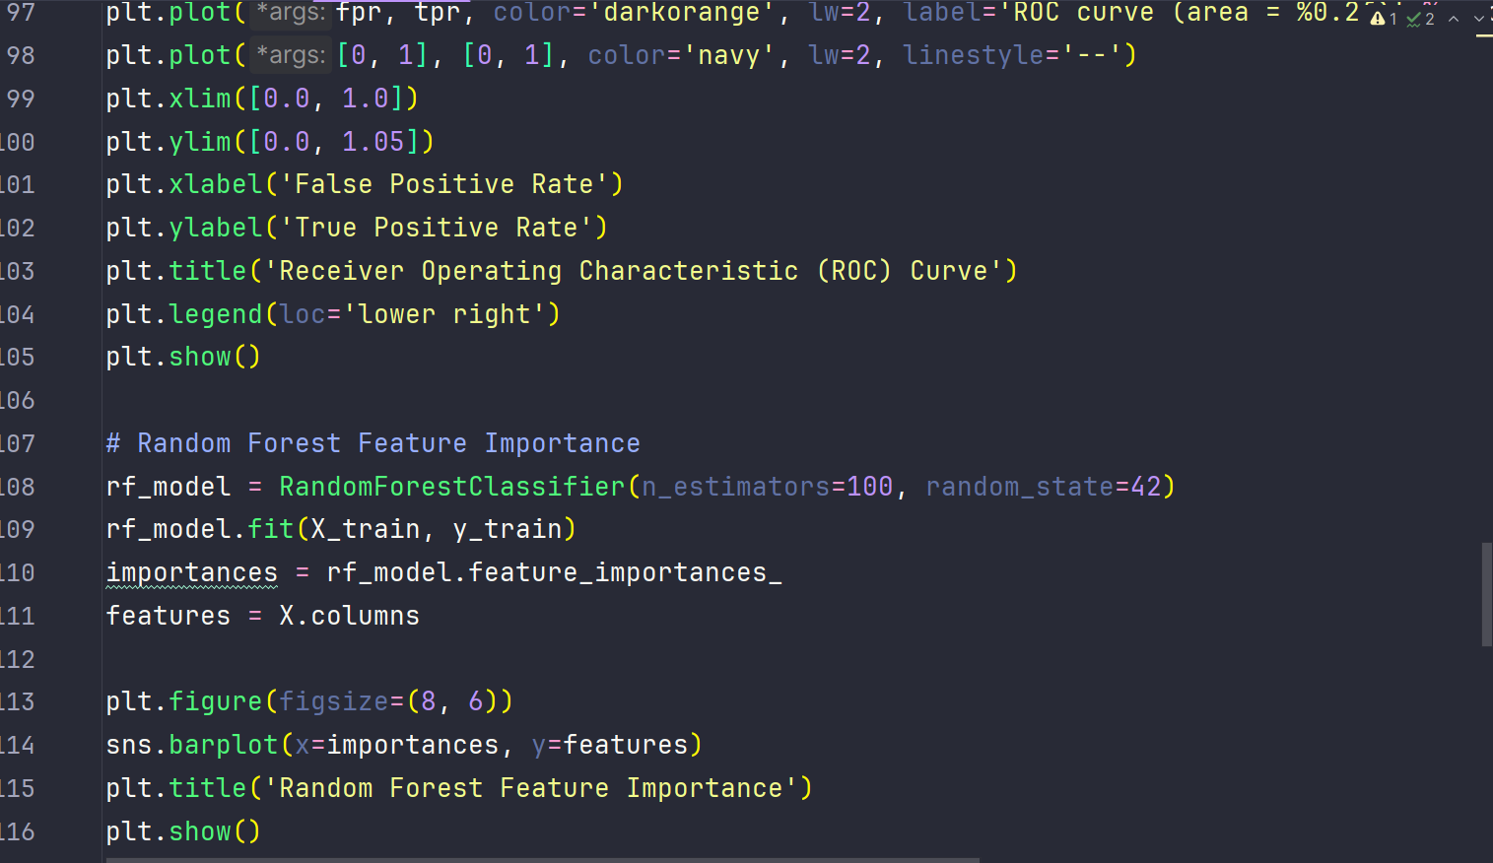
Code

Slide 19
Demo
https://files.fm/u/wjmwxvej6n

Slide 20

Cost of the project
Sleep

Slide 21
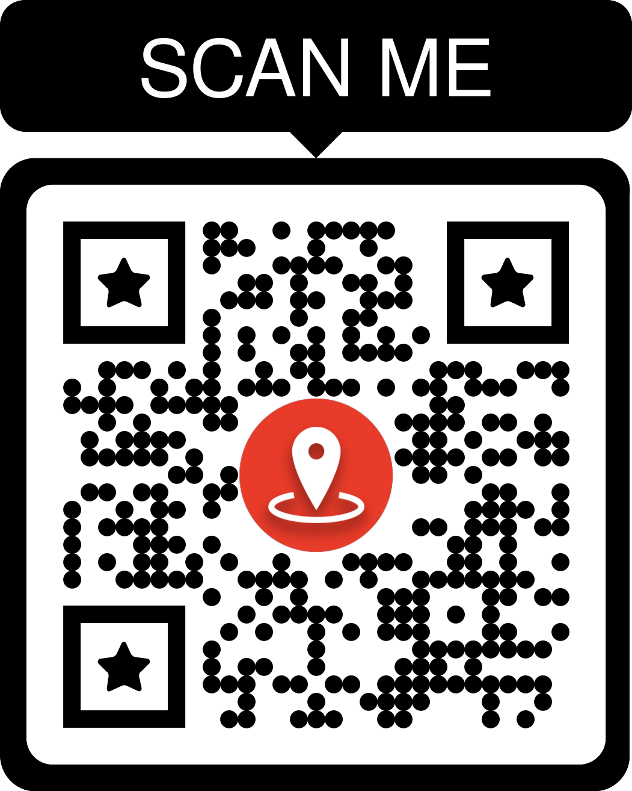
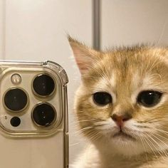
Github Its too long to explain https://github.com/Aziz251984/todolist

Slide 22
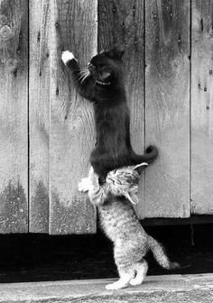
Future plans
Short-term:
Improve the user interface to make it more intuitive and visually appealing.
Integrate additional features, like notifications or reminders for tasks.
Medium-term:
Implement analytics to track user activity and task completion rates.
Expand the app’s functionality with features such as recurring tasks or priority-based task sorting.
Long-term:
Launch a mobile app version for iOS and Android to reach a broader audience.
Integrate AI-driven recommendations for task management based on user behavior.

Slide 23
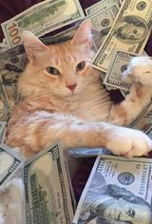
Monetization Strategy:
Freemium Model: Offer basic features for free, with premium features available in a paid version (e.g., task analytics, unlimited categories, or advanced notifications).
Subscription Service: Monthly or yearly subscription plans for users who want advanced features.

Slide 24


Questions? Really after all this? Reach to your goals with TODOISM

