Slide 1
Representing shapes as Latent Codes
Milestone presentation
Yahya Hefnawi, Aziz ben Ali 19.12.2024

Slide 2
Outline
Motivation
Brief introduction
Experiments
Results
Summary
Next steps
Questions

Slide 3
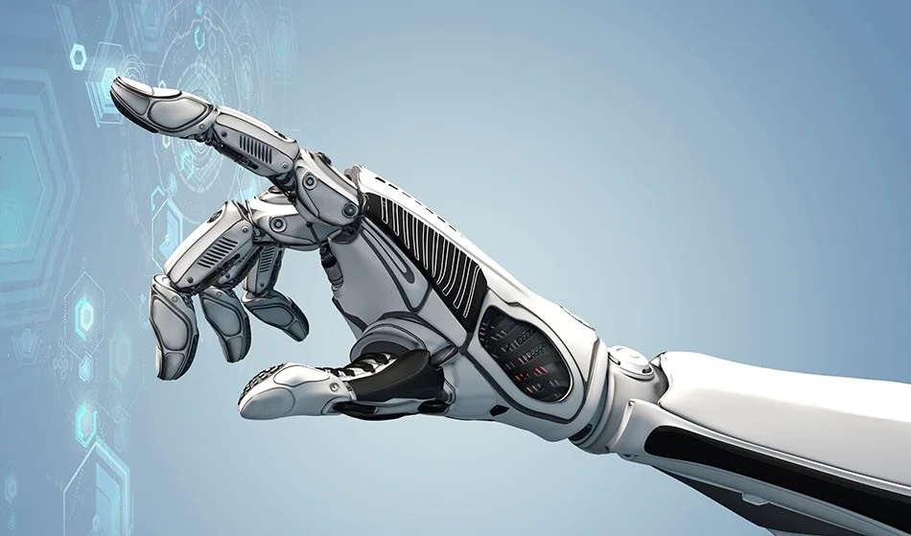
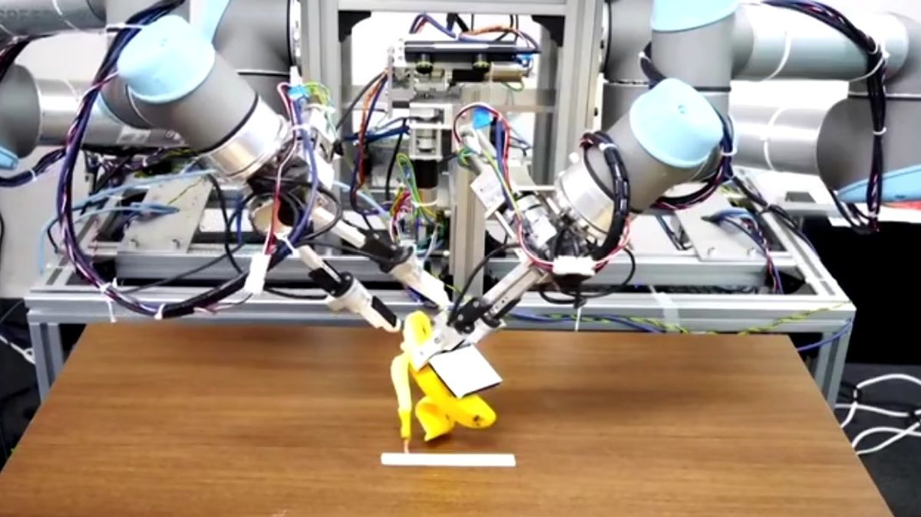
Motivation
3D representations and Grasping
Important for grasping tasks (e.g robot peeling a banana)
Enables robots to understand and adapt to complex geometries
Narrows down the gap further between humans and robots
Image source: AZoSensors (https://www.azosensors.com/article.aspx?ArticleID=32)
Source: VOI (https://voi.id/en/technology/154974)

Slide 4

!
High computational cost
Robot Exhausted
*Image source: 123RF (https://www.123rf.com/free-vector_52730758_exhausted-robot.html)

Slide 5
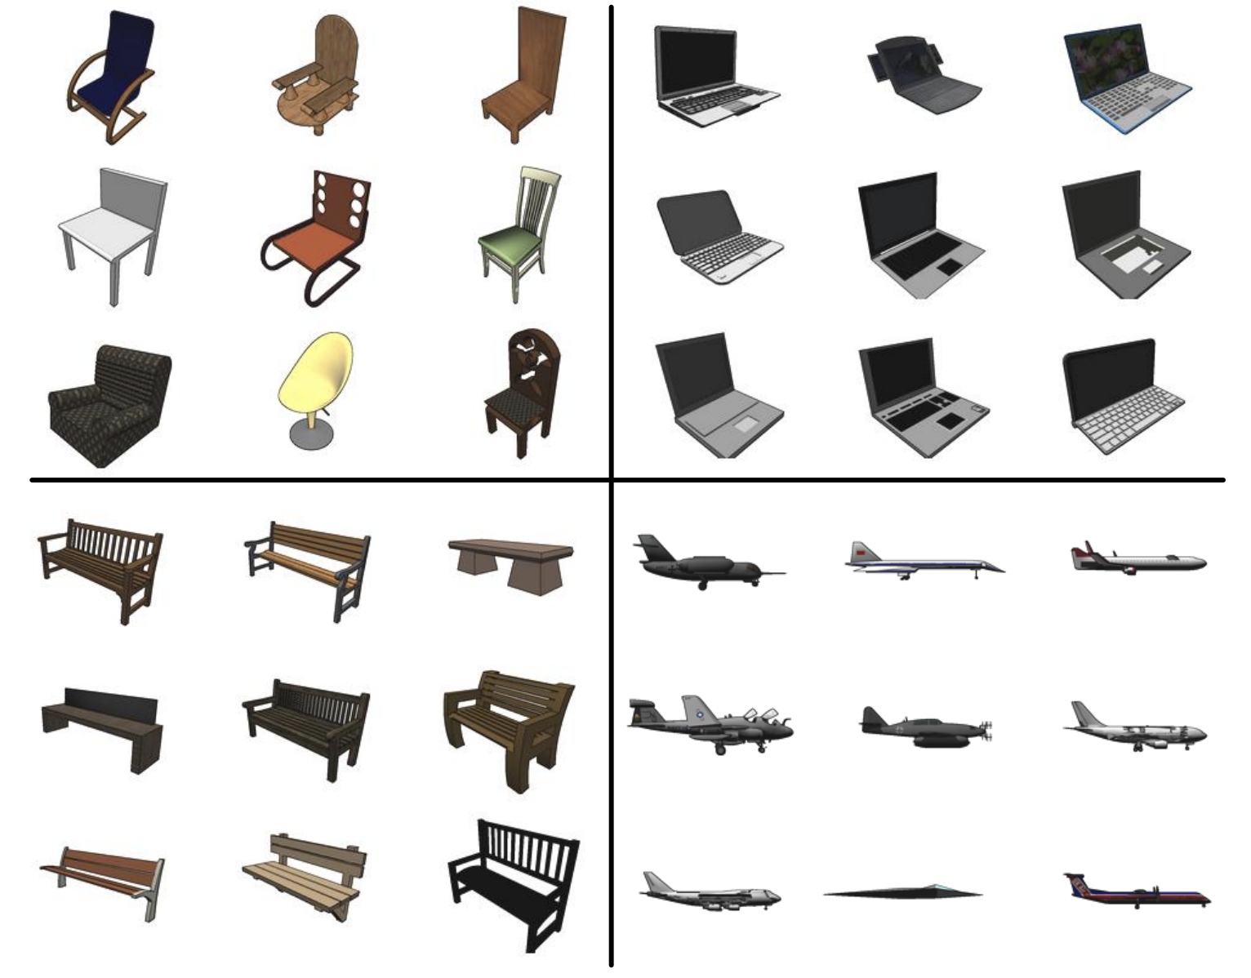
Can we represent 3d objects in a compact way?
  Latent space
Image source: Arxiv (https://arxiv.org/pdf/1512.03012v1)

Slide 6
Introduction to DeepSDF architecture
X
Y
Z
SDF value
Latent Vector
Latent representation

Slide 7
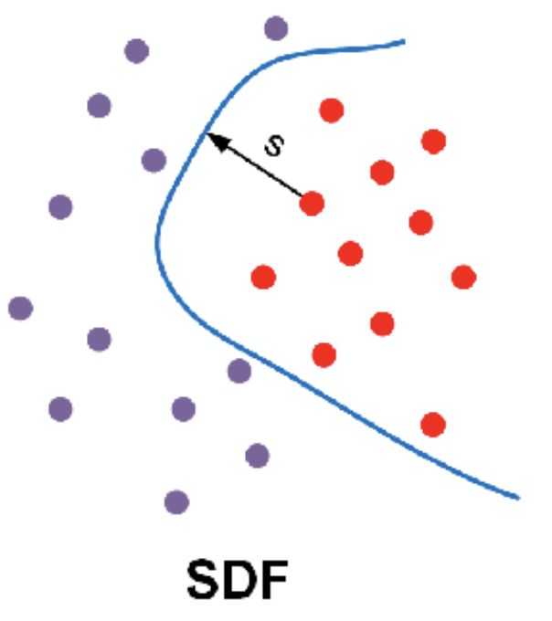
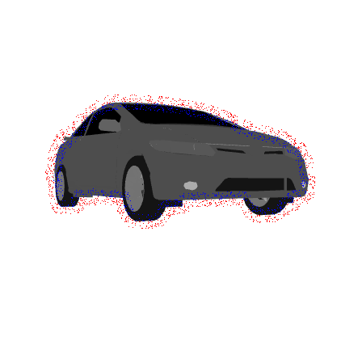
Introduction to DeepSDF architecture
X
Y
Z
SDF value
Signed distance function
Latent Vector
Latent representation
Experiment on one of the cars from shape net
*Image source: ResearchGate (https://www.researchgate.net/figure/The-comparison-between-original-SDF-and-SDF-with-the-tolerance-parameter-e-With-the_fig2_346788625)

Slide 8
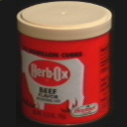
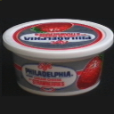
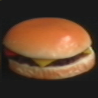
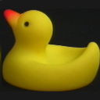

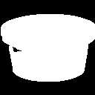
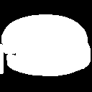
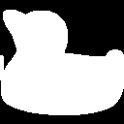
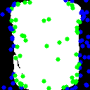
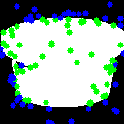
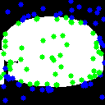
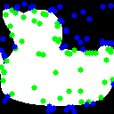
Experiment 1 - coil 100
Images
Binarized Masks
Binarized Masks
With SDF values

Slide 9
Experiment 1 - coil 100
Images
Binarized Masks
Binarized Masks
With SDF values
Model fails to generalize

Slide 10
Experiment 2 - Fashion Mnist
Edge detection and binarization of images fail

Slide 11
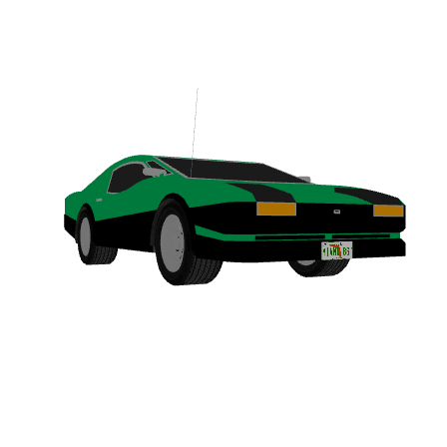
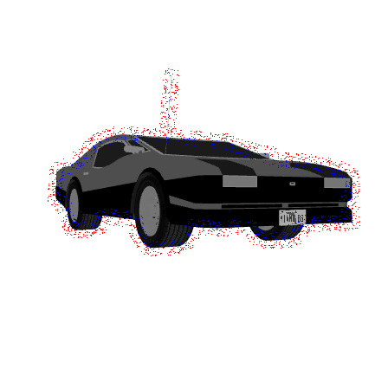
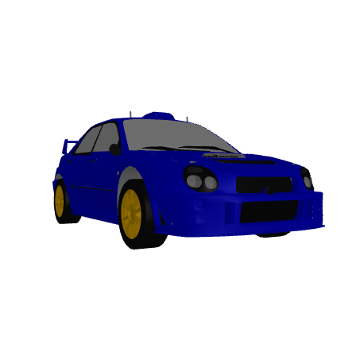
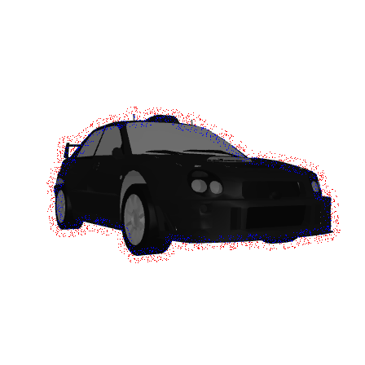
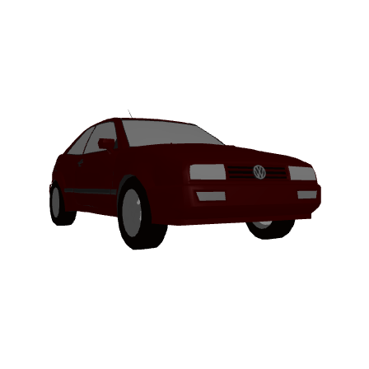
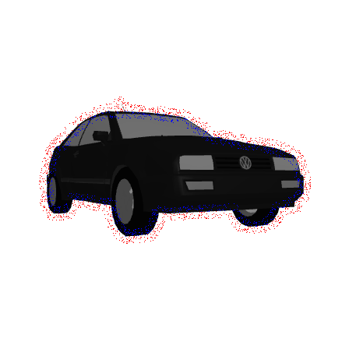
Experiment 3 - 2D version of shapeNet (Cars)
X
Y
DeepSDF
SDF value
Latent Vector
Model succeeds
Latent representation

Slide 12
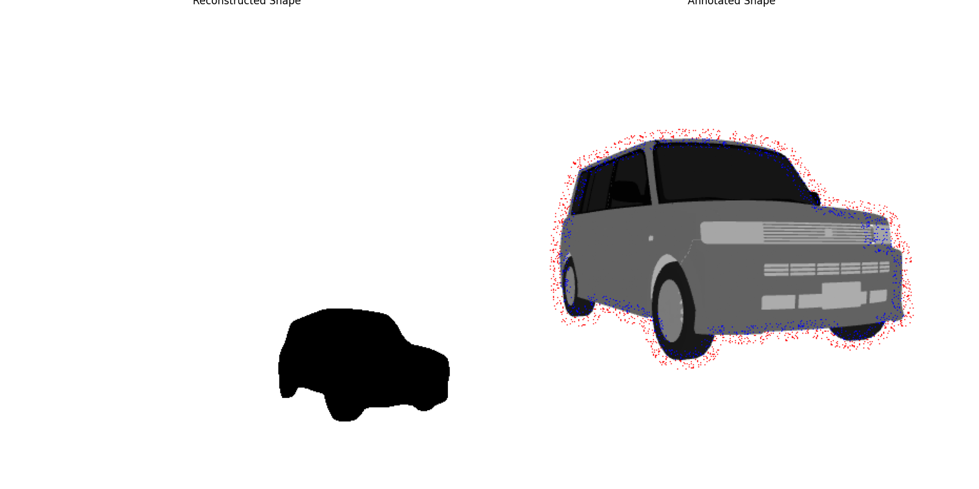
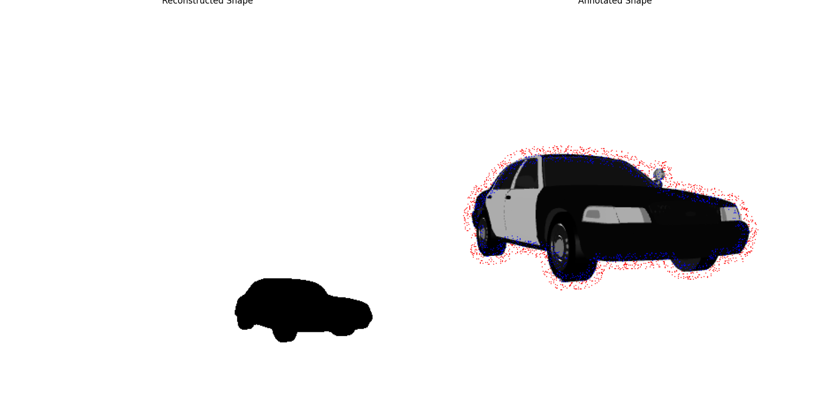
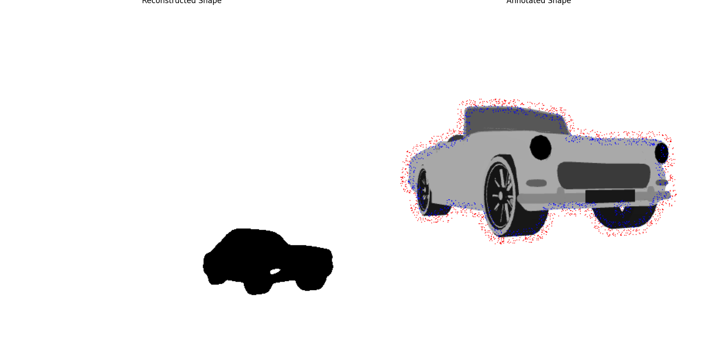
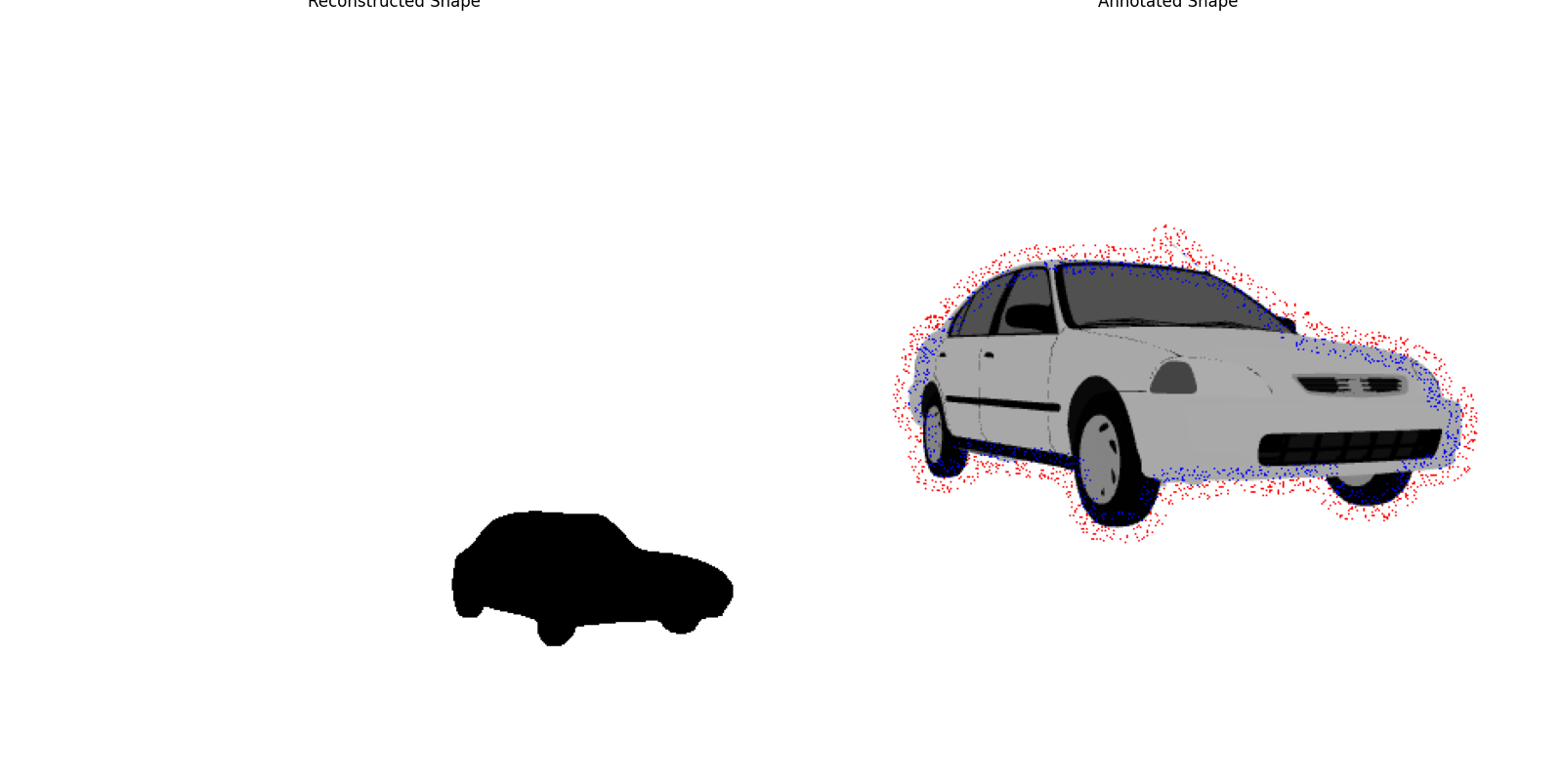
Results 1 - cars class
Test data (Unseen data)

Slide 13

Latent space - A closer look

Slide 14
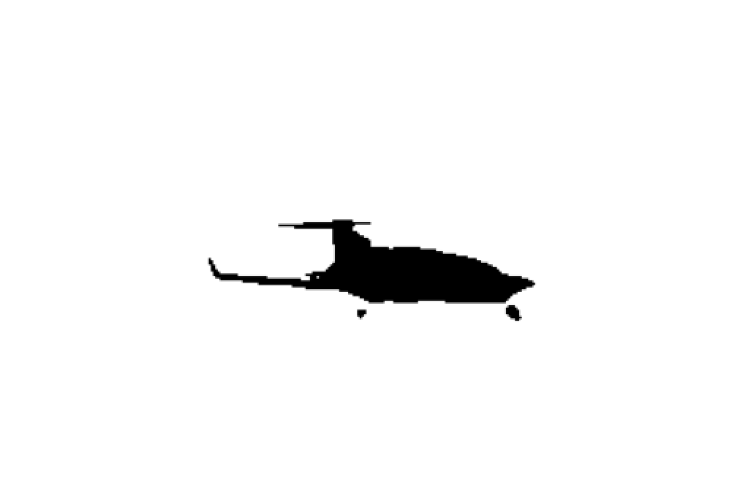
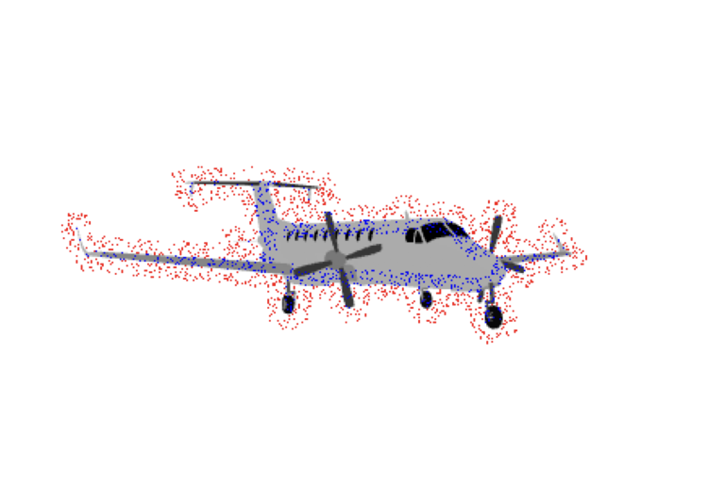
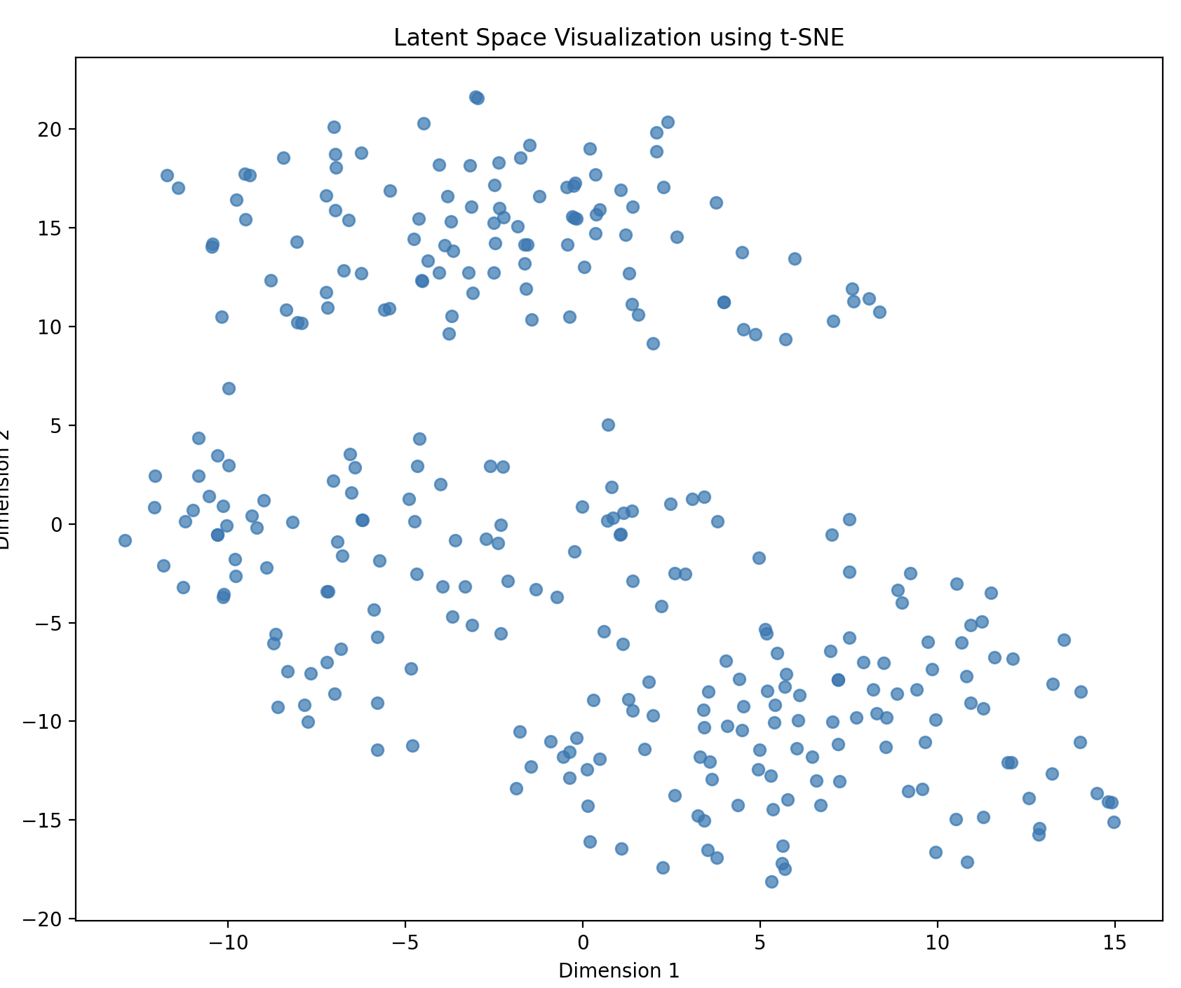
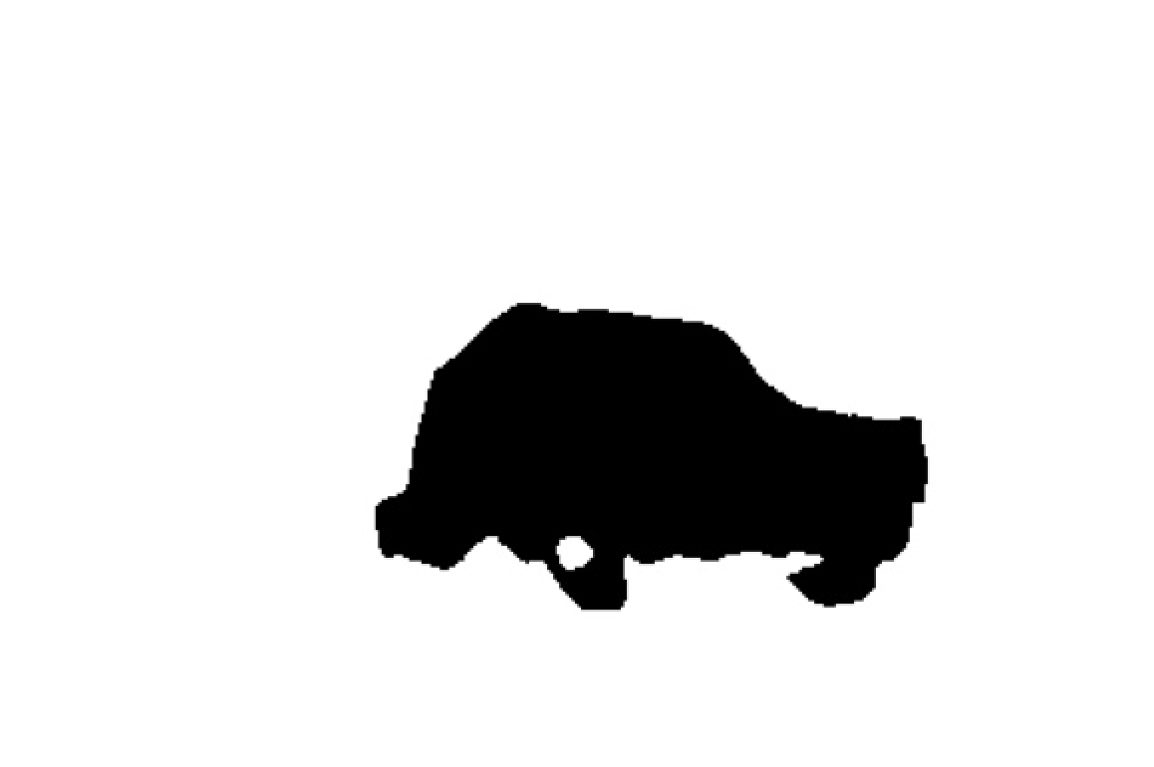
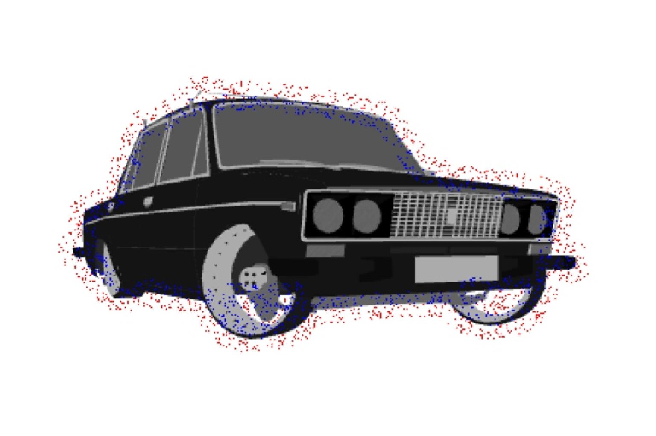
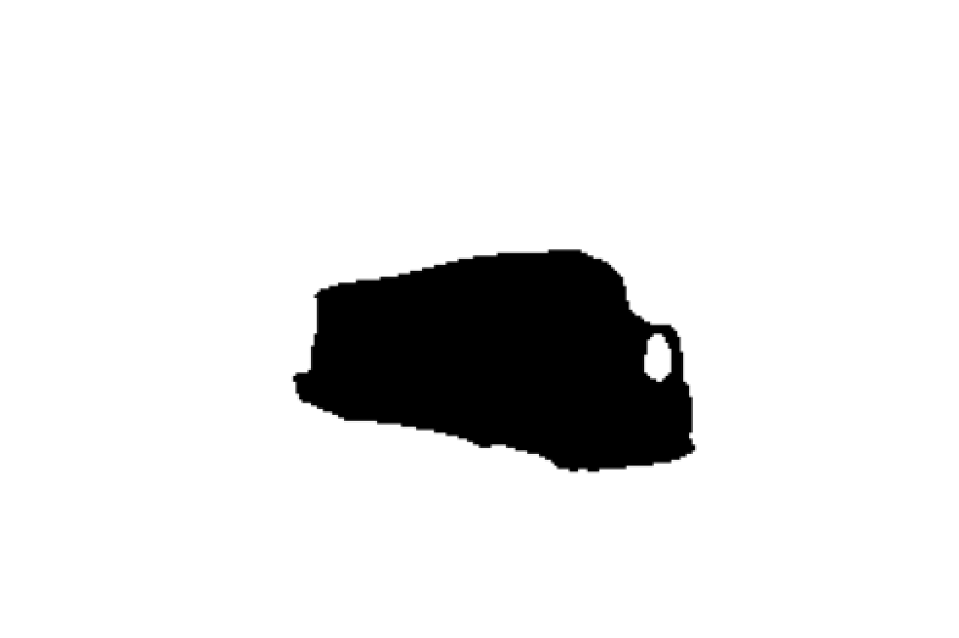
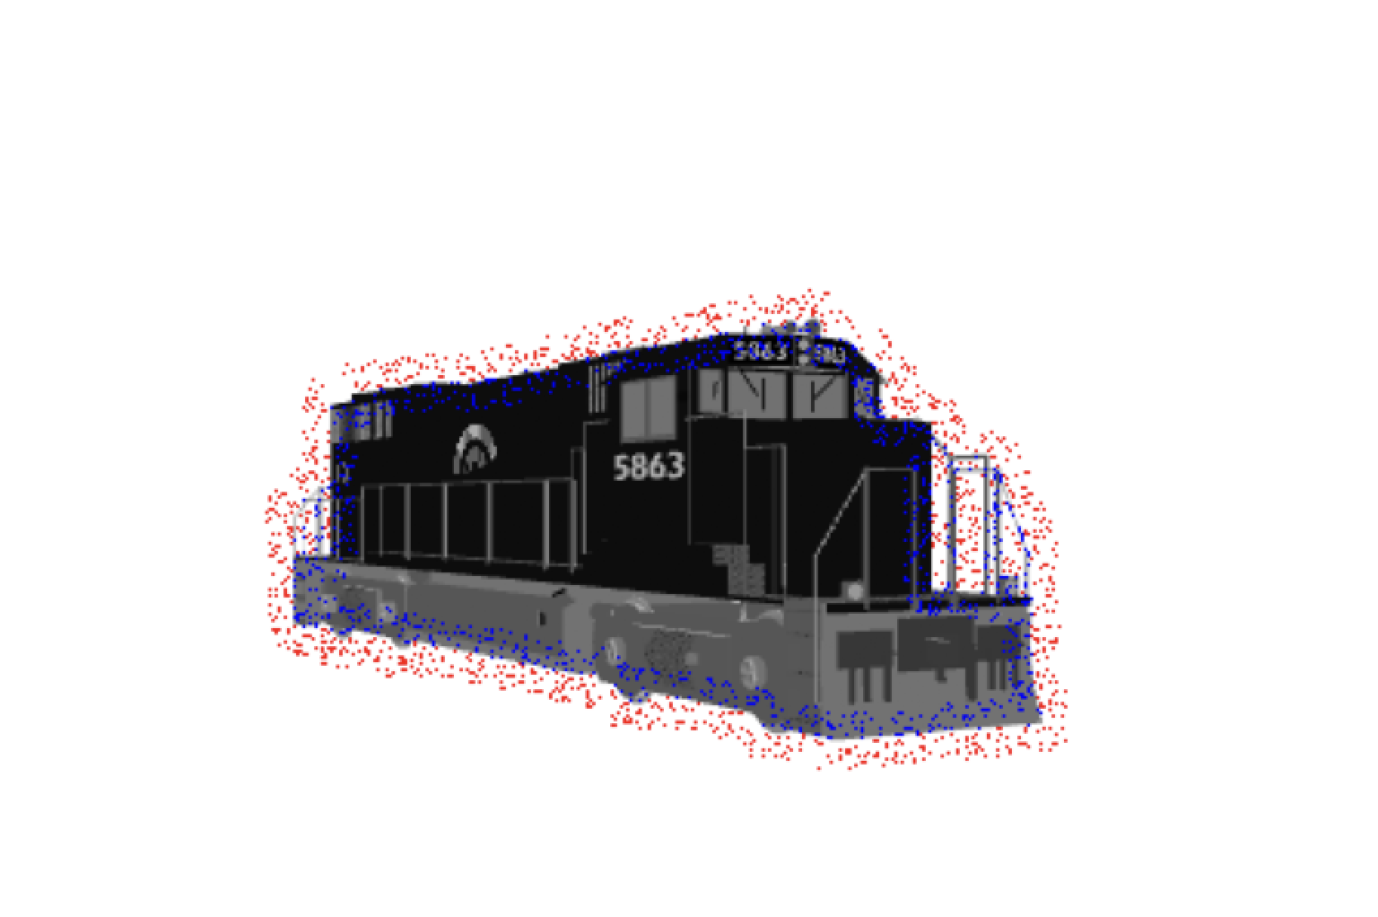
Experiment 4 - 2D version of shapeNet (Multi-class)
Trained on Cars, Airplanes and trains
Closer look on the Latent space

Slide 15
Latent space - A closer look (Multi-class)

Slide 16

Summary
Conducted multiple experiments on different datasets (i.e coil 100, fashionMnist, and different classes of 2d shape net)
Tested the model on unseen data
Visualised how the model interpolates between points in training data. (Probability distribution captured and latent space succeeds to generalise)
Happy robot
*Image source: Stable Diffusion Web (https://stablediffusionweb.com/image/17873125-happy-blue-robot-clipart-design)

Slide 17
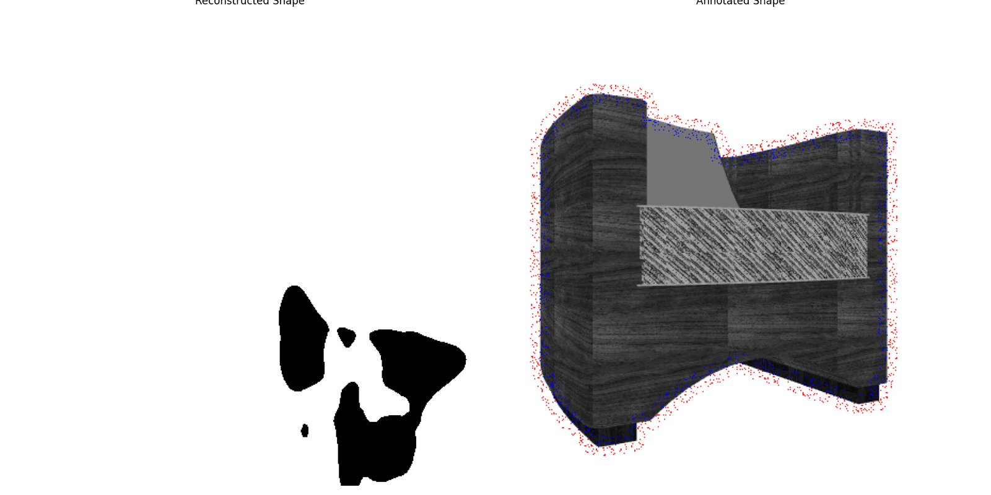
Next steps
Improve the multi-class model on different classes.
Bayesian inference to calculate uncertainty
Extend to 3d shapes
Undergoing experiment

Slide 18
Questions

Slide 19
Thank You

Slide 20
References
DeepSDF: Learning Continuous Signed Distance
Functions for Shape Representation

