Slide 1
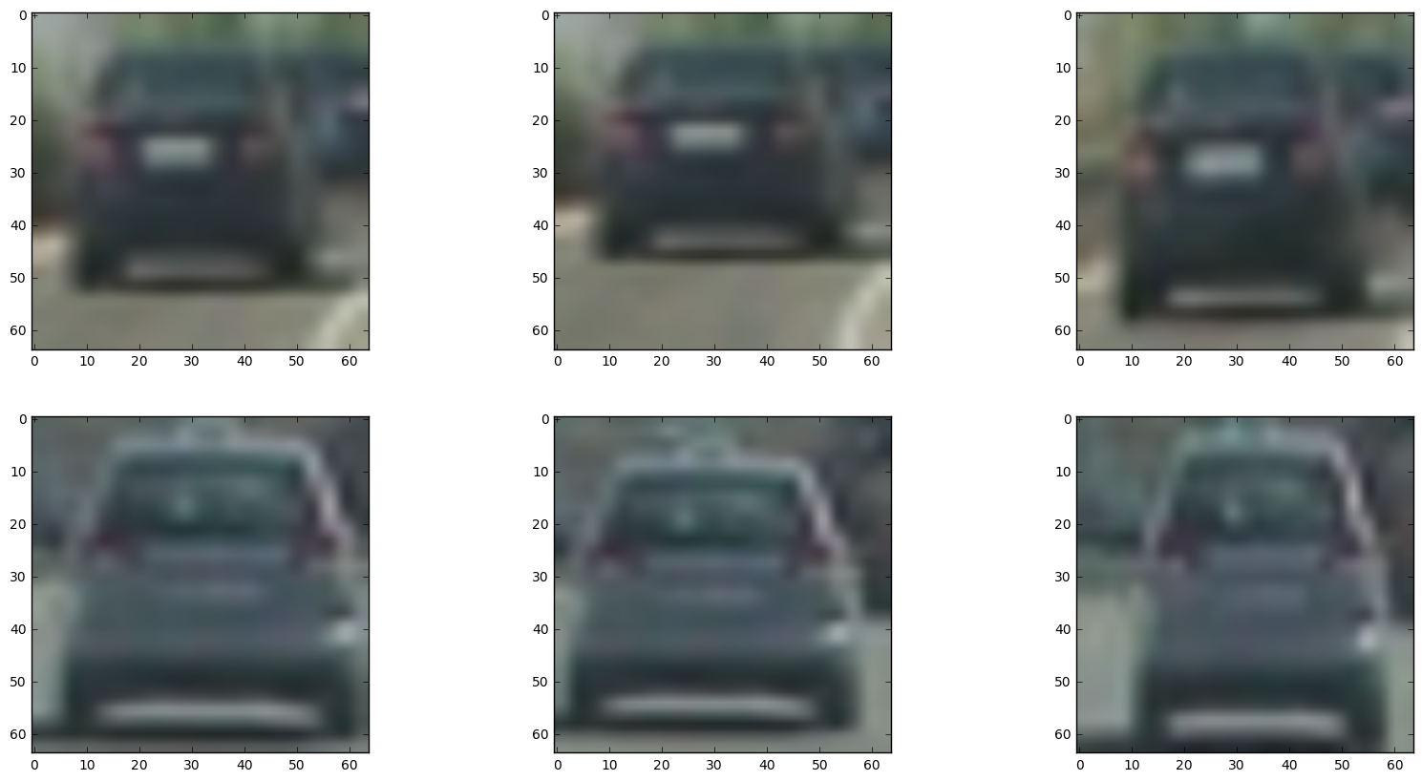
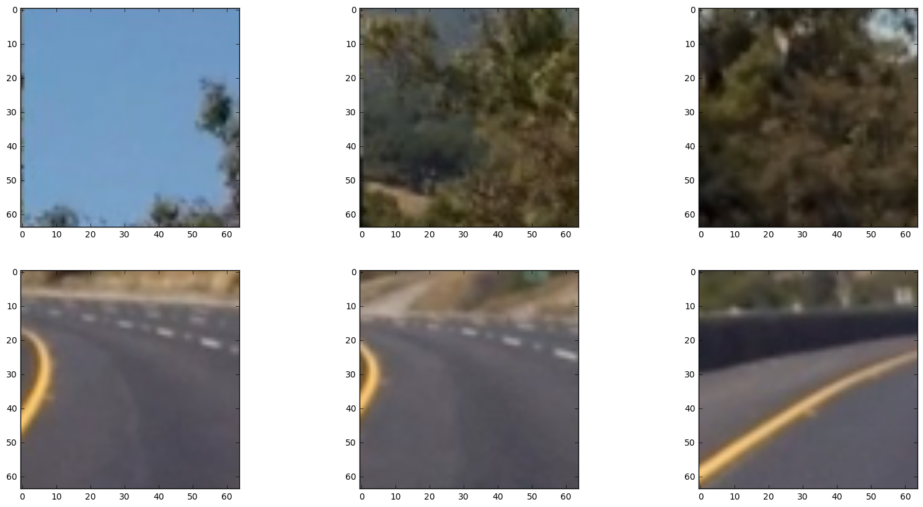
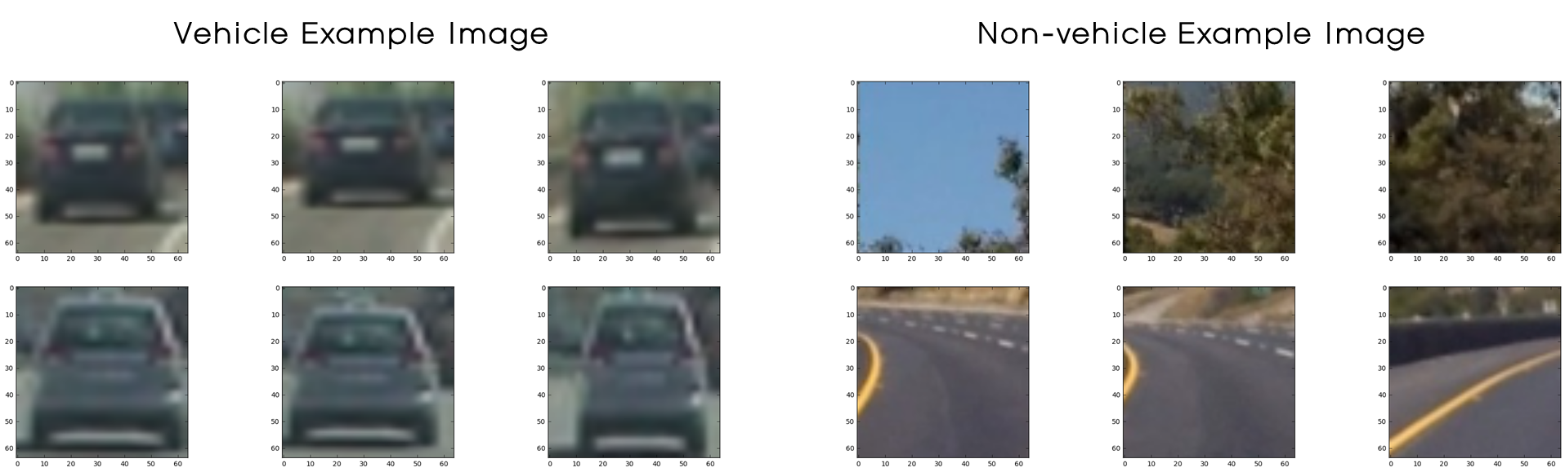
Vehicle Example Image
Non-vehicle Example Image

Slide 2
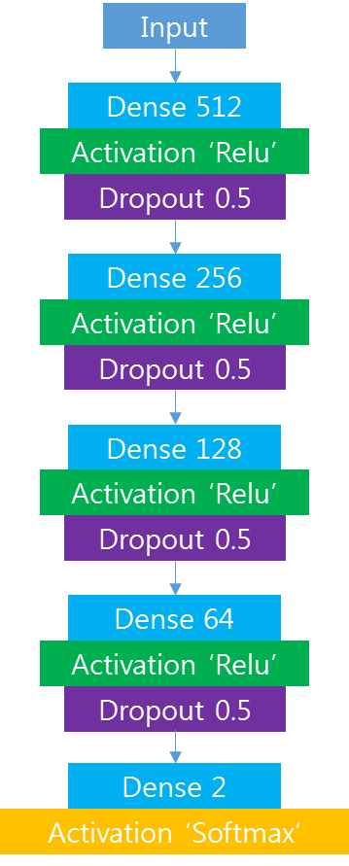
Input
Dense 512
Activation ‘Relu’
Dropout 0.5
Dense 256
Activation ‘Relu’
Dropout 0.5
Dense 128
Activation ‘Relu’
Dropout 0.5
Dense 64
Activation ‘Relu’
Dropout 0.5
Dense 2
Activation ‘Softmax’

Slide 3
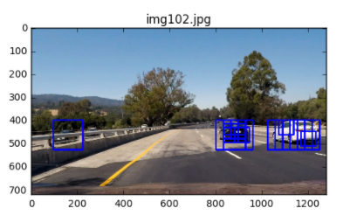
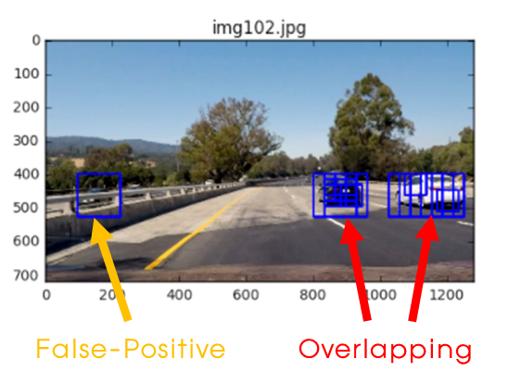
False-Positive
Overlapping

