Slide 1
END-OF-STUDIES INTERNSHIP · SOPRA HR SOFTWARE × ESPRIT
Reading the Paperwork
HR documents → machine-learning features
[Your name]
Supervisors: [company] · [academic] [date]
Notes:
══ 0:00 · 0:20 ══
SAY
• Name, and where the internship was.
• One sentence on what the next 24 minutes are for.
THE ONE THING
► Do not narrate the agenda. An agenda slide spends 30 seconds telling people they will later learn something.
NEXT → 02 — the cost

Slide 2
ACT I · THE PROBLEM WORTH MONEY
0:20 · 1:00
slide 02
What one resignation costs
[ X ]×
monthly salary, to replace one person
↑ replace with a sourced figure
Notes:
══ 0:20 · 1:00 ══
SAY
• One resignation costs recruitment, onboarding, lost productivity.
• And the knowledge that left, which nobody wrote down.
• Expensive, consequential — and partly predictable.
• That is why every HR platform wants a turnover model.
THE ONE THING
► Open on cost, not technology. The commercial half of the room needs a reason to listen before any architecture appears.
WATCH OUT
! FILL THIS IN with a sourced figure. An invented number is the first thing a jury challenges — and the only number on the slide.
IF ASKED
Q Where does that figure come from?
A Name the source out loud. If you are unsure of it, say the range rather than the point estimate.
NEXT → 03 — but the data is unreadable

Slide 3
ACT I
1:20 · 1:20
slide 03
The data exists
Thousands of performance reviews
Every resignation letter ever received
Offer letters, CVs — and a lot of paper
It just isn't readable.
Notes:
══ 1:20 · 1:20 ══
SAY
• Here is what surprised me. The obstacle is not modelling.
• Published work runs on a few public datasets. The most-used one has about 1,470 rows — and is itself synthetic.
• Meanwhile a twenty-year-old company holds thousands of reviews, every resignation letter it ever received, and a great deal of paper.
• None of it reaches any model.
THE ONE THING
► Say the last line slowly. It is the thesis of the whole talk, and everything after it is a consequence.
POINT AT
· The three archive lines, then the quote
NEXT → 04 — what already existed

Slide 4
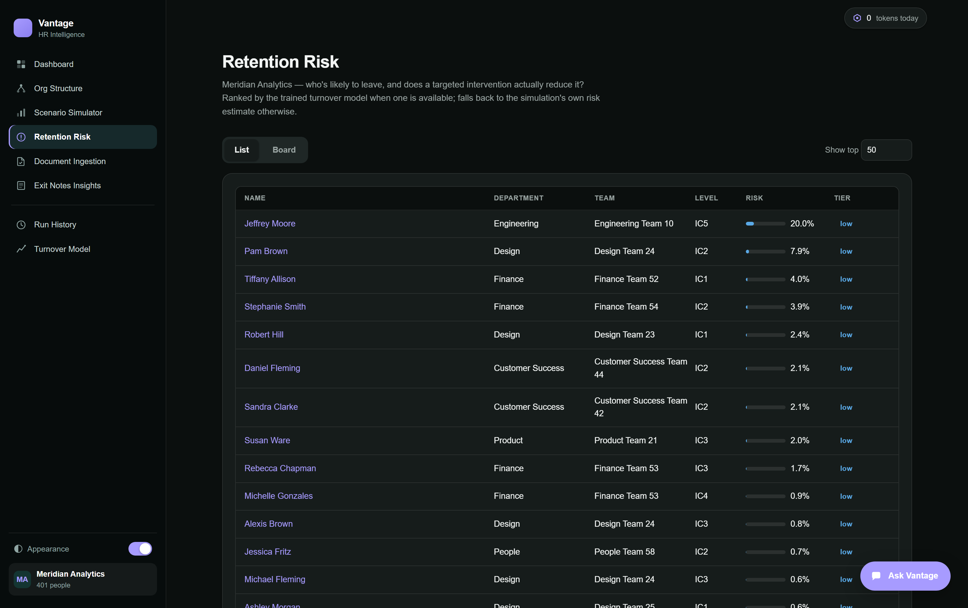
ACT I
2:40 · 1:20
slide 04
What already existed
Notes:
══ 2:40 · 1:20 ══
SAY
• The platform simulates an organisation week by week, so employees actually resign inside the model.
• That means the classifier trains on real events rather than a risk score somebody assigned.
• It worked. It had one problem: everything in it came from its own simulation. Nothing real ever entered.
THE ONE THING
► The difference between learning something and restating an assumption.
WATCH OUT
! 80 seconds. Resist explaining the simulation — it is context, not your contribution. If you are running long, this is the first cut.
NEXT → 05 — the gap

Slide 5
ACT I
4:00 · 1:20
slide 05
Three features were constants
rating_last = 3.0
rating_prev = 3.0
rating_delta = 0.0
3 of 18
carried no information
Notes:
══ 4:00 · 1:20 ══
SAY
• When the scoring layer needed performance history, it had none.
• So it supplied a neutral 3 out of 5 — for everybody.
• Three of eighteen features were the same number for every employee. A tree never splits on them, so the effective count was fifteen.
• And a declining rating is one of the more reliable early signals of a resignation. The missing signal was not an arbitrary one.
THE ONE THING
► This is the pivot. From here the audience knows exactly what problem the next fifteen minutes solve.
POINT AT
· The three constants, then the 3-of-18
NEXT → 06 — the pipeline

Slide 6
ACT II · WHAT I BUILT
5:20 · 1:40
slide 06
One pipeline, one gate
Document
CSV · PDF · text · PHOTO
Parse
rules · LLM · OCR
STAGING
nothing proceeds
HUMAN
approves per field
Employees · reviews
exit notes · cohort
No path from extraction to a personnel record.
Notes:
══ 5:20 · 1:40 ══
SAY
• Documents arrive as CSV, PDF, free text — or a photograph.
• Structured files parse deterministically. A roster needs no model and no API key at all.
• Prose goes to a language model. Paper goes through OCR.
• All three routes end in the same place: a staging table.
• There is no code path from extraction to a personnel record.
THE ONE THING
► 'No unreviewed write' is a property of the architecture, not a rule someone follows.
POINT AT
· The STAGING box — it is the largest for a reason
· Then the HUMAN box
WATCH OUT
! You will point back at this slide three times. Make sure the room sees the staging box now.
NEXT → 07 — the demo

Slide 7
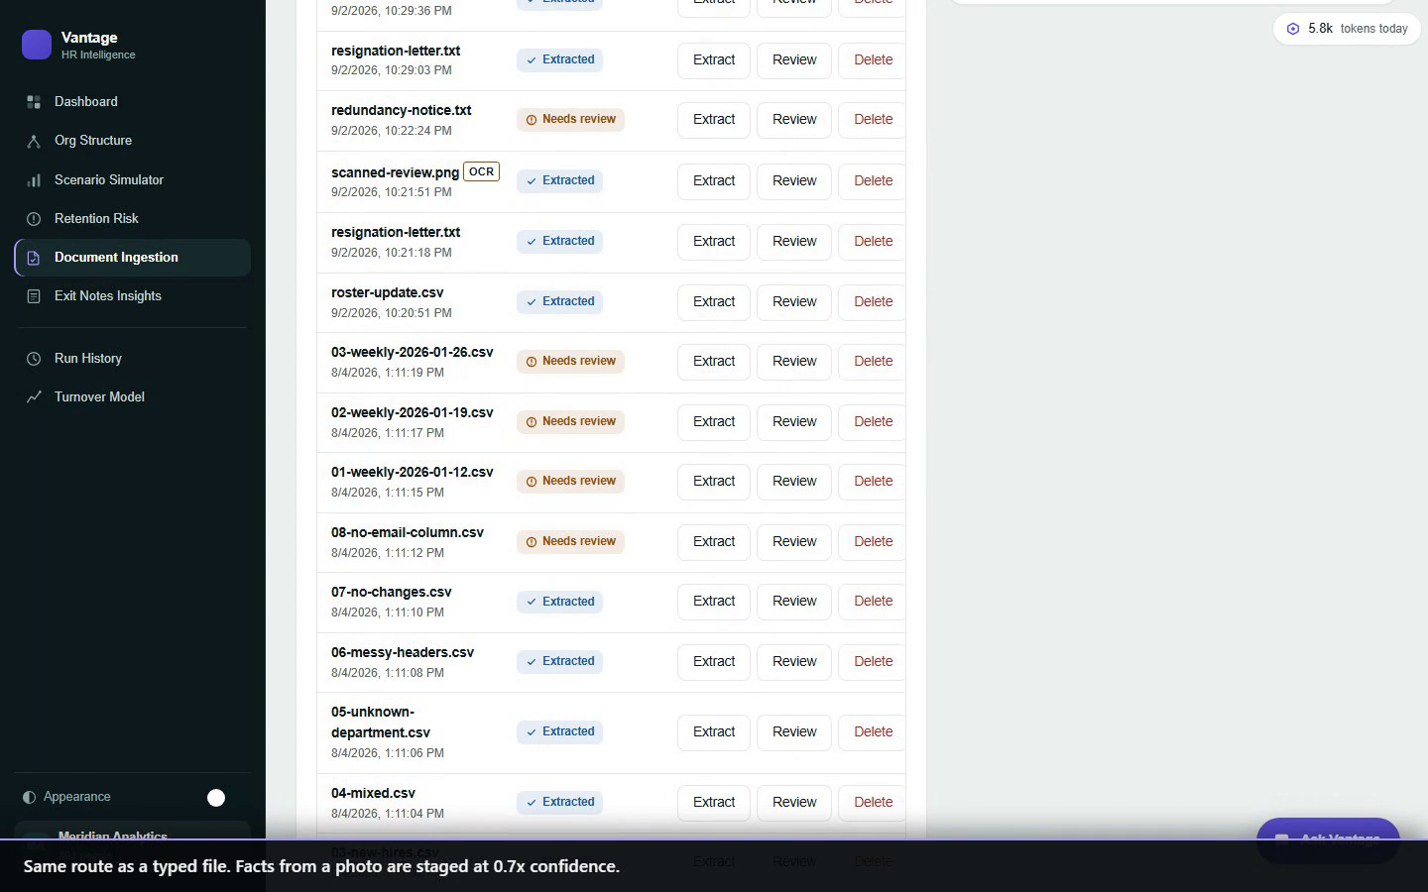
ACT II
7:00 · 2:30
slide 07
A photograph of paper
Uploaded → marked OCR
Transcribed once, on upload
Then the identical route
Staged at 0.7× confidence
Notes:
══ 7:00 · 2:30 ══
SAY
• Narrate what is happening, not what you are clicking.
• A photograph produces the same text a typed document would.
• From there, nothing downstream is special-cased for paper.
• Only the confidence differs — and it differs automatically.
THE ONE THING
► Paper is a front door, not a second pipeline.
POINT AT
· The OCR badge on the row
· The confidence figure when the facts stage
WATCH OUT
! This is a recording, on purpose. A live cloud call on conference wifi is a two-minute silence. Let it play; do not talk over the whole clip — narrate the first beat, then stop.
IF ASKED
Q How accurate is the transcription?
A Honest answer: not measured against a real archive. That is why every fact from a photo is discounted rather than trusted.
Q Why not just use Tesseract?
A It is one of the four backends. A vision model reads for meaning, so it copes with skew and handwriting.
NEXT → 08 — principle 1

Slide 8
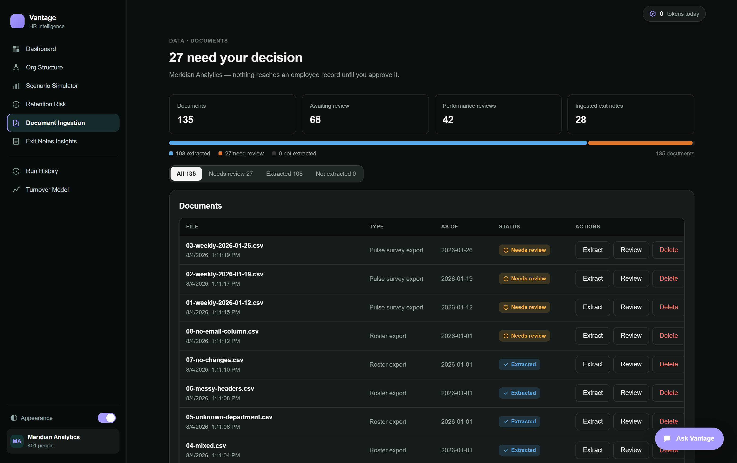
ACT III · WHY IT CAN BE TRUSTED
9:30 · 1:20
slide 08
Nothing is written without a human
Notes:
══ 9:30 · 1:20 ══
SAY
• Both parsers write only to the staging table.
• The apply endpoint is the only writer of employee data, and it acts only on facts approved by identifier.
• Every staged change carries its current value, the proposed value, a confidence — and the sentence it came from.
THE ONE THING
► For a vendor holding client personnel data under GDPR this is not a nice-to-have. It is the difference between a feature you can sell and one legal will not let you ship.
POINT AT
· The evidence column — approving is a decision, not an act of faith
WATCH OUT
! Say the GDPR line looking at the business half of the room. This is where a sceptical buyer relaxes.
NEXT → 09 — principle 2

Slide 9
ACT III
10:50 · 2:00
slide 09
Make the wrong thing unrepresentable
ResignationLetterExtract
employee_email
effective_date
is_voluntary
note_text
No workload field.
No morale field.
No feature fields at all.
Notes:
══ 10:50 · 2:00 ══
SAY
• A resignation letter says the author was exhausted and unsupported.
• Workload and manager support are legitimate features. So why not use them?
• Because the letter is written AT the moment of the outcome.
• A model trained on it learns that people who write about exhaustion in resignation letters resign. Excellent AUC. Zero predictive value — at scoring time no such letter exists.
• So the schema has nowhere to put those values.
THE ONE THING
► A confused model, a careless contributor, a bad prompt — none of them can leak through this path. The field is not there.
POINT AT
· The four fields
· Then the two lines under them
WATCH OUT
! Two full minutes. This is the strongest technical idea in the talk. If a jury remembers one thing, make it this.
IF ASKED
Q Couldn't you just filter those fields out later?
A You could, and it would work until someone forgot. A check that must be remembered eventually is not.
Q Isn't the note text itself a feature?
A It feeds sentiment analysis for humans to read, not the model's feature frame.
NEXT → 10 — principle 3

Slide 10
ACT III
12:50 · 1:20
slide 10
You only get letters from leavers
Letters only
24 positives · 0 negatives
100%
base rate
Letters + roster
24 positives · 377 negatives
5.99%
base rate
Notes:
══ 12:50 · 1:20 ══
SAY
• An organisation never receives a resignation letter from someone who stayed.
• So a training set built from letters alone is a hundred per cent positive. The model learns that everybody leaves.
• Cohort construction refuses to build a training set unless a roster establishes who did not leave — and refuses outright above a fifty per cent base rate.
THE ONE THING
► The roster is not an optional enrichment. It is what makes the labels mean anything at all.
POINT AT
· 100% on the left, then 5.99% on the right
WATCH OUT
! The most accessible idea in the talk — non-technical listeners follow it completely. If you must cut slide 09, this one survives.
NEXT → 11 — when the model lied

Slide 11
ACT III
14:10 · 1:20
slide 11
When the model made something up
The prompt said: if the department is missing, return an error.
department_name: "no department stated"
A valid string. It passed validation.
Structure catches a class. Wording catches a phrasing.
Notes:
══ 14:10 · 1:20 ══
SAY
• My favourite failure.
• The prompt told the model to report a missing field. It complied semantically and failed structurally — it put the refusal INSIDE the field.
• Schema validation passed, because that is a perfectly valid string.
• It staged a plausible-looking hire.
• The fix was not a better prompt. The department is now resolved against departments that actually exist.
THE ONE THING
► Prompt wording constrains one phrasing of a failure. A structural check constrains the whole class of it.
POINT AT
· The string, then the line under it
WATCH OUT
! Tell this as an anecdote — it is the one place in the talk to sound amused. It does more work than any results slide, because it shows you tested adversarially.
IF ASKED
Q Would a better model have avoided it?
A Maybe, on that phrasing. That is exactly why the fix is not a prompt.
NEXT → 12 — paper and portability

Slide 12
ACT III
15:30 · 1:20
slide 12
Paper, and not being locked in
Paper
Photo → transcription → the same pipeline. Staged at 0.7× confidence. A scanned PDF takes the same route.
Portability
Groq ⇄ AWS Bedrock. One environment variable. Runs inside the client's own account.
Notes:
══ 15:30 · 1:20 ══
SAY
• Plenty of HR records are still paper.
• A photograph produces the same text a typed document would, and travels the identical route.
• What differs is confidence — and it differs automatically. OCR can turn a three into an eight in a salary, and nothing downstream would catch it, because both are valid numbers.
• And the provider is a configuration setting, not a code decision.
THE ONE THING
► A client who requires everything inside their own AWS account gets that without a code change.
POINT AT
· 0.7× on the left
· One environment variable on the right
WATCH OUT
! Two commercial objections answered before they are asked: 'our clients aren't digitised' and 'we can't send data to a third party'.
IF ASKED
Q What does OCR cost per page?
A Metered separately under its own feature — roughly a thousand tokens for a typical page.
NEXT → 13 — results

Slide 13
ACT IV · WHAT IT PRODUCED
16:50 · 1:30
slide 13
Tested against documents built to fail
17/17
refusals correct
143
documents
350
tests
6
formats
Notes:
══ 16:50 · 1:30 ══
SAY
• I generated documents across six types.
• About one in six was built to be REFUSED — a review with no rating, a redundancy notice, a letter from someone who does not work here.
• A corpus of happy paths proves nothing about whether a parser invents data when a document is deficient.
• All seventeen refusals behaved correctly, and with specific reasons rather than a generic failure.
THE ONE THING
► Say 'designed to fail' out loud. Testing the refusals is what distinguishes engineering from a demo.
POINT AT
· 17 / 17 first, then the other three
IF ASKED
Q Why generated documents rather than real ones?
A Real HR documents are personal data. It is a genuine limitation and it is on slide 16.
NEXT → 14 — the second corpus

Slide 14
ACT IV
18:20 · 1:20
slide 14
The bug the first corpus could not find
1234,56 → 123456.0
85.000,50 → 85.0005
A decimal comma multiplies salary by 100.
Silently.
Notes:
══ 18:20 · 1:20 ══
SAY
• Those documents all tested CONTENT.
• So I built a second corpus that tests the CONTAINER — delimiters, encodings, locales, scales, page layout.
• It found this before a single file was uploaded.
• The parser strips every comma as a thousands separator. So a French salary is read a hundred times too large.
• Worse than a refusal — the wrong number reaches a reviewer looking completely plausible.
THE ONE THING
► Every one of my first 106 documents was UTF-8, comma-delimited and in English, because that is what you write when you are inventing plausible documents.
POINT AT
· The two rows, then the line under them
WATCH OUT
! Say plainly that it is still open. For an HR vendor with French-locale clients this is commercial, not just technical.
NEXT → 15 — the gap closed

Slide 15
ACT IV
19:40 · 1:20
slide 15
The gap from slide 5, closed
Informative features
15 of 18
→
18 of 18
Reviews in the database
0
→
38
Employees with a history
0
→
26
…with two periods
0
→
12
Notes:
══ 19:40 · 1:20 ══
SAY
• Twelve employees now have two-period histories, with real deltas instead of a hard-coded zero.
• The promotion gate records document-sourced examples separately, so a change in AUC can be attributed to a source.
• And the fixed synthetic evaluation cohort never sees ingested data — so documents can improve the model or do nothing, but cannot quietly degrade production.
THE ONE THING
► Call back to slide 5 explicitly: 'those three constants'. Closing a loop the audience remembers opening is worth more than a new fact.
POINT AT
· The last row — 0 → 12
NEXT → 16 — what doesn't work

Slide 16
ACT IV
21:00 · 1:00
slide 16
What doesn't work yet
83% of exit notes yield no theme
A decimal comma still corrupts salaries
Duplicate emails can match the wrong person
Validated on generated documents
No improvement in real turnover prediction is claimed.
Notes:
══ 21:00 · 1:00 ══
SAY
• Three things I would not claim.
• The sentiment analysis is a small hand-built lexicon and it fails on real prose. A letter saying the author was tired in a way a holiday does not fix scores zero. At twenty-four documents, that is most of them.
• The decimal comma is still open — it has a fixture, not a fix.
• And I have not shown an improvement in predicting real turnover.
THE ONE THING
► That last one needs a real organisation's documents and a real outcome window. Neither was available.
WATCH OUT
! DO NOT SKIP THIS SLIDE to save time. Naming your own limits before a jury does is the cheapest credibility you will buy all talk — and it pre-empts the obvious hostile question.
IF ASKED
Q So does it actually work?
A It demonstrably ingests documents safely. Whether it improves prediction is unmeasured, and I am not claiming it.
NEXT → 17 — the commercial case

Slide 17
ACT V · WHERE IT GOES
22:00 · 1:20
slide 17
Why a client would pay for this
Dormant asset
Archives they already own
Auditable
Every value traces to a sentence
Their infrastructure
Runs in the client's own account
Known unit cost
~460 tokens, ~5 seconds per document
Notes:
══ 22:00 · 1:20 ══
SAY
• The pitch in one line: this turns an archive a client is already paying to store into something their analytics can use.
• With an audit trail that survives a data-protection review.
• And because the cost per document is measured rather than estimated, a client can be quoted before a pilot rather than after it.
THE ONE THING
► Four claims, no more. Each answers a question a buyer actually asks: what do I get, can I defend it, where does my data go, what does it cost.
NEXT → 18 — close

Slide 18
ACT V
23:20 · 0:40
slide 18
Next, and close
Next — the sentiment model · the decimal comma · a real archive
Make the wrong thing
unrepresentable,
rather than detectable.
Notes:
══ 23:20 · 0:40 ══
SAY
• The highest-return next step is the sentiment model, because eighty-three per cent of what we ingest currently produces no signal.
• And if you take one idea away —
• Every safety property in this pipeline is structural. A letter cannot leak a feature because the schema has no feature fields. A batch of letters cannot become a training set because the base rate is checked.
• Each could have been a rule in a document. And each would eventually have been forgotten.
THE ONE THING
► Stop talking after that sentence. Leave the line on screen and let the silence be the invitation — do not add 'any questions?'
NEXT → — questions —

Slide 19
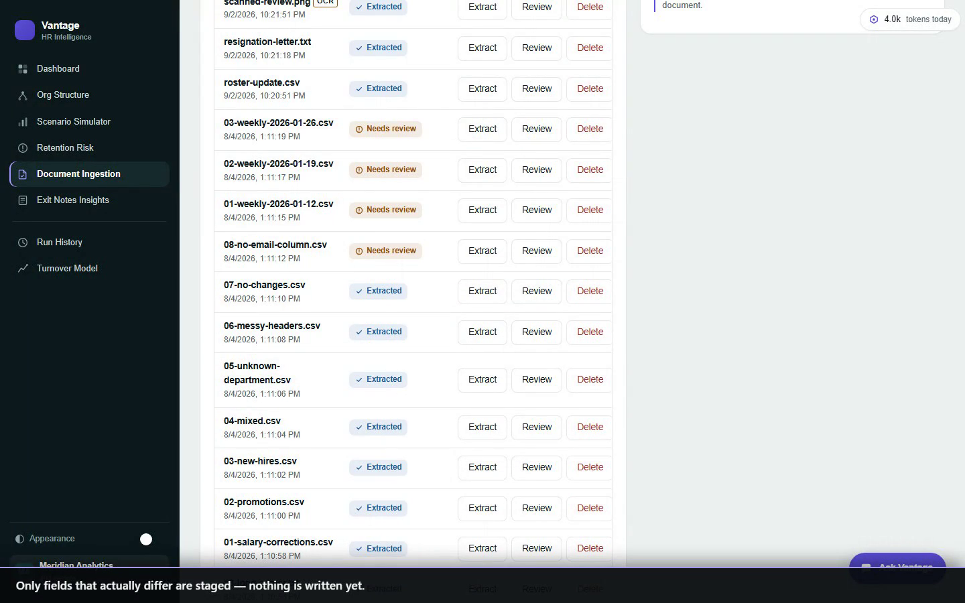
BACKUP · NOT IN THE RUN
Roster CSV
No model, no API key
Compared row by row
Only differences staged
An identical row proposes nothing
Notes:
SAY
• Backup clip. Not part of the 24-minute run.
• Use only if the room asks for it.

Slide 20
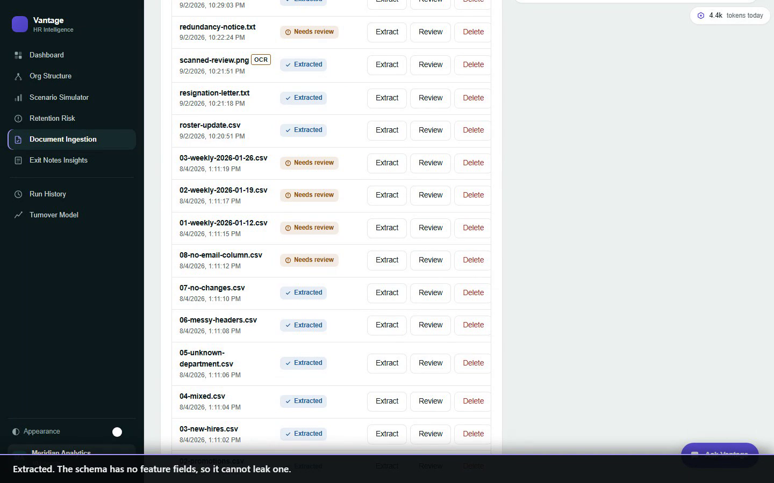
BACKUP · NOT IN THE RUN
Resignation letter
Free prose, read by the model
Contributes a label and a date
Never a feature
Note text flows to exit-note analysis
Notes:
SAY
• Backup clip. Not part of the 24-minute run.
• Use only if the room asks for it.

Slide 21
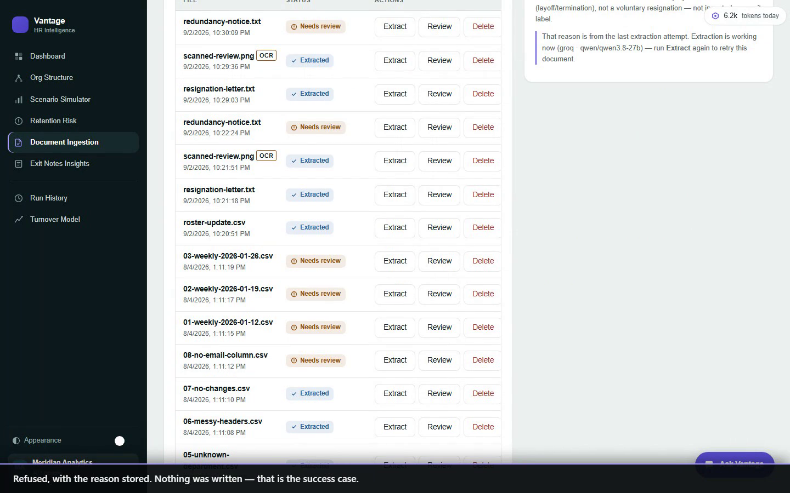
BACKUP · NOT IN THE RUN
Honest refusal
A layoff is not a resignation
Refused, with the reason stored
Nothing was written
That is the success case
Notes:
SAY
• Backup clip. Not part of the 24-minute run.
• Use only if the room asks for it.

Slide 22
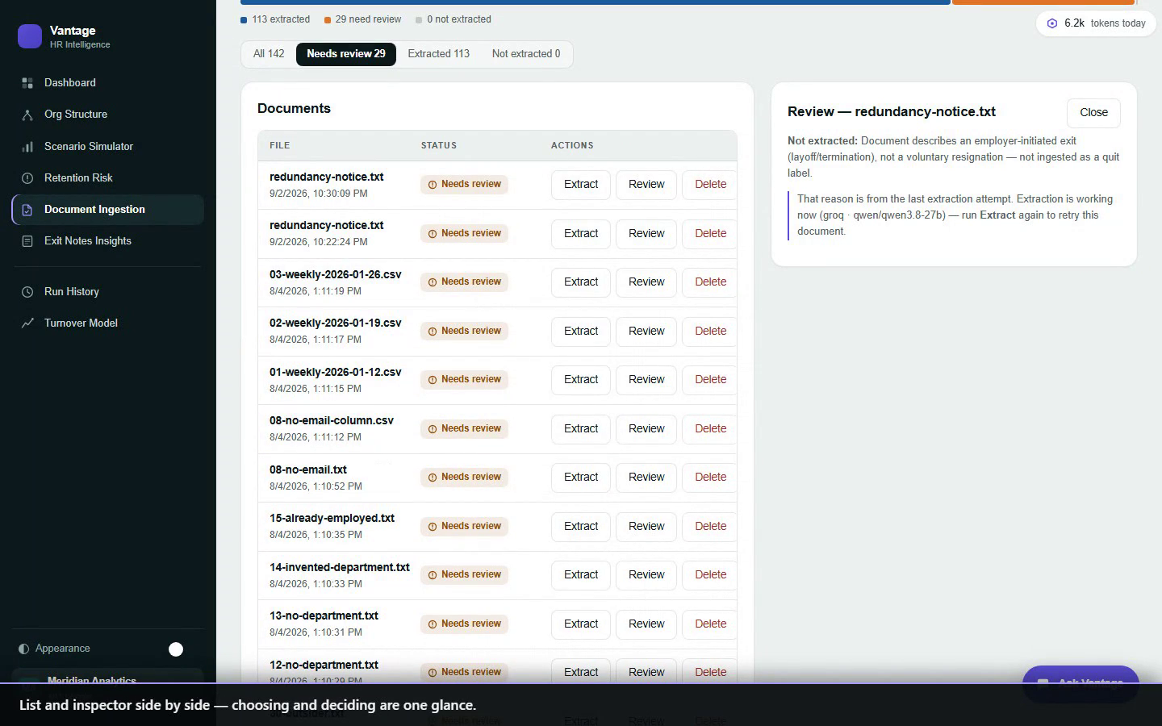
BACKUP · NOT IN THE RUN
The review queue
142 documents
Filter to what needs you
List and inspector together
Every proposal carries its sentence
Notes:
SAY
• Backup clip. Not part of the 24-minute run.
• Use only if the room asks for it.

Slide 23
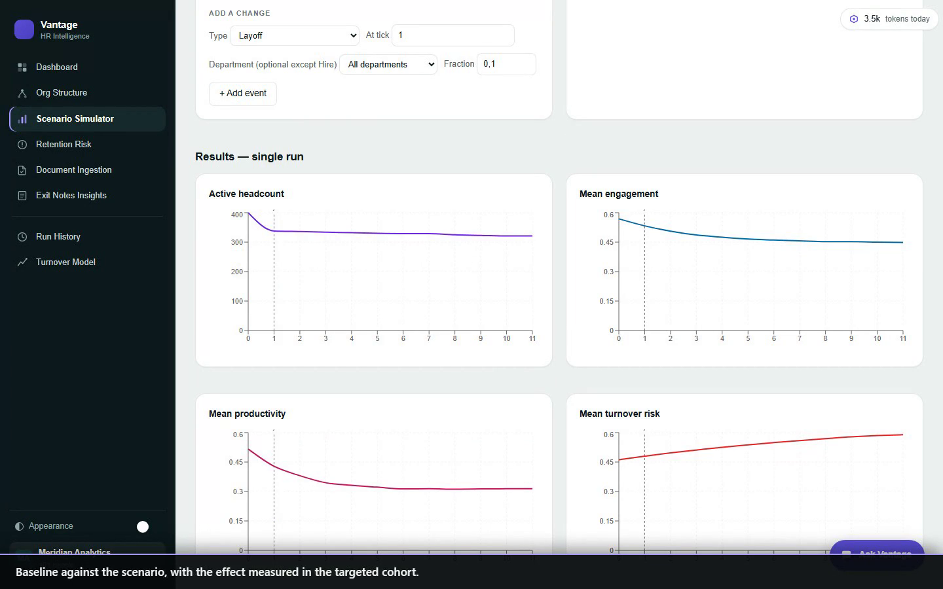
BACKUP · NOT IN THE RUN
Scenario simulator
A template drops events
Time is drawn, not tabulated
Baseline against scenario
Measured in the targeted cohort
Notes:
SAY
• Backup clip. Not part of the 24-minute run.
• Use only if the room asks for it.

Slide 24
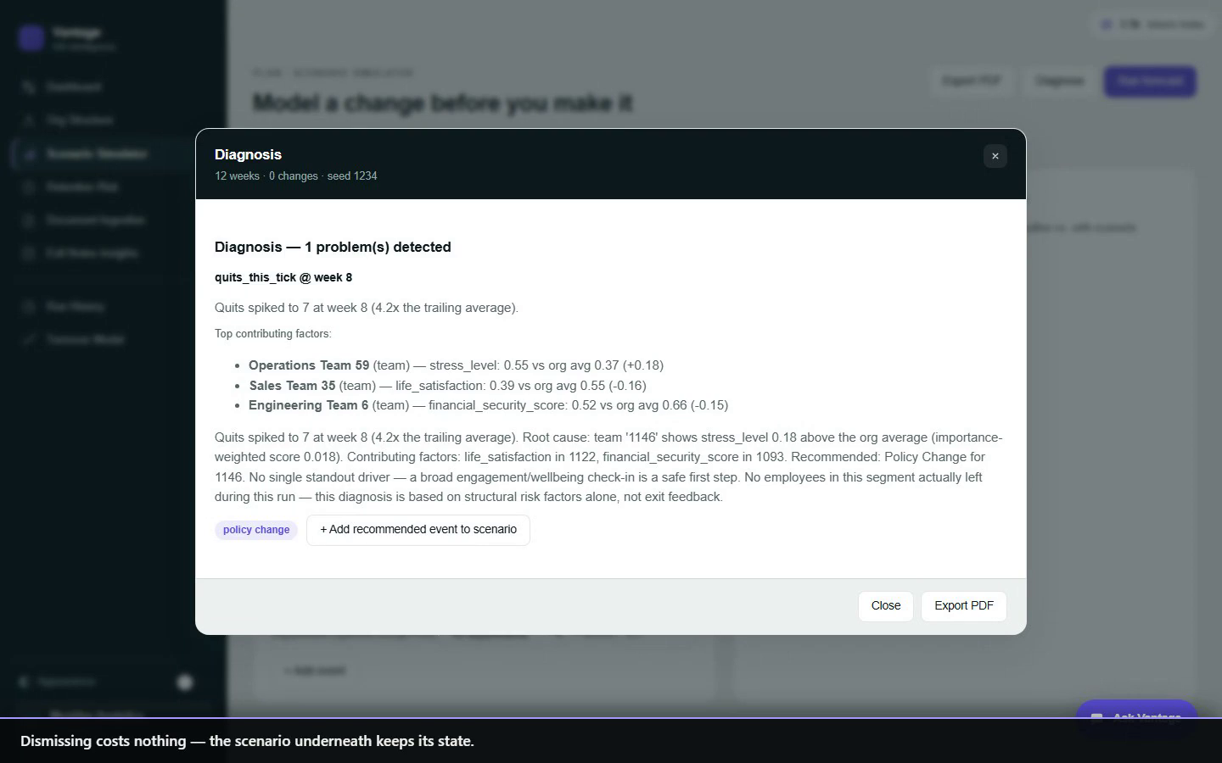
BACKUP · NOT IN THE RUN
Diagnosis report
Opens over the page
Top drivers and cohort
A recommendation you can apply
Dismissing costs nothing
Notes:
SAY
• Backup clip. Not part of the 24-minute run.
• Use only if the room asks for it.

Slide 25
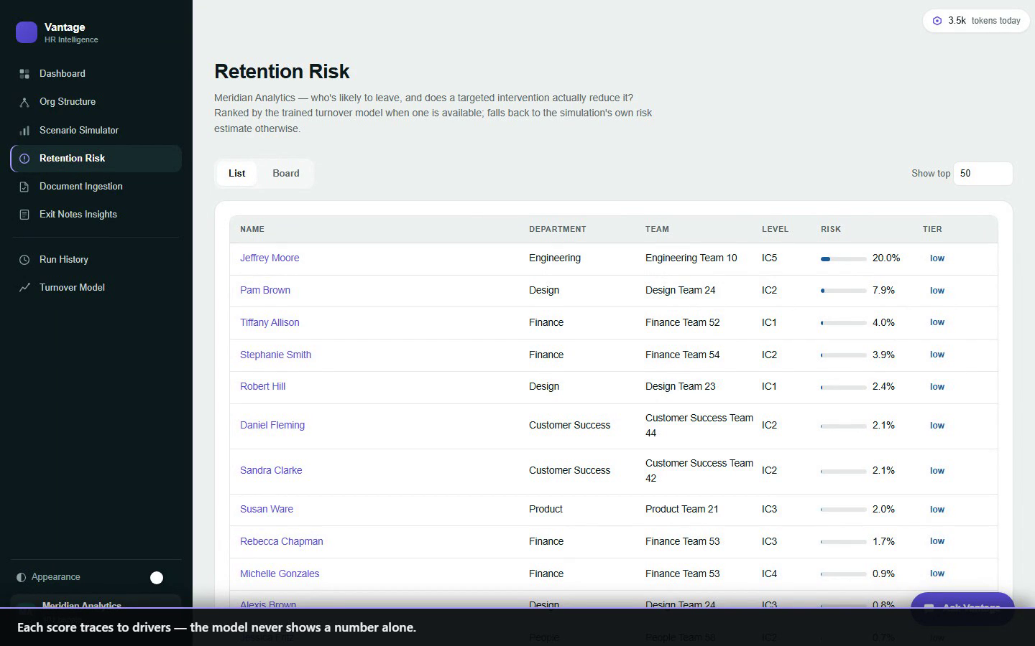
BACKUP · NOT IN THE RUN
Retention risk
Who ranks highest
Each score traces to drivers
Never a number alone
Notes:
SAY
• Backup clip. Not part of the 24-minute run.
• Use only if the room asks for it.

Slide 26
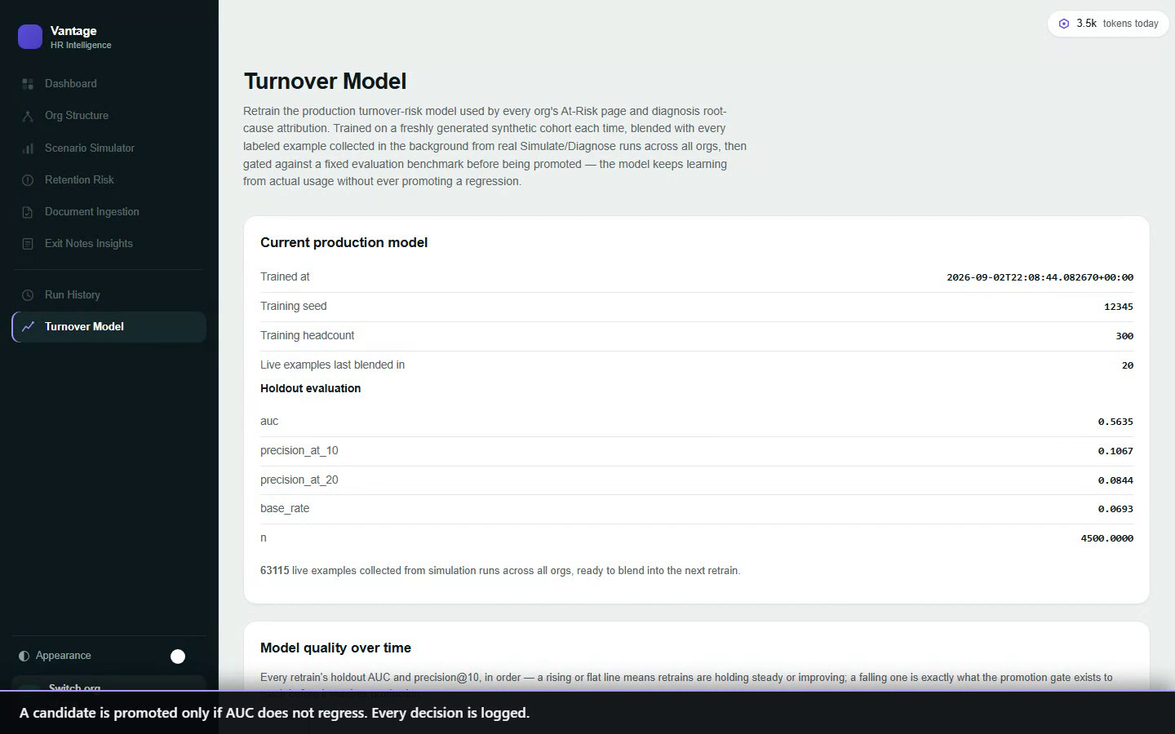
BACKUP · NOT IN THE RUN
Model and promotion gate
Promoted only if AUC holds
Every decision logged
Document examples counted separately
Notes:
SAY
• Backup clip. Not part of the 24-minute run.
• Use only if the room asks for it.

Slide 27
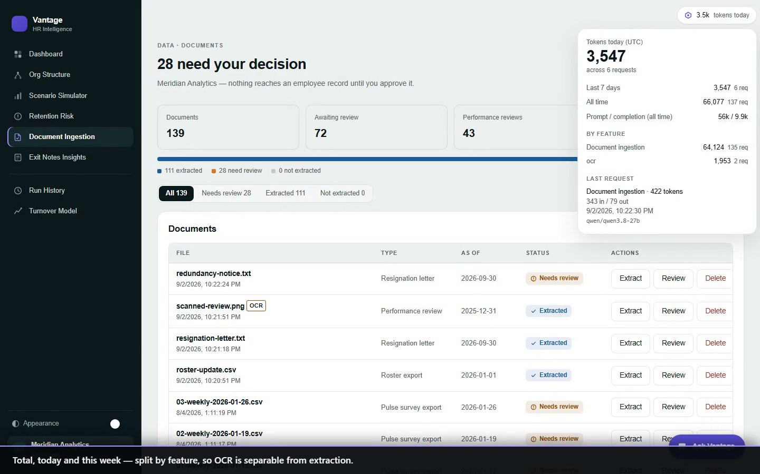
BACKUP · NOT IN THE RUN
Token usage
Total, today, this week
Split by feature
The model that actually served it
Notes:
SAY
• Backup clip. Not part of the 24-minute run.
• Use only if the room asks for it.

Slide 28
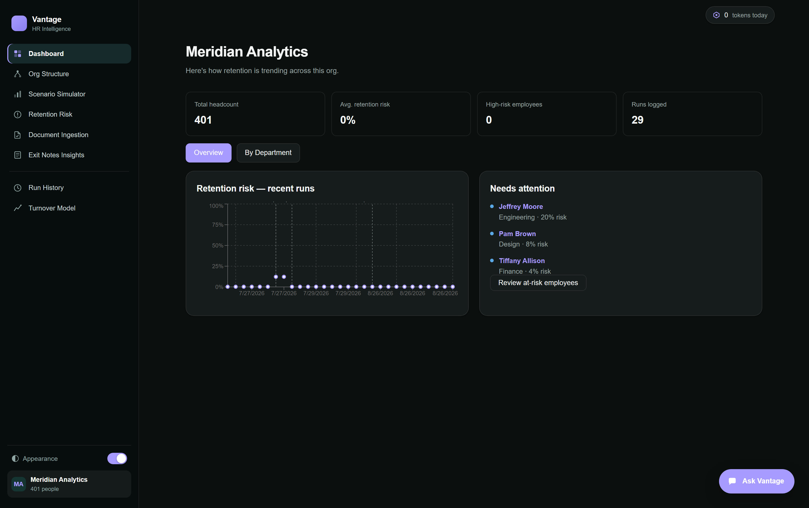
BACKUP · NOT IN THE RUN
Dashboard
Notes:
SAY
• Backup screen. Not part of the 24-minute run.

Slide 29
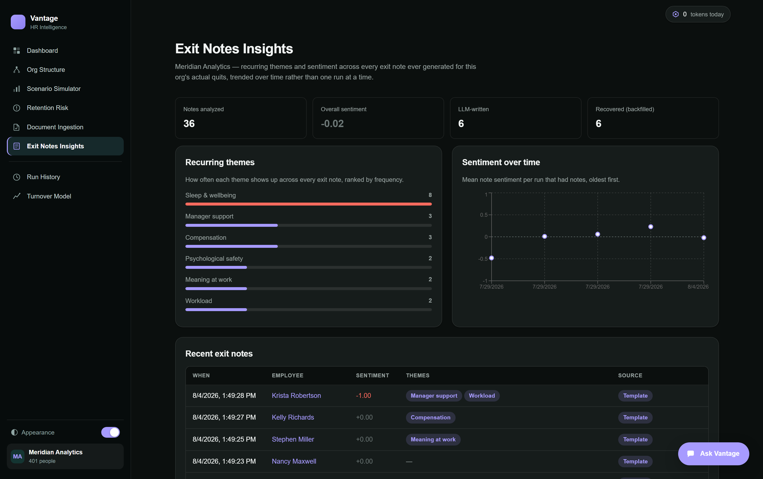
BACKUP · NOT IN THE RUN
Exit Notes Insights
Notes:
SAY
• Backup screen. Not part of the 24-minute run.

