Slide 1
CSE 231 – Digital Logic design
Dr. Khaleda Ali
Introduction to number systems and codes

Slide 2
Analog/Analogue Systems
Analogue Systems
  V(t) can have any value between its minimum and maximum value
V(t)

Slide 3
Digital Systems
Digital Systems
  V(t) must take a value selected from a set of values called an alphabet
  Binary digital systems form the basis of almost all hardware systems currently
V(t)
1
0
1
0
1
For example, Binary Alphabet: 0, 1.

Slide 4
Slide example
Consider a child’s slide in a playground:
a set of discrete steps
continuous movement
levels

Slide 6
Relationship between Analogue and Digital systems
5 Volt
Advantages of Digital Systems
  Analogue systems: slight error in input yields large error in output
  Digital systems more accurate and reliable
  Computers use digital circuits internally
  Interface circuits (for instance, sensors and actuators) are often analogue
Input
Range
for 1
Output
Range
for 1
2.8
2.4
Input
Range
for 0
0.8
Output
Range
for 0
0.4
0 Volt

Slide 7
Exercise
Explain whether the following are analog or digital:
  A photograph or painting
  A scanned image
  Sound from a computer’s loud speaker
  Sound file stored on disc

Slide 8
Binary Inputs and Outputs
Coding:
  A single binary input can only have two values: True or False (Yes or No) (1 or 0)
Notes:
A volume control on a stereo requires more than two positions (off and full volume)
2 inputs can represent 4 values
3 inputs can represent 8 values
4 inputs can represent 16 values
5 inputs can represent 32 values
...
Example 1 There would be 2¹⁰ = 1024 = 1K combinations
Example 2 Need to represent 10 digits Using three bits only allows us to represent 8 and 4 bits allows us to represent 16 - have to use 4 inputs.

Slide 9
Binary
More bits = more combinations
0 0 0 1 1 0 1 1
    Each additional input doubles the number of combinations we can represent
    i.e. with n inputs it is possible to represent 2^{n} combinations

Slide 10
Combinations
Example 1:
  How many combinations are possible with 10 binary inputs?
Example 2:
  What is the minimum number of bits needed to represent the digits ‘0’ to ‘9’ as a binary code?”
2^4=16;0:15

Slide 11
52
What does this number represent?
What does it mean?

Slide 12
1011001.101
What does this number represent?
Consider the base (or radix) of the number.

Slide 13
Number Systems
R is the radix or base of the number system
  Must be a positive number
  R digits in the number system: [0 .. R-1]
Important number systems for digital systems:
  Base 2 (binary): [0, 1]
  Base 8 (octal): [0 .. 7]
  Base 16 (hexadecimal): [0 .. 9, A, B, C, D, E, F]

Slide 14
Number Systems
Positional Notation
D = [a₄a₃a₂a₁a₀.a₋₁a₋₂a₋₃]_{R}
5=[101]2
D = decimal value
a _{i} = i^{th} position in the number
R = radix or base of the number

Slide 15
Number Systems
Power Series Expansion
D = a_{n} x R⁴ + a_{n-1} x R³ + … + a₀ x R⁰
+ a₋₁ x R⁻¹ + a₋₂ x R⁻² + … a_{-m} x R^{-m}
D = decimal value
a _{i} = i^{th} position in the number
R = radix or base of the number
13=8+4+1=1X(2^3)+1X(2^2)+0X(2^1)+1X(2^0)=1101
10=8+2=1X(2^3)+0X(2^2)+1X(2^1)+0X(2^0)=(1010)binary
65=1X (2^6)+0X (2^5)+0X (2^4)+0X (2^3)+0X (2^2)+0X (2^1)+1X(2^0)=1000001

Slide 16
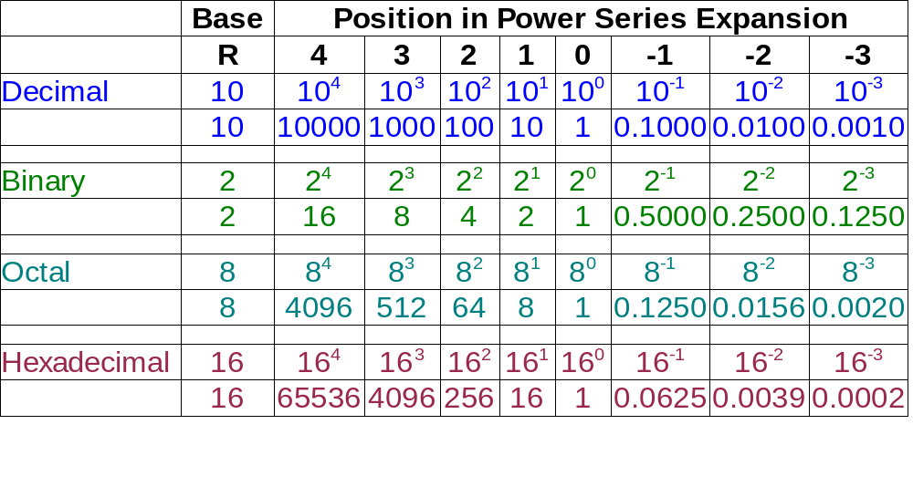
Number Systems

Slide 17
Conversion between Number Systems

Slide 18
Conversion of Decimal Integer
Use repeated division to convert to any base
  N = 57 (decimal)
  Convert to binary (R = 2) and octal (R = 8)
57 / 2 = 28: rem = 1 = a0
28 / 2 = 14: rem = 0 = a1
14 / 2 = 7: rem = 0 = a2
7 / 2 = 3: rem = 1 = a3
3 / 2 = 1: rem = 1 = a4
1 / 2 = 0: rem = 1 = a5
57₁₀ = 111001₂
57 / 8 = 7: rem = 1 = a0
7 / 8 = 0: rem = 7 = a1
57₁₀ = 71₈
User power series expansion to confirm results.

Slide 19
Conversion of Decimal Fraction
Use repeated multiplication to convert to any base
  N = 0.625 (decimal)
  Convert to binary (R = 2) and octal (R = 8)
0.625 * 2 = 1.250: a-1 = 1
0.250 * 2 = 0.500: a-2 = 0
0.500 * 2 = 1.000: a-3 = 1
0.625₁₀ = 0.101₂
0.625 * 8 = 5.000: a-1 = 5
0.625₁₀ = 0.5₈
Use power series expansion to confirm results.

Slide 20
Conversion of Decimal Fraction
In some cases, conversion results in a repeating fraction
  Convert 0.7₁₀ to binary
0.7 * 2 = 1.4: a-1 = 1
0.4 * 2 = 0.8: a-2 = 0
0.8 * 2 = 1.6: a-3 = 1
0.6 * 2 = 1.2: a-4 = 1
0.2 * 2 = 0.4: a-5 = 0
0.4 * 2 = 0.8: a-6 = 0
0.7₁₀ = 0.1 0110 0110 0110 ...₂

Slide 21
Number System Conversion
Conversion of a mixed decimal number is implemented as follows:
  Convert the integer part of the number using repeated division.
  Convert the fractional part of the decimal number using repeated multiplication.
  Combine the integer and fractional components in the new base.

Slide 22
Number System Conversion
Example:
Convert 48.5625₁₀ to binary.
Confirm the results using the Power Series Expansion.

Slide 23
Number System Conversion
Conversion between any two bases, A and B, can be carried out directly using repeated division and repeated multiplication.
  Base A → Base B
However, it is generally easier to convert base A to its decimal equivalent and then convert the decimal value to base B.
  Base A → Decimal → Base B
Power Series Expansion
Repeated Division, Repeated Multiplication

Slide 24
Number System Conversion
Conversion between binary and octal can be carried out by inspection.
  Each octal digit corresponds to 3 bits
    101 110 010 . 011 001₂ = 5 6 2 . 3 1₈
    010 011 100 . 101 001₂ = 2 3 4 . 5 1₈
    7 4 5 . 3 2₈ = 111 100 101 . 011 010₂
    3 0 6 . 0 5₈ = 011 000 110 . 000 101₂
  Is the number 392.24₈ a valid octal number?

Slide 25
Number System Conversion
Conversion between binary and hexadecimal can be carried out by inspection.
  Each hexadecimal digit corresponds to 4 bits
    1001 1010 0110 . 1011 0101₂ = 9 A 6 . B 5₁₆
    1100 1011 1000 . 1110 0111₂ = C B 8 . E 7₁₆
    E 9 4 . D 2₁₆ = 1110 1001 0100 . 1101 0010₂
    1 C 7 . 8 F₁₆ = 0001 1100 0111 . 1000 1111₂
  Note that the hexadecimal number system requires additional characters to represent its 16 values.

Slide 26
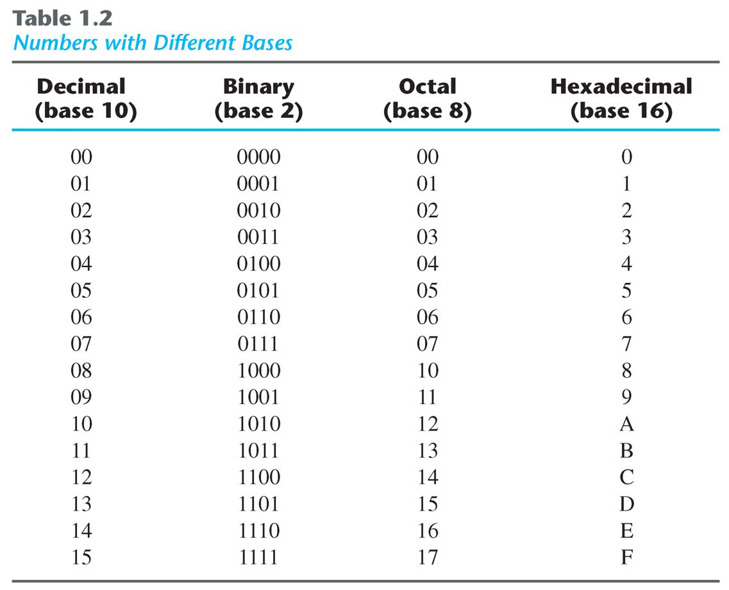
Number Systems

Slide 27
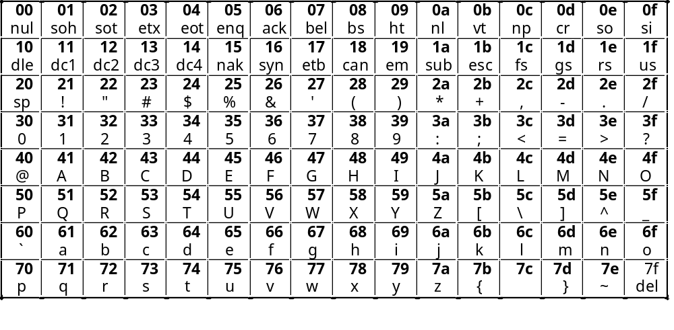
Binary Inputs and Outputs
Characters
  Three main coding schemes used: ASCII (widespread use), EBCDIC (not used often) and UNICODE (new)
  ASCII table (in hex) :

Slide 28
Gray Codes
Dec | Gray
0 | 000
1 | 001
2 | 011
3 | 010
4 | 110
5 | 111
6 | 101
7 | 100
Other codes exist for specific purposes
Gray codes provide a sequence where only one bit changes for each increment
Allows increments without ambiguity due to bits changing at different times.
  E.g. changing from 3 to 4, normal binary has all three bits changing 011 -> 100. Depending on the order in which the bits change any intermediate value may be created.

Slide 29
Basic Binary Arithmetic

Slide 30
Basic Binary Arithmetic
Binary Addition

Slide 31
Binary Addition
0 0 1 1
+ 0 + 1 + 0 + 1
0 1 1 10
Sum
Carry
Sum

Slide 32
Binary Addition
Examples:
01011011
+ 01110010
11001101
10110101
+ 01101100
00111100
+ 10101010

Slide 33
Basic Binary Arithmetic
Binary Subtraction

Slide 34
Binary Subtraction
Borrow
0 10 1 1
- 0 - 1 - 0 - 1
0 1 1 0
Difference

Slide 35
Binary Subtraction
Examples:
01110101
- 00110010
01000011
10110001
- 01101100
00111100
- 10101100

Slide 36
Basic Binary Arithmetic
Single-bit Addition
Single-bit Subtraction
Carry
Sum
Difference
x
y
c
s
x
y
d
0
0
0
0
0
0
0
0
1
0
1
0
1
1
1
0
0
1
1
0
1
1
1
1
0
1
1
0
What logic function is this?
What logic function is this?

Slide 37
Binary Multiplication

Slide 38
Binary Multiplication
0 0 1 1
x 0 x 1 x 0 x 1
0 0 0 1
Product

Slide 39
Binary Multiplication
Examples:
10110001
x 01101101
00111100
x 10101100

