Slide 2
Overview
Part 1 - Storage Elements and Analysis
Introduction to sequential circuits
Types of sequential circuits
Storage elements
Latches
Flip-flops
Sequential circuit analysis
State tables
State diagrams
Circuit and System Timing
Part 2 - Sequential Circuit Design
Specification
Assignment of State Codes
Implementation

Slide 3
Introduction to Sequential Circuits
Inputs
Outputs
Combina-tional
Logic
A Sequential circuit contains:
Storage elements: Latches or Flip-Flops
Combinatorial Logic:
Implements a multiple-output switching function
Inputs are signals from the outside.
Outputs are signals to the outside.
Other inputs, State or Present State, are signals from storage elements.
The remaining outputs, Next State are inputs to storage elements.
Storage Elements
Next
State
State

Slide 4
Introduction to Sequential Circuits
Combinatorial Logic
Next state function Next State = f(Inputs, State)
Output function (Mealy) Outputs = g(Inputs, State)
Output function (Moore) Outputs = h(State)
Output function type depends on specification and affects the design significantly
Outputs
Inputs
Combina-tional
Logic
Storage Elements
Next
State
State

Slide 5
Types of Sequential Circuits
Depends on the times at which:
storage elements observe their inputs, and
storage elements change their state
Synchronous
Behavior defined from knowledge of its signals at discrete instances of time
Storage elements observe inputs and can change state only in relation to a timing signal (clock pulses from a clock)
Asynchronous
Behavior defined from knowledge of inputs an any instant of time and the order in continuous time in which inputs change
If clock just regarded as another input, all circuits are asynchronous!
Nevertheless, the synchronous abstraction makes complex designs tractable!

Slide 6
Synchronous Clocked Sequential Circuit
Inputs
Combinational circuit
Outputs
Flip Flops
Next state
Present state
Timing signal (clock)
Clock
a periodic external event (input)
Clock
synchronizes when current state changes happen
keeps system well-behaved
makes it easier to design and build large systems

Slide 7
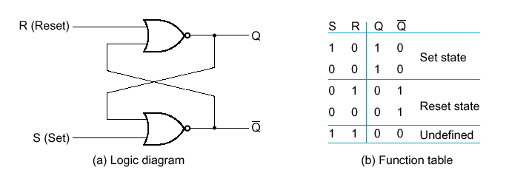
Basic (NOR) S – R Latch
SR latch is made from two cross-coupled NORs
Usually S=0 and R=0
When Q = 1, the SR-Latch is in the Set state
When Q = 0, the SR-Latch is in the Reset state
S=1 and R=1 generates illogical results

Slide 8
Basic (NOR) S – R Latch
Cross-coupling two NOR gates gives the S – R Latch:
Which has the time sequence behavior:
R (reset)
Q
S (set)
Q
Time
R
S
Q
Q
Comment
0
0
?
?
Stored state unknown
0
1
1
0
“Set” Q to 1
0
0
1
0
Now Q “remembers” 1
1
0
0
1
“Reset” Q to 0
0
0
0
1
Now Q “remembers” 0
1
1
0
0
Both go low
0
0
?
?
Unstable!

Slide 9
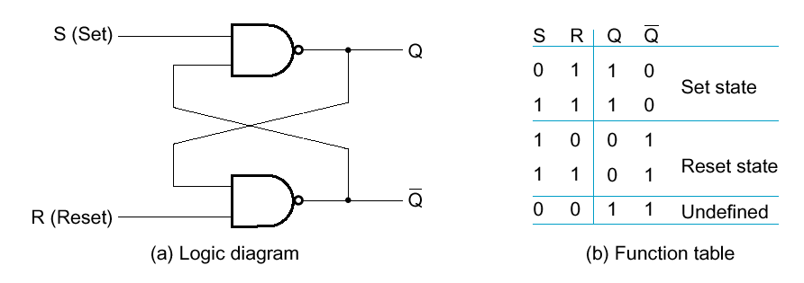
Basic (NAND) S – R Latch
SR latch is made from two cross-coupled NANDs
Sometimes called S R latch
Usually S=1 and R=1
S=0 and R=0 generates illogical results

Slide 10
Basic (NAND) S – R Latch
“Cross-Coupling” two NAND gates gives the S -R Latch:
Which has the time sequence behavior:
S = 0, R = 0 is forbidden as input pattern
S (set)
Q
Q
R (reset)
Time
R
S
Q
Q
Comment
1
1
?
?
Stored state unknown
1
0
1
0
“Set” Q to 1
1
1
1
0
Now Q “remembers” 1
0
1
0
1
“Reset” Q to 0
1
1
0
1
Now Q “remembers” 0
0
0
1
1
Both go high
1
1
?
?
Unstable!

Slide 11
Clocked S - R Latch
Adding two NAND gates to the basic S - R NAND latch gives the clocked S – R latch:
Has a time sequence behavior similar to the basic S-R latch except that the S and R inputs are only observed when the line C is high.
C means “control” or “clock”.
S
Q
C
Q
R

Slide 12
Clocked S - R Latch (continued)
The Clocked S-R Latch can be described by a table:
The table describes what happens after the clock [at time (t+1)] based on:
current inputs (S,R) and
current state Q(t).
S
Q
C
Q
R

Slide 13
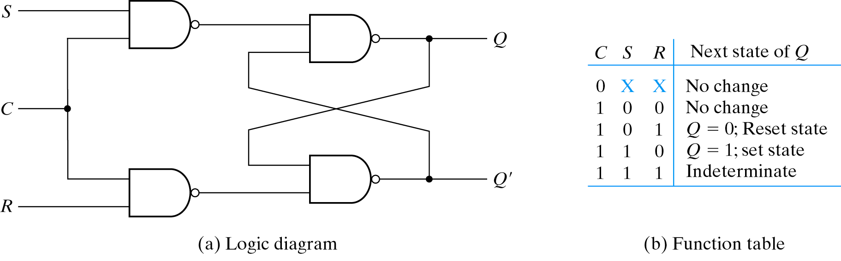
Clocked S - R Latch (continued)
Avoid uncontrolled latch changes
C = 0 disables all latch state changes
Control signal enables data change when C = 1

Slide 14
D Latch
Adding an inverter to the S-R Latch, gives the D Latch:
Note that there are no “indeterminate” states!
D
Q
C
Q
Q
D
Q(t+1)
Comment
0
0
0
No change
D
Q
0
1
1
Set Q
1
0
0
Clear Q
C
Q
1
1
1
No Change

Slide 15
Flip-Flops
The latch timing problem
Master-slave flip-flop
Edge-triggered flip-flop
Standard symbols for storage elements
Direct inputs to flip-flops
Flip-flop timing

Slide 16
The Latch Timing Problem
In a sequential circuit, paths may exist through combinational logic:
From one storage element to another
From a storage element back to the same storage element
The combinational logic between a latch output and a latch input may be as simple as an interconnect
For a clocked D-latch, the output Q depends on the input D whenever the clock input C has value 1

Slide 17
The Latch Timing Problem (continued)
Consider the following circuit:
Suppose that initially Y = 0.
As long as C = 1, the value of Y continues to change!
The changes are based on the delay present on the loop through the connection from Y back to Y.
This behavior is clearly unacceptable.
Desired behavior: Y changes only once per clock pulse
Y
D
Q
Clock
C
Q
Clock
Y

Slide 18
The Latch Timing Problem (continued)
A solution to the latch timing problem is to break the closed path from Y to Y within the storage element
The commonly-used, path-breaking solutions replace the clocked D-latch with:
a master-slave flip-flop
an edge-triggered flip-flop

Slide 19
S-R Master-Slave Flip-Flop
Consists of two clocked S-R latches in series with the clock on the second latch inverted
The input is observed by the first latch with C = 1
The output is changed by the second latch with C = 0
The path from input to output is broken by the difference in clocking values (C = 1 and C = 0).
The behavior demonstrated by the example with D driven by Y given previously is prevented since the clock must change from 1 to 0 before a change in Y based on D can occur.
S
S
Q
S
Q
Q
C
C
C
R
R
Q
R
Q
Q

Slide 20
Flip-Flop Problem
The change in the flip-flop output is delayed by the pulse width which makes the circuit slower or
S and/or R are permitted to change while C = 1
Suppose Q = 0 and S goes to 1 and then back to 0 with R remaining at 0
The master latch sets to 1
A 1 is transferred to the slave
Suppose Q = 0 and S goes to 1 and back to 0 and R goes to 1 and back to 0
The master latch sets and then resets
A 0 is transferred to the slave
This behavior is called 1s catching

Slide 21
Flip-Flop Solution
Use edge-triggering instead of master-slave
An edge-triggered flip-flop ignores the pulse while it is at a constant level and triggers only during a transition of the clock signal
Edge-triggered flip-flops can be built directly at the electronic circuit level, or
A master-slave D flip-flop which also exhibits edge-triggered behavior can be used.

Slide 22
Edge-Triggered D Flip-Flop
The edge-triggered D flip-flop is the same as the master- slave D flip-flop
It can be formed by:
Replacing the first clocked S-R latch with a clocked D latch or
Adding a D input and inverter to a master-slave S-R flip-flop
The delay of the S-R master-slave flip-flop can be avoided since the 1s-catching behavior is not present with D replacing S and R inputs
The change of the D flip-flop output is associated with the negative edge at the end of the pulse
It is called a negative-edge triggered flip-flop
D
D
Q
S
Q
Q
C
C
C
Q
R
Q
Q

Slide 23
Positive-Edge Triggered D Flip-Flop
Formed by adding inverter to clock input
Q changes to the value on D applied at the positive clock edge within timing constraints to be specified
Our choice as the standard flip-flop for most sequential circuits
D
D
Q
S
Q
Q
C
C
C
Q
R
Q
Q

Slide 24
Terms of Use
© 2004 by Pearson Education,Inc. All rights reserved.
The following terms of use apply in addition to the standard Pearson Education Legal Notice.
Permission is given to incorporate these materials into classroom presentations and handouts only to instructors adopting Logic and Computer Design Fundamentals as the course text.
Permission is granted to the instructors adopting the book to post these materials on a protected website or protected ftp site in original or modified form. All other website or ftp postings, including those offering the materials for a fee, are prohibited.
You may not remove or in any way alter this Terms of Use notice or any trademark, copyright, or other proprietary notice, including the copyright watermark on each slide.
Return to Title Page

