Slide 2
Registers
Register – a collection of binary storage elements
In theory, a register is sequential logic which can be defined by a state table
More often think of a register as storing a vector of binary values
Frequently used to perform simple data storage and data movement and processing operations

Slide 3
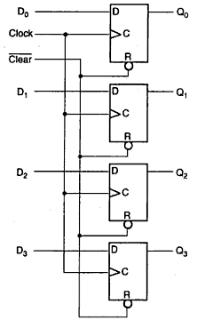
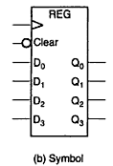
4-Bit Register
Clear goes to R
We put ‘1’ all the time
Put ‘0’ if want to clear the values

Slide 4
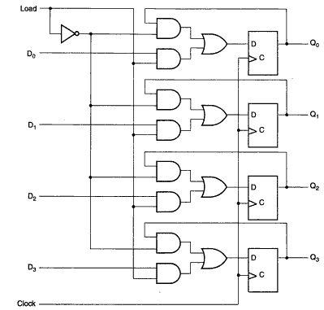

Register with Parallel Load
If data is not changed no need to trigger the clock
Clock inputs = C inputs
When Load = 1, register is clocked normally, new data is loaded
Note, clock pulses arrive periodically, Load determines if new data would be loaded or not

Slide 5
Shift Registers
Shift Registers move data laterally within the register toward its MSB or LSB position
In the simplest case, the shift register is simply a set of D flip-flops connected in a row like this:
Data input, In, is called a serial input or the shift right input.
Data output, Out, is often called the serial output.
The vector (A, B, C, Out) is called the parallel output.

Slide 6
Shift Registers (continued)
The behavior of the serial shift register is given in the listing on the lower right
T0 is the register state just before the first clock pulse occurs
T1 is after the first pulse and before the second.
Initially unknown states are denoted by “?”
Complete the last three rows of the table
In
A
B
C
Out
D
Q
D
Q
D
Q
D
Q
Clock CP
CP
In
A
B
C
Out
T0
0
?
?
?
?
T1
1
0
?
?
?
T2
1
1
0
?
?
T3
0
1
1
0
?
T4
1
T5
1
T6
1
Notes:
ROW T4: 10110
Row T5: 11011
Row T6: 11101

Slide 7
Parallel Load Shift Registers
DA
DB
By adding a mux between each shift register stage, data can be shifted or loaded
If SHIFT is low, A and B are replaced by the data on D_{A} and D_{B} lines, else data shifts right on each clock.
By adding more bits, we can make n-bit parallel load shift registers.
A parallel load shift register with an added “hold” operation that stores data unchanged is given in Figure 7-10 of the text.
A
B
IN
D
Q
D
Q
SHIFT
CP

Slide 8
Universal Shift Register

Slide 9
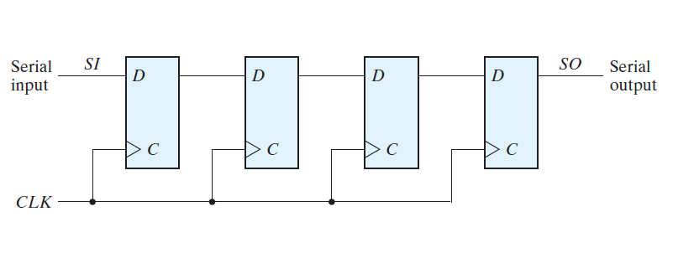
Four Bit Shift Register
1
2
3
4
Q of DFF1 gets SI after the first rising edge of the CLK
Q of DFF2 gets SI after the second rising edge of the CLK
Q of DFF3 gets SI after the third rising edge of the CLK
Q of DFF4 gets SI after the fourth rising edge of the CLK

Slide 10
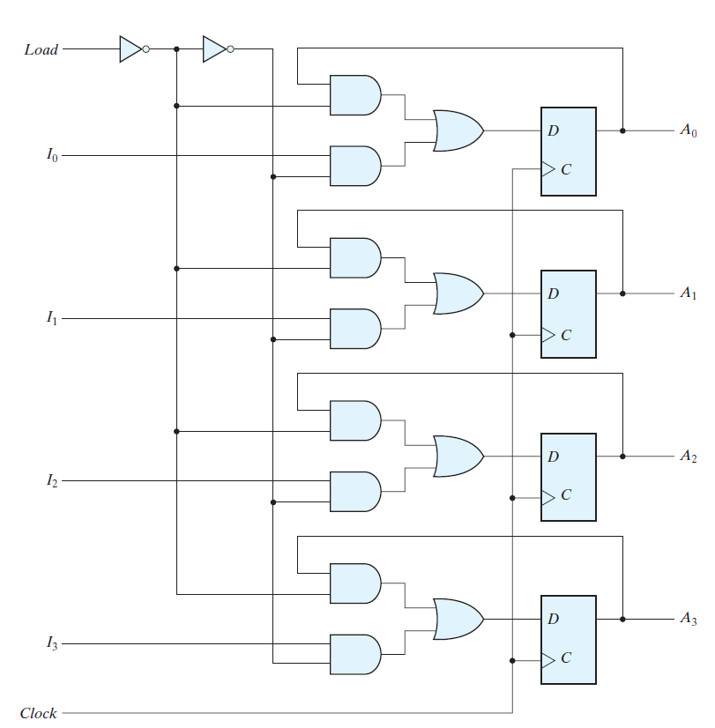
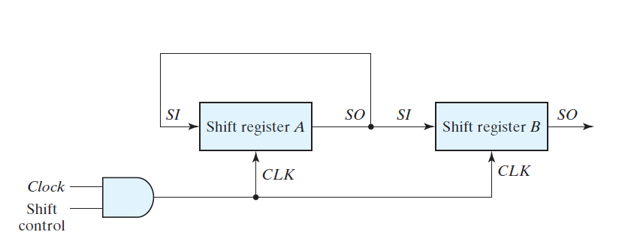
Parallel Transfer Versus Serial Transfer
(Serial Transfer)
Take multiple clock cycles
to transfer data.
Assume n=4, each shift
Register has 4 DFF.
Parallel Transfer
Transfer all the bit in one clock cycle.
Require combinatorial circuits.

Slide 11
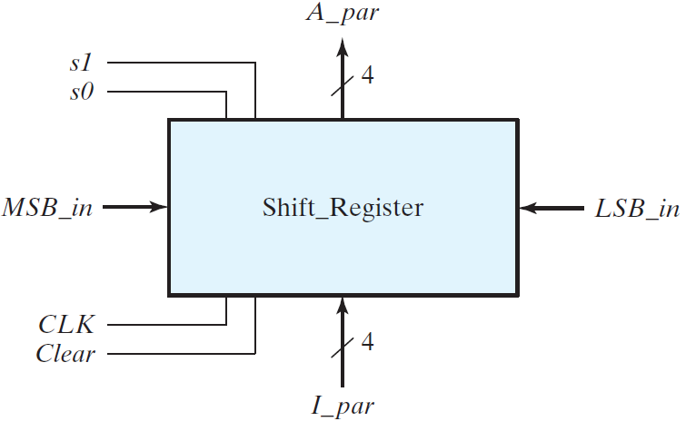
Block Diagram of a Universal Shift Register
This is called the universal shift register because it has both shifts and parallel load capabilities.

Slide 12
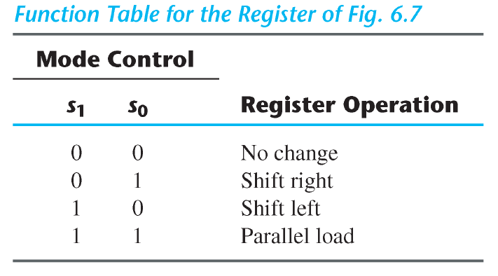
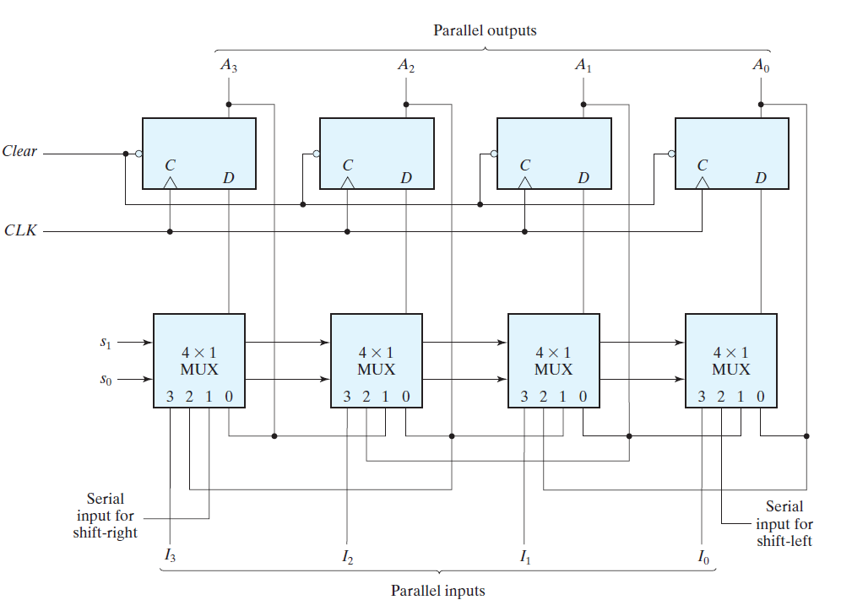
Detail Implementation

Slide 13
Mode Control

Slide 14
S0=0, S1=0 [No Change Mode]
S0=0, S1=0

Slide 15
S0=1, S1=0 [Shift Right Mode]
S1=0 , S0=1

Slide 16
S0=0, S1=1 [Shift Left Mode]
S1=1 , S0=0

Slide 17
S0=1, S1=1 [Parallel Load Mode]
S1=1 , S0=1

