Slide 2
Overview
Part1 - Introduction
Design Topics
Design hierarchy
Design Procedure
The major design steps: specification, formulation, optimization, technology mapping, and verification
Technology Mapping
From AND, OR, and NOT to other gate types
Decoders
Part 2
Encoders
Multiplexers
Binary Adders

Slide 3
Encoding
Encoding - the opposite of decoding - the conversion of an m-bit input code to a n-bit output code with n ≤ m ≤ 2^{n} such that each valid code word produces a unique output code
Circuits that perform encoding are called encoders
An encoder has 2^{n} (or fewer) input lines and n output lines which generate the binary code corresponding to the input values
Typically, an encoder converts a code containing exactly one bit that is 1 to a binary code corres-ponding to the position in which the 1 appears.

Slide 4
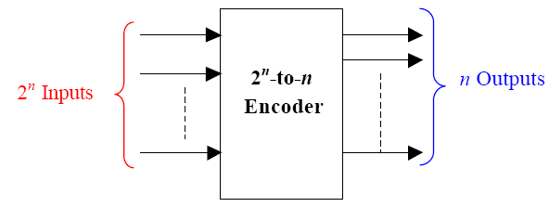
Encoder

Slide 5
Encoder Example
A decimal-to-BCD encoder
Inputs: 10 bits corresponding to decimal digits 0 through 9, (D₀, …, D₉)
Outputs: 4 bits with BCD codes
Function: If input bit D_{i} is a 1, then the output (A₃, A₂, A₁, A₀) is the BCD code for i,
The truth table could be formed, but alternatively, the equations for each of the four outputs can be obtained directly.

Slide 6
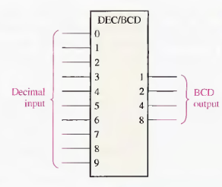
Decimal-to-BCD encoder

Slide 7
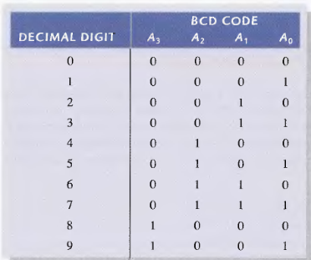
Encoder Example (continued)
Input D_{i} is a term in equation A_{j} if bit A_{j} is 1 in the binary value for i.
Equations:
A₃ = D₈ + D₉
A₂ = D₄ + D₅ + D₆ + D₇
A₁ = D₂ + D₃ + D₆ + D₇
A₀ = D₁ + D₃ + D₅ + D₇ + D₉
F₁ = D₆ + D₇ can be extracted from A₂ and A₁ Is there any cost saving?
Notes:
No. The total gate input cost remains the same.

Slide 8
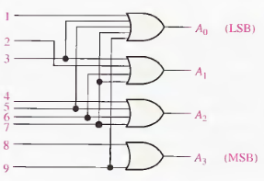
Encoder Example (continued)
A₃ = D₈ + D₉
A₂ = D₄ + D₅ + D₆ + D₇
A₁ = D₂ + D₃ + D₆ + D₇
A₀ = D₁ + D₃ + D₅ + D₇ + D₉

Slide 9
Priority Encoder
If more than one input value is 1, then the encoder just designed does not work.
One encoder that can accept all possible combinations of input values and produce a meaningful result is a priority encoder.
Among the 1s that appear, it selects the most significant input position (or the least significant input position) containing a 1 and responds with the corresponding binary code for that position.

Slide 10
Priority Encoder Example
Priority encoder with 5 inputs (D₄, D₃, D₂, D₁, D₀) - highest priority to most significant 1 present - Code outputs A2, A1, A0 and V where V indicates at least one 1 present.
Xs in input part of table represent 0 or 1; thus table entries correspond to product terms instead of minterms. The column on the left shows that all 32 minterms are present in the product terms in the table
No. of Min-terms/Row | Inputs |  |  |  |  | Outputs
 | D4 | D3 | D2 | D1 | D0 | A2 | A1 | A0 | V
1 | 0 | 0 | 0 | 0 | 0 | X | X | X | 0
1 | 0 | 0 | 0 | 0 | 1 | 0 | 0 | 0 | 1
2 | 0 | 0 | 0 | 1 | X | 0 | 0 | 1 | 1
4 | 0 | 0 | 1 | X | X | 0 | 1 | 0 | 1
8 | 0 | 1 | X | X | X | 0 | 1 | 1 | 1
16 | 1 | X | X | X | X | 1 | 0 | 0 | 1
Notes:
Go over table explaining how entries were obtained, particularly those containing Xs

Slide 11
Priority Encoder Example (continued)
Could use a K-map to get equations, but can be read directly from table and manually optimized if careful:
A₂ = D₄
A₁ = D₃ + D₂ = F₁, F₁ = (D₃ + D₂)
A₀ = D₃ + D₁ = (D₃ + D₁)
V = D₄ + F₁ + D₁ + D₀
D₄
D₄
D₃
D₄
D₄
D₄
D₃
D₂
D₄
D₂

Slide 12
Selecting
Selecting of data or information is a critical function in digital systems and computers
Circuits that perform selecting have:
A set of information inputs from which the selection is made
A single output
A set of control lines for making the selection
Logic circuits that perform selecting are called multiplexers
Selecting can also be done by three-state logic or transmission gates

Slide 13
Multiplexers
A multiplexer selects information from an input line and directs the information to an output line
A typical multiplexer has n control inputs (S_{n − 1}, … S₀) called selection inputs, 2^{n} information inputs (I₂^{n} ₋ ₁, … I₀), and one output Y
A multiplexer can be designed to have m information inputs with m < 2^{n} as well as n selection inputs

Slide 14
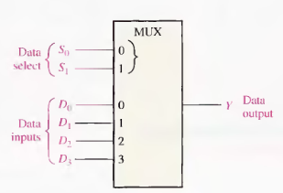
4-to-1-line Multiplexer

Slide 15
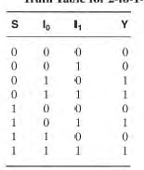
2-to-1-Line Multiplexer
Since 2 = 2¹, n = 1
Selection variable S:
S = 0 selects input I₀
S = 1 selects input I₁
The equation:
Y = I₀ + SI₁
The circuit:
S | Y
0 | I₀
1 | I₁
S

Slide 16
2-to-1-Line Multiplexer (continued)
Note the regions of the multiplexer circuit shown:
1-to-2-line Decoder
2 Enabling circuits
2-input OR gate
To obtain a basis for multiplexer expansion, we combine the Enabling circuits and OR gate into a 2 × 2 AND-OR circuit:
1-to-2-line decoder
2 × 2 AND-OR

Slide 17
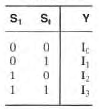
Example: 4-to-1-line Multiplexer
2-to-2²-line decoder
2² × 2 AND-OR
Y = (S₁ S₀) I₀ + (S₁ S₀) I₁ + (S₁ S₀) I₂ + (S₁ S₀) I₃

Slide 18
Combinational Function Implementation
Alternative implementation techniques:
Decoders and OR gates
Multiplexers (and inverter)

Slide 19
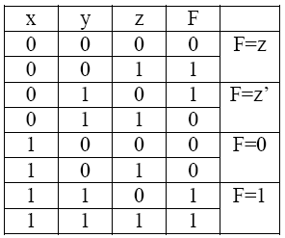
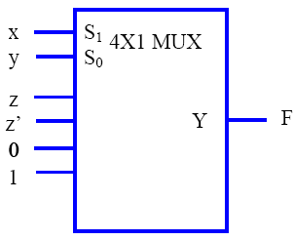
Combinational Function Implementation
F(x,y,z) = Σ(1,2,6,7) using 4-to-1 multiplexer.
Connect the variables x and y to the selection inputs S1, and S0. The inputs of the multiplexers can be obtained from the truth table as shown below.

Slide 20
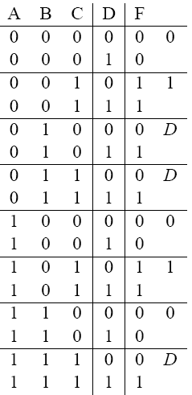
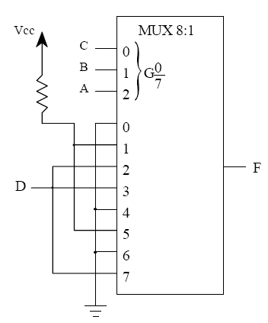
F(A, B, C, D) = Σ(2, 3, 5, 7, 10, 11, 15)

Slide 21
F(A, B, C, D) = Σ(2, 3, 5, 7, 10, 11, 15)

Slide 22
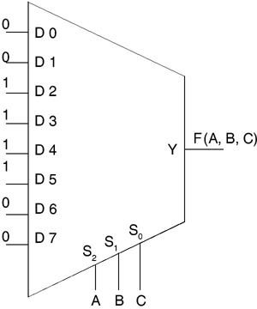
Implement F (A, B, C) = Σm(2, 3, 4, 5) using 8-to-1 Multiplexer

Slide 23
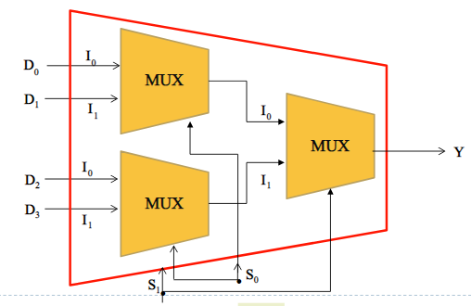
MUX Expansion
Design 4-to-1 MUX using 2-to-1 MUX only.

Slide 24
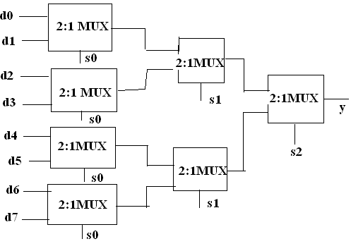
8-to-1 MUX using 2-to-1 MUX

Slide 25
Functional Blocks: Addition
Binary addition used frequently
Addition Development:
Half-Adder (HA), a 2-input bit-wise addition functional block,
Full-Adder (FA), a 3-input bit-wise addition functional block,
Ripple Carry Adder, an iterative array to perform binary addition, and
Carry-Look-Ahead Adder (CLA), a hierarchical structure to improve performance.

Slide 26
Functional Block: Half-Adder
A 2-input, 1-bit width binary adder that performs the following computations:
A half adder adds two bits to produce a two-bit sum
The sum is expressed as a sum bit , S and a carry bit, C
The half adder can be specified as a truth table for S and C ⇒
X
0
0
1
1
+ Y
+ 0
+ 1
+ 0
+ 1
C S
0 0
0 1
0 1
1 0
X
Y
C
S
0
0
0
0
0
1
0
1
1
0
0
1
1
1
1
0

Slide 27
Logic Simplification: Half-Adder
The K-Map for S, C is:
This is a pretty trivial map! By inspection:
And
S
Y
C
Y
1
0
1
0
1
X
1
X
1
S
=
X
⋅
Y
+
X
⋅
Y
=
X
⊕
Y
2
3
2
3
C
=
X
⋅
Y
The most common half adder implementation is:
X
S
Y
S
=
X
⊕
Y
C
C
=
X
⋅
Y

Slide 28
Functional Block: Full-Adder
A full adder is similar to a half adder, but includes a carry-in bit from lower stages. Like the half-adder, it computes a sum bit, S and a carry bit, C.
For a carry-in (Z) of 0, it is the same as the half-adder:
For a carry- in (Z) of 1:
Z
0
0
0
0
X
0
0
1
1
+ Y
+ 0
+ 1
+ 0
+ 1
C S
0
0
0 1
0 1
1 0
Z
1
1
1
1
X
0
0
1
1
+ Y
+ 0
+ 1
+ 0
+ 1
C S
0 1
1 0
1 0
1
1

Slide 29
Logic Optimization: Full-Adder
Full-Adder Truth Table:
Full-Adder K-Map:
X
Y
Z
C
S
0
0
0
0
0
0
0
1
0
1
0
1
0
0
1
0
1
1
1
0
1
0
0
0
1
1
0
1
1
0
1
1
0
1
0
1
1
1
1
1
S
Y
C
Y
1
1
1
0
1
3
2
0
1
3
2
X
1
1
X
1
1
1
4
5
7
6
4
5
7
6
Z
Z

Slide 30
Equations: Full-Adder
From the K-Map, we get:
The S function is the three-bit XOR function (Odd Function):
The Carry bit C is 1 if both X and Y are 1 (the sum is 2), or if the sum is 1 and a carry-in (Z) occurs. Thus C can be re-written as:
The term X·Y is carry generate.
The term X⊕Y is carry propagate.
S
=
X
Y
Z
+
X
Y
Z
+
X
Y
Z
+
X
Y
Z
C
=
X
Y
+
X
Z
+
Y
Z
S
=
X
⊕
Y
⊕
Z
C
=
X
Y
+
(
X
⊕
Y
)
Z

Slide 31
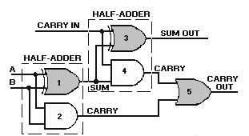
Full-Adder Implement
S
=
A
⊕
B
⊕
C_{in}
C_{out}
=
AB
+
(
A
⊕
B
)
C_{in}

Slide 32
4-bit Ripple-Carry Binary Adder
A four-bit Ripple Carry Adder made from four 1-bit Full Adders:

Slide 33
Carry Propagation & Delay
One problem with the addition of binary numbers is the length of time to propagate the ripple carry from the least significant bit to the most significant bit.
The gate-level propagation path for a 4-bit ripple carry adder of the last example:
Note: The "long path" is from A₀ or B₀ though the circuit to S₃.
A3
A2
A1
A0
B3
B2
B1
B0
C3
C2
C1
C0
C4
S3
S2
S1
S0

Slide 34
Carry Lookahead
Given Stage i from a Full Adder, we know that there will be a carry generated when A_{i} = B_{i} = "1", whether or not there is a carry-in.
Alternately, there will be a carry propagated if the “half-sum” is "1" and a carry-in, C_{i} occurs.
These two signal conditions are called generate, denoted as G_{i}, and propagate, denoted as P_{i} respectively and are identified in the circuit:
A_{i}
B_{i}
G_{i}
P_{i}
C_{i}
C_{i+1}
S_{i}

Slide 35
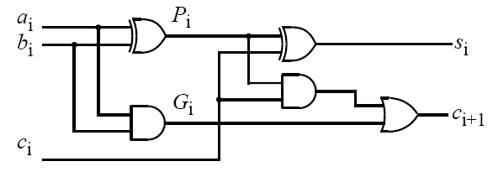

Slide 36
Carry Lookahead (continued)
In the ripple carry adder:
Gi, Pi, and Si are local to each cell of the adder
Ci is also local each cell
In the carry lookahead adder, in order to reduce the length of the carry chain, Ci is changed to a more global function spanning multiple cells
Defining the equations for the Full Adder in term of the P_{i} and G_{i}:

Slide 37
Carry Lookahead (continued)
P
=
A
⊕
B
G
=
A
B
i
i
i
i
i
i
S
=
P
⊕
C
C
=
G
+
P
C
i
i
i
i
+
1
i
i
i

Slide 38
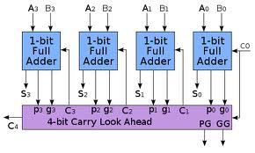
4-bit Carry Look-ahead Adder

Slide 39
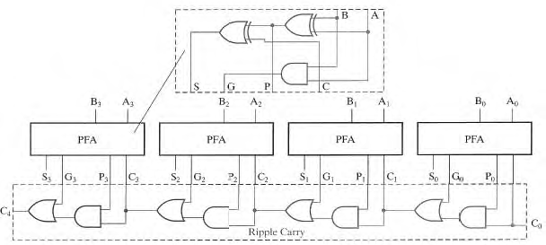
4-bit Carry Look-ahead Adder

Slide 40
Carry Lookahead Development
C_{i+1} can be removed from the cells and used to derive a set of carry equations spanning multiple cells.
Beginning at the cell 0 with carry in C₀:
C1 = G0 + P0 C0
C2 = G1 + P1 C1 = G1 + P1(G0 + P0 C0)
= G1 + P1G0 + P1P0 C0
C3 = G2 + P2 C2 = G2 + P2(G1 + P1G0 + P1P0 C0)
= G2 + P2G1 + P2P1G0 + P2P1P0 C0
C4 = G3 + P3 C3
= G3 + P3G2 + P3P2G1 + P3P2P1G0 + P3P2P1P0 C0

