Slide 1
Universal Shift Register

Slide 2
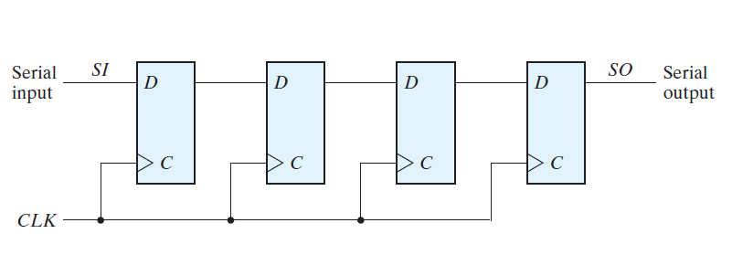
Four Bit Shift Register
1
2
3
4
Q of DFF1 gets SI after the first rising edge of the CLK
Q of DFF2 gets SI after the second rising edge of the CLK
Q of DFF3 gets SI after the third rising edge of the CLK
Q of DFF4 gets SI after the fourth rising edge of the CLK

Slide 3
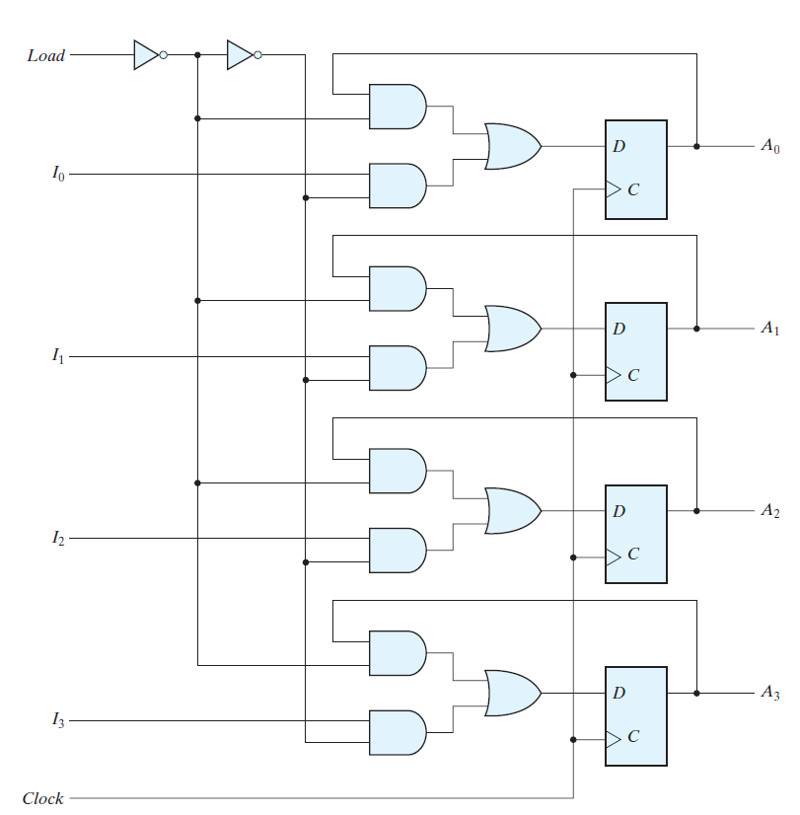
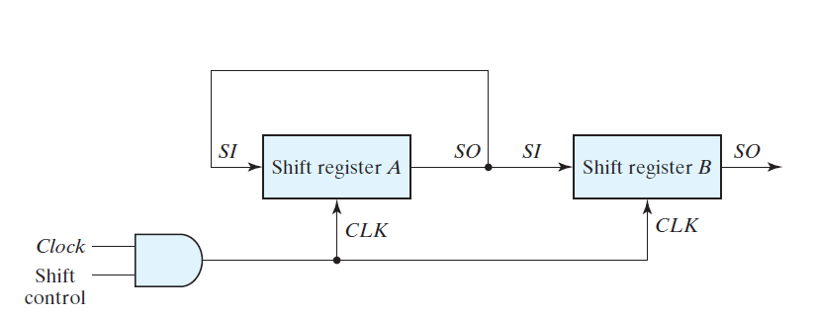
Parallel Transfer Versus Serial Transfer
(Serial Transfer)
Take multiple clock cycles
to transfer data.
Assume n=4, each shift
Register has 4 DFF.
Parallel Transfer
Transfer all the bit in one clock cycle.
Require combinatorial circuits.

Slide 4
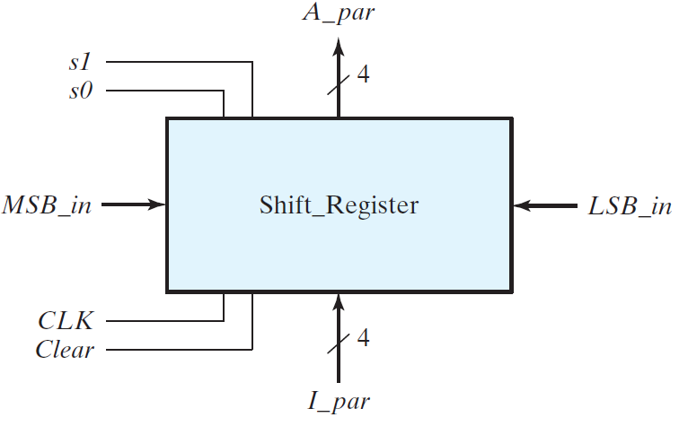
Block Diagram of a Universal Shift Register
This is called the universal shift register because it has both shifts and parallel load capabilities.

Slide 5
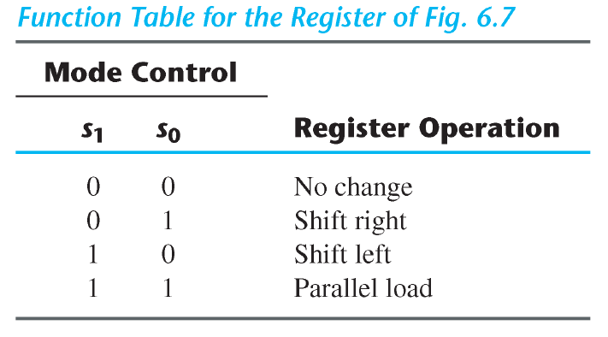
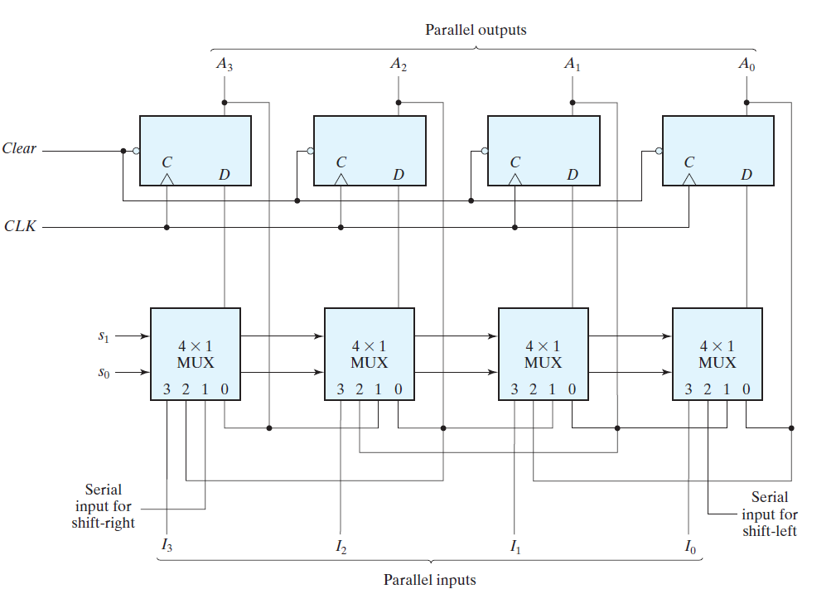
Detail Implementation

Slide 6
Mode Control

Slide 7
S0=0, S1=0 [No Change Mode]
S0=0, S1=0

Slide 8
S0=1, S1=0 [Shift Right Mode]
S1=0 , S0=1

Slide 9
S0=0, S1=1 [Shift Left Mode]
S1=1 , S0=0

Slide 10
S0=1, S1=1 [Parallel Load Mode]
S1=1 , S0=1

