Slide 1
VERITRIAGE / FINREG TRACK 5
NORTH STAR
VeriTriage
The proof layer for
regulated banking AI.
The agent proposes. The verifier proves. The human signs.
AGENT
VERIFIER
HUMAN
Bedrock gathers evidence and proposes a disposition.
C# recomputes every number and statutory gate.
The MLRO signs the proof receipt.
397,853 ČNB rows · 72/72 tests · 4.9ms deep analysis · R 0.20 hero
01 / 08
Notes:
20s: The agent proposes. The verifier proves. The human signs. VeriTriage is the proof layer that makes agentic AML triage deployable.

Slide 2
01 / PROBLEM
WHY NOW
The bottleneck is proof, not detection.
A mid-size PSP already has alerts. It does not have a defensible dossier in time.
5,000
23.5
€1.16M
ALERTS / DAY
FTE ANALYSTS
WASTED / YEAR
THE REAL CLOCK
PSR Art. 83 / 55–56 and AML § 20 create bounded freeze and postponement windows.
Missing the window means eating the loss — or explaining it to the ČNB.
The work is re-building the same story from CSV, registries and PDFs.
WHAT THE BANK NEEDS
One reproducible answer:
why this alert, which evidence, which statute, who signed.
Not another black-box score.
VERITRIAGE · THE FINTECHERS · TRACK 5 AML
02 / 08
Notes:
20s: The bank has alerts. The bottleneck is the defensible dossier before the statutory clock. That is the product.

Slide 3
02 / ENGINE
HOW IT WORKS
Four steps. One auditable decision.
Semantic reasoning is allowed to propose; it is not allowed to prove.
1
2
3
4
AGENT
C# VERIFIER
OVERRIDE
HUMAN SIGN
Bedrock gathers entity, transaction and statutory evidence. It proposes a disposition.
Recomputes every amount and checks 5 deterministic gates. Fail-closed.
If evidence or math disagrees, the verifier forces ESCALATE. The AI proposal is logged.
The MLRO signs a SHA-256 receipt with a real P-256 key. The proof is exportable.
DETERMINISTIC CORE
4.9 ms
72 / 72
5 gates
0
zero LLM tokens
tests green
schema · scope · OCR · math · grounding
fabricated legal text
VERITRIAGE · THE FINTECHERS · TRACK 5 AML
03 / 08
Notes:
20s: Four steps: agent, verifier, override, human. The verifier is pure C#, zero LLM tokens, five gates, fail-closed.

Slide 4
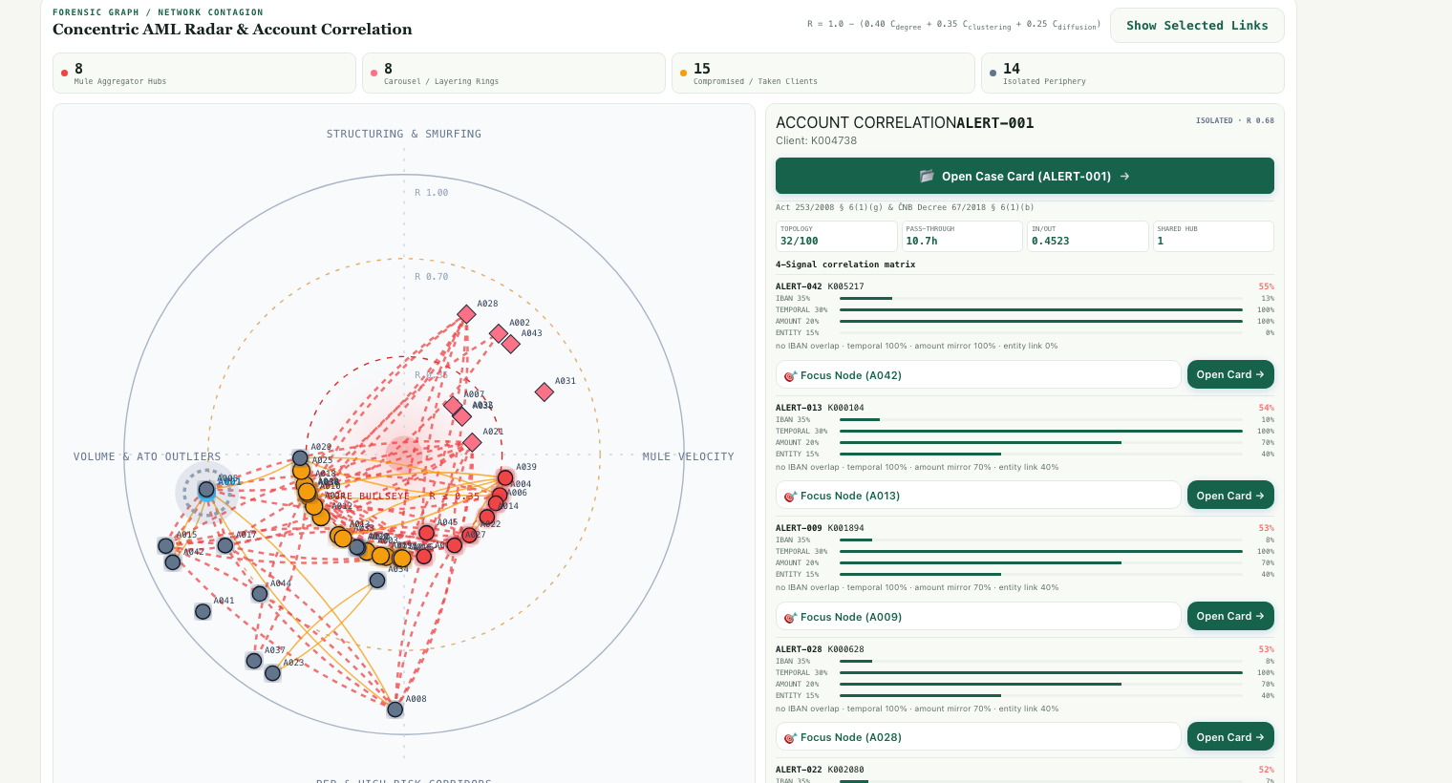
03 / TOPOLOGY
WHO IS WHO
The graph separates mules from victims.
45 alerts into four roles. The bank can freeze the mule without treating a phished client as the criminal.
MULE HUBS
8
highest shared hub + topology
RINGS
8
cyclic / multi-hop structuring
TAKEN CLIENTS
15
low/medium tier draining to hubs
HERO: ALERT-045 · R = 0.20
14 isolated periphery
VERITRIAGE · THE FINTECHERS · TRACK 5 AML
04 / 08
Notes:
20s: The graph is not decoration. It differentiates the complicit mule hub from the compromised victim. Eight mule hubs, eight rings, fifteen taken clients.

Slide 5
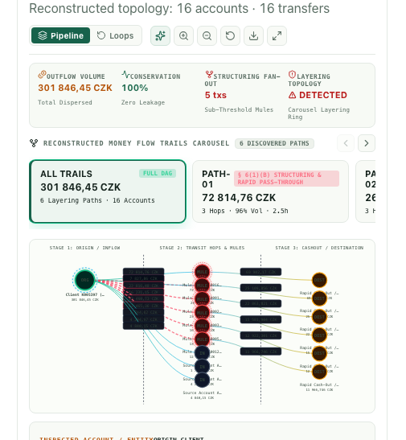
04 / MONEY FLOW
FOLLOW THE MONEY
Follow the money from the account.
A reconstructed money trail, not a single transaction score.
OUTFLOW
301,846 CZK
dispersed
TRANSFERS
16
reconstructed
STRUCTURING
5 tx
sub-threshold
§ 6(1)(b): multi-account structuring.
The trail is the evidence.
VERITRIAGE · THE FINTECHERS · TRACK 5 AML
05 / 08
Notes:
20s: This is the money-flow DAG. It reconstructs 16 accounts and 16 transfers, with 301,846 CZK outflow and five sub-threshold transfers. The point is the path, not a single score.

Slide 6
05 / DEEP ANALYSIS
4.9 MS
Deep analysis: arithmetic first, tokens never.
The deterministic engine scans the client history, builds the 5-vector profile and writes a legal brief.
397,853
4.9 ms
1.71x
13 / 95.5k
ROWS SCANNED
DEEP ANALYSIS
VELOCITY / COUNT
72H CZK CLUSTER
HERO PRIORITY
96 / 100
1.71x volume · 13 transfers in 72h · HHI 916 · ACZ00005 · 3 linked clients
B40 + V11 + P25 + S20
Every number recomputed in System.Decimal. No LLM in this path.
DETERMINISTIC BRIEF
TRACEABLE
HUMAN-READY
Markdown + exportable legal dossier. Reproducible, no prompt variance.
Every claim tied to the transaction cluster and statutory clause.
The MLRO sees the proof, not a black-box score.
VERITRIAGE · THE FINTECHERS · TRACK 5 AML
06 / 08
Notes:
20s: Deep analysis is 4.9 milliseconds, zero tokens: 397,853 rows, 1.71x velocity, 13 sub-threshold transfers, priority 96. The brief is generated from the arithmetic.

Slide 7
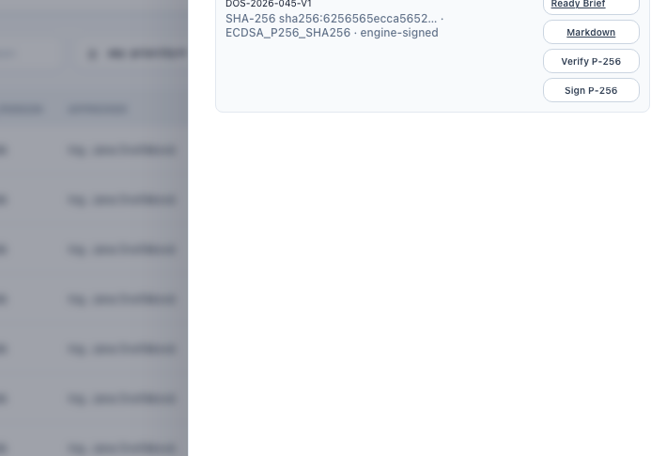
06 / LEGAL ARTIFACT
FAÚ OPO
From alert to a signed FAÚ § 18 dossier.
The output is not a screen. It is a legal artifact a human can sign and a regulator can inspect.
4-EYES
Same-person approval returns HTTP 400. Independent MLRO required.
SHARED HUB
PEP + structuring + network role bound to the evidence.
LEGAL MEMO
§ 6(1)(a), § 6(1)(b), § 9a(2)(c), § 18. Six-section memo.
NON-REPUDIATION
SHA-256 audit chain + real P-256 dossier signature.
The MLRO signs the decision — not the model.
VERITRIAGE · THE FINTECHERS · TRACK 5 AML
07 / 08
Notes:
20s: The output is a dossier: 4-eyes enforced server-side, legal citations, audit chain, real P-256 signature. The model never signs; the MLRO does.

Slide 8
07 / NEXT
THE ASK
A proof layer the bank
can actually deploy.
What is live now
397,853
4.9 ms
72 / 72
ČNB rows in the full ledger
deterministic deep analysis
tests green
8 / 8 / 15 / 14
45
P-256
mule / ring / taken / isolated
FINREG rows, exact 11-column CSV
real dossier signature + audit chain
THE ASK
THE FINTECHERS
Two pilot PSPs + FINREG feedback to move into a pre-production sandbox.
Track 5 · AML
Demo: localhost:3100
Synthetic ČNB data · Bedrock snapshot fallback is labeled · no live-AWS claim.
08 / 08
Notes:
20s: Live now: 397,853-row ledger, 4.9ms deep analysis, 72/72 tests, balanced topology, exact CSV, real P-256 signatures. Ask: two pilot PSPs and FINREG feedback.

