Slide 1
Comparative Volatility Analysis
of International Equity Indices
DATA 201 Final Project
Team Members: Aziz Muminov

Slide 2
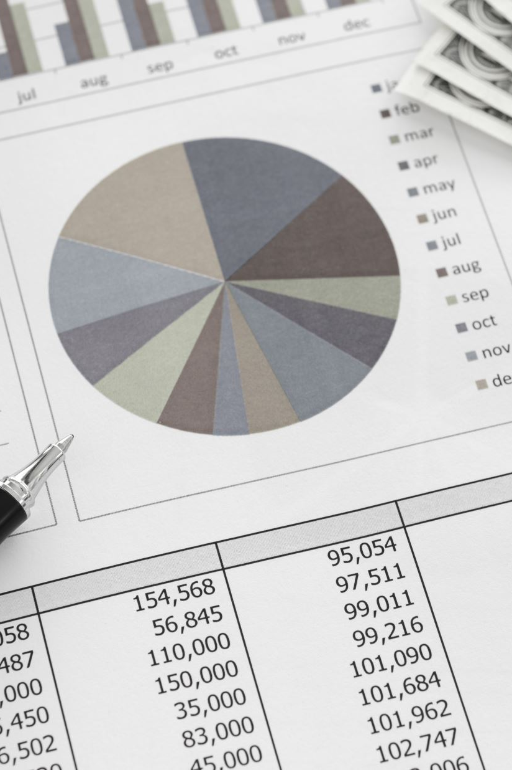
Problem Statement & Relevance
Why Analyze Volatility?
Volatility impacts investment risk, portfolio allocation, and macroeconomic policy.
Key question: How do volatility patterns and forecast accuracy differ across S&P 500 (U.S.), Nikkei 225 (Japan), and FTSE 100 (UK)?
Relevance:
Addresses real-world challenges in global market risk management.

Slide 3
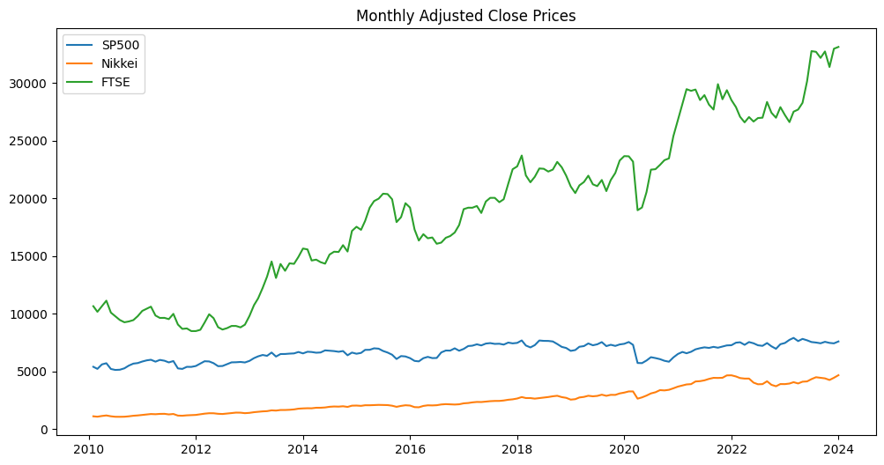
Data Overview
Datasets:
Sources: Yahoo Finance (^GSPC, ^N225, ^FTSE)
Frequency: Daily (2010–2024), resampled to monthly averages.
Key Variables: Adjusted Close Prices, Log Returns

Slide 4
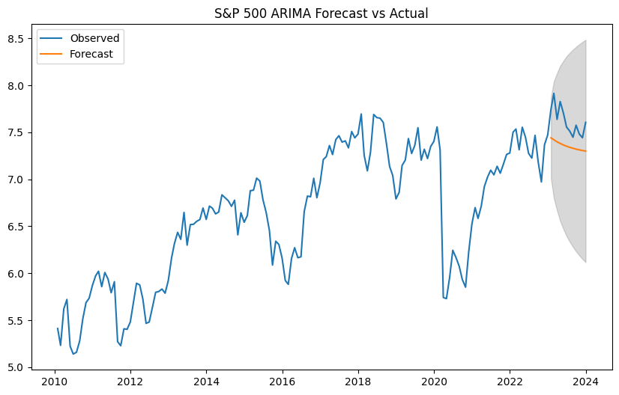
Methodology
ARIMA: Forecast price trends (rescaled ÷1000)
Parameters: ARIMA(2,1,2)
Evaluation: RMSE: 0.2885
GARCH(1,1): rescaled(*1000) Model volatility clustering
Key Insight: High persistence (α + β = 0.94)

Slide 5
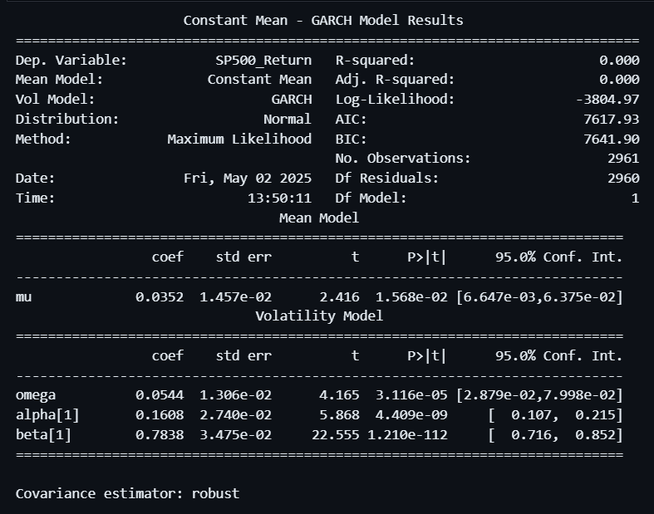

Slide 6
ARIMA RMSE
Index RMSE
0 S&P500 0.288479
1 Nikkei 0.488249
2 FTSE 4.214614
Note that ARIMA performs worse in high volatile markets

Slide 7
Results
A. ARIMA Forecast Accuracy
S&P 500 RMSE: 0.2885
Nikkei RMSE: 0.4882
S&P 500 forecasts more accurate than Nikkei and FTSE (lower RMSE).
Underestimated late‑2023 upward trend due to structural breaks (e.g., Fed rate cuts).
B. GARCH Volatility Insights
High Persistence: α + β = 0.94 → Volatility shocks linger for months.
2020 Pandemic Crash: Sharp spike in volatility consistent with historical events.
Bhardwaj, S. & Paul, Ranjit & Singh, Dharam & Singh, Kamalesh. (2014). An Empirical Investigation of Arima and Garch Models in Agricultural Price Forecasting. Economic Affairs. 59. 415-428. 10.5958/0976-4666.2014.00009.6.

Slide 8
Challenges & Lessons
Challenges:
Scaling Issues: Rescaling data improved ARIMA/GARCH convergence.
Model Limitations:
ARIMA struggled with structural breaks (e.g., 2020 pandemic).
GARCH assumes normality, but returns exhibit fat tails.
Lessons Learned:
Importance of stationarity checks (ADF tests confirmed log returns are stationary).
Cross‑market dependencies (e.g., Nikkei → S&P 500 spillovers).

Slide 9
Conclusion & Future Work
Key Takeaways:
S&P 500 exhibits lower volatility and higher forecast accuracy than Nikkei.
GARCH captures volatility persistence but needs enhancement for tail risk
Future Work:
ExtendTest EGARCH/TGARCH for asymmetric volatility (negative vs. positive shocks).

