Slide 1
The Week’s Pulse: Daily Volatility Analysis
Aziz Muminov – Time Series Class

Slide 2
Data & Methodology
• Data: Daily log-returns of S&P 500, Nikkei 225, FTSE 100
• Model: Univariate GARCH(1,1)
• Theme: Weekday volatility comparison (Mon–Fri)

Slide 3
Average Conditional Volatility by Weekday
Weekday | SP500_Return | Nikkei_Return | FTSE_Return
Mon | 0.009425 | 0.009470 | 0.012273
Tue | 0.009584 | 0.009742 | 0.012372
Wed | 0.009399 | 0.009517 | 0.012210
Thu | 0.009381 | 0.009489 | 0.012174
Fri | 0.009420 | 0.009447 | 0.012141

Slide 4
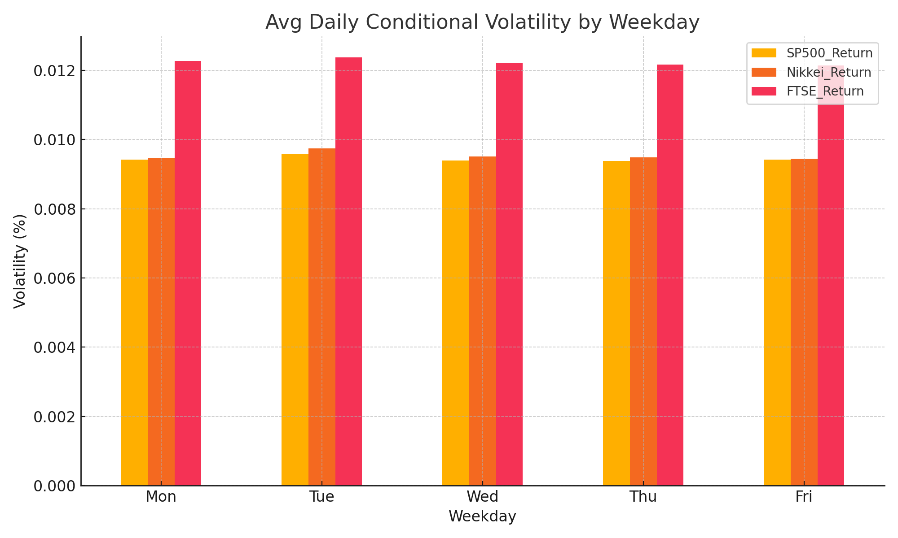
Weekday Volatility Patterns

Slide 5
Key Insights
• Tuesdays exhibit the highest volatility across all indices.
• Thursdays register the lowest average volatility.
• The midweek spike suggests clustering of impactful events early in the week.

Slide 6
Markets Analyzed
S&P 500 (SP500_Return)
Nikkei 225 (Nikkei_Return)
FTSE 100 (FTSE_Return)

Slide 7
Modeling Approach
Compute daily log-returns: ln(Pₜ / Pₜ₋₁)
Fit univariate GARCH(1,1) on each return series
Tag weekdays (Mon=0 … Fri=4) for each return
Average conditional volatility per weekday
Visualize patterns with grouped bar charts

